Slide 1

A CORRECT PARAMETER FOR CLIMATE CHANGE ESTIMATION
Faculty of Natural Sciences and Mathematics
Slavoljub Mijović
smijovic@yahoo.com

Slide 2
Contents
Introduction: climate systems;
IPCC & Climate Change;
A definition of ‘greenhouse effect’;
A short history of Climate physics;
Modelling;
Disorder of complex systems;
‘Paradox of the mean temperature’;

Slide 3
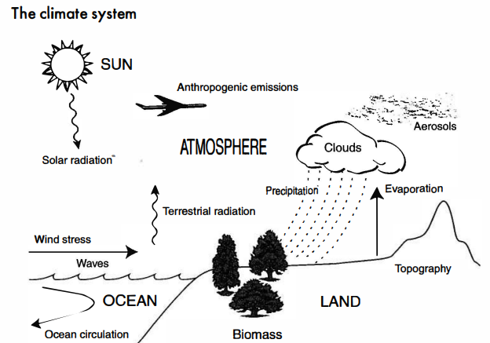
The most general task: Understand and predict the climate
  Complexity;
  Diversity of factors;
  Interactions;
  Feedbacks;
Problem: Find the balance point
Existence, stability and uniqueness;
Chaotic behavior with feedbacks loops;
Multiple quasi-stable equilibrium states;
Climate-the mean state of the whole system, averaged in space and time
Parameters: the surface temperature, and its global and seasonal variations;
oxygen abundance in the atmosphere; the mean air pressure; cloud cover;
wind field; humidity, precipitation …

Slide 4
How to deal with this task?
Climate Change
Changes in the Earth's orbit, that alter the planet's distance from the Sun, or in its obliquity, the angle between the spin axis and the orbital plane.
Changes in the energy output of the Sun.
Changes in the albedo of the Earth, affecting the fraction of the solar input that is reflected back into space.
Changes in the composition of the atmosphere, altering the greenhouse warming of the surface.
Changes in the ocean circulation, affecting the distribution of incoming solar energy around the globe.
Very detailed numerical models are required;
Problems of attribution (deciding how an observed phenomenon arises);
Simulation (representing phenomena by mathematical formulations of physical laws);
Predictability (modelling time-dependent behavior into the future) .
The Intergovernmental Panel on Climate Change (IPCC),
the United Nations body for assessing the science related to climate change
For example, only IPCC Sixth Report-Climate Change 2021 was based on an assessment of over 14,000 scientific publications and in IPCC Fifth Report stated, with high confidence, that human-induced warming reached approximately 1°C (likely between 0.8°C and 1.2°C) above pre-industrial levels in 2017, increasing at 0.2°C (likely between 0.1°C and 0.3°C) per decade

Slide 5
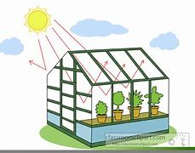
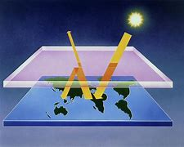
GREENHOUSE EFFECT
Temperature is the key climate variable, and when we choose a single parameter to represent climate and climate change, it is usually the average temperature of the Earth's surface
In a basic approach greenhouse effect is easy to understand, even for non scientists. To balance the absorbed incoming energy from the Sun, the Earth radiates the same amount energy back to space. Due to existing so-called greenhouse gases in the atmosphere, a part of this radiation from the Earth is captured and reradiate back to the Earth, thus increasing the temperature of the Earth
There is not full analogy with the common garden greenhouse, which transmits heat from the Sun to its interior, mostly as visible radiation, but is opaque to the longer wavelengths at which radiative cooling takes place. (Since the domestic greenhouse also inhibits convective cooling, and insulates against conductive cooling).
‘natural’ pre-industrial levels of greenhouse gases 30-35K
in the present century, the increased greenhouse gas
concentrations of human origin would increase
the temperature 5K in this century.

Slide 6
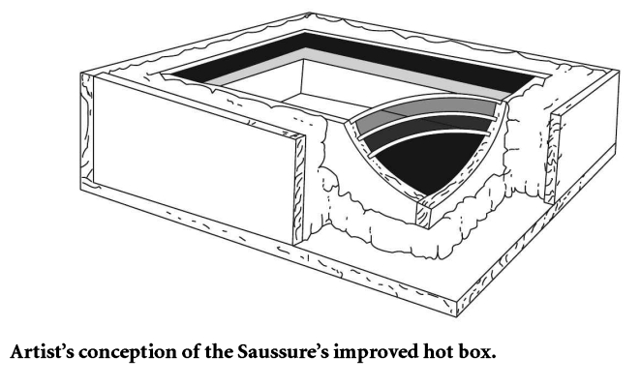
A short history of Climate physics
Joseph Fourier’s study of the Earth’s energy budget (1827):
An important conclusion that prevailing Earth’s energy source is solar radiation;
The temperature of the Earth, or indeed any planet, is determined by a balance between the rate at which the energy is received and the rate at which the energy is lost.
Emission of infrared radiation is the only means by which a planet loses heat
Visible light is converted into infrared light when it is absorbed at a solid or liquid surface
The atmosphere has an asymmetric effect on the incoming sunlight and the outgoing infrared,
The existence of the atmosphere must raise the temperature of the Earth's surface, and called it 'un effet de verre‘;

Slide 7
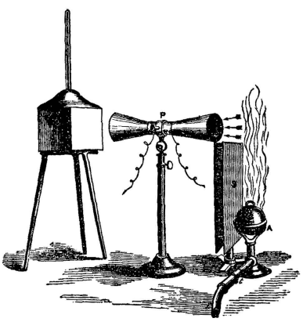
John Tyndall (1861),
The experimental foundations for future studies of greenhouse effect, measuring the absorption of infra-red (IR) radiation by the cool gas, and the emission of IR by the gas when it is heated;
John Tyndall successfully identified the constituents of the atmosphere that allow it to act as a heat-trapping envelope, and evaluated the relative magnitudes of their contributions to the greenhouse effect of the atmosphere
The most impressive implication of his study was that essentially all of the greenhouse activity of the atmosphere is due to a few trace gases such as water vapor and carbon dioxide;
Tyndall realized an easy way to change the climate of the Earth through time;

Slide 8
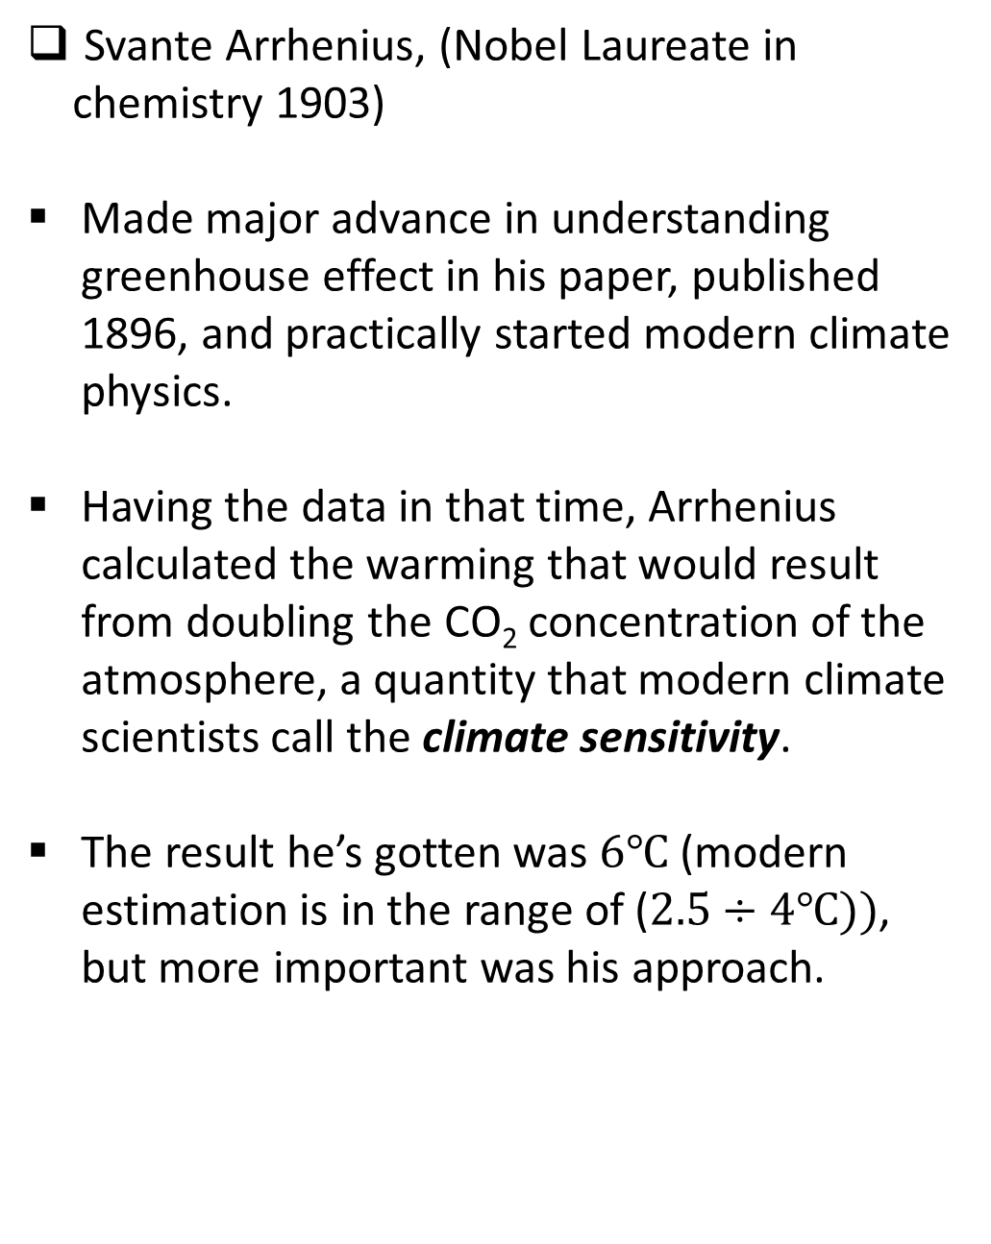
Svante Arrhenius, (Nobel Laureate in chemistry 1903)
Made major advance in understanding greenhouse effect in his paper, published 1896, and practically started modern climate physics.
Having the data in that time, Arrhenius calculated the warming that would result from doubling the CO₂ concentration of the atmosphere, a quantity that modern climate scientists call the climate sensitivity.
The result he’s gotten was $6℃$ (modern estimation is in the range of ($2.5÷4℃))$, but more important was his approach.
Basically, what Arrhenius had to do was invent the field of climate modeling, which had never before been done quantitatively for planets with atmospheres.
MODELLING
Models are simplified representations of reality, usually very complex phenomena like our climate system
Mathematical formulation of a model – the set of time dependent differential equations
Simple models vs. complex models
All models are based on energy balance budget

Slide 9
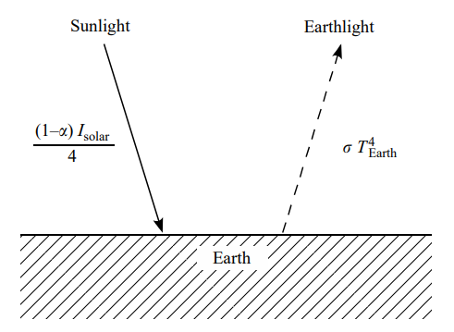

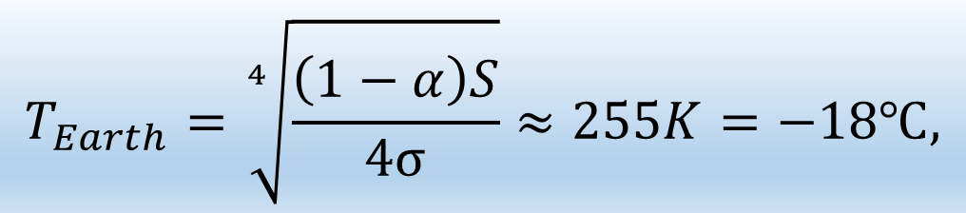
The zeroth order model
$$F_{in}=F_{out},$$
$$T_{Earth}=\sqrt[4]{\frac{\left(1−α\right)S}{4σ}}≈255K=−18℃,$$
Energy diagram for Earth with no atmosphere

Slide 10
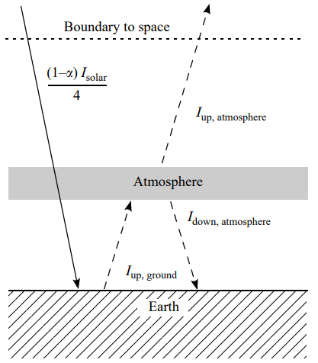


2. Arrhenius one-layer model
$$2^{1/4}T_{BP}≈303K=30℃.$$
N-layers atmosphere
$${\left(N+1\right)}^{1/4}T_{BP}$$
‘runaway greenhouse effect’
Energy diagram for Earth with no atmosphere

Slide 11
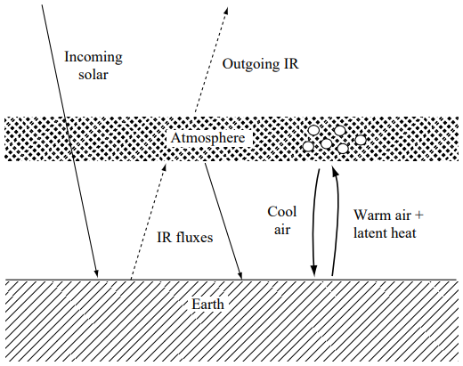
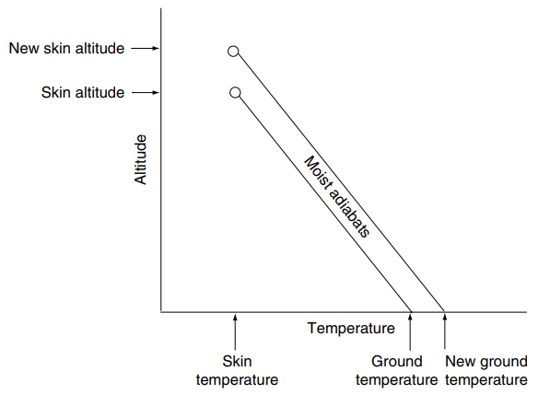
3. Manabe’s climate model ( convection in the layer model)
Syukuro Manabe (Nobel Laureate in physics 2021)
the first scientist who used the state of energy balance
when both radiation and convection are taking place; (1967)
the entire atmosphere is treated as a single
one-dimensional column
Schematically representation of Manabe’s climate model
A demonstration of the effect of the lapse rate on
the strength of the greenhouse effect

Slide 12
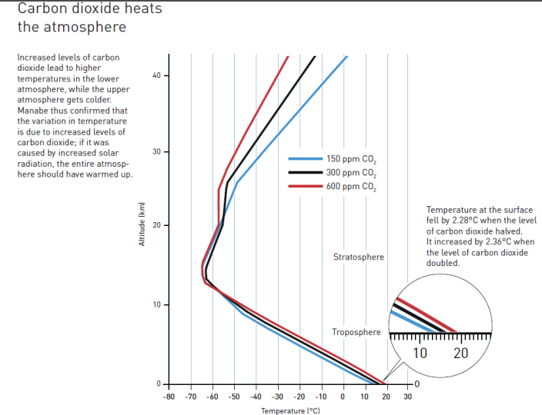

Slide 13
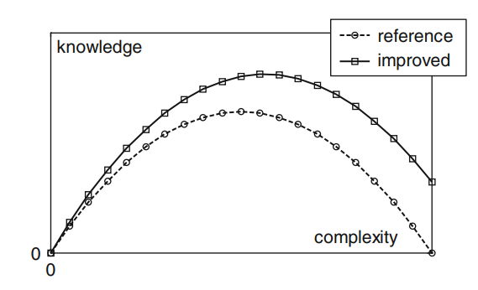
General Circulation Model
Problems?
The most sophisticated numerical climate models are known as general circulation models (GCMs).
It including the fluid dynamical equations that represent the circulation of the atmosphere in a realistic way.
Nowadays we have ocean GCMs as well, and advanced climate models include atmospheric and oceanic GCMs that are coupled together.
They consist of a large number of inter-related, time-dependent mathematical equations requiring a massive supercomputer to run.
‘effectiveness’
‘model confidence’
‘articulation’
‘level of detail’
Model evaluation: knowledge gained vs. complexity
Instability, nonlinearity, transition from order to disorder

Slide 14

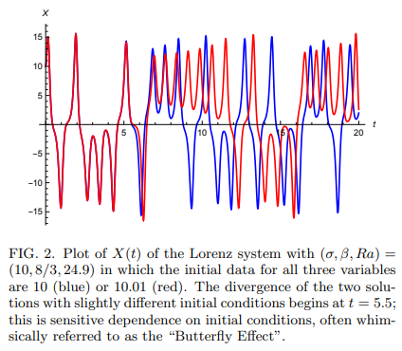
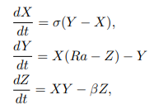
‘toy model’
of convection in the atmosphere
where X describes the intensity of convective motion, Y is the temperature difference between ascending and descending flow and Z is the deviation from linearity of the vertical temperature profile

Slide 15
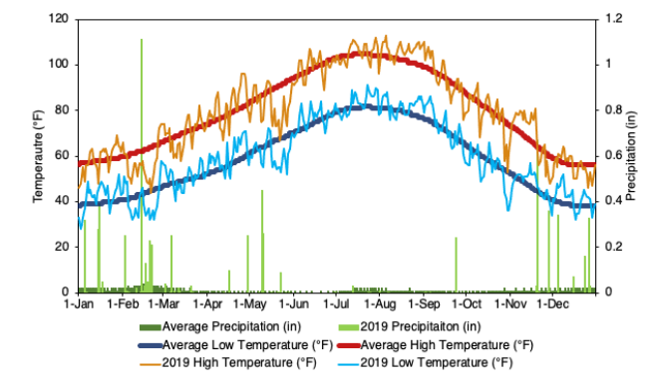
Klaus Hasselmann (Nobel Laureate in Physics 2021)
Derivate the signal from the natural
variability in climate models ;
made a framework to systematically
compare climate models and observations
He found statistically the optimal
detector of climate change, clearly
prooving how to separate stohastic
weather as „noise“, from the climate
change signal
This is variable that has the maximal signal-to-noise ratio

Slide 16
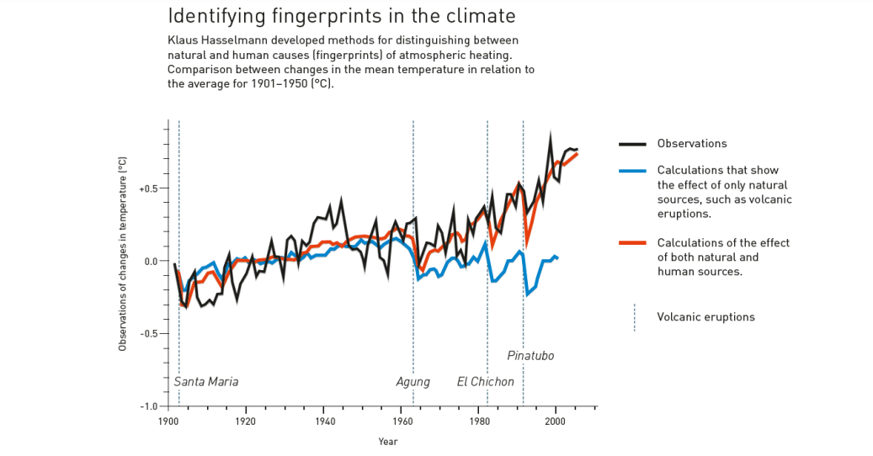

Slide 17
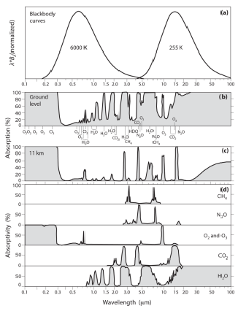
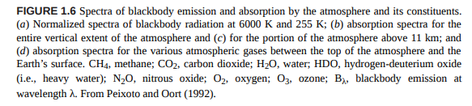
FACTS AND RESULTS

Slide 18
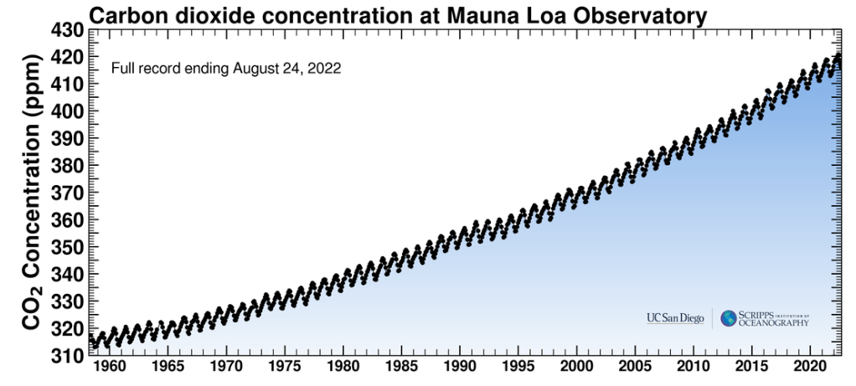
https://keelingcurve.ucsd.edu

Slide 19
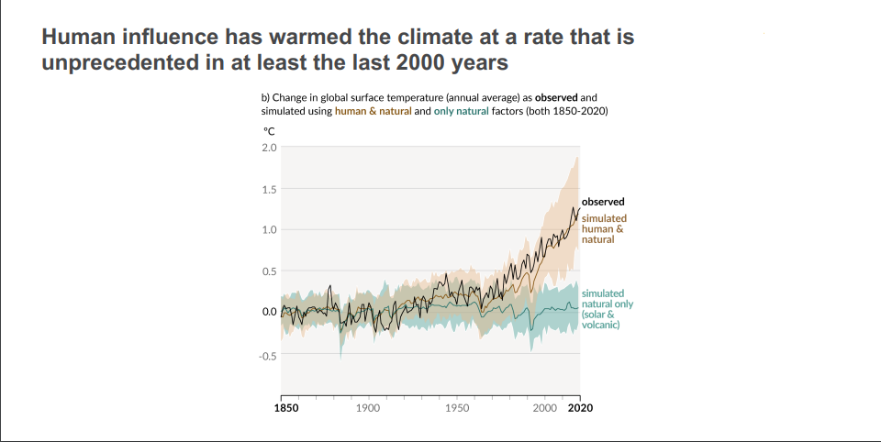

Slide 20
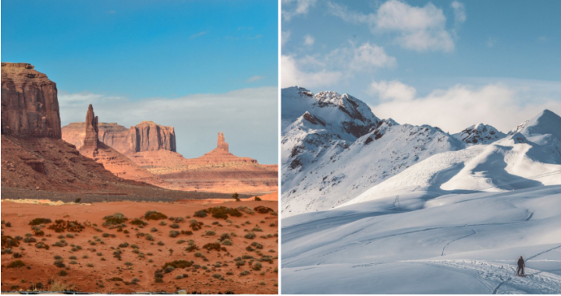
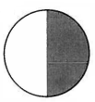





Does the mean global temperature makes sense? (My heretical approach)
$T_{1}=320K;$ $T_{2}=256K$; $T_{Z}=288K$
$${T_{mean}=(T}_{1}+T_{2})/2$$
Only a statistical indicator!
No physical meaning!
it is not sensitive to climate change
Three boundary cases with different mean global temperatures and the same solar constant
3. With rotation
1. Uniform temperature
2. No rotation
$$T_{Z1}=255K$$
$$T_{Z3}=231K$$
$$T_{Z2}=152K$$

Slide 21





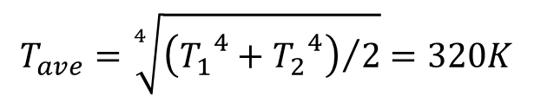

OPEN QUESTIONS
„Paradox of the mean temperaure“
each model is only a representative of reality and not a proof;
Lack of basic controlled experiments;
Separation convective and radiative processes;
The average temperature of the Earth's surface can not be
the key climate variable?
Or
“From misconception to discovery”
MOON’s EXAMPLE
$$T_{moon}=270K$$
$$T_{1}=380K$$
$$T_{2}=120K$$
$$∆T=260K!$$
$T_{ave}=320K$!
Taking into account that the average daytime moon’s temperaure is 380K and the average nighttime moon’s temperaure is 120K, surprisingly, we get that the outgoing flux corresponds to a uniformly warmed moon at a temperature of 320K!
$$2π{R_{M}}^{2}σ{T_{1}}^{4}+2π{R_{M}}^{2}σ{T_{2}}^{4}=4π{R_{M}}^{2}σ{T_{ave}}^{4}$$
$$T_{ave}=\sqrt[4]{{\left({T_{1}}^{4}+{T_{2}}^{4}\right)}/2}=320K$$
$$T_{real}=190K$$

Slide 22
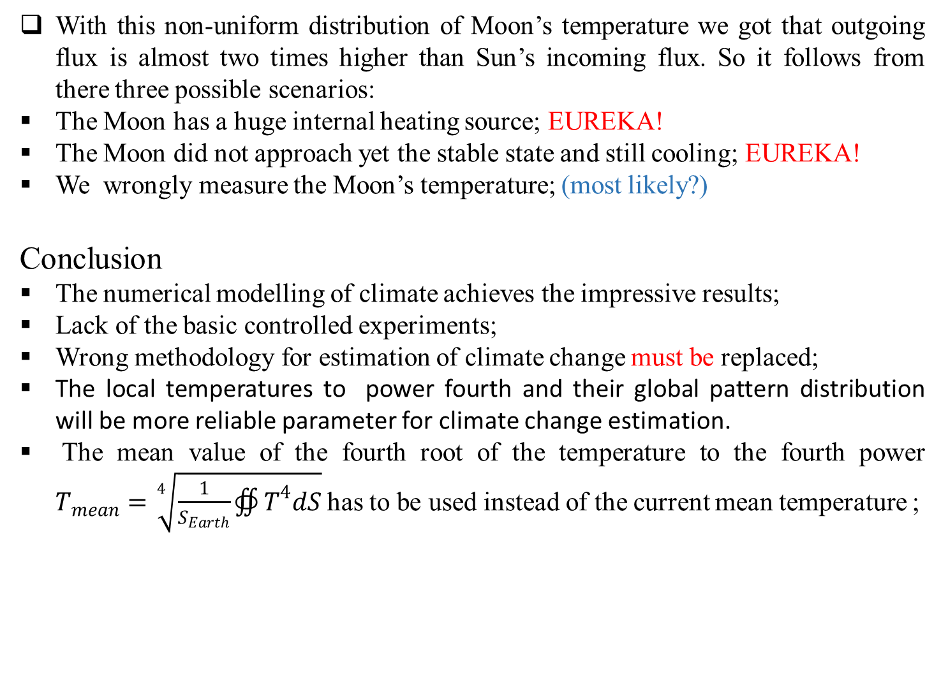
Three possible scenarios for the Moon
With this non-uniform distribution of Moon’s temperature we got that outgoing flux is almost two times higher than Sun’s incoming flux. So it follows from there three possible scenarios:
The Moon has a huge internal heating source; EUREKA!
The Moon did not approach yet the stable state and still cooling; EUREKA!
We wrongly measure the Moon’s temperature; (most likely?)
Conclusion
The numerical modelling of climate achieves the impressive results;
Lack of the basic controlled experiments;
Wrong methodology for estimation of climate change must be replaced;
The local temperatures to power fourth and their global pattern distribution will be more reliable parameter for climate change estimation.
The mean value of the fourth root of the temperature to the fourth power $T_{mean}=\sqrt[4]{\frac{1}{S_{Earth}}∯{T^{4}dS}}$ has to be used instead of the current mean temperature ;

Slide 23
Thank you!

