Slide 1

South East European International Institute for Sustainable Technologies
(SEEIIST)
L.Litov

Slide 2
SEEIIST
Proposed by Herwig Shopper – former director general of CERN
Objectives of the project
  to promote collaboration between science, technology and industry
  to provide platforms for the development of the education
  technology transfer from European laboratories like CERN and others
  mitigate tensions between countries in the region
  to form a research nucleus in the region of South-East Europe
The goals can only be achieved with one major new Institute based on the latest technologies to enable ‘first class research’

Slide 3
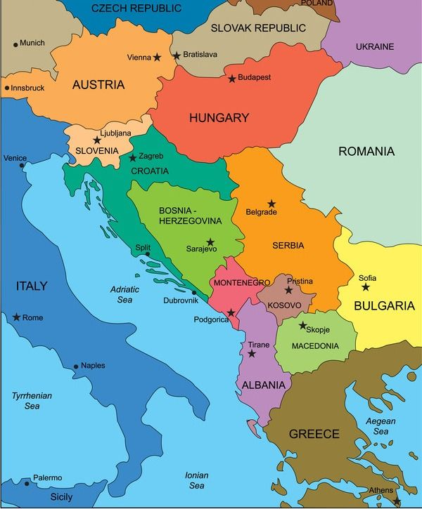
SEEIIST
Participants
Albania,
Bosnia and Herzegovina,
Bulgaria,
Greece,
Montenegro,
Republic of Croatia,
Republic of Kosovo,
Republic of Nord Macedonia,
Republic of Slovenia,
Republic of Serbia

Slide 4
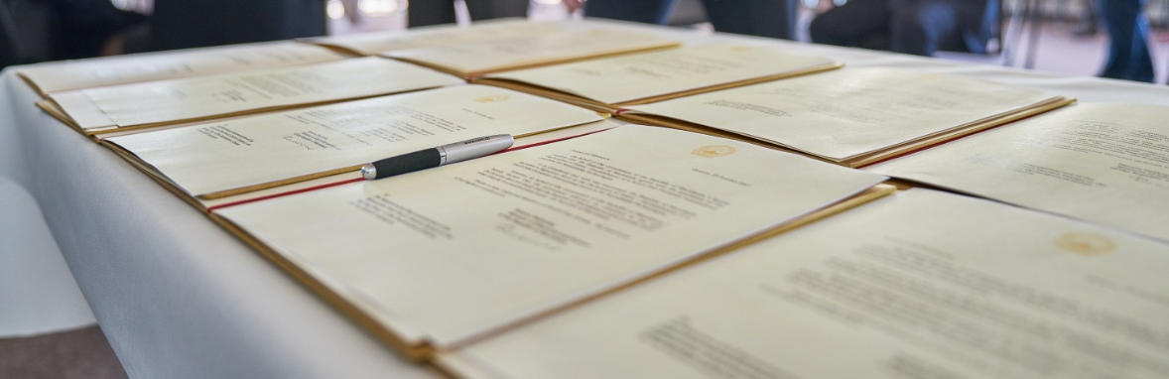
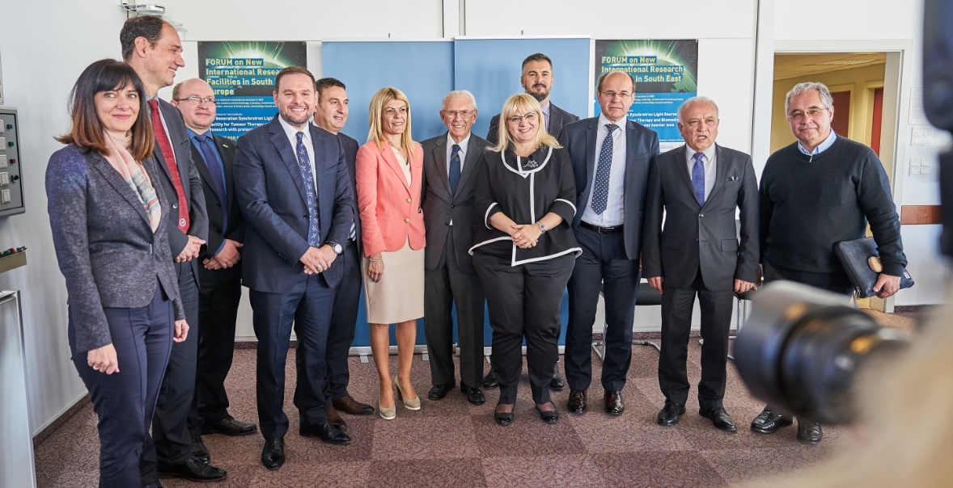
SEEIIST
Political steps
Declaration of Intent signed at CERN on October 25, 2017
Signature of Declaration
of Intent by SEE Ministers
of Science/corresponding Ministers or their representatives at CERN
DoI – signed by 8 countries
Croatia – ad referendum
Greece – Observer,
signed 2021

Slide 5
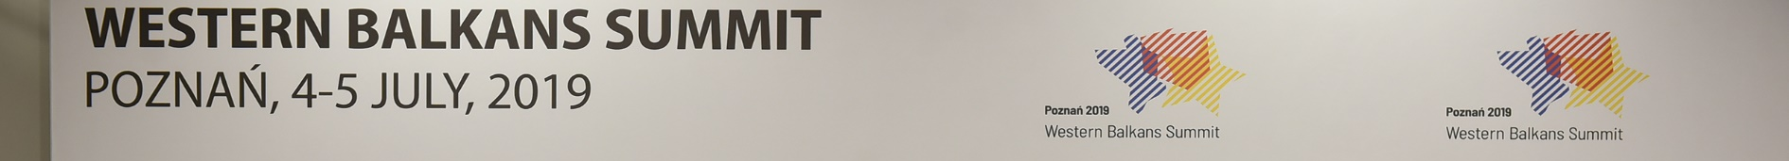

SEEIIST
Political steps
Memorandum of Cooperation signed by six Prime Ministers of the SEE Region
Signature of the 6th Summit of the Berlin Process

Slide 6
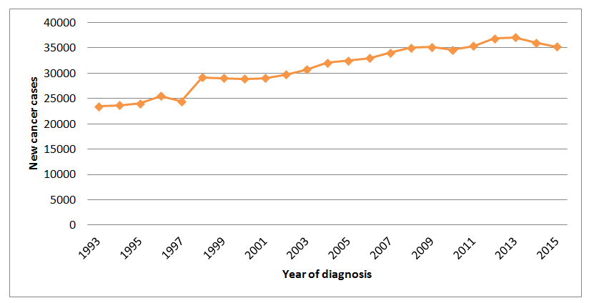
Some arguments for HT
Tendency of increase of the new cancer cases and dead cases in the region
Bulgarian data, to be normalized to the decreasing number of population

Slide 7
Radiotherapy
Advantages
The cheapest method for treatment (5% of total price)
Good efficiency – 30 -40 %
Noninvasive method, less lateral effects
Limitations
Maximal dose
30% of patients are not effected

Slide 8
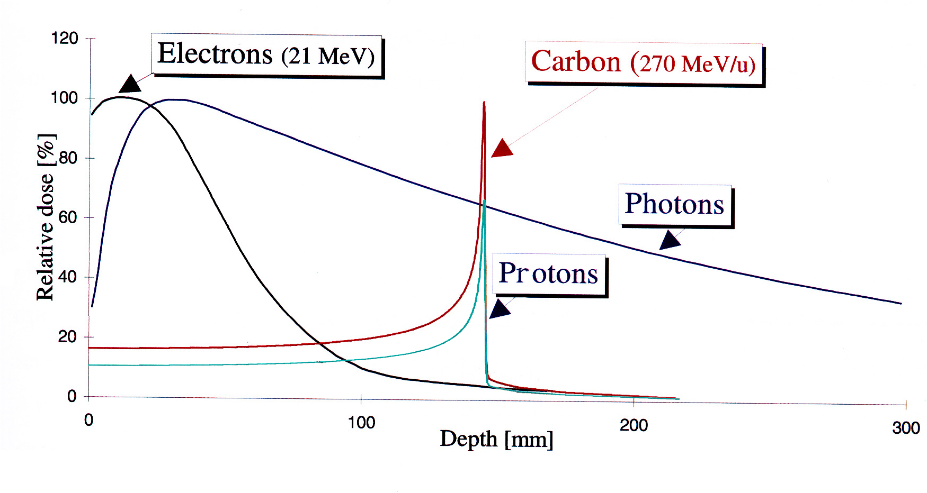
Hadron Therapy

Slide 9
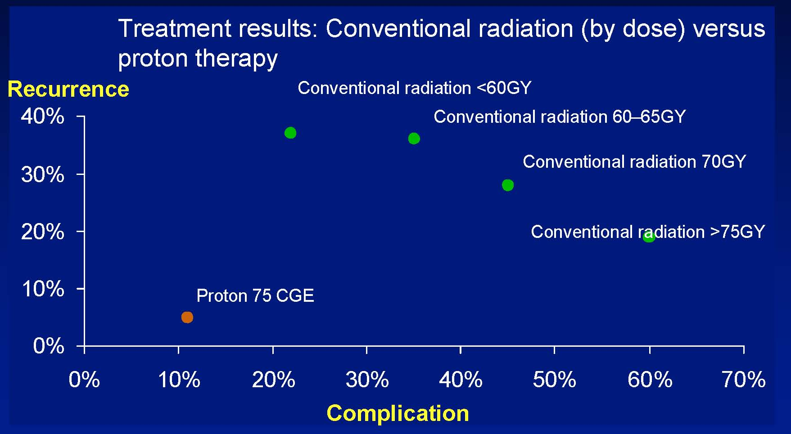
Treatment efficiency

Slide 10
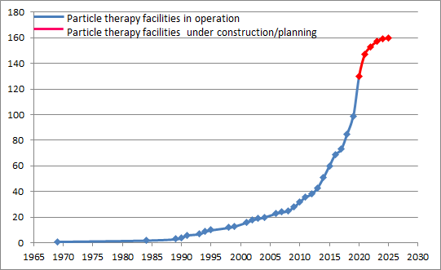
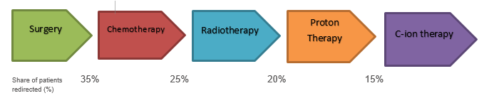
Some arguments for HT
The hadron therapy is one of the most advanced and effective methods for
tumor treatment
In operation – 117
Ion therapy - 12
In construction – 38
Ion therapy - 6
Planned – 28
Ion therapy – 2
Patient treated /2019/ - 220 000
with protons
In 2019 – 37 500 with carbon ions

Slide 11
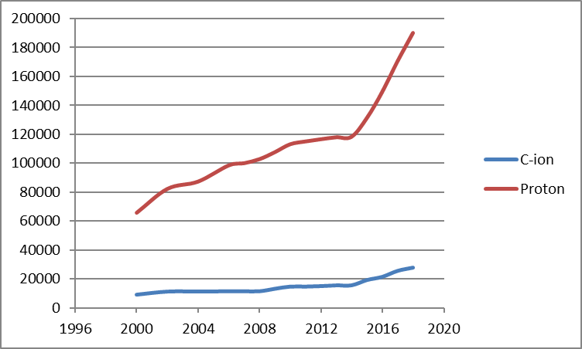
Patients treated with protons and C-ions
Protons – 220 000
C-ions – 37500

Slide 12
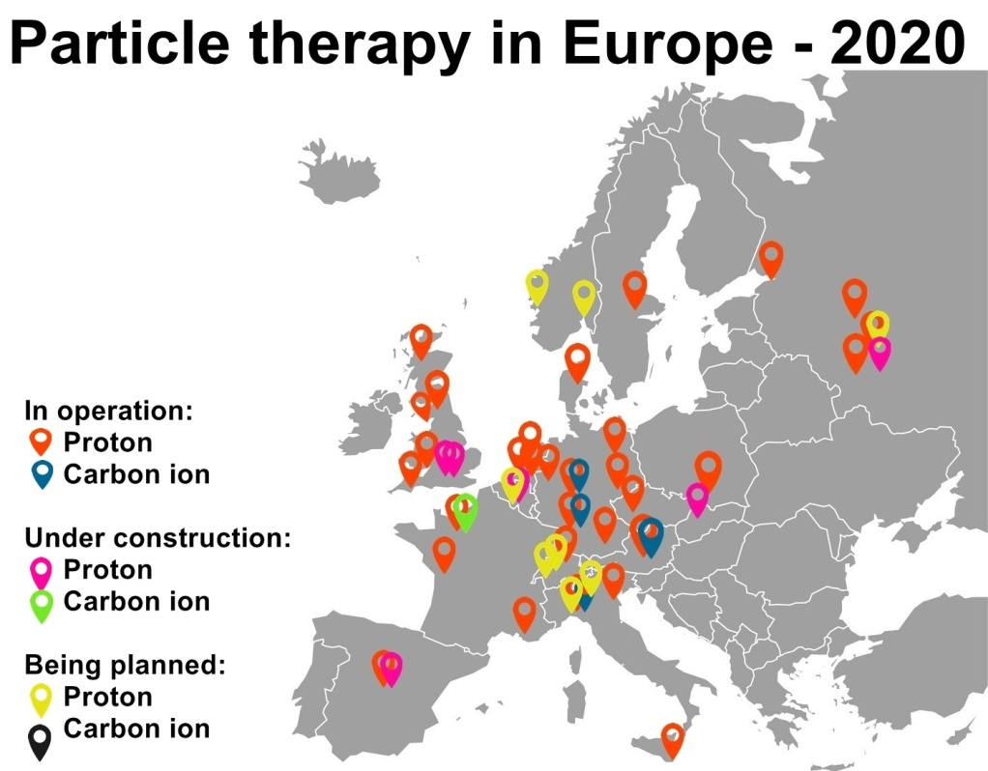
Some additional arguments for HT
Practically unavailable for the citizens of the region
Very expensive – 50 000 Euro at HIT

Slide 13
Expected number of patients
The population of the 10 countries in the project – 43 million
Population of Balkan peninsula (including European part of Turkey) – 75 millions
Estimated number of expected patients
  SEEIIST member states > 1400
  Balkans > 2450
Numbers strongly depend from the national protocols for cancer treatment and can vary significantly
  The above numbers should be considered as a lower limit
The SEEIIST HT center will not cover the needs of the region

Slide 14
SEEIIST accelerator complex

Slide 15
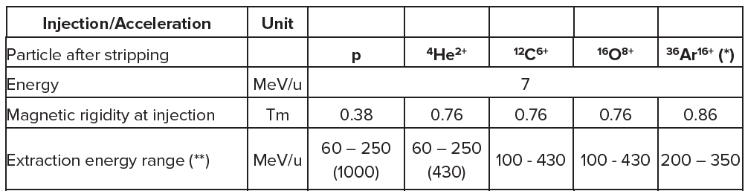
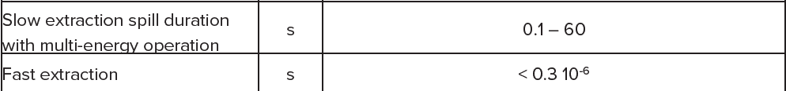
SEEIIST accelerator
Warm magnets with improved design
Fast and slow beam extraction
Possibility for Flash therapy
First ion accelerator in the world

Slide 16
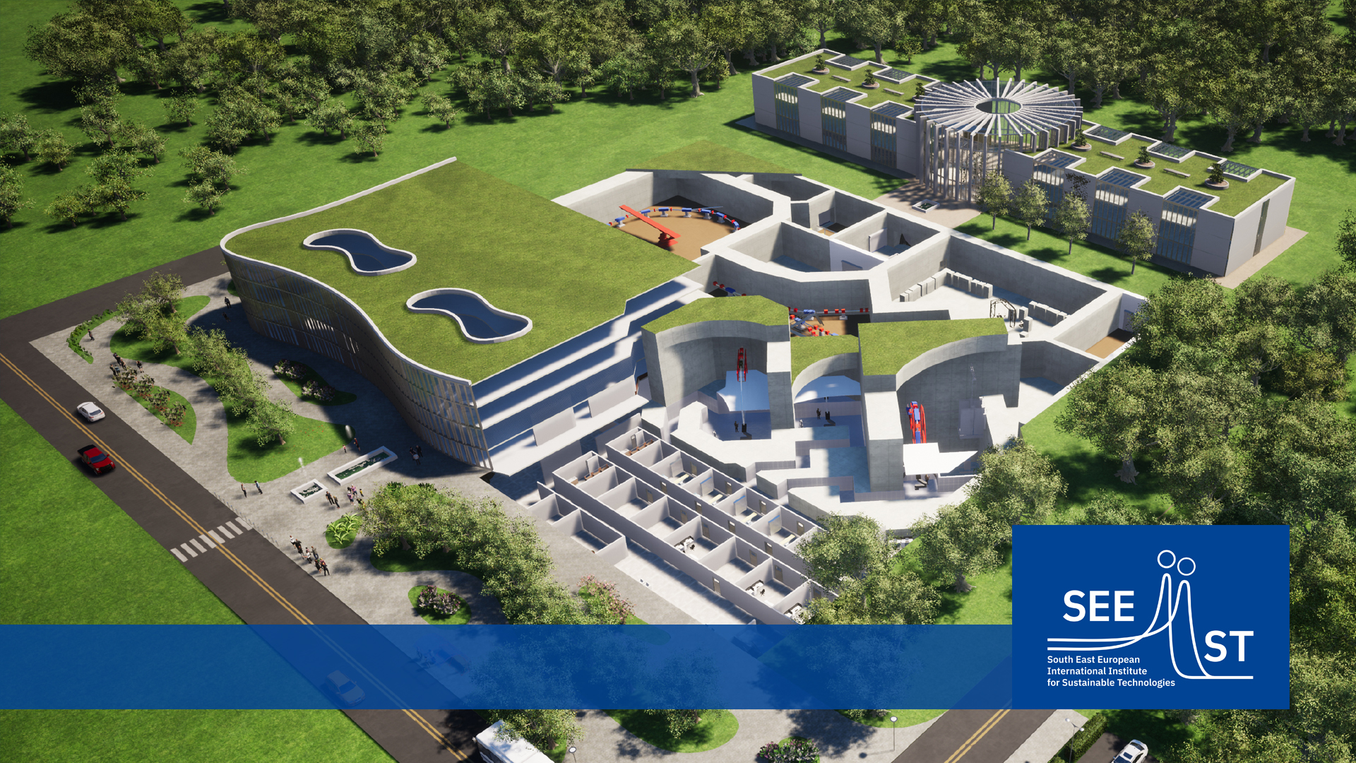
SEEIIST

Slide 17
SEEIIST

Slide 18
Center for ion therapy and biomedical research
Sustainable running of the centre
  First requirement is to prove that the centre will run and be used in the most efficient way
In case we build HT centre with three treatment rooms
  50% acc. time – patients treatment
  50% – research program
Nominal treatment capacity of the Centre |  | Exploitation level till break-even point
Number of rooms | 3
Days of operation/year | 250
Treatment hours/day (7 – 14) | 5
Time for fraction | 30 min | Capacity reached | 70%
Room utilization | 95 % | Average number of fractions/patient | 18
Room availability | 95 % | Number of patients/year | 260
Maximal number of fractions/year | 6670 | Number of patients/year | 375

Slide 19
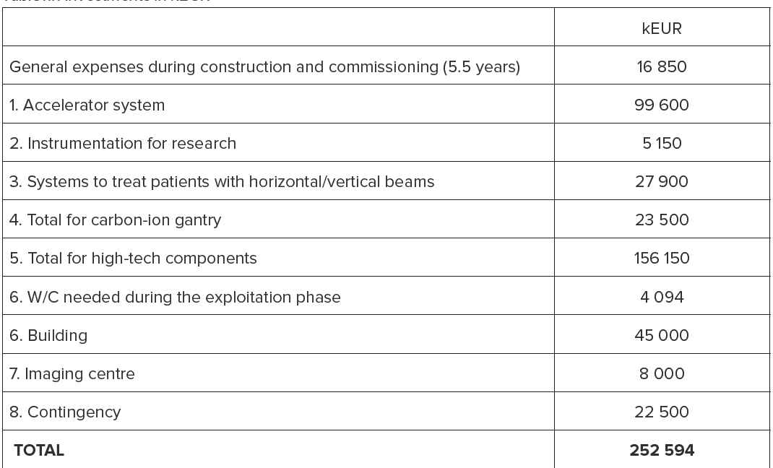
SEEIIST cost

Slide 20
Running cost full operation

Slide 21
Treatment cost

Slide 22
Stages of the project
Stages of the project
Preparatory phase
  First stage
    preparation of Conceptual Design (CDR)
  Second stage –
    detailed technical design of the infrastructure (TDR)
    Legal framework and establishment of the Institute
    Business plan
Construction phase – 5-6 years
Detailed work plan with corresponding time scale was developed

Slide 23
Time scale

Slide 24
Hubs and Networks
Distributed infrastructure
  Digital Hub
  Accelerator development Hub
  Scientific Hub (Radiobiology)
  Sustainability Hub (Sun Power)
  Training Hub
  Animal Research Hub
  Imaging Hub
WG – Hubs and Networks
Hubs can be established earlier than central infrastructure

Slide 25
Research Program
Science community
  Supported by CERN and GSI
  SEEIIST is embedded in
    European Network for Light Ion Therapy (ENLIGHT)
    Infrastructure in Proton International Research (INSPIRE), Manchester Univ.
    European Particle Therapy Network (EPTN) – task force of European Society for Radiotherapy and Oncology
    International Biophysics Collaboration (IBC) – at FAIR
  HITRIplus
  Collaboration agreements with CERN, PSI, CNAO, ICTP

Slide 26
Research Program
Research is main mission of SEEIIST
  Two very large experimental halls
  High duty cycle linear accelerator (7 MeV/u) – radioisotopes
  Irradiation of small and large animals
  Most advanced accelerator technology
    Dose delivery in single synchrotron cycle
    Fast extraction and shaping of the beam – FLASH therapy
  Large number of scientific and technical staff to support research activities of the external teams
  At least 50% of the days + nights and weekends will be used for non-clinical research

Slide 27
Research Program
Clinical Trials
  Patients will be enrolled in clinical trials
  The first years – phase I/II trials with proton and Carbon ions
  Later – phase III trials comparing C-ions with other ions and ions with conventional Intensity modulated Radiation
  Trials extended to locations with high mortality – pancreas and lung
  FLASH therapy

Slide 28
Research Program
Radiobiology
  New therapy solutions
    Radio therapy with immunotherapy
    Radio-genomics for personalized medicine
    Ultra-high dose rate (FLASH therapy)
    Mini-beam radiotherapy (MBRT)
    Basic radiobiology
Animal studies
  Animal models for the radiobiology studies - rodents
  Treatment of large sick animals
  Comparative trials in pets

Slide 29
Research Program
Medical Physics
  Flash therapy of moving organs
  Tomography with helium ions
  Ion acustic imaging
  In beam MRI – real-time information
Material science
  Test of radiation hardness of shielding materials
  Space microelectronics
  Production of nanotubes

Slide 30
Invitation to participate
HITRI+ - Heavy Ion Therapy Research Integration plus
  HORIZON 2020
  Coordinated by CNAO
  18 participating organizations
  Project in its first year
  Conceptual design of the accelerator
  Transnational access / Transnational_Access_What_is_TNA – HITRIplus/
  Access at HIT, CNAO, MedAustron, GSI, and UKGM
    Clinical access
    Research access
https://youtu.be/zxK1cRuKMLw

Slide 31
Thank you for your attention!

Slide 32
Accelerators
Linear accelerators
  Electrons up to 20 MeV
  X-rays with multileaf collimator system
  3 GHz linac 230 MeV protons - LIGHT system
Circular accelerators
  Cyclotrons
    Protons with energy up to 250 MeV
  Synchrotrons
    Protons with energy up to 250 ( 800) MeV
    Light ions – up to 450 MeV/u

Slide 33
Cyclotrons
IBA (1996) , SHI
250 Tons
Isochronous
Cyclotron
IBA (2018)
60 Tons
Synchrocyclotron
Varian (2005)
90 Tons
Isochronous
Cyclotron
MEVION (2013)
15 Tons
Synchrocyclotron

Slide 34
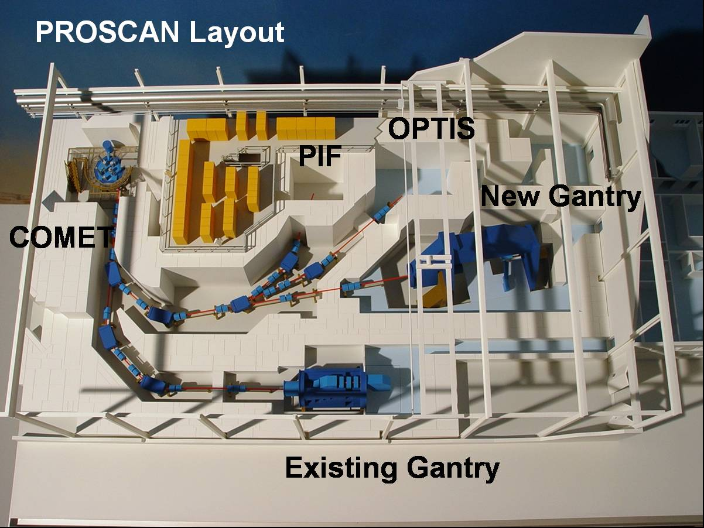
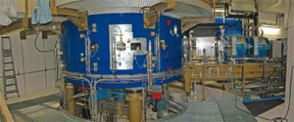
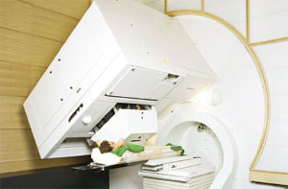
PSI - Swiserland
Courtesy PSI

Slide 35
Loma Linda Medical Center
Synchrotron – up to 250 MeV
Three gantry rooms
One room with horizontal beam

Slide 36
Nagoya Proton Therapy Center, Japan

Slide 37
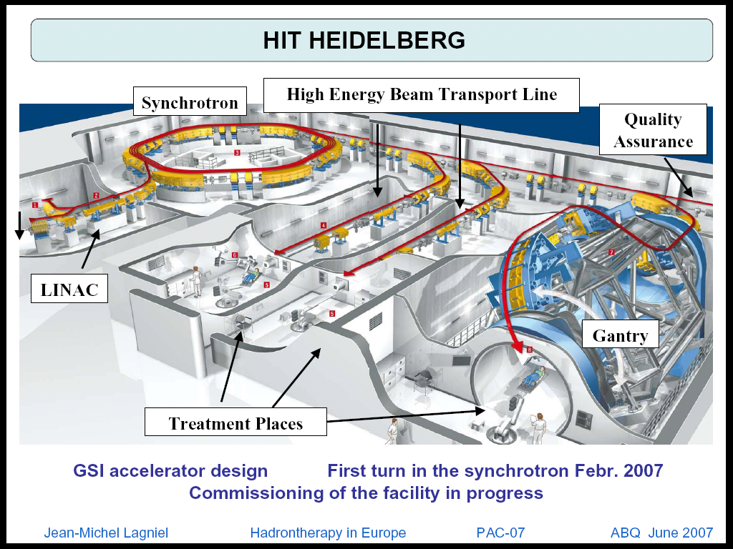
Heidelberg ion beam therapy center
Compact synchrotron
Scanning Gantry
Two horizontal beams
p, He, C, O, …
E < 430 MeV/n
30 cm beam range
1000 pacient/year

Slide 38
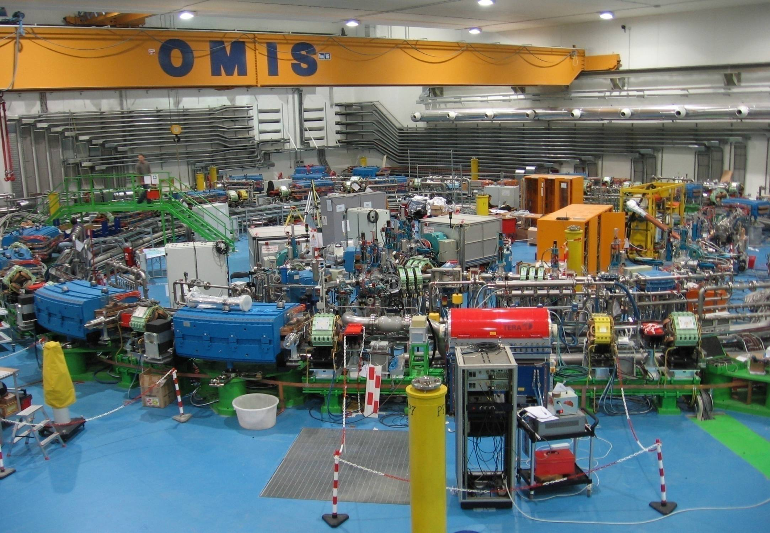
CNAO Pavia

Slide 39
Towards flash therapy
What is flash therapy
Ultra short irradiation time (< 500 ms)
Very high dose intensity 20 – 2000 Gy/s
The healthy tissue is less affected
Pulmonary fibrosis in mice

Slide 40
Towards flash therapy
First patient treatment
5.6 MeV linac electrons
15 Gy
10 fractions
Pulses in 90 ms
Multiresistant tumor

Slide 41
Towards flash therapy - protons
Varian FlashForward Consortium
17.5 Gy in flash mode
25% reduction in fibrosis versus conventional
35% reduction in dermatitis
Lung fibrosis

Slide 42
Towards flash therapy - protons
Varian FlashForward Consortium
Flash reduces differential gene expression
Flash protons – gene expression close to the non irradiated sample
Lung fibrosis

Slide 43
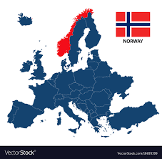
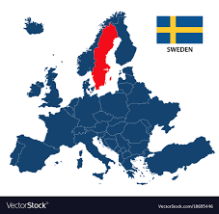

Cancer Statistics – mortality ratio
SEEU
The highest 74 % (BIH, ALB, MKD, MNG, GR )
The lowest 50% (SLO)
EU
The highest 64% (Hungary, Lithuania)
The lowest 34% (Norway, Sweden, Switzerland)
Less imaging and treatment equipment – one of several factors for higher Mortality/Incidence ratio

Slide 44
Depth regulation – energy change
GEANT4 simulations in water
Protons and C – ions
at the same depth
protons
C - ions

Slide 45
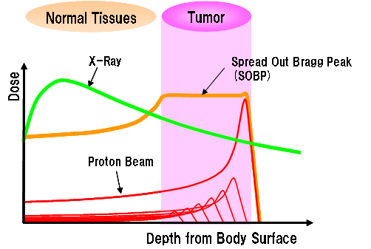
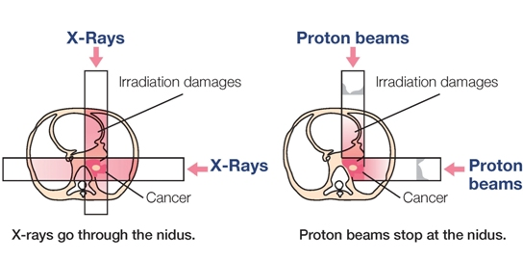
Tumor irradiation
Spread out Bragg peak – uniform irradiation of the tumor cells
http://www.shi.co.jp/quantum/eng/product/proton/proton.html

Slide 46
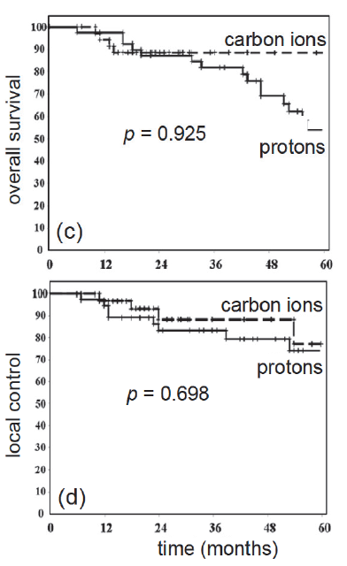
Medical program and clinical research
Protons and ions (C)
Clinical trials comparing protons and C-ions
  Adenoid cystic carcinoma of the head and neck region

Slide 47
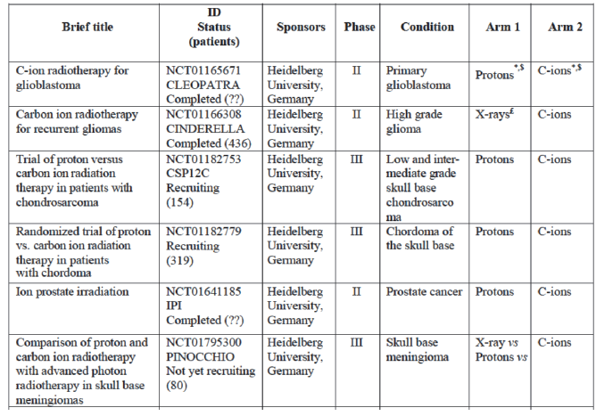
Medical program and clinical research
Ongoing clinical trials

Slide 48
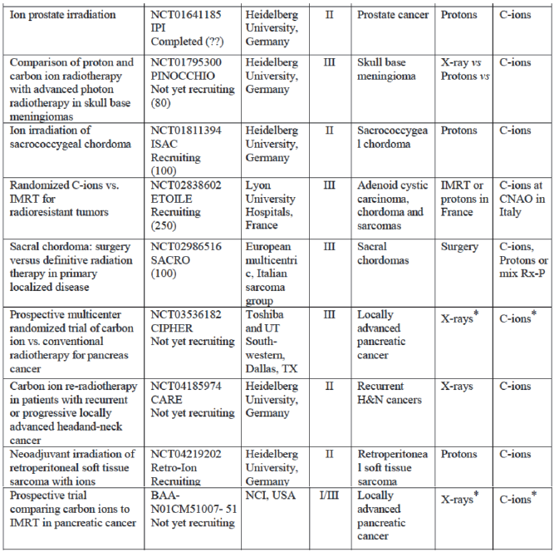
Medical program and clinical research
Ongoing clinical trials

Slide 49
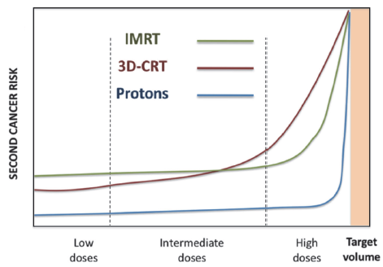
Medical program and clinical research
Paediatric patients

Slide 50
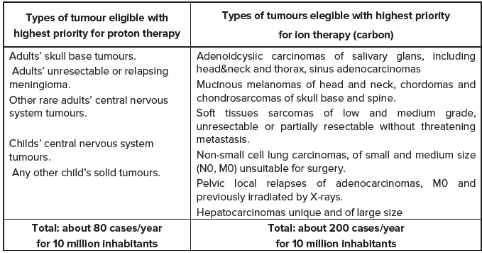
Medical program
Types of tumors to be treated and their epidemiology
Highest priority protons and ions

Slide 51
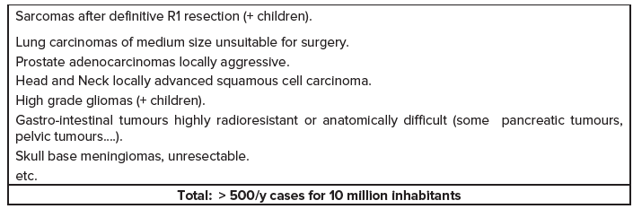
Medical program
Types of tumors to be treated and their epidemiology
Indications of secondary priority for light ions therapy

Slide 52
Medical program
Hypofractionation
  To reduce the number of fractions and to increase the dose per fraction
  Stereotactic Body Radiation Therapy (SBRT) (1-3 fractions – 25-30 Gy)
  Damage of vascular endothelial cells
  Charged particles ideаl for this type of therapy
  Very promising data with protons and ions

Slide 53
Medical program
Hypoxia
  To reduce the Oxygen Enhancement ratio (OER)

Slide 54
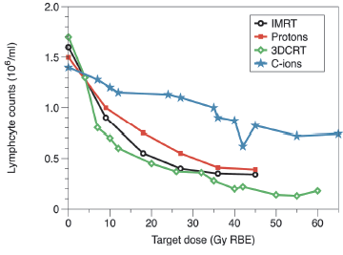
Medical program
Combined treatments
  Control of metastasis – combined radio therapy + chemotherapy
  Investigation of synergistic interaction of the drugs and ion irradiations
  Combination of particle therapy with immunotherapy
  Lymphopenia
  The imunne system suppression is reduced in the case of Protons and C-ions

Slide 55
Medical program
Radiogenomics – personalized precise medicine
  The goal is to develop genetic risk profile - individualization of radiation dose prescriptions
    Genetic profile determines the radiosensetivity
    Genetic mutations of DNA repair genes induce extreme radiosensetivity
    An example – mutations in ATM protein
  Participate in the DNA repair and cell cycle control (G1/S)
  Tumor tissues
    Biomarker signatures
    Response is highly variable

Slide 56
Medical program
Therapy with other ions
  Currently on protons and C-ions
    He versus protons (less lateral scattering)

Slide 57
Medical program
Therapy with other ions

Slide 58
Radiobiological program
In vitro and in vivo radiobiology
  Increased proton RBE at the end of the range –should it be considered in the treatment planning?
  Interplay between partial volume and RBE effects – requires in vivo investigation
  Systematical study of combination with stimulation of the immune system
  Stem cells radiosensetivity
  Drugs, nanoparticles and other agents modify the radiation response.
  Influence of the radiation on cells migration
  Experimental data for biophysical models used for therapy planning
  Investigation of the probability for secondary cancer induction
  FLASH therapy mechanism

Slide 59
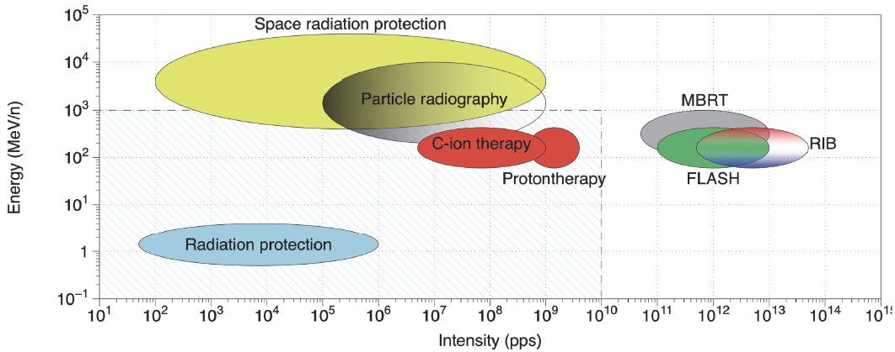
Radiobiological program
  Radioactive ion beams (beam visualization)

Slide 60
Animal program
Animal facility
Small animals
  xenografts models of tumors – small animals (rodens)
  Suppressed immune reaction
  Establish in- house small animal facility
  Accept a small animals from outside
  Investigate different protocols and trace short and long term effects
  Animal facility close to the experimental area
Big animals
  External veterinary
  Dogs and cats with tumors
  Swine – treatment of cardiac arrhythmias

Slide 61
Medical physics program
Beam characterization
  Stopping power and range measurement
  Fragments cross sections measurement (ToF , Medipix)
  Evolution of the beam spot size along the trajectory
Dose delivery
  Scanning pencil beams require precise control
  Moving organs
  Flash therapy
  Scanning micro beam

Slide 62
Medical physics program
Imaging Modalities, Motion Management and Quality Assurance
  Measurement of leaving tissue stopping power
    Proton or Helium tomography
  Accuracy of dose deposition
    Gamma cameras, PET
  Tracking of moving organs
    MRI, ultrasound scanners
Biophysical modeling
  At macroscopic and microscopic scale simulation
  Development of clinical treatment planning systems
  Big data analysis and development of new treatment protocols
  Parallel processing and HPC, use of AI

Slide 63
Material science program
Irradiation of materials under high pressure
  May cause drastic changes in the properties
Ionoacustic phenomena
  Energy deposed by the ion beam (at Bragg Peak) creates ultrasound waves
  Obtain information on internal structure
  Ion therapy – localize the Bregg peak

Slide 64
Material science program
Radiation hardness
  Shielding, beam dumps etc at new accelerators like FAIR, European Spallation Source (ESS), HL-LHC and FCC at CERN, fusion and fission reactors
  Beam intercepting devices – collimators, beam dumps, production targets etc.
  New materials – at extreme doses
  Thermal stress waves measurement

