Slide 1
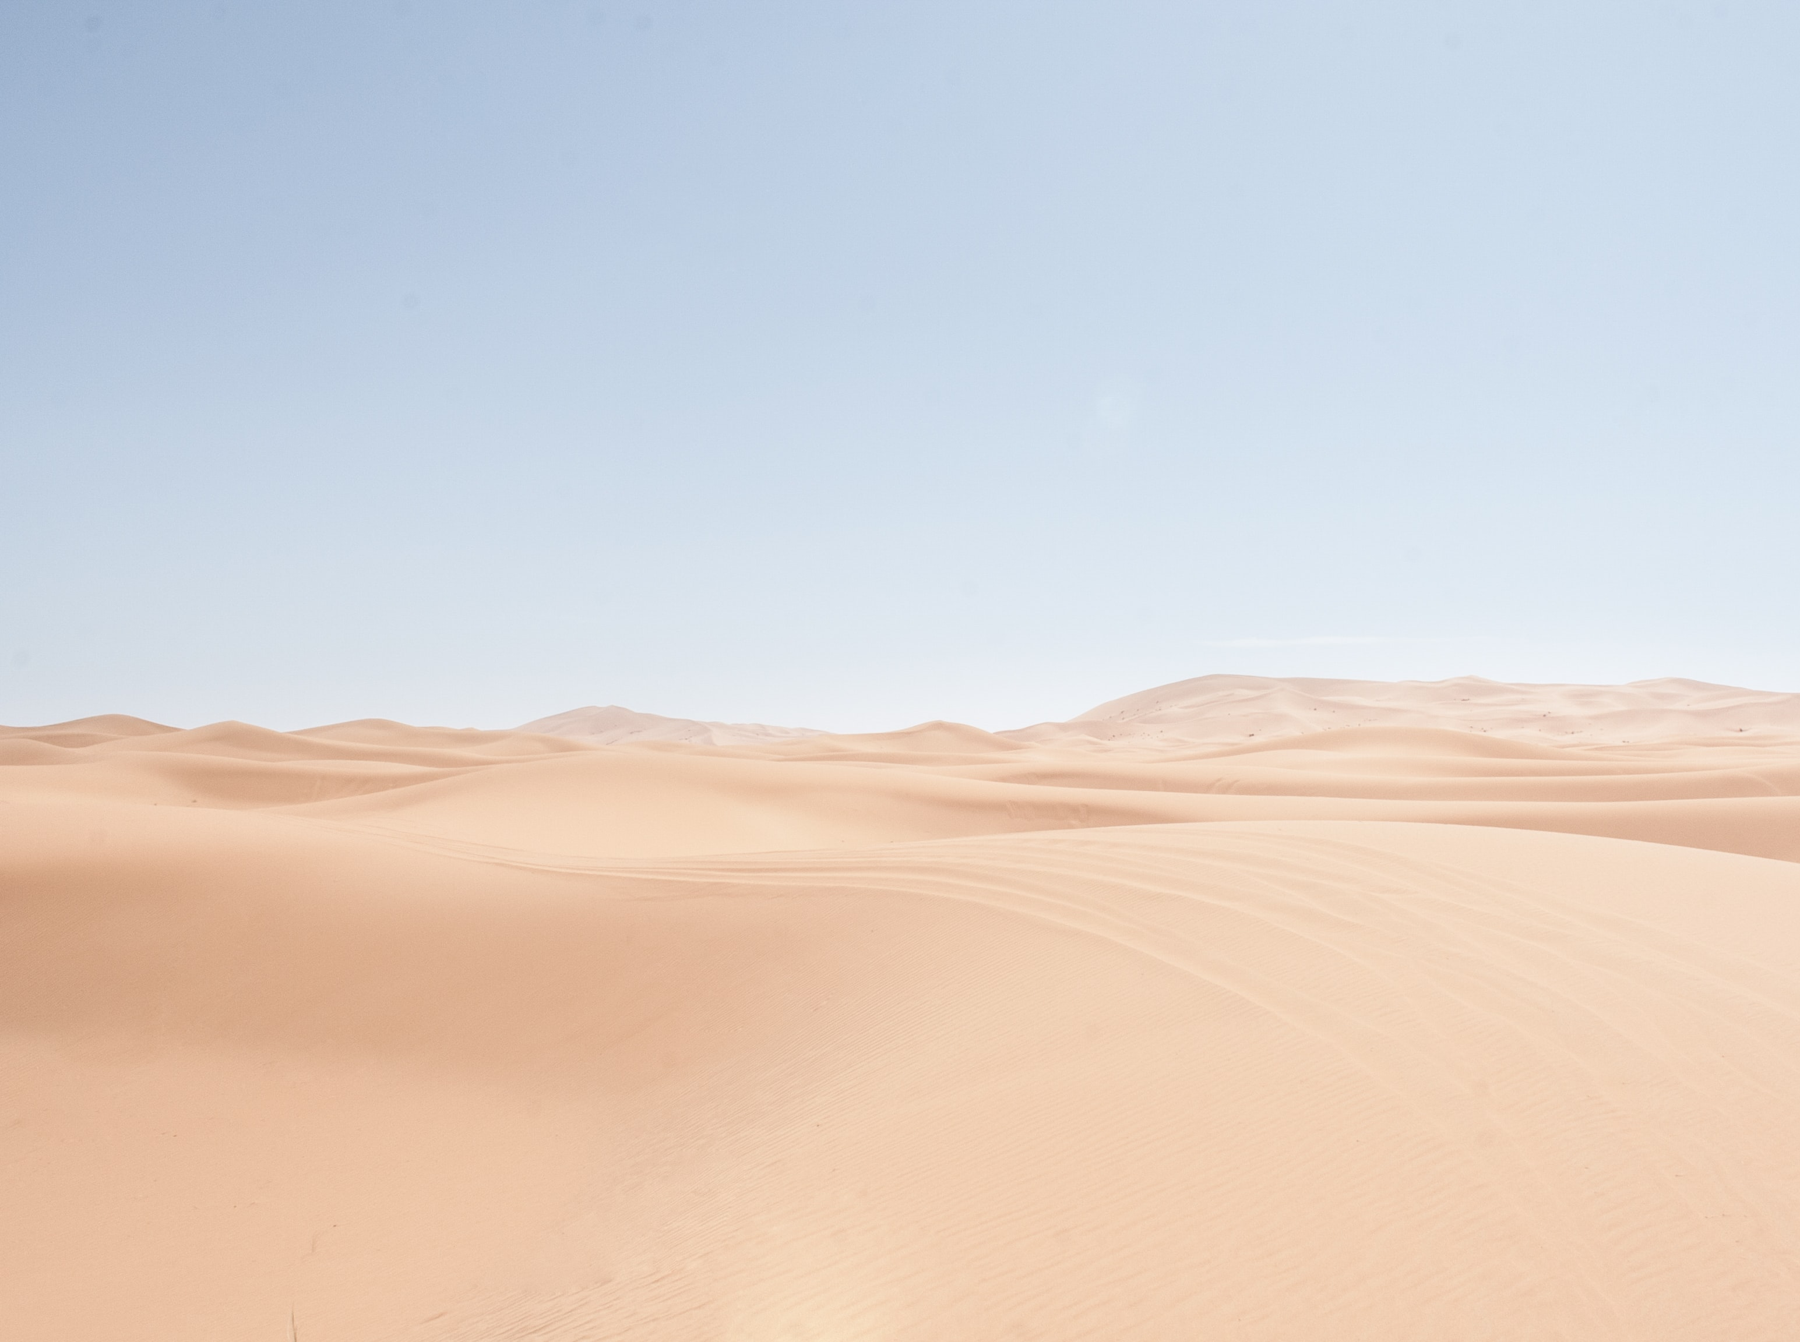
Mineral Dust Single Scattering Albedo and Radiative Effects Based on DREAM Model
Maja Kuzmanoski^{1,}, Luka Ilić^{1,2} and Slobodan Ničković^{3,1}
¹Institute of Physics Belgrade
² Now at Barcelona Supercomputing Center, Barcelona, Spain
³ Republic Hydrometeorological Service of Serbia (RHMSS)

Slide 2
Atmospheric mineral dust
One of the most abundant aerosol types
Dust has impact on environmental processes
Important role in climate system
    absorption and scattering of solar and terrestrial
    radiation
    contributing to cloud processes

Slide 3
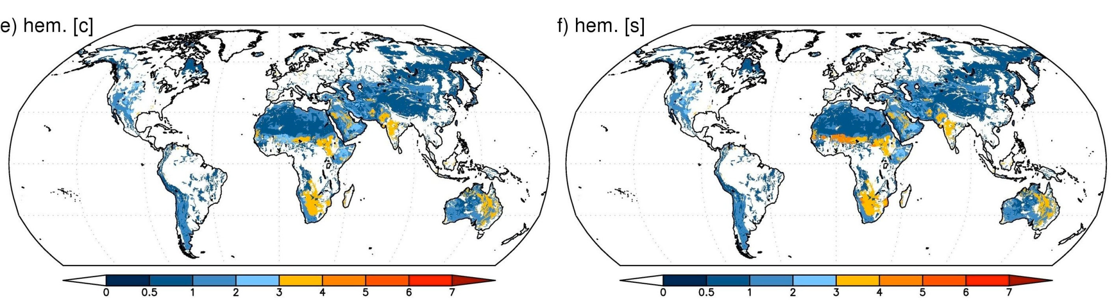
Motivation
SSA is among key properties determining dust direct radiative effects
Dust SSA depends on particle mineral composition, which is determined by mineralogy of dust emission sources
Variability of dust mineral composition is not accounted for in models
At UV and visible wavelengths, the content of iron oxides is of particular importance
Ničković et al., ACP, 2012

Slide 4
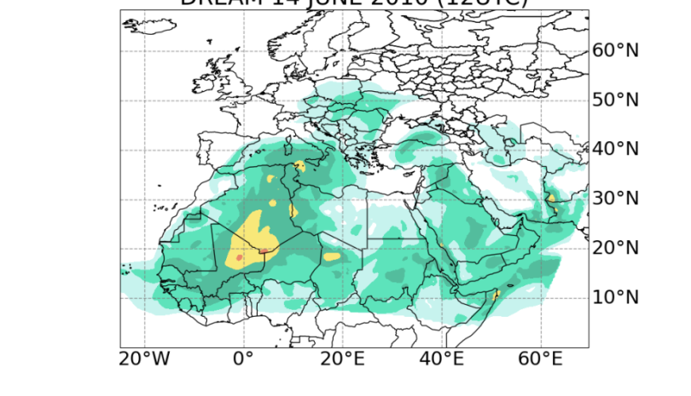
Dust Regional Atmospheric
Model (DREAM)
DREAM model simulates atmospheric cycle of mineral dust aerosol (Ničković et al., JGR, 2001; Ničković et al. ACP, 2013)
It is embedded into the Eta atmospheric model
Model domain covers Saharan and Middle East dust sources, as well as a large part of the European continent
Horizontal resolution of 1/5° (~ 30 km) and 28 vertical levels.
Particle size distribution is described by 8 particle size bins with effective radii of 0.15, 0.25, 0.45, 0.78, 1.3, 2.2, 3.8 and 7.1 μm
In this study dust and hematite concentrations in 8 particle size bins are used

Slide 5
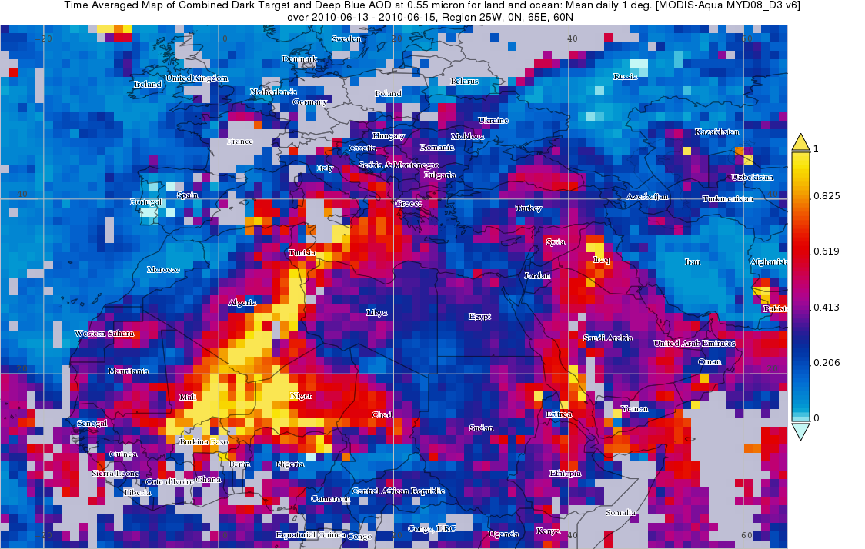
Dust episode, June 2010
AOD(550 nm) from Aqua MODIS sensor
June 13-15, 2010

Slide 6
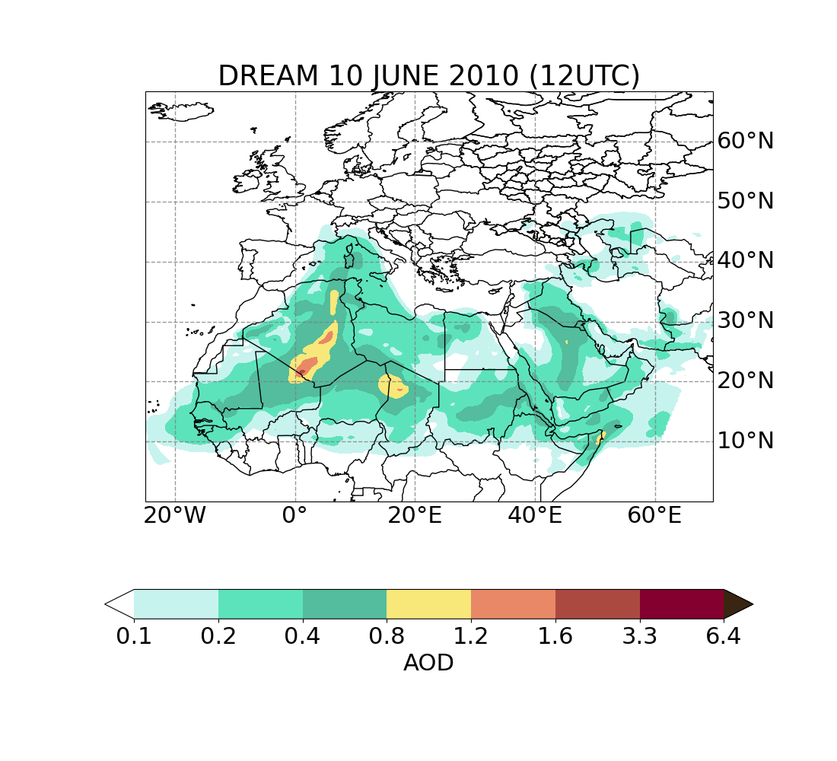
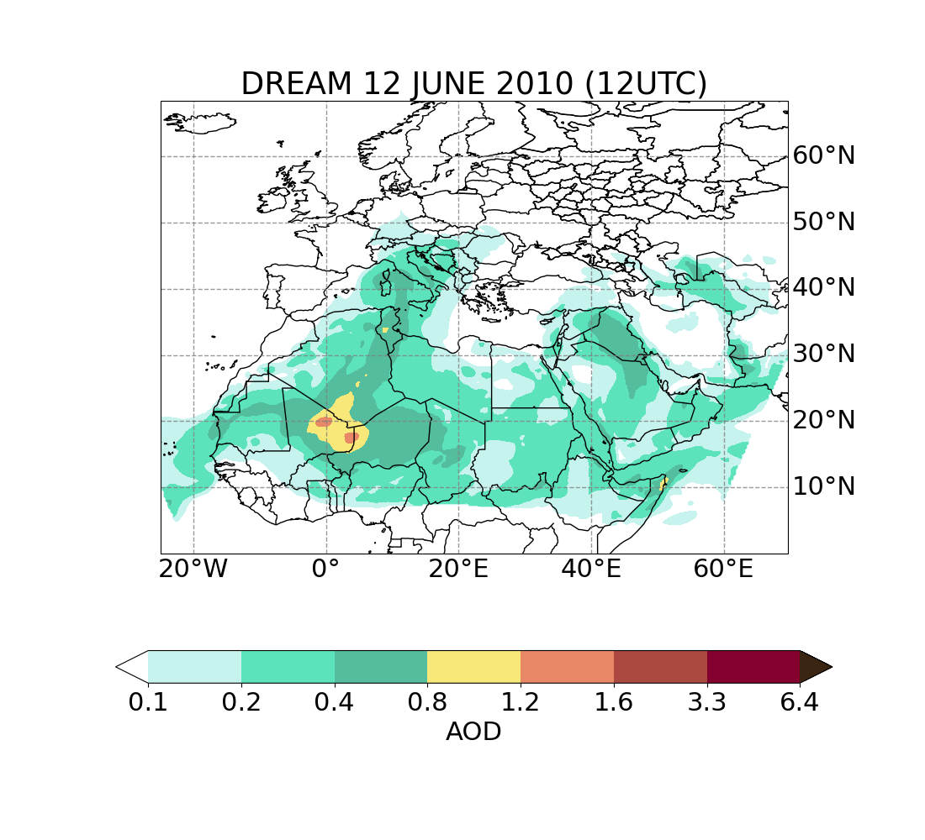

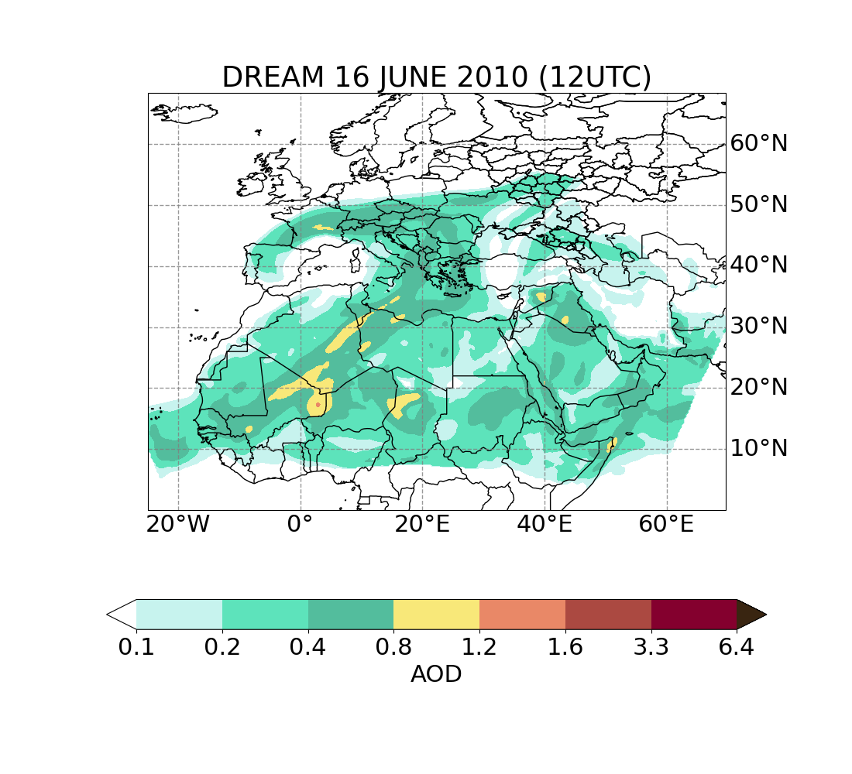
Dust episode of June 2010 - DREAM

Slide 7
Dust single scattering albedo
SSA is calculated based on dust and hematite mass concentrations from model simulations
Apart from hematite, dust was assumed to consist of illite, kaolinite, montmorillonite and quartz (Balkanski et al., ACP, 2007)
  Hematite refractive index values from Longtin et al. (1988)
  Mineral refractive indices from Egan and Hilgeman (1979) and Longtin et al. (1988) for individual components.
External mixture
Internal mixture

Slide 8
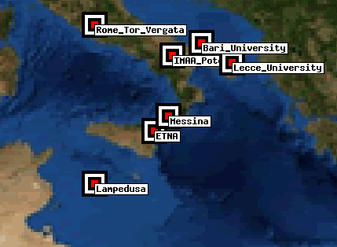
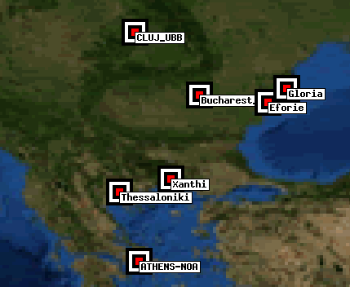
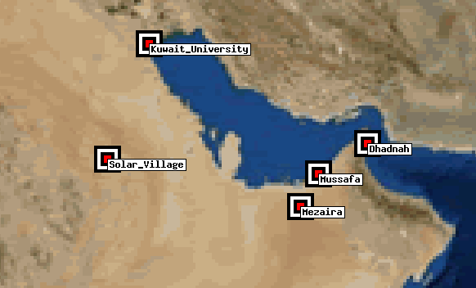
SSA

Slide 9
Comparison with AERONET
AERONET sunphotometers
Direct radiation measurements: AOD at eight wavelengths
in the range 340-1640 nm
Inversion of diffuse and direct radiation measurements:
  aerosol size distribution (0.05 – 15 µm radius range)
  aerosol refractive index (440, 675, 870, 1020 nm)
  SSA (440, 675, 870, 1020 nm)
External mixture
AERONET datasets with
Angstrom exponent < 0.5 were considered
Internal mixture

Slide 10
Dust direct radiative effects (SW)
24h-average SW (0.24-4.6 μm) radiative forcing
calculated using libradtran (Mayer and Kylling, ACP, 2005), RTE solver DISORT (Stamnes et al., 1988; 2000)
SSA(440 nm): 0.94 0.94 0.91
IGBP
surface type: water urban desert
AOD₅₅₀ = 0.32
AOD₅₅₀ = 0.55
AOD₅₅₀ = 0.80

Slide 11
Conclusions
DREAM model simulations showed low hematite mass fraction and low spatial variability of SSA at 440 nm.
Assumption of external mixture resulted in larger modeled SSA values and weaker wavelength dependence in comparison with AERONET measurements.
The assumption of internal mixture resulted in closer agreement with AERONET SSA values.
Fine anthropogenic particles could contribute to lower SSA based on AERONET measurements.
In studied cases variability in radiative effects is mainly result of variability of AOD and surface albedo; however, even relatively small SSA changes (0.03) over highly reflective surface significantly contribute to changes in radiative effects.

Slide 12
Acknowledgements
We would like to thank the AERONET network and the principal investigators, as well as their staff, for establishing and maintaining the AERONET sites used in this work.
Analysis and visualization of MODIS AOD data used in this presentation were produced with the Giovanni online data system, developed and maintained by the NASA GES DISC

