Slide 1
Thermal radiation measurements in biophotonics
Dejan V. Pantelić¹, Branislav Salatić², Danica Pavlović²
¹Senzor INFIZ, Pregrevica 118, 11080 Zemun, Belgrade, Serbia ² Institute of Physics Belgrade, Pregrevica 118, 11080 Zemun, Belgrade, Serbia

Slide 2
- Thermal radiation in nature and its importance for life (IR atmospheric windows, radiative heating and passive cooling)
Thermal radiation measurement and imaging (principles, cameras)
Thermal management of insects, photonic structures in the infrared
A tale of few insects:
Cataglyphis bombycina (Roger, 1859)
Rosalia alpina (Linnaeus, 1758)
Morimus funereus (Mulsant, 1863)

Slide 3
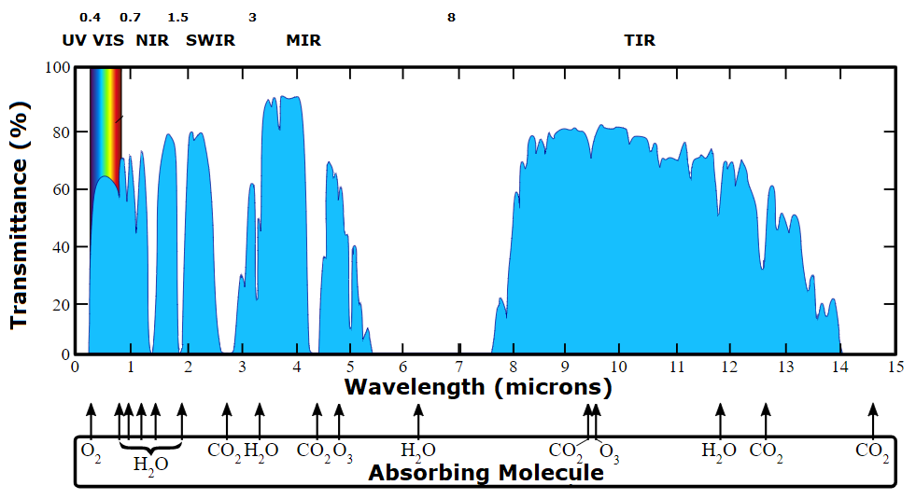
Atmospheric windows
Living organisms establish equilibrium with the environment through convection, conduction and radiation
Dominant mechanisms depends on the lifestyle and habitat

Slide 4
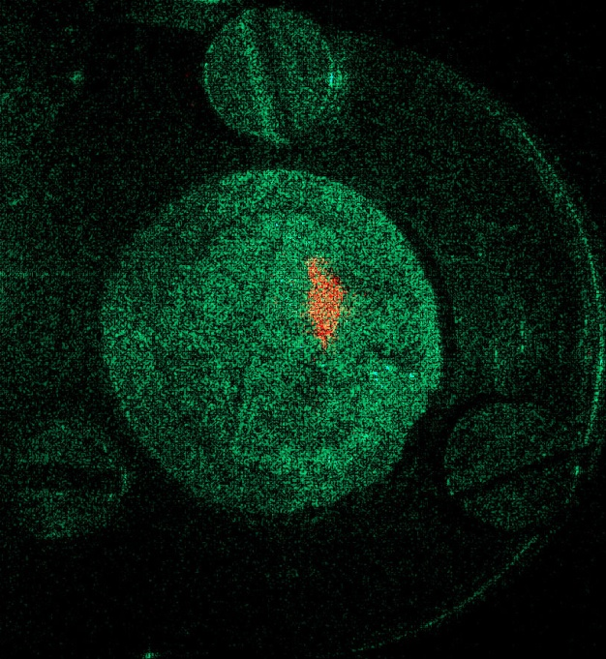
Thermal radiation detection and imaging
Basic principles
Uncooled: bolometric, bimaterial bending, pyroelectric, photophoretic
Cooled: photodetection with narrow bandgap semiconductors (InSb, InAs)
Micromechanical cantilevers
Natural micromechanical cantilevers
200 μm
Y. Wen, et al., Microsystems & Nanoengineering 3, (2017) 17071
D. Grujić, et al., Opt. Express 26, 14143-14158 (2018)

Slide 5
Thermographic imaging and cameras
Cooled – faster, more sensitive, more complex and expensive
Uncooled – bolometer or microcantilever
Low-cost camera module:
LEPTON 3:
8 – 14 μm, 120 x 160 pixel, sensitivity < 50 mK, 17 μm pixel size, 9 Hz, $259
High-end cameras achieve 4 kPix resolution at several tens k$
Numerous applications in medicine, industry, surveillance and (regretfully) military

Slide 6
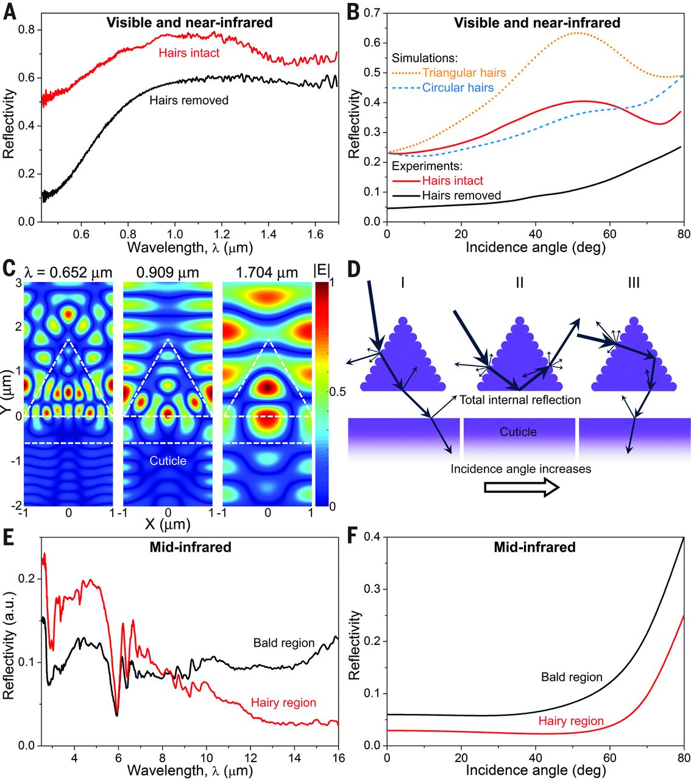
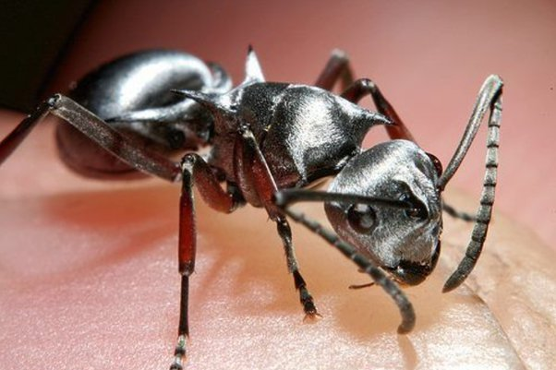
Silver Saharan ant - Cataglyphis bombycina (Roger, 1859)
N. N. Shi, C-C. Tsai, F. Camino, G. D. Bernard, N. Yu, R. Wehner, Keeping cool: Enhanced optical reflection and radiative heat dissipation in Saharan silver ants, Science 349, (2015) 298 – 301

Slide 7
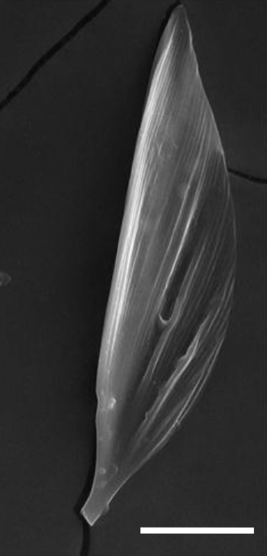
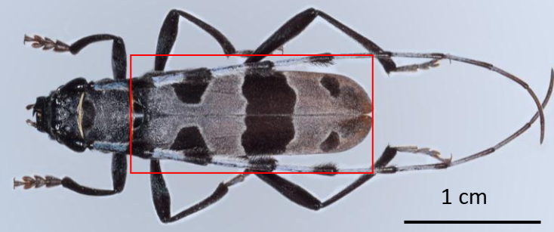
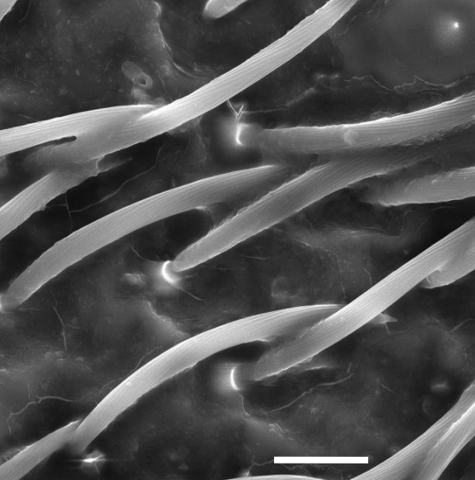
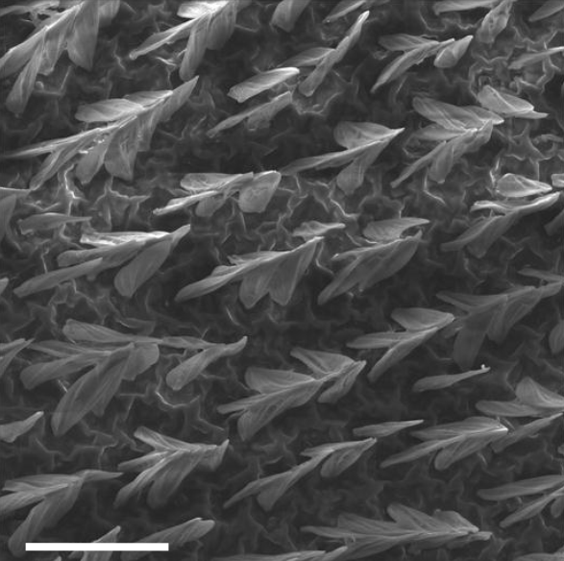
Rosalia alpina (Linnaeus, 1758)
A longicorn insect with large black patches imitating those on trees
Insect has wings and flays; eggs grow under the diseased tree bark

Slide 8
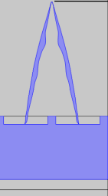
But there is a problem, black patches efficiently absorb visible light
How to stay camouflaged without overheating?

Slide 9
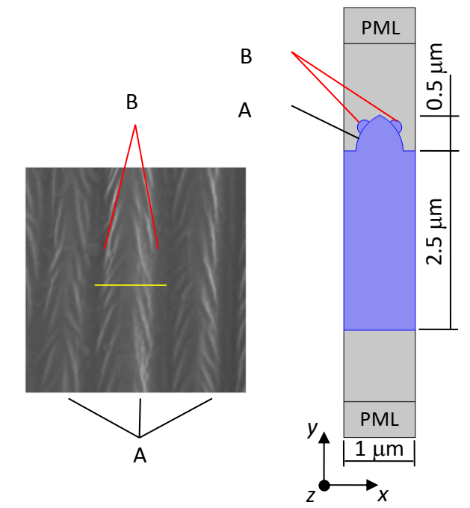
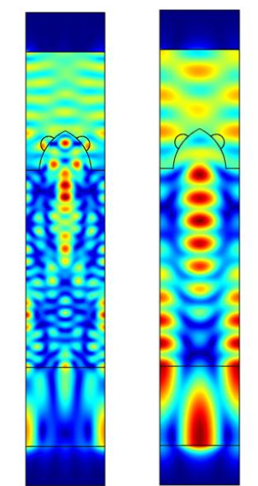
Finite element model of visible light absorption
400 nm 800 nm

Slide 10
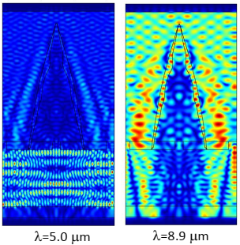
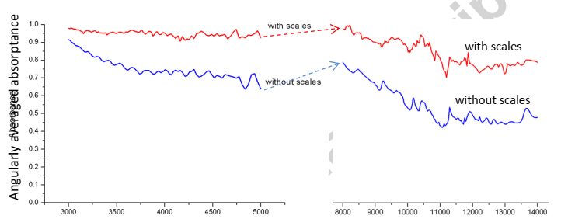
Finite element model of infrared radiation emission
Emissivity
Wavelength [nm]

Slide 11
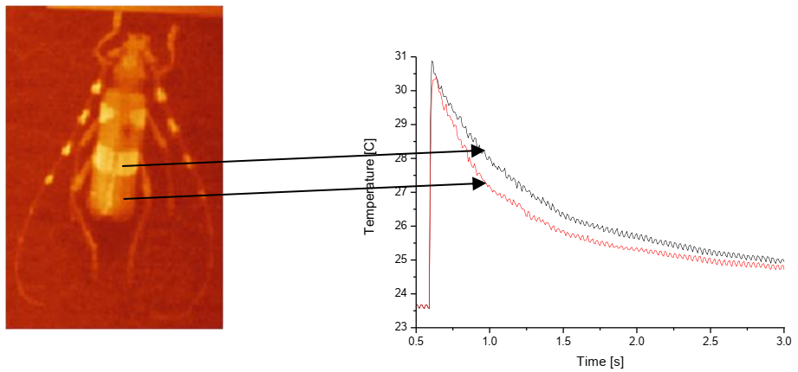
Thermal camera image of irradiated insect

Slide 12
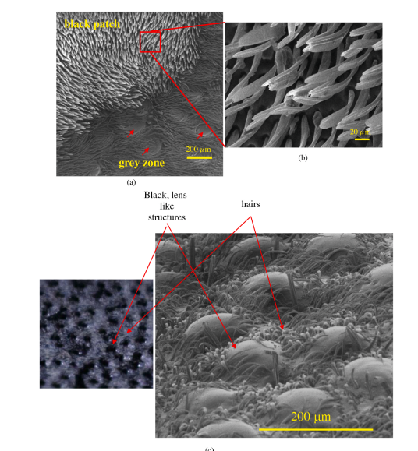
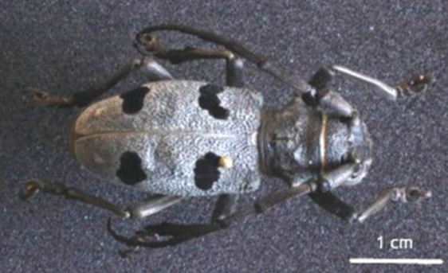
Morimus funereus (Mulsant, 1863)
Grayish longicorn insect with dark black spots on its elytra – hard armor around insect body
Appearance similar to Rosalia, but does not like sun; rudimentary nonflying wings

Slide 13
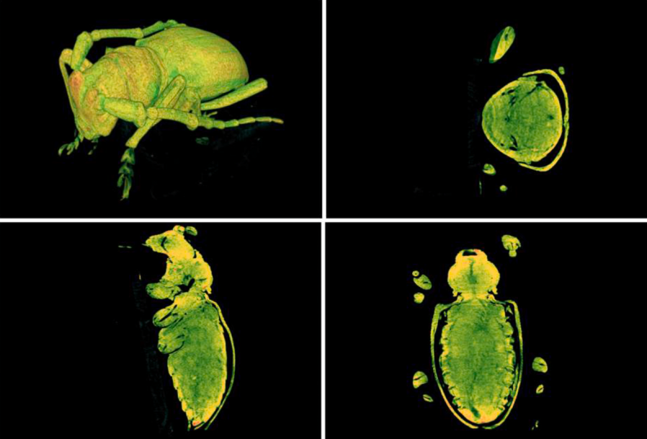
Overall anatomy of an insect as recorded by micro CT

Slide 14
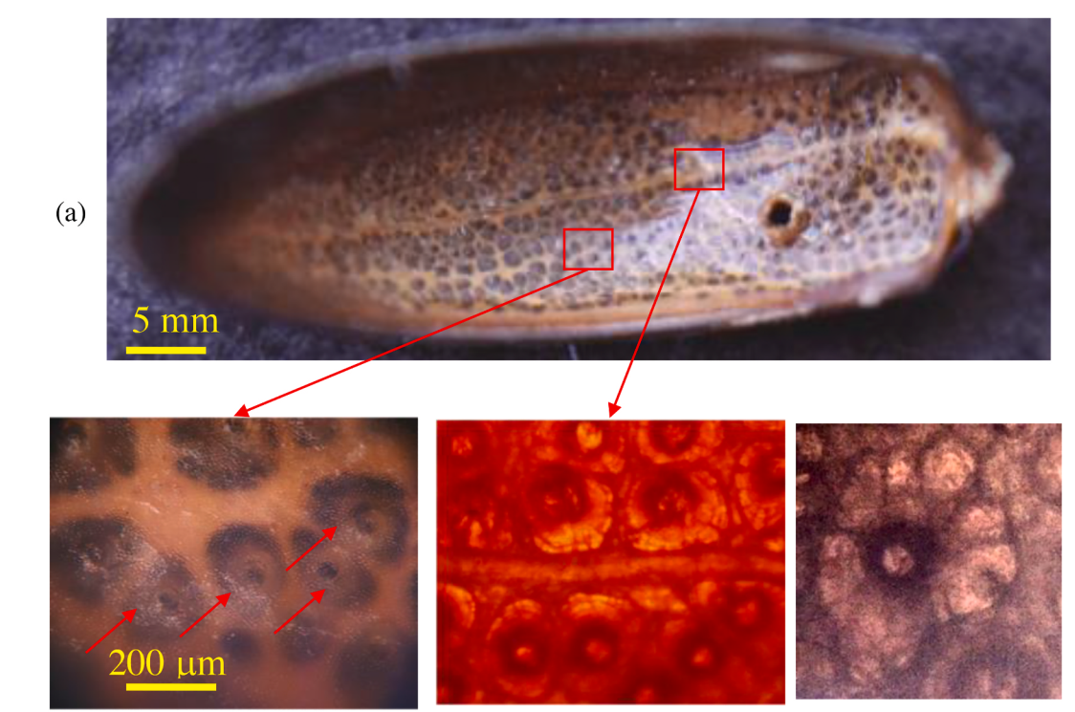
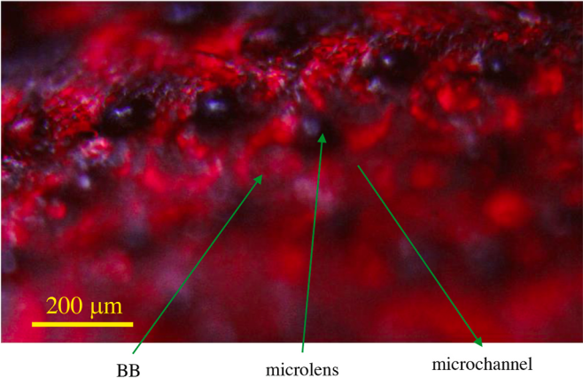
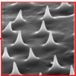
Underside of elytron with black body-like cavities
Architecture of a cavity
Thorns

Slide 15
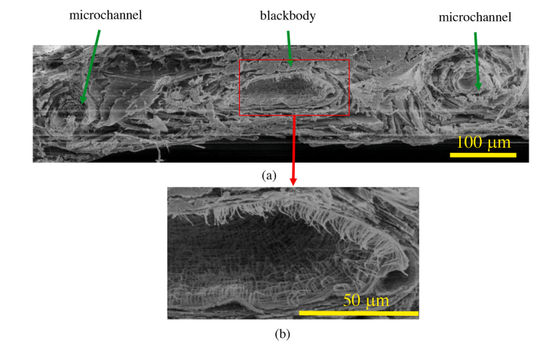
Cross-sectional image of elytron
Optical model

Slide 16
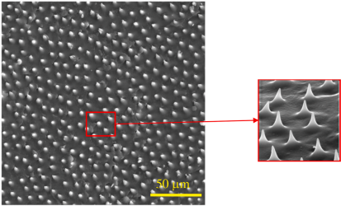
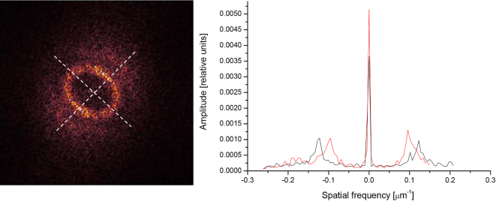
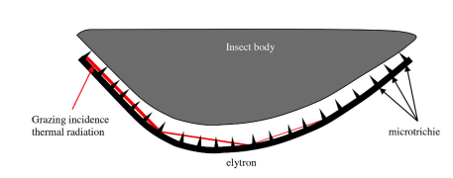
Hyper-uniform spatial distribution of thorns as a bandgap meta-material

Slide 17
Thank you

