Slide 1


­­­On the nature of optical rogue wave­­­s
M.R. Belić, S. Nikolić, O. Ashour, N. Aleksić,
Texas A&M University at Qatar, 23874 Doha, Qatar
Funded by Qatar National Research Fund
Texas A&M University at Qatar
BPU11 Congress, Belgrade, Serbia, August 2022

Slide 2

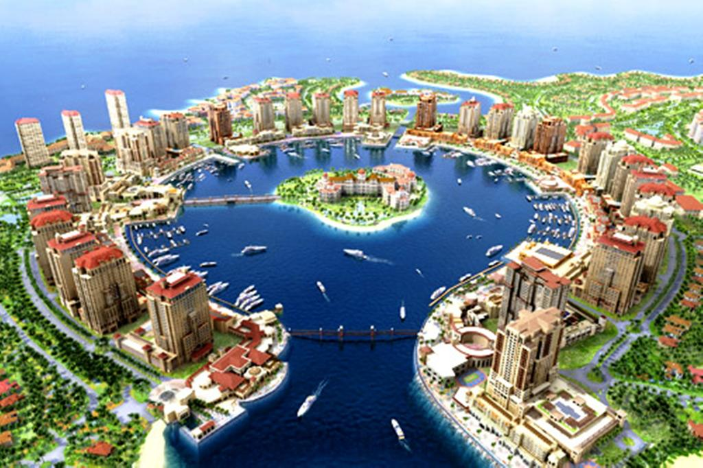
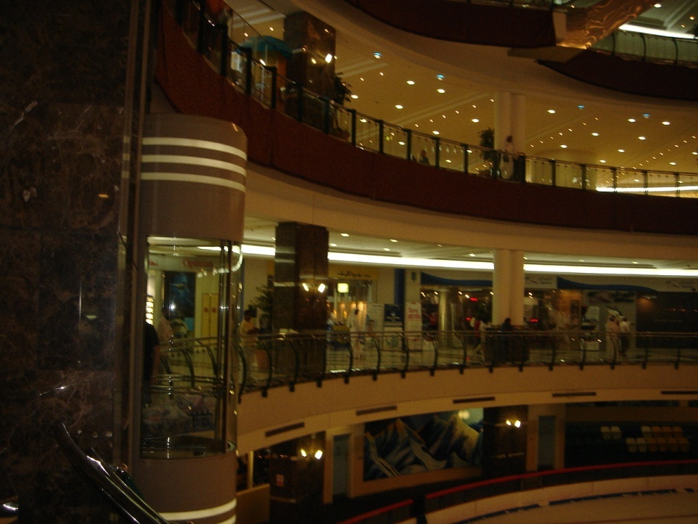

Doha, Qatar
Downtown Doha:
A real photo
My place: The Pearl
My supermarket:
The City Center Mall
My beach:
My secret
Notes:
2

Slide 3
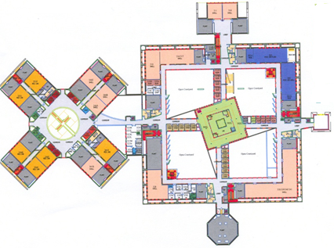
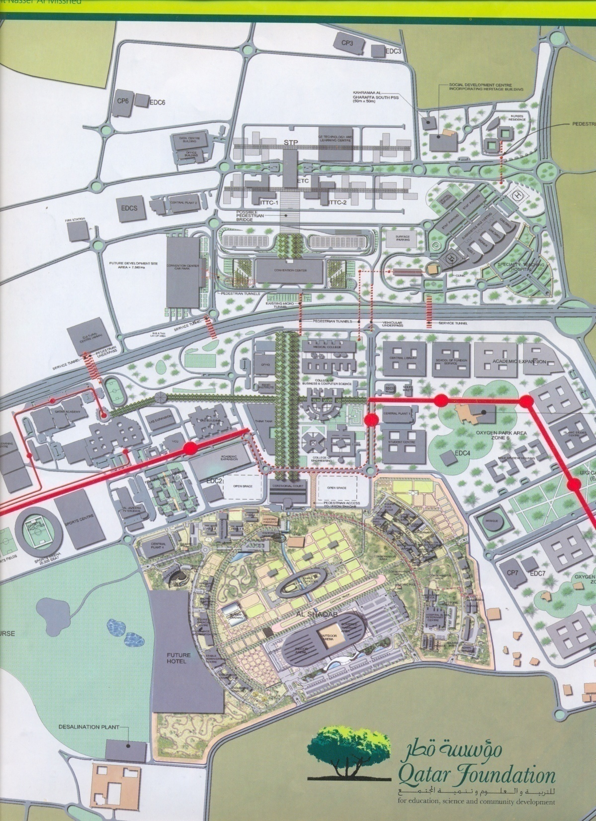
Education city
Member Schools
VCU
Weil Cornell
TAMU
Carnegie-Mellon
Georgetown
Northwestern
Hamad bin Khalifa Univ.
TAMUQ
Ed City
Stadium
Welcome to the FIFA games!
Notes:
3

Slide 4
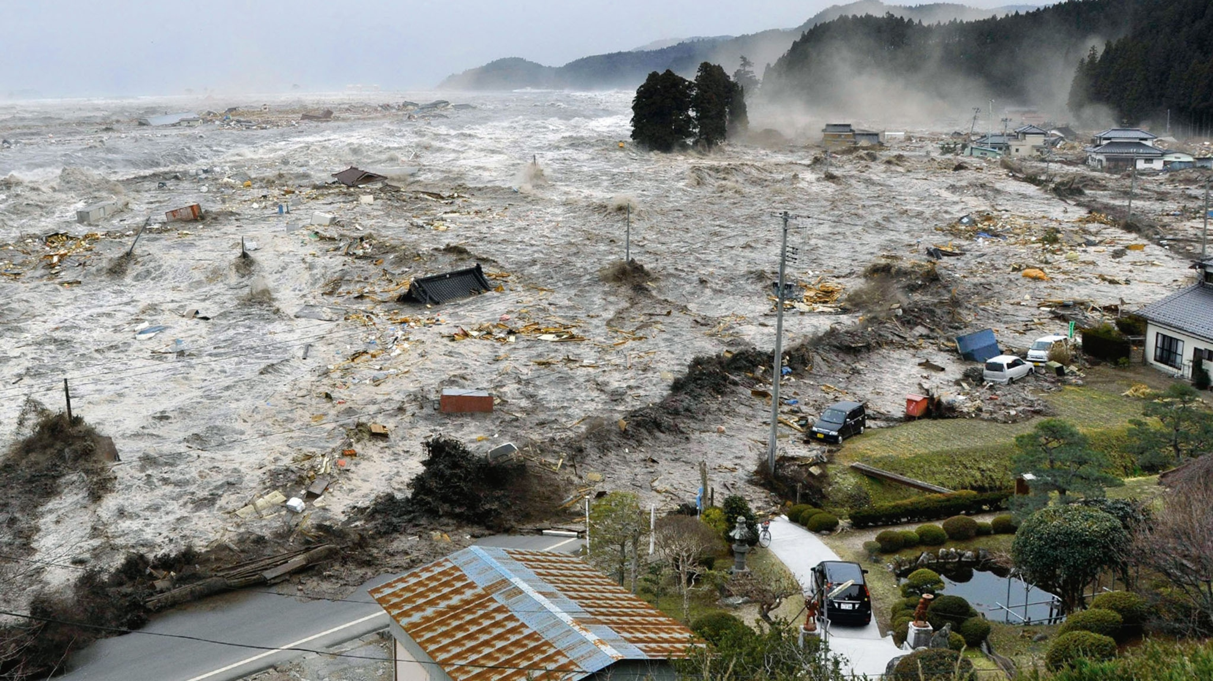
Outline
Abstract: Rogue waves are giant nonlinear waves that suddenly appear and disappear in oceans and optics. We discuss the facts and fictions related to their strange nature, dynamic generation, ingrained instability, and potential applications. We propose the method of mode pruning for suppressing the modulation instability of rogue waves. We demonstrate how to produce Talbot carpets – recurrent images of light and plasma waves – by rogue waves, for possible use in nanolithography.
A phony photoshop rogue wave
Not a rogue wave:
Tsunami wave in Japan

Slide 5
­­­Nature of optical rogue wave­­­s: Facts and fictions
Conflicting opinions: Are the rogue waves
Linear or nonlinear?
Random or deterministic?
Numerical or physical?
FACTS:
Nonlinear, because the cause of RWs is the modulation or Benjamin-Feir instability;
Deterministic, because modulation instability leads to deterministic homoclinic chaos;
Physical, because they are observed in many experiments and media. But…

Slide 6
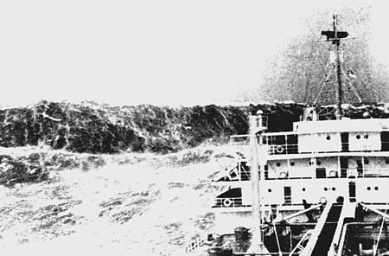
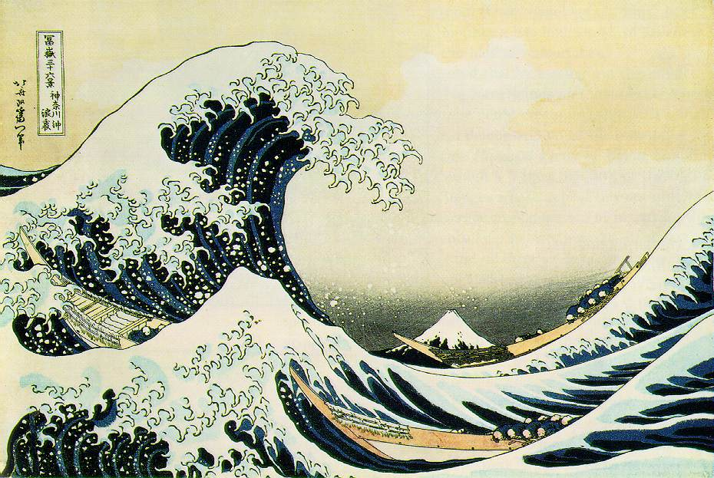
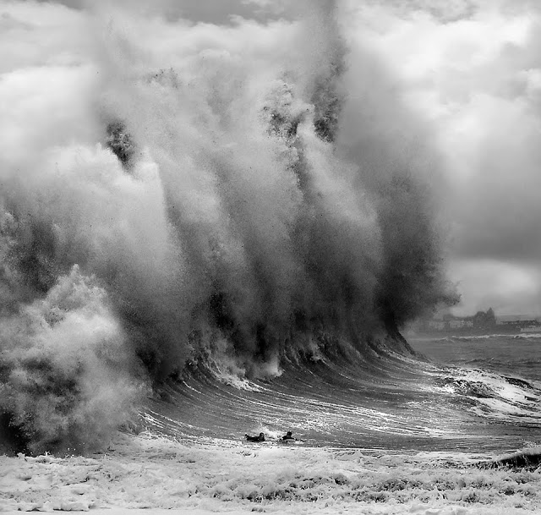
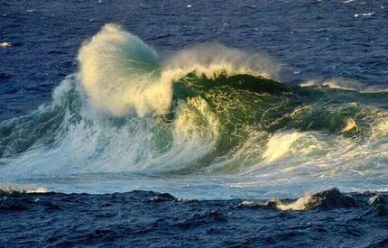
Reminder: What is a rogue wave?
The great wave off Kanagawa
(A woodblock print by Hokusai)
A giant solitary wave
Fuji mountain
Can be described by the NLSE!
Unsuspecting surfers!

Slide 7
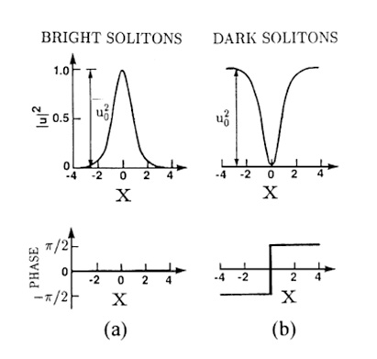
How does optics come into picture?
Through the Schrödinger Equation! Paraxial wave equation in optics is equivalent to the SE in QM
: Nonlinearity strength
Intensity and Phase of the Soliton
: Bright soliton
Basic stable solutions
: Dark soliton
Rogue waves are also solutions of the NLSE!

Slide 8
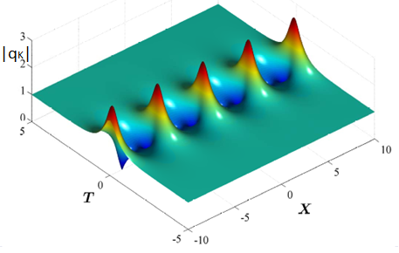
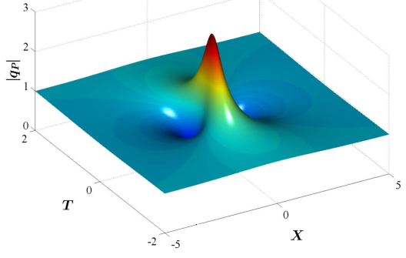
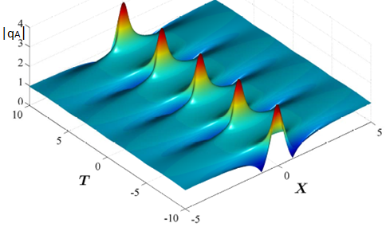
Basic rogue waves in NLO
Peregrine soliton
Kuznetsov-Ma breather
Akhmediev breather
Higher-order breathers: RWs
Solutions of NLSE
iqx + qTT + 2|q|^2q = 0

Slide 9
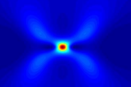
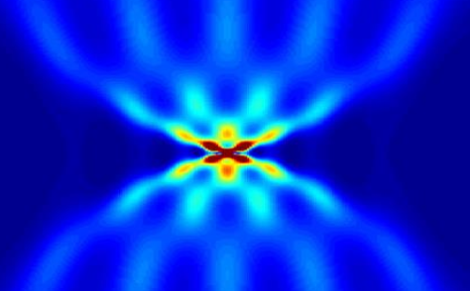
Real rogue waves: 2nd and higher-order solutions
2nd and 3rd order from interacting KMBs, PSs, and ABs
(Roadmap paper on optical RWs, 2016)
Weak interaction
Strong interaction
Dynamically
Generated
RWs using
Darboux
Transform
Initial cond: Sum of cosines
Basic 2nd order RW 5th order RW!

Slide 10
The problem: Modulation Instability
Basic nonlinear optical process in which a weak perturbation of the background wave produces an exponential growth of spectral sidebands that constructively interfere to build RWs.
Relevant for the generation of RWs from ABs.
Key effect: Homoclinic chaos caused by MI of ABs.
Key question: How observable RWs with MI are?
Major difficulty: How to distinguish RWs from numerical artefacts!
M. J. Ablowitz et al., SIAM J. Appl. Math. 50, 339 (1990)
S.A. Chin et al, Phys. Lett. A380, 3625 (2016)

Slide 11
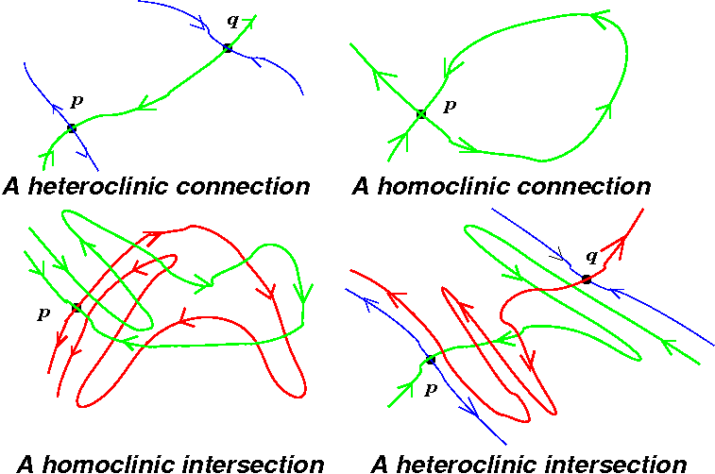
Homoclinic chaos
Dynamically, optical RWs represent homoclinic orbits of unstable sideband modes that, due to MI, generate homoclinic chaos.
Chaos brings sensitive
dependence on initial and
boundary conditions
• Init’l cond’s are found
using DT, followed by
numerical integration.
Numerical integration
leads to problems!
Saddle points

Slide 12
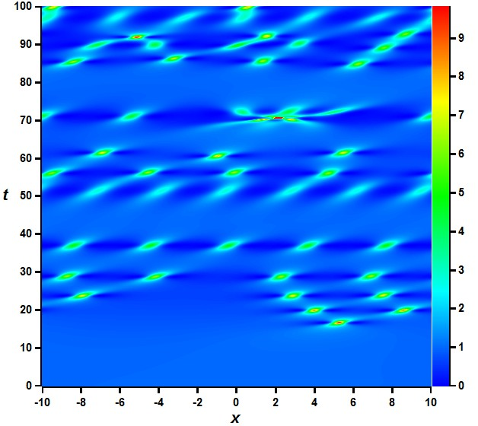
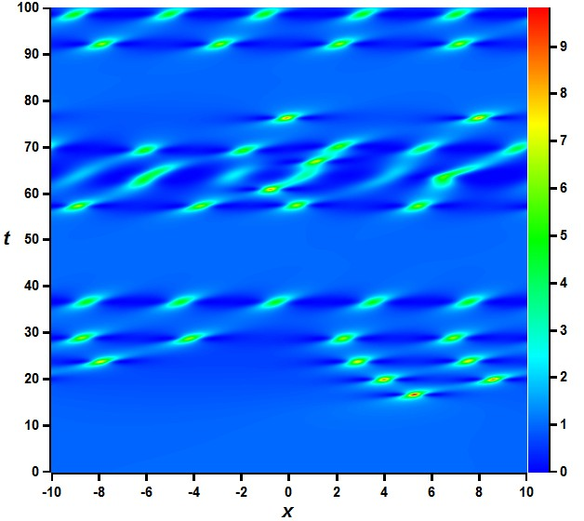
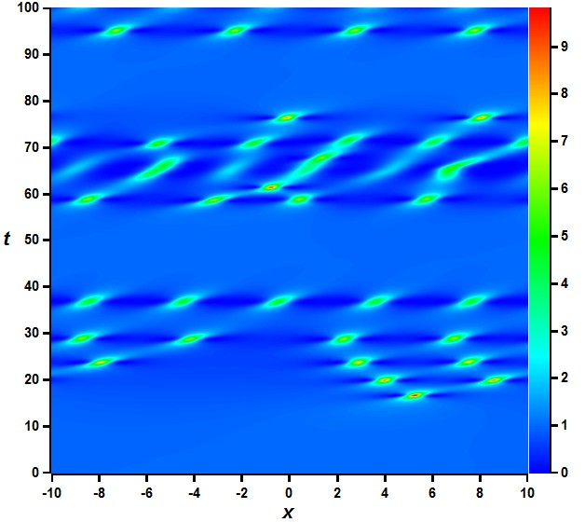
Numerical Instabilities and Chaos
Round-off errors grow
Instabilities develop in numerical solutions
Spurious RWs appear
Are the RWs seen part of the model or numerics?
Belic et al., NODY 108, 1655 (2022)
PRA 80, 043818 (2009)
2nd BPM; halved Δt
6th order symplectic

Slide 13
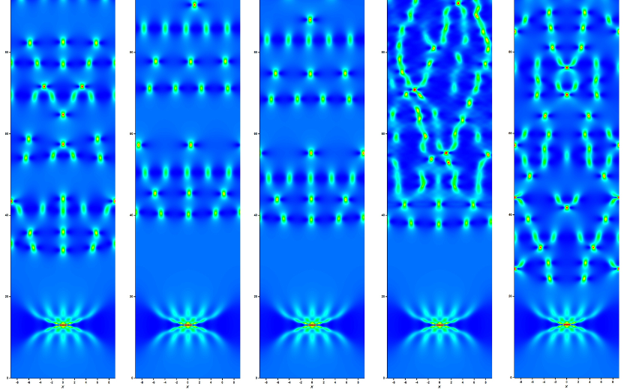
Different algorithms lead to different chaos!

Slide 14
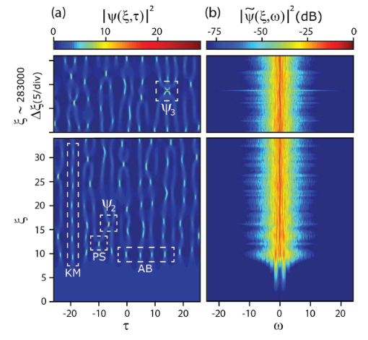
How to trust RW generation from noise?
Toenger et al., Sci. Reps. 5,10380 (2015)
Temporal evolution
Frequency evolution

Slide 15
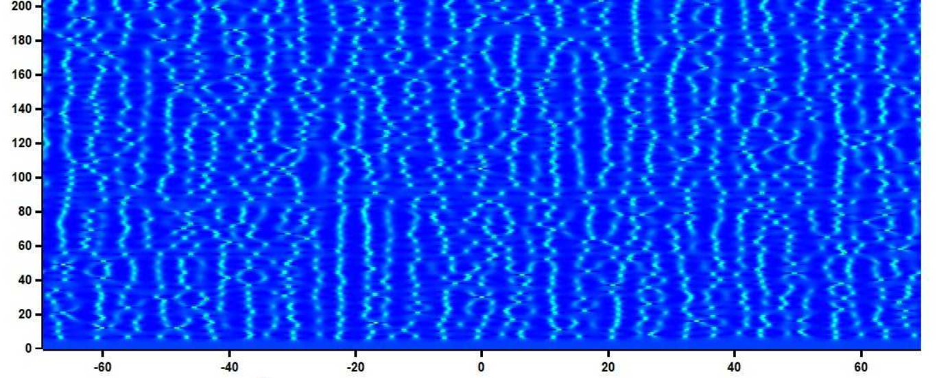
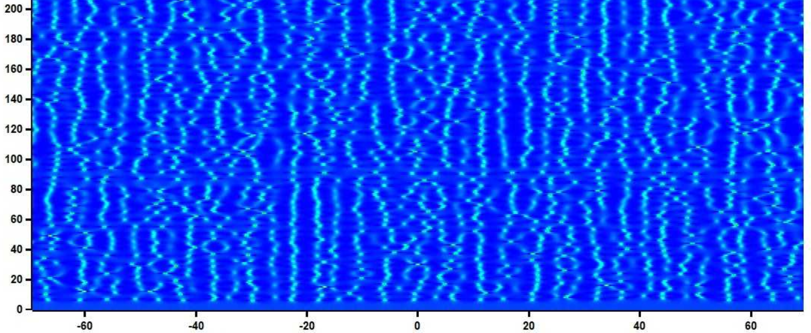
Our RW generation from white noise
2nd-order beam propagation method 4th-order symplectic algorithm
Different algorithms offer different evolutions!

Slide 16
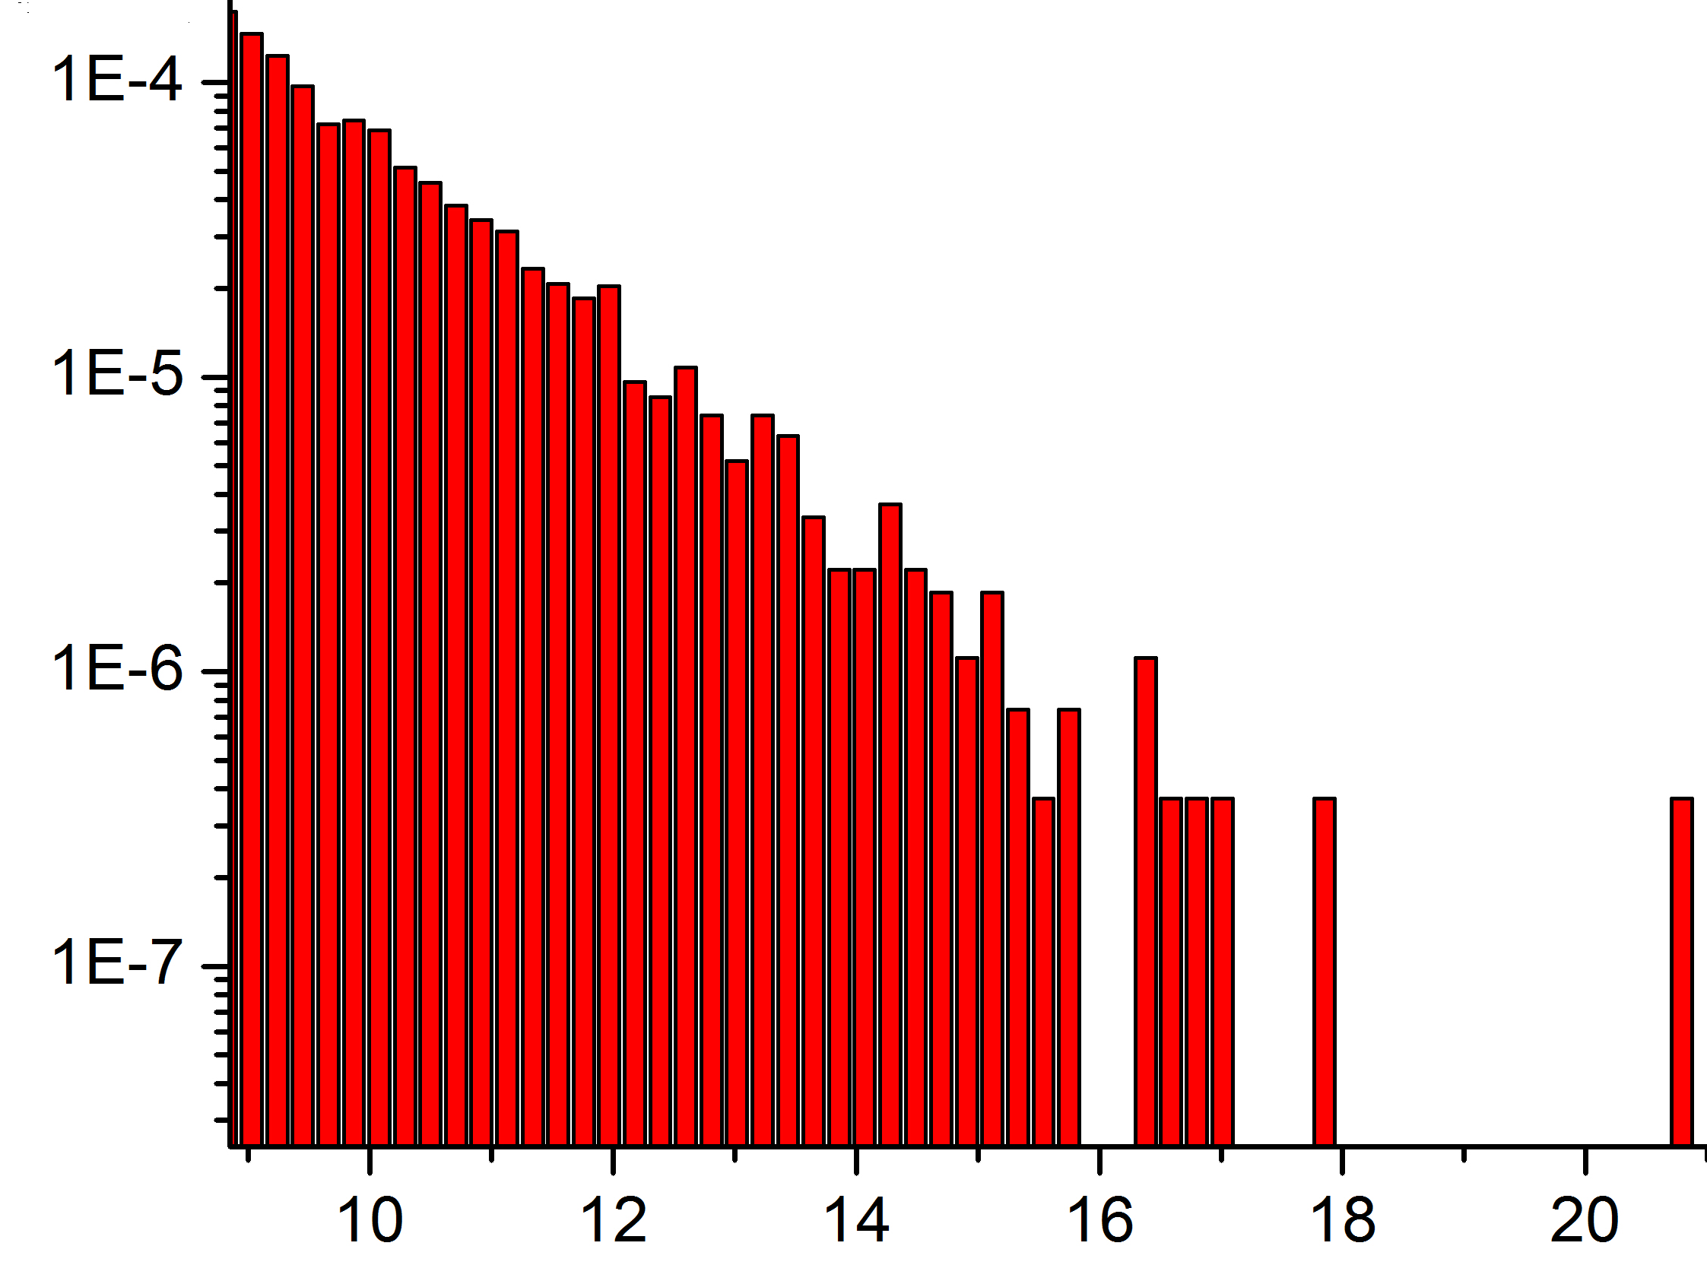
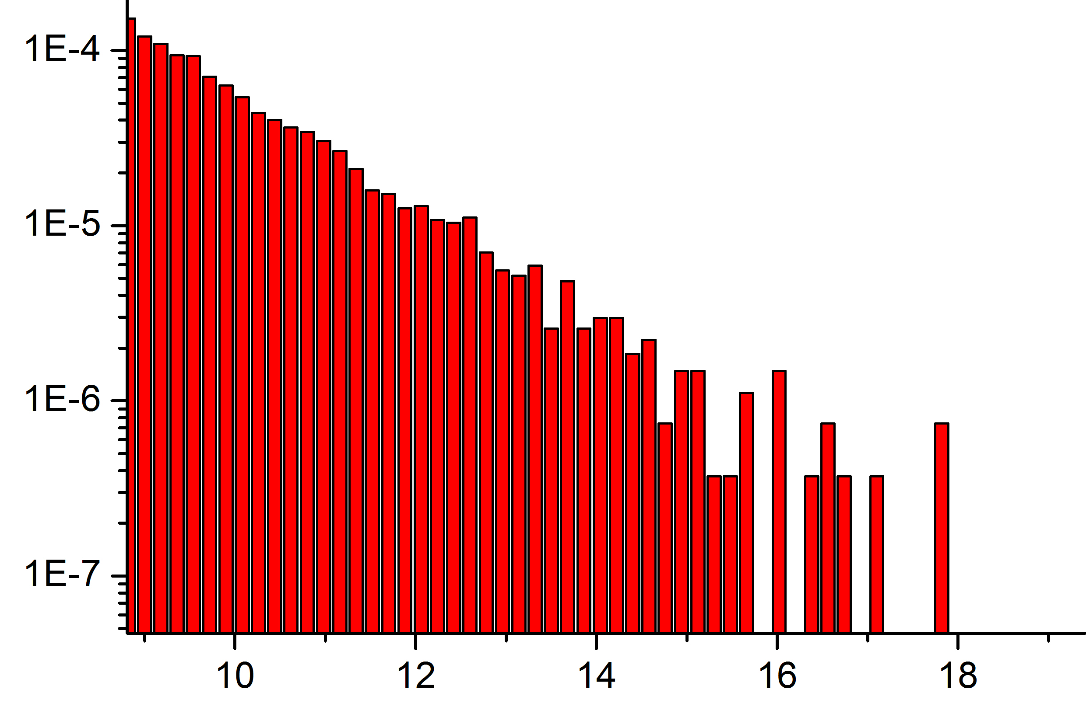
Statistics of high intensity peaks
Belic et al., NODY 108, 1655 (2022)
The number of peaks, the maximum of intensity, and the slope of distributions, among other things, are different.
The intensity scale starts from the intensity of Peregrine soliton I_{PS}=9.
6.5x10⁶x2048 grid points and more than 10⁶ peaks above I_{TH}=2.
There are 2346 RW peaks on the left and 2643 on the right.
Different algorithms lead to different statistics!
2nd-order beam propagation method 4th-order symplectic algorithm

Slide 17
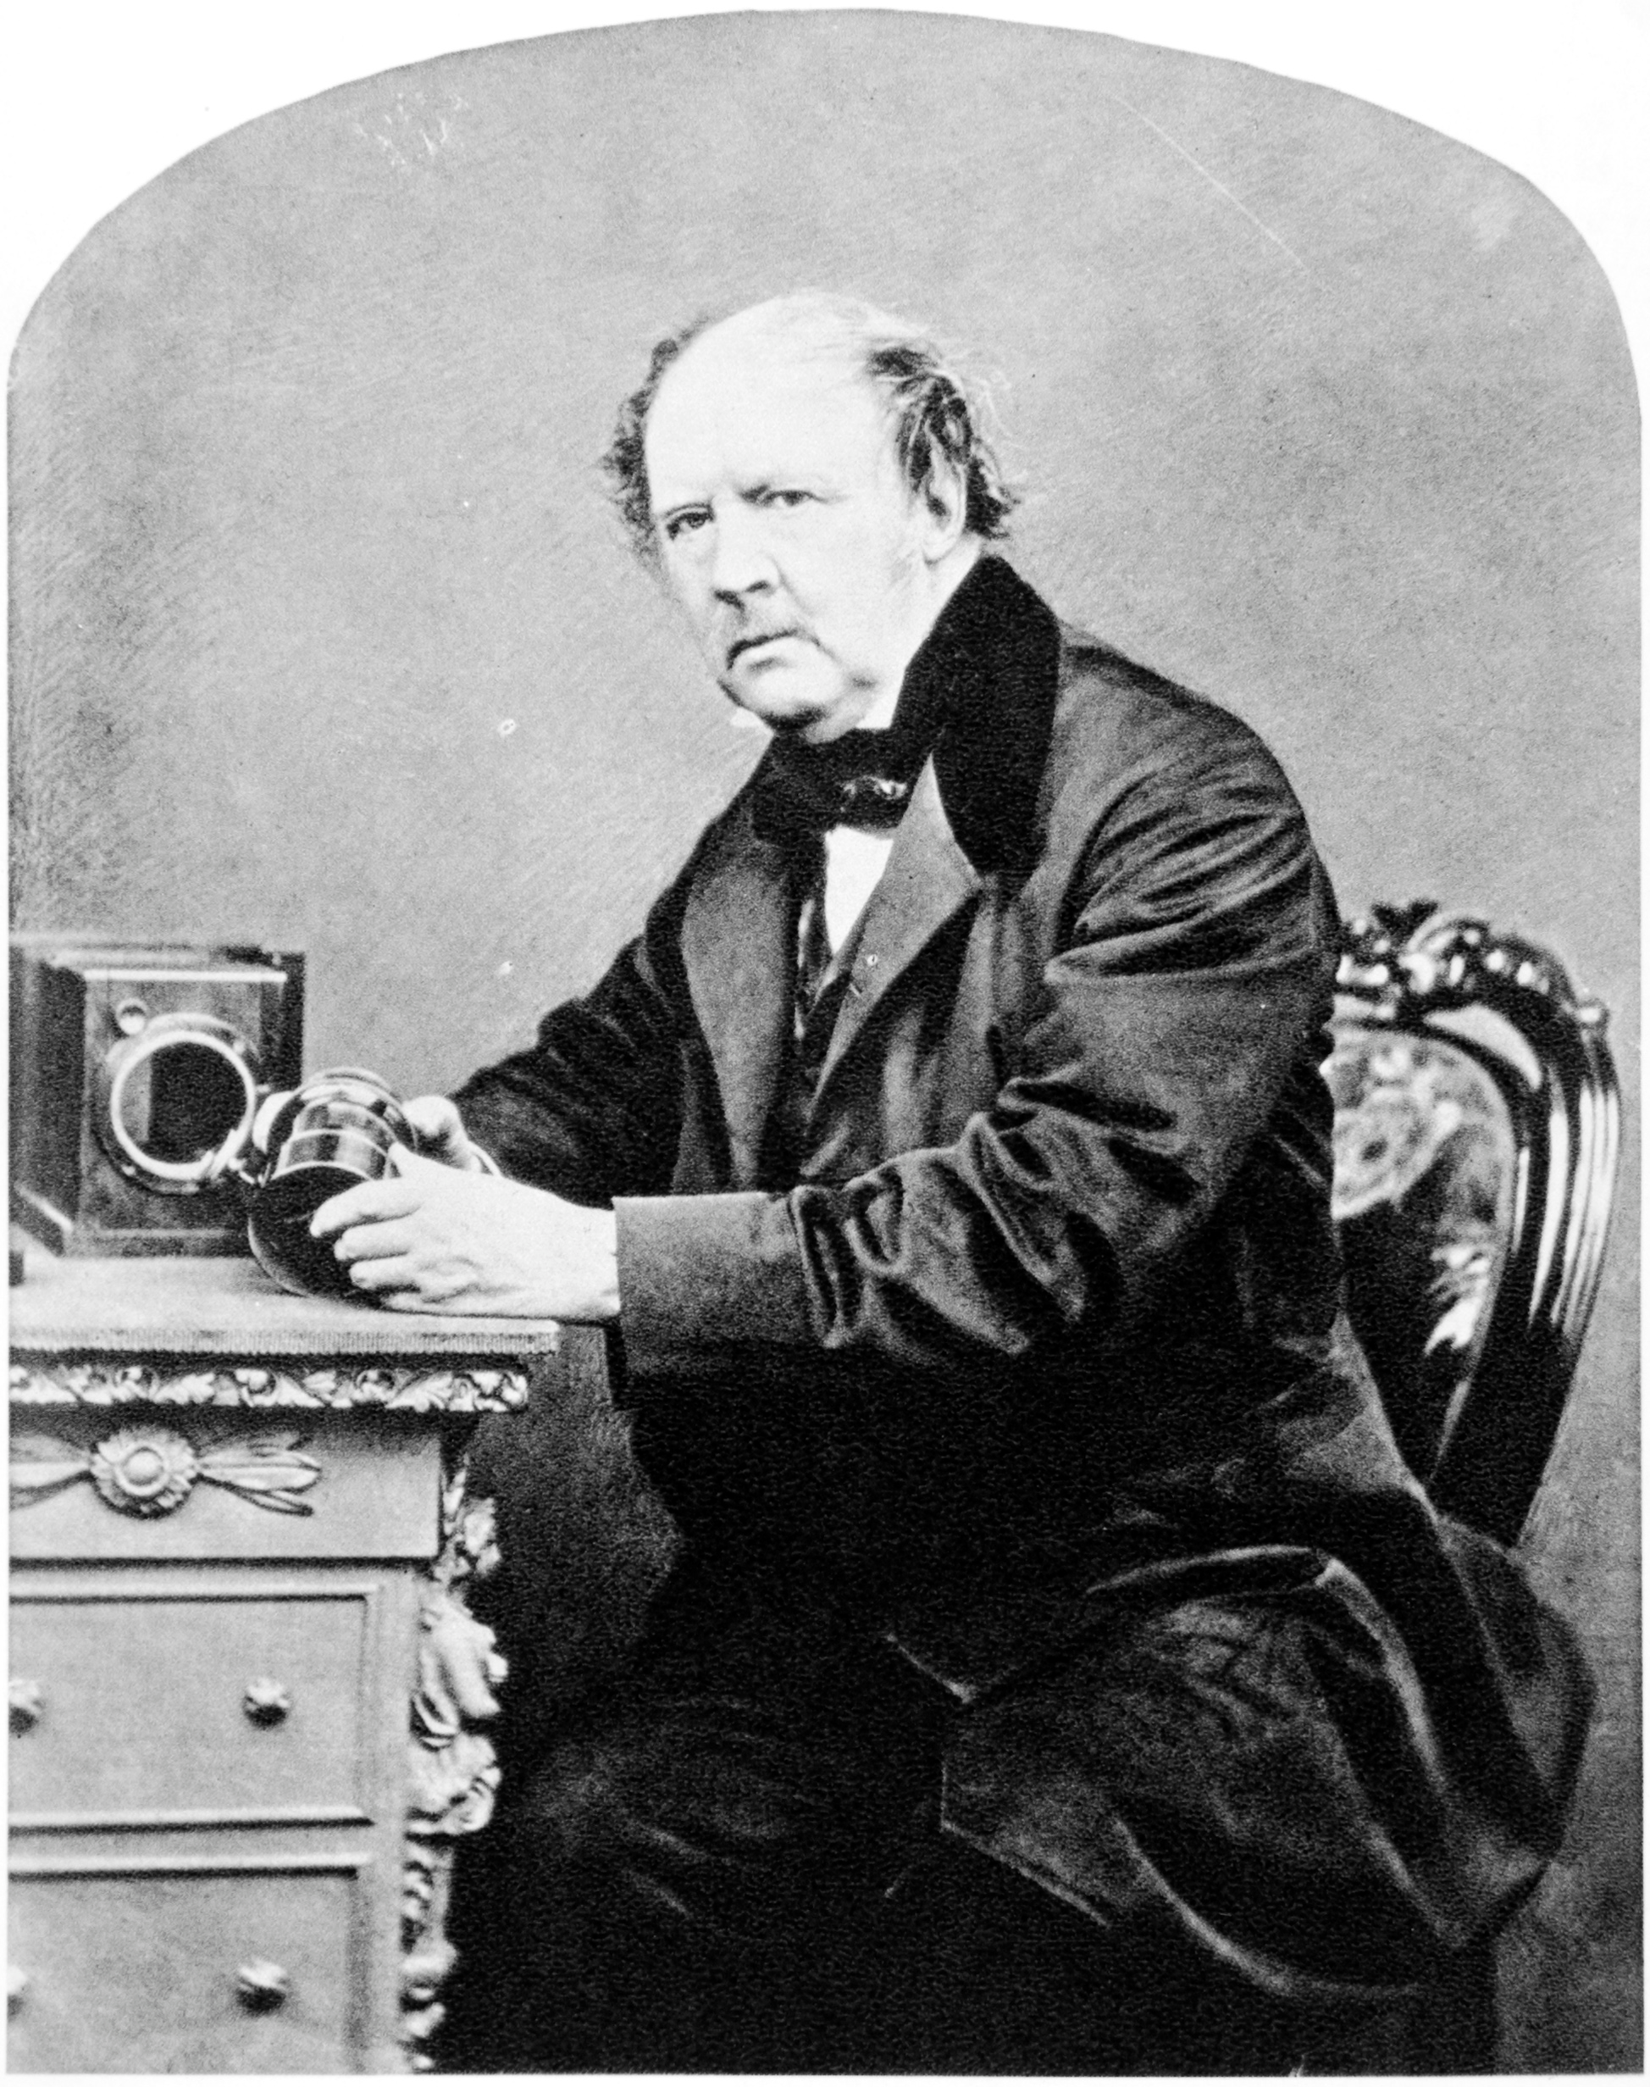
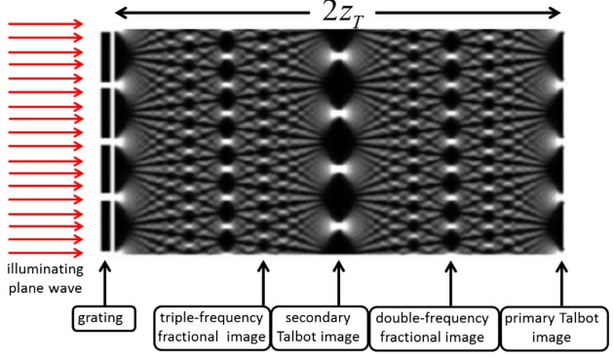
Fallout: Talbot Effect of RWs
Wikipedia: Talbot effect is a near-field diffraction effect observed in 1836 by Henry Fox Talbot. When a plane wave is incident upon a periodic diffraction grating, the image of the grating is repeated at regular distances away from the grating plane. The regular distance is called the Talbot length, and the repeated images are called self-images or Talbot images. At half the Talbot length, a self-image also occurs, but phase-shifted by half a period. At smaller regular fractions of the Talbot length, sub-images can also be observed. The overall image is known as the Talbot carpet.
Talbot carpet
Henry Fox Talbot

Slide 18
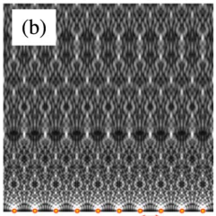
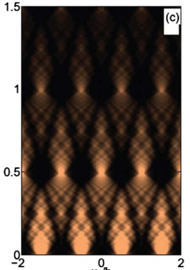
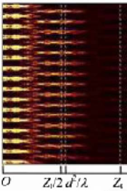
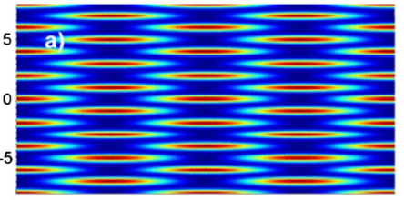
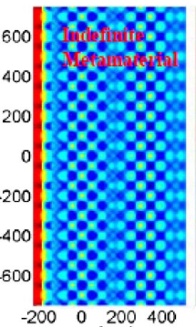
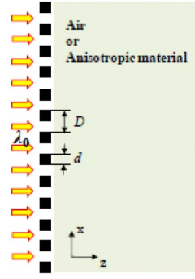
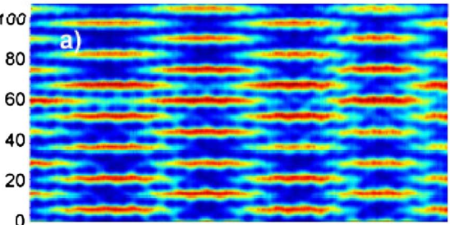
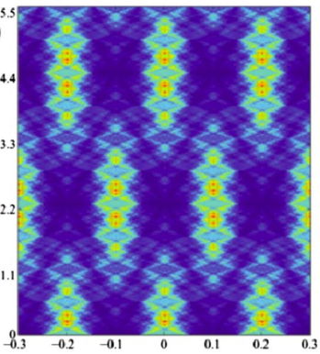
Current research on Talbot carpets
SPP from drilled nanoholes SPP on silver SPP experimental Discrete Talbot
Lithography

Slide 19
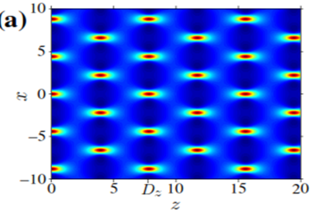
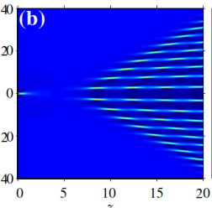
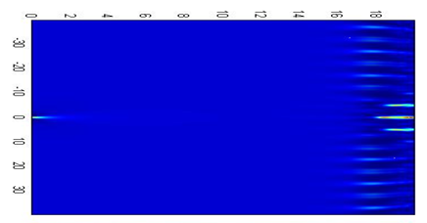
Bring the two together:
Talbot Carpets by RWs
An expected phenomenon seen:
Stable doubly-periodic Akhmediev
Breather as a Talbot carpet
An unexpected phenomenon seen:
Unstable propagation of the Peregrine wave:
It depends on the algorithm!
Zhang et al., PRE 89, 032902 (2014)
2nd order BPM
4th order symplectic

Slide 20
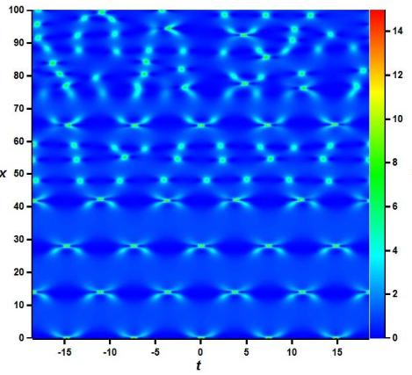
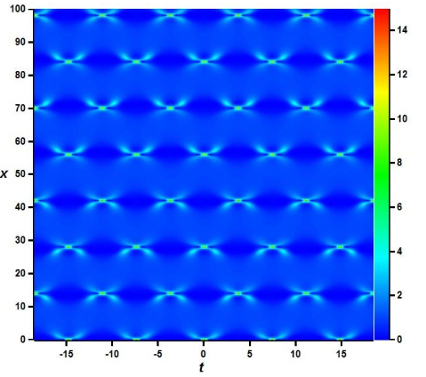
RW Carpets: How to suppress MI
Stabilization by mode pruning
Perfect carpets from “random” RWs
Second order RW carpets
Nikolic et al., NODY 97, 1215 (2019)
Without stabilization Stabilized

Slide 21

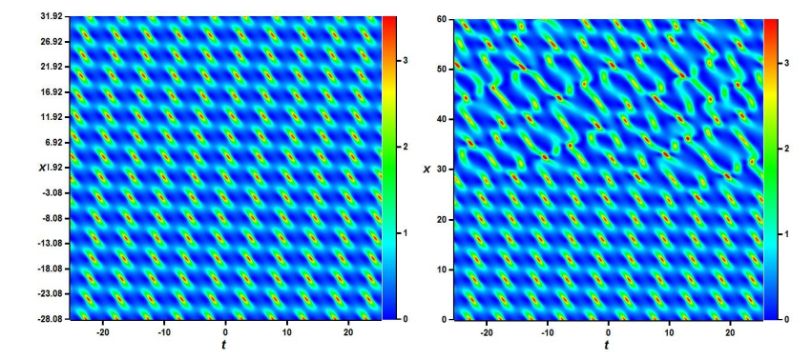
Carpets elsewhere: Hirota
Hirota Equation:
Nikolic et al., NODY 97, 1215 (2019)
With stabilization Without stabilization

Slide 22

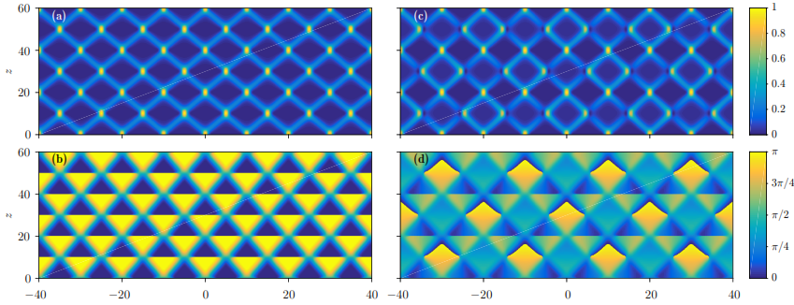
Carpets in fractional Schrȍdinger
Zhang et al., SREPS 6, 23645 (2016)

Slide 23
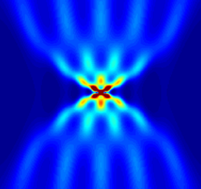
Summary
Utilized the simple NLSE as the paraxial WE in optics
Generated RWs as finite-background solutions of NLSE
Established RWs as NL, deterministic and physical in nature
Driven RWs to HC chaos by modulation instability
Shown that statistics of RWs depend on numerical algorithm
Formed Talbot carpets by RWs
Stabilized carpets by mode pruning
Basic question: Are these effects
real or just numerical artefacts?
Thank you!

