Slide 1
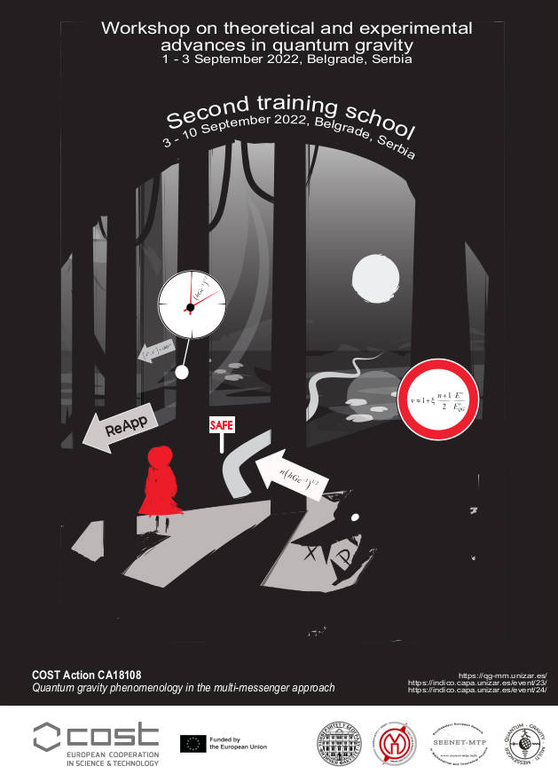



Theoretical and experimental challenges in quantum gravity phenomenology
José M. Carmona

Slide 2
Theoretical and experimental challenges in quantum gravity phenomenology
José M. Carmona
The development of quantum gravity phenomenology
The LIV and DSR paradigms
Some challenges in quantum gravity phenomenology
Conclusions

Slide 3
1. THE DEVELOPMENT OF QUANTUM GRAVITY PHENOMENOLOGY

Slide 4
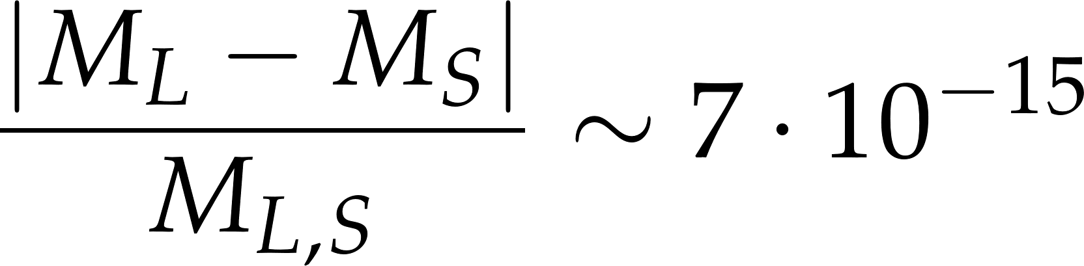
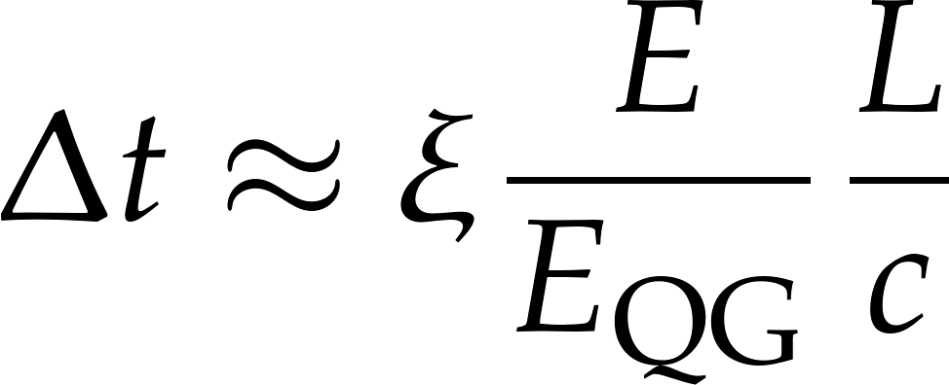

INITIAL IDEAS IN QuGraPheno
Initial ideas and suggestions to test quantum gravity by amplification mechanisms:
Testing CPT invariance in neutral mesons
(Ellis, Lopez, Mavromatos, Nanopoulos, PRD 1996)
Time of flight studies in GRBs (HEGRA, Whipple telescopes; EGRET satellite)
(Amelino-Camelia, Ellis, Mavromatos, Nanopoulos, Sarkar, Nature 1998)

Slide 5
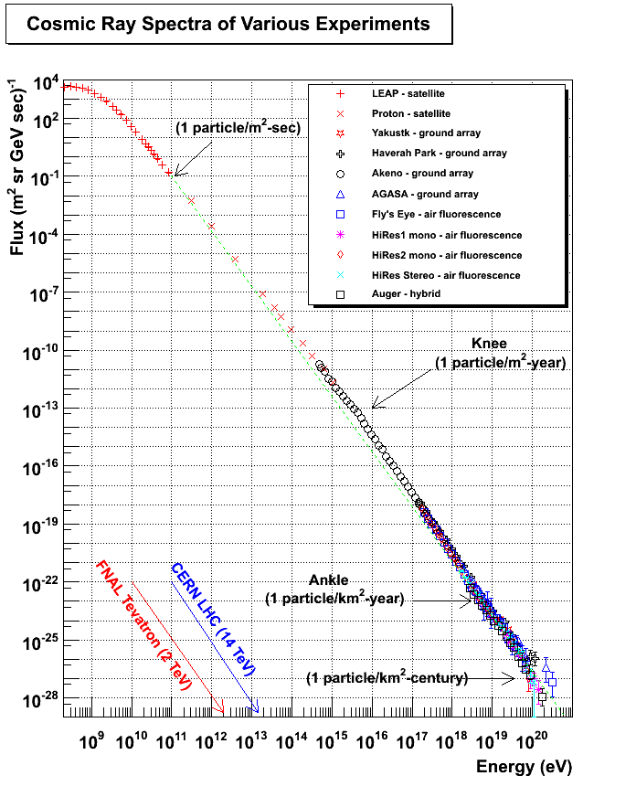


THE AGASA RESULTS AND THE GZK CUTOFF
Cutoff GZK:
(Greisen, 1966; Zatsepin and Kuzmin, 1966)

Slide 6
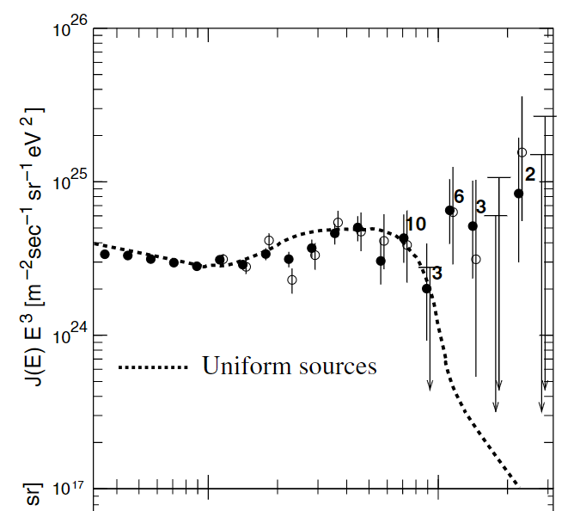
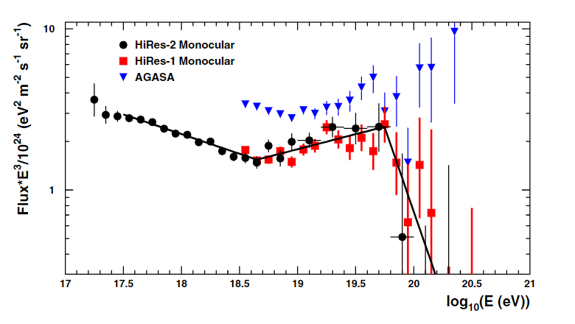
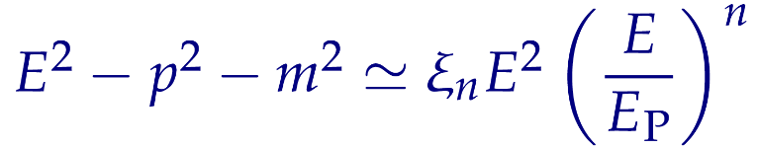




THE AGASA RESULTS AND THE GZK CUTOFF
(Takeda et al., Astrop. Phys. 2003, Akeno Giant Air Shower Array (AGASA) experiment)
(Abbasi et al., PRL 2008,
High Resolution Fly’s Eye (HiRES) experiment)
No GZK cutoff
(Aloisio, Blasi, Ghia, Grillo, PRD 2000)

Slide 7
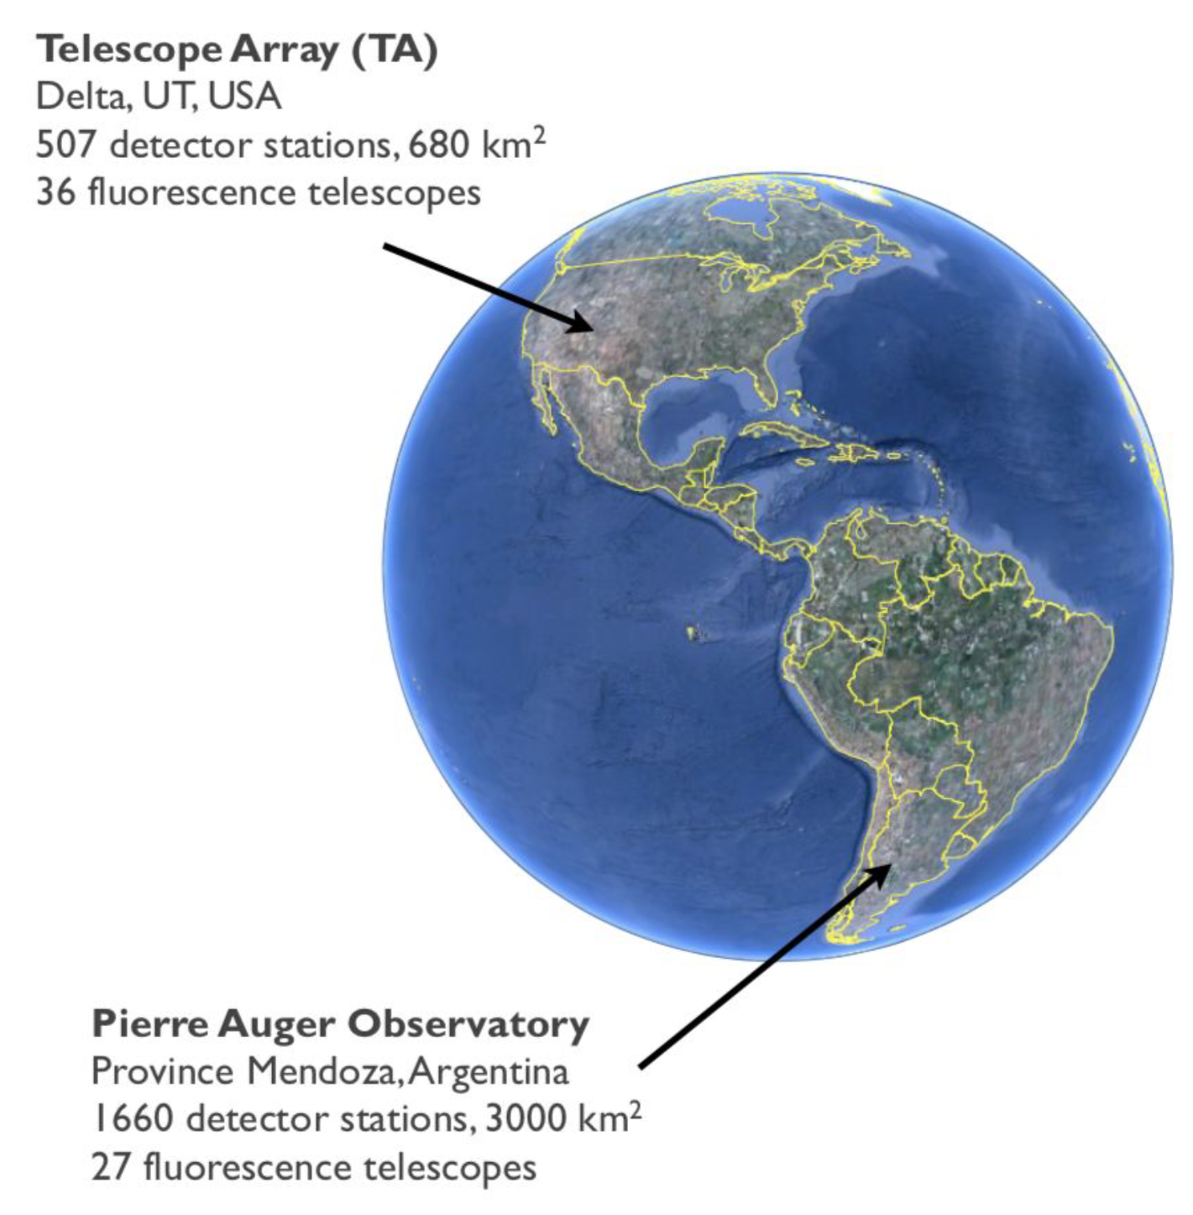
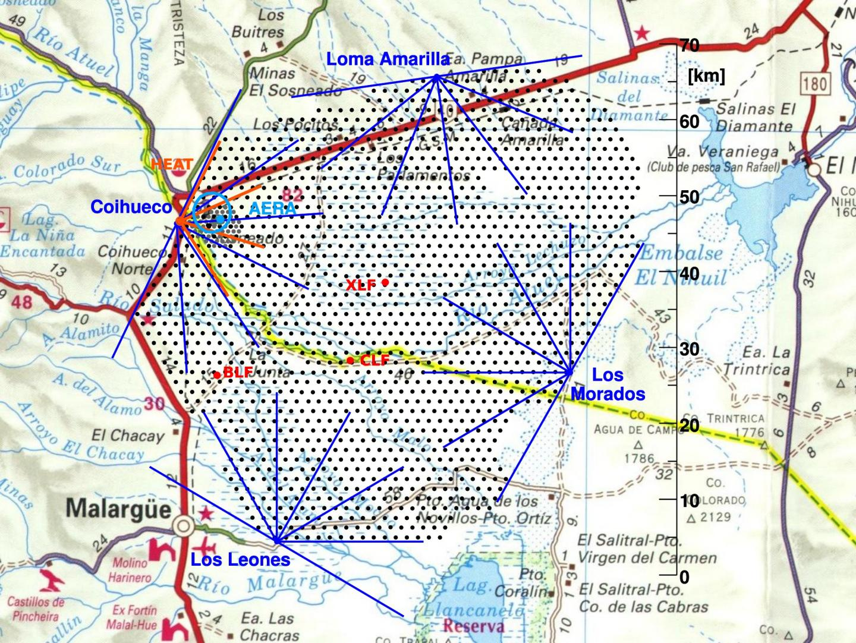
THE UHECR SPECTRUM

Slide 8
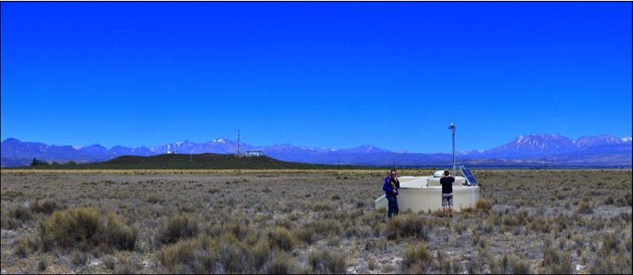
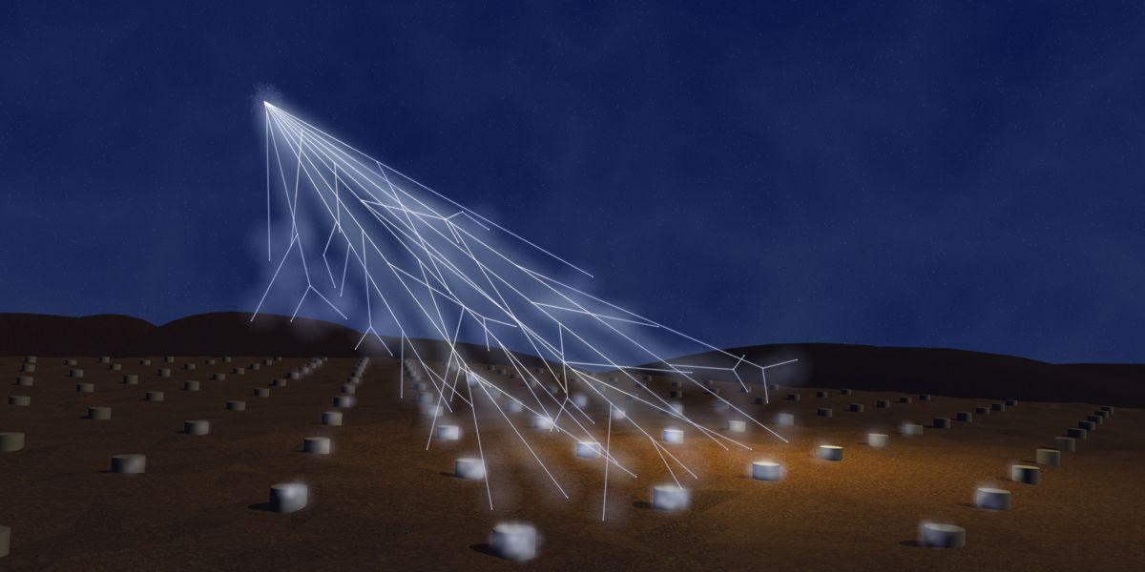
THE UHECR SPECTRUM

Slide 9
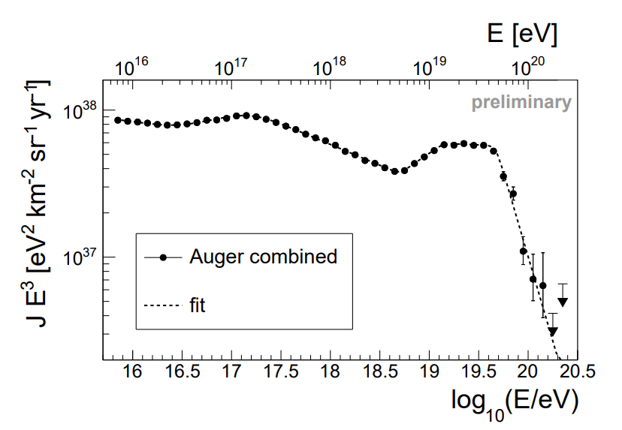
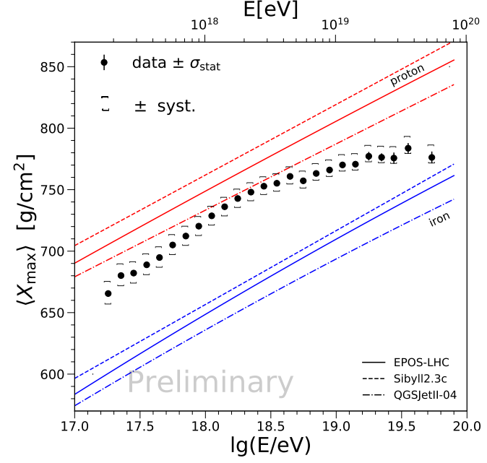
THE UHECR SPECTRUM
(Pierre Auger Collaboration, PoS (ICRC 2021)
(Pierre Auger Collaboration, PoS (ICRC 2019)

Slide 10
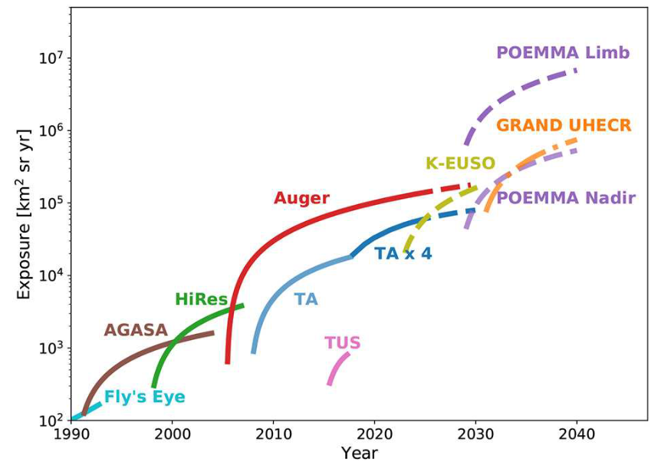
THE UHECR SPECTRUM
(Alves Batista et al.,
Front. Astron. Space Sci., 2019)
(Pierre Auger Collaboration, PoS (ICRC 2021)

Slide 11
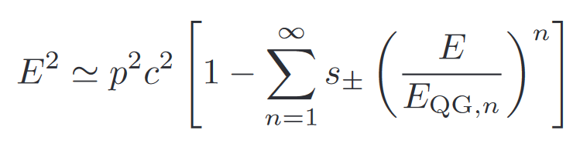
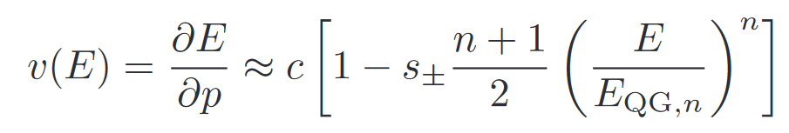
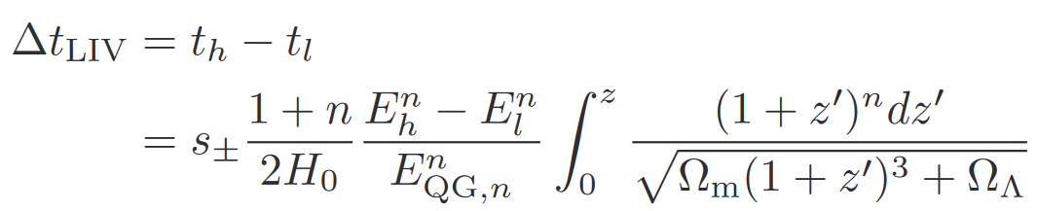
TIME DELAY STUDIES

Slide 12
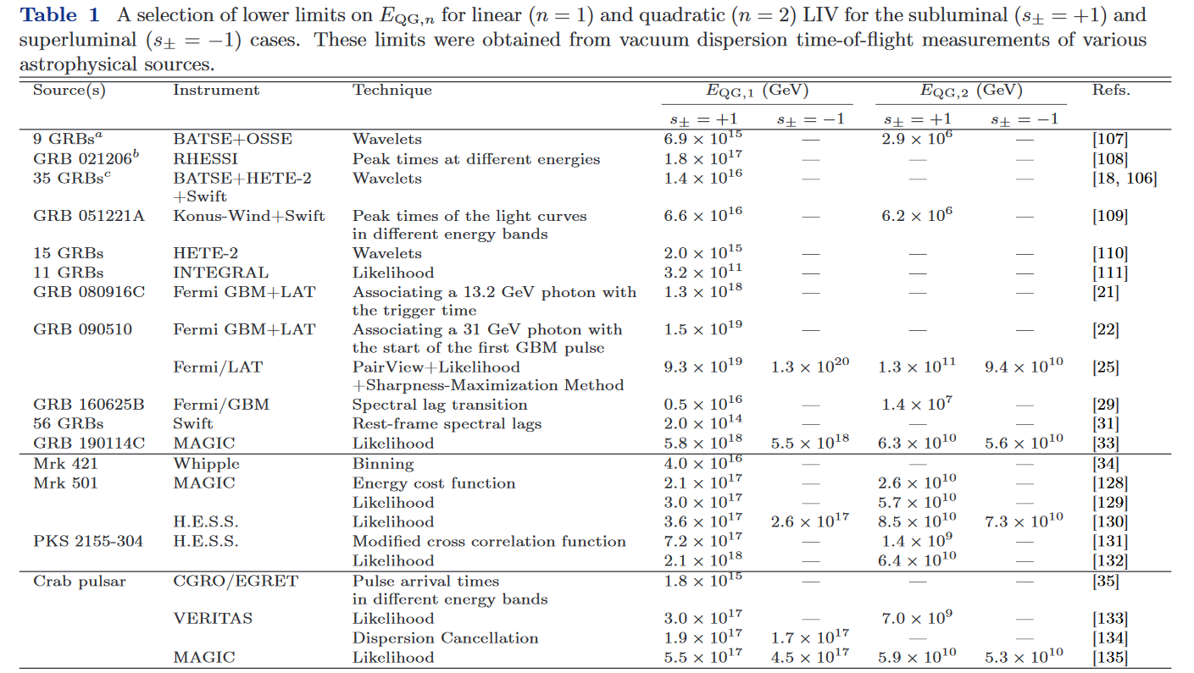


TIME DELAY STUDIES
(Wei, Wu, Front. Phys., 2021)

Slide 13
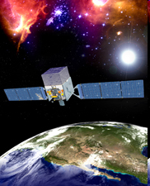
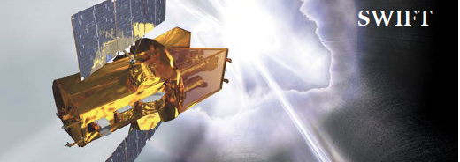
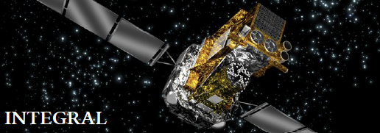
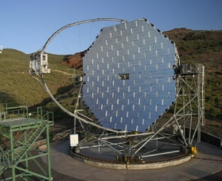
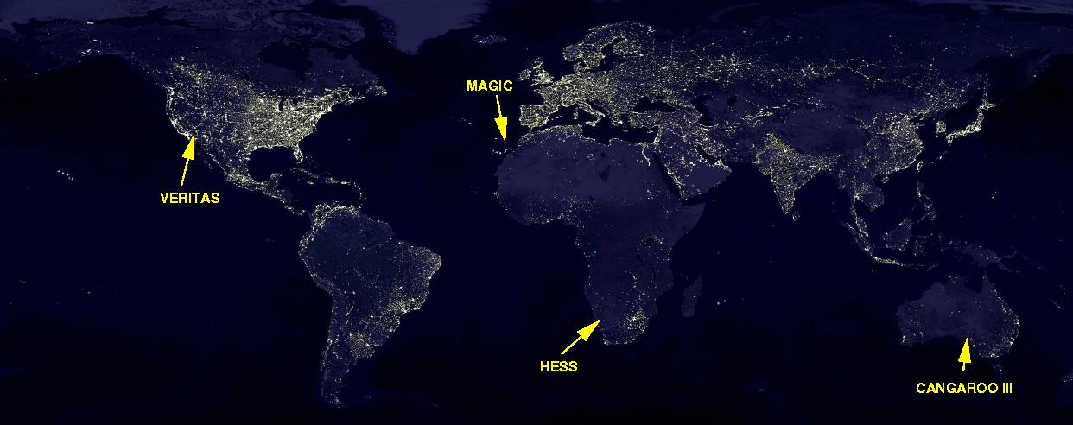
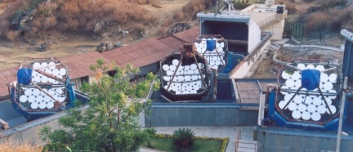
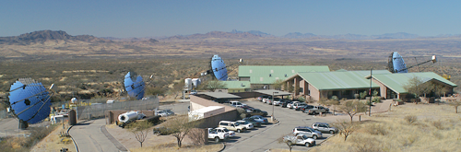
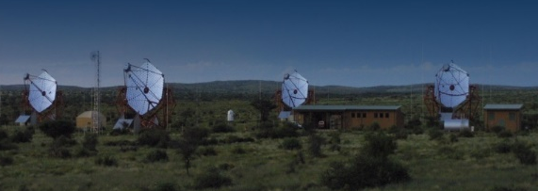
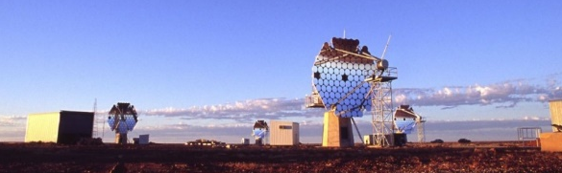
TIME DELAY STUDIES
MAGIC
N.E. Mavromatos
FERMI-LAT
FUTURE
Canarias
MACE

Slide 14
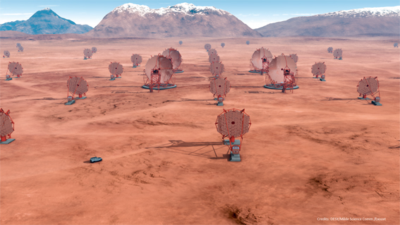
TIME DELAY STUDIES
MAGIC
N.E. Mavromatos
FERMI-LAT
FUTURE
Canarias
MACE
Cherenkov Telescope Array

Slide 15
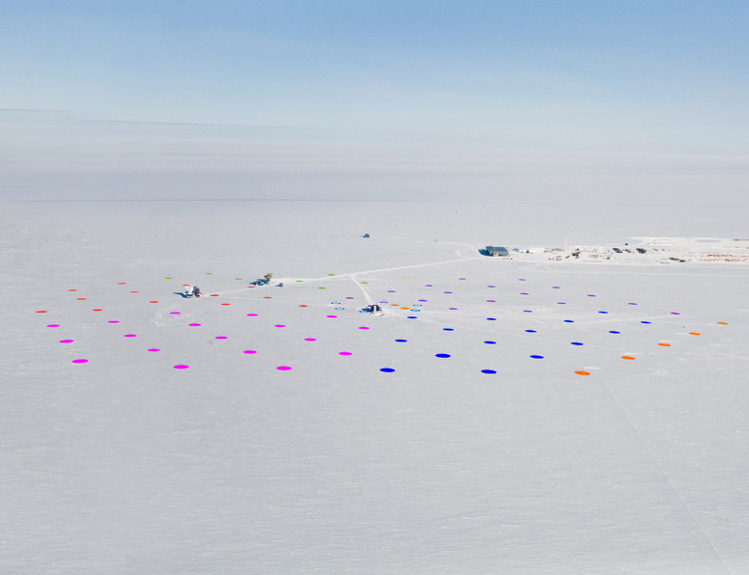
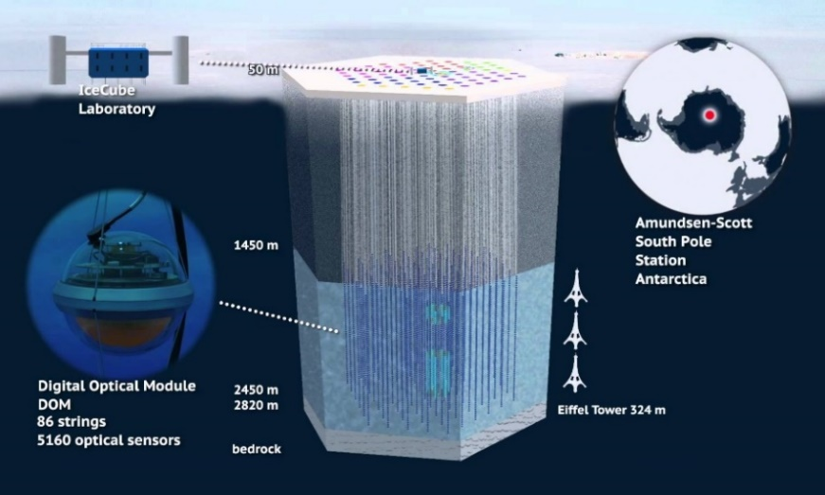

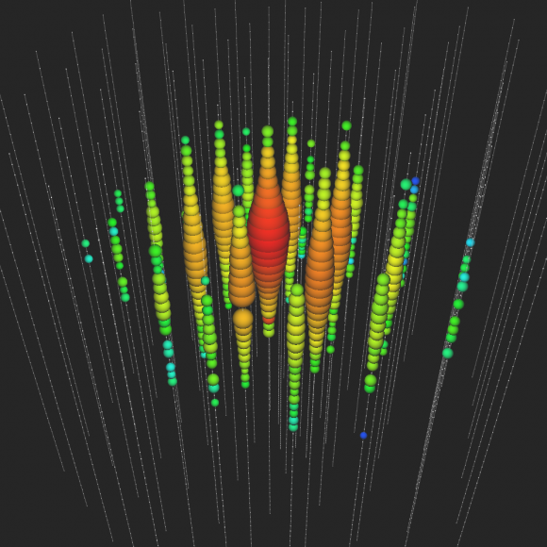
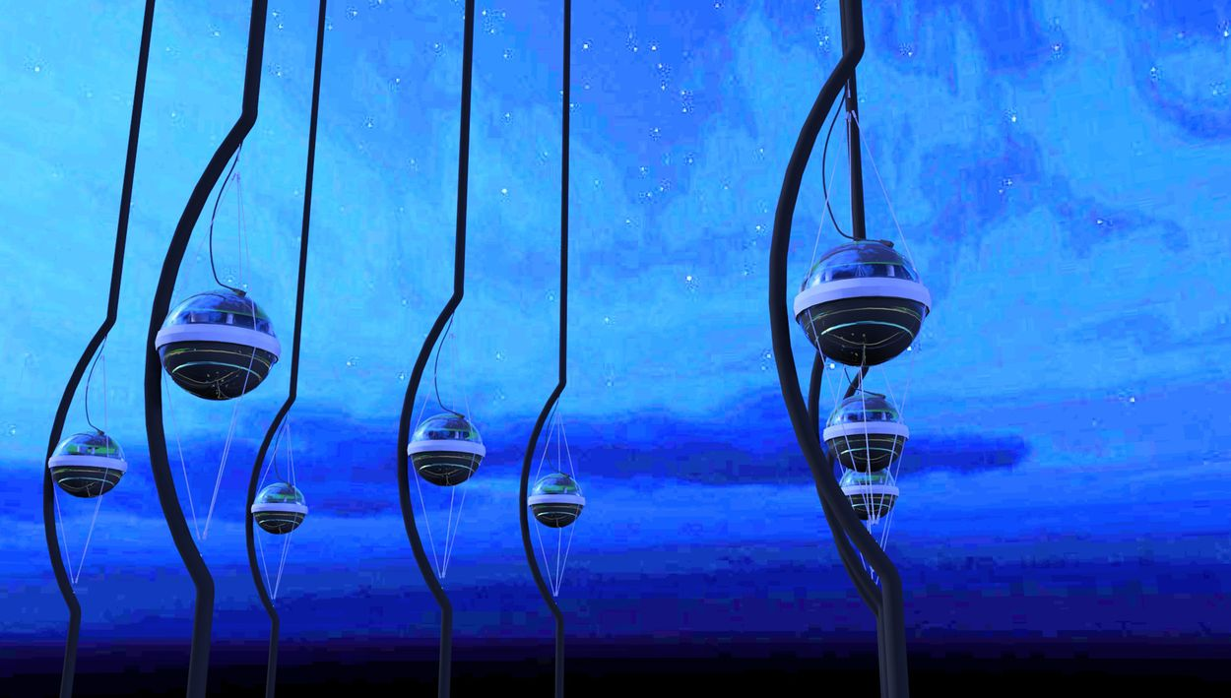
ASTROPHYSICAL NEUTRINOS ENTER THE GAME
Big Bird, 2 PeV (2014)

Slide 16
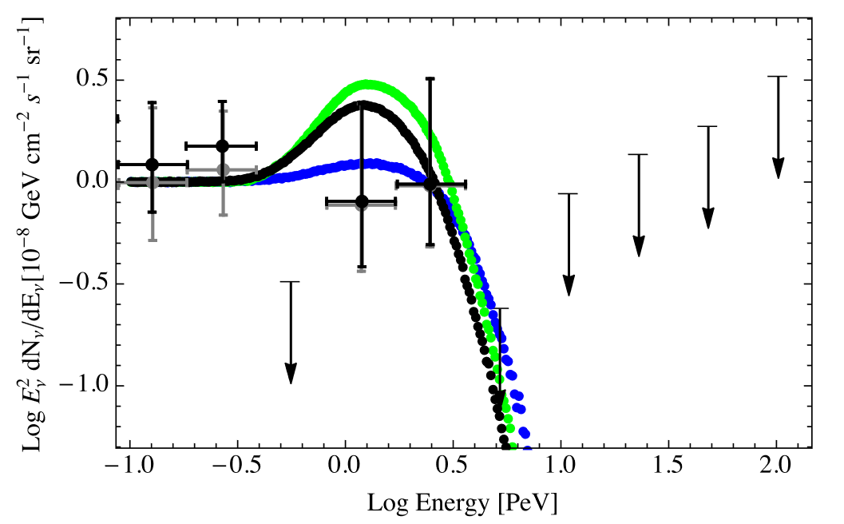
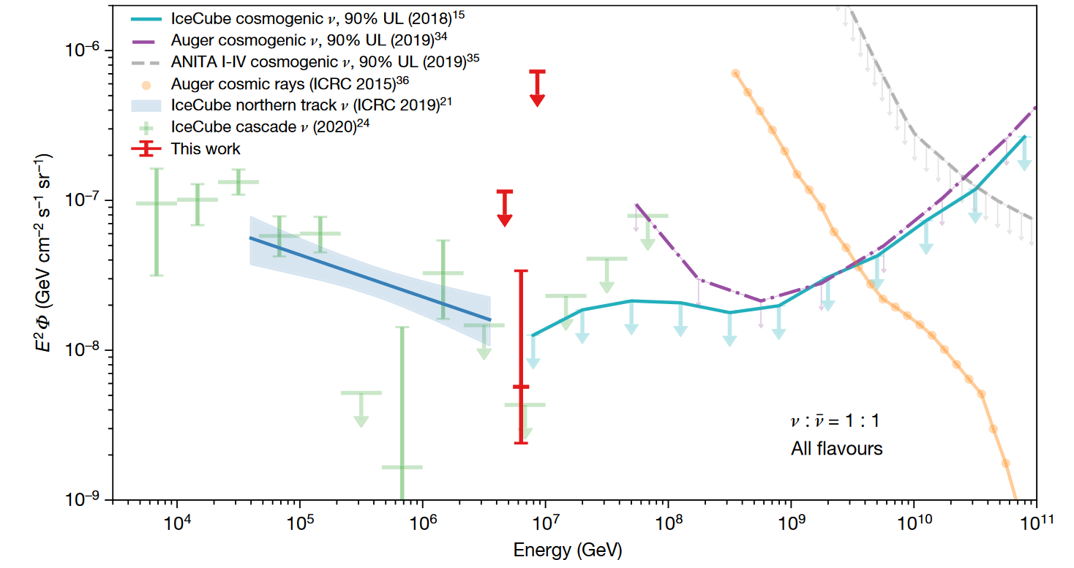
ASTROPHYSICAL NEUTRINOS ENTER THE GAME
Astrophysical neutrino flux from IceCube data (points)
(IceCube Collab., PRL 2014)
Neutrino spectrum with LIV propagation, showing a cutoff
(Stecker, Scully, Liberati, Mattingly, PRD 2015)
Detection of an event at the Glashow resonance
(IceCube Collab., Nature 2021)

Slide 17
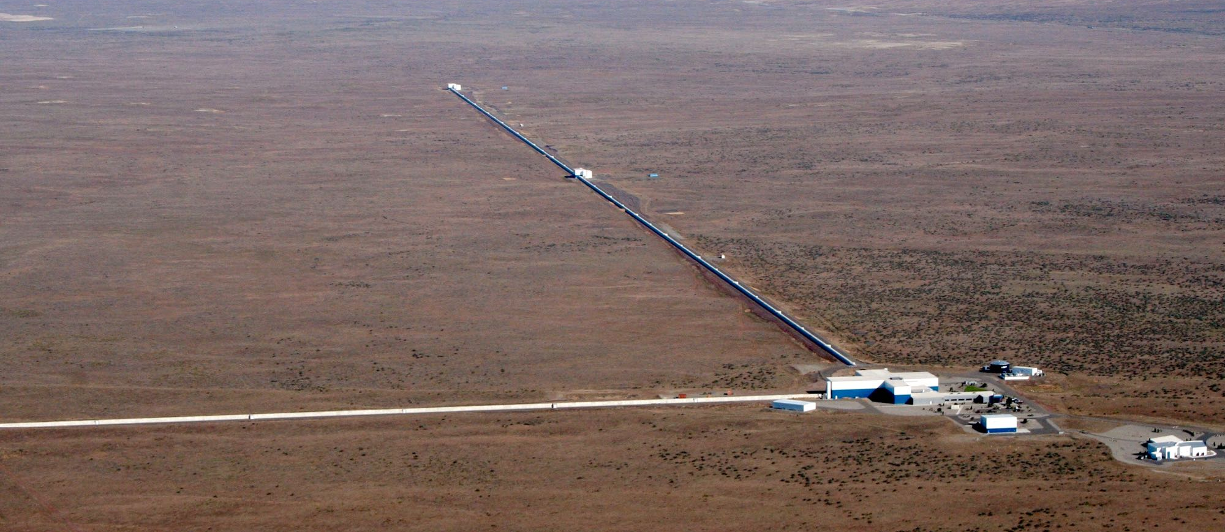
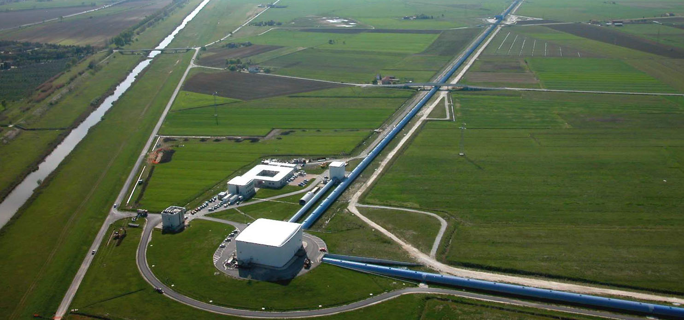
GWs AND MULTI-MESSENGER ASTRONOMY
LIGO
VIRGO

Slide 18
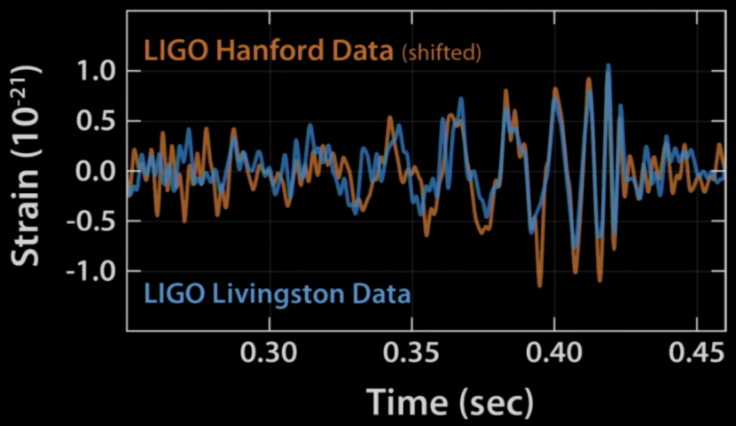
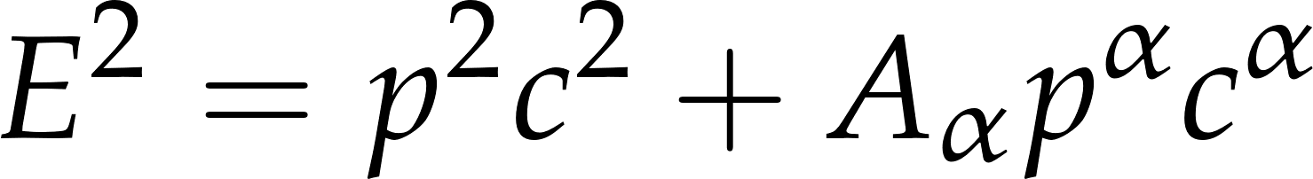
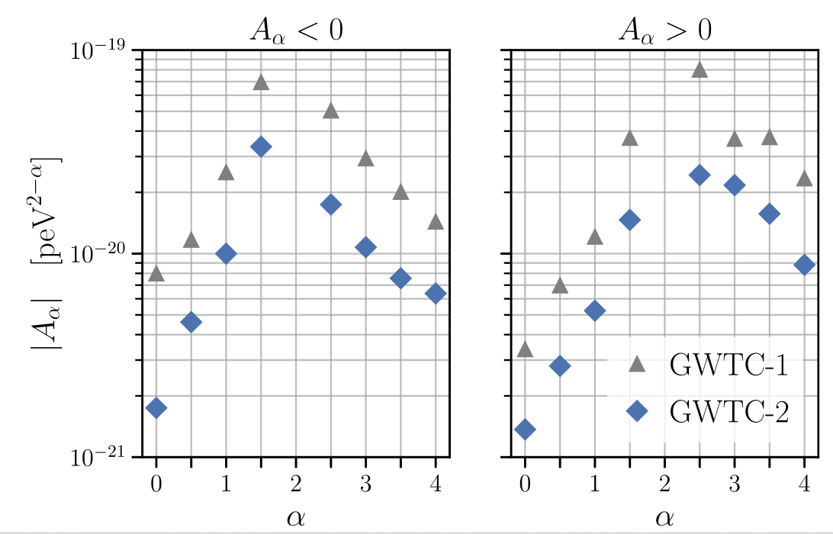
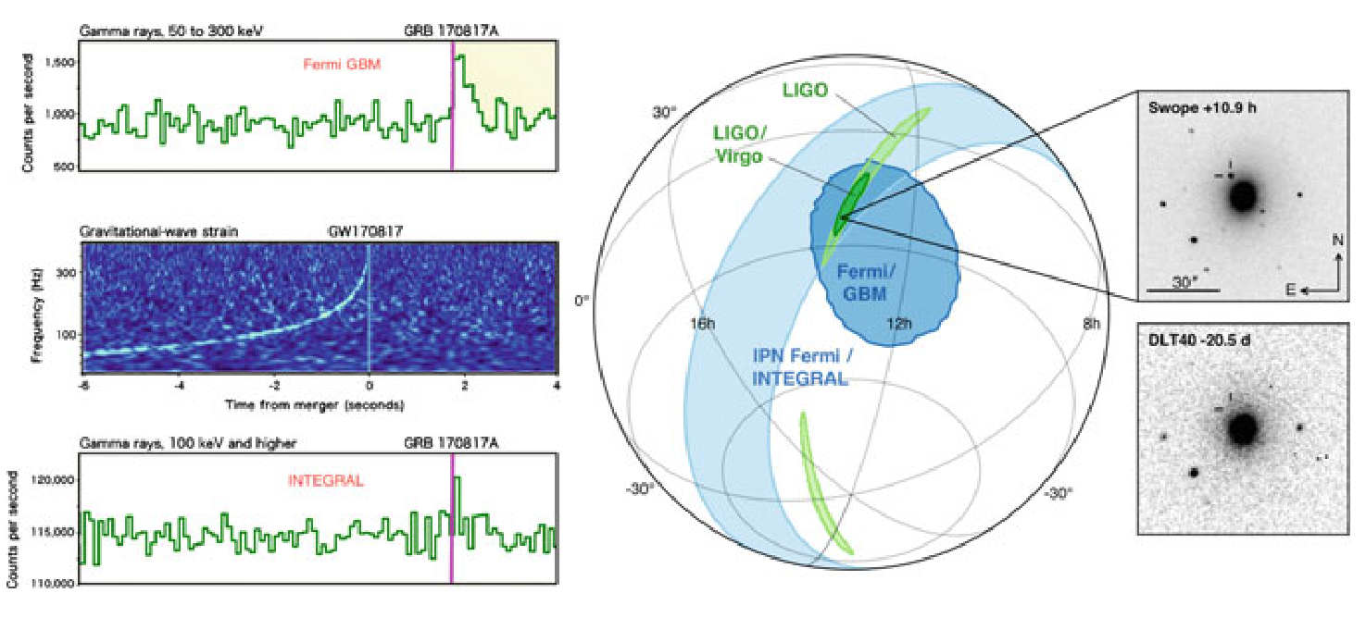
GWs AND MULTI-MESSENGER ASTRONOMY
Constraints on the graviton dispersion relation:
2015
2017
(LIGO-VIRGO Collab., PRD 2021)

Slide 19
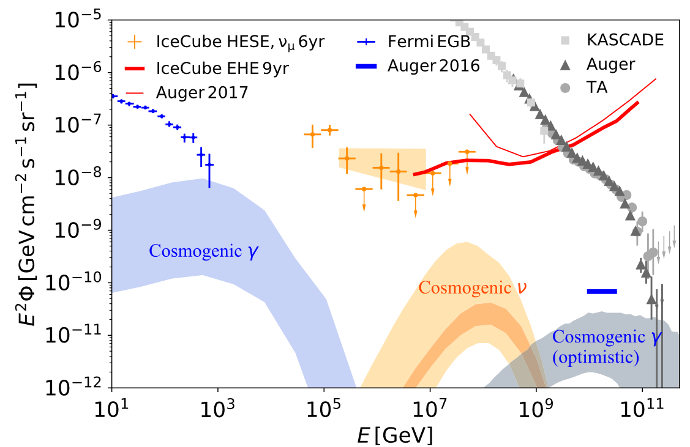
GWs AND MULTI-MESSENGER ASTRONOMY
(Alves Batista et al., Front. Astron. Space Sci., 2019)

Slide 20
2. THE LIV AND DSR PARADIGMS

Slide 21
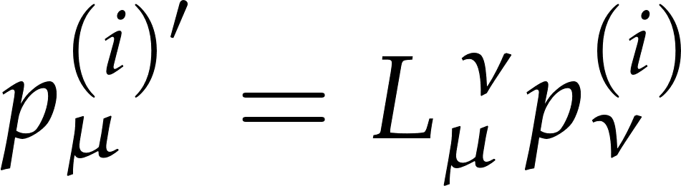

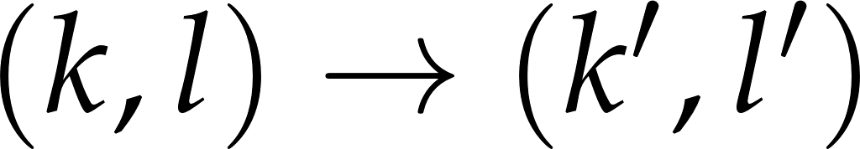
DEFORMED RELATIVISTIC KINEMATICS
Special relativity:
Invariance under linear Lorentz transformations:
Deformed relativistic kinematics MCL + MDR:
Deformed kinematics: SR is obtained in the limit
Relativistic invariance under Λ-deformed Lorentz transformations:

Slide 22
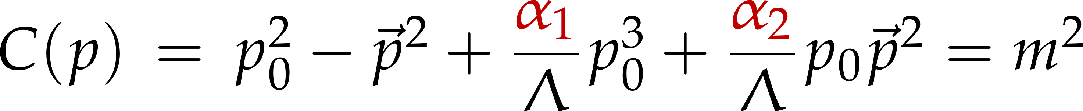
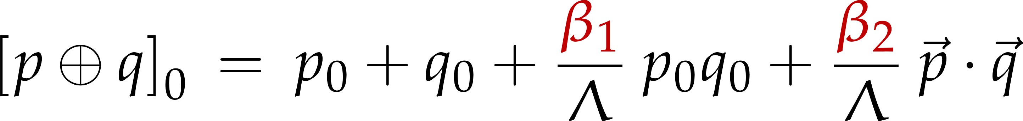
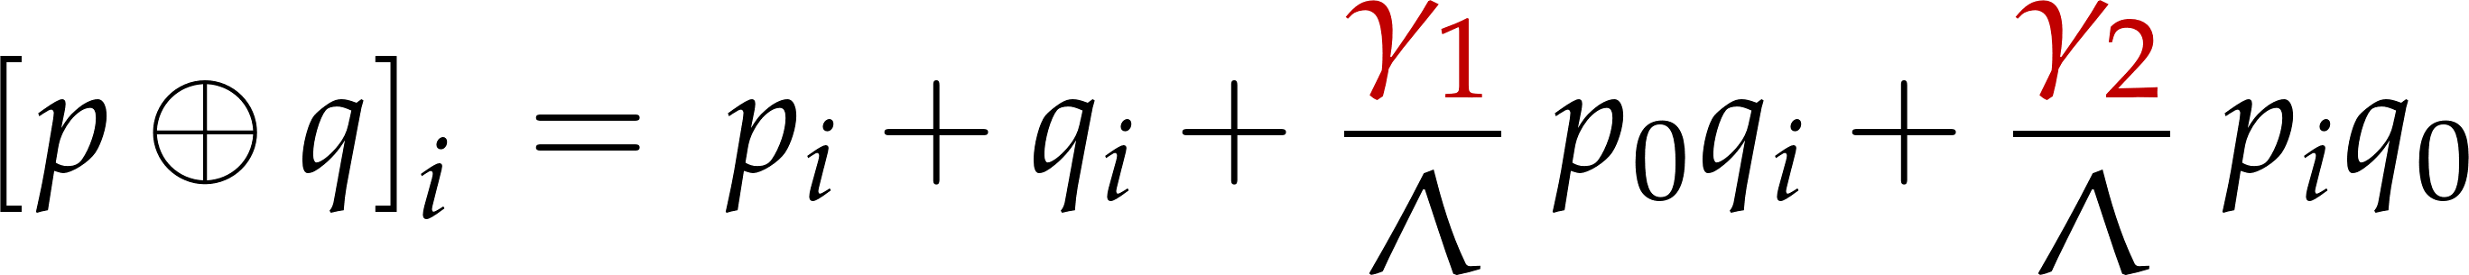
EXAMPLE: A FIRST-ORDER DSR
MDR:
MCL:
Relativity principle: (Carmona, Cortés, Mercati, PRD 2012)
(generalization of the “golden rule” derived in (Amelino-Camelia, PRD 2012)
Because of these “golden rules”, the kinematics of the relativistic invariance (DSR) and non-invariance (LIV) cases is very different

Slide 23
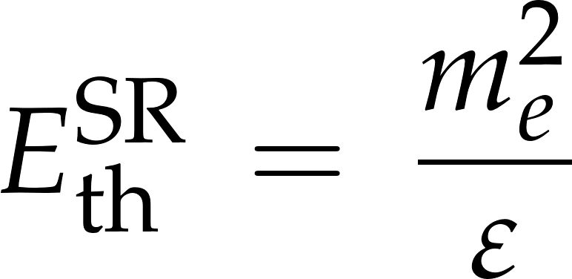
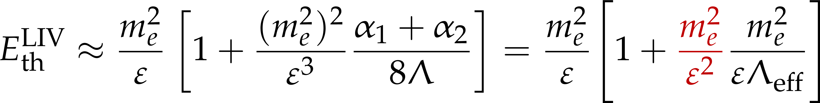
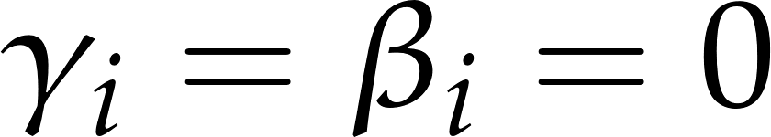
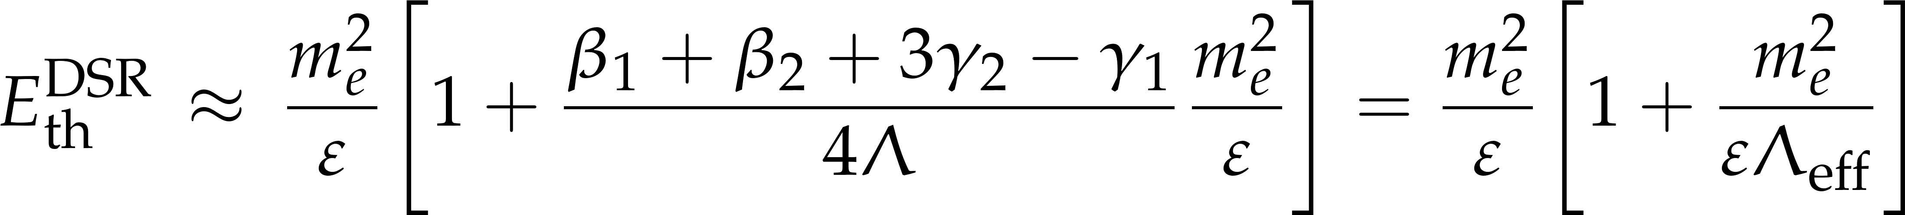
PAIR PRODUCTION IN A PHOTON BACKGROUND
SR threshold:
Beyond SR threshold equation:
LIV case:
DSR case:

Slide 24










ABOUT LOCALITY
Conservation of total momentum translational invariance
Special relativity: , translations are constant displacements
Deformed relativistic kinematics: , translations are momentum-dependent displacements
SR has the property of absolute locality; in a deformed relativistic kinematics, however, this property is lost
Local interaction
A translated observer sees the interaction as non-local

Slide 25





RELATIVE LOCALITY
Classical model of worldlines through a variational principle: relative locality
(Amelino-Camelia, Freidel, Kowalski-Glikman, Smolin, PRD 2011)

Slide 26
3. SOME CHALLENGES IN QUANTUM GRAVITY PHENOMENOLOGY

Slide 27
#1 – DETERMINATION OF TIME DELAYS
We need new strategies to give a definite answer wrt the presence or not of time delays:
Combination of experiments, as in the IACT’s LIV consortium
(Bolmont et al., The Astrophysical Journal 2022)
Inclusion of propagation effects in the analyses (such as non-standard interactions with the photon background)
New approaches to minimize the intrinsic effects at the sources
(Levi, Sol, Bolmont et al., PoS ICRC21)
A better understanding of the predictions of DSR with respect to time delays

Slide 28



TIME DELAYS: LIV vs DSR
LIV
DSR

Slide 29




TIME DELAYS IN DSR
It is a sum of two contributions that can cancel, producing no observable time delays
The time delay is invariant under the change of energy-momentum variables
This model is compatible with relative locality
(Carmona, Cortés, Relancio, Reyes, arXiv: 2207-03799)

Slide 30
#2 – SPECTRUM MODIFICATIONS
Most of the analyses looking for QuGra corrections have been done at the kinematic level, e.g., looking for the generation, suppression or modification of thresholds of reactions, such as those related to the GZK cutoff
A more complete analysis of the expected effects on the spectra of the cosmic messengers will be necessary to reveal quantum gravity footprints:
    Analysis of the end of the UHECR spectrum
    Influence of the cosmic backgrounds
    Simulations of atmospheric showers
It will be necessary a better understanding of the dynamics of the LIV and DSR cases

Slide 31

LHAASO

Slide 32







LIV and LHAASO
Allowed process in special relativity (SR):
LIV: modification of the dispersion relation
Absorption of TeV photons in the EBL
Sensitivity of to the Planck scale
(H. Martínez-Huerta et al., Symmetry 2020)
LHAASO results severely constrains the superluminal scenario because of pair-emission and photon splitting processes

Slide 33










ABSORPTION OF VHE PHOTONS IN SR
Probability of survival of a VHE photon:
At low redshift:
and taking
(De Angelis, Galanti, Roncadelli, MNRAS 2013)

Slide 34



ABSORPTION OF VHE PHOTONS IN DSR
In DSR, a good approximation turns out to be:
(Carmona, Cortés, Relancio, Reyes, Vincueria, Eur. Phys. J. Plus 2022)

Slide 35



#3 – DYNAMICAL CALCULATIONS
LIV decay widths (as in the case of superluminal neutrinos) have been studied in the framework of the SME, mostly for the case of d = 4 LIV operators
(Cohen, Glashow, PRL 2011)
(Bezrukov, Lee, PRD 2012)
(Huo, Li, Liao, Nanopoulos, Qi, PRD 2012)
(Carmona, Cortés, Mazón, PRD 2012)
The detailed study of the spectrum of superluminal neutrinos will require specific calculations for d > 4 operators which include
(Carmona, Cortés, Relancio, Reyes, in preparation)

Slide 36
4. CONCLUSIONS

Slide 37
FINAL THOUGHTS
Quantum gravity phenomenology has shown to be more elusive and subtle than initially thought
The first twenty years of this field has allowed us to put into practice smart theoretical and experimental ideas, but the expected effects have turned out to be not as direct as they could have been foreseen and further efforts will be needed to discover quantum gravity footprints
Fortunately, a new generation of experiments (IceCube Gen-2, the upgrades of the Pierre Auger observatory, CTA, LHAASO,...) is going to produce new results, at higher energies and sensitivities, in the coming years
This represents an outstanding opportunity to develop new strategies and approaches for the transition from an exploratory stage to a precision era, favored by the experimental advances in the detection of the cosmic messengers in their high-energy regime
Thanks for your attention

