Slide 1
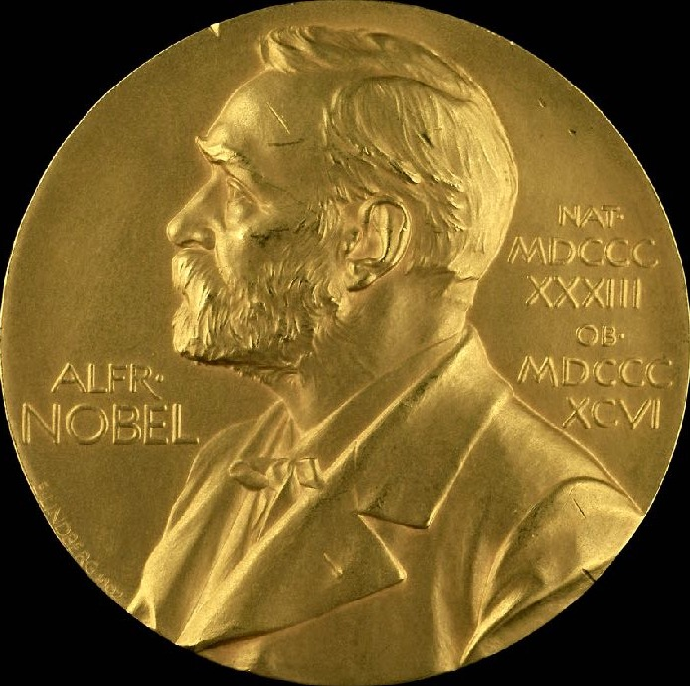


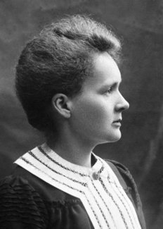
The Nobel Prizes awarded to Marie Curie
and the one not awarded to Lise Meitner
BPU 11
Belgrade 30 August 2022
Karl Grandin, RSAS

Slide 2
…or Nobel 101
BPU 11
Belgrade 30 August 2022
Karl Grandin, RSAS

Slide 3
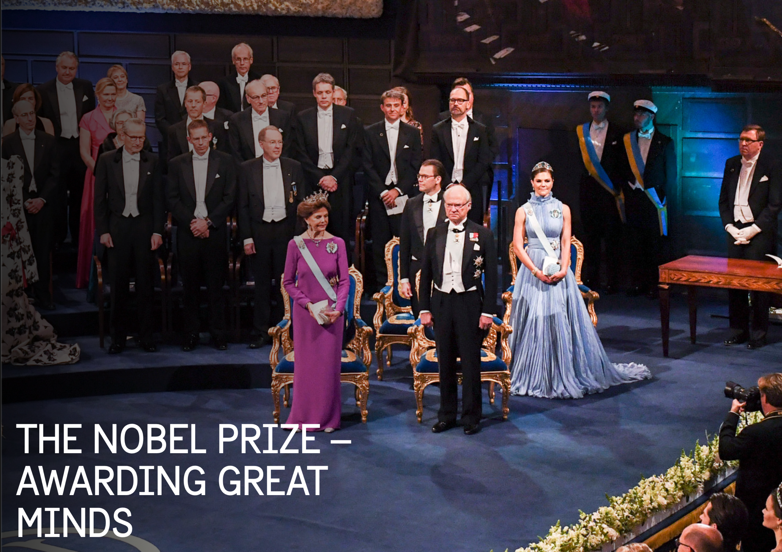

Slide 4
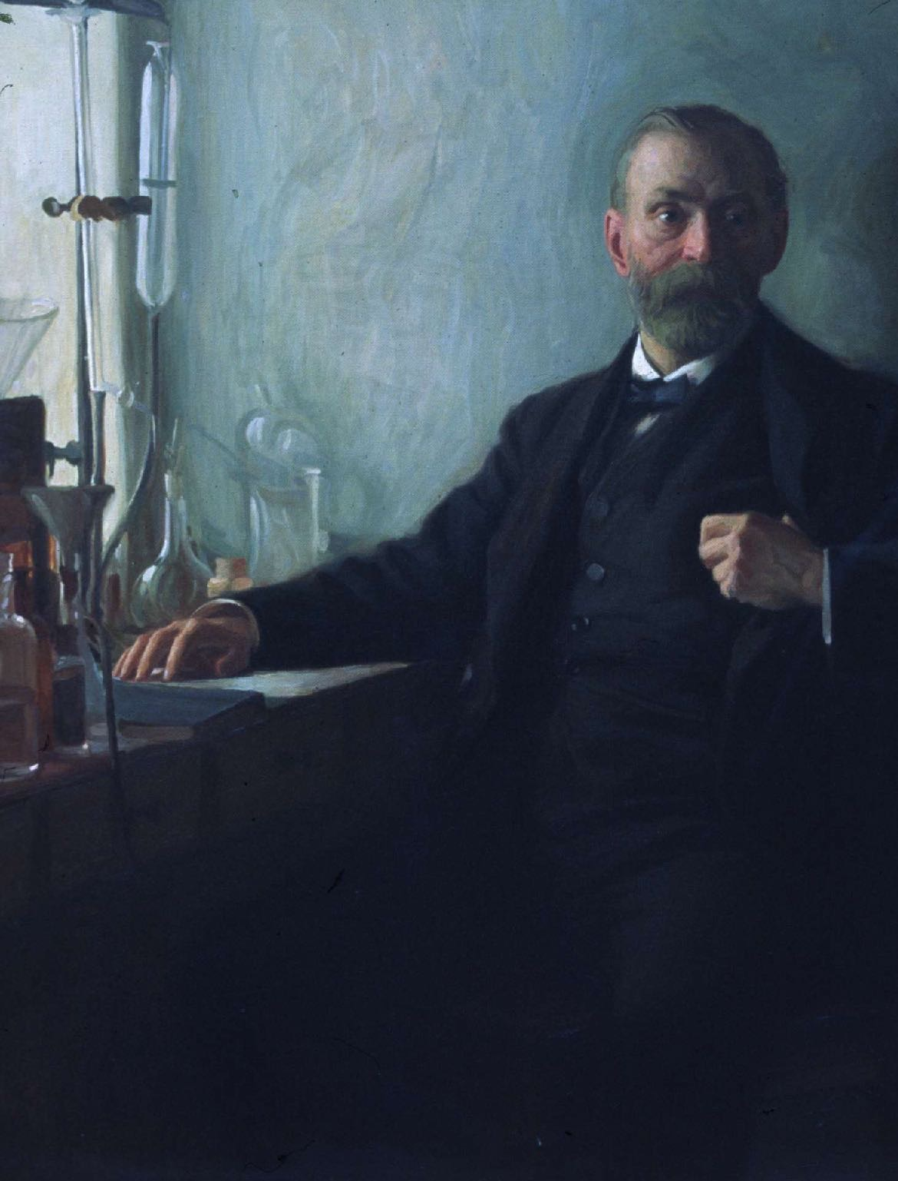
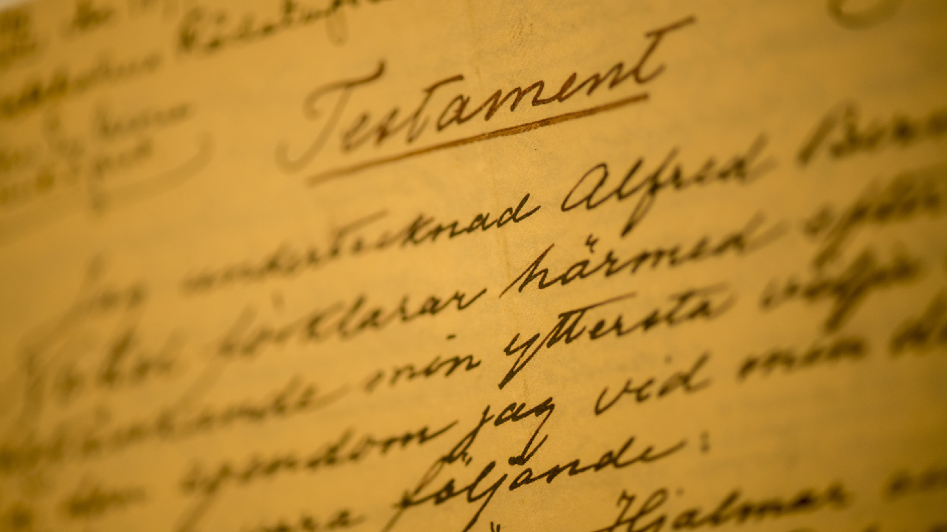

Slide 5


Nobel organisations
Physics
RSAS
Chemistry
RSAS
Medicine
Karolinska Institutet
Literature
Svenska Akademien
Peace
Norwegian Storting
Nobel Foundation

Slide 6


Slide 7


Entitled to nominate
Physics and Chemistry
§1 Swedish and foreign members of the Royal Swedish Academy of Sciences
§2 Members of the Nobel Committees in Physics and Chemistry
§3 Nobel Laureates in Physics and Chemistry
§4 Permanent and Assistant Professors in Physics and Chemistry at the universities and institutes of technology in the Nordic countries, as well as at the Karolinska Institute
§5 Holders of corresponding chairs in at least six universities or university colleges selected by the Academy of Sciences with a view to ensuring an appropriate distribution among countries and seats of learning
§6 Other scientists from whom the Academy may see fit to invite proposals

Slide 8
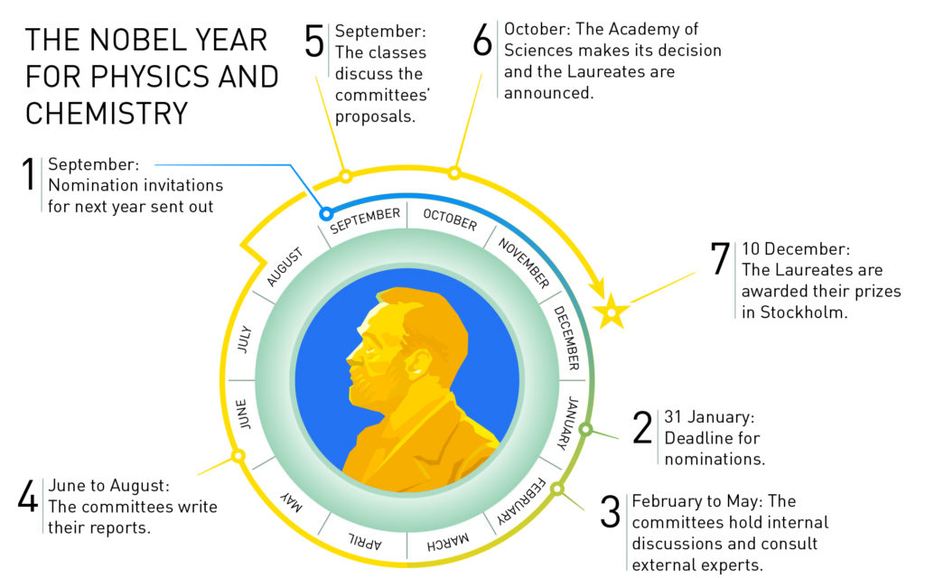

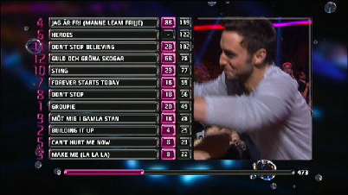
Notes:
Det lååånga Nobelåret, sommarens utredningar av huvudkandidaterna

Slide 9
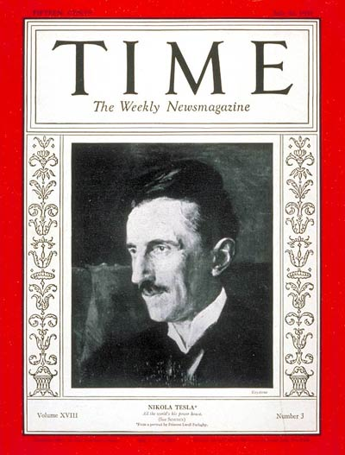
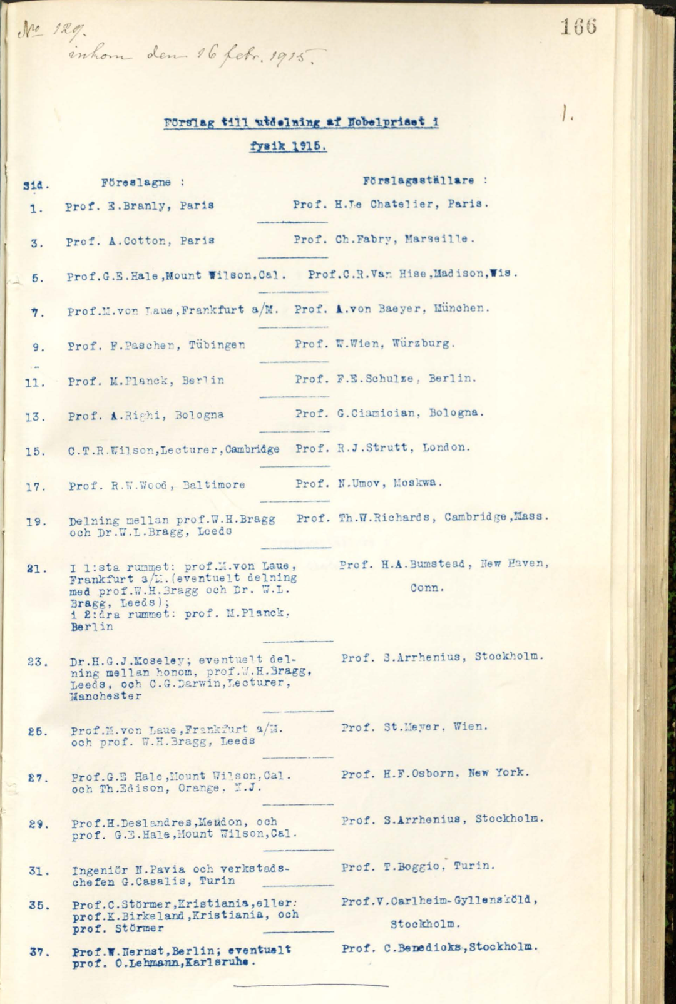

Tesla and the Nobel Prize…
In the whole of 1901–1943 out of
total 1433 nominations in physics,

Slide 10

Tesla and the Nobel Prize…
In the whole of 1901–1943 out of
total 1433 nominations in physics,
Tesla received only one!

Slide 11
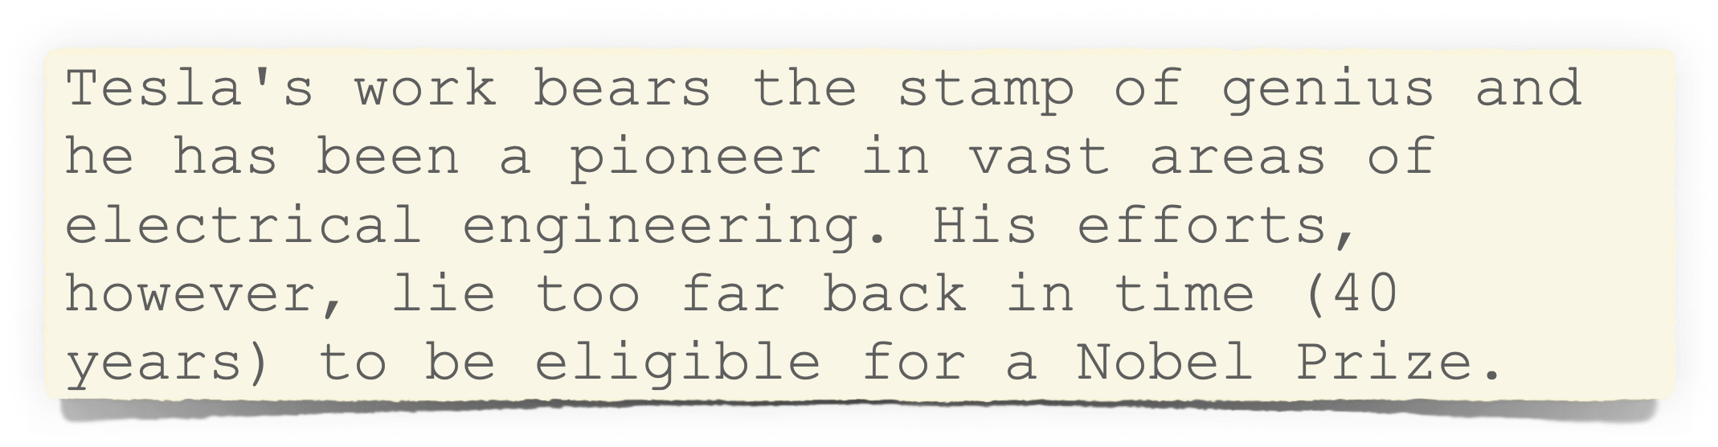
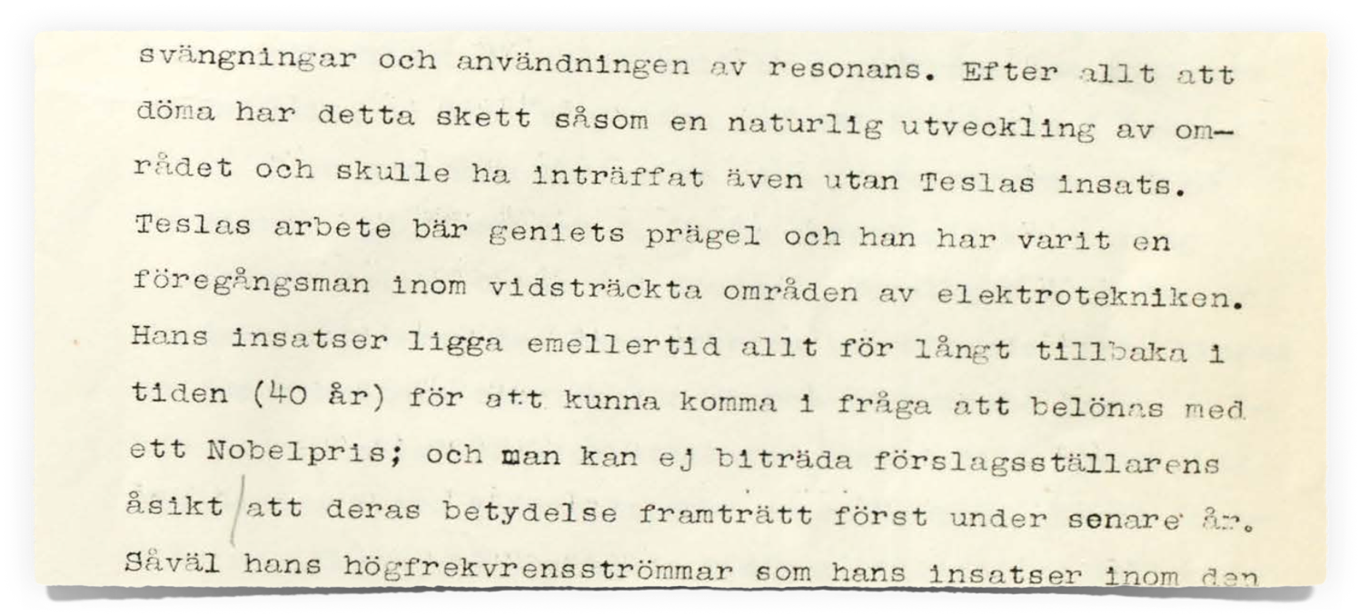
Tesla and the Nobel Prize…
In the whole of 1901–1943 out of
total 1433 nominations in physics,
Tesla received only one!

Slide 12
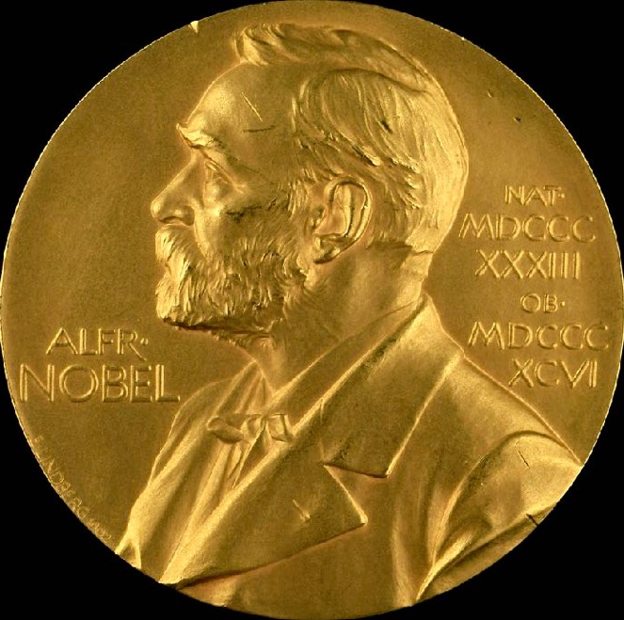

Slide 13
Marie Curie who was awarded two Nobel Prizes
1903 Did Pierre Curie gallantly secure a Nobel Prize for Marie with the help of a Swedish mathematician?
1905 PC & MC visit Stockholm and PC deliver their Nobel Lecture
1910 The RSAS did what the French Academy did not do, made MC a member
1911 Despite the smearing of MC she went to Stockholm for her 2nd Nobel Prize

Slide 14
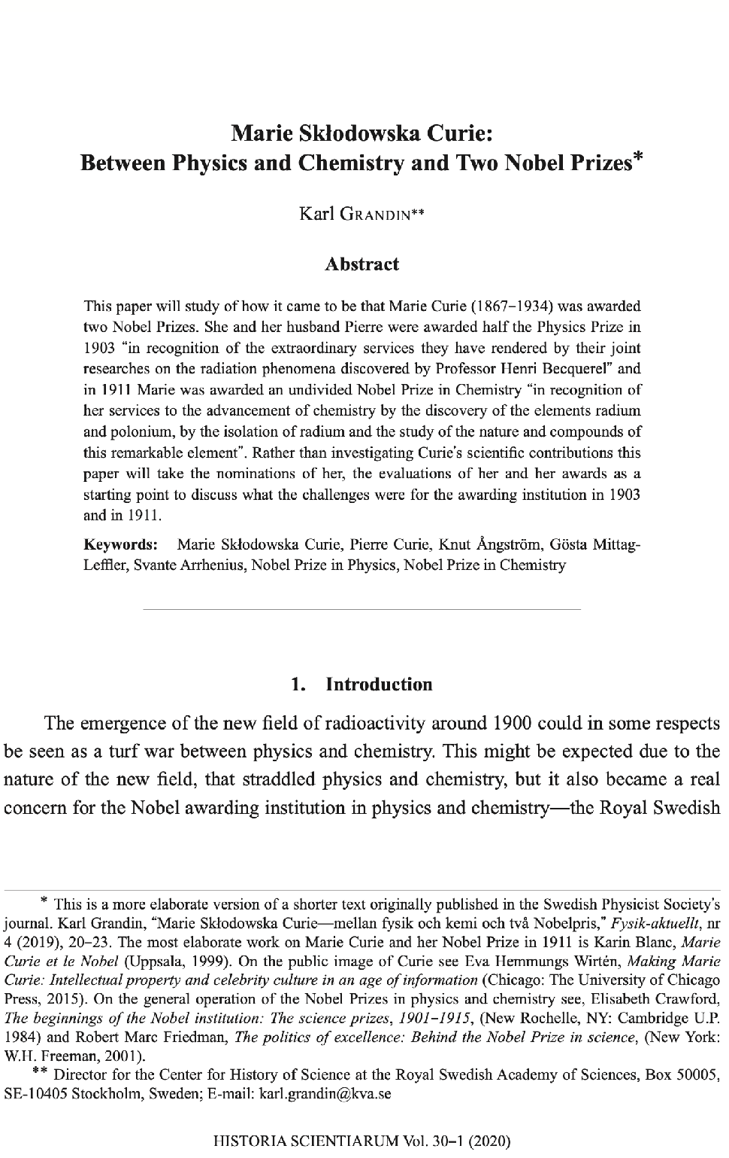
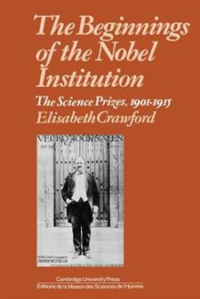


Slide 15

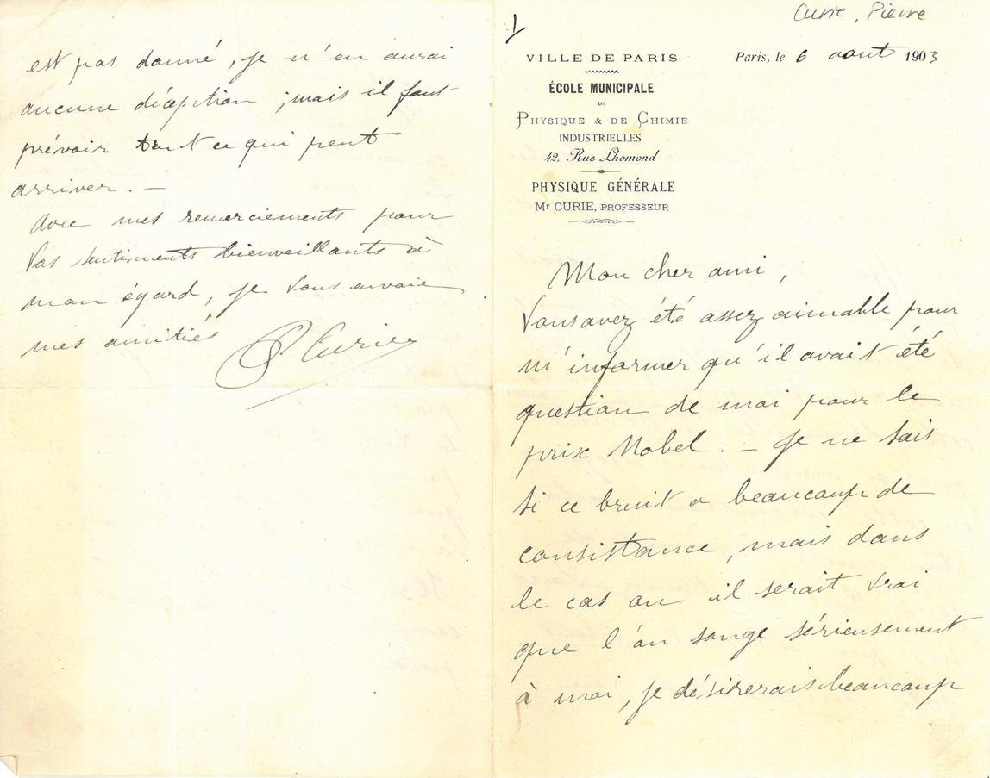
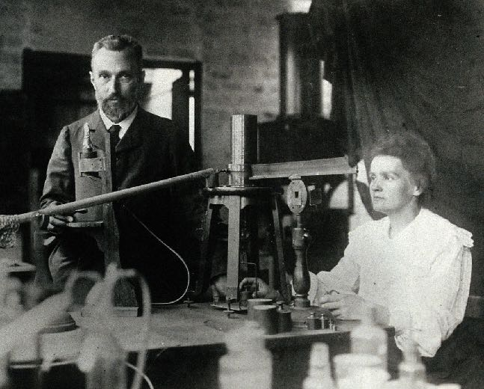
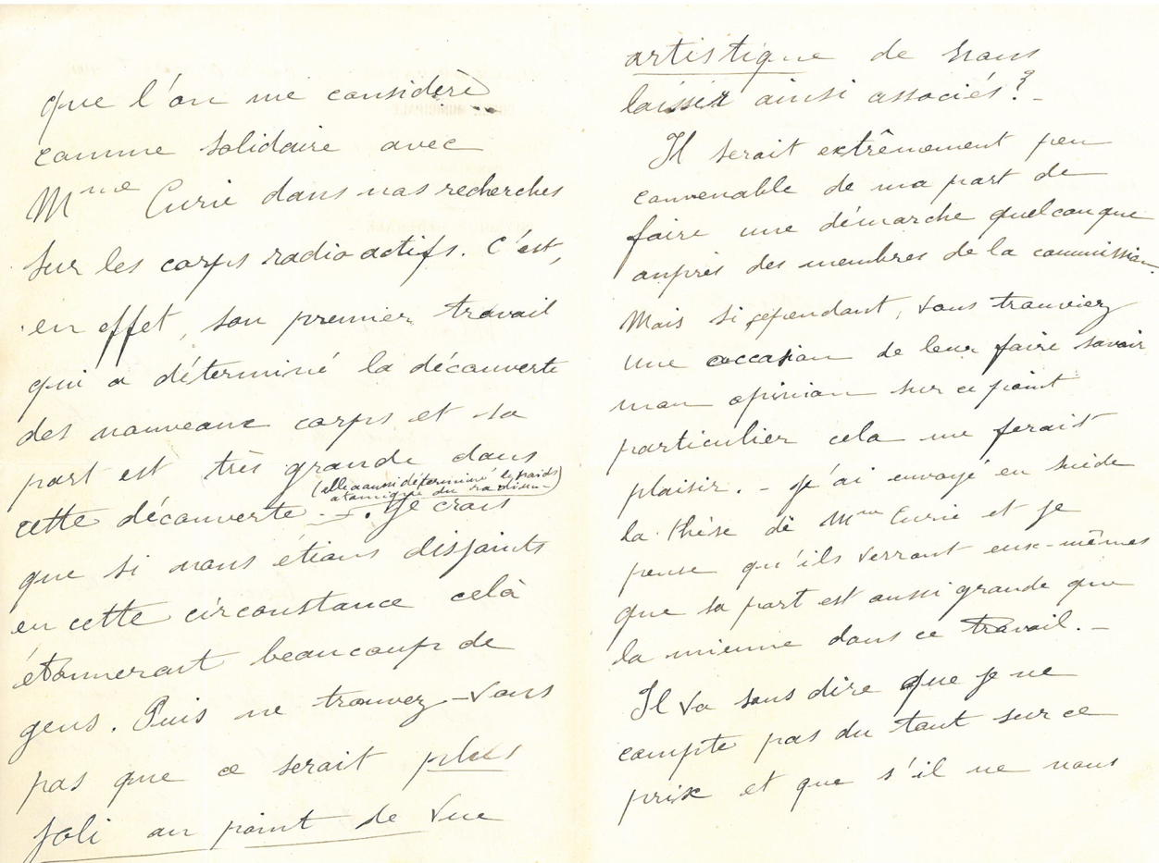

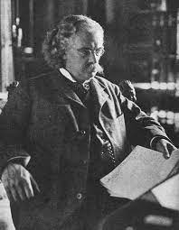

Slide 16
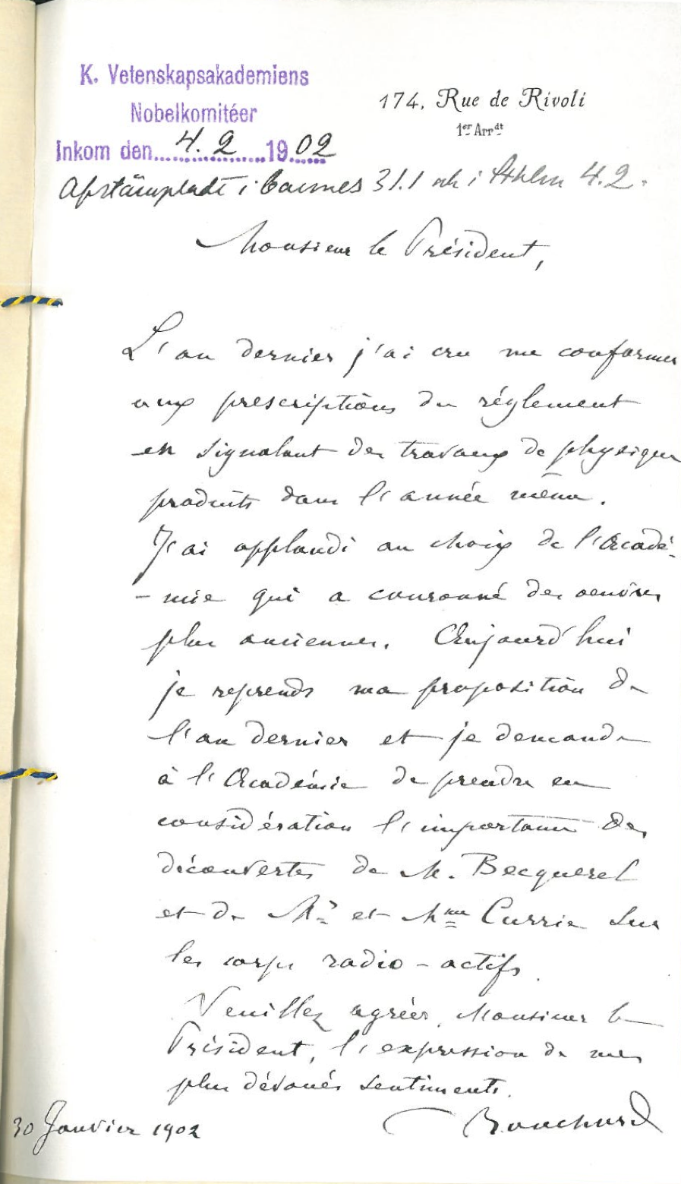
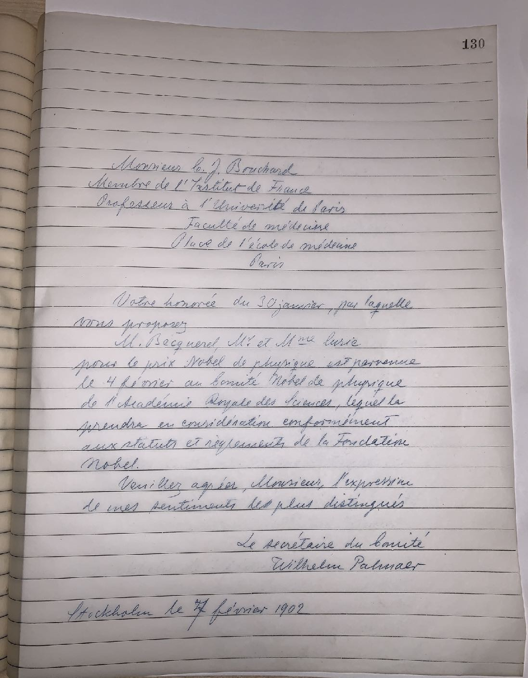

Slide 17
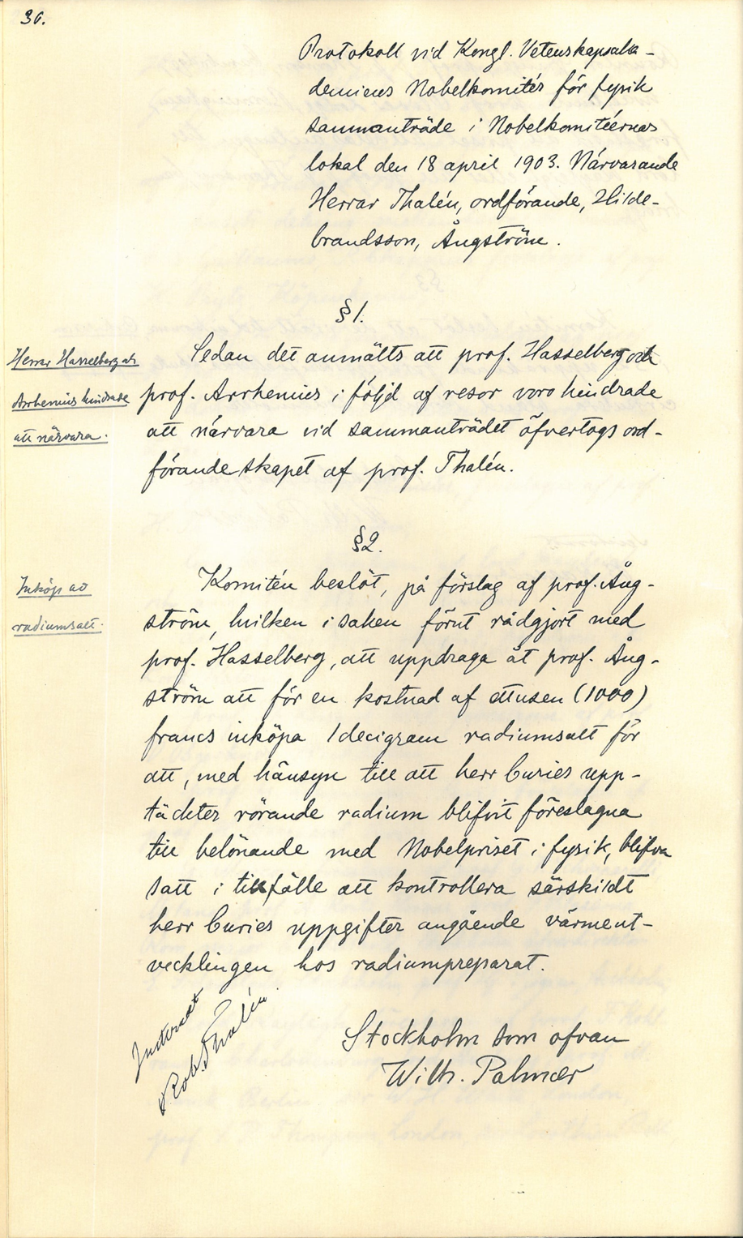
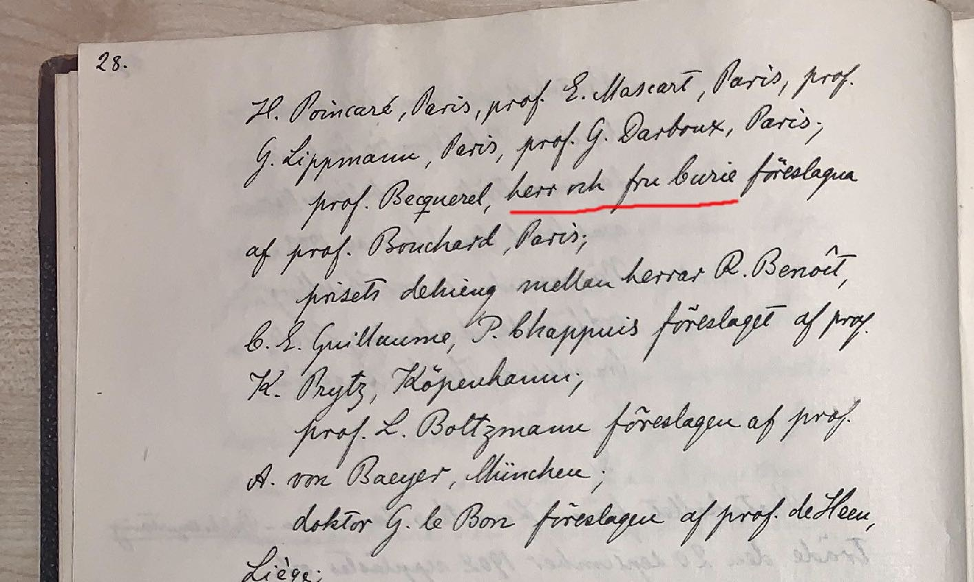
List of valid nominations February 3rd, 1903

Slide 18
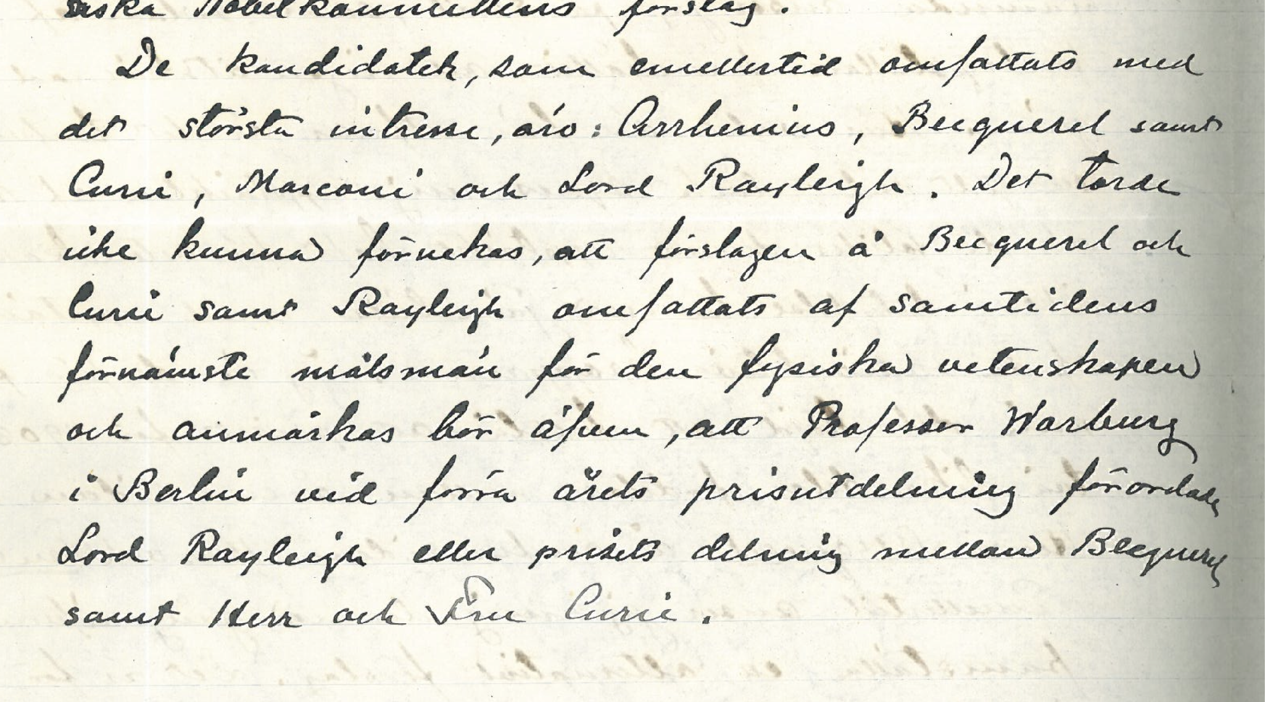
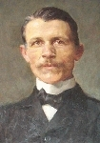
August 5, 1903

Slide 19
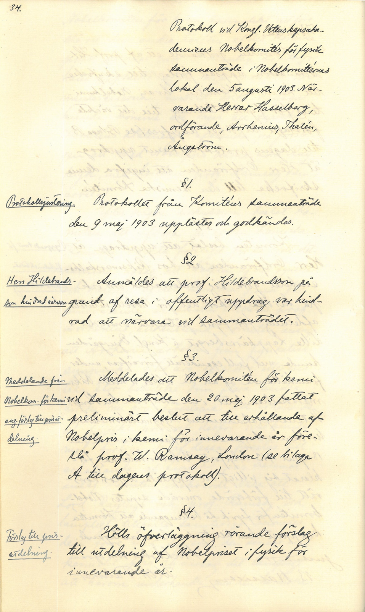
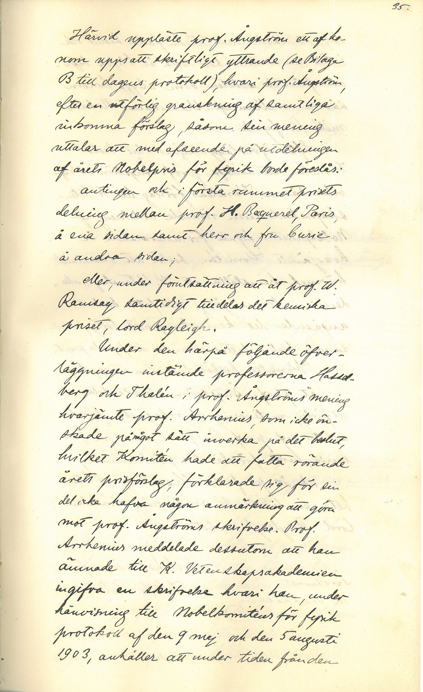

Slide 20
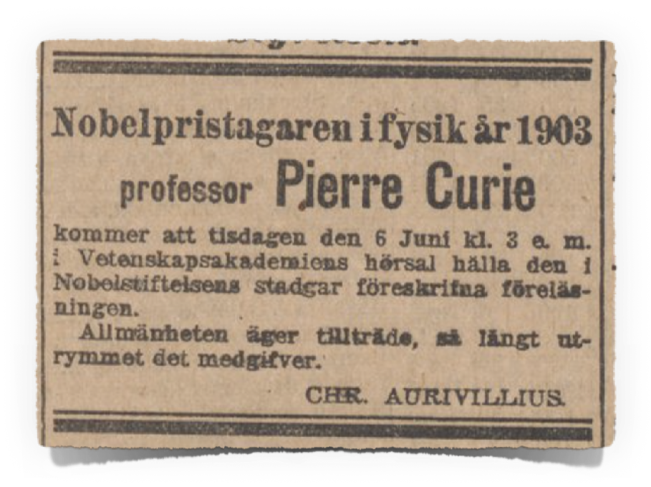
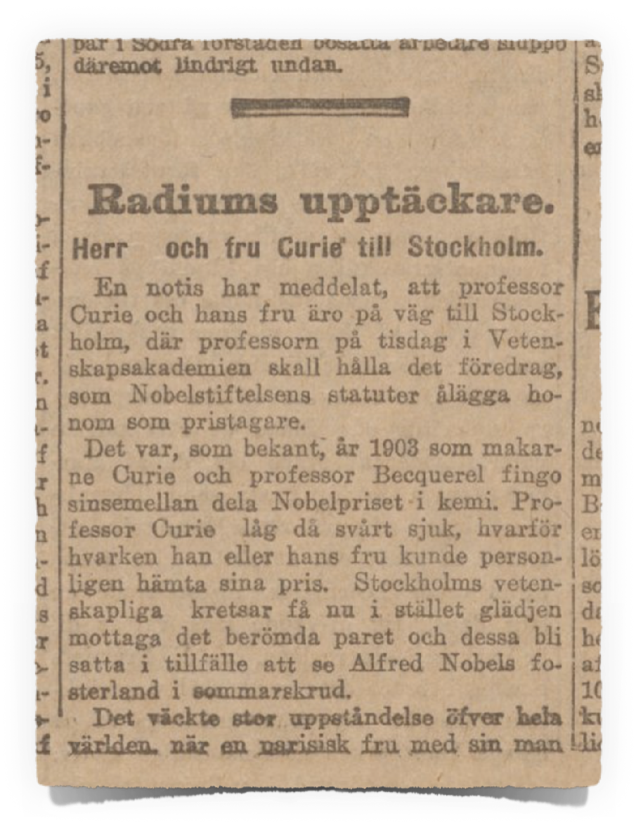
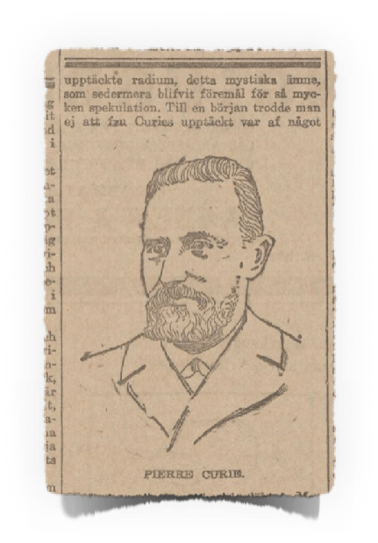
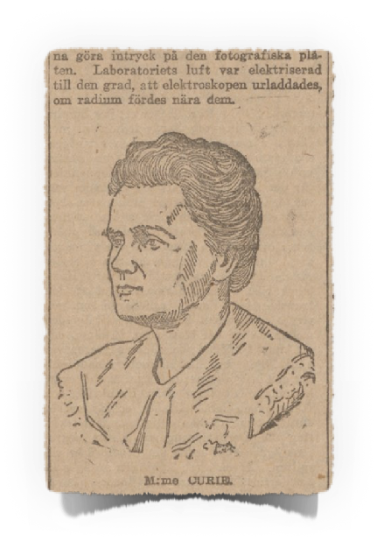
June 1905

Slide 21
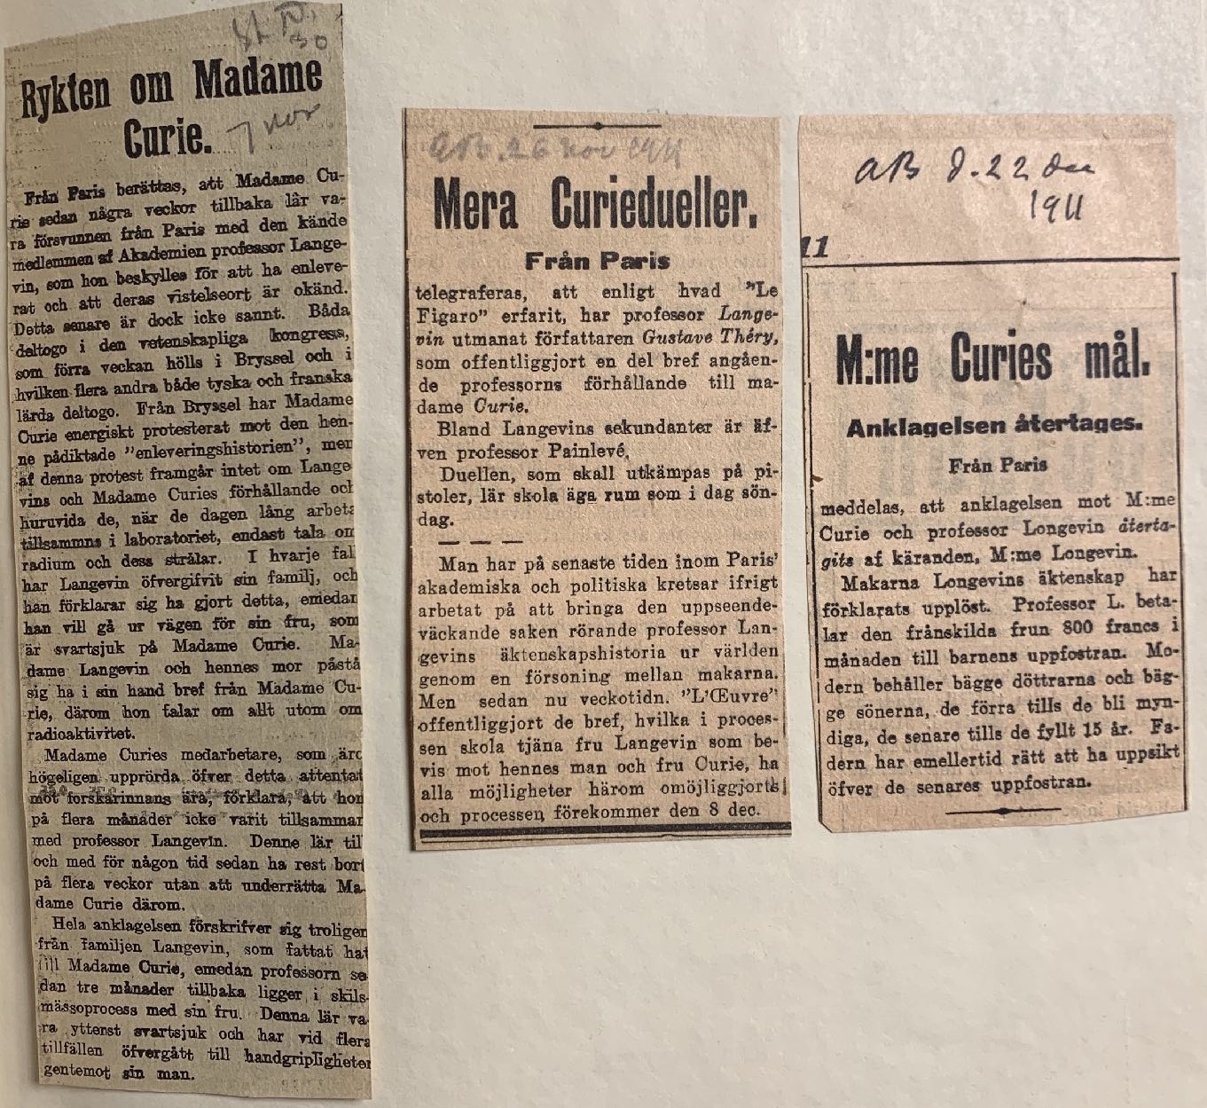
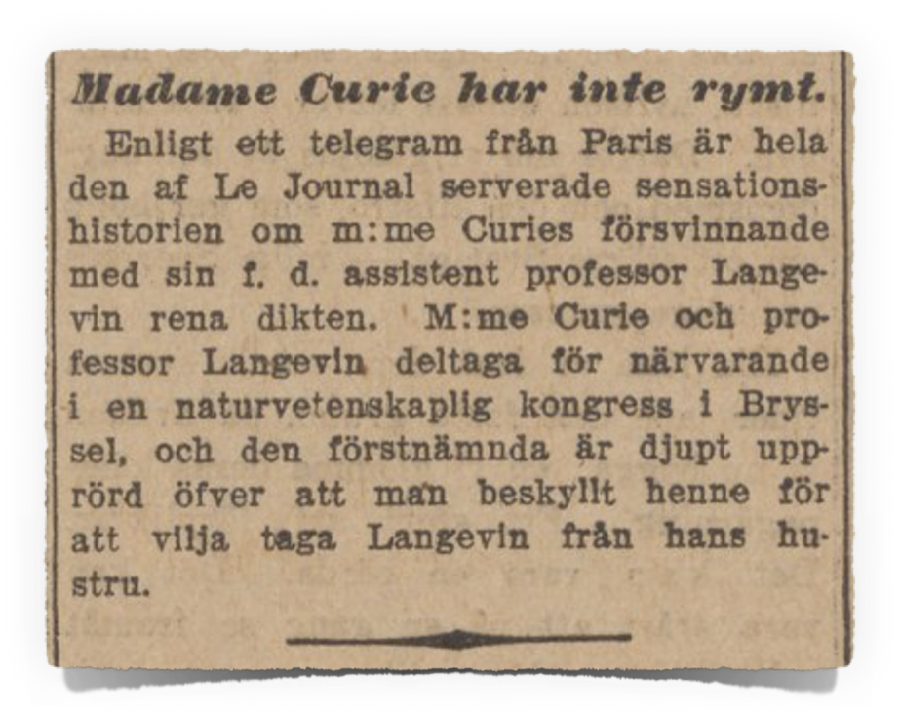
1911

Slide 22
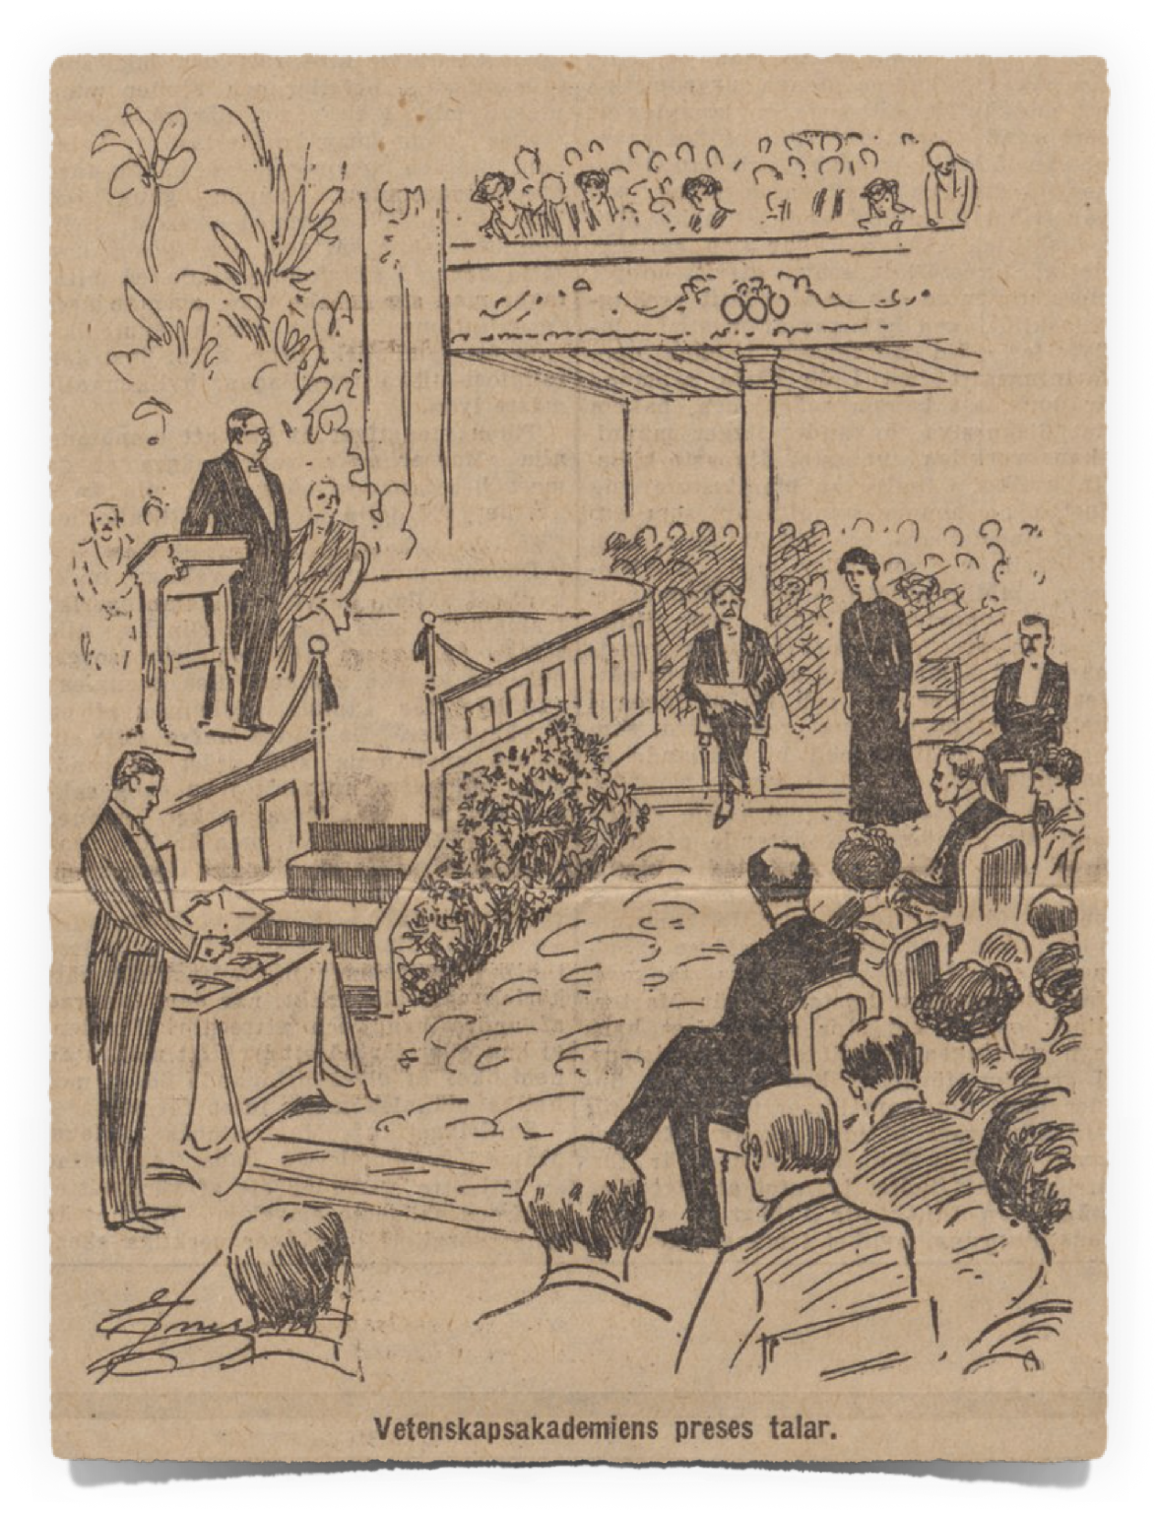

Slide 23
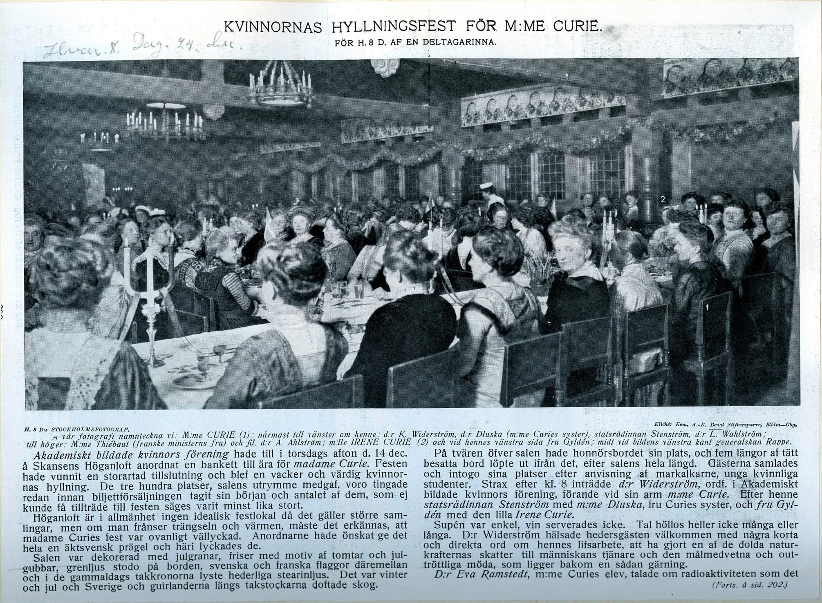

Slide 25
Lise Meitner who was never awarded a Nobel Prize
Long time collaboration in Berlin with Otto Hahn
1938 fled Nazi Germany for Sweden, why?
1945 Nuclear bomb, Nobel Prize Chemistry to Otto Hahn
1945– FMRSAS, 1951 MRSAS
1960 leaves Sweden after 22 years

Slide 26
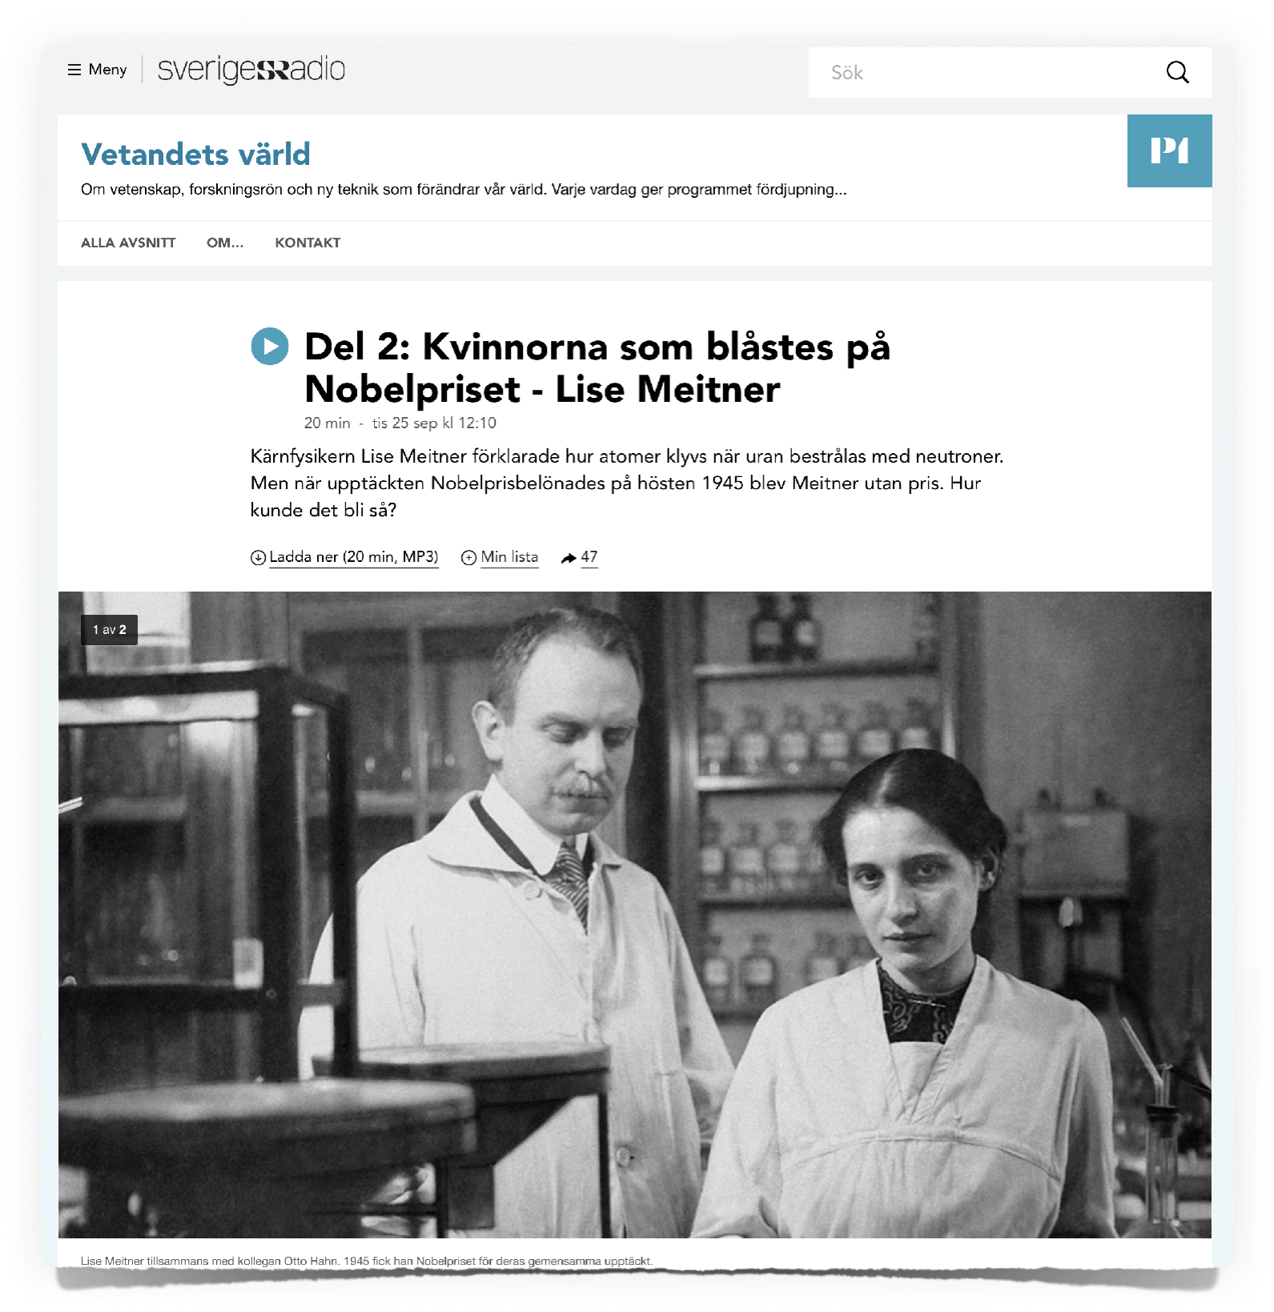
“The women who were swindled out of the Nobel Prize”

Slide 27

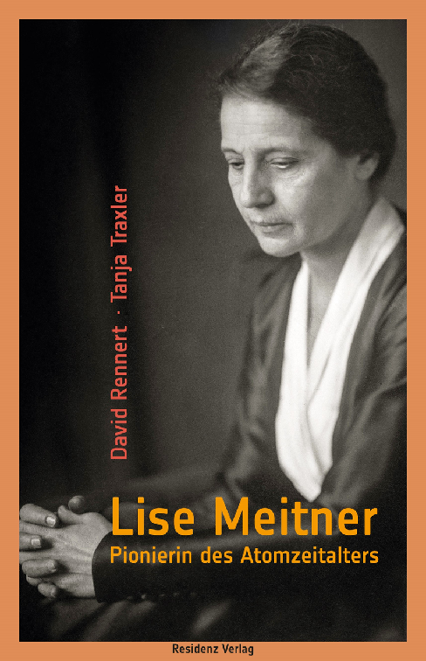
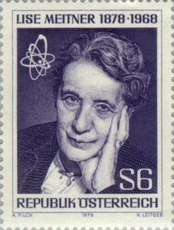
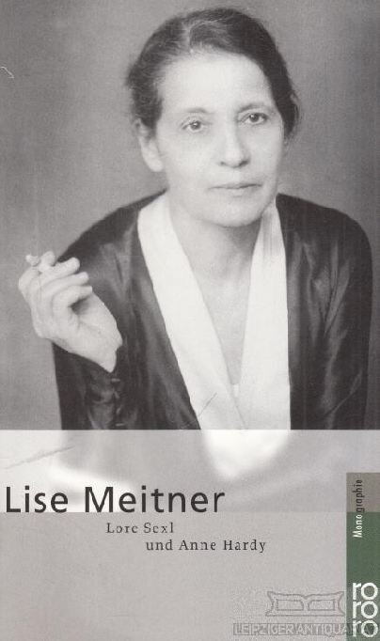
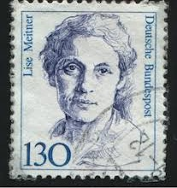

Slide 28

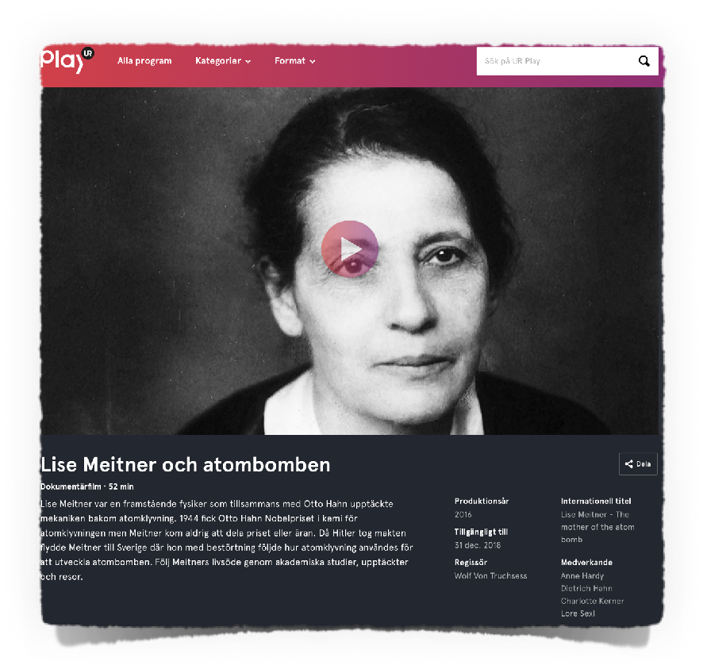
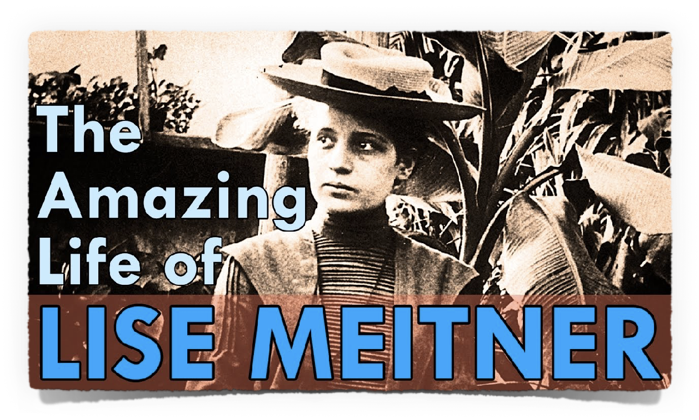

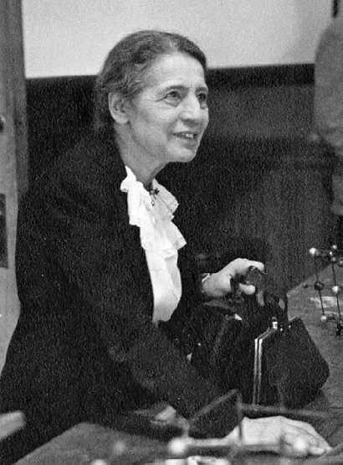

Slide 29

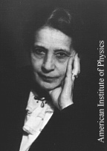

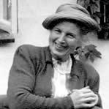
Lise Meitner to Margarethe Bohr 25/11-1945
”Du weisst ja, dass ich immer das Gefühl habe, das ich mit meiner ganzen Art nicht nach Schweden passe und ich habe auch noch keinen schwedischen Physiker getroffen”.
’You know that I always have the feeling that I, with my disposition, don't fit in in Sweden, and I haven't met any Swedish physicist either’.

Slide 30

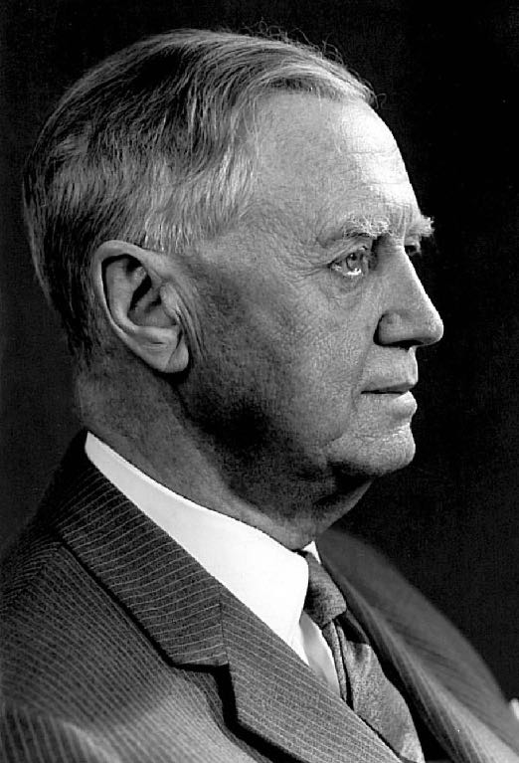
The Research institute for experimental physics
of the Swedish Academy of Sciences, 1937–
Manne Siegbahn

Slide 31

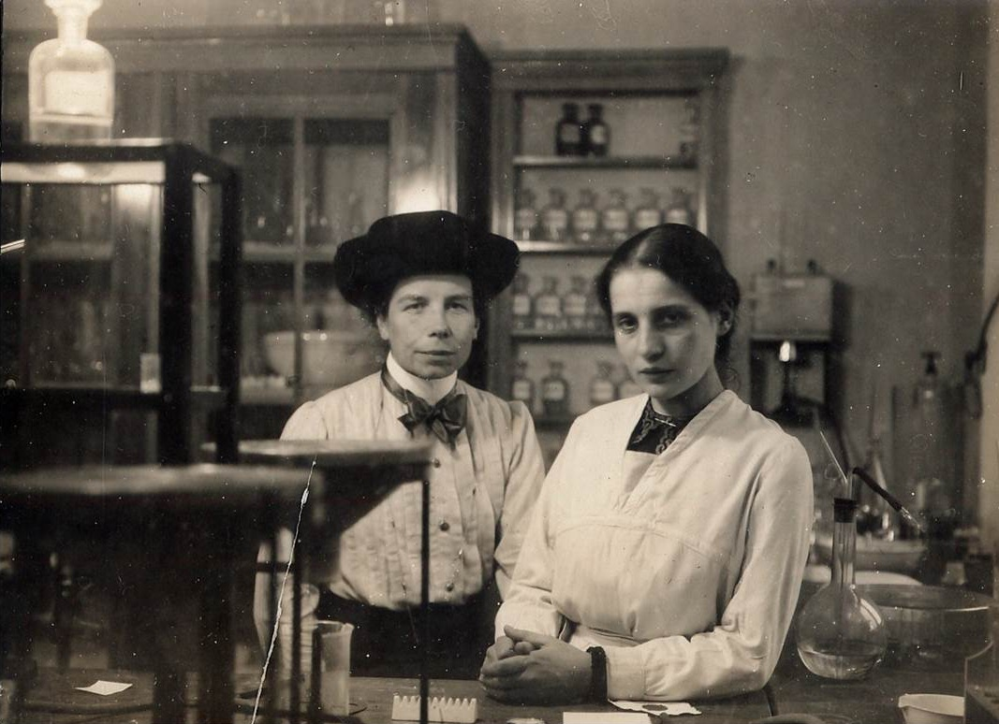
Eva von Bahr and
Lise Meitner in Berlin

Slide 32
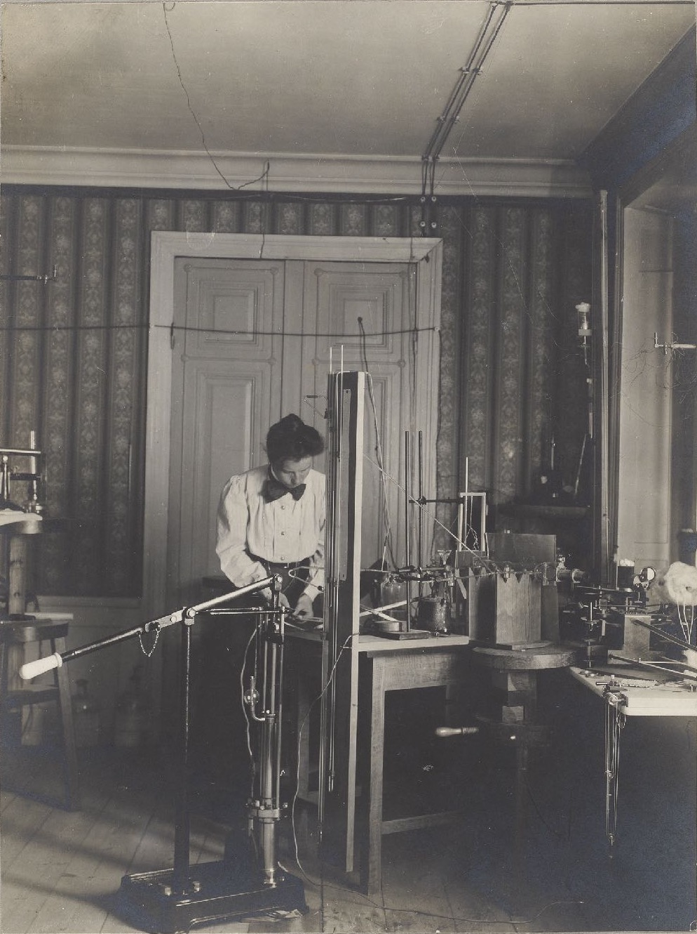

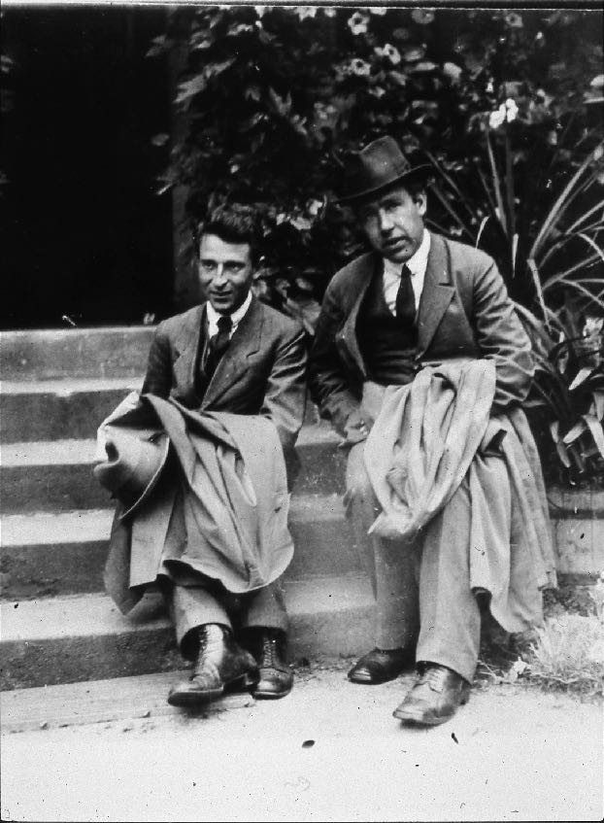
Eva von Bahr at Uppsala Physics institute
Oskar Klein and Niels Bohr

Slide 33


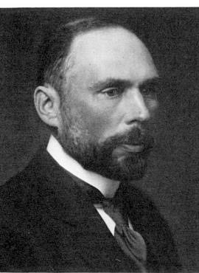
Eva von Bahr-Bergius to Carl Wilhelm Oseen 31/1-1939
”It doesn't seem possible to get any [assistant] now and Lise sounds rather unhappy. She says, she feels like a charlatan, who receives money [from the Nobel Committee 5,400 SEK + Eva vB-B], although she cannot accomplish much, and her life seems to her completely pointless. […] If she for the past two years had not been so unaccustomed to simpler technical work such as glass blowing, soldering etc. that she now cannot cope with such.”

Slide 34
Carl Wilhelm Oseen to Eva von Bahr-Bergius 2/2-1939
”Is it true what L.M. says, that it is an assistant she needs? Isn't it rather so, that what she needs is a - even with regard to staff - fully equipped institute, as whose brain she could be? The quote that you mentioned, seems to me, to point quite firmly in this direction.
  If so, then it is obvious that Sweden cannot give her what she needs. As it was by Bohr's mediation she came here, it seems to me that in the present situation, one should turn to him.
It is not certain that even a fully equipped institute would give what L.M. needs. It may be that it would also have to be located in Berlin, at a certain - for L.M. well-known address - and that it needs a second floor, where Hahn is working.
In other words it may be that L.M. has reached the age when a transplanting is no longer possible.
You probably know that it was impossible to get a grant from the Wallenberg Fund.
We have done the best we could.”

Slide 35
Financial support for Lise Meitner
1/2 year
Total 60,000 SEK – the NP ca 120,000 SEK in 1945

Slide 36
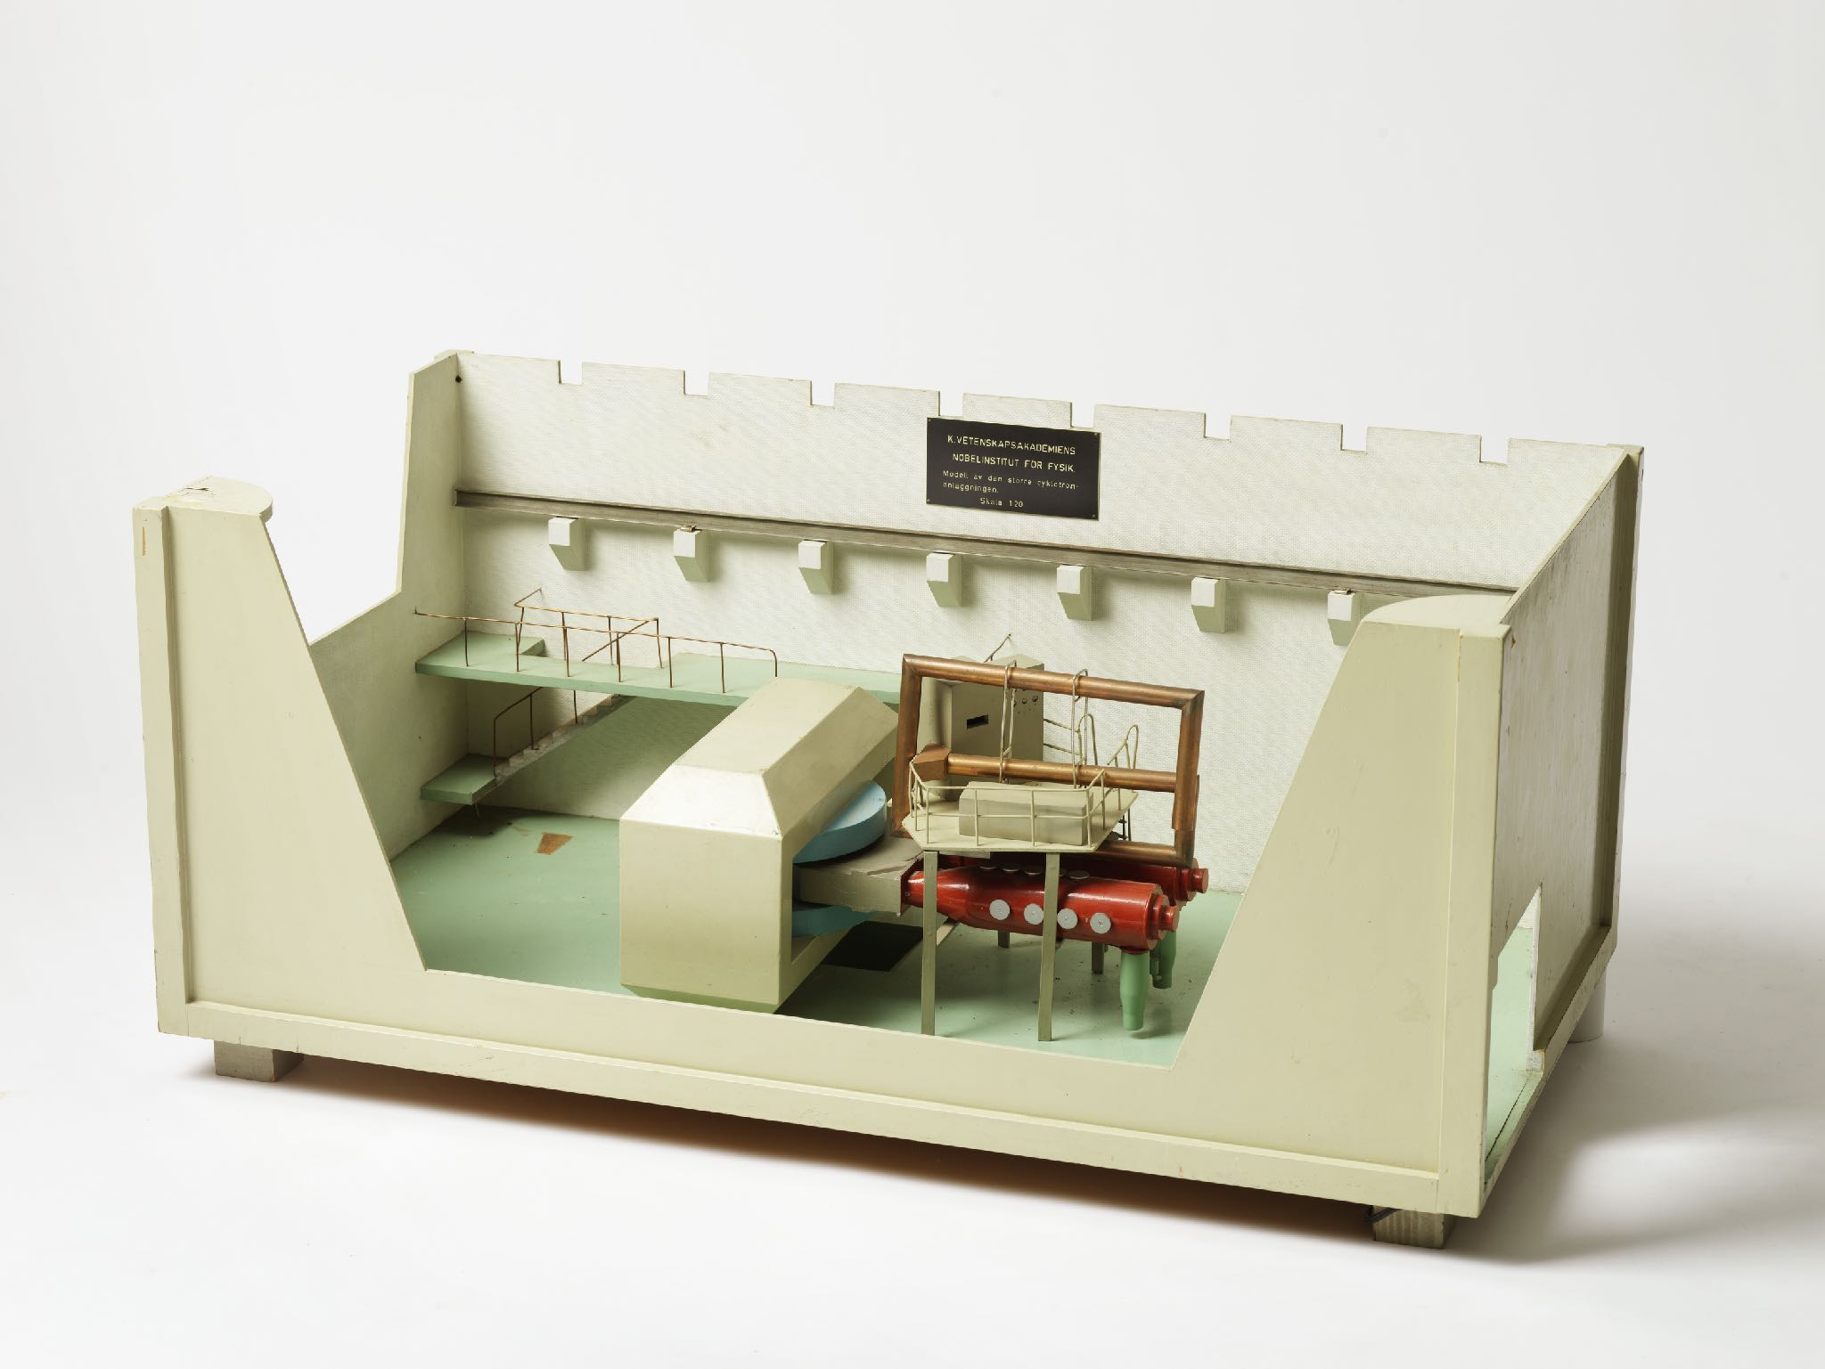
The summer of 1945 Meitner works with uranium experiments,
but the cyclotron had not operated as intended.

Slide 37



Atomic bombs over
Hiroshima 6 August and over Nagasaki 9 August 1945

Slide 38
Nominations for Lise Meitner
Special reports on LM

Slide 39



Erik Hulthén’s special report 9/6 1945

Slide 40


Niels Bohr till Oskar Klein 11/9-1945
”Of course, it is crucial whether a deal now can be reached to control the new destructive weapons, but since that would be beneficial to all, I have the best hopes for an agreement to be reached in due time and thereby truly secure world peace . [- - -] As you will see from the introductory section on the scientific background [to the atomic bomb], there is an general consensus in the [scientific] community of Lise Meitner and Robert Frisch's contribution to the development […] This might well be decisive help for the Nobel Committee's deliberations. It would not only be a well deserved encouragement, but possibly also of significance for the whole case’s international side, if Meitner and Frisch could be considered for a prize awarded at the same time as [one for] Hahn.”

Slide 41





NK i fysik Kapprock 10/9 1945
”It have to be right” – Wait and see!

Slide 42







KVA’s Nobel minutes 15/11 1945
General report chemistry 20/9 1945

Slide 43
Oskar Klein till Niels Bohr 17/11-1945
”At the poll, just over half of the votes were cast for Hahn and slightly less than half for postponement. As far as I could understand, this surprising result was due to a (perhaps not entirely unjustified) fear of some opportunistic, political reasons - the desire to keep up with America and I got a strong impression that there is widespread sympathy for another prize to be given to Lise Meitner and Frisch or maybe to LM alone. However, I do not know Siegbahn's position […]. [The] prize-awarding to all [of them] at the same time would have been much more suited for creating harmony both for everyone involved and in all the circles now disputing who made the greatest effort.”

Slide 44

Consolation Prize?
Cf. Nobel decision made 15 November!

Slide 45




Slide 46
Thank you!

