Slide 1
Characterization of thermoluminescence properties of eye glasses for applications in retrospective / accidental dosimetry
M. Karampiperi, N.A. Kazakis
11th Conference of the Balkan Physical Union August 2022 Belgrade

Slide 2
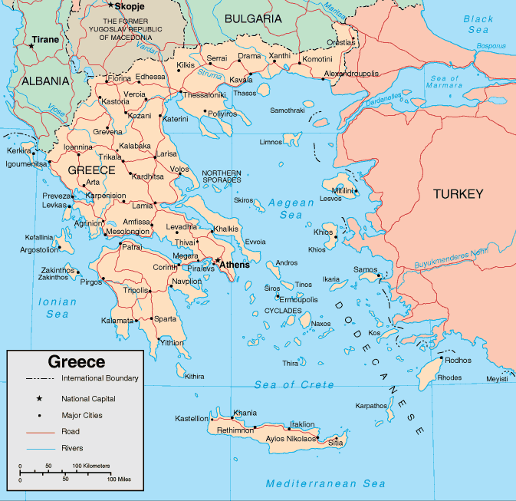
Contents
Aim
Luminescence
Materials & Methods
Results
Glow curve
Sensitization
Dose response
Dose recovery
Fading
Chemical treatment
Conclusions & Future

Slide 3
Aim of the study
Importance of retrospective/accidental dosimetry.
Thermoluminescence (TL) is a broadly used method for radiation dosimetry.
Eye glasses exist in many households worldwide.
They have promising luminescence characteristics.

Slide 4
Luminescence
Conduction band
Impurities introduce energy states in the energy gap easing the transition of the electrons from the valence to the conduction band.
Conduction band
Energy gap
E_{g}>5 eV
E_{g}~2 eV
Valence band
Valence band
Insulator
Semiconductor
Conductor

Slide 5
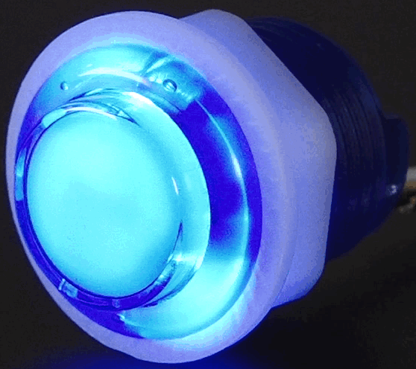
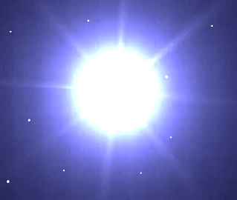
Luminescence
Steps of Luminescence process
I. Excitation
II. Trapping
III. Stimulation
IV. Recombination & light emission
Conduction band
E_{c}
E
Trap
Heat → Thermoluminescence (TL)
Optical light → Optically stimulated luminescence (OSL)
Infra-red light → Infra-red stimulated luminescence (IRSL)
Ionizing Radiation
Recombination centers
E_{v}
Valence band
e⁻
holes
(I) Excitation
(II) Storage
(III) Stimulation
(IV) Recombination

Slide 6
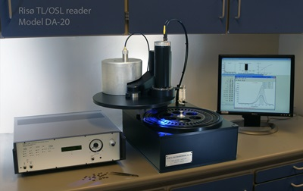
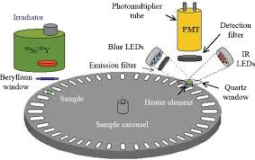
Materials & Methods
All TL measurements were conducted with a Riso TL/OSL reader (model TL/OSL-DA-15), equipped with:
A 90Sr/90Y beta particle source delivering a nominal dose rate of about 3.0 Gy/min
A 9235QA photomultiplier tube for the light detection, with a filter combination of a Corning 7–59 (320–440 nm) and a heat absorbing Pilkington HA-3.
Measurement conditions
Heating rate of 2 °C/s
Maximum temperature of 450°C
Nitrogen environment for TL measurements

Slide 7
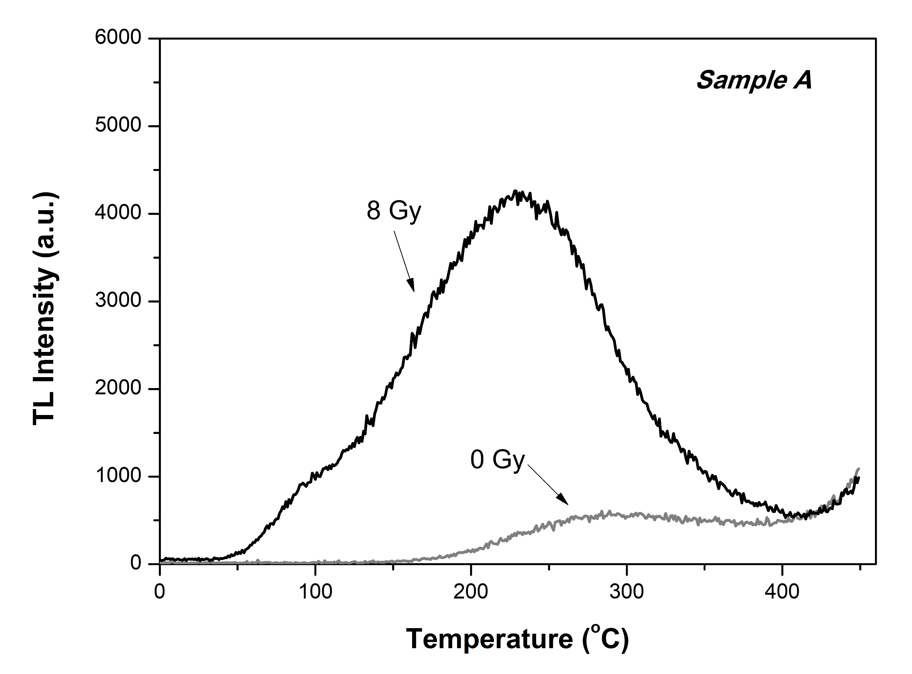
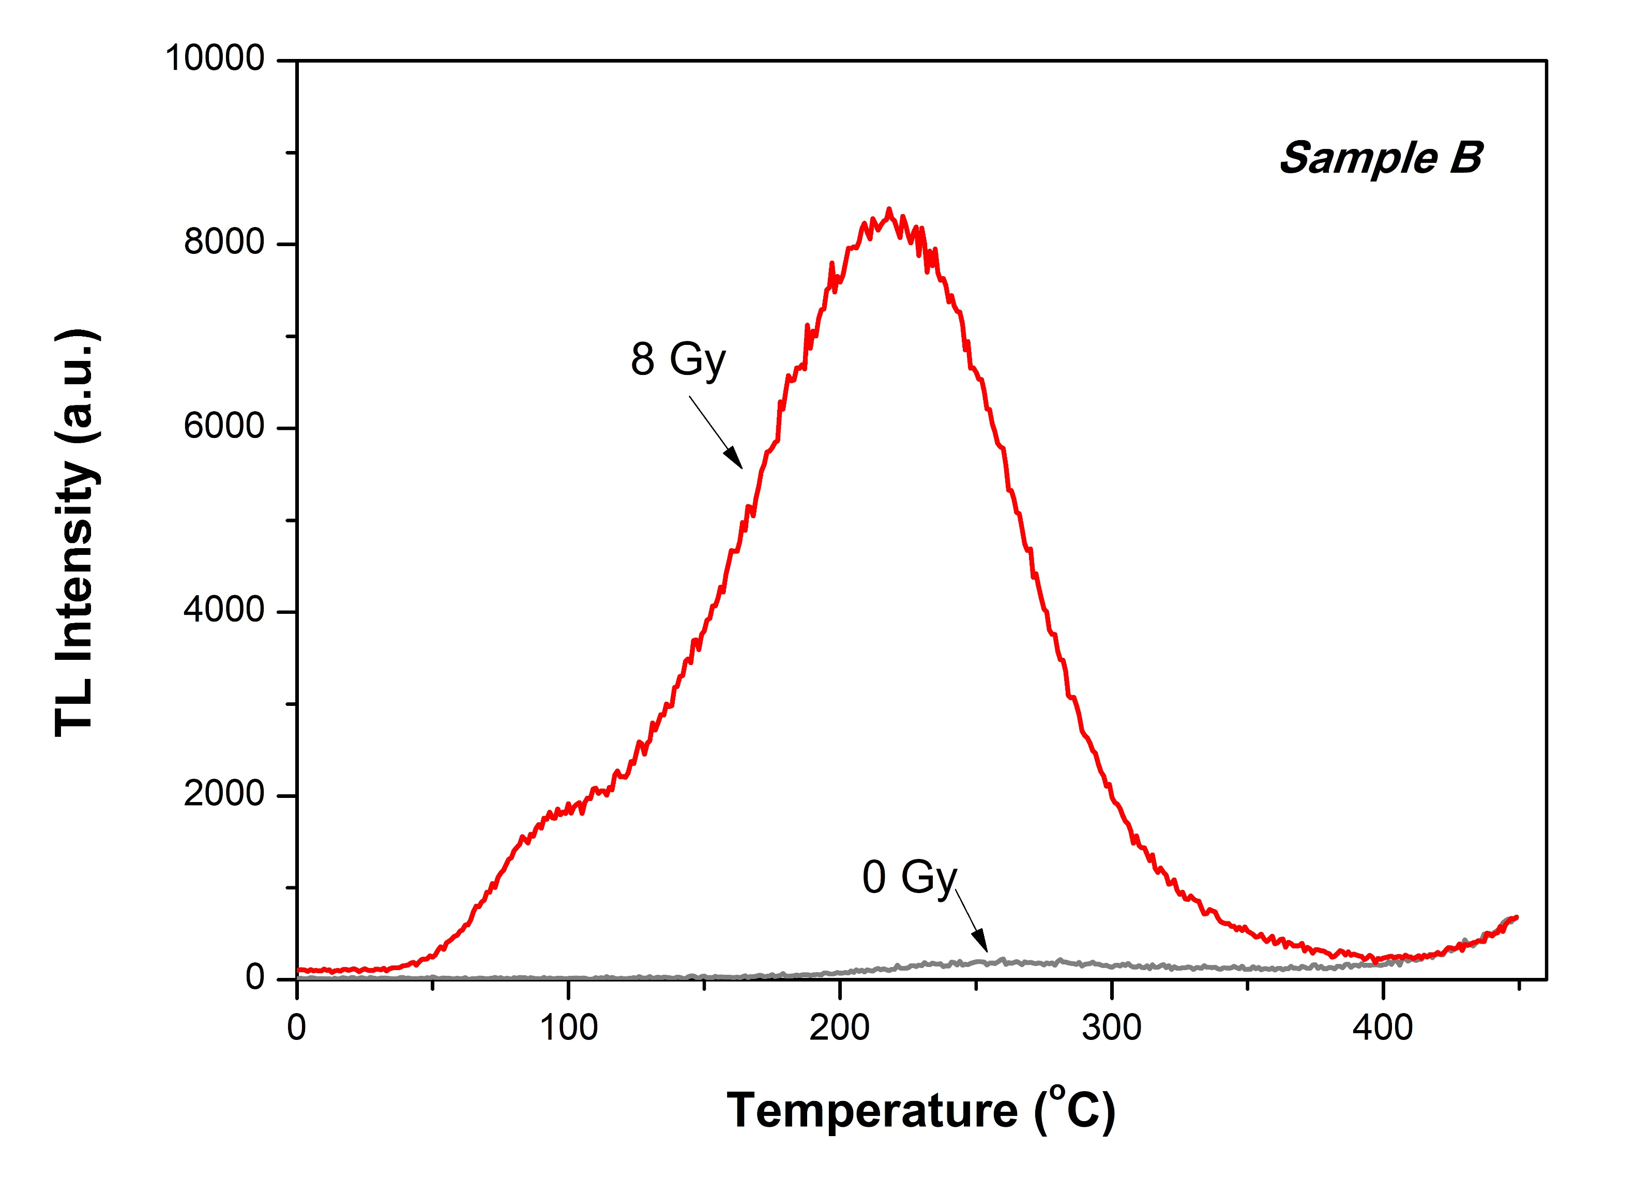
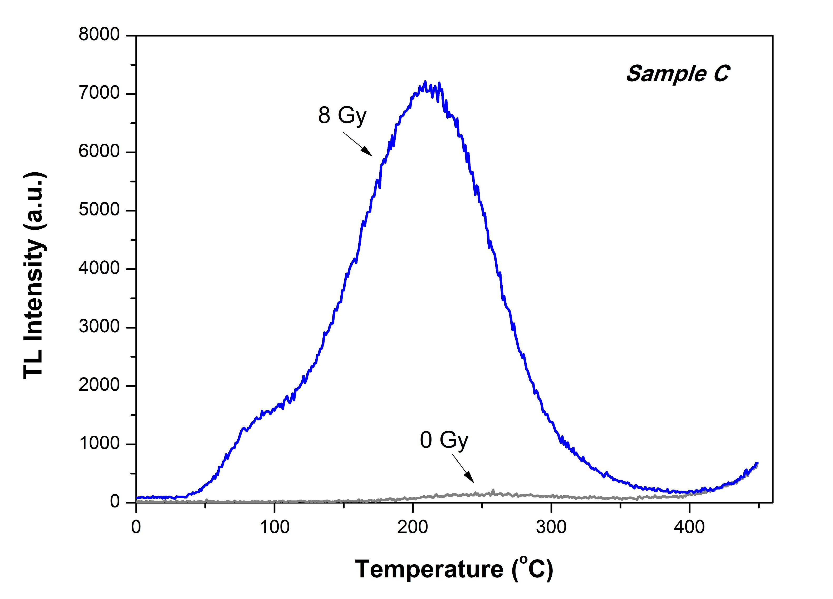
Glow curves
Temperature range under study : 220-350 $℃$
More temperature ranges were investigated, 100-350 $℃$ and 150-350 $℃$
Similar results for all of them, with exception the fading study
Relatively low residual signal

Slide 8
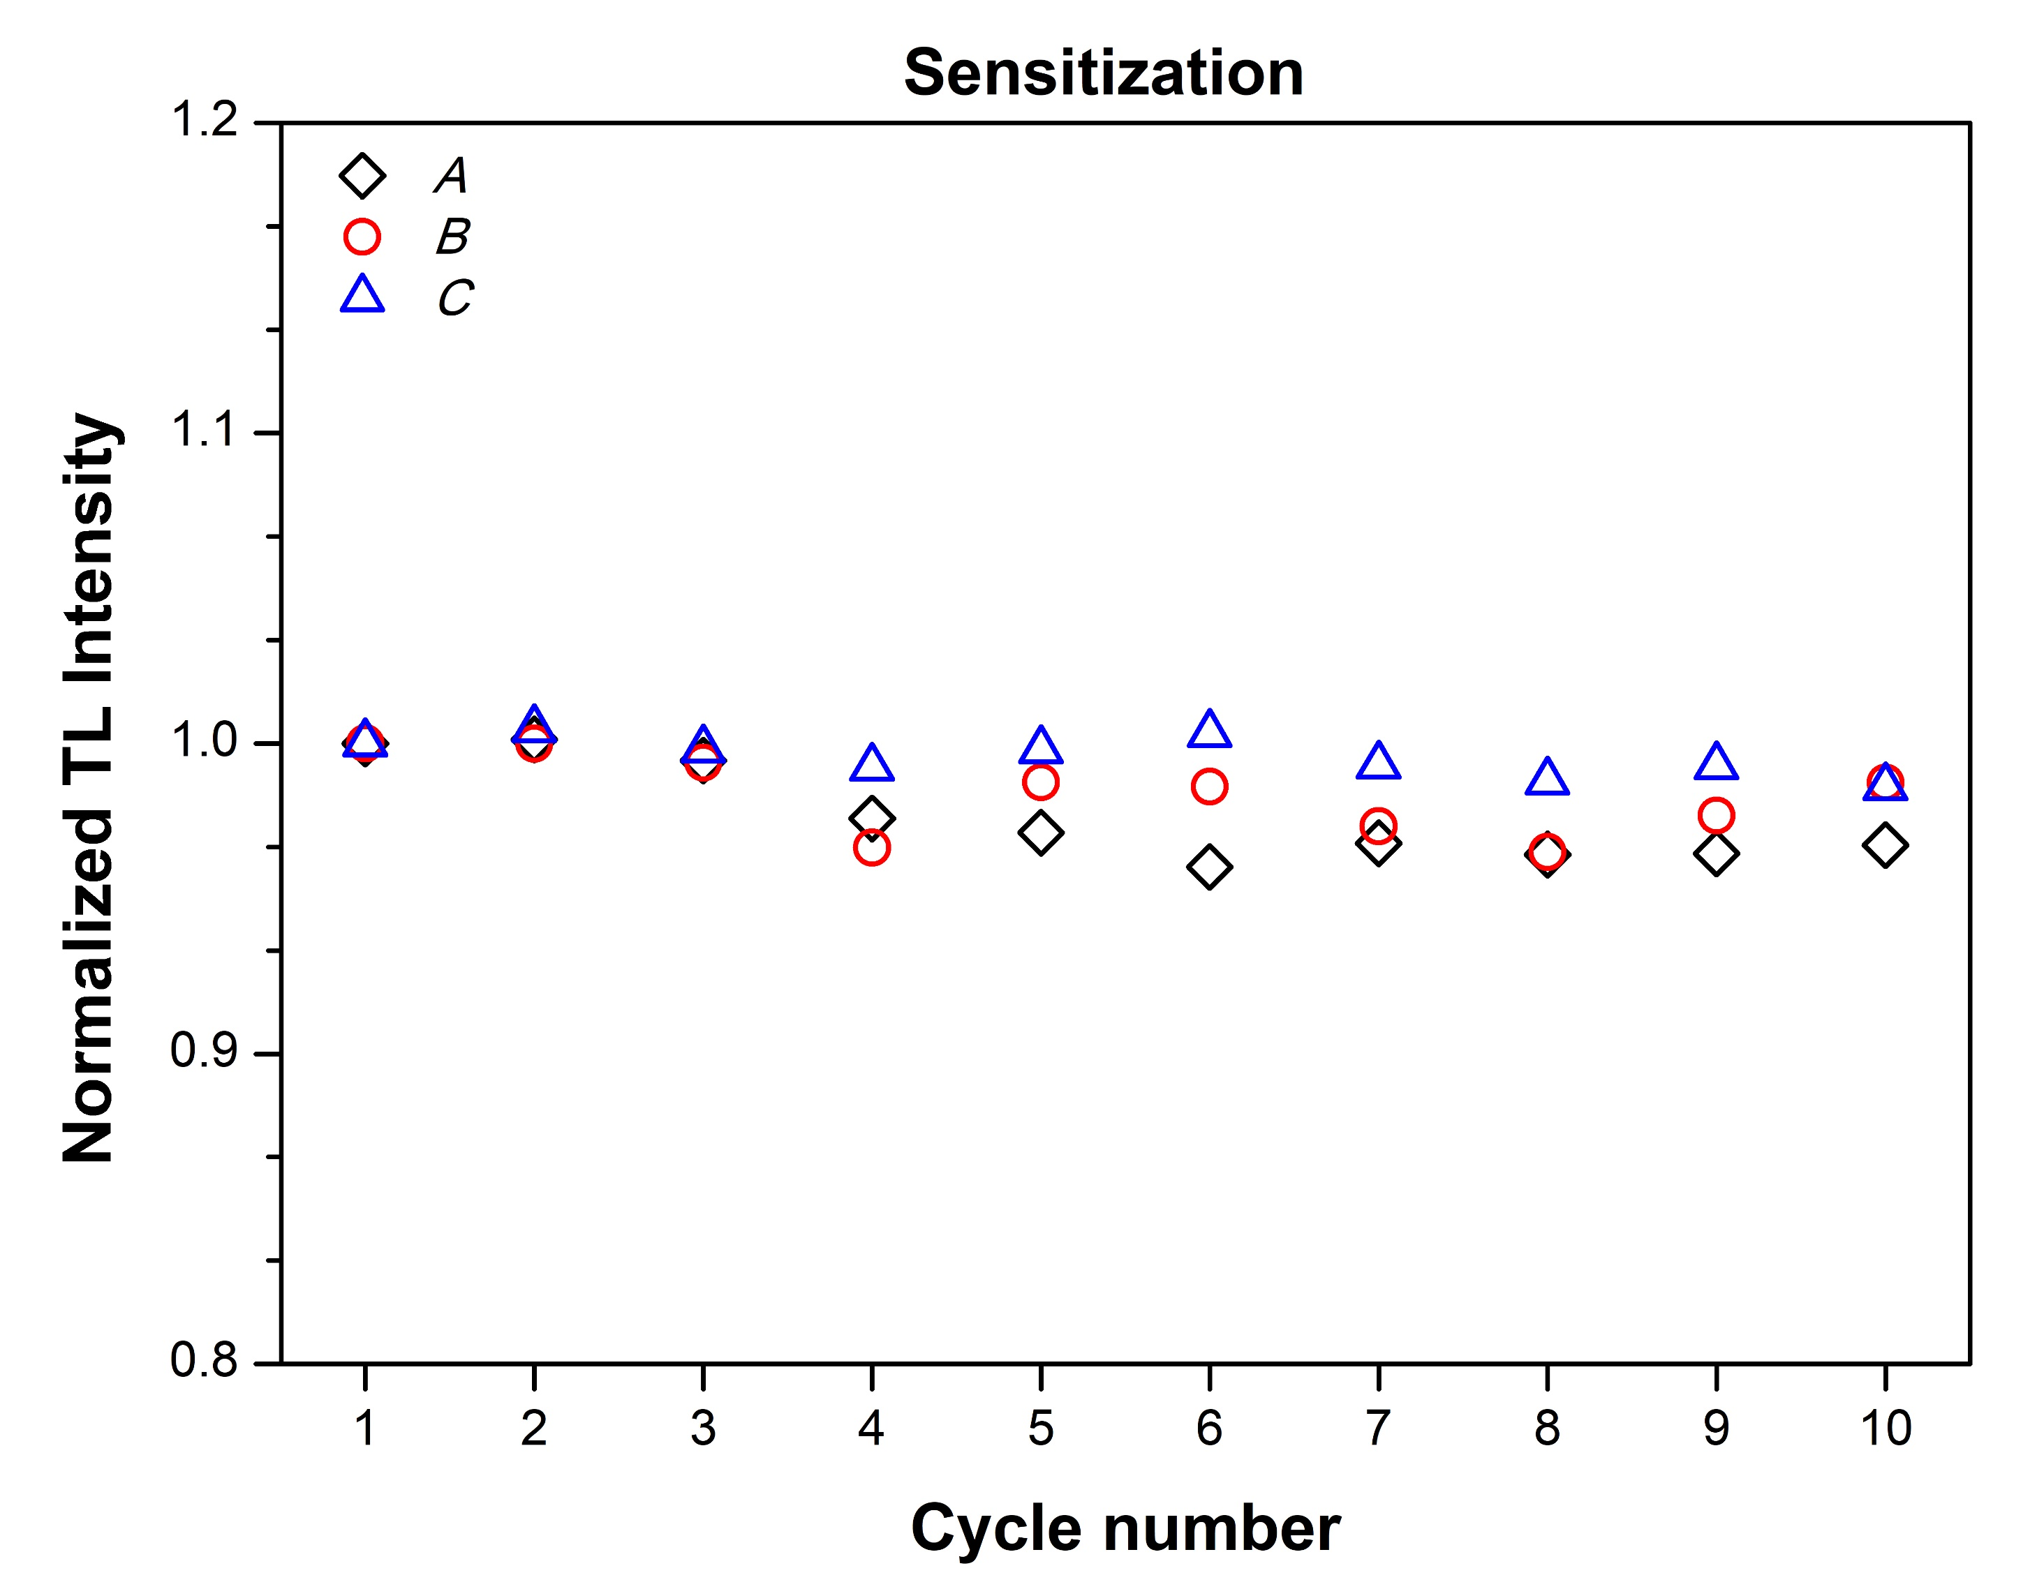
Sensitization
Table I. Protocol for sensitization study.
Step 1: | TL (residual)
Step 2: | Dose 1Gy
Step 3: | TL
Step 4: | Repeat steps 2-3 for 9 more times
Sensitization for the three samples, after 10 repetition cycles
A : $\sim 3\%$
B : $\sim 2\%$
C : $\sim 1\%$

Slide 9
Dose response
Table II. Protocol for dose response without and with preheat.
Step 1: | TL
Step 2: | Dose Di
Step 3: (*) | Preheat at 110 $℃$ for 1 min
Step 4: (*) | Pause for 1 min (allow to cool down)
Step 5: | TL
Step 6: | Test dose, TD = 1 Gy
Step 7: (*) | Preheat at 110 $℃$ for 1 min
Step 8: (*) | Pause for 1 min (allow to cool down)
Step 9: | TL
Step 10: | Repeat steps 2-9 for next dose (100 mGy, 500 mGy, 1 Gy, 2 Gy, 4 Gy, 8 Gy, 12 Gy, 16 Gy)
Ideal dosimetric characteristics:
Linear behaviour in the whole dose- range of interest
Similar trend for all the different lenses
The steps with (*) are applied only when preheat is involved.

Slide 10
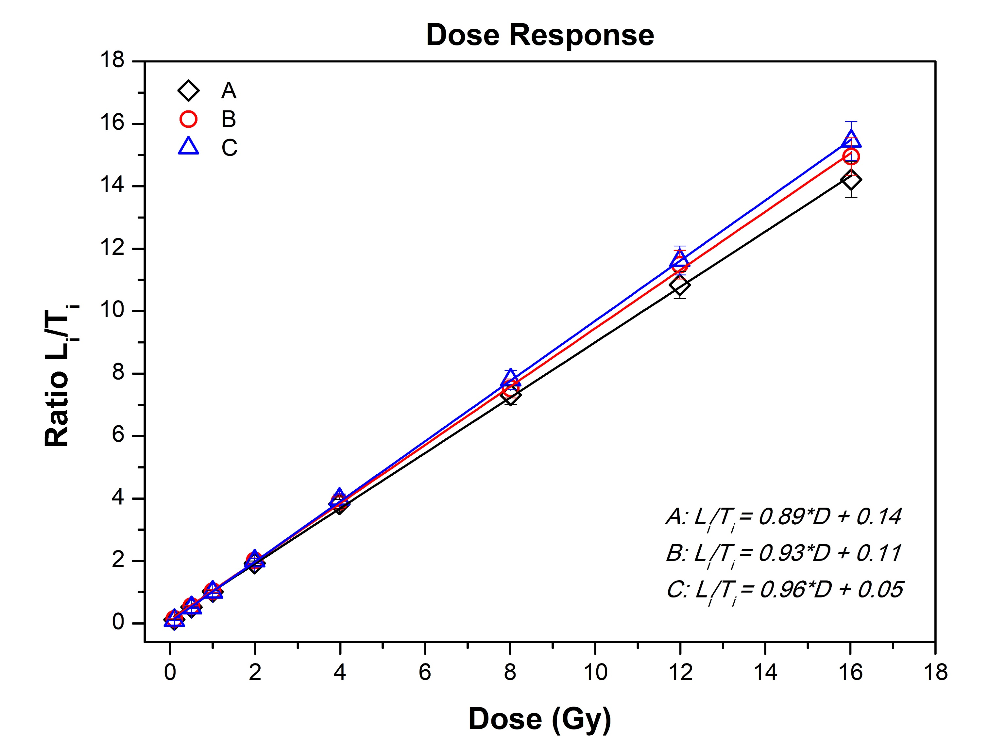
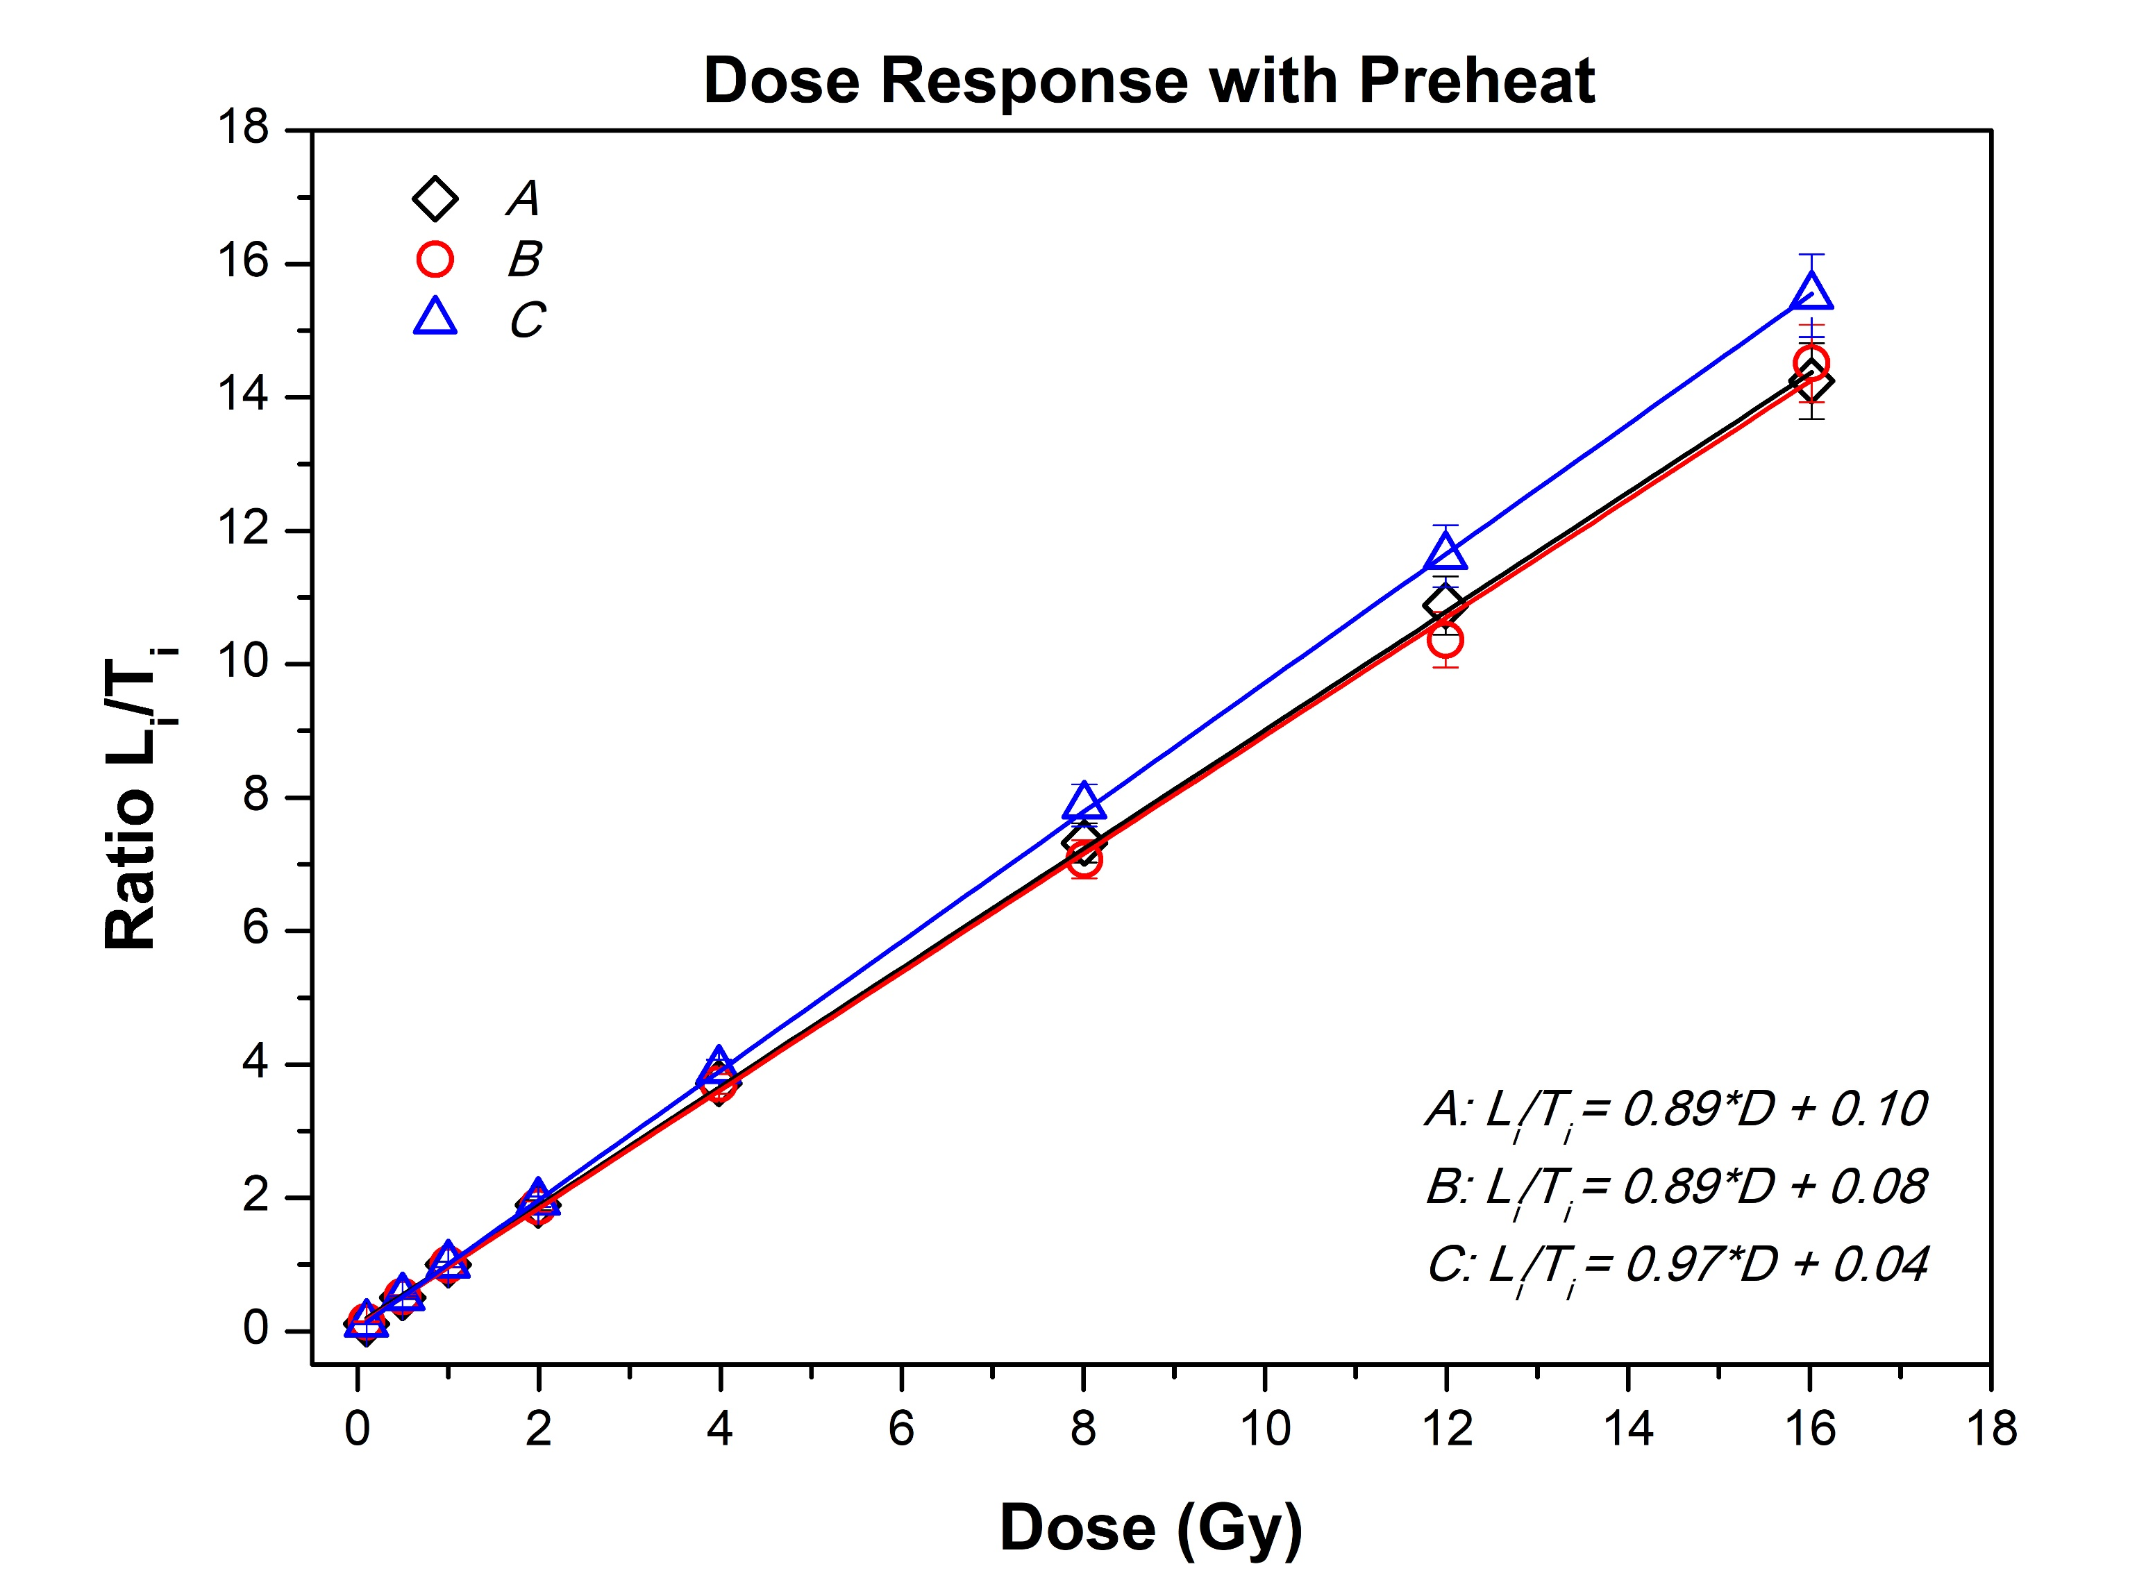
Dose response
Negligible change in the linearity of the samples and practically same fitting equations.

Slide 11
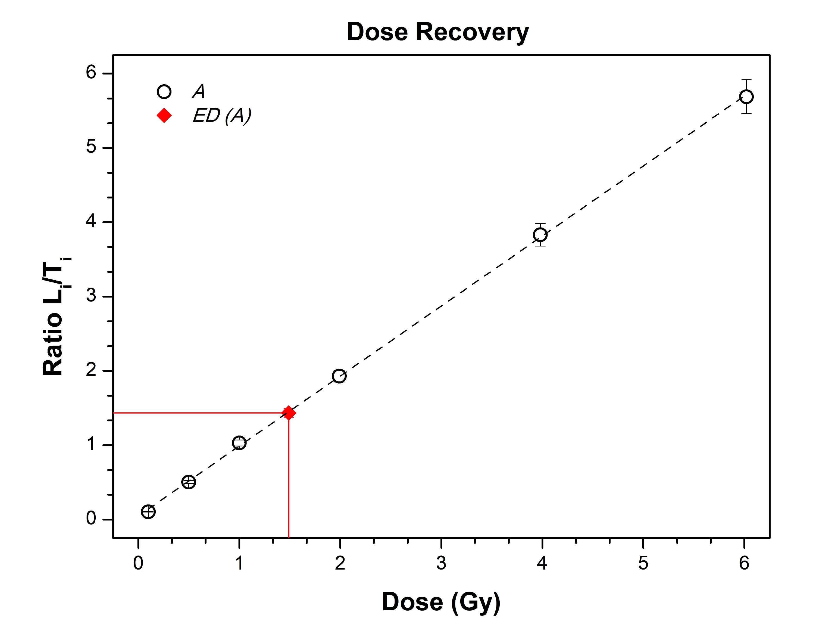
Dose recovery
Table III. Results of the recovered dose (ED) and comparison with the nominal dose (ND).
 |  | Free intercept |  | Intercept (0,0)
Sample | ND(Gy) | ED (Gy) | δ % | ED (Gy) | δ %
A | 1.49 | 1.48 ± 0.01 | $−$1% | 1.52 ± 0.03 | $+$2%
B | 1.49 | 1.52 ± 0.03 | $+$2% | 1.54 ± 0.04 | $+$4%
C | 1.49 | 1.44 ± 0.01 | $−3$% | 1.45 ± 0.01 | $−3$%
δ% $>0 →$Over-estimation
δ% $<0 →$Under-estimation
δ% = $\frac{ED−ND}{ND}\%$

Slide 12
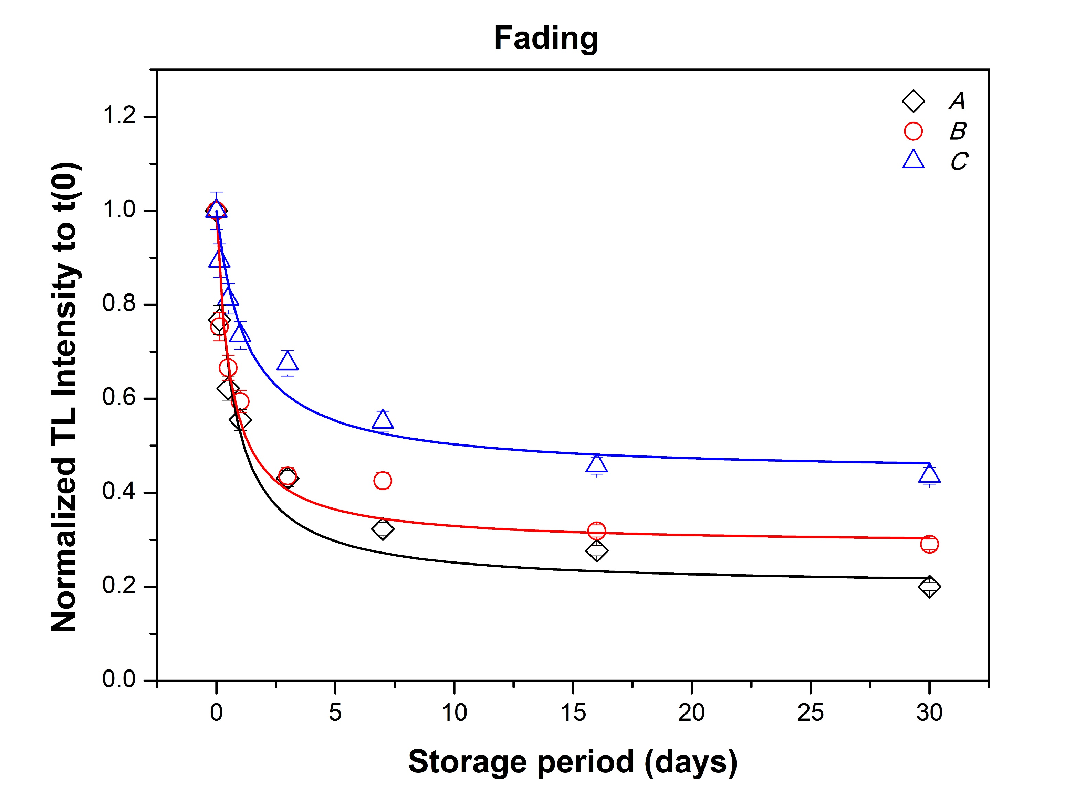
Fading study
$$I_{f}=I_{∞}+\frac{I_{0}^{′}}{I_{0}^{′}kt+1}$$
where $I_{∞}$, $I_{∞}+$ $I_{0}^{′}$ and $I_{f}$ is the normalized Li/Ti ratio at infinity, zero and any time, $t$ is the storage time and $k$ the decay constant.
Table IV. Results of the fading study.
Sample | $$I_{∞}$$ | $$I_{0}^{′}$$ | $k$ (days⁻¹)
A | 0.20 | 0.80 | 1.81 ± 0.34
B | 0.29 | 0.71 | 2.40 ± 0.50
C | 0.44 | 0.54 | 1.40 ± 0.24
20 %, 29% and 44% of the initial signal remains after 1 month storage time, for the samples A, B and C, respectively.

Slide 13
Chemical treatment
Background signal is often present on products made of glass (e.g. mobile displays).
The origin of the signal is not clear but it can be due to manufacturing and polishing of the glass.
Many studies focus on how to reduce the background signal, without affecting the TL signal, with chemical or physical methods.
In the present study, two chemical substances were tested, HF and HNO₃.
The samples were split into three groups.
The protocol for every group was the same.
One group was the control, one group was placed into HF for 4 min and one group was placed into HNO₃ for 10 min.
The ratio of the intensity between 1 Gy and 0 Gy is compared between the two groups.

Slide 14
Chemical treatment
Table V. Results of the chemical treatment for the reduction of the background signal.
 | I(1Gy)/I(0Gy)
Sample | Control | HF | HNO₃
A | 0.75 | 0.92 | 0.60
B | 0.19 | 0.21 | 0.17
C | 3.74 | 3.62 | 3.25
HNO₃ leads decreased ratio!
HF increases the ratio → indication that the background signal is surface originated.
For the temperature regions 100-350 $℃$ and 150-350 $℃$, the decrease of the background signal is more prominent.

Slide 15
Conclusions & Future Work
Excellent luminescence properties:
Negligible sensitization
Linear dose response
Accurate estimation of “unknown” dose
Sufficient remaining signal after 1 month storage
Similar behaviour for all the types of eye-glasses that were studied
HF treatment seems to lead to partial depletion of the background signal
Further investigation of the depletion of the residual signal with chemical and/or physical means
Analysis of the complex and broad Glow Curves to individual components based on mathematical models
Study extended to eye glasses made of polymers/plastic.

Slide 16
Thank you for your attention!

