Slide 1
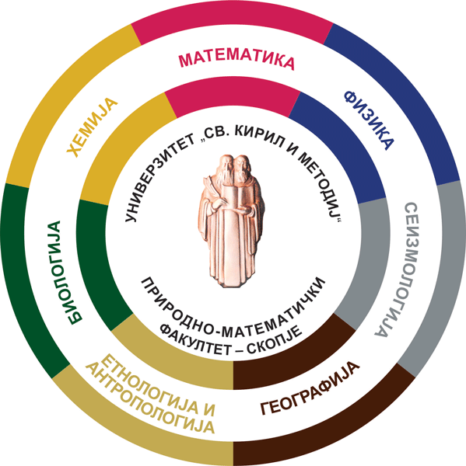
Lightcurve analysis on asteroids from NAO Rozhen observations in 2021
Elena Vchkova Bebekovska, Gordana Apostolovska, Andon Kostov , Zahary Donchev
Institute of Physics, Faculty of Science, Ss. Cyril and Methodius University, Arhimedova 3, 1000 Skopje, Republic of Macedonia
Institute of Astronomy and National Astronomical Observatory, Bulgarian Academy of Sciences, Tsarigradsko Chaussee Blvd. 72, BG-1784, Sofia, Bulgaria

Slide 2
NAO Rozhen
2 m Ritchey-Chretien-Coude (RCC) telescope
50/70 cm Schmidt telescope
60 cm Cassegrain telescope
The dome of the 2m telescope ( photo credit nao-rozhen.org)

Slide 3
Asteroids
Minor planets orbiting around Sun
Ligthcurve (LC)- the change of the asteroid’s brightness due to its rotation
The shape of the LC might be influenced by different factors such as: asteroid shape, albedo, aspect angle and etc.
Simulation of lightcurve (Weslay A., 2004)

Slide 4
Data proceeding
Identification of the object
Dark field and Flat field corrections
Photometry

Slide 5
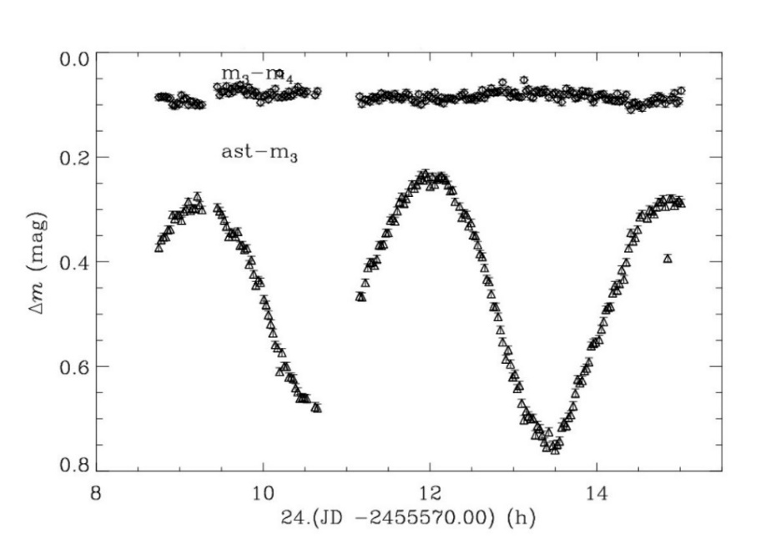
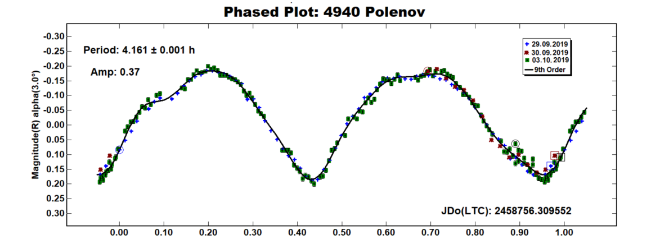
Data proceeding
Constructing the instrumental lightcurve
Constructing differential lightcurve
Constructing composite lightcurve and determination of the rotational period
Calculation of the axis ratio

Slide 6
Asteroid 418 Alemannia
This asteroid in 2021 was observed in three different months.
Four different differential lightcurves for each month.
Calculations of the axis ratio
$$R={10}^{(\frac{A}{2.5})}$$
Phase angle corrections of the amplitude (Zappala V. et al., 1990)
$$A_{0}=\frac{A}{1+m∙α}$$
0,013 for M type
0,015 for C type
0,03 for S type

Slide 7
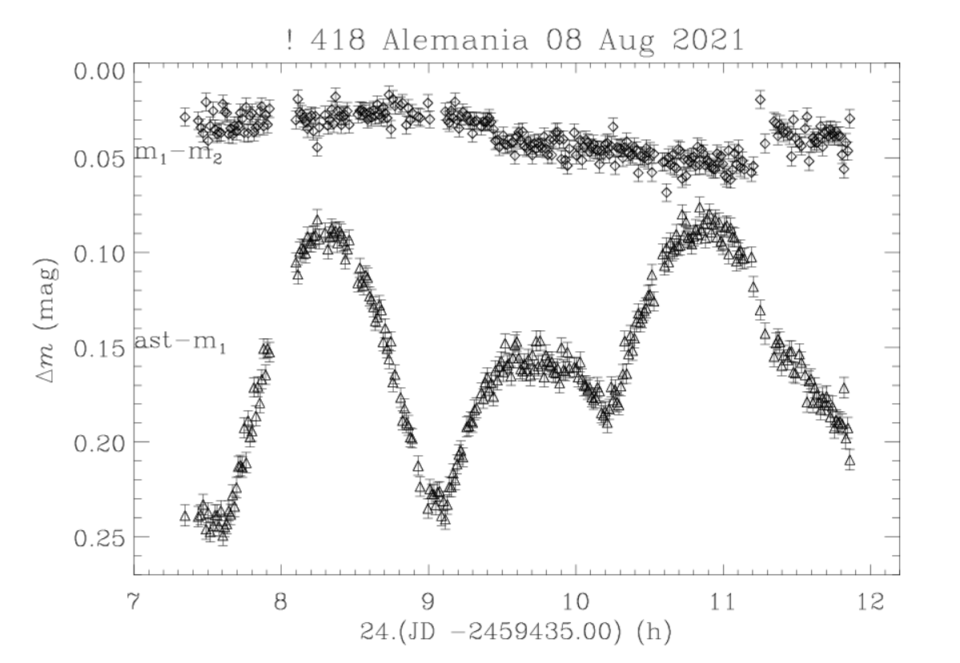
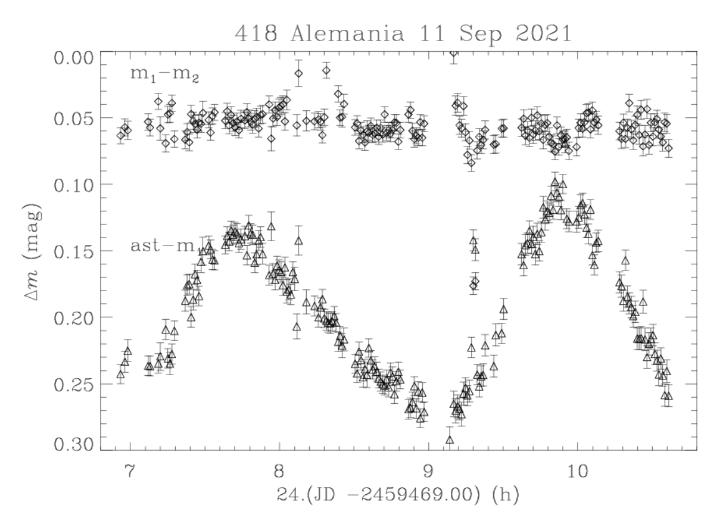
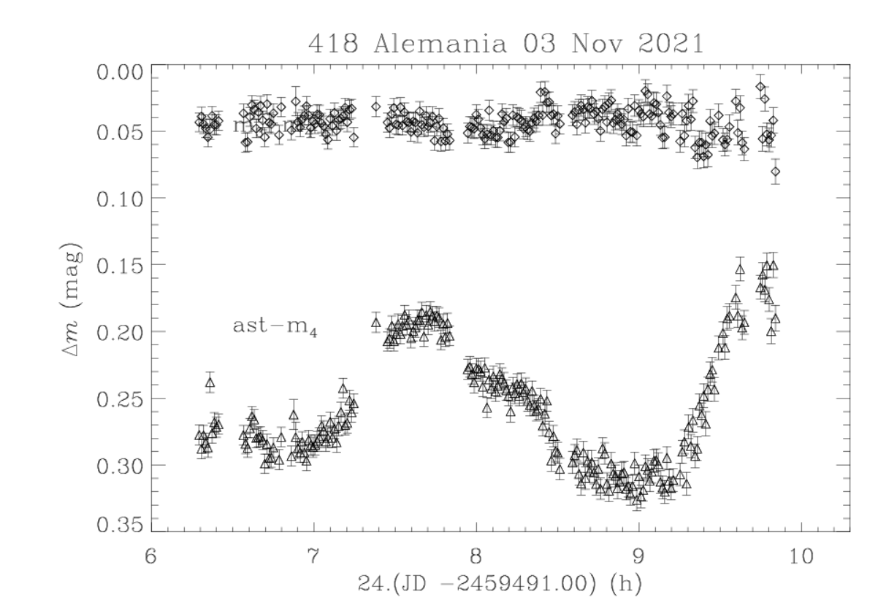

Slide 8
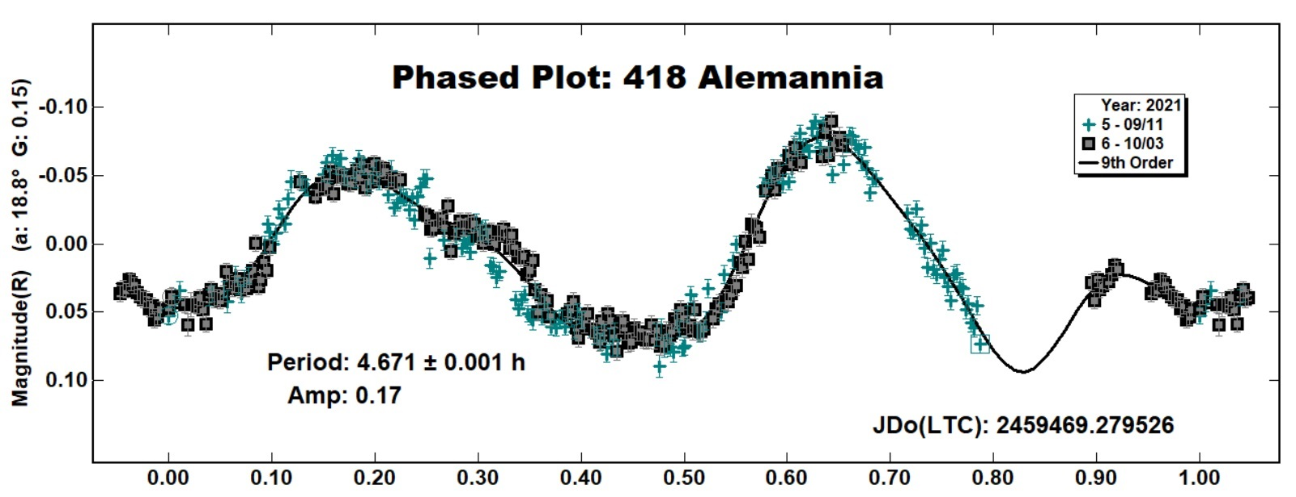
Asteroid 418 Alemannia
Composite lightcurve for asteroid 418 Alemannia from observations in September and October 2021
Results:
Rotation period: 4.671±0.001 h
Axis ratio: from 1.10 to 1.27
Shape: Possibility of irregular shape

Slide 9
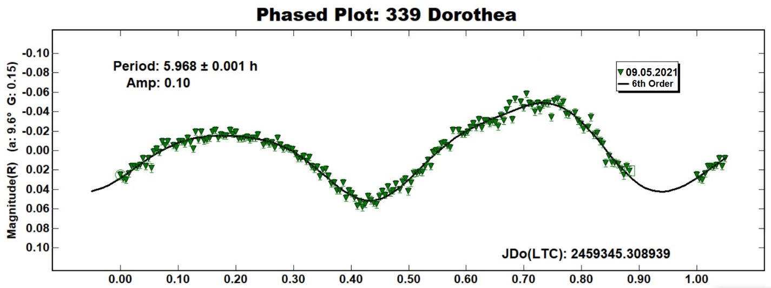
Asteroid 339 Dorothea
Composite lightcurve for asteroid 339 Dorothea from observations in May 2021
Results:
Rotation period: 5.968 ± 0.001 h
Axis ratio: $a/b=1,1$0
Shape: Possibility of close to spherical shape

Slide 10
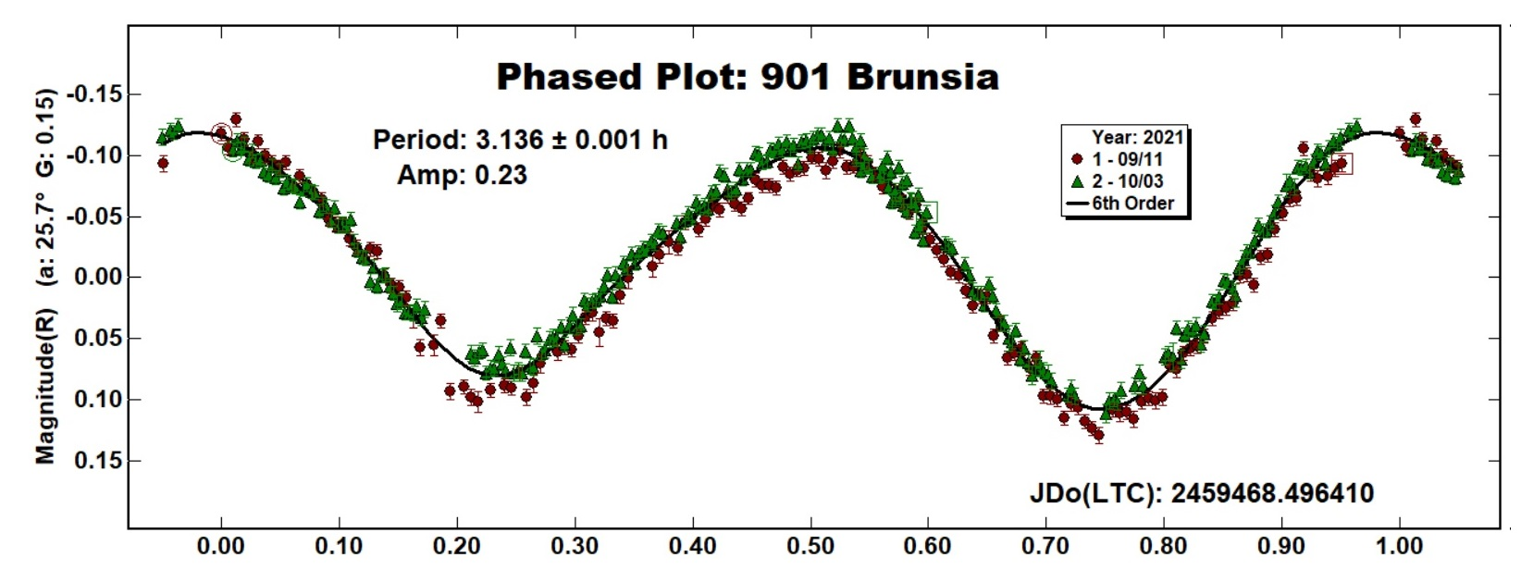
Asteroid 901 Brunsia
Composite lightcurve for asteroid 901 Brunsia form observations in September and October 2021
Results:
Rotation period: 3.136±0.001h
Axis ratio: 1.2
Shape: Possibility for regular ellipsoid shape with minor irregularities (the depth of the minima)

Slide 11
Asteroid 2650 Elinor
Composite lightcurve for asteroid 2650 Elinor form observations in August 2021
Results:
Rotation period: 2.762 ± 0.001 h
Axis ratio: 1.15
Shape: Possibility for irregular shape

Slide 12
What’s next???

Slide 13
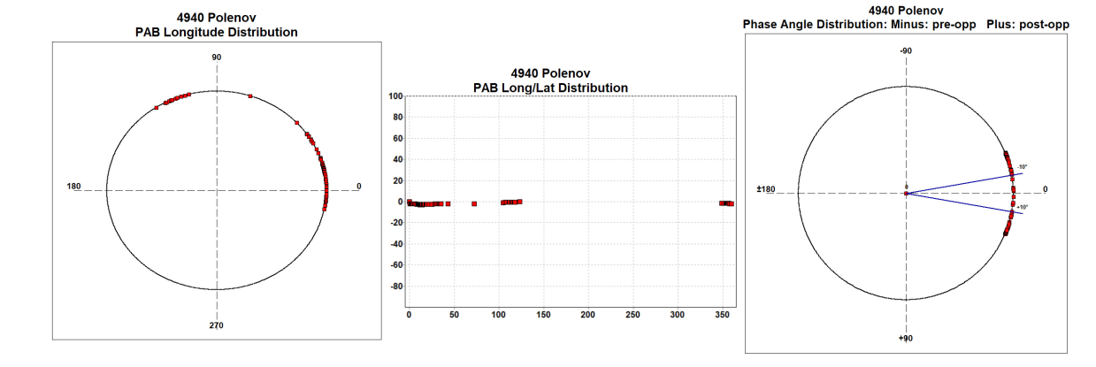
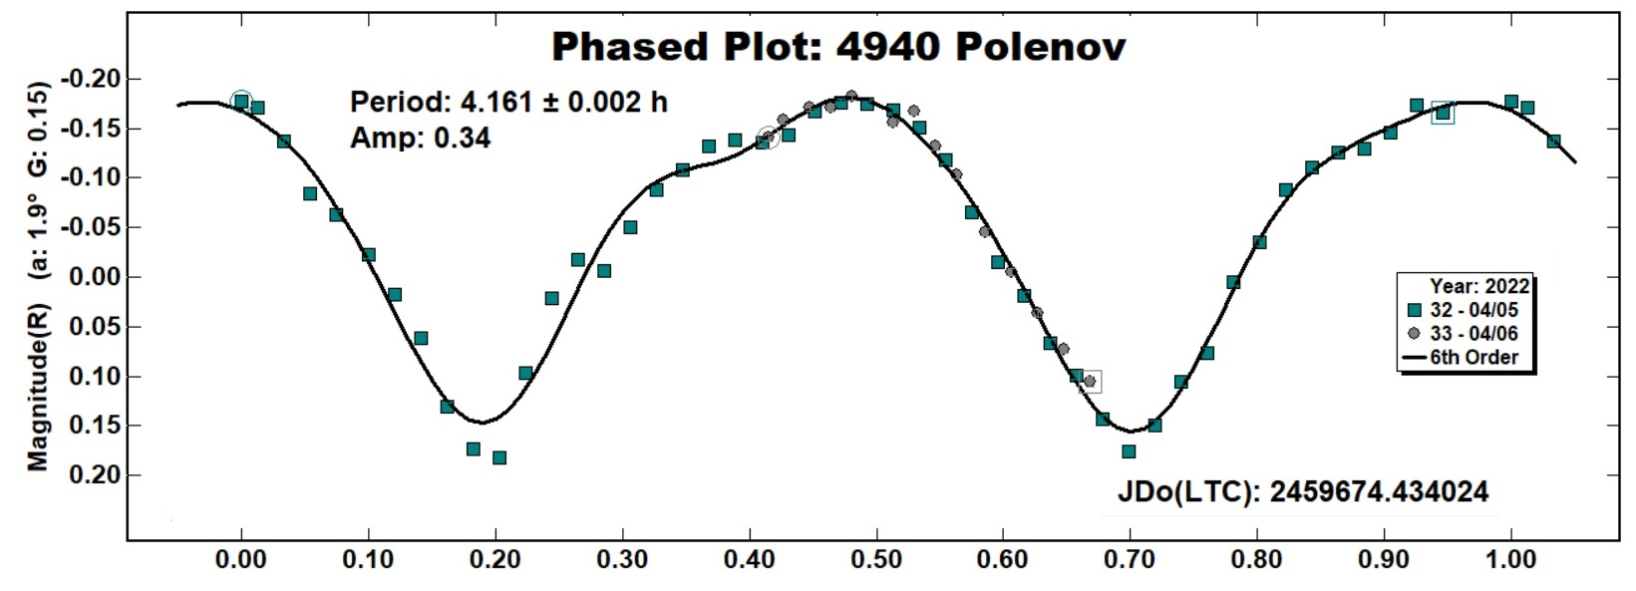
Shape of asteroids from long term studies
Asteroid 4940 Polenov
Observed at three different oppositions in 2014, 2019 and 2020
Observed at NAO Rozhen and AS Vidojevica
Sparse data

Slide 14
References:
Buie M.W., (1996). CCDPHOT - An IDL widget based CCD photometry reduction system,”. Astronomical Data Analysis Software and Systems V, ASP Conference Series, Vol. 101, 135.
Harris A. (1985). Asteroid Lightcurve Studies. Asteroids, Comets and Meteors, Proceeeding of the meeting, 35-43. Uppsala.
ITTVIS. (2022). IDL-Interactive Data Visualization Softwere Solution: https://www.ittvis.com/idl/
Warner B. et al., (2009). The asteroid lightcurve database. Icarus, Vol. 202, 134-146.
Warner, B. (2011, 01 19). The Minor Planet Observer. The Minor Planet Observer and Palmer Divide Observatory: http://www.minorplanetobserver.com/MPOSoftware/MPOCanopus.htm
Weslay A., (2004). Pearson Education.
Zappala V. et al., (1990). An analysis of the amplitude-phase relationship. Astronomy and astrophysics, Vol. 231, 548-560.

Slide 15
Grateful acknowledgments to: - Bulgarian Academy of Sciences, Institute of Astronomy and NAO Rozhen, for observing grant support - BPU 11 LOC and SOC

Slide 16
Questions???
Thank you for your attention

