Slide 1
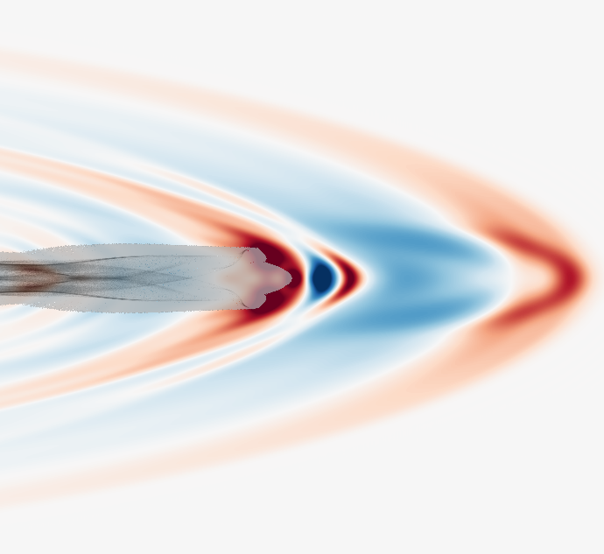
BPU 11 CONGRESS
28 August – 1 September 2022
Serbian Academy of Sciences and Arts
THz waves generated by laser-plasma interactions
Luc BERGÉ
CEA, DAM, DIF – 91297 Arpajon – France

Slide 2
OUTLINE
THz pulse generation from photocurrents
2. Ultraintense THz waves produced by strongly magnetized, relativistic plasmas

Slide 3


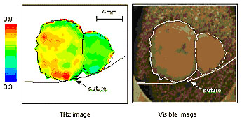
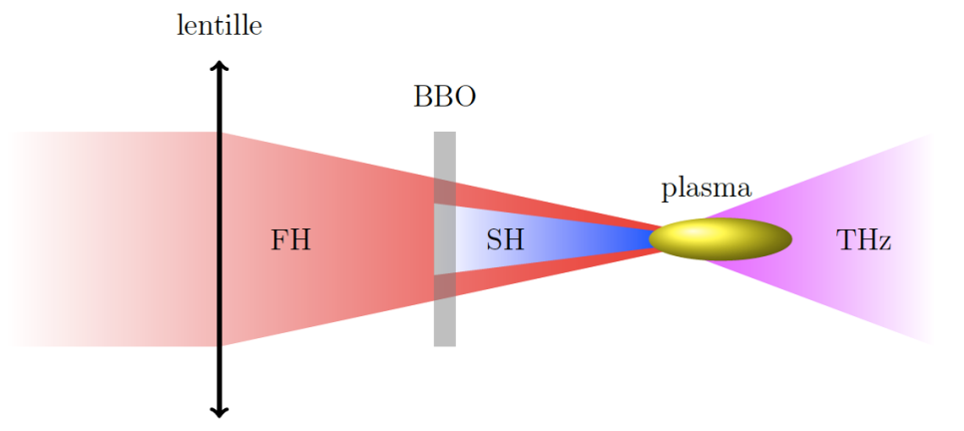
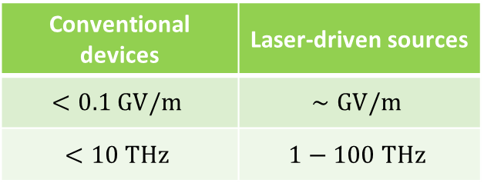
1. THz pulse generation from photocurrents
10 GHz
100 GHz
1 THz
10 THz
100 THz
1 PHz
microwaves
mm
waves
terahertz
waves
IR
visible
UV
30 mm
3 mm
300 μm
30 μm
3 μm
300 nm
D. J. Cook & R. M. Hochstrasser., Opt. Lett. 25, 1210 (2000)
K. Y. Kim et al., Nat. Photon. 2, 605 (2008)
Conventional devices | Laser-driven sources
$$<0.1 GV/m$$ | $$∼GV/m$$
$$<10 THz$$ | $$1−100 THz$$

Slide 4
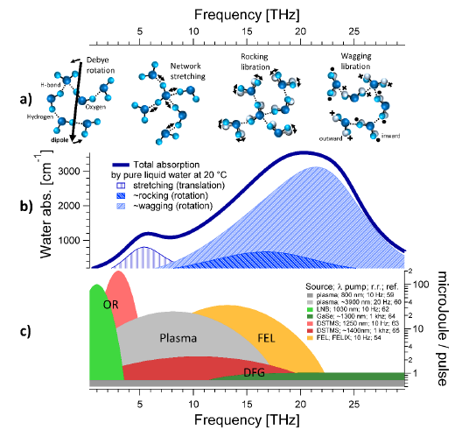
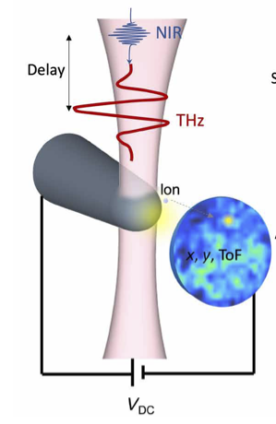
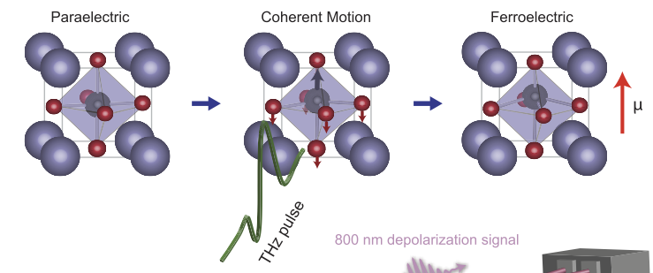

Need of intense THz pulses sources
F. Novelli et al., Materials 13, 1311 (2020)
$Probing/$Altering molecular dynamics of water
J. La Rue et al., Phys. Rev. Lett. 115, 036103 (2017)
X. Li et al., Science 364, 1079–1082 (2019)
A. Vella et al., Sci. Adv. 7, 7259 (2021)
THz-induced selective chemistry &
probe tomography
E. A. Nanni et al., Nat. Comm. 6, 8486 (2015)
Terahertz-driven linear electron acceleration

Slide 5
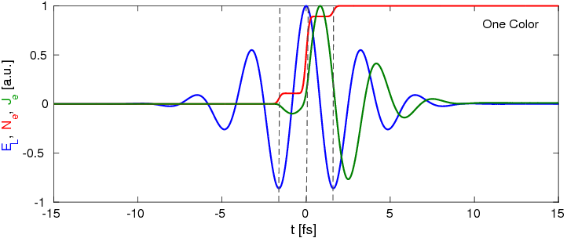
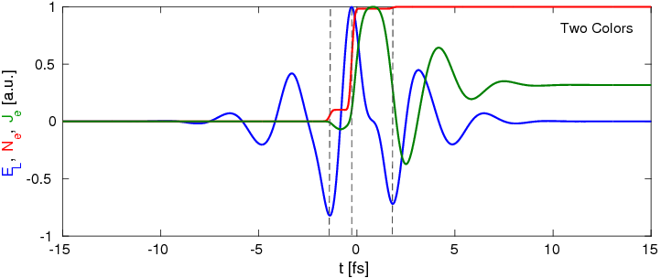
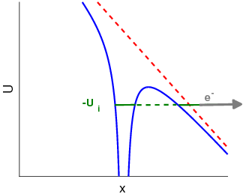
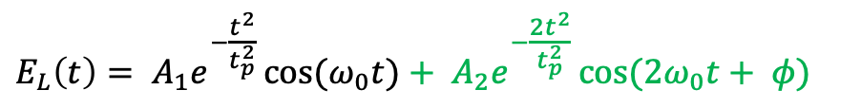
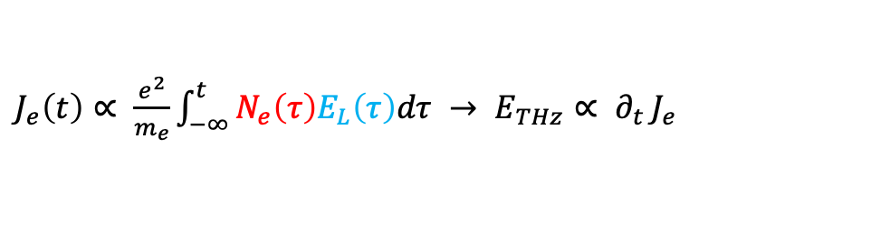
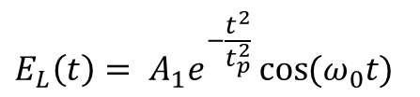
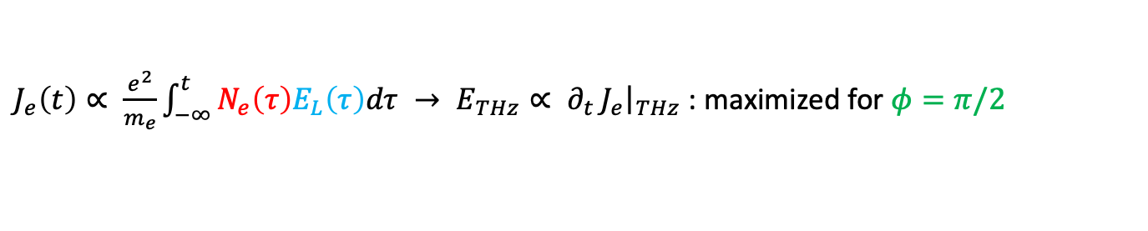
THz emission from laser-induced photocurrents
1 color
2 colors
$$E_{L}\left(t\right)= A_{1}e^{−\frac{t^{2}}{t_{p}^{2}}}\cos{(ω_{0}t)}$$
$$E_{L}\left(t\right)= A_{1}e^{−\frac{t^{2}}{t_{p}^{2}}}\cos{(ω_{0}t)}+ A_{2}e^{−\frac{2t^{2}}{t_{p}^{2}}}\cos{({2ω}_{0}t+ φ)}$$
$∂_{t}N_{e}=W(E_{L})(N_{a}−N_{e})$ with $W\left(t\right)$ the tunneling rate
The photoionized electrons carry a finite transverse current:
$J_{e}\left(t\right)∝ \frac{e^{2}}{m_{e}}\int_{−∞}^{t}{N_{e}\left(τ\right)E_{L}\left(τ\right)dτ → E_{THz}∝ ∂_{t}}J_{e}$
$J_{e}\left(t\right)∝ \frac{e^{2}}{m_{e}}\int_{−∞}^{t}{N_{e}\left(τ\right)E_{L}\left(τ\right)dτ → E_{THz}∝ ∂_{t}}J_{e}{\left.​\right|}_{THz}$ : maximized for $φ=π/2$
I. Babushkin et al., New J. Phys. 13, 123029 (2011)

Slide 6



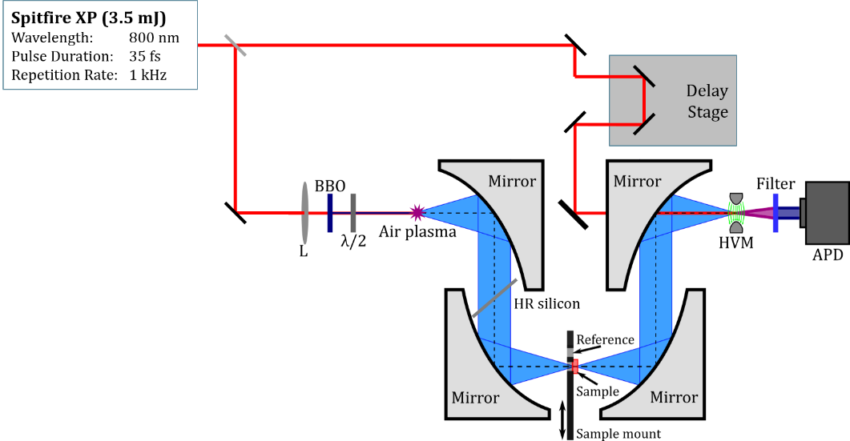

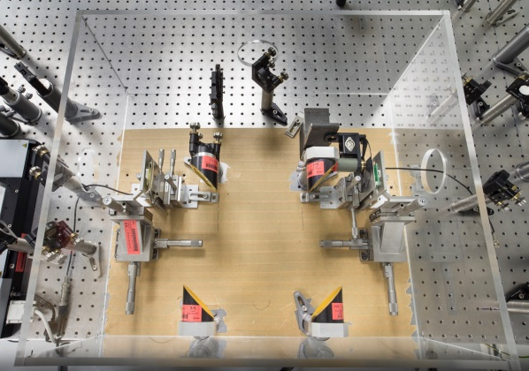
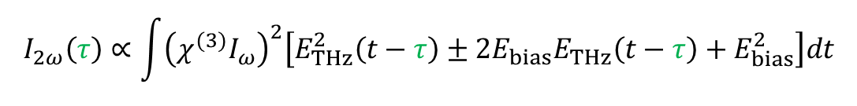
The ALTESSE Project
Air-Biased Coherent Detection (ABCD) Technique
L
N. Karpowicz et al., Appl. Phys. Lett. 92, 011131 (2008)
$$I_{2ω}\left(τ\right)∝\int{{\left(χ^{(3)}I_{ω}\right)}^{2}\left[E_{THz}^{2}\left(t−τ\right)±2E_{bias}E_{THz}\left(t−τ\right)+E_{bias}^{2}\right]dt}$$

Slide 7
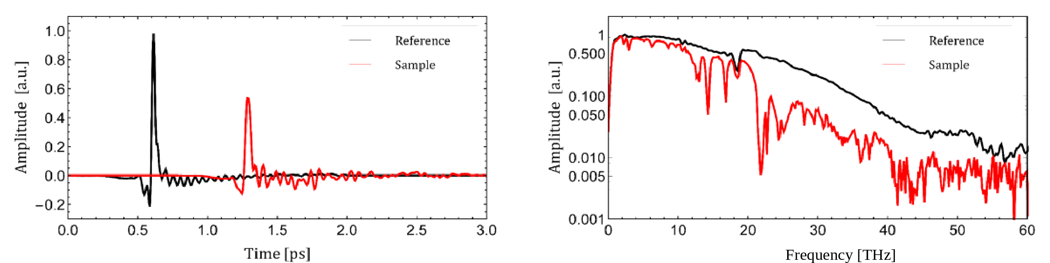
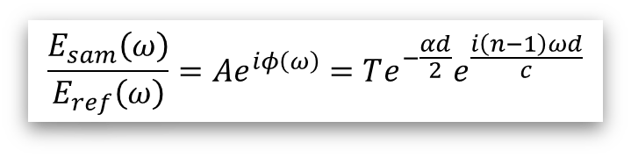
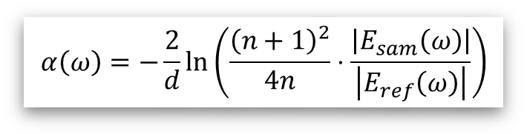
Coherent ABCD THz-time-domain spectroscopy
THz signature of thymine pellet (time & Fourier domains)
FFT
Emission up to 60 THz!
$$\frac{E_{sam}\left(ω\right)}{E_{ref}\left(ω\right)}=Ae^{iφ\left(ω\right)}=Te^{−\frac{αd}{2}}e^{\frac{i\left(n−1\right)ωd}{c}}$$
$$α\left(ω\right)=−\frac{2}{d}\ln\left(\frac{{\left(n+1\right)}^{2}}{4n}⋅\frac{\left|E_{sam}\left(ω\right)\right|}{\left|E_{ref}\left(ω\right)\right|}\right)$$

Slide 8
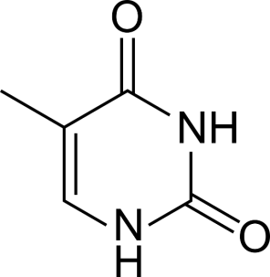
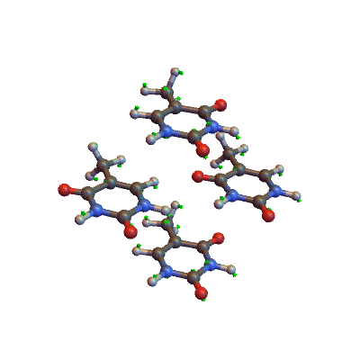
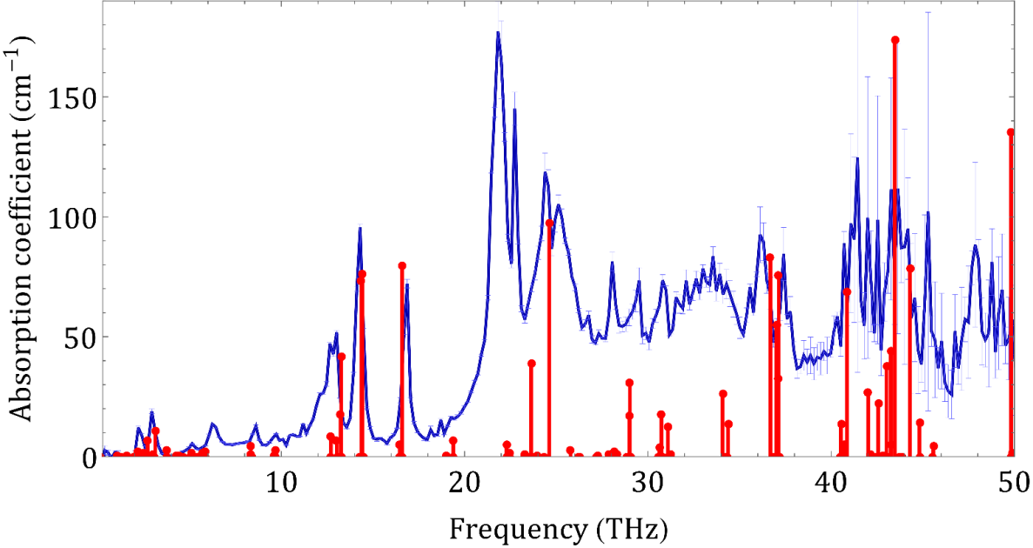
Thymine phonon spectra interpreted using density functional theory (DFT) simulations
CASTEP DFT simulations
3.1 THz

Slide 9
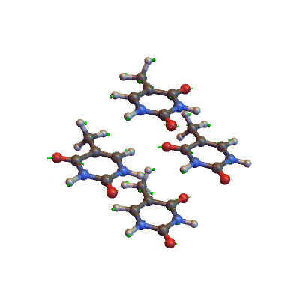
Thymine phonon spectra interpreted using density functional theory (DFT) simulations
CASTEP DFT simulations
16.6 THz
LB et al., Europhys. Lett. 126, 24001 (2019)

Slide 10
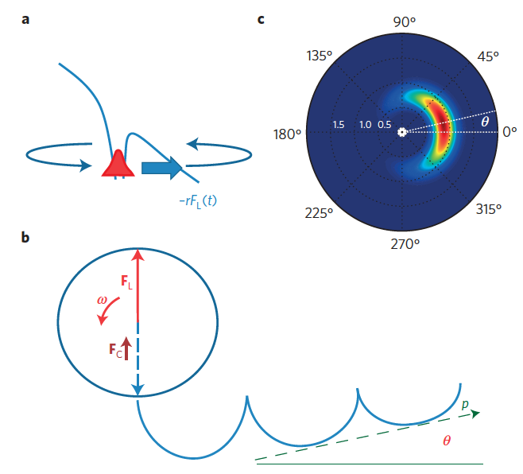
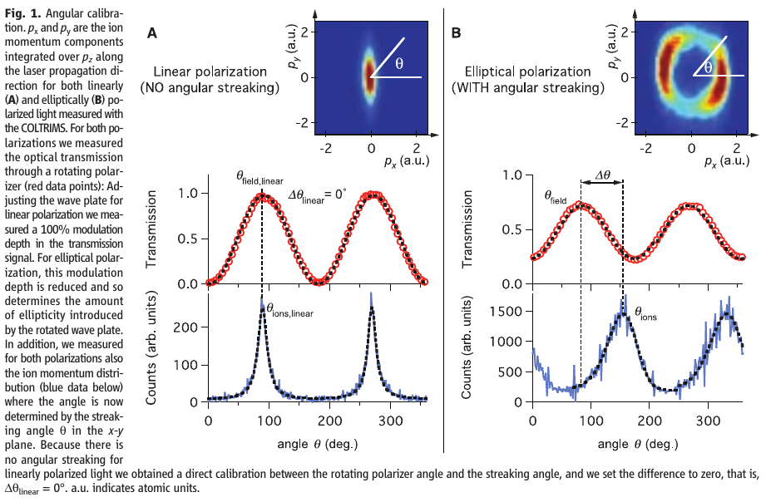
All-optical attoclock to image tunneling wavepackets
Tunneling of electrons out of atoms is a quantum
mechanical process that happens quickly.
Measurements of this process through attoclock
measurement tools, usually photo-electrons or photo-ions: complex, expensive and no direct information on the tunneling process.
Key idea: Exiting electron momentum keeps final deflection at infinity. Play with the driving field (number of colors, polarization) and select the right Brunel harmonics to (indirectly) measure it.
L. Eckle et al., Science 322, 1525 (2008)
L. Torlina et al., Nat. Phys. 11, 503 (2015)

Slide 11
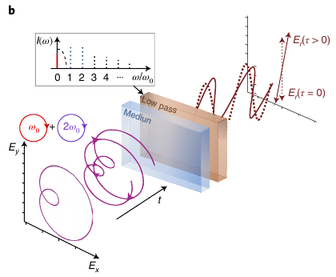
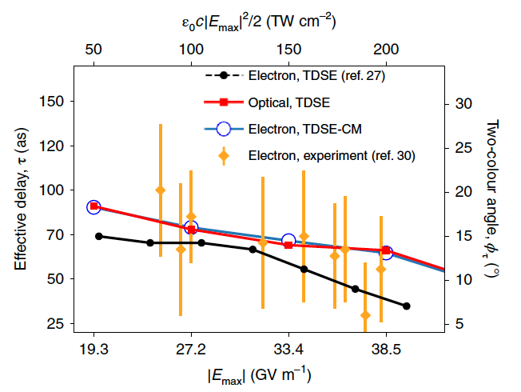
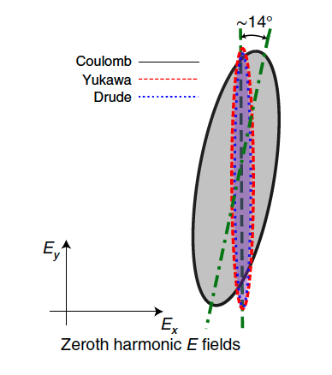
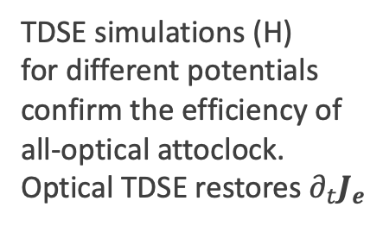
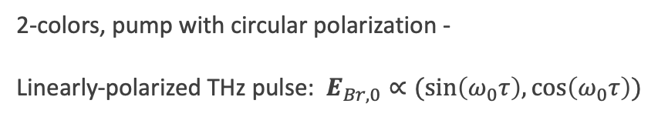
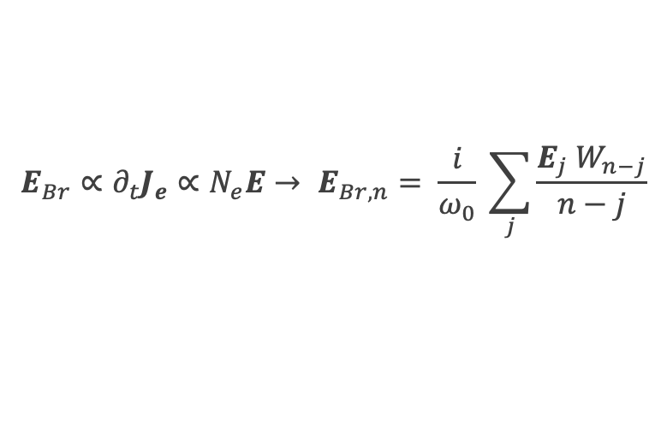
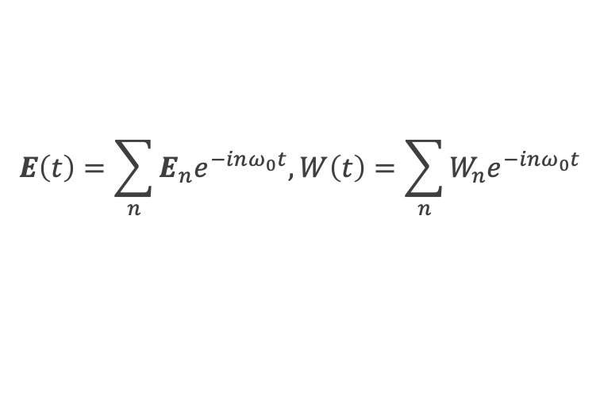
All-optical attoclock: Principle and TDSE simulations
$$E\left(t\right)=\sum_{n}{E_{n}e^{−inω_{0}t}, W\left(t\right)=\sum_{n}{W_{n}e^{−inω_{0}t}}}$$
$$E_{Br}∝∂_{t}J_{e}∝N_{e}E→ E_{Br,n}= \frac{i}{ω_{0}} \sum_{j}{\frac{E_{j} W_{n−j}}{n−j}}$$
2-colors, pump with circular polarization -
Linearly-polarized THz pulse: $E_{Br,0}∝(sin\left(ω_{0}τ\right),cos\left(ω_{0}τ\right))$
TDSE simulations (H)
for different potentials
confirm the efficiency of
all-optical attoclock.
Optical TDSE restores $∂_{t}J_{e}$
I. Babushkin et al., Nature Phys. 18, 417–422 (2022)

Slide 12
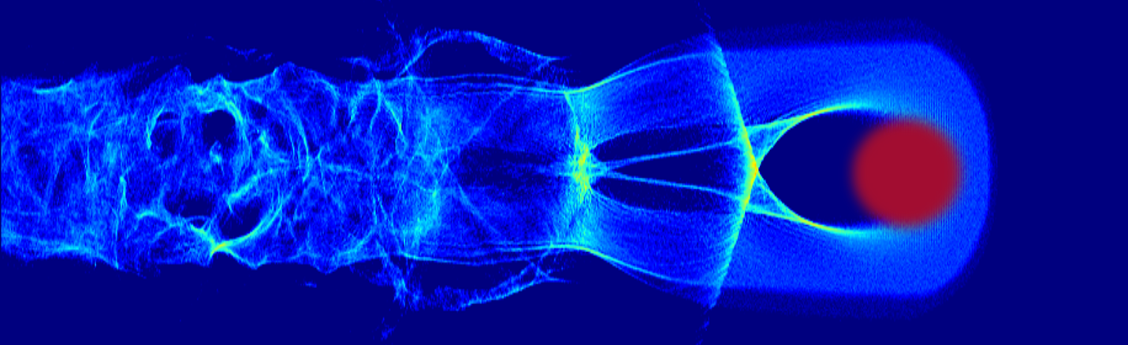
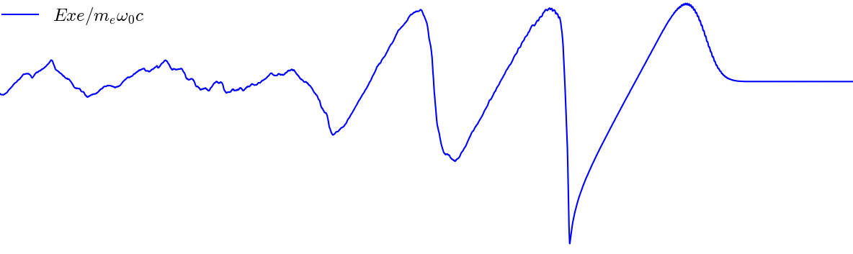







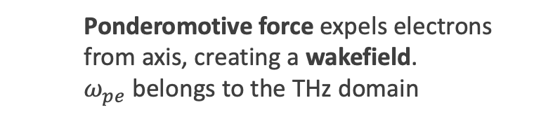




2. Ultraintense THz waves produced by strongly
magnetized, relativistic plasmas
$$y$$
Wakefield of a relativistic laser ionizing a gas
$$N_{e}[{10}^{17} {cm}^{−3}]$$
$$50$$
$$y=0$$
laser
$$10 μm$$
Electron density
$$0.5$$
$$E_{x}(x,y=0)$$
$$x$$
$$x$$
$$∼400 GV.m^{−1}$$
high laser intensity ($a_{0}>1$)
low plasma density ($N_{e}∼{10}^{18} {cm}^{−3}$)
resonant conditions ($cτ∼w_{0}∼λ_{pe}∼10 μm$)
  Ponderomotive force expels electrons from axis, creating a wakefield.
  $ω_{pe}$ belongs to the THz domain

Slide 13





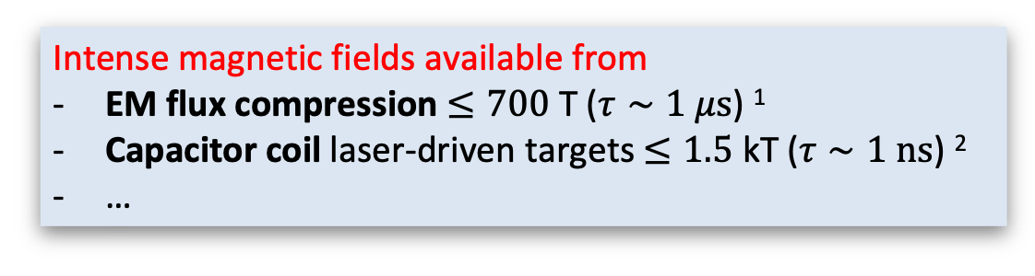

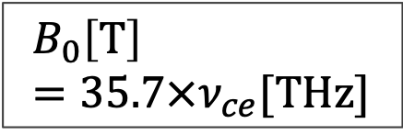
What about adding an external magnetic field?
Cyclotron frequency
$$ω_{ce}=2πν_{ce}=\frac{eB_{0}}{m_{e}}$$
$${\vec{B}}_{0}$$
$$\vec{F}=−e\left(\vec{v}×{\vec{B}}_{0}\right)$$
$$B_{0} [T]$$ | $$ν_{ce} [THz]$$
$$0$$ | $$0$$
$$143$$ | $$4$$
$$215$$ | $$6$$
$$286$$ | $$8$$
$$B_{0}\left[T\right]=35.7×ν_{ce}[THz]$$
$$e^{−}$$
$$\vec{v}$$
Intense magnetic fields available from
EM flux compression $≤700$ T ($τ∼1 μs$) ¹
Capacitor coil laser-driven targets $≤1.5$ kT ($τ∼1 ns$) ²
…
¹ S. Takeyama et al., Journ. of Phys. D: App. Phys. 44, 425003 (2011)
² S. Fujioka et al., Sci. Rep. 3, 1170 (2012)

Slide 14
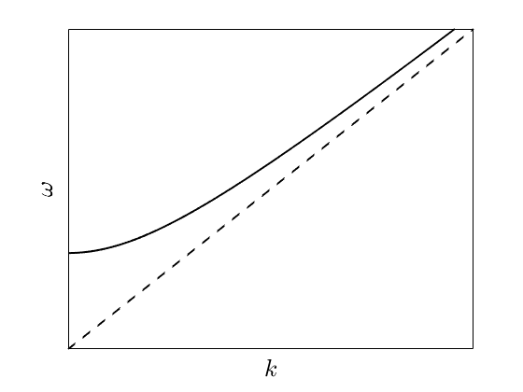
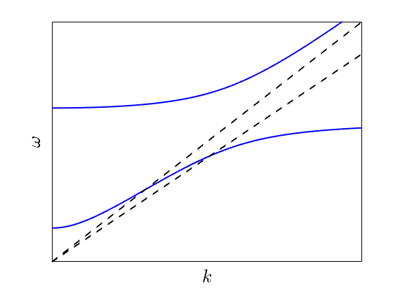
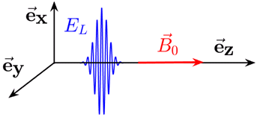

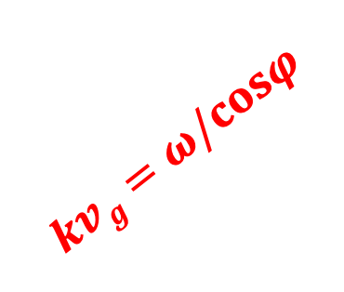












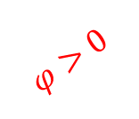
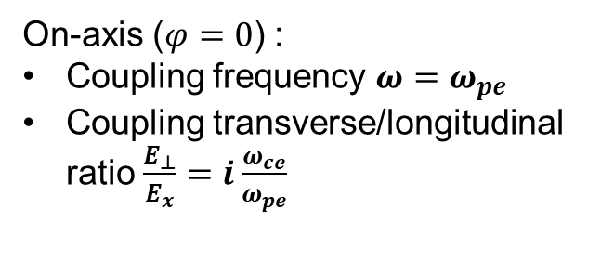


Basic principle of Cerenkov Wake Radiation :
Plane wave model
$$e_{z}$$
$$ω_{pe}={\left(\frac{e^{2}N_{e}}{ε_{0}m_{e}}\right)}^{1/2}$$
$$kvg=ω/cosφ$$
$$B_{0}⊥e_{x}$$
$$e_{y}$$
$$v_{g}≈c$$
$$φ$$
$$ω_{H}$$
$$e_{x}$$
$$φ=0$$
$$φ>0$$
$$ω_{pe}$$
$$ω_{H}^{2}=ω_{pe}^{2}+ω_{ce}^{2}$$
$B_{0}≠0$ : Electromagnetic plasma dispersion relation reads
$$\frac{k^{2}c^{2}}{ω^{2}}=1−\frac{ω_{pe}^{2}}{ω^{2}}\frac{ω^{2}−ω_{pe}^{2}}{ω^{2}−ω_{H}^{2}}$$
Hybrid mode (X mode) : coupling of the longitudinal electrostatic wakefield ($E_{x}$) to the transverse propagative field ($E_{⊥}$)
$B_{0}=0$ : Electromagnetic plasma dispersion relation reads
$$\frac{k^{2}c^{2}}{ω^{2}}=1−\frac{ω_{pe}^{2}}{ω^{2}}$$
On-axis ($φ=0$) :
Coupling frequency $ω=ω_{pe}$
Coupling transverse/longitudinal ratio $\frac{E_{⊥}}{E_{x}}=i\frac{ω_{ce}}{ω_{pe}}$
$$b$$
$b<1$ in the literature $→$ $b>1$ ?
J. Yoshii et al., Phys. Rev. Lett. 79, 4194 (1997)

Slide 15
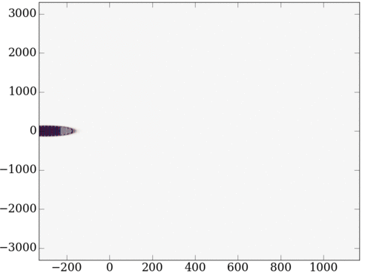
















2D PIC simulation of a wakefield-driven THz pulse
in a magnetized plasma
Ionised Helium
Neutral Helium
$$E_{z}$$
$$B_{0}$$
$$E_{L}$$
$$e_{z}$$
$$c$$
$$y [cω_{0}^{−1}]$$
$$e_{y}$$
$$e_{x}$$
$$x$$
$$B_{0}$$
$$e_{y}$$
$$e_{z}$$
$$e_{x}$$
$$ξ [cω_{0}^{−1}]$$
Helium slab of length $400 μm$
Up/Down ramps of length up to 20$0 μm$
$ν_{pe}∈\left[4,6,8,10\right]$ THz
$ν_{ce}∈\left[0,4,6,8,10\right]$ THz $↔$ $B_{0}∈\left[0−357\right]$ T
Laser : $a_{0}=4$, duration $τ=35$ fs FWHM,
waist $w_{0}=10 μm$, wavelength $λ_{0}=1 μm$
Moving simulation box
$→$ Comoving coordinates
$(ξ=x−ct,y,τ=t)$
$→$ PIC units
Distance : $cω_{0}^{−1}≃0.159 μm$
Time : $ω_{0}^{−1}≃0.531 fs$

Slide 16
















































CWR in 2D Geometry
$$η(τ)=\frac{THz energy at τ}{Initial laser energy}$$
$$160$$
$$ν_{ce}=ν_{pe}$$
$$×{10}^{−3}$$
$E_{z}$ [$GV.m^{−1}$]
$$3$$
$$ν_{ce}=ν_{pe}$$
$$b=2$$
$$60$$
$$ν_{ce}=2ν_{pe}$$
$$0$$
$$2$$
$y$ $[μ$m$]$
$$0$$
Conversion efficiency
$$b=1$$
$$1$$
$${\vec{B}}_{0}$$
$$−160$$
$$−60$$
$$160$$
$$n_{e}$$
$$ν_{ce}=2ν_{pe}$$
$$0$$
$E_{z}$ [$GV.m^{−1}$]
$$1000$$
$$2000$$
$$3000$$
$$4000$$
$$5000$$
$$120$$
$τ$[$ω_{0}^{−1}$]
$$0$$
Gradient attenuation whenever
$$\tilde{b}≡\frac{ν_{ce}}{\sqrt{γ}ν_{pe}}≤1$$
$γ=\frac{1}{\sqrt{1−\frac{{\vec{v}}^{2}}{c^{2}}}}$ : Electron Lorentz factor
$y$ $[μ$m$]$
$$0$$
$${\vec{B}}_{0}$$
$$−160$$
$$−192$$
$$−120$$
$$−128$$
$$−64$$
$ξ$[$μm$]
$$a_{0}=4$$
$ν_{pe}=8$ THz, $ν_{ce}=8$ ou $16$ THz
$$ν_{ce}=\frac{1}{2π}\frac{eB_{0}}{m_{e}}$$

Slide 17













































Ultraintense THz waves outside the plasma
$$E_{z}[GV.m^{−1}]$$
$$E_{z}[GV.m^{−1}]$$
$$−64$$
$$−32$$
$$0$$
$$32$$
$$64$$
$$−128$$
$$−64$$
$$0$$
$$64$$
$$128$$
$$90$$
$$60$$
$$b=1$$
$$b=2$$
$$30$$
$y$ $[μm]$
$$0$$
$$−30$$
$$\tilde{b}=0.67$$
$$\tilde{b}=1.34$$
$$−60$$
$$B_{0}$$
$$B_{0}$$
$$−90$$
$$−180$$
$$−120$$
$$−60$$
$$−180$$
$$−120$$
$$−60$$
$ξ$ $[μm]$
$ξ$ $[μm]$
Single-cycle THz pulse with field strength $>100 GV.m^{−1}$ transmitted to vacuum
C. Tailliez et al., Phys. Rev. Lett. 128, 174802 (2022)
17
(c)
(d)
$$B_{0}$$
$$B_{0}$$
$$−180$$
$$−120$$
$$−60$$
$$−180$$
$$−120$$
$$−60$$
$ξ$ $[μm]$
$ξ$ $[μm]$

Slide 18
CONCLUSIONS
Photocurrents:
  Good for THz spectroscopy
Brunel harmonics:
  Good for attoclock measurements
Wake Radiations from magnetized plasmas:
  THz fields of hundreds of GV.m⁻¹ can be achieved

Slide 19

Acknowledgments
Thank you for your attention
Colomban Tailliez
Xavier Davoine
Arnaud Debayle
Jérémy Déchard
Alisée Nguyen
Pedro González de Alaiza Martínez
Stefan Skupin
Ihar Babushkin
Peter Uhd Jepsen
Korbinian Kaltenacker
Binbin Zhou
And many others ….

Slide 20
Backup slides

Slide 21



Towards remote sensing
Noisy detection conditions
15 m
LB et al., Europhys. Lett. 126, 24001 (2019)

Slide 22


The « Usual » Attoclock Technique
L. Eckle et al., Science 322, 1525(2008)
Keldysh parameter: $γ=ω_{0}\frac{\sqrt{2I_{p}}}{E_{0}}≈ω_{0}Δt_{T}$ with $Δt_{T}$= 450 as
Experiments report $Δt_{T}<$ 34 as [6 as on the average] – No real tunneling delay time.

Slide 23






All-optical attoclock: Revealing asymmetry of potentials
$$E\left(t\right)=\sum_{n}{E_{n}e^{−inω_{0}t}, W\left(t\right)=\sum_{n}{W_{n}e^{−inω_{0}t}}}$$
$$E_{Br}∝∂_{t}J_{e}∝N_{e}E→ E_{Br,n}= \frac{i}{ω_{0}} \sum_{j}{\frac{E_{j} W_{n−j}}{n−j}}$$
1-color, close-to-circular polarization:
$$E_{Br,3}∝\left(1+\frac{r}{2},−i ε\left(1−\frac{r}{2}\right)\right), r= \frac{W_{4}}{W_{2}}$$
$$W_{opt}\left(t\right)=W_{0}+W_{2}cos\left(2ω_{0}t+δ_{2}\right)+W_{4}cos (4ω_{0}t+δ_{4})$$
Harmonics of ionization bursts are encoded in the Brunel radiation and gives information on ionization delay and asymmetry (Coulomb vs Yukawa potentials)
$$W_{e}\left(t\right)=P\left(φ\right)\frac{dφ}{dt} , t=M\left(φ\right)≈ε φ/ω_{0}$$

Slide 24



Experimental validation with helium
Ionization dynamics of helium from single-color pumps – we look at 3rd harmonics
A 800-nm, 43 fs pump (P, $ε=0.61$) creates a plasma spot (P) from which 3rd harmonic (H) is measured
Attoclock prototype measured something that had never been detected using photoelectrons: A slight asymmetry in the ionization process.
Optical attoclock should be more precise than usual attoclock procedure. This new technique could be used to collect time-resolved measurements in systems where electrons cannot be detected, such as solids.
I. Babushkin et al., Nature Phys. 18, 417–422 (2022)
I. Babushkin et al., Nat. Phys. 18, 417–422 (2022)

Slide 25










Principle of the particle-in-cell (PIC) method ¹
Projection of charge density $ρ$ and current $J$ on a grid
Solving Maxwell equations
$$\text{∇}×E+{∂B}/{∂t}=0$$
$$\text{∇}×B−\frac{1}{c^{2}}{∂E}/{∂t}=μ_{0}J$$
Updating the momenta and
locations of the macroparticles
$${dp}/{dt}=q\left(E+v×B\right)$$
$${dr}/{dt}=p/{mγ}$$
$$Δt$$
Computing the fields seen by each macroparticle
$$E_{y}$$
$$E_{x}$$
$$E_{z}$$
$$B_{z}$$
$$−q$$
$$q$$
¹C. K. Birdsall and A. B. Langdon, Plasma Physics via Computer Simulation (1985)

Slide 26











Density down ramp-induced attenuation for $b≤1$
Density down ramp of length $L$ : decay due to dispersion relation variation (when $b≤1$)
$${10}^{0}$$
$$Γ=exp(−∫Im\left(k\right)dx)$$
$${10}^{−2}$$
$${10}^{−4}$$
$$0$$
$$0.5$$
$$1$$
$$1.5$$
$$2$$
$$b$$
$$64$$
$$b=1.5$$
$$b=0.5$$
$$N_{e}$$
$$E_{⊥}^{out plasma}=E_{⊥}^{in plasma}×e^{−\int_{L}{Im\left(k\right)dx}}$$
$$32$$
$$E_{⊥} (GV.m^{−1})$$
$$0$$
J. Yoshii et al., Phys. Rev. Lett. 79, 4194 (1997)
1D-PIC, $a_{0}=0.85$
$$−32$$
$$0$$
$$500$$
$$1000$$
$$1500$$
$$2000$$
$$x (c/ω_{0})$$

