Slide 1




Probability seismic hazard analysis (PSHA) for East Macedonian Seismic zone
Faculty of Natural Sciences and Mathematics
Seismological Observatory
Ljubcho Jovanov, Katerina Drogreshka, Jasmina Najdovska
11th International Conference of the Balkan Physical Union
28 August – 1 September 2022, Belgrade, Serbia

Slide 2

01
Tectonics of the Balkan Penninsula, North Macedonia
02
Data
03
Methods
04
Results and disscusion
05
Conclusion

Slide 3
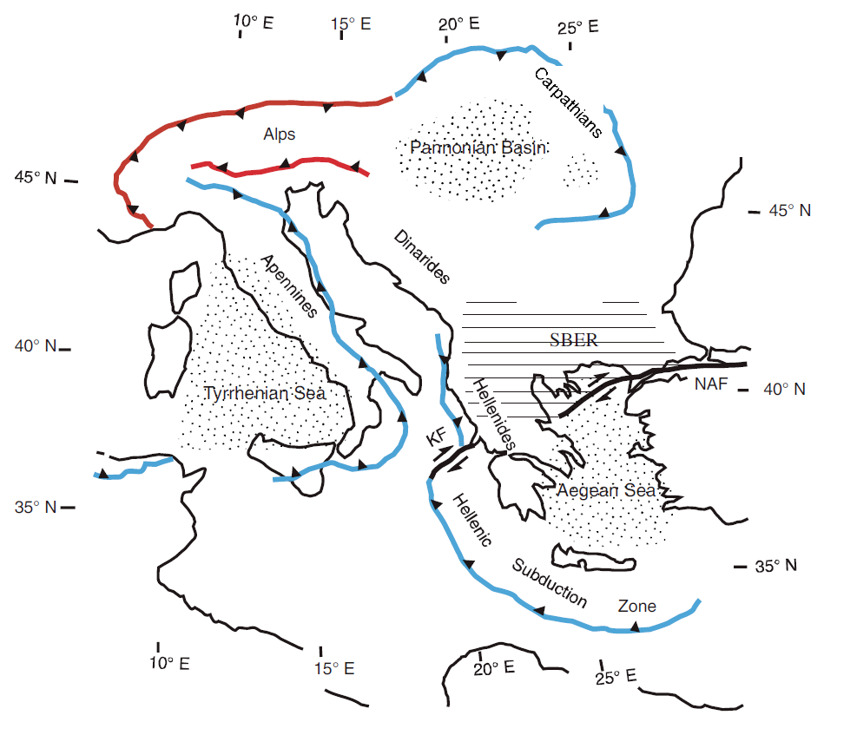
Tectonic of the Balkan Peninsula
The Earth’s crust on the Balkan Peninsula is characterized by high seismic activity as a result of several regional tectonic regimes.
Fig. 1 The Southern part of the Balkan – meeting point of three large tectonic movements
(Burchfiel B. C. at al., 2008)

Slide 4
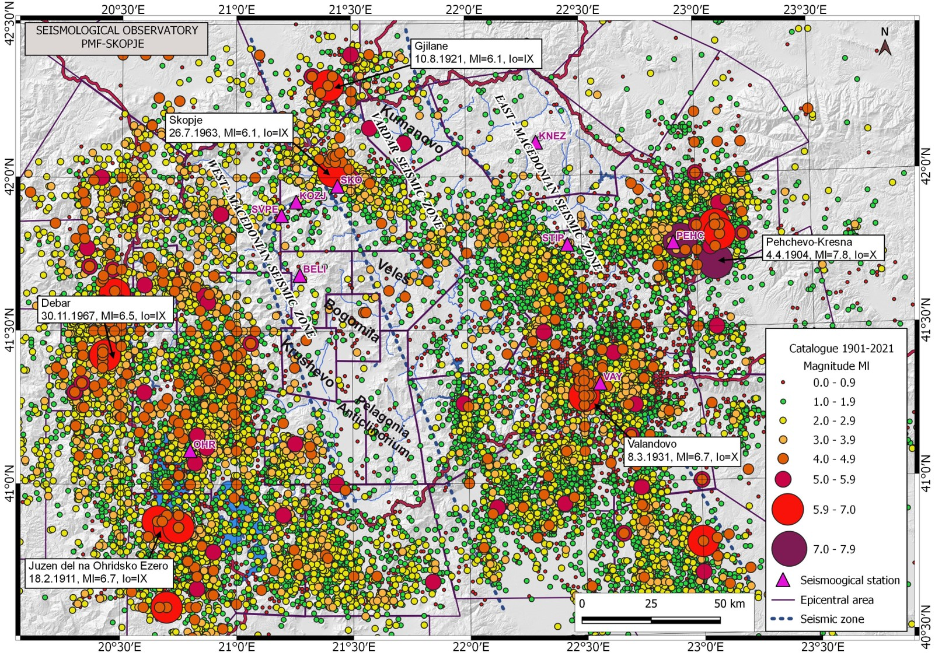
Tectonic of the territory of N. Macedonia
The territory of North Macedonia is exposed to strong earthquakes authored by autochthonous sources as a result of the complex geological structure of the crust and the recent neotectonic movements.
Fig. 2 Epicentral map of the earthquakes between 1901-2021

Slide 5
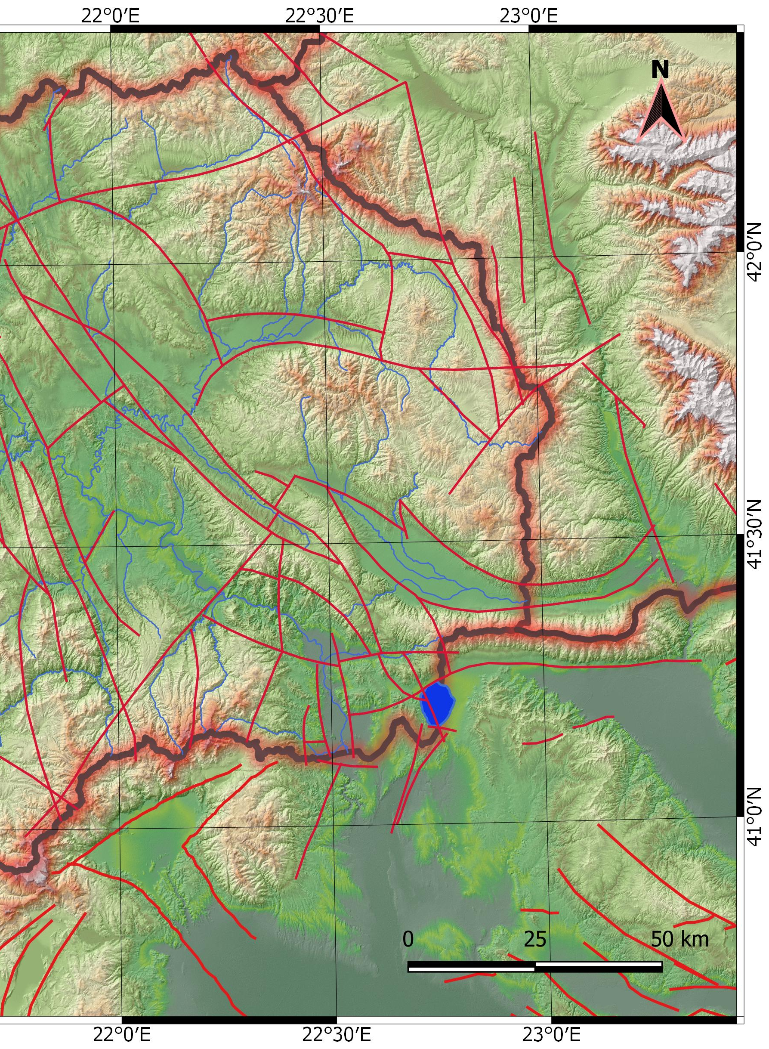
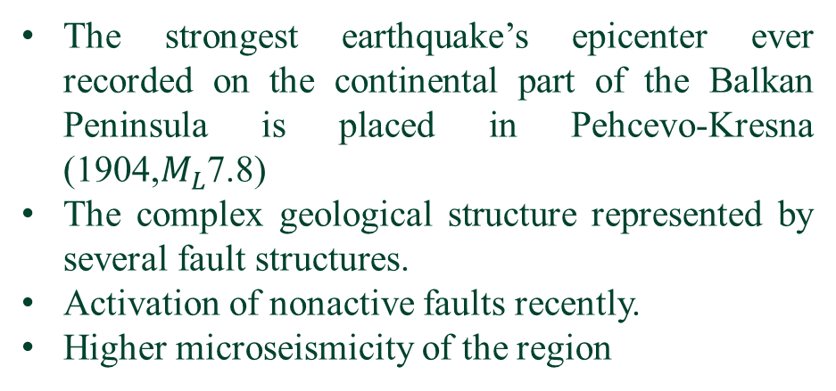
Tectonic of the East Macedonian Seismic zone
The strongest earthquake’s epicenter ever recorded on the continental part of the Balkan Peninsula is placed in Pehcevo-Kresna (1904,$M_{L}$7.8)
The complex geological structure represented by several fault structures.
Activation of nonactive faults recently.
Higher microseismicity of the region
Pehcevo-Kresna
1904, M_{L}7.8
Fig. 3 Map of faults placed in the Eastern zone

Slide 6

Data
Usage of macroseismic data
SORM’s database of earthquakes from 1901 onward
Subcatalogue of events from 1980 to 2021
Unfinished process of relocation
Subcatalogue of events from 1980 to 2018
(4297 earthquakes)
Different magnitude scales
Weak sensitivity of the instruments
Declustered catalogue
(1620 eliminated)
Declustered catalogue with $M_{C}$ applied
(128 events left)
Gardner and Knopoff method in ZMAP
Applied M_{c}=2.7

Slide 7
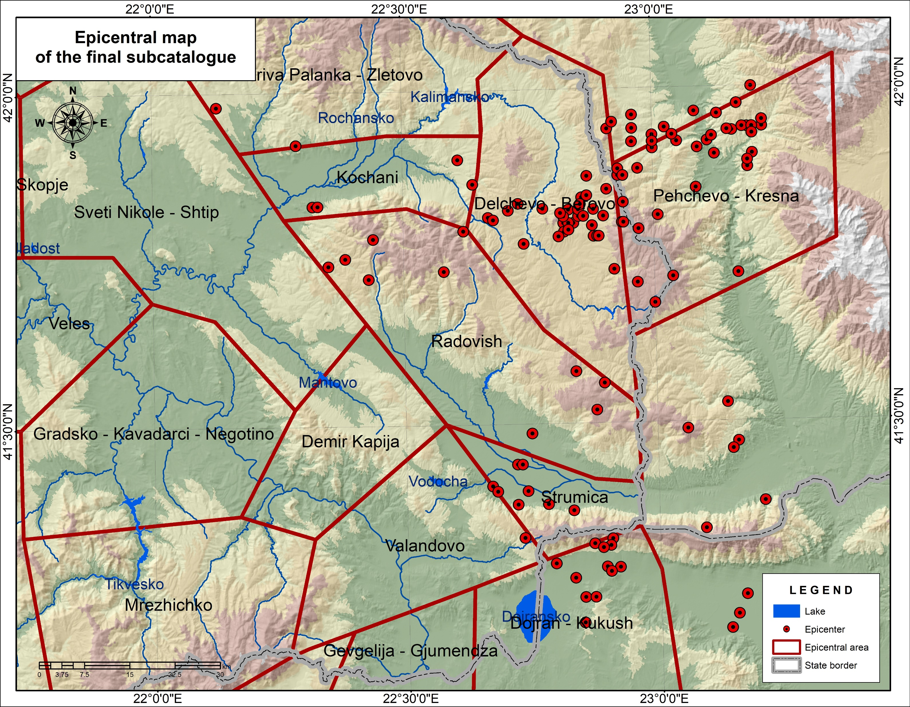
Data
The six epicentral areas of the Eastern zone
The division of the zone to epicentral areas was rejected as a result of the insufficient number of earthquakes in the margins of the areas.
Fig. 4 Epicentral map of the events from the final subcatalogue

Slide 8



Methods
The empirical relation between the frequency of earthquake occurrence and magnitudes, known as Gutenberg-Richter law was used
$$logN=a−bM$$
The main seismic hazard parameters were calculated
$$T_{m}=\frac{{10}^{bM}}{{10}^{a_{1}}}$$
The mean return period
$$M_{t}=\frac{a_{1}+logt}{b}$$
the most probable maximum magnitude
the probability for an earthquake occurrence
$$P_{t}=1−e^{−{10}^{a_{1}−bM}t}$$
For all of the relations mentioned above, local magnitude scale ($M_{L})$ was used

Slide 9
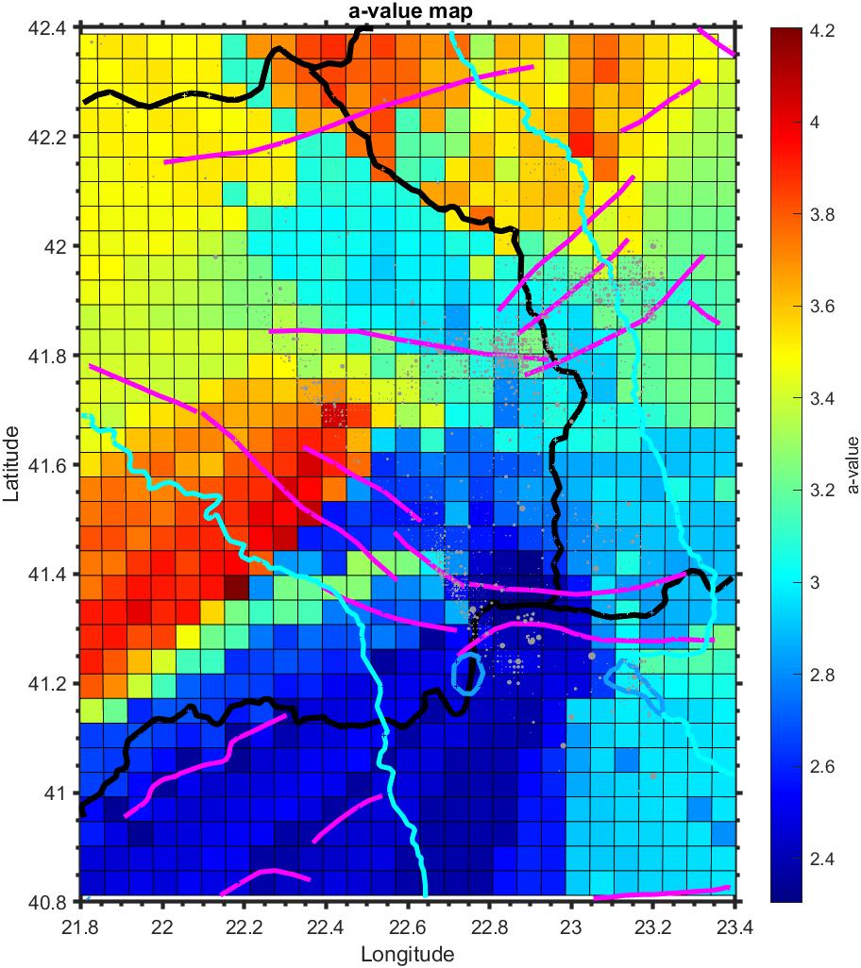
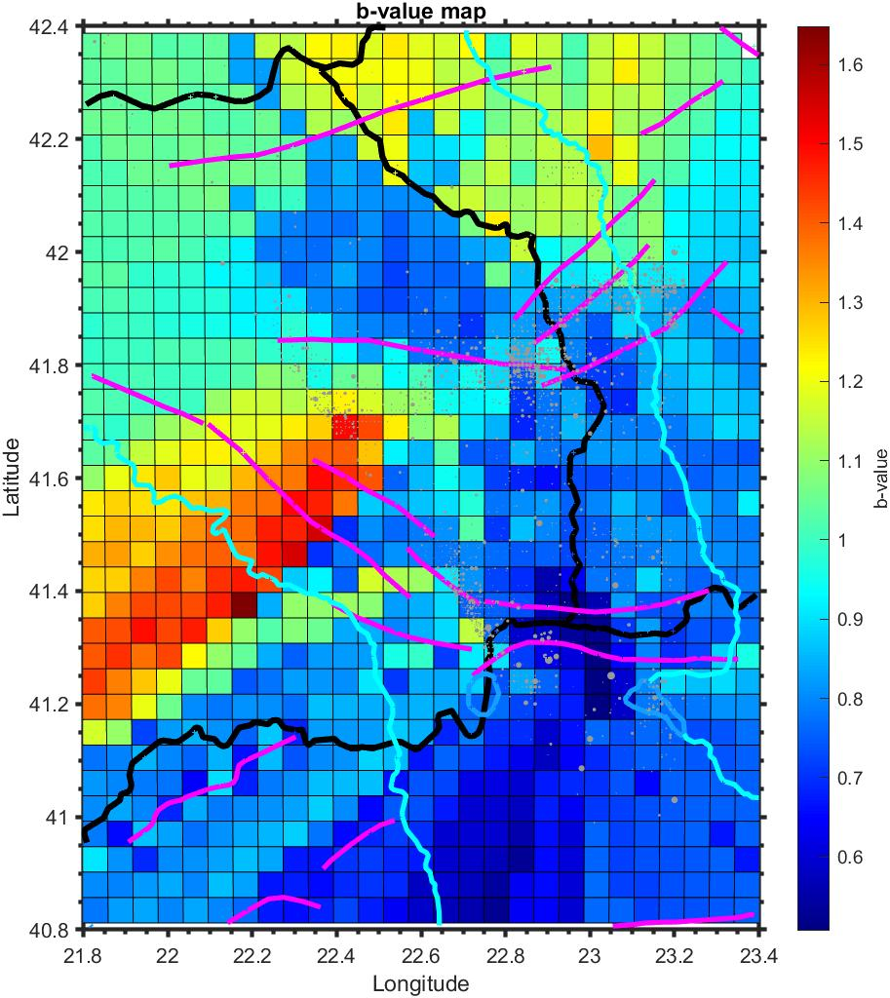
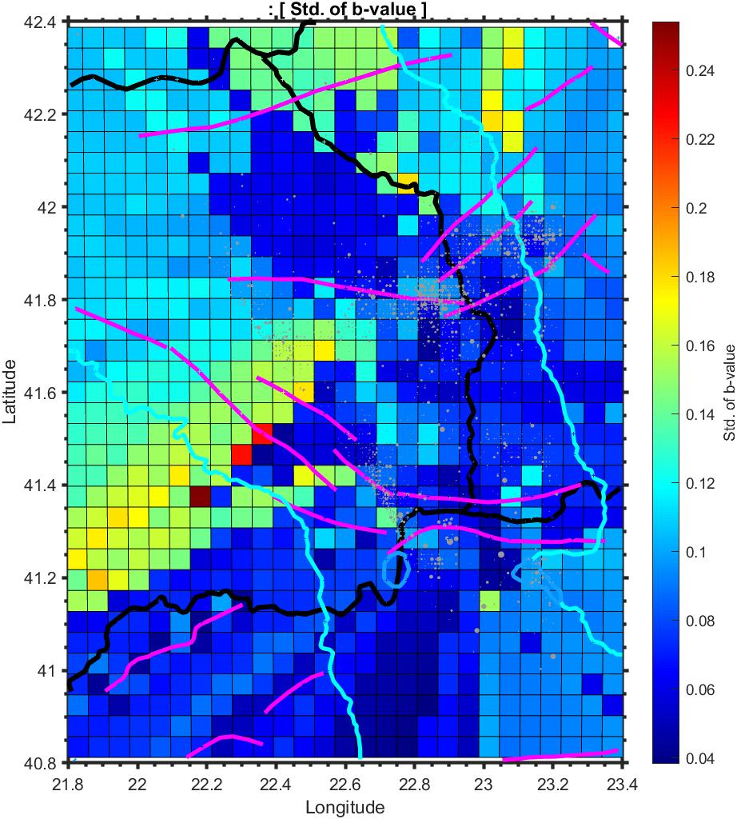
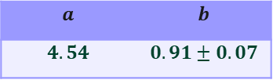
Results and discussion
Values of the parameters a and b
$$a$$ | $$b$$
$$4.54$$ | $$0.91±0.07$$
The amount of accumulated stress
Seismicity rate
a) Map of spatial variations of parameter a
b) Map of spatial variations of parameter b
c) Map of standard deviation of parameter b
Fig. 5 Map of spatial distributions of a, b and standard deviation of b

Slide 10
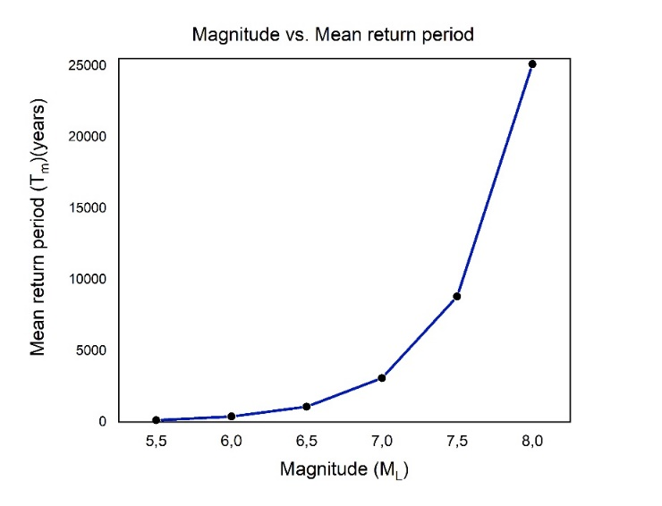
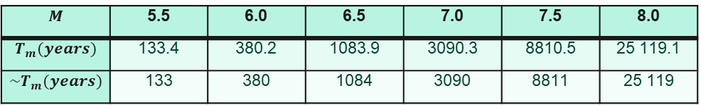
Results and discussion
The mean return period
Table 1
$$M$$ | 5.5 | 6.0 | 6.5 | 7.0 | 7.5 | 8.0
$$T_{m}(years)$$ | 133.4 | 380.2 | 1083.9 | 3090.3 | 8810.5 | 25 119.1
$$\sim T_{m}(years)$$ | 133 | 380 | 1084 | 3090 | 8811 | 25 119
The mean return period for an earthquake with magnitude near to or equal to the magnitude of the 1904’s earthquake corresponds with the previous known results T~10 000 years
Fig. 6 Magnitude vs. mean return period graph

Slide 11
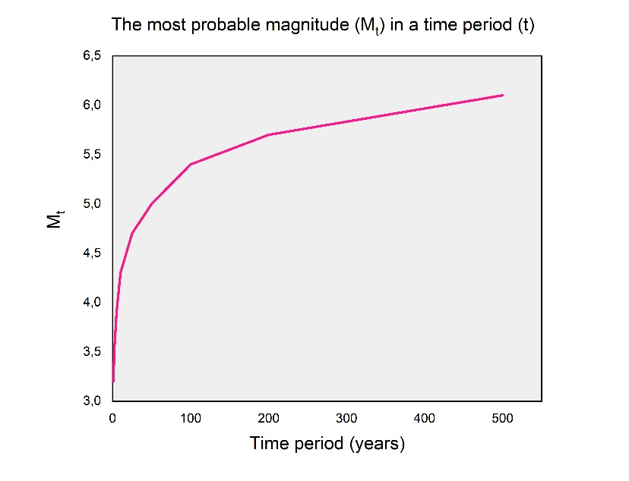
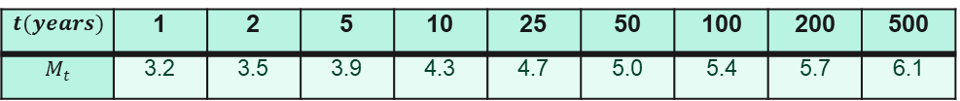
Results and discussion
The most probable magnitude
Table 2
$$t(years)$$ | 1 | 2 | 5 | 10 | 25 | 50 | 100 | 200 | 500
$$M_{t}$$ | 3.2 | 3.5 | 3.9 | 4.3 | 4.7 | 5.0 | 5.4 | 5.7 | 6.1
The correctness of the results was proved by an earthquake registered in 2021 with a magnitude of M_{L}4.2
Fig. 7 Graph of the variation of the most probable magnitude
in a time period

Slide 12
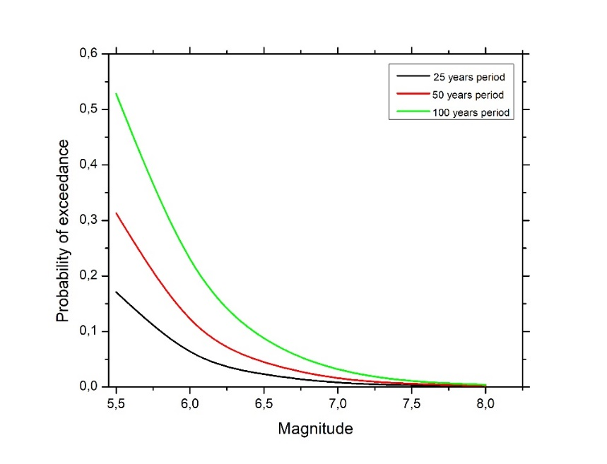
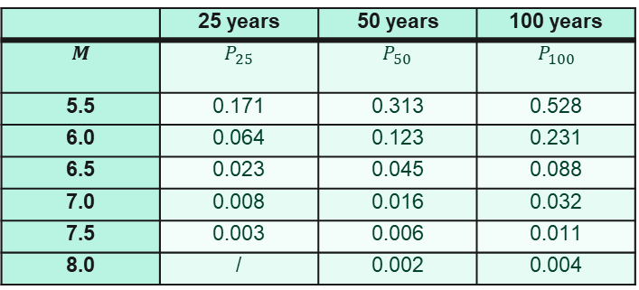
Results and discussion
The probability for an earthquake occurrence
Table 3
 | 25 years | 50 years | 100 years
$$M$$ | $$P_{25}$$ | $$P_{50}$$ | $$P_{100}$$
5.5 | 0.171 | 0.313 | 0.528
6.0 | 0.064 | 0.123 | 0.231
6.5 | 0.023 | 0.045 | 0.088
7.0 | 0.008 | 0.016 | 0.032
7.5 | 0.003 | 0.006 | 0.011
8.0 | / | 0.002 | 0.004
Good news! – the probability of occurrence of a strong to very strong earthquakes is less than 10% for the next century.
Fig. 8 Graph of the probability of exceedance for an earthquake with
given magnitude

Slide 13
Conclusion
the probabilistic seismic hazard analysis can give us reliable results about the expected seismicity of a given region.
The accuracy of the result is dependent by many factors: the geology of the terrain, the number of running stations, the regional tectonic regimes etc.
Living in an era of accelerated change of global tectonic regime on the Balkans, and in Europe at all, the interval of confidence of the results is much smaller.

Slide 14
Thank you for your attention!

