Slide 1



Physical Parameters of Chocolate with the addition of Arthrospira Platensis
G. Gavrailov, I. Pehlivanov, G. Gentscheva, Kr. Nikolova,
I. Milkova-Tomova, D. Kovacheva, V. Andonova

Slide 2
Introduction
The current research is focused on the possibilities of diversifying the taste of chocolate products by creating innovative products aimed at a healthy lifestyle.
The market of chocolate products in Bulgaria is part of the global economic market and is influenced by trends in consumer demand.

Slide 3
Introduction
Our country's daily consumption per person is about 20-50 grams, while in the EU, the amount is between 30 and 90 grams on average.
According to Eurostat, each European has consumed an average of about 10 kg of chocolate per year, nearly three times more than the intermediate level in Bulgaria.

Slide 4
The aim
The present work aims to create an innovative chocolate product with suitable physicochemical properties and organoleptic characteristics, simultaneously preserving the taste and contributing to the healthy nutrition of consumers.

Slide 5
Tasks to solve
Achieving the goal
Develop a technological scheme
Investigate physical properties
Data from sensory acceptance
Selection of suitable algae
Arthrospira Platensis
from bioreactor

Slide 6
Used materials
Ingredients used to develop chocolates:
Ghirardelli dark chocolate couverture with 85% cocoa content, purchased commercially.
Spirulina biomass grown in a bioreactor /Varvara, Bulgaria/ purchased from a producer after conventional drying.

Slide 7
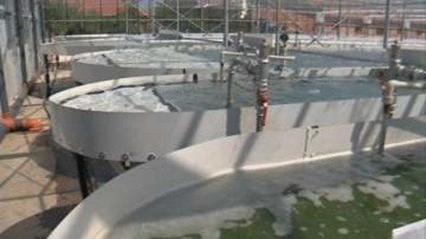
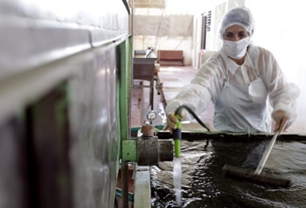
Conditions for production of biomass into a bioreactor
Conditions into the reactor
Production of biomass
The steps for the production of biomass are the following:
Creating sowing;
Changing the habitat of the samples from the laboratory into the production conditions;
Growing the samples into a large volume;

Slide 8
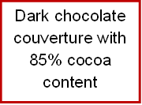



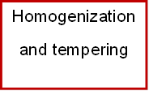


Technological scheme

Slide 9
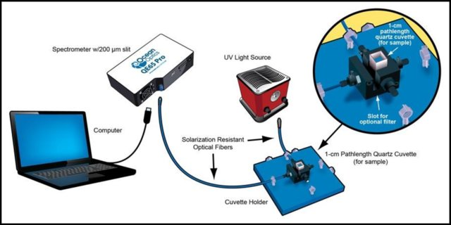
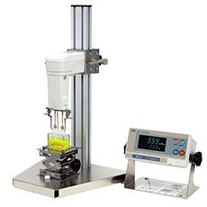
Used physical methods
Fluorescence spectroscopy
Physical methods
X-ray structural analysis
Rheology
Microscopy

Slide 10
Specification of investigated samples
Sample | Content of Arthrospira Platensis, % | Content of cocoa mass, %
Sample 1 | 3 | 85
Sample 2 | 5 | 85
Sample 3 | 10 | 85

Slide 11
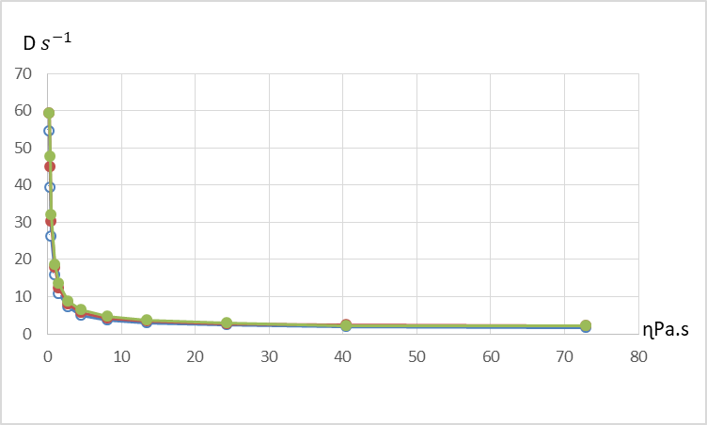
Rheological behavior of chocolate mass with 85% cocoa content
The samples have the character of non-Newtonian fluids.
As the velocity gradient increases, the viscosity decreases.
All solid glycerides in the oil fraction of the chocolate mass are in a molten state at a temperature of 40ºC.
The samples have a similar rheological behavior. Increasing the concentration of Spirulina (3, 5, 10%) did not affect the nature of the rheological curves.

Slide 12
X –ray structural analysis
X-ray analysis showed peaks of crystalline sucrose and cocoa.
In addition to these peaks, in the X-ray diffraction pattern of the sample with 10% Arthrospira Platensis content, some peaks may be due to complex crystals of the protein structure of freshwater algae.

Slide 13
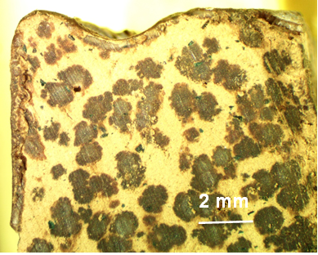
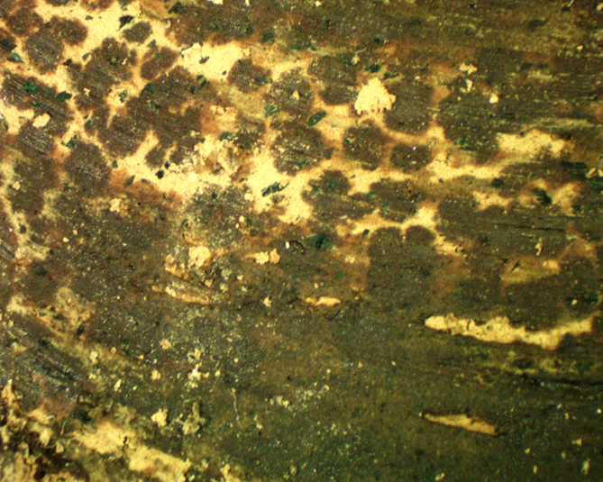
Microscopy analysis
85% cocoa + 3% Spirulina
85% cocoa + 10% Spirulina
2 mm

Slide 14
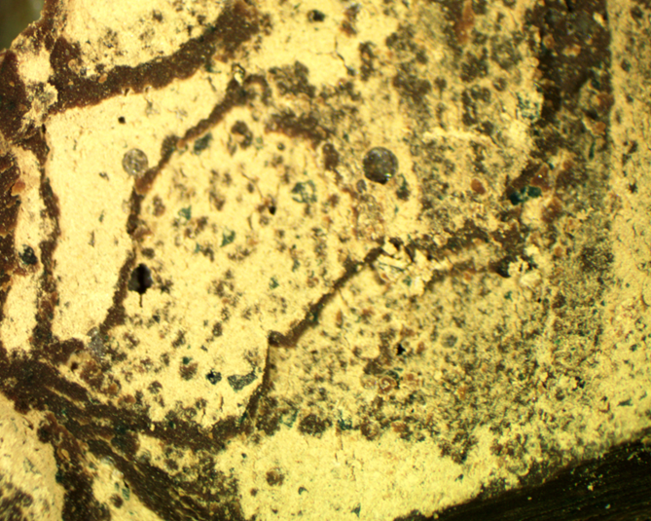
Microscopy analysis
85% cocoa + 5% Spirulina
The presence of 10% Spirulina led to a uniform distribution in the volume of the cocoa mass and relatively good homogenization.
The presence of 5% Spirulina led to its uniform distribution in the volume of the product, but unlike the other two, cracks (breaks) were observed inside.
2 mm

Slide 15
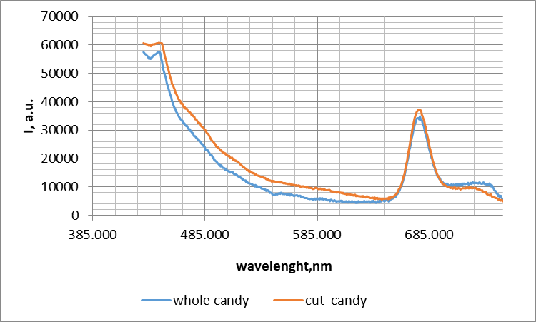
Fluorescence spectroscopy
The fluorescence spectra of the whole and cut candy with 3 % Spirulina were obtained at the excitation wavelength of 385 nm.
The two spectra were identical. A fluorescent maximum around 685 nm was seen due to the chlorophyll of the Spirulina.
The maximum of the cut candy was more intense because much of the cyanobacteria powder was concentrated inside the product.

Slide 16
Sensory analysis
"Taste Intensity" and "Structural Profile" studies were conducted on samples with the same cocoa mass content (85%) and different concentrations of Spirulina.
A panel of trained sensory experts evaluated the products. Each participant tested the product and gave "descriptive" indicators to fill out the system of questions accurately.
The specific indicators were developed based on the organoleptic indicators and coincided with the descriptions of the chocolate product.
Coded, the samples were presented differently to each trained participant. The results are shown on the following slides.

Slide 17
Sensory analysis
Tasters reported an intense cocoa flavor and almost no aftertaste in sample 1.
The most pronounced aftertaste was in sample 3.
Sample 2 had a distinctly sweet taste for the tasters.
A bitter taste was primarily reported in sample 3.

Slide 18
Sensory analysis
Regardless of the concentration of added Spirulina (3, 5 and 10%), the samples had the same values for the indicators "stickiness," "softness“ and "hardness“.

Slide 19
Sensory analysis
Tasters reported that sample 2 had the smoothest surface compared to the other samples, and sample 3 had the roughest surface.

Slide 20
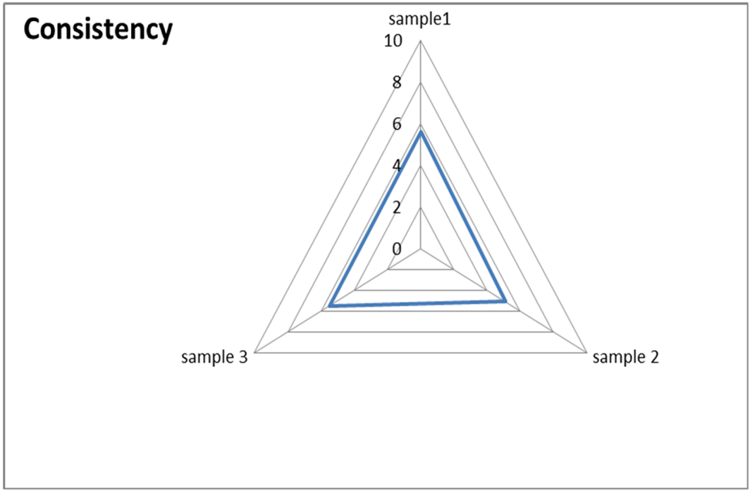
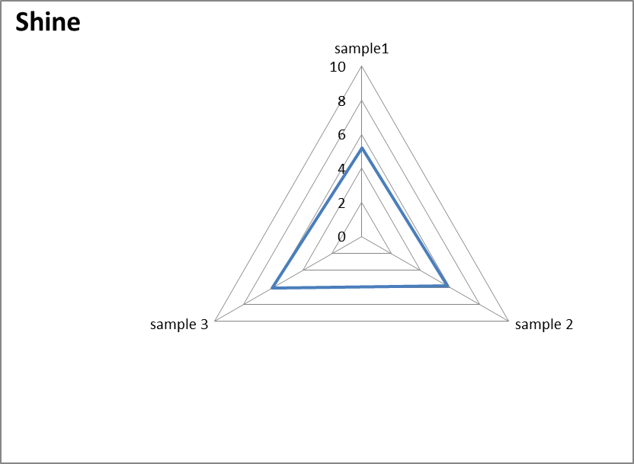
Sensory analysis
A dependence was observed - as the content of Spirulina increased, the shine of the chocolate products also increased.
The consistency scores for all samples were very close. The values were between 5 and 6 points. The latter fact shows that the content of Spirulina does not significantly affect the consistency of the product.

Slide 21
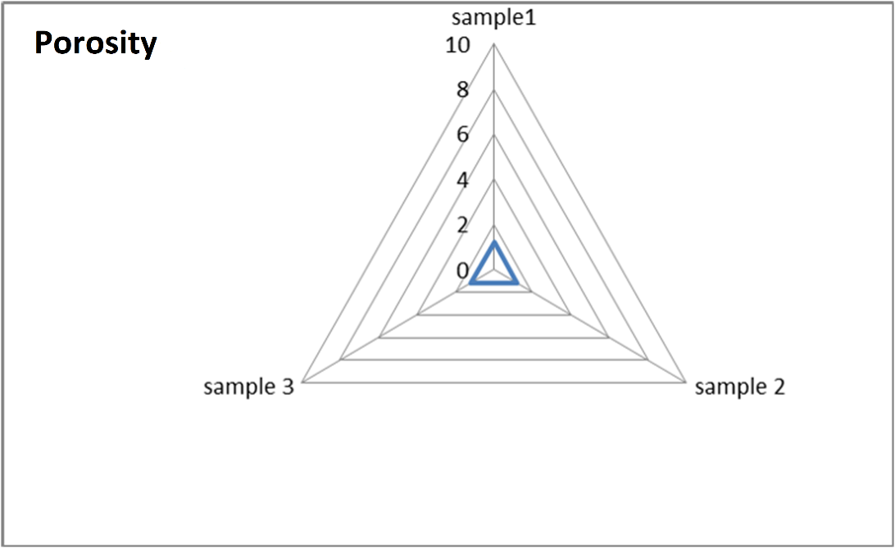
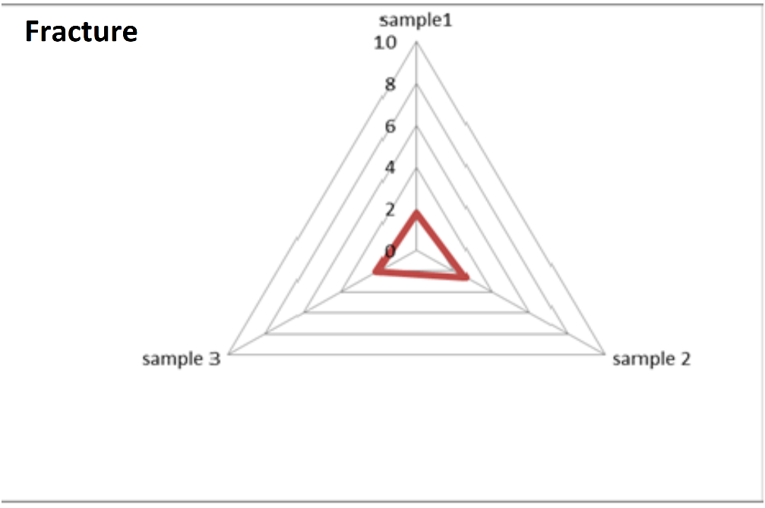
Sensory analysis
Dark chocolate products had a slightly pronounced "break". Increasing the concentration of Spirulina increased the values for the "break" indicator. According to the sensory assessment, they were highest in the presence of 5% Spirulina. The latter result correlates with images taken with a reflection microscope. The clearly defined cracks inside the product are only present in sample 2.

Slide 22
Conclusions
The rheological curves of the samples showed that the studied systems are non-Newtonian fluids.
Increasing the concentration of Spirulina did not affect stickiness, softness, and firmness.
According to sensory analysis, samples with 5% Spirulina had a pronounced sweet taste, and those with 3% had stronger cocoa taste. The most pronounced aftertaste was found in the 10% sample.
Fluorescence spectra of whole and sliced ​​candies obtained at an excitation wavelength of 385 nm showed a fluorescence maximum of around 685 nm due to Spirulina chlorophyll.
Increasing, the concentration of Spirulina increased the values for the "break" indicator.
As the Spirulina content increased, the shine of the chocolate products increased.

Slide 23
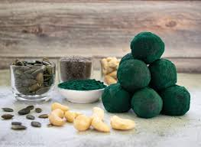
THANK YOU FOR YOUR ATTENTION!

