Slide 1
The Role of Size and Shape in the Stability of the Quantum Brownian Rotator
Igor Petrović, Jasmina Jeknić-Dugić, Momir Arsenijević, Miroljub Dugić

Slide 2
Quantum mechanical or classical approach
Problem of transition from the quantum to the classical world
Problem of quantum measurement
The role of size of the physical system
Standard quantum mechanical theory is insensitive to the size of the physical system

Slide 3
If the physical system is open, the interaction with the environment is certainly affected by both its size and shape
Molecular rotators
- excellent candidates for the described research
- interesting due to their application within so-called molecular machines
- importance of studying the role of size and shape in their stability

Slide 4
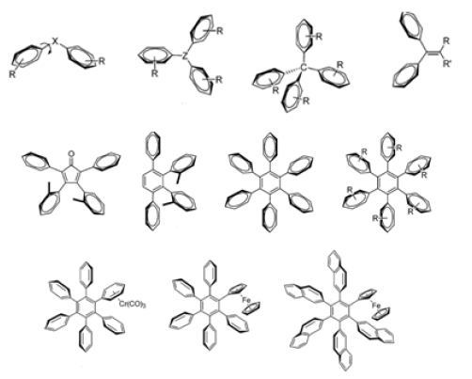
A type of molecular rotators that is very suitable for the mentioned research are the so-called molecular propellers which consist of several atomic groups linked to a single atomic group at the center
Their function and properties strongly depends on their geometrical shape and size

Slide 5
For molecular propellers, it is possible to include the size into the model via number of blades
If the average moment of inertia of one blade is I0 then it is obvious that the propeller with N blades has a total moment of inertia I which is equal to:
The strength of the interaction also linearly depends on the number of blades, so that the damping rate can be written as

Slide 6
Molecular rotators is open to the environmental influence and can be modelled by the so-called phenomenological (no restrictions on the values of the rotator's frequency ω the damping factor γ and the bath's temperature) Caldeira-Leggett master equation:
(1)
the Hamiltonian reads
. (2)

Slide 7
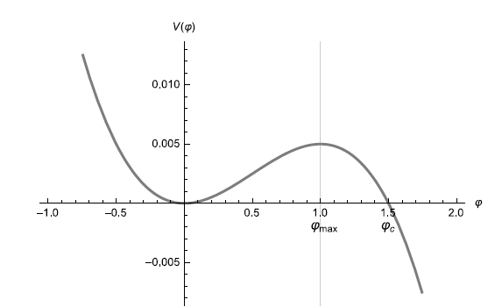
We have considered three diffrerent cases:
1. Free Brownian rotator:
2. Brownian rotator in harmonic potential:
3. Brownian rotator in cubic potential (weakly unharmonic):

Slide 8
There are planty of different methods for investigation of dynamical stability.
We utilized two of them:
– standard deviations for angle and conjugate momentum
– QFPT- a quantum counterpart of standard method of so-called first passage time

Slide 9
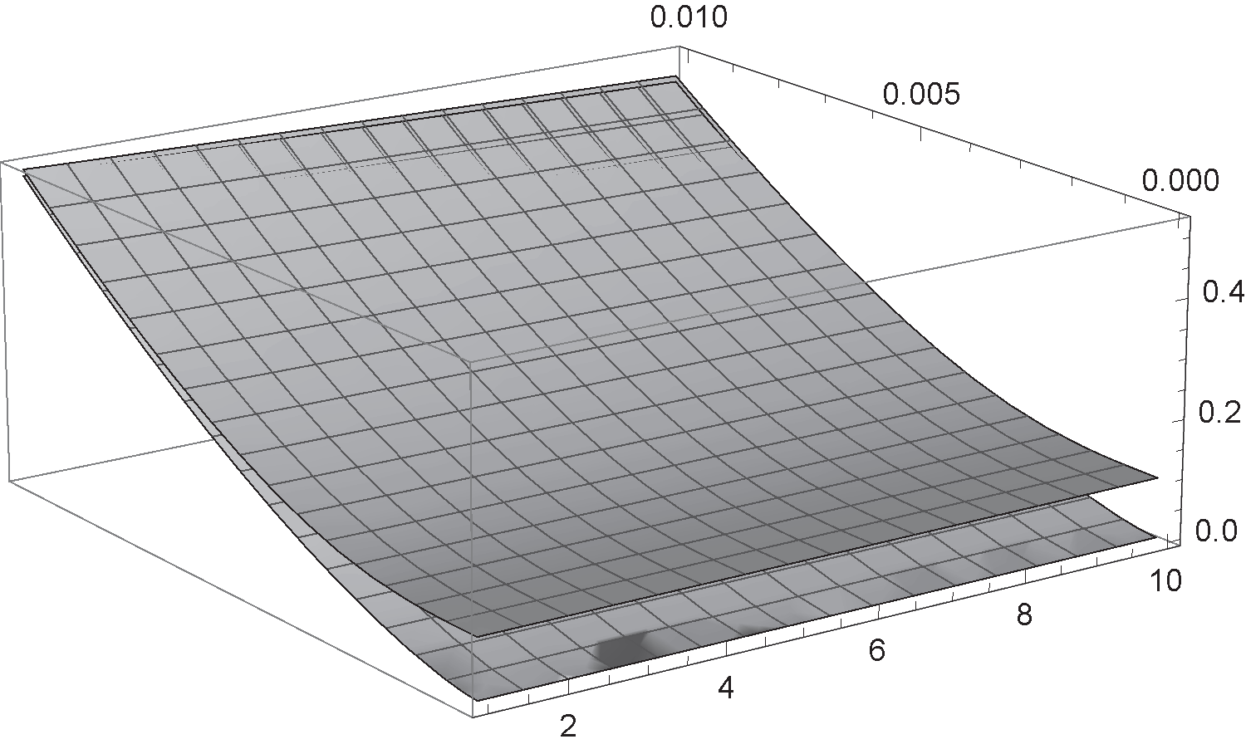
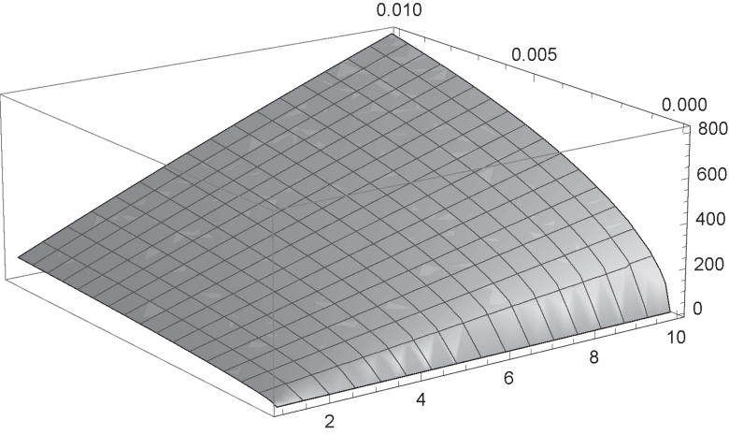
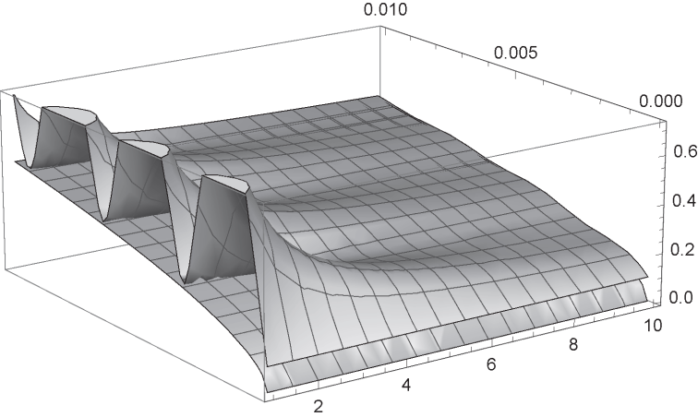
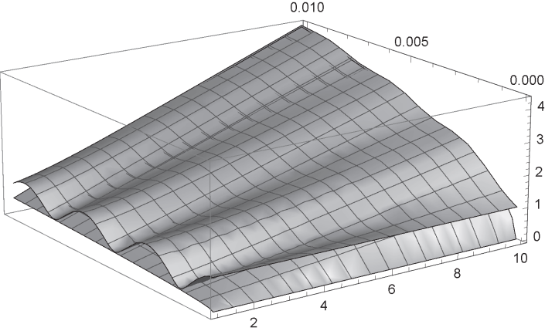
Underdamped regime for free rotator:
Underdamped regime for rotator in harmonic potential:

Slide 10
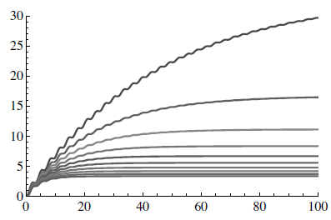
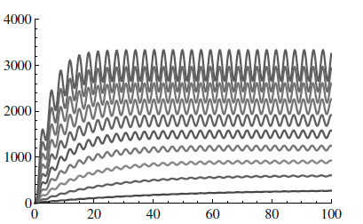
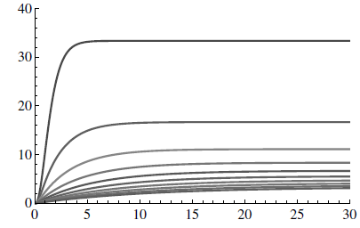
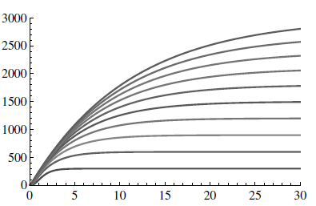
Underdamped regime for rotator in cubic potential: ω =1

Slide 11
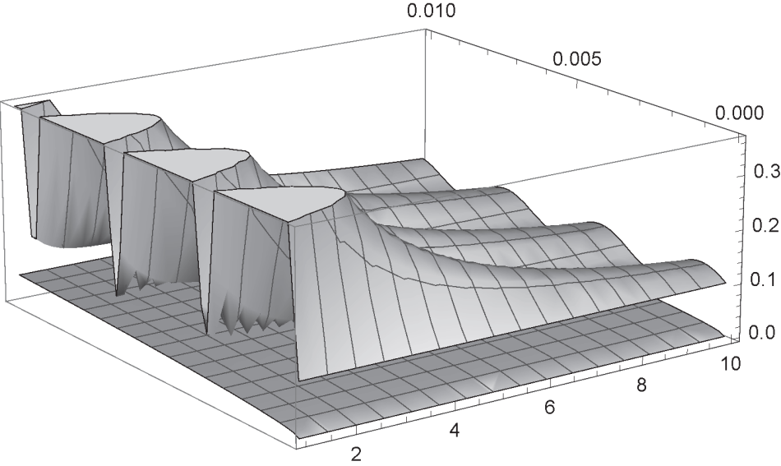
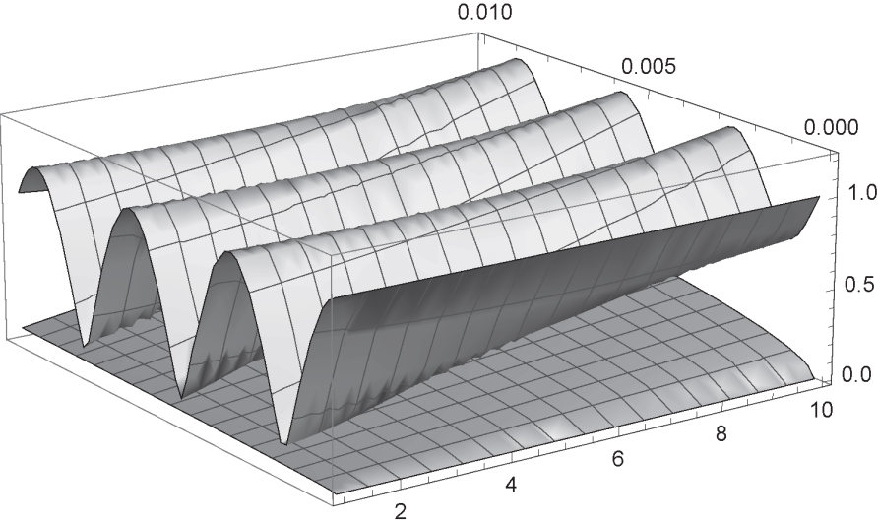
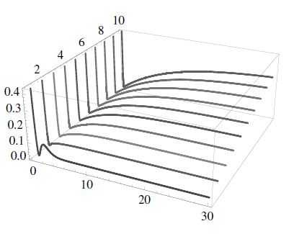
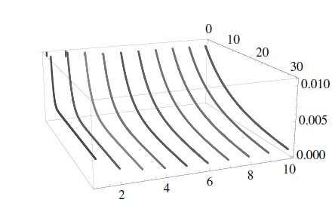
Non - underdamped regime for rotator in harmonic potential:
Non - underdamped regime for rotator in cubic potential: ω =1

Slide 12
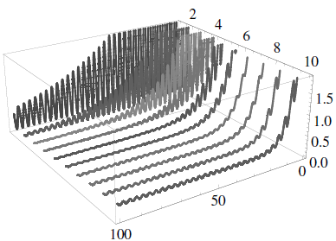
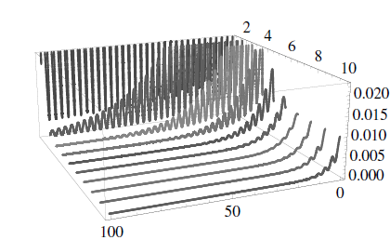
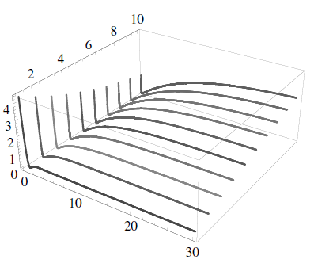
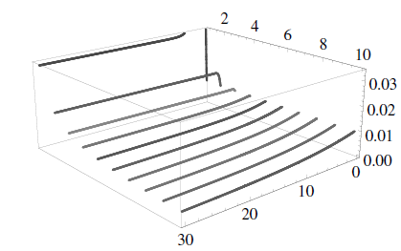
Non - underdamped regime for rotator in cubic potential: ω =1

Slide 13
the dynamics are complex and highly dependent on environmental parameters
there are still no simple rules or guidelines that would provide the desired level of dynamic stability of molecular propellers.
it is necessary to apply a combination of different stability criteria
combinations of the criteria require a procedure that is along the lines of optimization procedures in engineering

Slide 14
decrease of standard deviations with the passage of time in the case of nonharmonic rotator
nonmonotonic dependence of the standard deviation of the angle on the number of blades
"size" of a physical system is not such a simple term in a quantum / classical context
the role of the size of the propellers cannot be reduced to the more-or-less pure inertial effects widely known and expected in the classical physical context

