Slide 1



Analysis of the pollen phenology distributions and their impact on the modeled concentrations in Thessaloniki, Greece
S. Papadogiannaki, S. Kontos, D. Parliari, D. Melas
Laboratory of Atmospheric Physics, School of Physics, Aristotle University of Thessaloniki
spapadog@physics.auth.gr

Slide 2

Pollen causes various allergic reactions such as allergic rhinitis and asthma.
Allergy-related respiratory diseases are considered as one of the most important public health problems for the 21st century. (Pawankar et al., 2013; European Academy of Allergy and Clinical & Immunology (EAACI) , 2015; D'Amato et al., 2015).
Affects over 150.000.000 people in Europe (Katelaris et al., 2012).
Most vulnerable group are children (Asher et al., 2006).
Pollen allergenicity is influenced by climate, humidity, temperature and air pollution (D'Amato et al., 2001; Sofiev and Bergmann, 2013).
On average, the concentration of atmospheric pollen doubles every decade (Damialis et al., 2007).
Laboratory Of Atmospheric Physics

Slide 3

Biological weather is defined as the short-term state and change of bio-aerosols in the atmosphere, such as plant pollen and fungal spores.
One of the major sources of aeroallergens in direct contact with people is plant pollen.
Goals of the study:
Analysis of pollen species that have the highest contribution in Thessaloniki
Prediction of pollen concentrations via an innovative modeling system
Laboratory Of Atmospheric Physics
Analysis of the pollen’s phenological distributions

Slide 4
Pollen Index (grains/m³)
a/a | Taxa | 2016-2021 | 2016 | 2017 | 2019 | 2020 | 2021
1 | Cupressaceae | 42525 | 8004 | 12133 | 7747 | 7016 | 7622
2 | Urticaceae | 24240 | 4940 | 5962 | 4161 | 4804 | 4371
3 | Quercus | 19455 | 4675 | 4117 | 2683 | 2023 | 5956
4 | Platanus | 12901 | 2870 | 1495 | 2316 | 2446 | 3769
5 | Pinaceae | 8640 | 2608 | 1631 | 1301 | 1116 | 1982
6 | Carpinus | 3295 | 1230 | 214 | 66 | 1630 | 154
7 | Oleaceae | 1769 | 352 | 249 | 499 | 383 | 284
8 | Poaceae | 1400 | 416 | 168 | 200 | 261 | 353
Sum |  | 117140 | 25905 | 26401 | 19576 | 20350 | 24906
Laboratory Of Atmospheric Physics
Cupressaceae and Gramineae species have the highest contribution in the city of Thessaloniki.
Then, follow the deciduous broad-leaved forest trees and the Oleaceae.

Slide 5
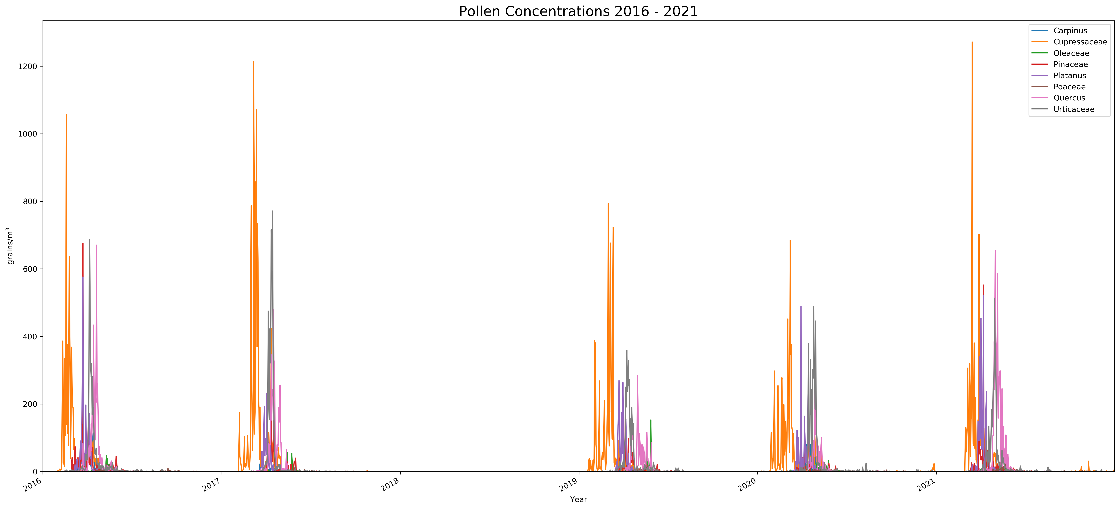
Laboratory Of Atmospheric Physics
Τhe years 2019-2020 show reduced pollen concentrations.
Quercus has its highest peak in 2016.

Slide 6
High resolution modeling system
First
Second
Last
Weather Research and Forecasting (WRF) meteorological model
Natural EMissions mOdel (NEMO)
Chemistry-transport Model (CAMx)
Laboratory Of Atmospheric Physics

Slide 7
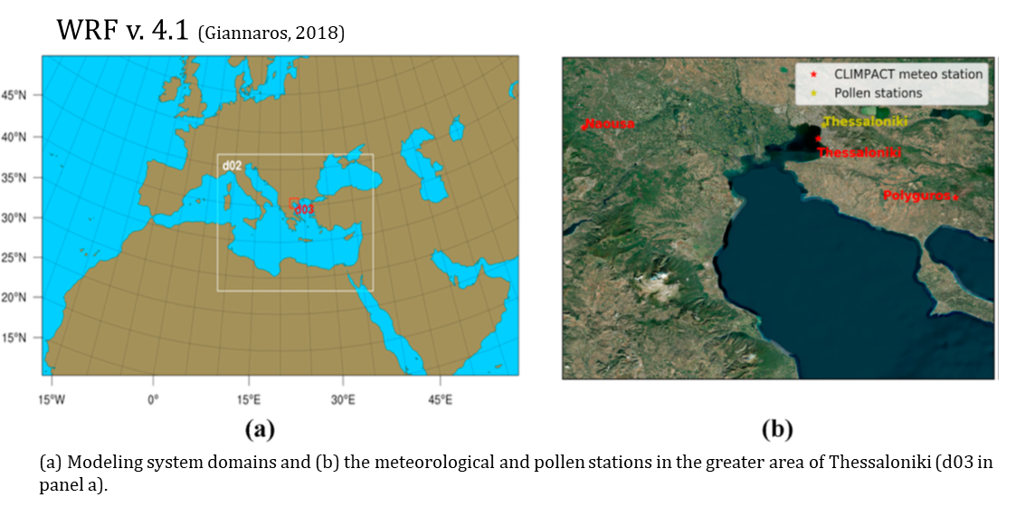
First
Weather Research and Forecasting (WRF) meteorological model
Domain | Spatial Resolution
do1 | 18 km
do2 | 6 km
do3 | 2 km
The simulations are performed in 4-days intervals
Hourly meteorological fields
Laboratory Of Atmospheric Physics

Slide 8
Second
Quercus pollen emission fields
Natural EMissions mOdel (NEMO)
Modifications:
Annual available pollen (grains/m²) – AAP and the representative pollen properties, particle density and diameter
Physical mechanisms
Daily fraction of AAP is calculating by fitting a Gaussian distribution for 2016 pollen data (Wozniak and Steiner, 2017)
The derivation of AAP requires two types of information:
    the area fraction of Quercus European Forest Inventory database (EFI) (Brus et al., 2012)
    the pollen grains/m² of crown diameter
EUFOR17 database
Fernandez-Gonzalez et al. (2020)
Laboratory Of Atmospheric Physics
Inhibition factors of precipitation, wind and relative humidity of Sofiev et al. (2013) are adopted, based on the applicability of Helbig et al. (2004) algorithms.

Slide 9
Second
Natural EMissions mOdel (NEMO)
E_{pollen}: Produced emissions in grains/m² for each gridcell within the time interval Δt (i.e. hourly)
ρ_{pollen}: Pollen grain density kg/m³
D_{p}: Pollen grain diameter (μm)
c_{b}: Constant equal to 10⁻⁴
f_{wind}, f_{prec} and f_{humid}: Inhibition factors for wind, precipitation and humidity
γ: Daily fraction of AAP
u*: Friction velocity, directly provided by WRF
Δz: First layer of the modeling system, equal to 28m
Chemistry-transport Model (CAMx)
Laboratory Of Atmospheric Physics
CAMx version 6.5: 3-D hourly concentrations of Quercus pollen
Last

Slide 10

Main pollen period: 23 March to 15 May 2016 - 95% method (Andersen, 1991)
Timeseries of the observed and simulated Quercus pollen concentrations for the period 23 March - 15 May of 2016. Initial run (base)
Laboratory Of Atmospheric Physics
The model can satisfactorily predict the phenological timing and the daily variability of the pollen concentrations.
The model underestimates the observed concentrations, especially during the start and end of the pollen season.

Slide 11
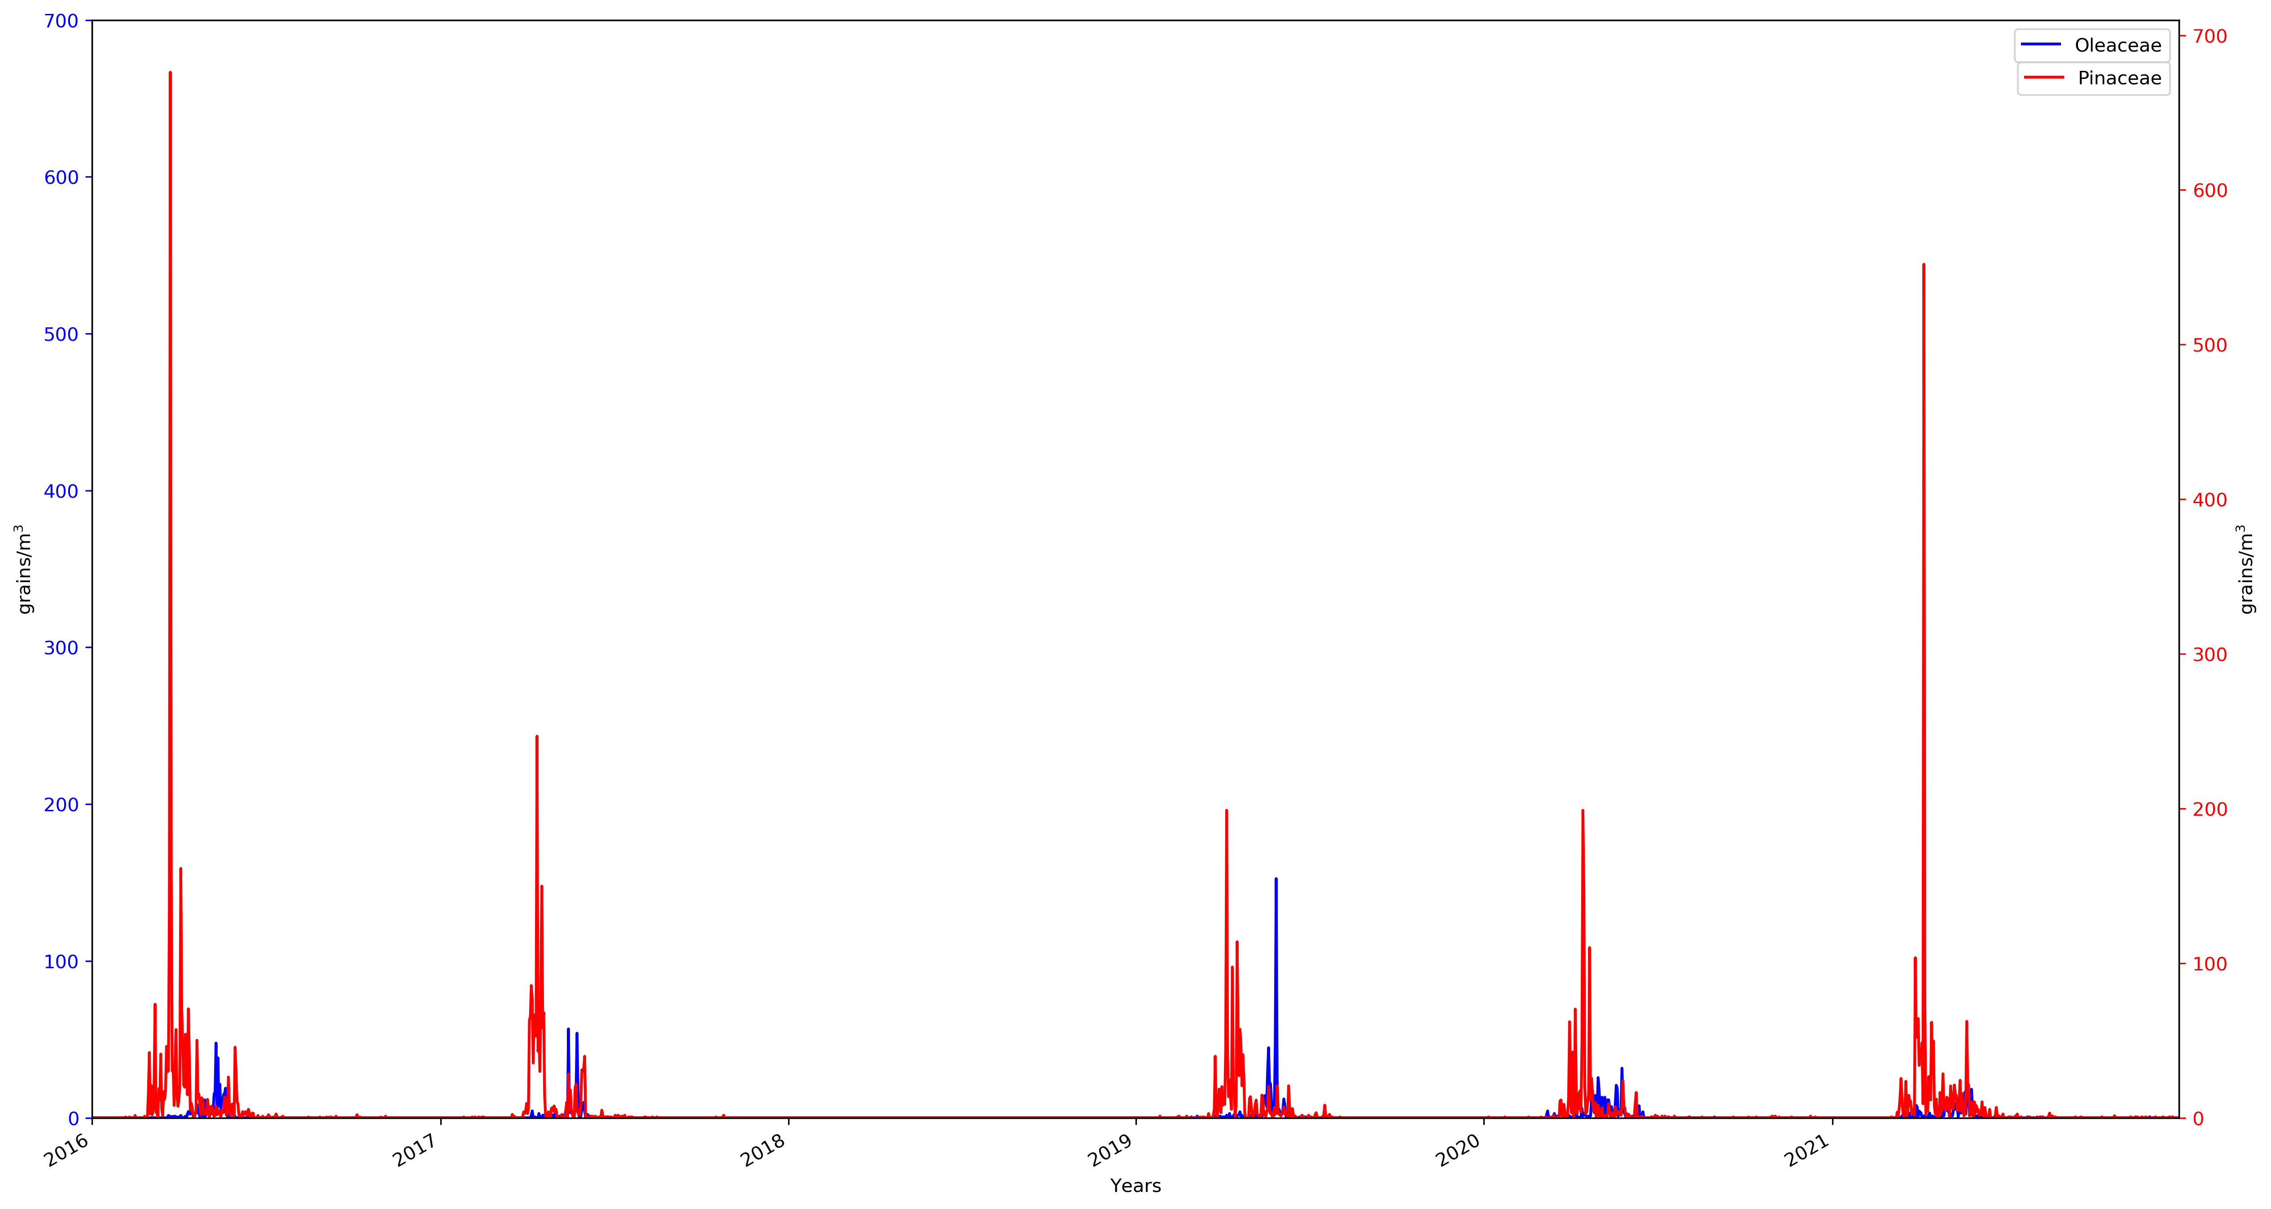
Mann-Kendall Test:
No trend
p-value: 0,43
Mann-Kendall Test:
Decreasing trend
p-value: 0,016
Laboratory Of Atmospheric Physics
Oleaceae and Pinaceae are the most frequently occurring study species in the Mediterranean Basin due to their allergenicity.
Pinaceae p-value indicates that a trend is present in the time series data.
Oleaceae doesn’t present biennial trend.

Slide 12
Oleaceae Phenology
Region | Year | Start DOY | Date | End DOY | Date | Duration
Thessaloniki - Greece | 2016 | 94 | 4 Apr. | 142 | 22 May | 48
 | 2017 | 100 | 10 Apr. | 155 | 4 Jun. | 55
 | 2019 | 99 | 9 Apr. | 157 | 6 Jun. | 58
 | 2020 | 75 | 16 Mar. | 164 | 13 Jun. | 89
 | 2021 | 86 | 27 Mar. | 171 | 20 Jun. | 85
 | 2016-2021 | 90 | 31 Mar. | 157 | 6 Jun. | 67
Pinaceae Phenology
Thessaloniki - Greece | 2016 | 62 | 3 Mar. | 154 | 3 Jun. | 92
 | 2017 | 94 | 4 Apr. | 152 | 1 Jun. | 58
 | 2019 | 84 | 25 Mar. | 166 | 15 Jun. | 82
 | 2020 | 82 | 23 Mar. | 161 | 10 Jun. | 79
 | 2021 | 73 | 14 Mar. | 161 | 10 Jun. | 88
 | 2016-2021 | 79 | 20 Mar. | 158 | 7 Jun. | 80
Laboratory Of Atmospheric Physics
Oleaceae main pollen season starts at the end of March – 1st week of April, ends at 1st week of June and lasts approximately 2 months.
Pinaceae main pollen season starts at the 2nd 15-day of March, ends at 1st week of June and lasts almost 3 months.

Slide 13
Normality Tests
Oleaceae
Pinaceae
Normality Tests | Statistic | p-value
Kolmogorov-Smirnov (one sample) | 0,69 | 1,07 10⁻¹⁵⁶
Kolmogorov-Smirnov (two samples) | 0,16 | 1,83 10⁻⁵
Shapiro-Wilk | 0,4 | 1,67 10⁻³¹
Lilliefors | 0,33 | 2,46 10⁻¹⁰⁵
Normality Tests | Statistic | p-value
Kolmogorov-Smirnov (one sample) | 0,69 | 9,72 10⁻²⁷⁸
Kolmogorov-Smirnov (two samples) | 0,16 | 1,83 10⁻⁵
Shapiro-Wilk | 0,29 | 2,91 10⁻⁴²
Lilliefors | 0,37 | 5,17 10⁻²³⁴
Laboratory Of Atmospheric Physics
Null hypothesis is rejected for both species.
As p-value is < 0.05, the data are not normally distributed.

Slide 14
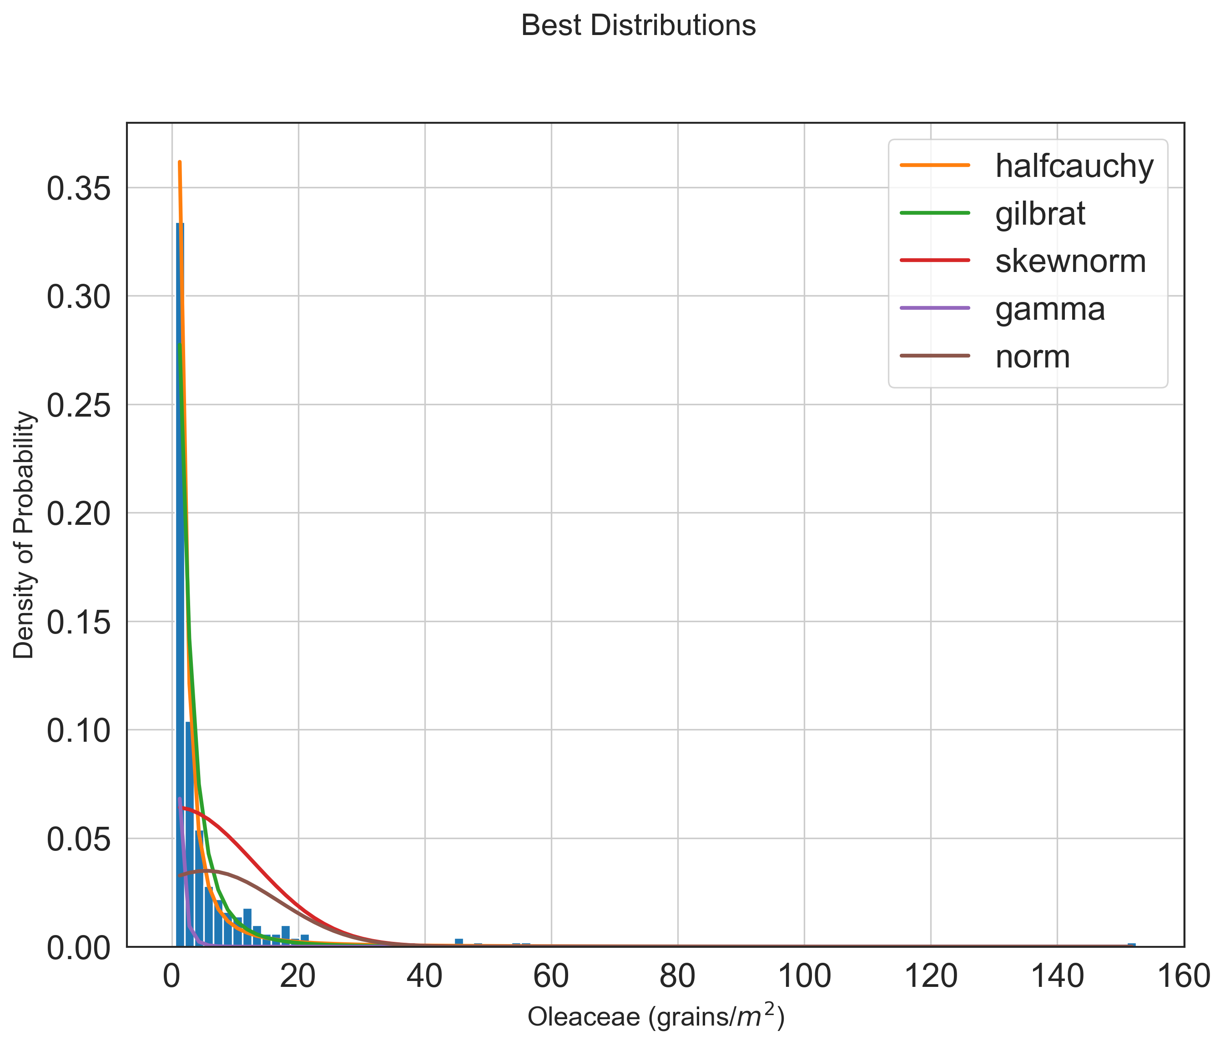
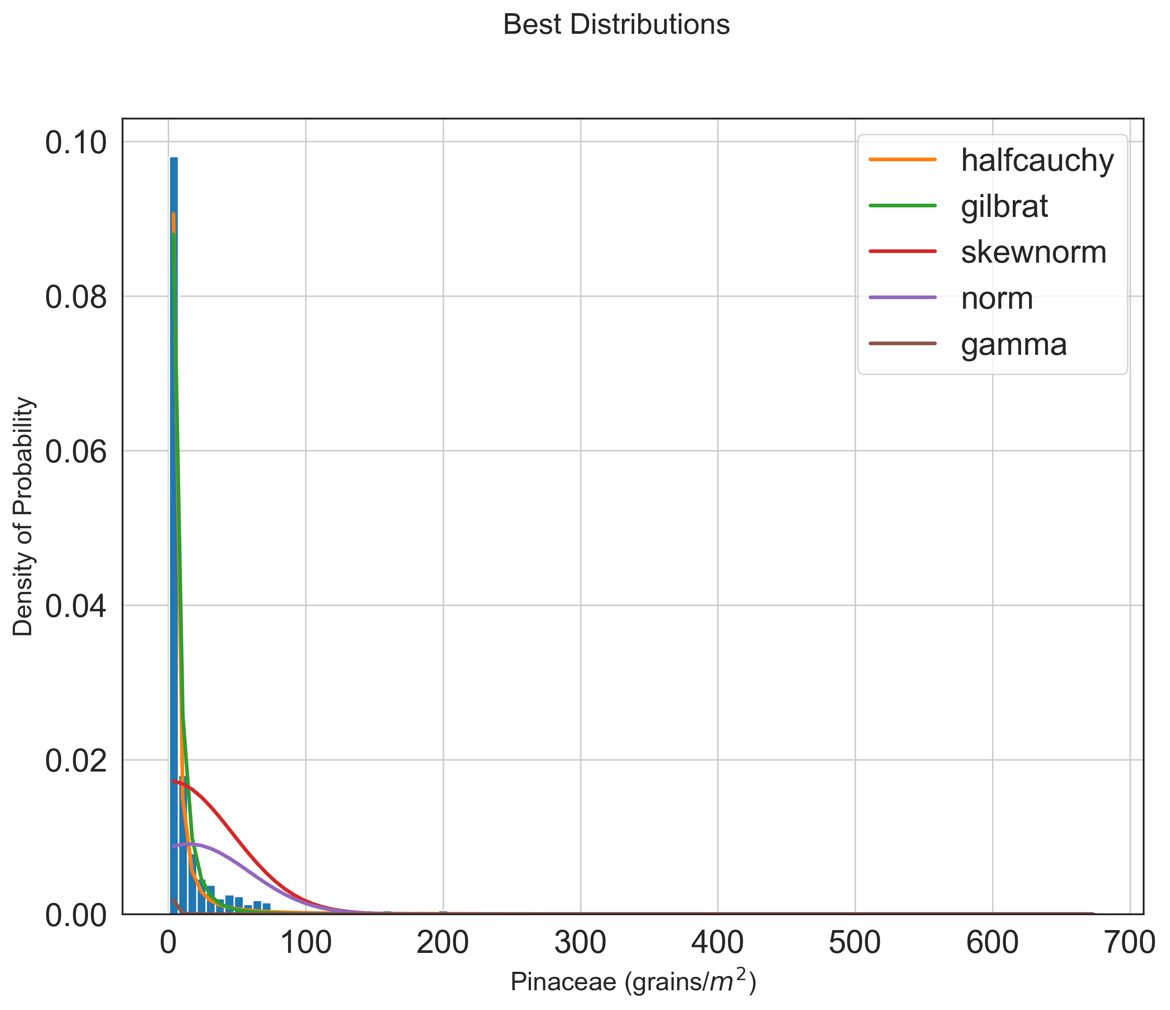
Distribution Plots
Distribution | SSE | AIC | BIC
halfcauchy | 0,001422 | 1653,287 | -4052,13
gilbrat | 0,005583 | 2154,749 | -3602,15
skewnorm | 0,082256 | 5559,741 | -2711,33
gamma | 0,084592 | 10924,96 | -2702,12
norm | 0,098336 | 6045,606 | -2658,38
Distribution | SSE | AIC | BIC
halfcauchy | 0,000089 | 2115,78 | -9155,02
gilbrat | 0,000181 | 2912,86 | -8739,11
skewnorm | 0,007174 | 7939,15 | -6584,30
norm | 0,008223 | 8329,50 | -6510,99
gamma | 0,009704 | 20643,27 | -6407,87
Laboratory Of Atmospheric Physics
The data show right skewness and Half-Cauchy exponential distribution best fits them.

Slide 15
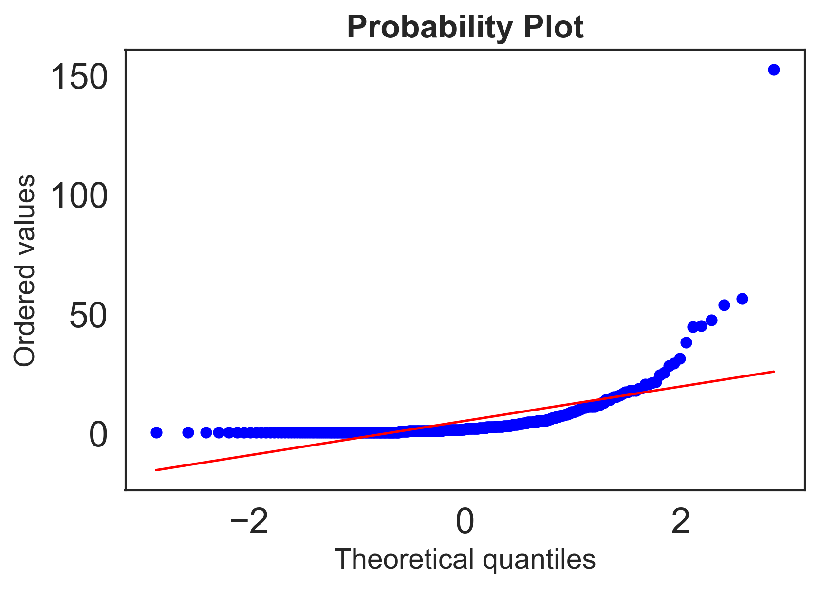
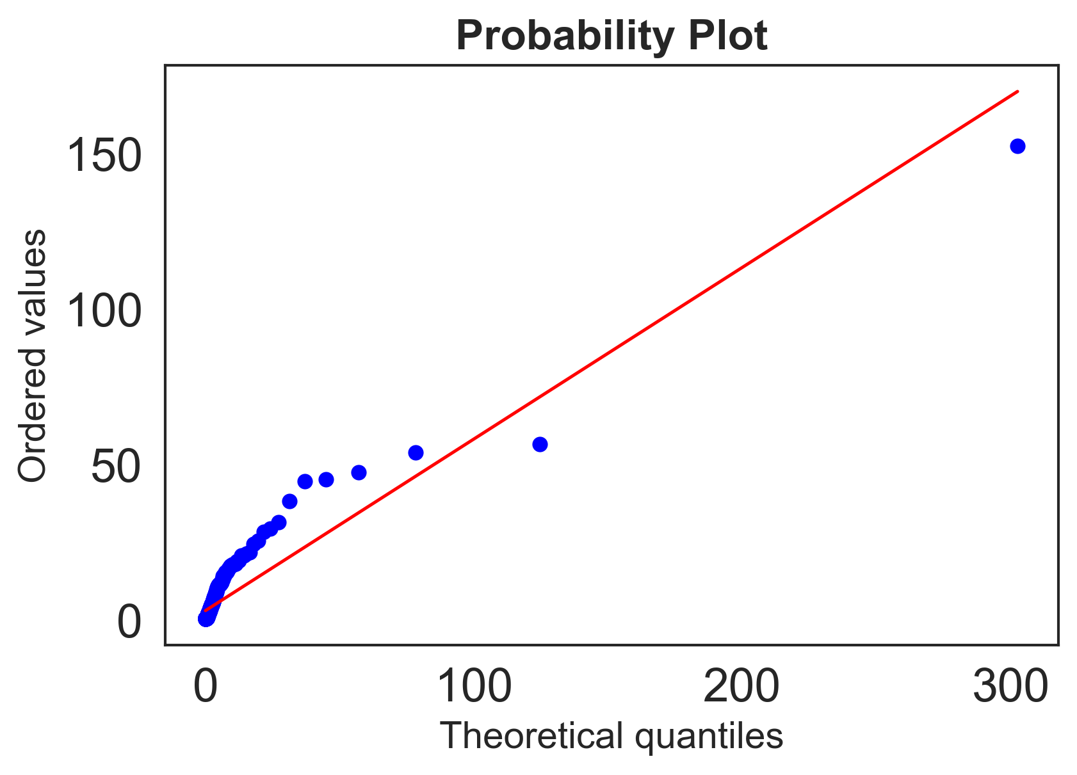
Probability Plots
Oleaceae
Laboratory Of Atmospheric Physics
The probability plots selected show the smallest error.
Nearly a straight line at probability plot proves the appropriateness of using the exponential distribution.

Slide 16
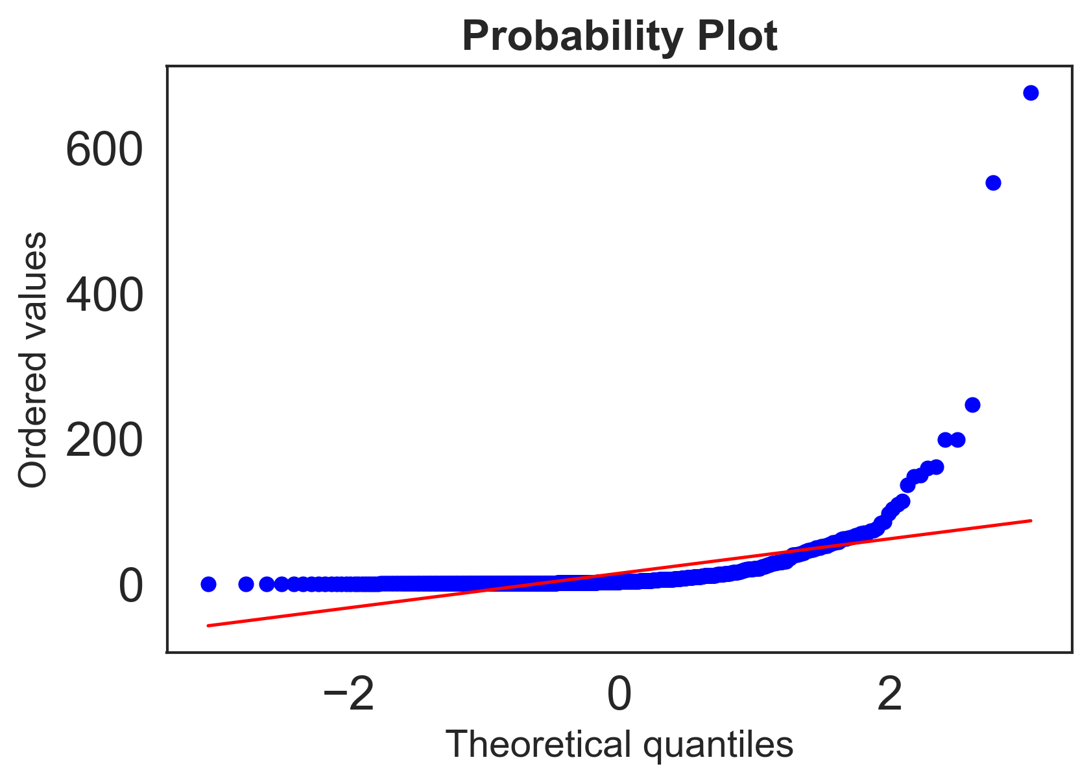
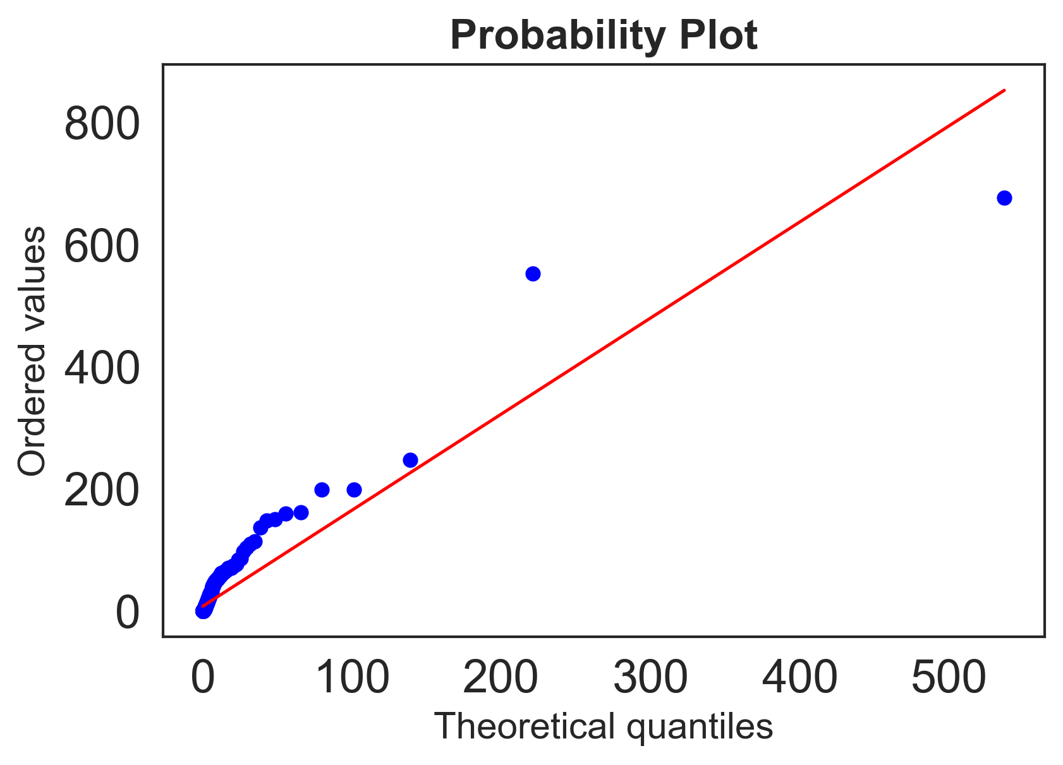
Probability Plots
Pinaceae
Laboratory Of Atmospheric Physics
The probability plots selected show the smallest error.
Nearly a straight line at probability plot proves the appropriateness of using the exponential distribution.

Slide 17
Future Prospects
Applying the exponential distribution instead of the normal one
Extending the modeling system to more pollen species
Calculation of pollen concentrations in Athens and other Greek cities
Laboratory Of Atmospheric Physics

Slide 18
Thank you!
Any questions?

Slide 19
Back-Up Slides

Slide 20
Laboratory Of Atmospheric Physics

Slide 21
Timeseries of a) the observed and the Quercus pollen concentrations of
the simulations, b) Quercus robur/petraea category contribution and c) Quercus other category contribution for the period 23 March - 15 May of
2016 at the pollen station of Thessaloniki.
Laboratory Of Atmospheric Physics

Slide 22
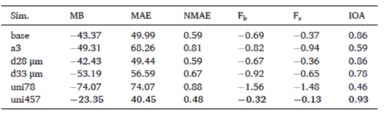
Simulations:
Base: a = 8
a₃: a = 3 (Wozniak and Steiner, 2017)
d₂₈: 28 μm
d₃₃: 33 μm
uni₇₈: 78 107 grains/m² of crown diameter (Molina et al., 1996 ; Wozniak and steiner, 2017)
uni₄₅₇: 457 107 grains/m² of crown diameter
Laboratory Of Atmospheric Physics

Slide 23
Laboratory Of Atmospheric Physics
Maps of the mean of the daily absolute differences and relative frequencies of airborne oak pollen levels at the surface derived from the a3 and base simulations (a,b), from d33 μm and d28 μm simulations (c,d) and uni457 and uni78 simulations (e,f) in the greater area of Thessaloniki for the period 23 March - 15 May of 2016.

Slide 24
Pinaceae Phenology
European Studies |  | Years | Start DOY | Date | End DOY | Date | Duration
Nilsson et al., 1981 | Stockholm - Sweden | 1973-1980 | 152 | 1 Jun. | 170 | 19 Jun. | 18
Jato et al., 1999 | Vigo - Spain | 1995-1998 | 54 | 23 Feb. | 116 | 26 Apr. | 60
Frenguelli et al., 2002 | Rerugia - Italy | 1982-2001 | 105 | 15 Apr. | 170 | 19 Jun. | 65
Docampo et al., 2007 | Nerja - Spain | 2001-2003 | 44 | 13 Feb. | 135 | 15 May | 92
Velasco-Jimenez et al., 2018 | Cordoba - Spain | 1993-2014 | 64 | 5 Mar. | 158 | 7 Jun. | 94
 | Granada - Spain | 1993-2014 | 70 | 11 Mar. | 161 | 10 Jun. | 91
 | Jaen - Spain | 1993-2014 | 66 | 7 Mar. | 154 | 3 Jun. | 88
 | Malaga - Spain | 1993-2014 | 45 | 14 Feb. | 165 | 14 Jun. | 120
Fernández-González et al., 2021 | Vigo, Ourense, Toledo - Spain | 1995-2016 | 56 | 25 Feb. | 114 | 24 Apr. | 60
Zemmer et al., 2022 | Instabul - Turkey | 2013-2016 | 90 | 31 Mar. | 209 | 28 Jul. | 120
Laboratory Of Atmospheric Physics

Slide 25
Oleaceae Phenology
European - African Studies |  | Years | Start DOY | Date | End DOY | Date | Duration
Frenguelli et al., 1989 | Perugia, Ascoli Piceno - Italy | 1982-1988 | 146 | 26 May | 174 | 23 Jun. | 28
González Minero et al., 1996 | Huelva - Spain | 1989-1994 | 111 | 21 Apr. | - | - | -
Alba et al., 1998 | Granada - Spain | 1992-1995 | 110 | 20 Apr. | 133 | 13 May | 23
Moriondo et al., 2001 | Prato - Italy | 1991-1998 | 148 | 28 May | 166 | 15 Jun. | 18
 | Florence - Italy | 1991-1998 | 148 | 28 May | 164 | 13 Jun. | 16
Orlandi et al., 2001 | Umbria - Italy | 1998-2000 | 97 | 7 Apr. | - | - | -
Rodríguez-Rajo et al., 2004 | Vigo - Spain | 1995-2002 | 118 | 28 Apr. | 159 | 8 Jun. | 41
Galán et al., 2005 | Málaga - Spain | 1982-2002 | 70 | 11 Mar. | - | - | -
 | Granada - Spain | 1982-2002 | 108 | 18 Apr. | - | - | -
 | Jaén - Spain | 1982-2002 | 113 | 23 Apr. | - | - | -
 | Priego - Spain | 1982-2002 | 106 | 16 Apr. | - | - | -
 | Córdoba - Spain | 1982-2002 | 97 | 7 Apr. | - | - | -
Docampo et al., 2007 | Nerja-Spain | 2001-2003 | 109 | 19 Apr. | 172 | 21 Jun. | 63
Bonofiglio et al., 2009 | Umbria - Italy | 1982-2007 | 148 | 28 May | 178 | 27 Jun. | 30
Sicard et al., 2012 | Nice - France | 1990-2009 | 115 | 25 Apr. | 197 | 6 Jul. | 82
Rojo et al., 2014 | Toledo - Spain | 2010-2013 | 135 | 15 May | 171 | 20 Jun. | 36
Achmakh et al., 2015 | Tétouan - Morocco | 2008-2012 | 87 | 28 Mar. | 171 | 20 Jun. | 84
Aguilera et al., 2015a | Andalusia - Spain | 1993-2011 | 113 | 23 Apr. | 179 | 28 Jun. | 66
Aguilera et al., 2015b | Tunisia | 1999-2011 | 102 | 12 Apr. | 143 | 23 May | 41
 | Italy | 1999-2011 | 123 | 3 May | 173 | 22 Jun. | 50
Ben Dhiab et al., 2016 | Tunisia | 1993-2011 | 107 | 17 Apr. | 129 | 9 May | 22
Fernández-Rodríguez et al., 2016 | Badajoz - Spain | 1994-2013 | 124 | 4 May | 158 | 7 Jun. | 34
Galera et al., 2018 | Cartagena - Spain | 1993-2016 | 112 | 22 Apr. | 168 | 17 Jun. | 56
Hadj Hamda et al., 2019 | Mornag - Tunisia | 2017 | 92 | 2 Apr. | 123 | 3 May | 31
 | MenzelM’hiri - Tunisia | 2017 | 83 | 24 Mar. | 107 | 17 Apr. | 24
 | Chaal - Tunisia | 2017 | 86 | 27 Mar. | 107 | 17 Apr. | 21
Cordero et al., 2021 | Madrid - Spain | 1993-2018 | 117 | 27 Apr. | 166 | 15 Jun. | 49
Tasioulis et al., 2022 | Thessaloniki-Greece | 1987-2018 | 92 | 2 Apr. | 168 | 17 Jun. | 76
Zemmer et al., 2022 | Instabul-Turkey | 2013-2016 | 126 | 6 May | 157 | 6 Jun. | 31
Laboratory Of Atmospheric Physics

