Slide 1
Students’ interpretation of graphs in physics and mathematics
Branislava Blajvaz Dragana Bogosavljević
Physics Teacher Math Teacher
Primary School Jovan Jovanović Zmaj
Sremska Mitrovica

Slide 2
Who are we and what we want to show in this research?
- working field - primary education
- idea - monitoring the primary educational
reforms through the correlation
between physics and math
- the main task - the students’ achievement
in contents implemented in
both subjects

Slide 3
Why are we investigating application of graphics?
Graphs are a part of the Physics 7th grade Curriculum
Graphs can also be introduced in the 6th grade (uniform linear motion)
Graphs are part of Math 6th and 7th Grade Curriculum
Direct and inverse dependence of quantities is part of 6th grade Curriculum

Slide 4
Research Sample
The research was conducted in the Primary school “Jovan Jovanović Zmaj” in Sremska Mitrovica.
Two classes of seventh grade students (13 years old) participated in the research.

Slide 5
Research Sample
A suitable research sample was selected
Gender | Number
Male | 26
Female | 31
Total | 57

Slide 6
Results
 | Physics (average score) | Mathematics (average score)
Total | 2,38 | 2,67
Boys | 2,84 | 2,65
Girls | 2,48 | 2,74

Slide 7
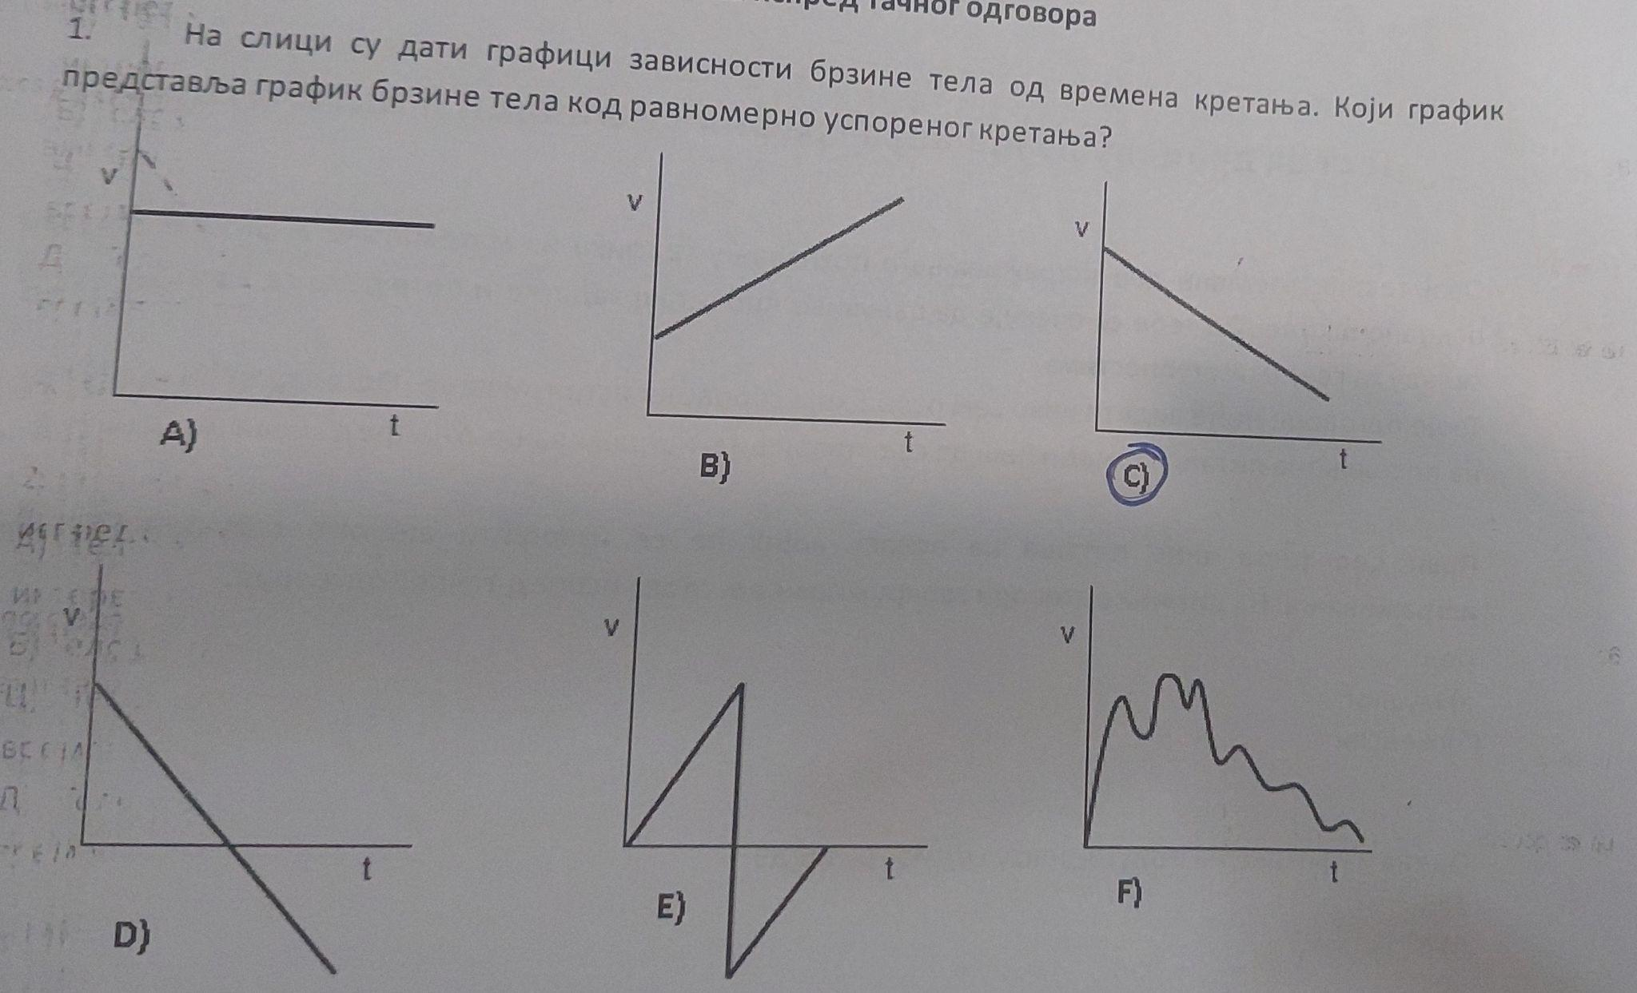
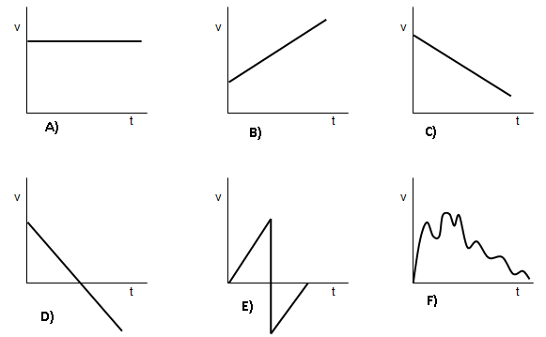
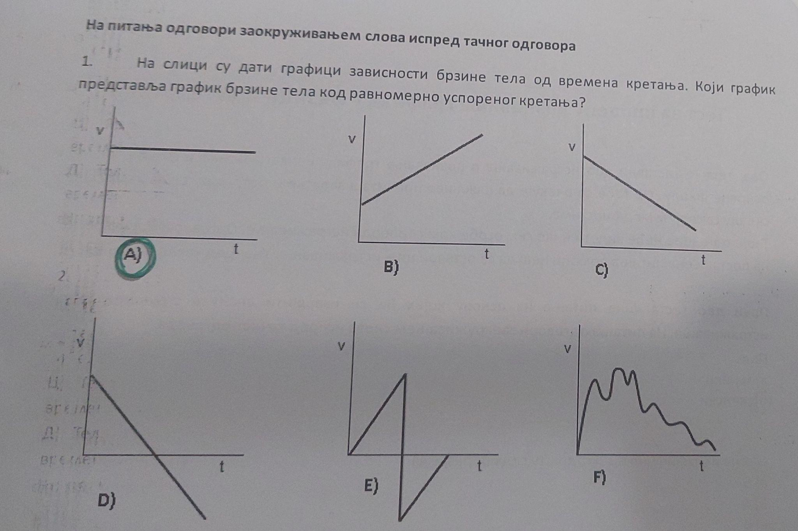
Graphs in Physics
Task 1
Which graph represents
velocity-time
graph in
a uniformly
deceleration
motion?
Results
Percentage of a task score: 82.46%
Male: 92.30%
Female: 74.19%

Slide 8
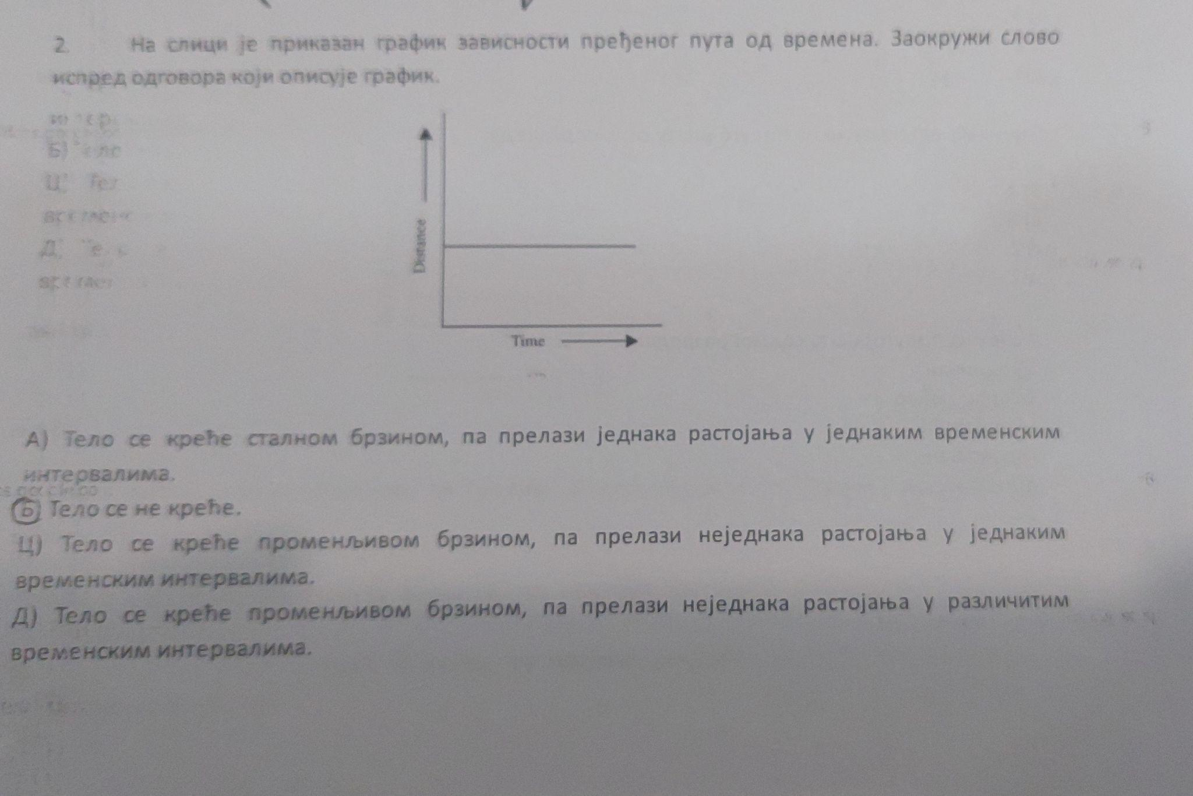
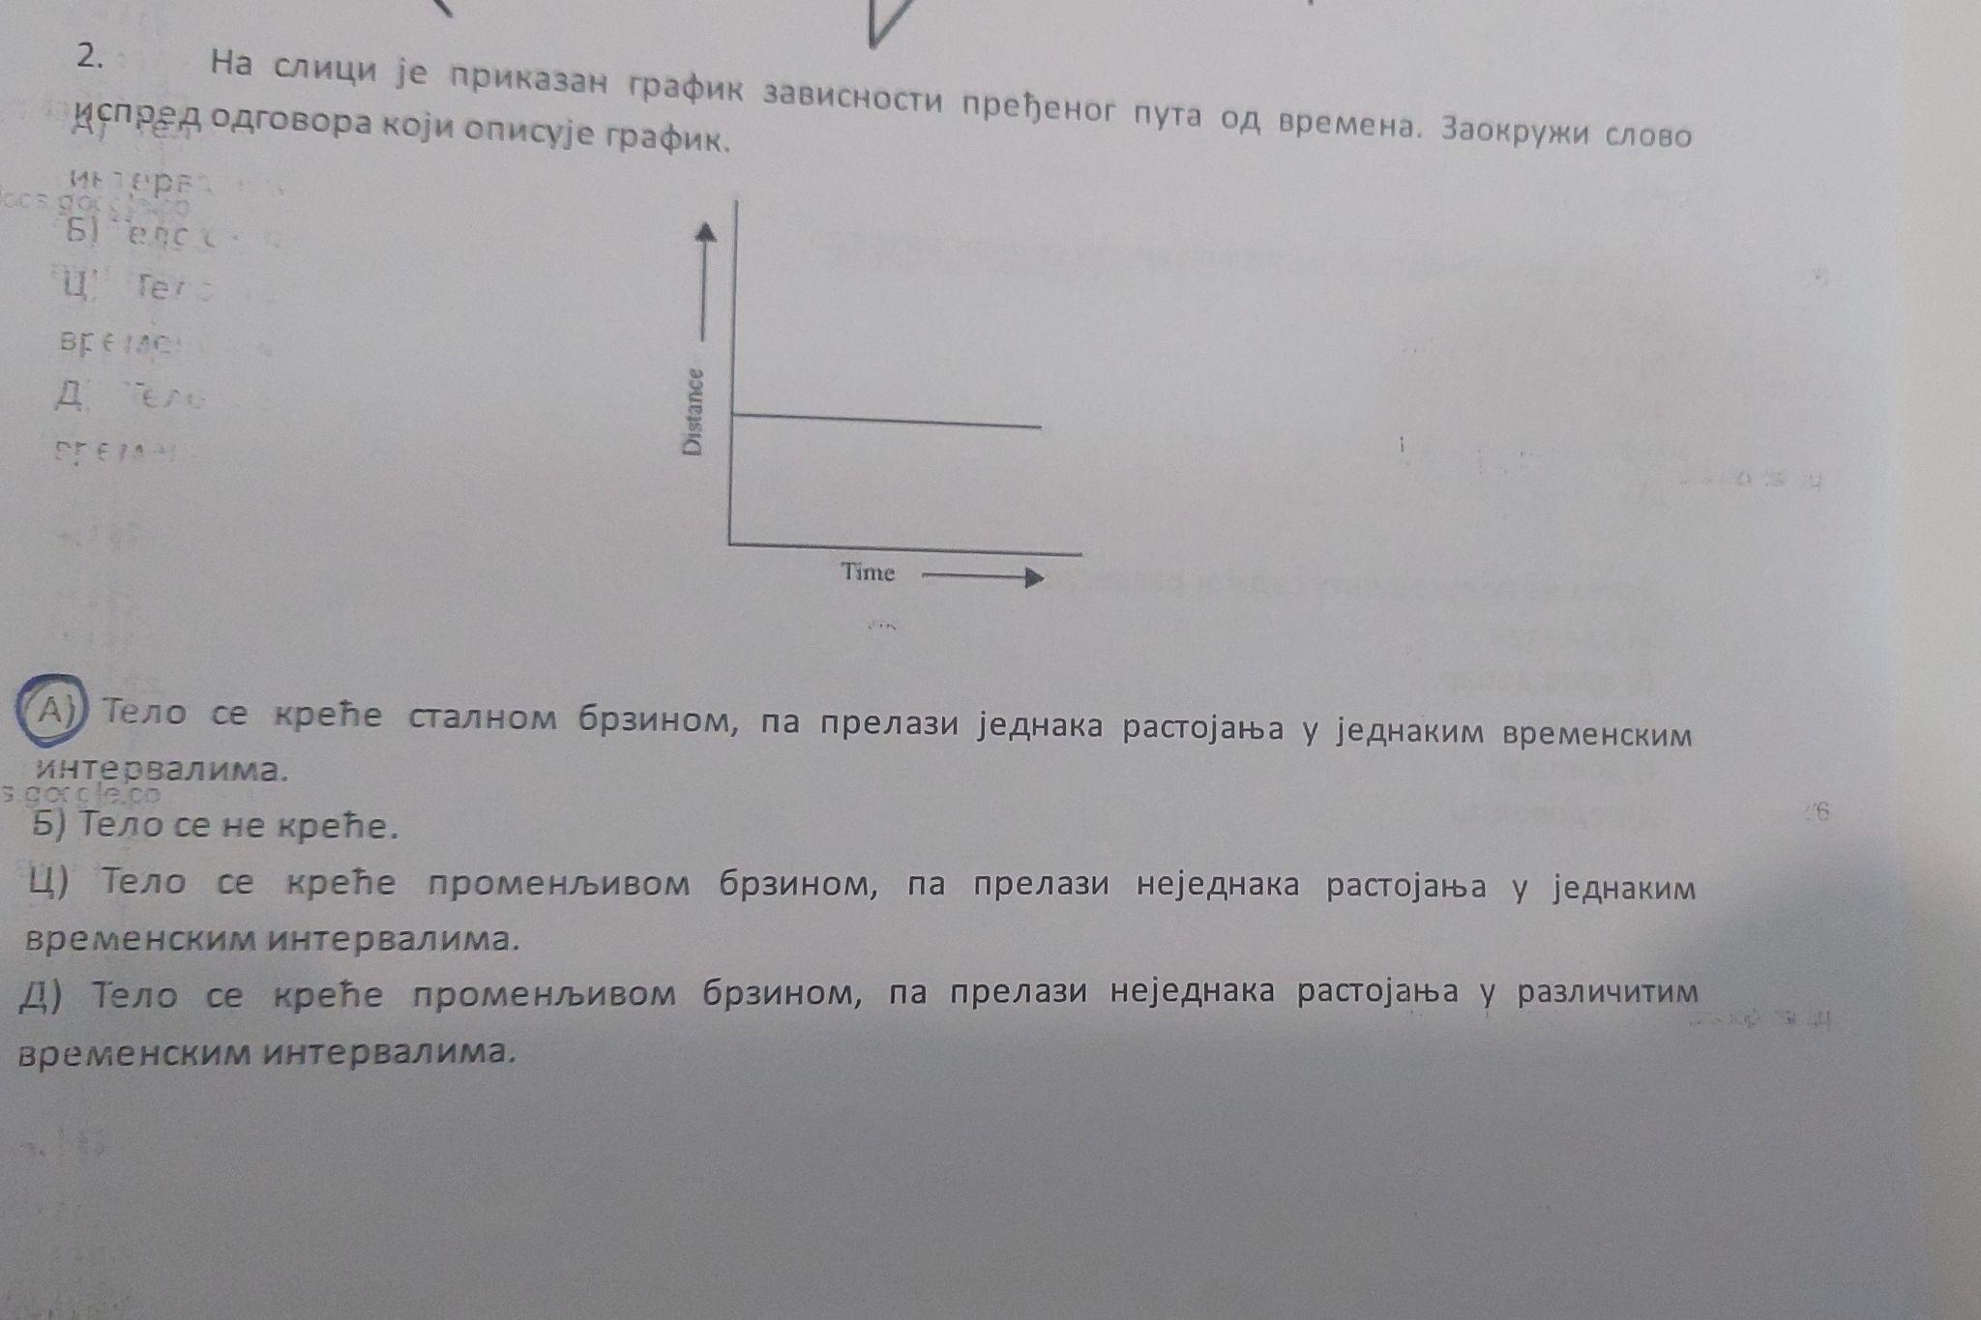
Graphs in Physics
Task 2
Which sentence describes the graph?
A)The body travels equal distances in equal time intervals
B)The body does not move
C)The body travels different distances in equal time intervals
Results
Percentage of a task score: 28,01%
Male: 26,92%
Female: 29,03%

Slide 9
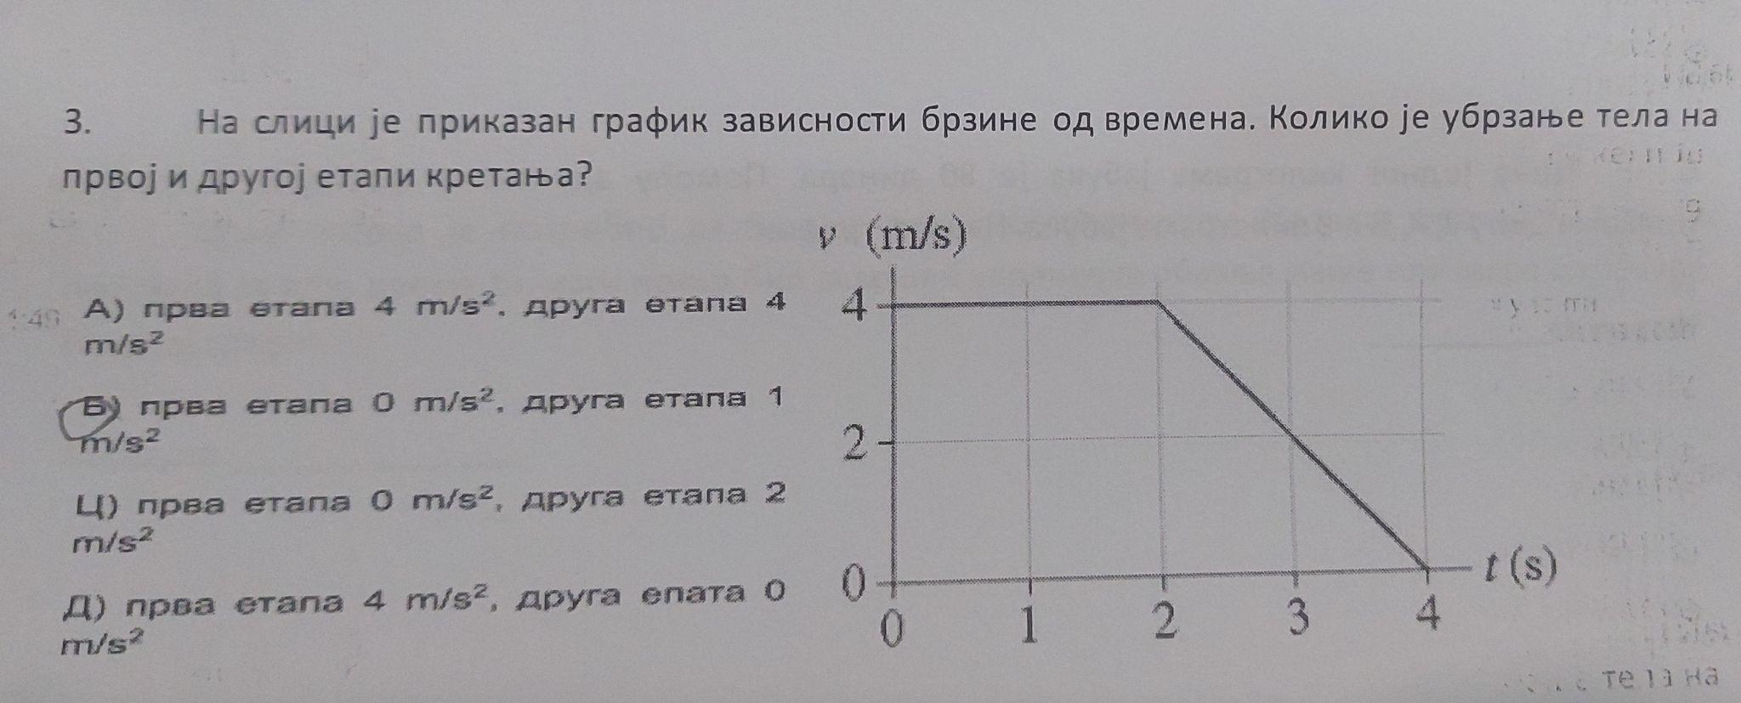
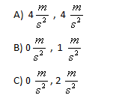
Graphs in Physics
Task 3
What is the acceleration of the body in the first and second stages of motion?
Results
Percentage of a task score: 21.05%
Male: 15.38%
Female: 22.58%

Slide 10
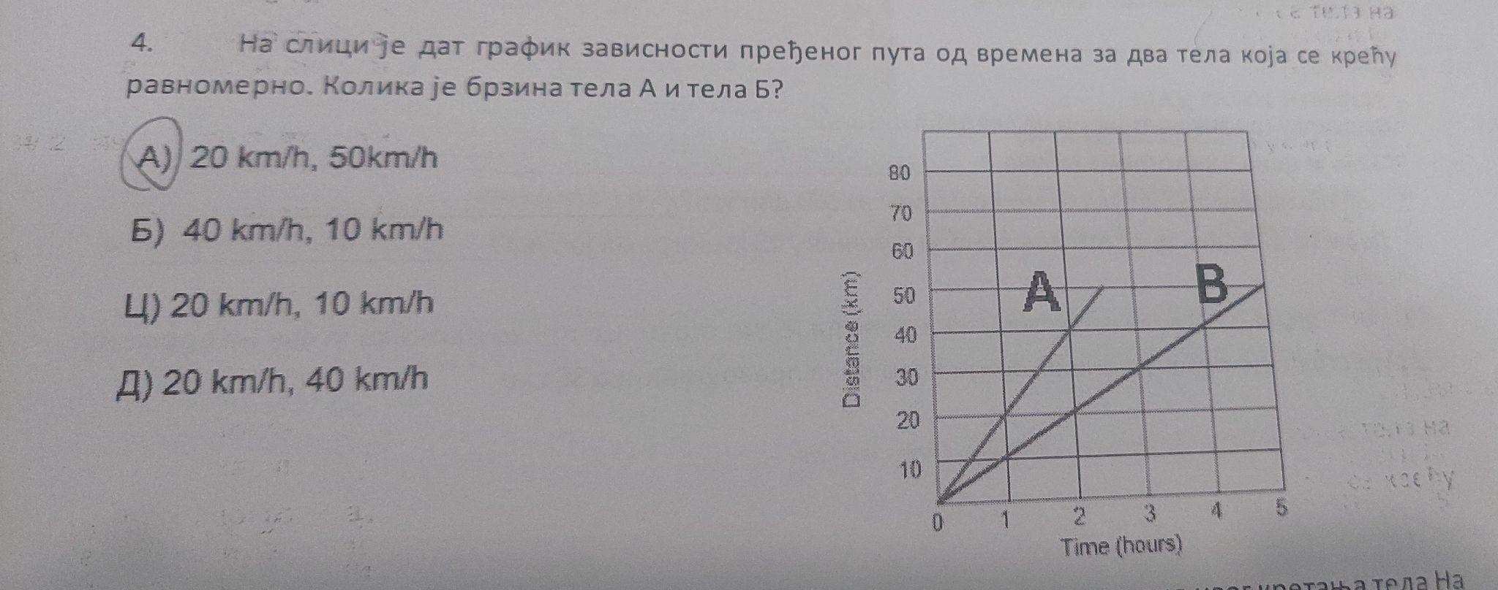
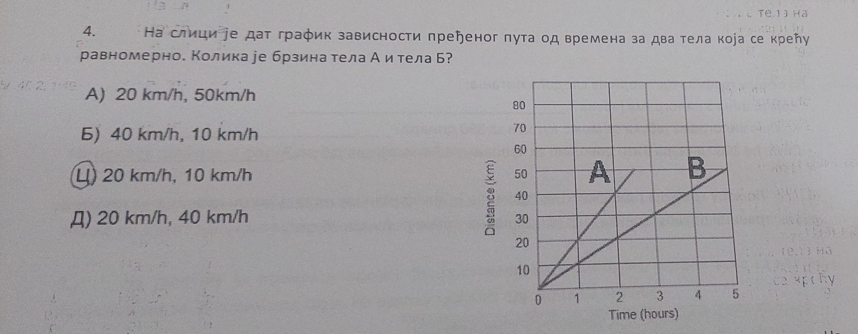
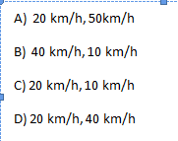
Graphs in Physics
Task 4
What is the velocity of the bodies?
Results
Percentage of a task score: 47.37%
Male: 50.00%
Female: 45.16%

Slide 11
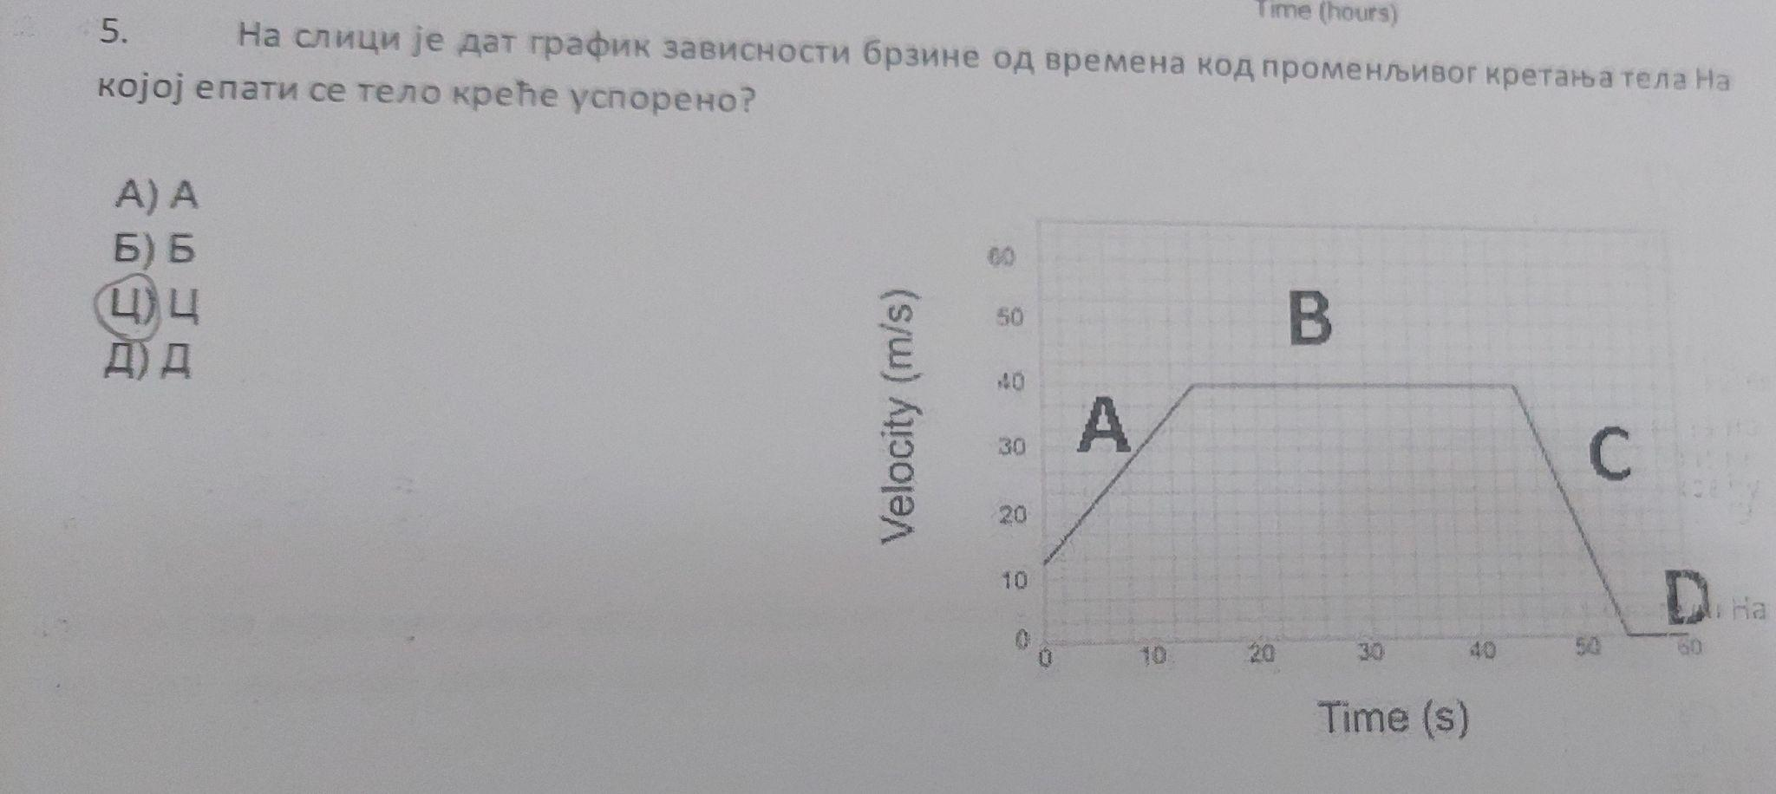
Graphs in Physics
Task 5
At what stage of the motion does the body slow down?
Results
Percentage of a task score: 80.70%
Male: 96.15%
Female: 67.74%

Slide 12
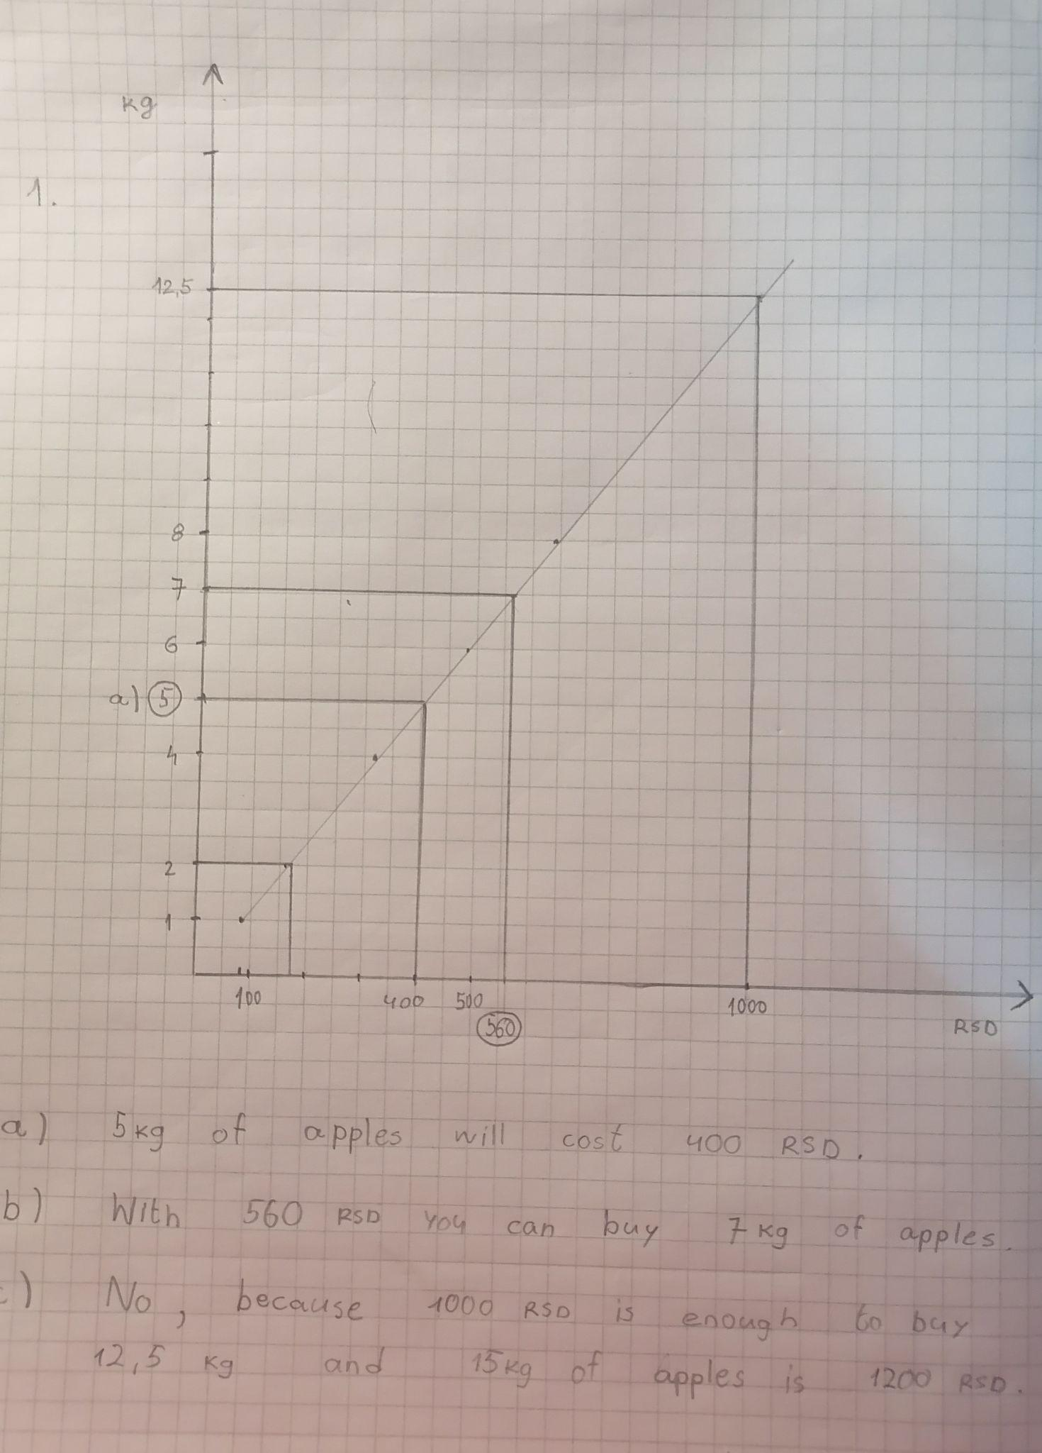
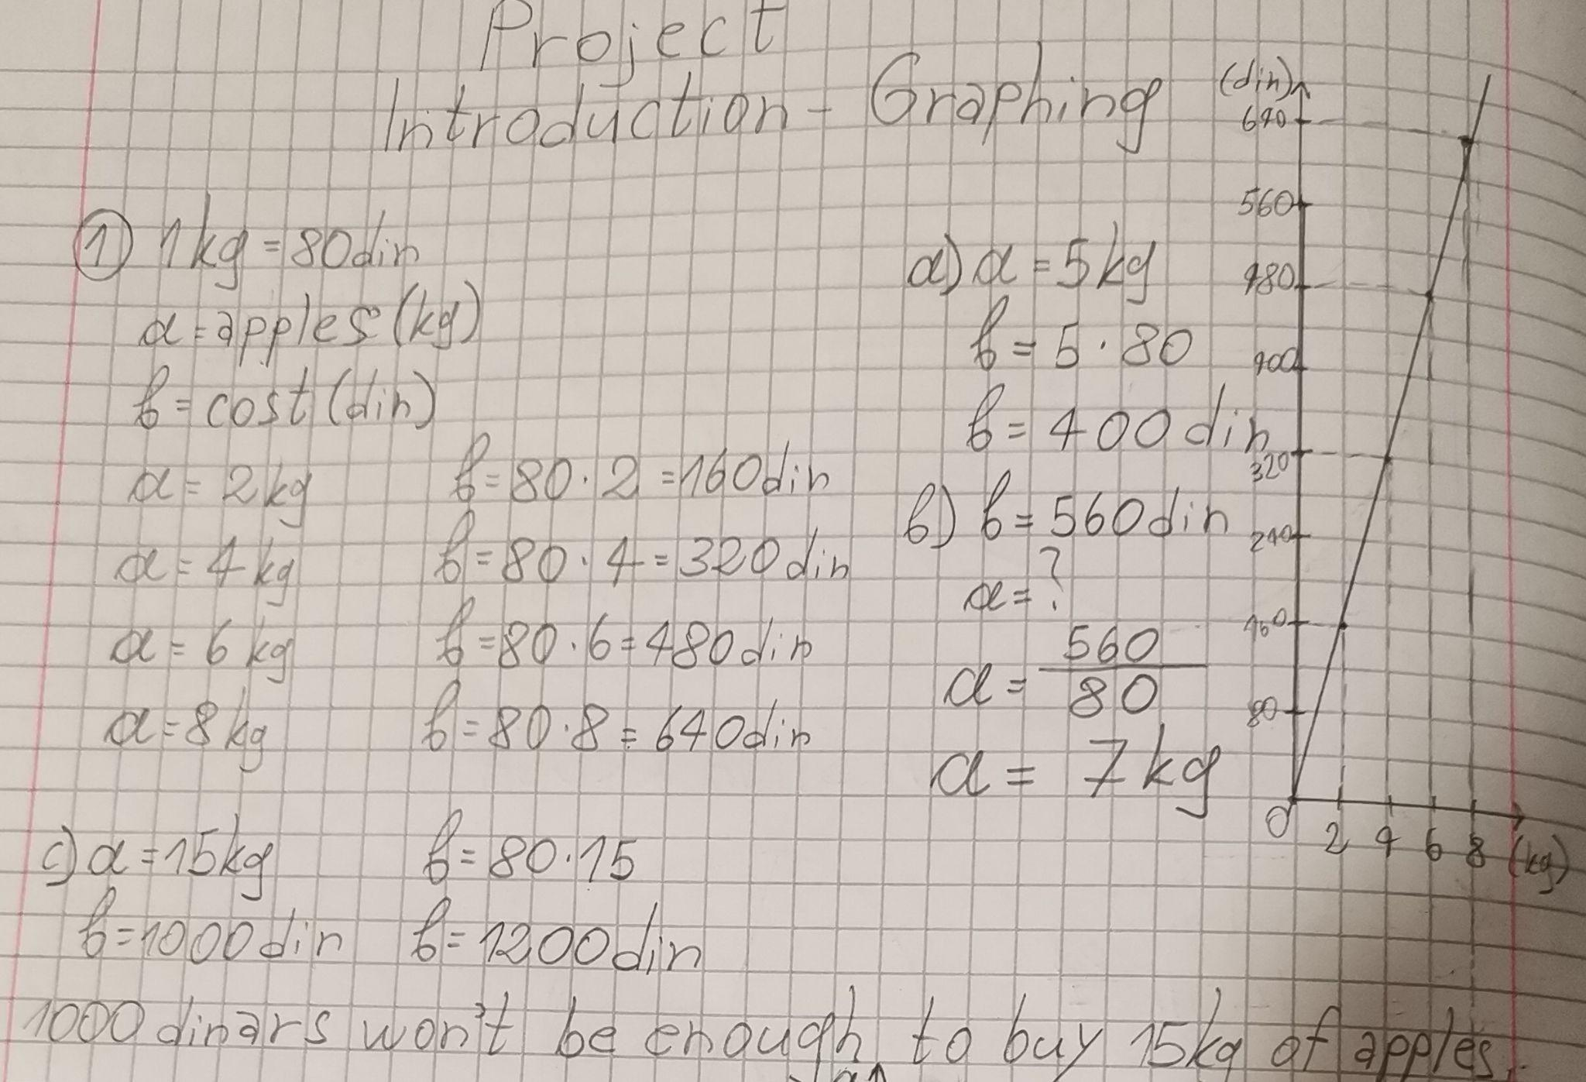
Graphs in Math - Evaluation
Task 6: (level - beginner)
The cost of 1 kg of apples is 80 serbian dinars. Use the adequate formula and graph to show the cost of 2, 4, 6, and 8 kilograms of apples.
a) What will be the cost of 5 kg?
b) How many kilograms of apples can you buy with 560 dinars?
c) Will 1000 dinars be enough to buy 15kg of apples?
Results:
Percentage of a task score:
Total - 85,96%
(49 out of 57)
Male - 84,61%
(22 out of 26)
Female - 87,1%
(27 out of 31)

Slide 13
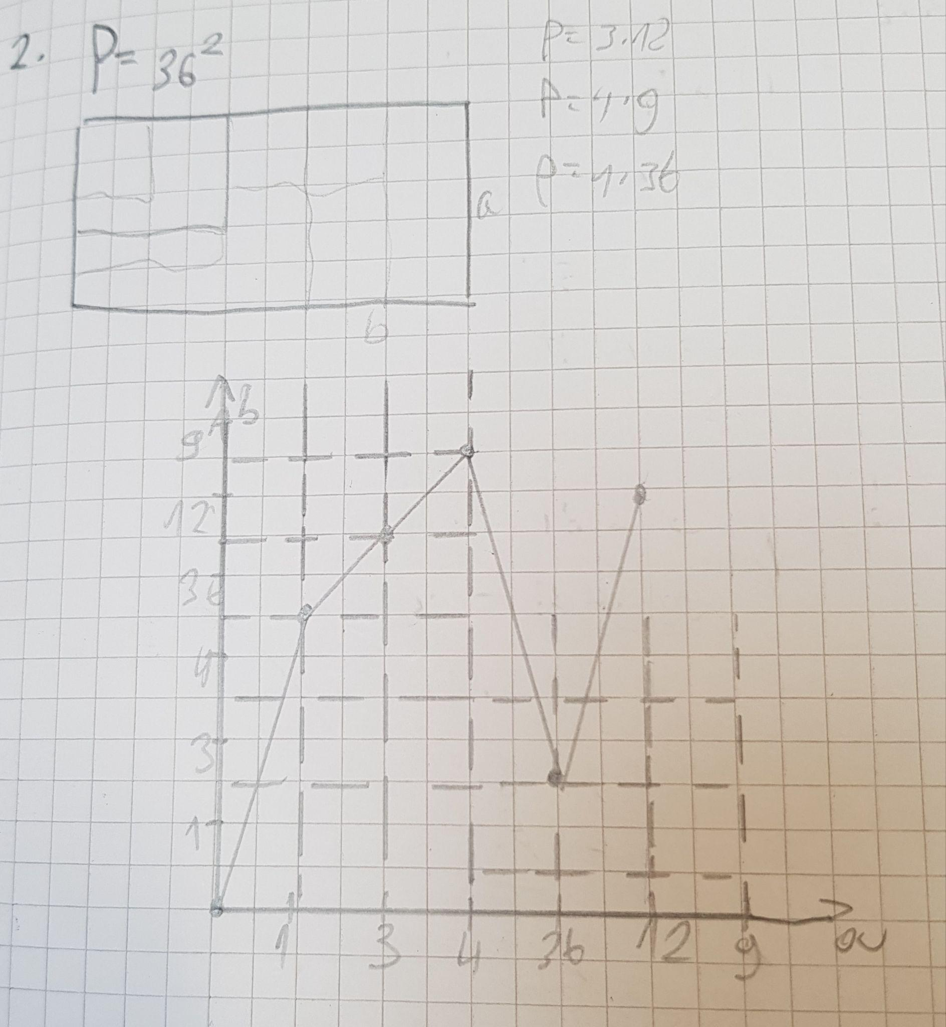
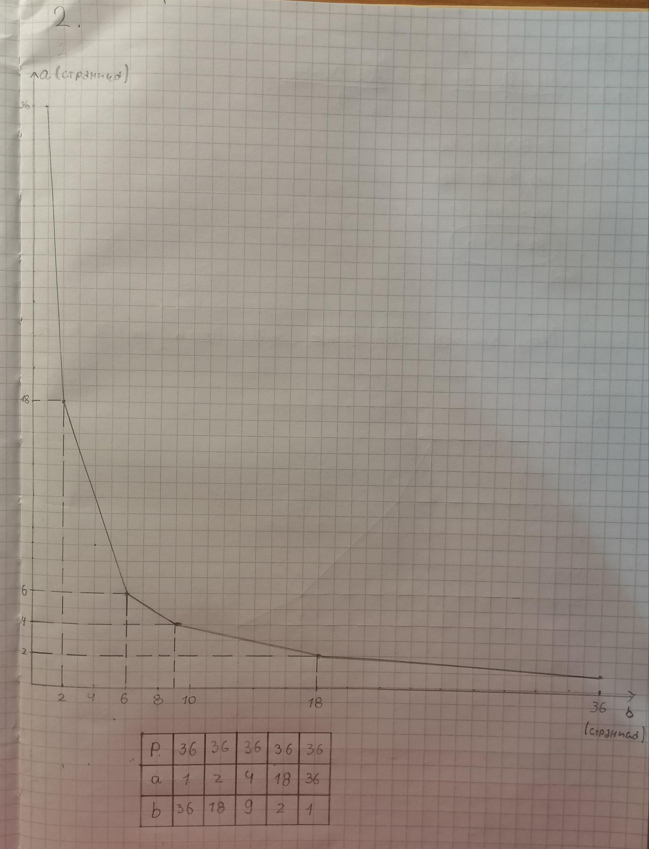
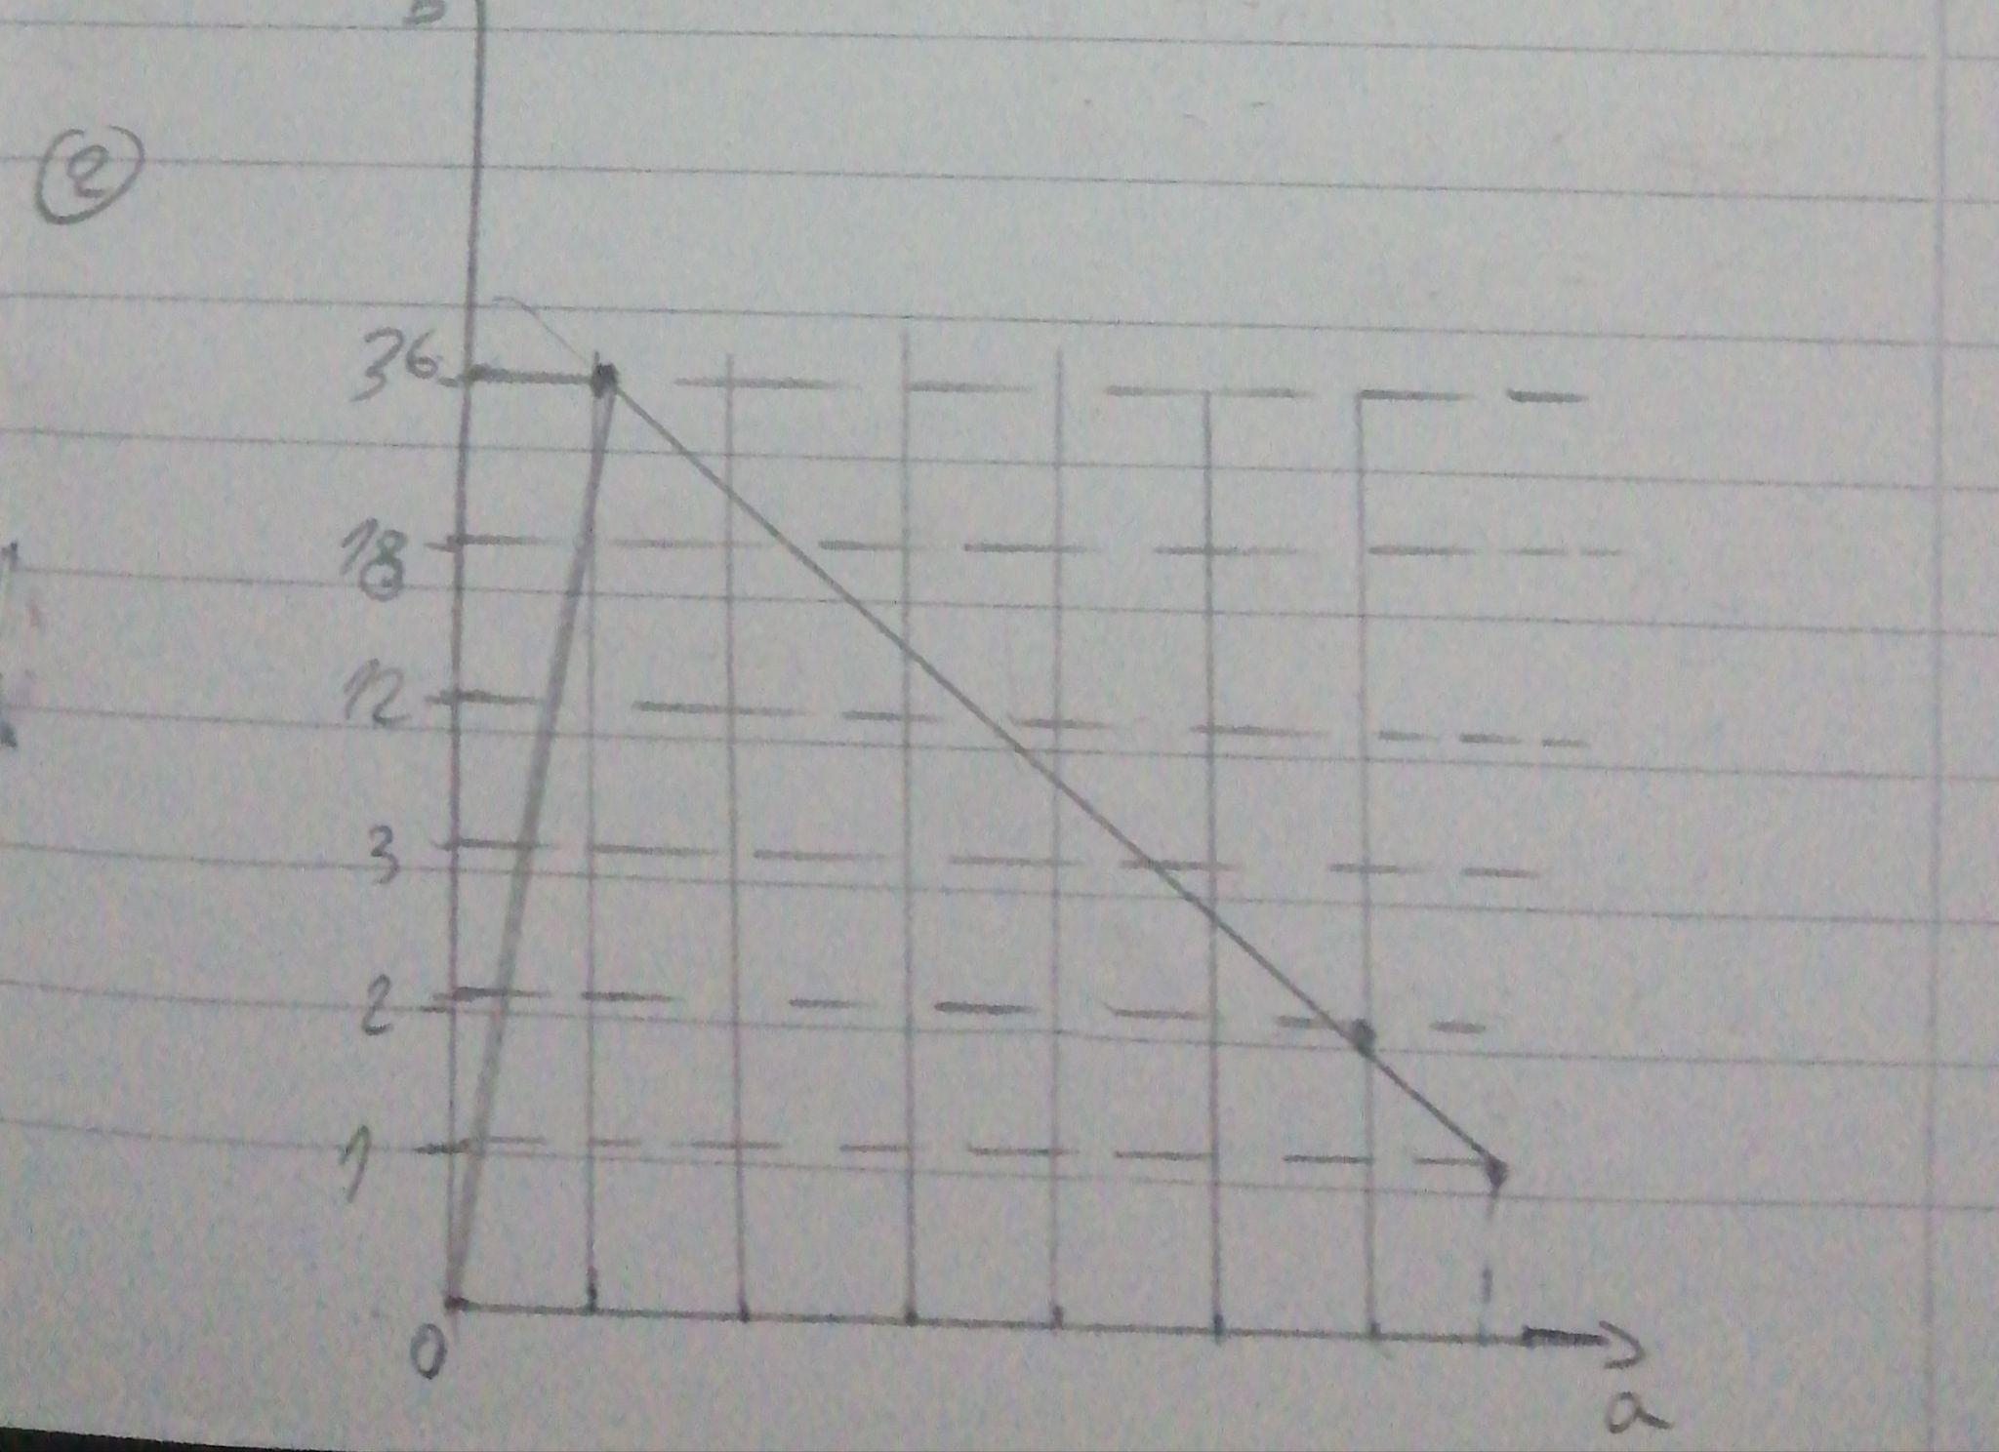
Graphs in Math - Evaluation
Task 7: (level - beginner)
Use the graph to show how quantity change of one side reflects on the length of the other side of a rectangle, if the area equals 36 square centimetres.
Results:
Percentage of a task score:
Total - 33,33%
(19 out of 57)
Male - 33,61%
(9 out of 26)
Female - 29,03%
(9 out of 31)

Slide 14
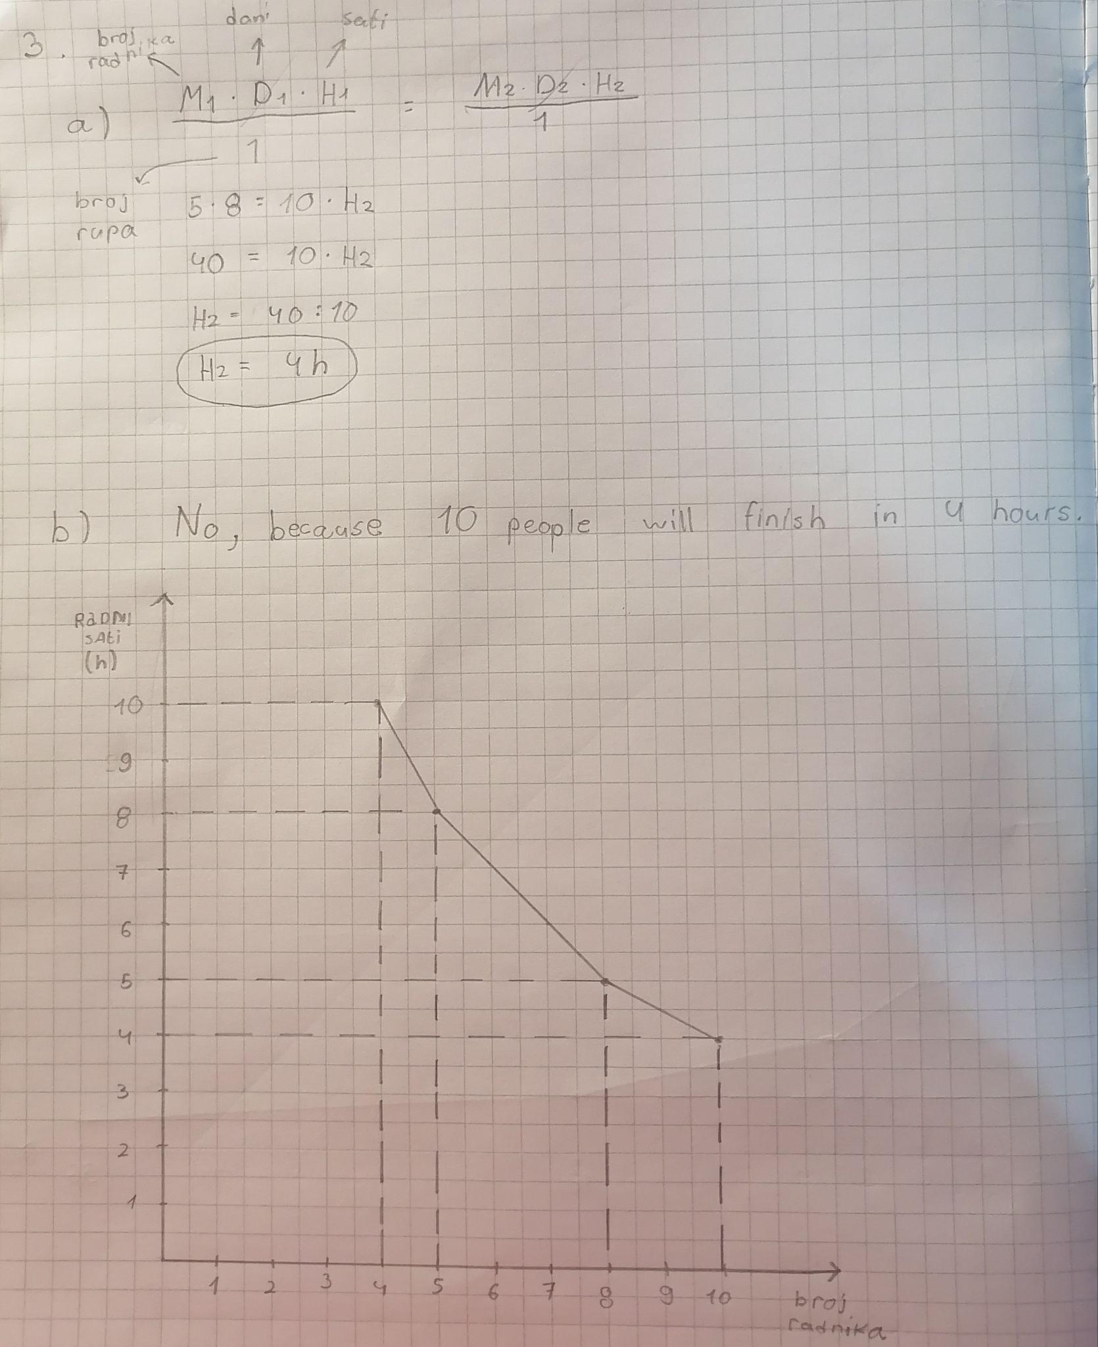
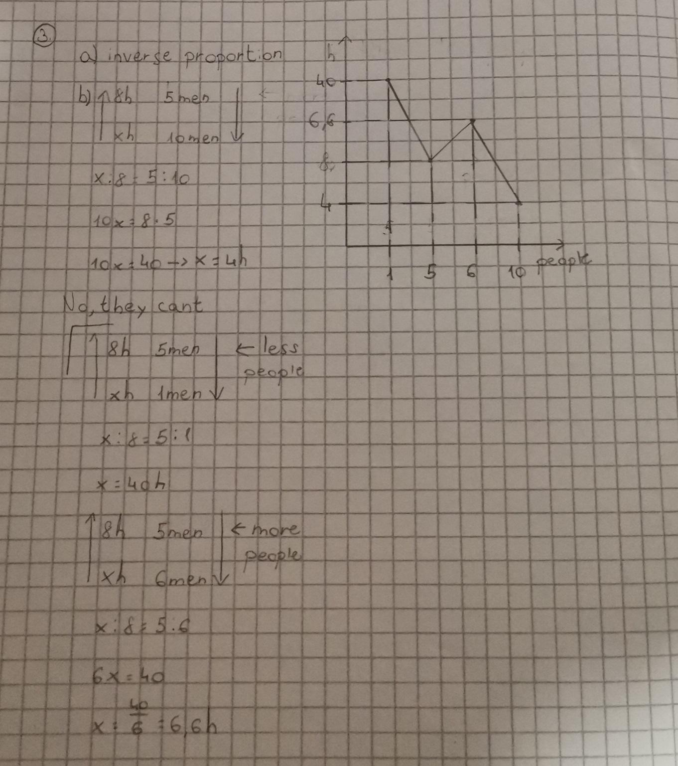
Graphs in Math - Evaluation
Task 8: (level - intermediate)
It takes 8 hours for five men to dig the hole. Define the adequate formula and use the graph to show when the same job will be finished if there are less/more than five people.
a) What type of proportion can you recognize here?
b) Can 10 people finish the digging within three hours?
Results:
Percentage of a task score:
Total - 31,58%
(18 out of 57)
Male - 38,46%
(10 out of 26)
Female - 25,8%
(8 out of 31)

Slide 15
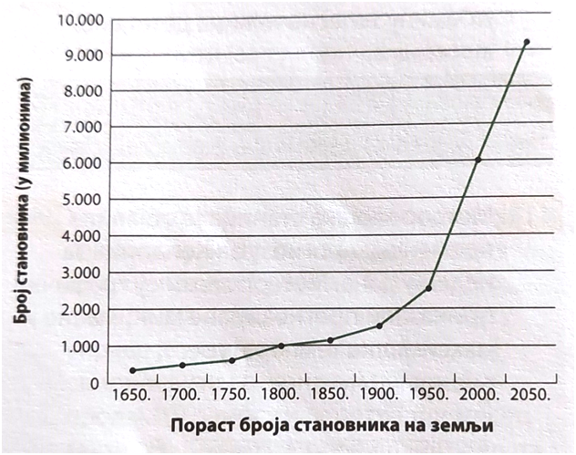
Graphs in Math - Evaluation
Task 9: (level - beginner)
The graph shows world population growth over the last four centuries, with scientific projection in 30 years from now.

Slide 16
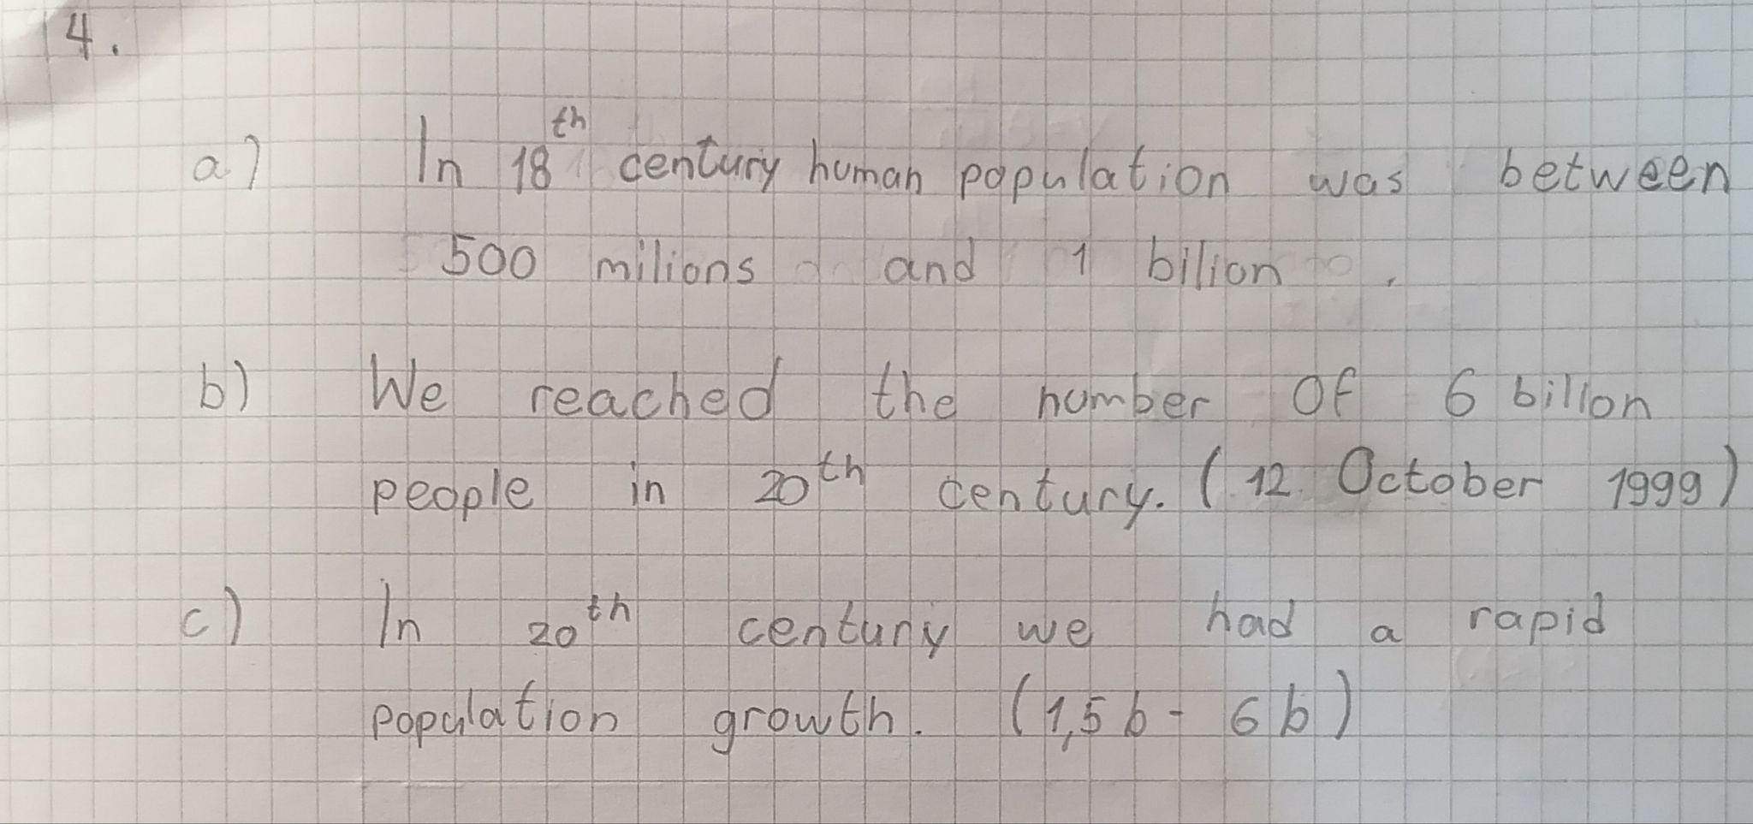
Graphs in Math - Evaluation
Task 9: (level - beginner)
a) How many people lived on Earth during the 18th century?
b) When did we reach the number of six billion people?
c) In which century did we have a rapid population growth?
Results:
Percentage of a task score:
Total - 64,91%
(37 out of 57)
Male - 57,69%
(15 out of 26)
Female - 70,97%
(22 out of 31)

Slide 17
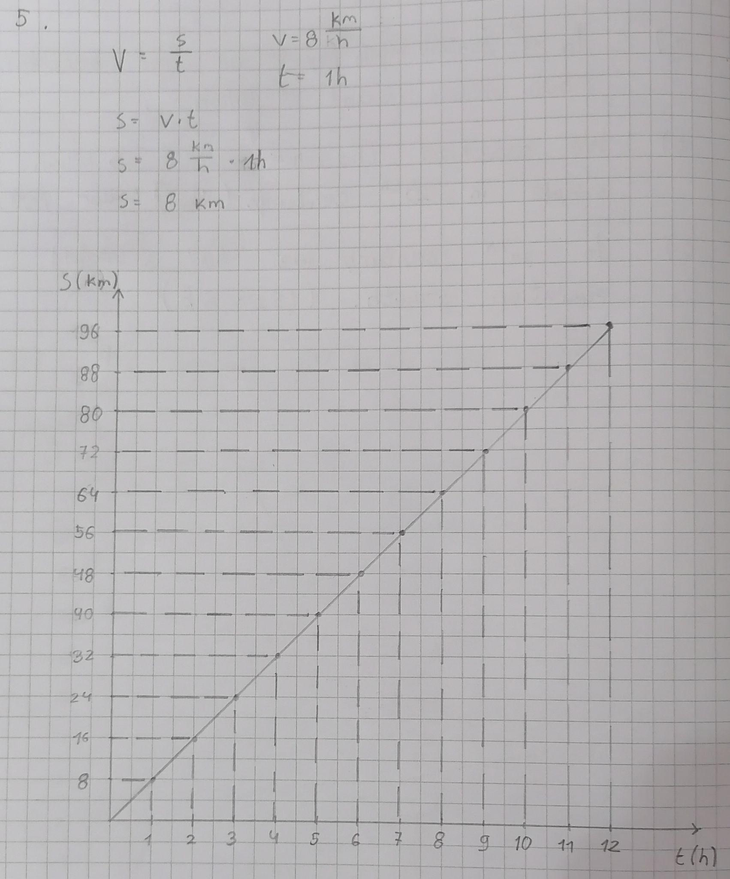
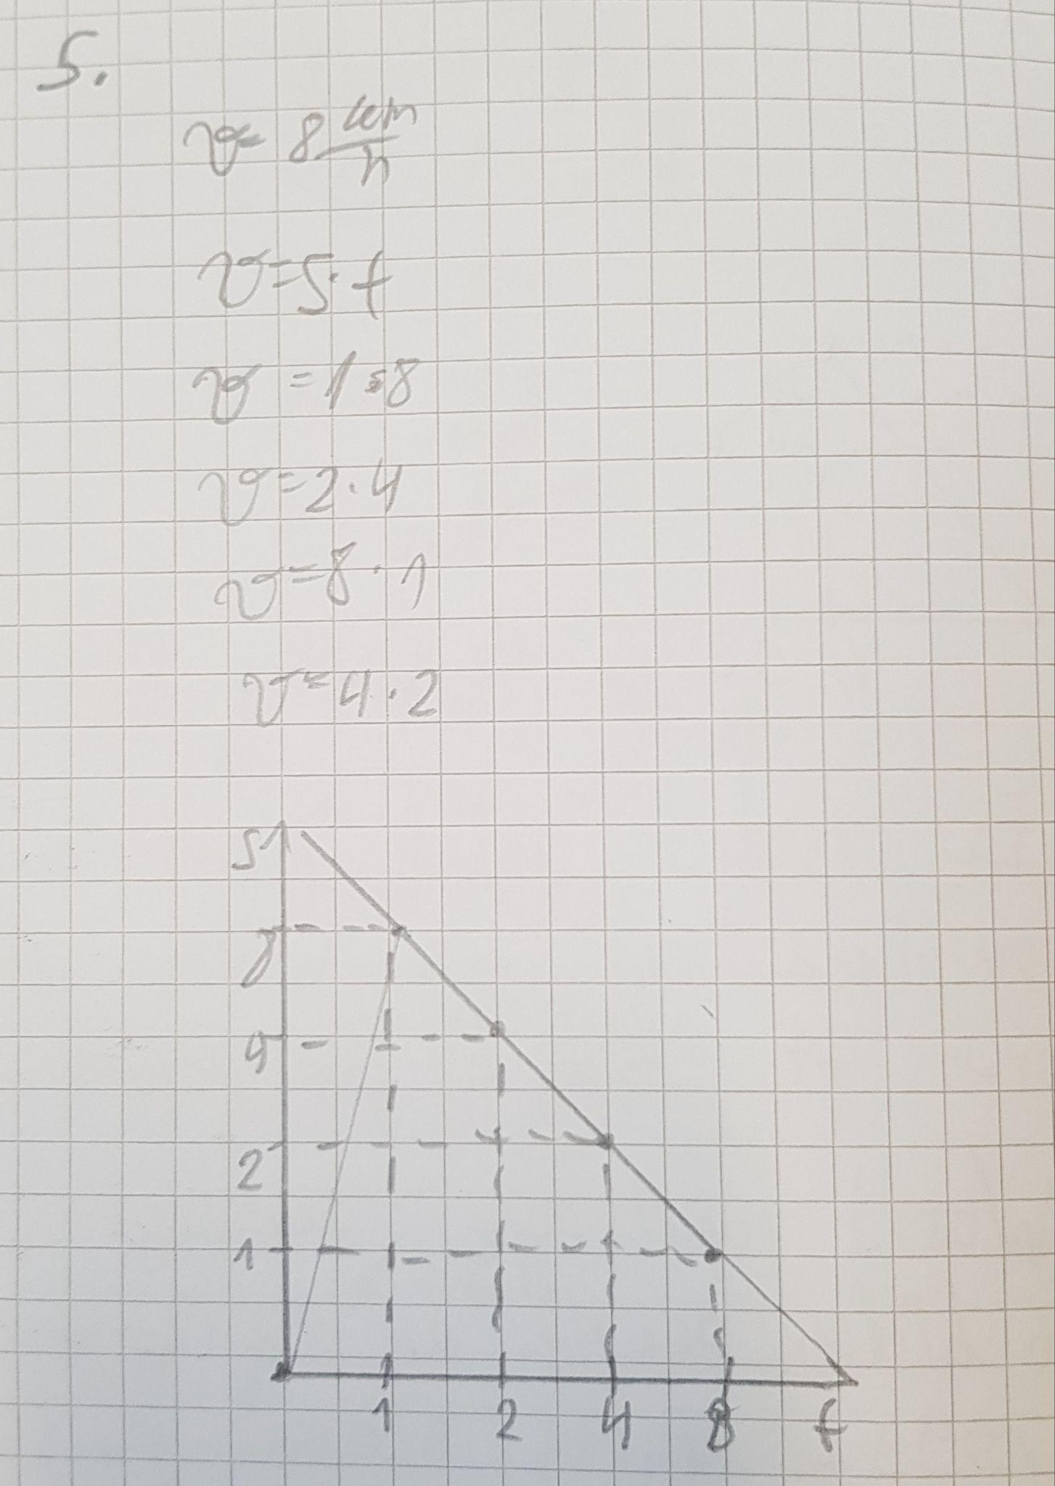
Graphs in Math - Evaluation
Task 10: (level - beginner)
The average speed of a camel through the desert is 8 km/h. Use the adequate formula and graph to show the relationship between the time and distance that she can reach.
Results:
Percentage of a task score:
Total - 54,38%
(31 out of 57)
Male - 50% (13 out of 26)
Female - 58,06%
(18 out of 31)

Slide 18
What to conclude?
Physics-most common mistakes:
Confused with distance-time graph
Don’t read coordinate axis
Math - most common mistakes:
Misleading graph/ No graph
Distorted scale/ not accurately drawn graph
Motivation

Slide 19
What to conclude?
increase simultaneous use of graphs in both subjects (do more research within the educational reforms)
better “translation” of ideas in order to understand each others interpretation
motivate students to include graphs more in their work

Slide 20
Authors
Branislava Blajvaz
Physics teacher. PhD student of physics.She works with talented children. She is the winner of numerous awards, co-author and reviewer of school textbooks. She has been the president of Serbian Physical Society for the Srem district since 2011.
Contact: branislava.blajvaz@zmajsm.edu.rs
Dragana Bogosavljević
Math teacher. Coordinator of Bilingual Team in Primary school “Jovan Jovanovic Zmaj”, Sremska Mitrovica. Passionate journalist. In love with the sun, sea, snow and salsa.
Contact: dragana.bogosavljevic@zmajsm.edu.rs.

