Slide 1
From Students’ Misconceptions to Reasoning: Lessons Learned from Physics Education Research Olga Gkioka Boğaziçi University, Istanbul, Turkey

Slide 2
Outline of the presentation
1. Research on students’ misconceptions related to physics concepts, ideas and laws.
2. Research on students’ reasoning in various areas of physics.
An example of recent research on undergraduate physics students’ reasoning when they evaluate experimental measurements in the laboratory.
3. Ongoing research investigating students’ reasoning related to mathematical functions and derivatives, and graphs and rates in the context of physics laboratory reports.
4. Implications for physics instruction, assessment and physics education research.

Slide 3
1. Research on students’ misconceptions related to physics concepts, ideas and laws. Examples:
Air does not have weight.
An object at rest does have any energy.
If the velocity of one object is zero (at one point), the object does not accelerate.
If an object accelerates, its speed always increases.
The heavier objects reach the ground earlier than the light ones.
The centripental force is one more (additional) force acting on objects moving on a circle.
A cyclist on a circular track is not accelerating, because she is travelling at a constant speed.

Slide 4
2. Research on students’ reasoning in various areas of physics
The “shift” of physics education research towards:
a. investigating undergraduate students’ reasoning in Physics and,
b. focusing on the discipline of Physics itself.
References
Viennot, L. (1985). Analyzing students’ reasoning: Tendencies in interpretation. American Journal of Physics, 53, 432 (1985)
McDermott, L. C. and Redish, E.F. (1999). Resource Letter: PER-1: Physics Education Research. American Journal of Physics, 67(9), 755-767.
McDermott, L.C. (2014). Melba Newell Phillips Medal Lecture 2013: Discipline-Based Education research-A view from Physics. American Journal of Physics, 82(8), 729.

Slide 5
An example from recent research on students’ reasoning
Undergraduate students’ reasoning about the quality of experimental measurements of covarying data.
by Paul van Kampen and Olga Gkioka 2021 Eur. J. Phys. 42 045704

Slide 6
The pendulum question

Slide 7
An example of ongoing research on undergraduate physics students’ reasoning related to functions and best fit lines
The aim is to explore undergraduate students’ reasoning related to mathematical functions and derivatives, and graphs and rates in the context of physics laboratory reports.
The participants: Undergraduate physics students and pre-service physics teachers
Research Question: To what extent do undergraduate students apply knowledge related to mathematical functions, rates and derivatives when they deal with experimental measurements in the laboratory?
Methods:
a) One-to-one interviews and,
b) Developement of written tasks

Slide 8
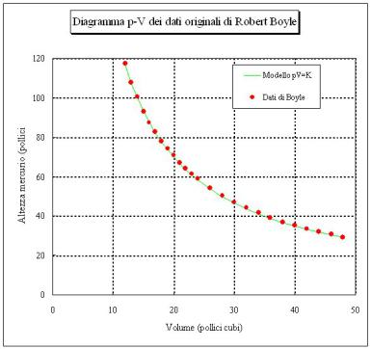
How do students understand instantaneous rates of change of pressure with respect to volume V? What is the related reasoning?

Slide 9
Initial findings (1):
Undergraduate physics students cannot apply knowledge acquired in Mathematics classes to Physics. Their understanding of functions and related derivatives is restricted.
They have experienced difficulties with inverse proportional relationships. For example: for an ideal gas, when T temperature is fixed, then, the pressure P is inversely proportional to the volume of the gas.

Slide 10
Initial findings (2):
Understanding of the rate at a point of a line graph is limited since they apply the formula slope=Δy/Δx, without a sound understanding of it.
The participants experienced difficulties with calculating instantaneous rates at points along the curve.
If P(V)V= nRT= fixed, how much is the rate of change of pressure P with respect to volume V? dP/dV?
If y(x)x=c, then, how much is dy/dx? Please show your full reasoning. Or, write down how you have worked out the problem.

Slide 11
The main argument of the study
Physics instructors need to develop open-ended tasks in which they ask undergraduate physics students to demonstrate their full reasoning.
The aim is for instructors to make sense of particular reasoning and difficulties in order to address them in follow-up instruction.
Tasks in physics educational research should be carefully designed and open-ended in order to explore students’ reasoning in detail.

