Slide 1
EPS Young Minds 2022 An overview Mattia Ostinato EPS YM Action Committee Chair

Slide 2
European Physical Society founded in 1968 in Geneva
| What is EPS?
As federation of national societies: 42 member societies
As learned society : 3500 individual members
40 associate members from academia and industry
Representing more than 130,000 European Physicists

Slide 3
| YM: overview of the programme
Started by EPS in 2010 as a platform for students and early career
researchers in Physics
Objectives
Develop future researchers in Physics
Promote Physics amongst the broad public
Connect young scientists in Europe
Approach
Create an infrastructure for young physicists to emerge and get involved
Support self-organized local sections
Encourage interaction between sections
YM Section
is a group of young physicists collaborating
to develop scientific works, professional development, networking & outreach activities

Slide 4
| Who can be part of a YM section?
UNDERGRADUATE
STUDENT
(Bachelor & Master)
PhD STUDENT
POST-DOC
PI
PROFESSOR

Slide 5
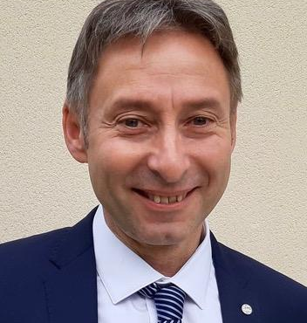
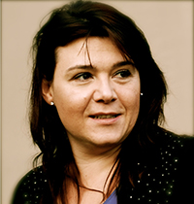
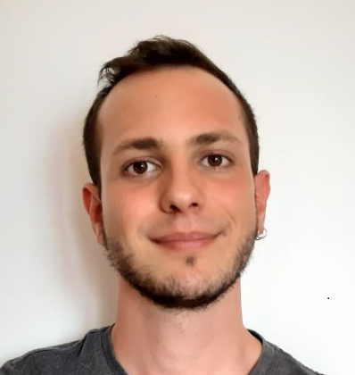
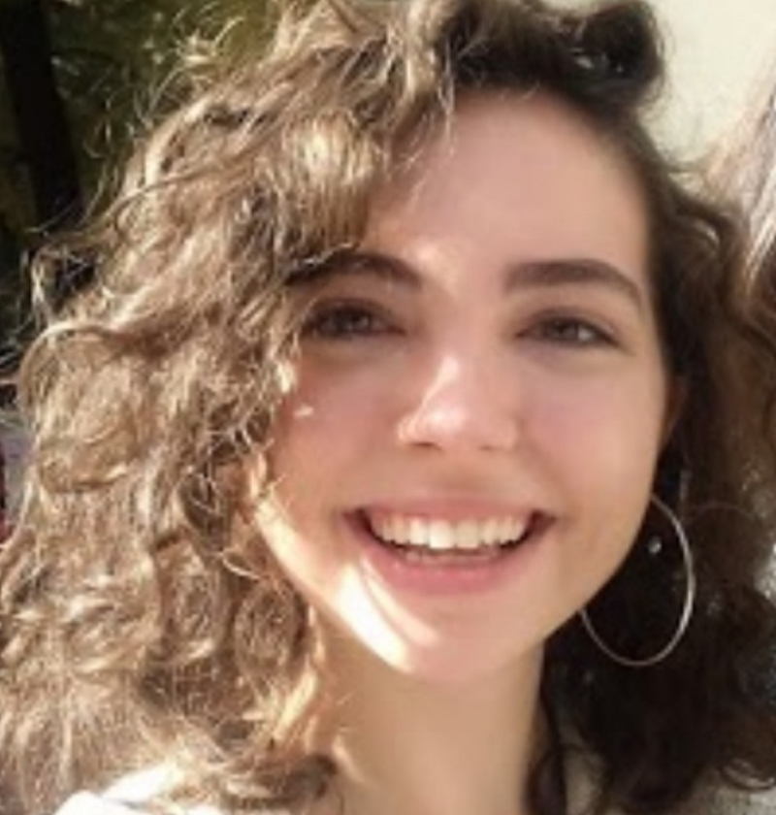
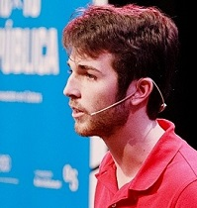
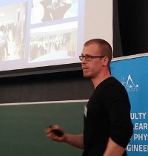
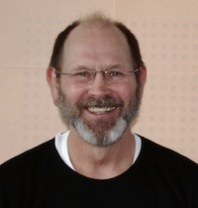
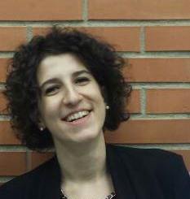
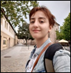
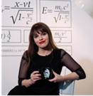
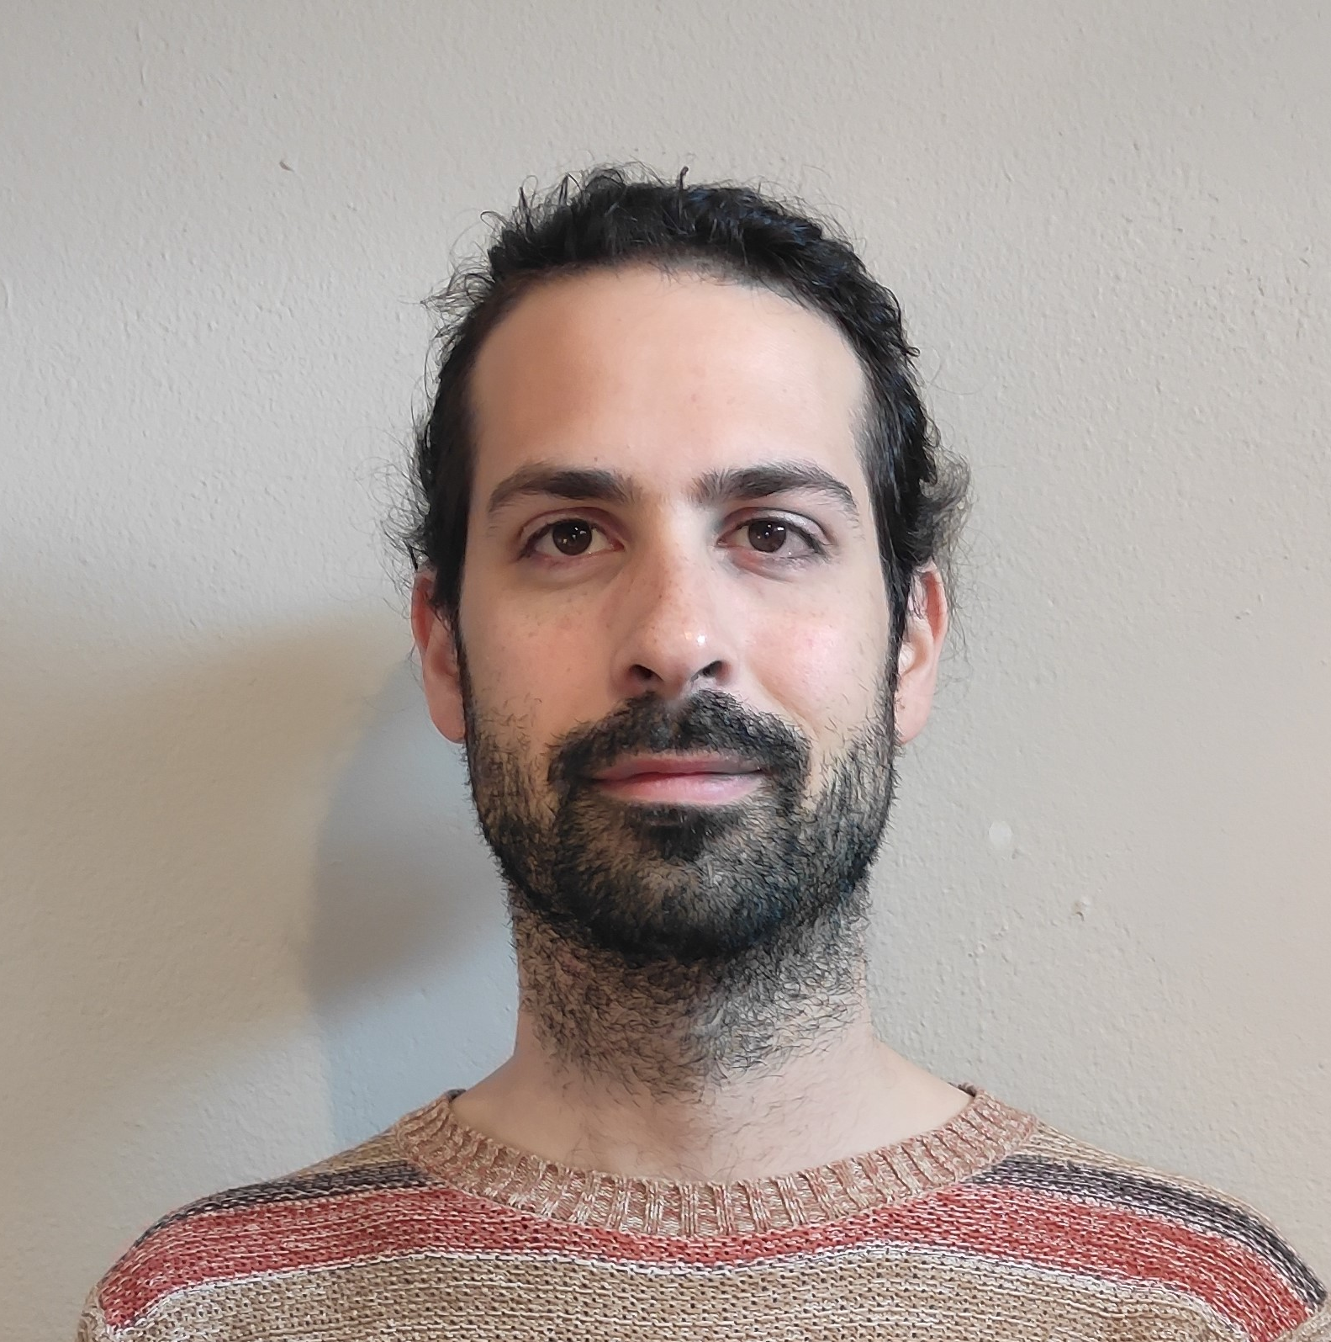
| The Young Minds Action Committee
The Action Committee is managing and developing the programme.
Luc Bergé
EPS President
Ophelia Fornari
Programme Manager
Mattia Ostinato
Programme Chair
Carmen Martin
Tanausú
Hernández
Richard Zeltner
David Lee
EPS Secretary
General
Roberta Caruso
EPS ExComm
Delegate
Anna Grigoryan
Mažena Sinkevičiene
Damián Rodríguez

Slide 6
| The Young Minds Action Committee
The Action Committee is managing and developing the programme.
Tasks and responsibilities:
It carries out the section management. For each section there is a direct contact person within the AC assigned.
It supports the organization of the annual leadership meeting.
It promotes the programme (e.g. towards establishing new sections, collaborations with other institutions, …)
It evaluates section grant applications.

Slide 7
more than 60 Sections, 36 countries…and counting!
Italy
Spain
UK
Ukraine
Poland
Sweden
Germany
Belgium
Hungary
Netherlands
Switzerland
France
Armenia
Russia
Portugal
Palestine
Egypt
Denmark
Finland
Czech Republic
Morocco
Belarus
Georgia
Serbia
Latvia
Macedonia
Lithuania
Croatia
Israel
Austria
Slovakia
Romania
Turkey
Ireland
Luxembourg
Greece
…

Slide 8
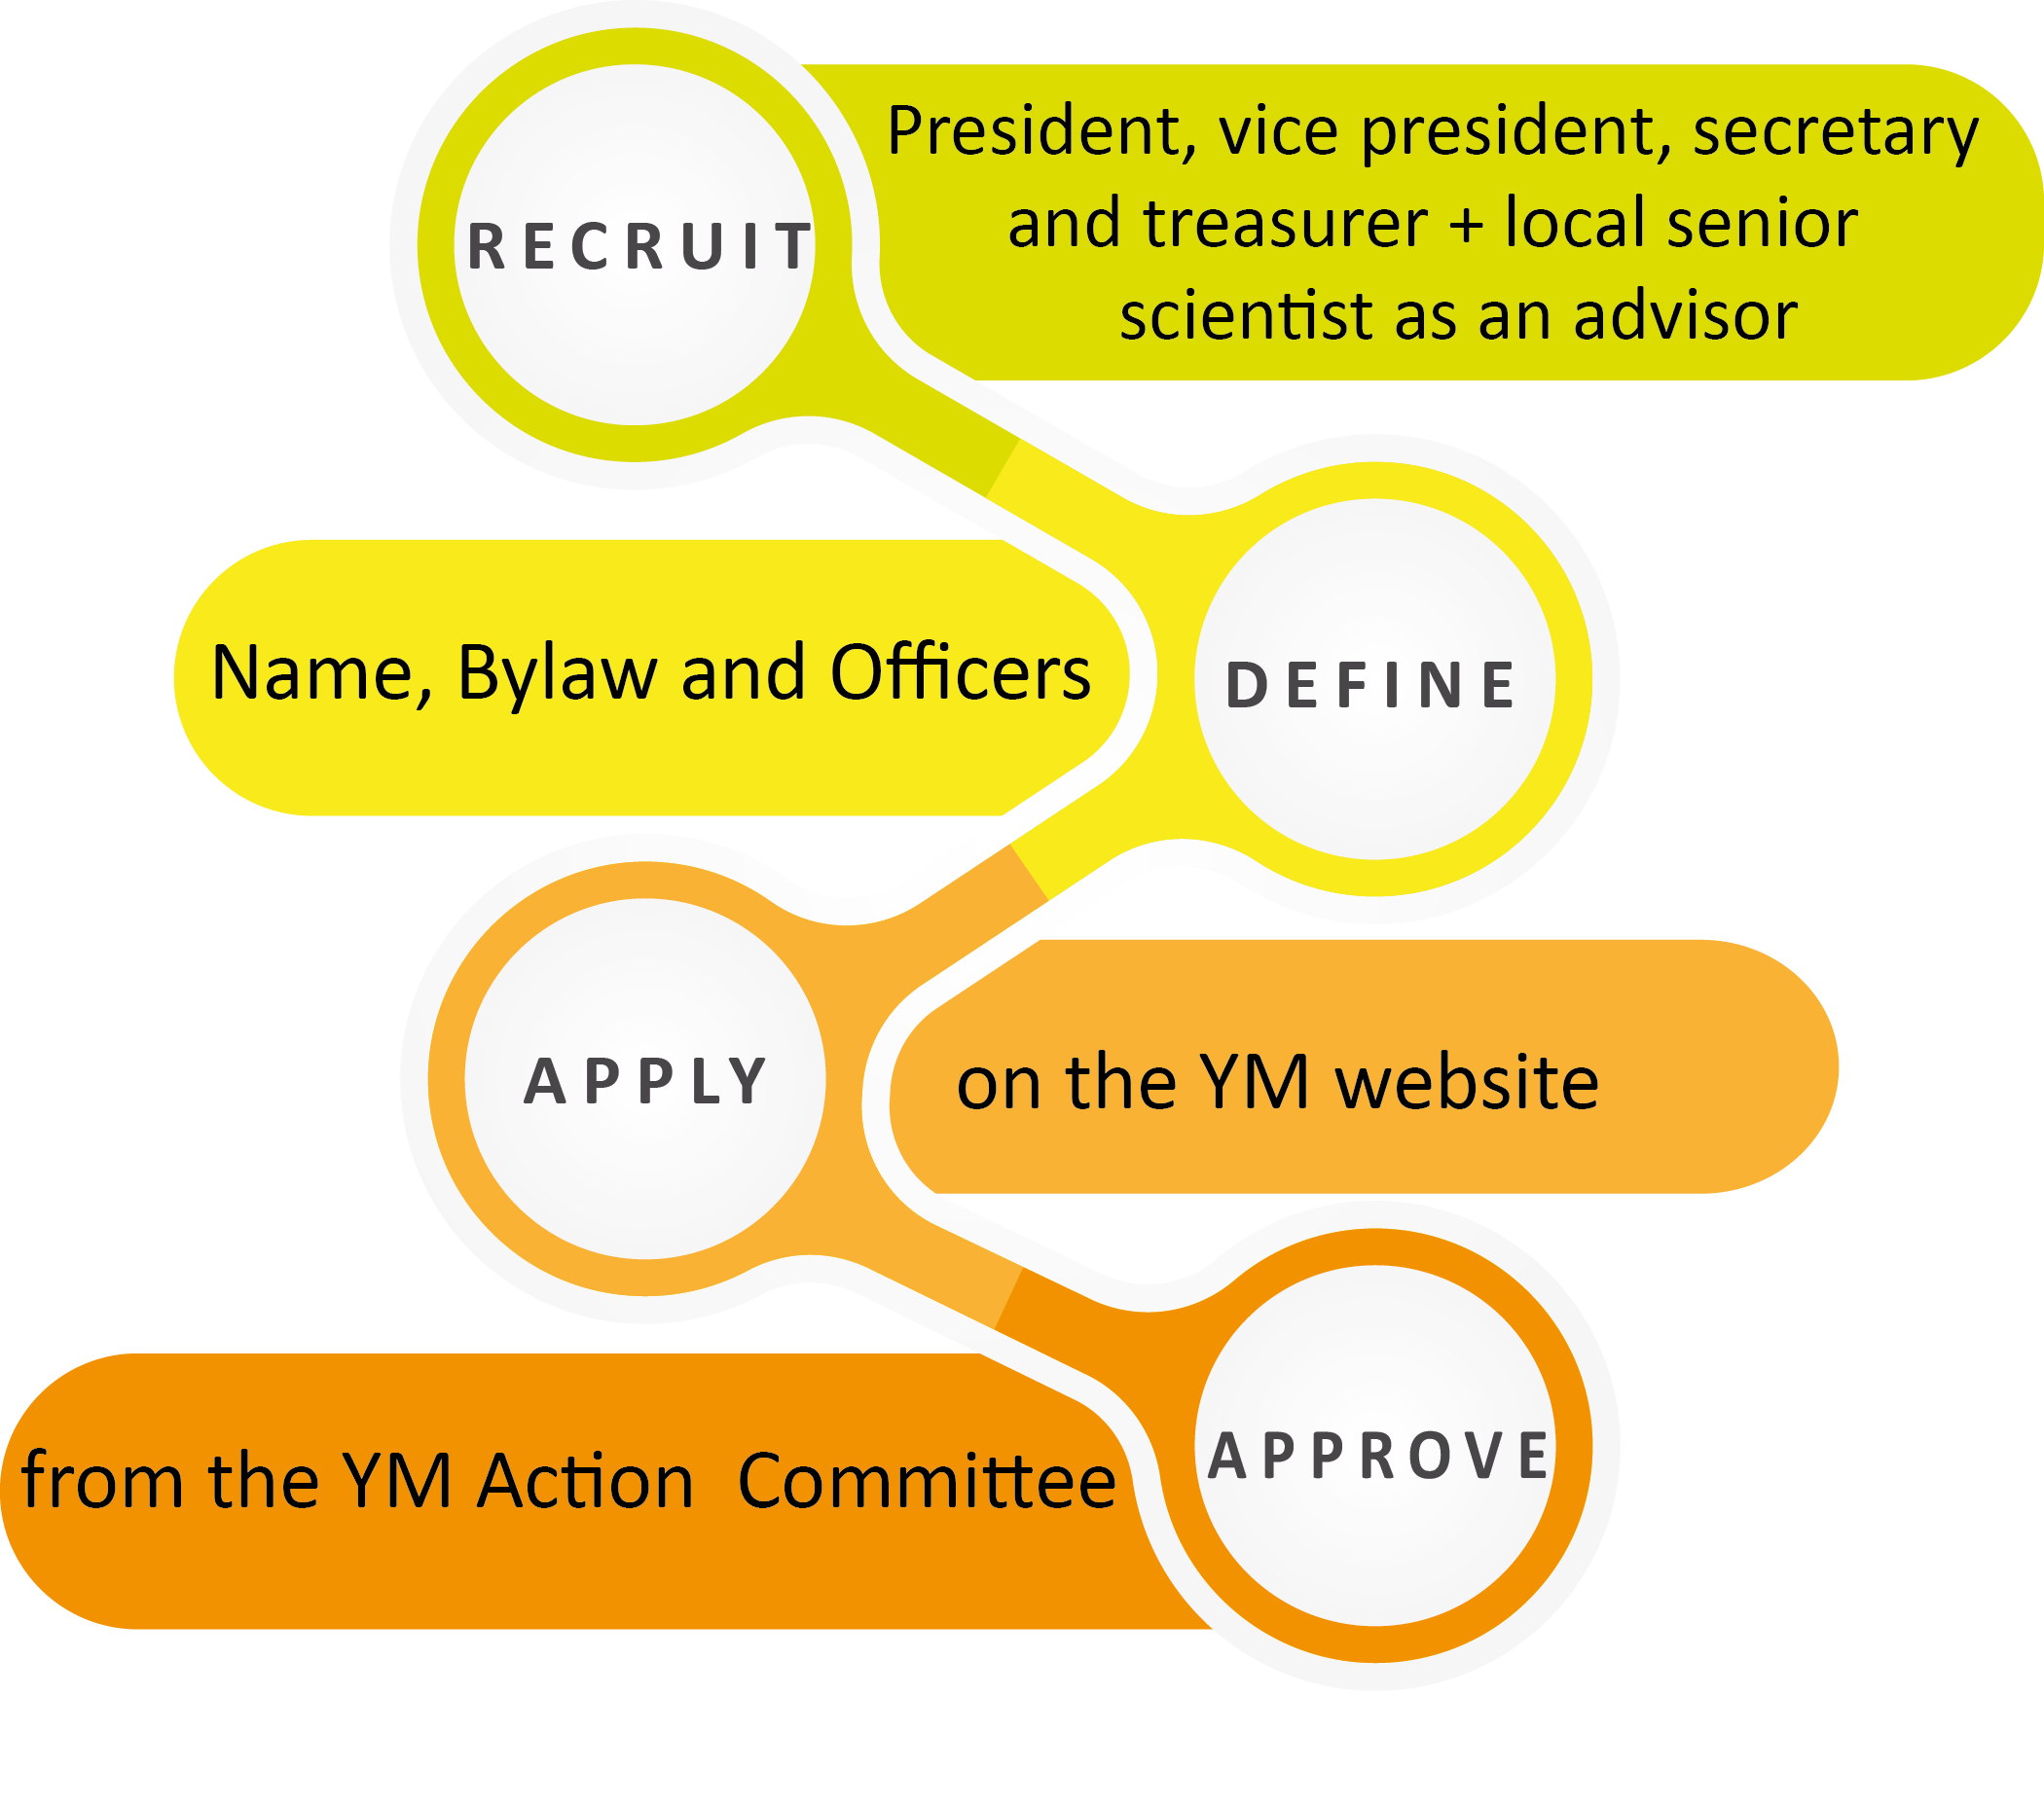
| Become a YM Section
http://www.epsyoungminds.org/how-to-apply/

Slide 9
| Benefits for a YM Section
YM Activity Grant
YM Conference Award
YM Leadership Meeting
Best Activity Award
Grants and focus sessions in EPS sponsored conferences

Slide 10
| YM Activity Grant
OUTREACH
to local schools and communities can provide a stimulus for new generations of scientists and increase the awareness for the importance of scientific research amongst the widest public.
Up to 1000€ per year
Two deadlines: January 15 and July 15
Report of each activity needed
Max 300€/year for catering
PROFESSIONAL DEVELOPMENT
Activities for students aimed to acquire new skills and knowledge both for professional and career advancement.
NETWORKING
In the era of social networks, students feel the need to start building their own scientific networks.

Slide 11
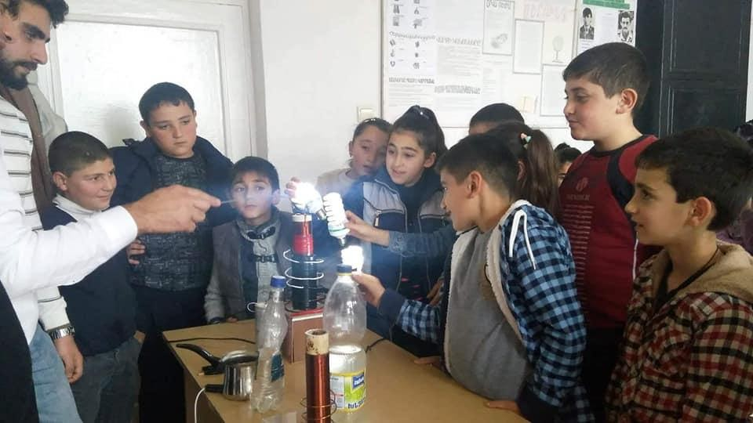
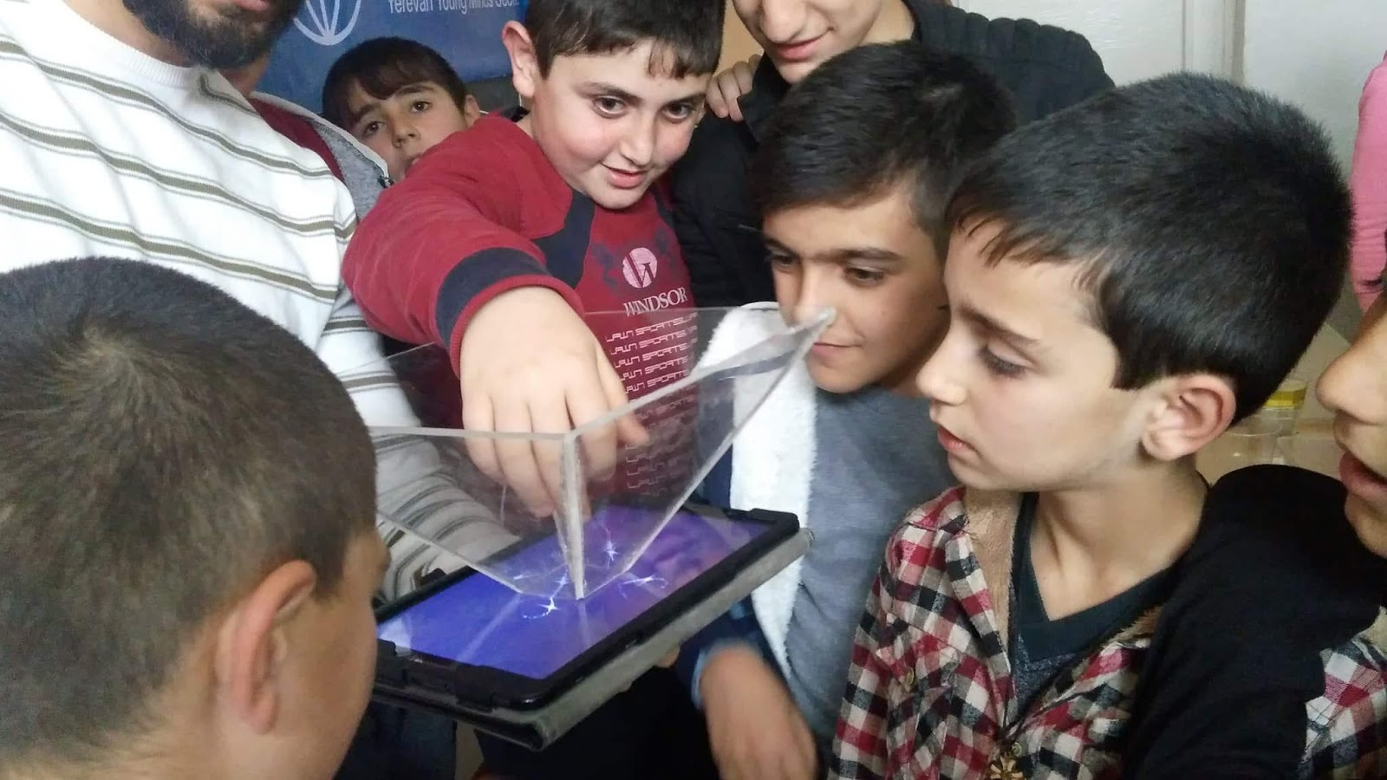
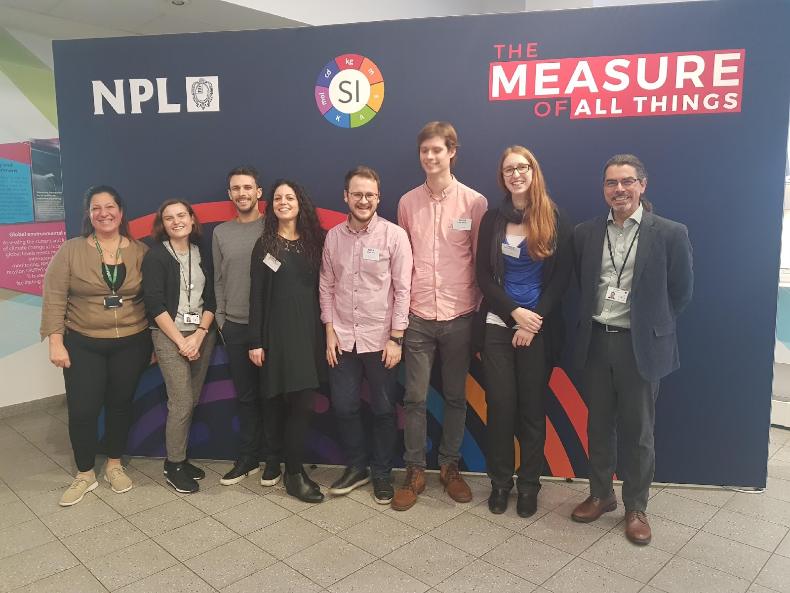
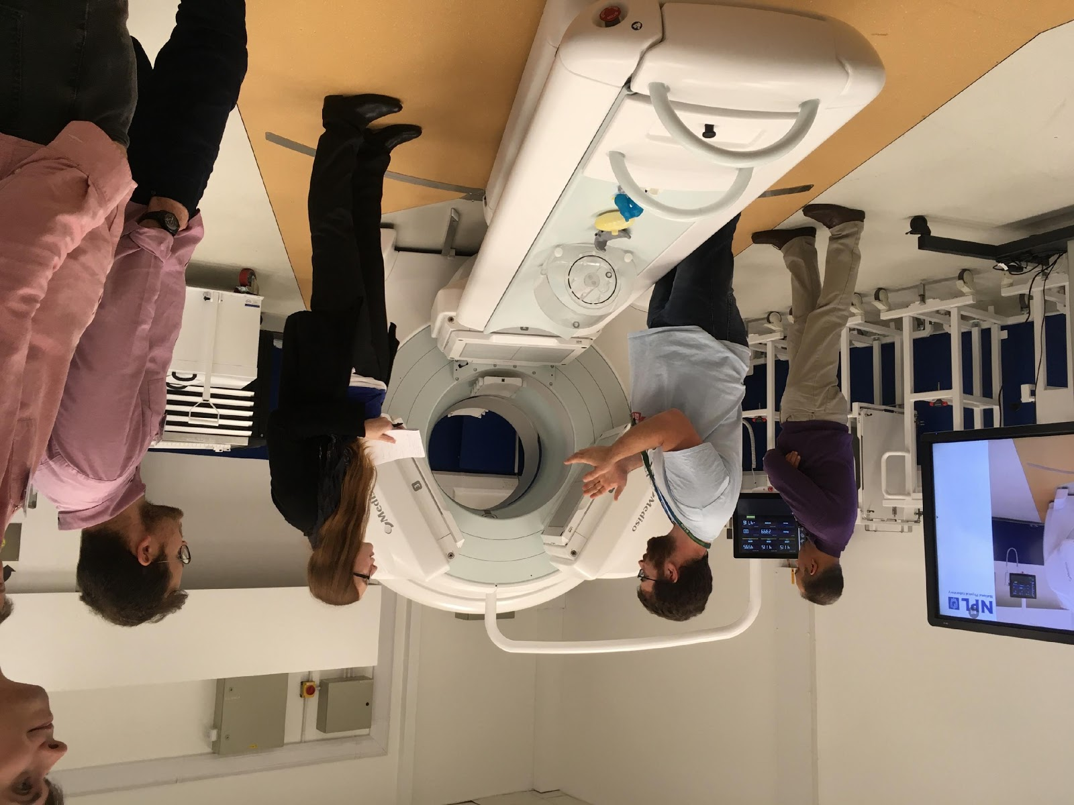
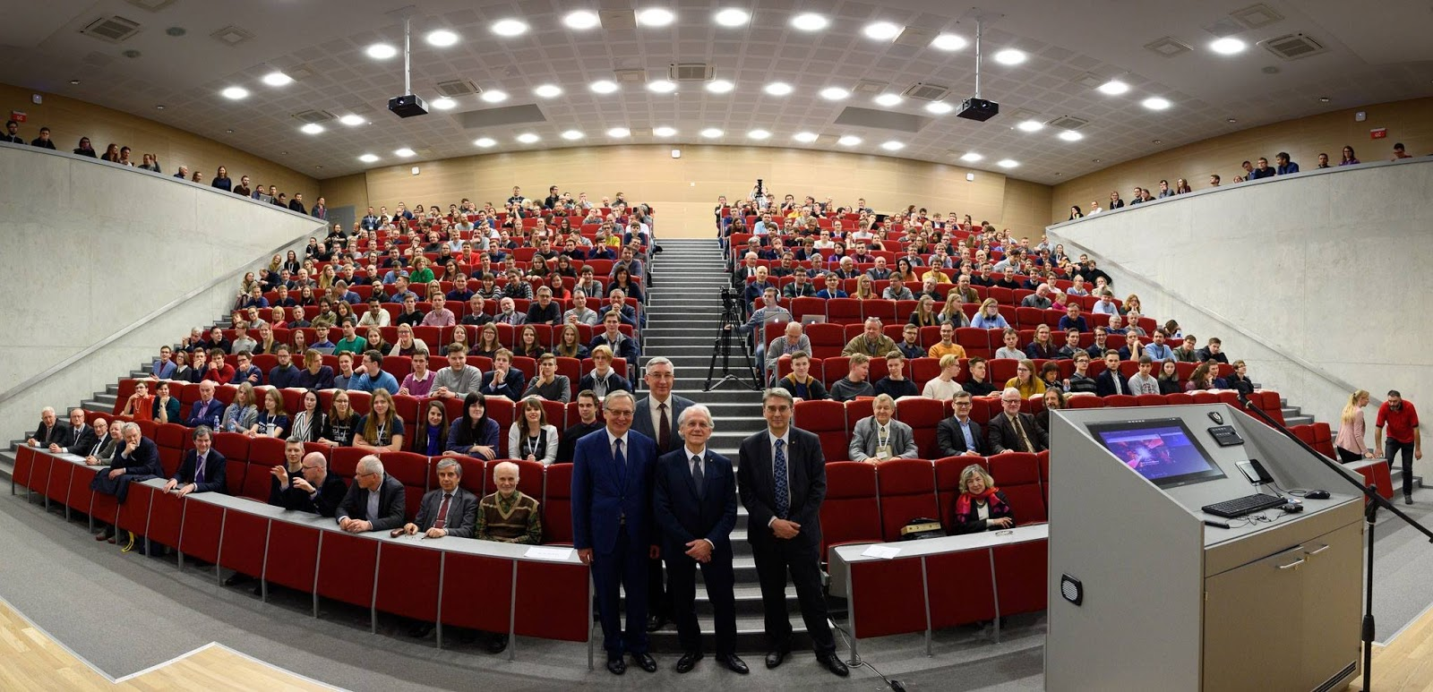
| YM Activity Grant – Example activities
OUTREACH
PROFESSIONAL DEVELOPMENT
Yerevan - Handmade Science : Construction of toolkits and visits to schools all over Armenia to demonstrate their use, informal meet-ups with kids
NETWORKING
First YMCA!
SCOPE (Strathclyde, UK) - Visit of NPL : Tour to the photonics and photometric laboratories, networking with the speakers over lunch, human resources recruiting event where HR department described work culture, benefits and career opportunities
Vilnius – Open readings 2019: 62nd International Conference for Students of Physics and Natural Sciences “Open Readings 2019”. Includes student presentations, high profile lectures and social events.

Slide 12
| Benefits: YMCA
Young Minds Conference Award
Up to 1000€ per year
Support sections in the organization of conferences for students and early career researchers and for the organization of sessions dedicated to young professionals within larger conferences
Four deadlines: January 15, April 15, July 15, October 15
Report needed

Slide 13
| Benefits: leadership meeting
An opportunity to meet other young scientists from all over Europe, who share the same passion for physics
One member per section is invited to attend
Each section can present its activities during oral and poster sessions
Assignation of the Best Activity Award sponsored by EPL
Your section can apply to organize the LM and be granted up to 1000€ extra for activities

Slide 14
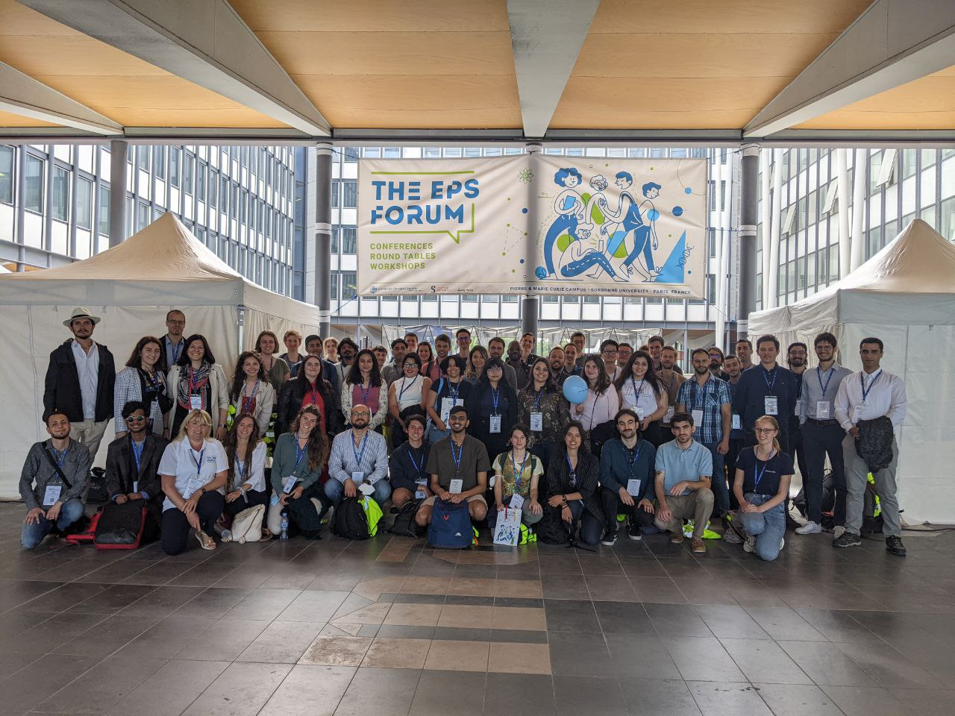
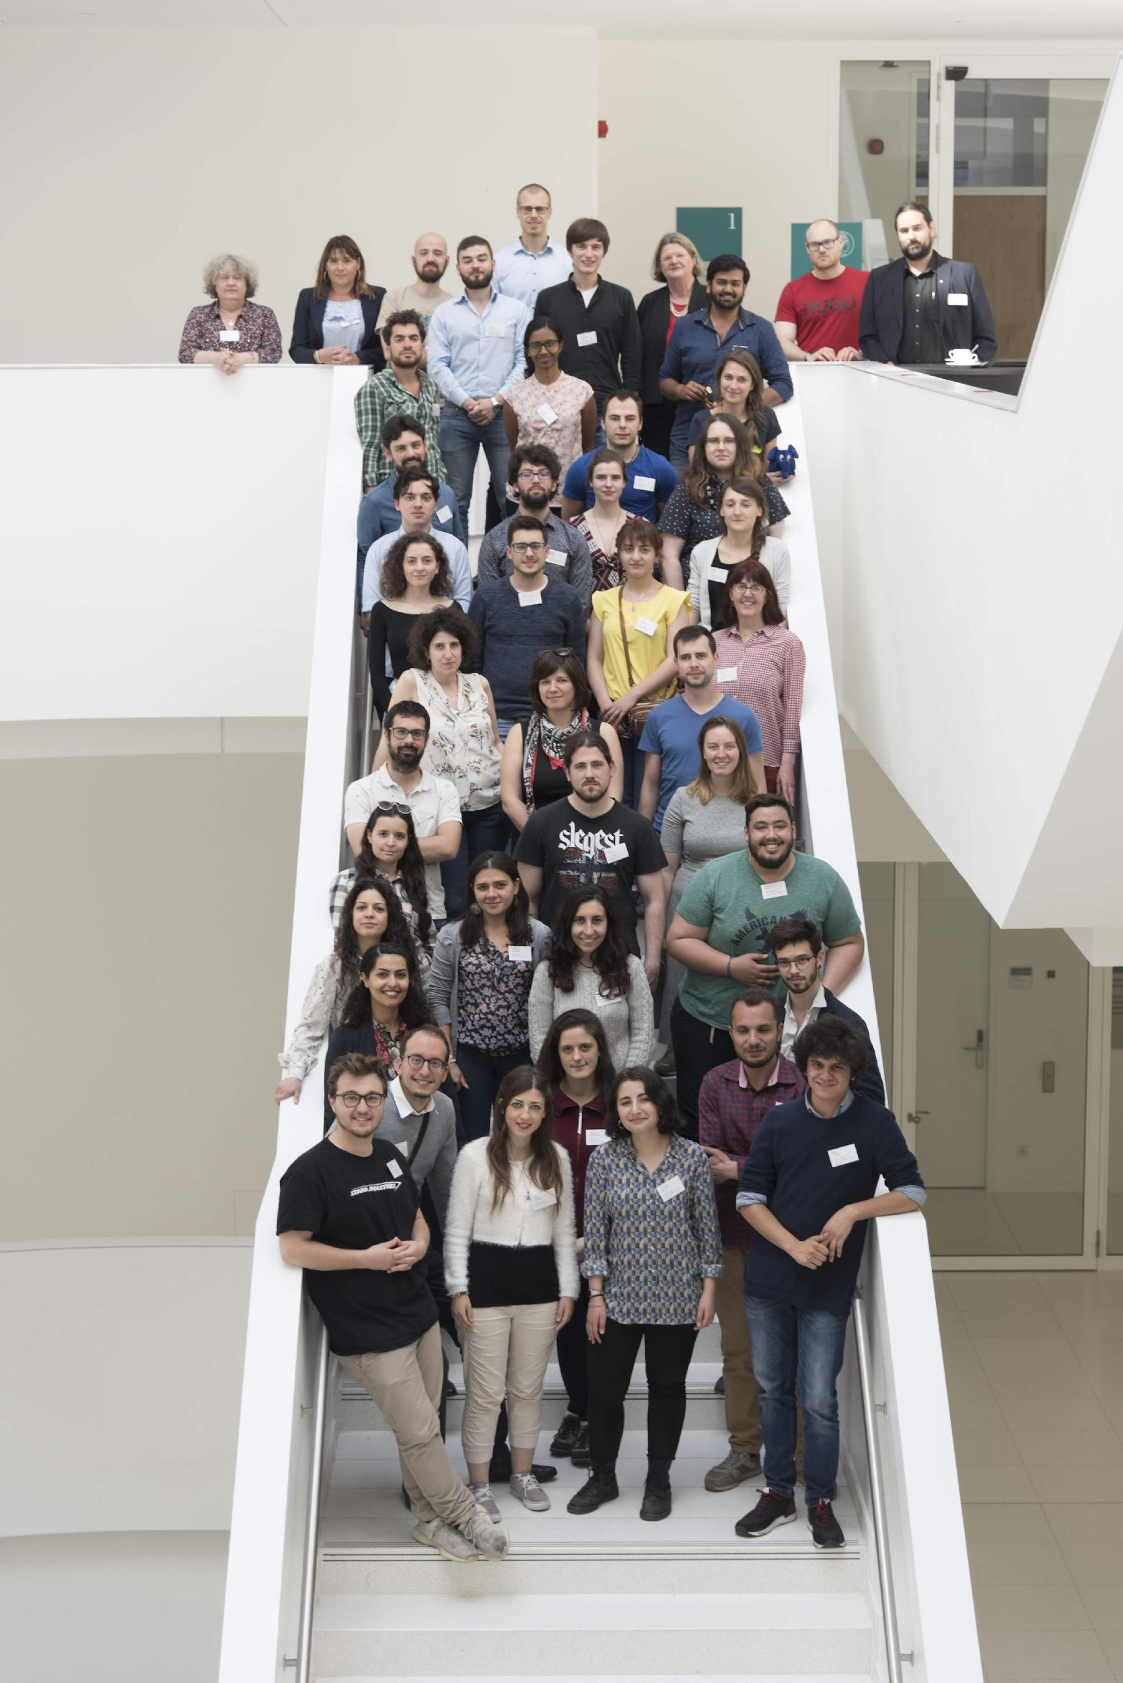
| Benefits: leadership meeting
2011: Geneva, Switzerland
2013: Mulhouse, France
2014: Paris, France
2015: Barcelona, Spain
2016: Budapest, Hungary
2017: Naples, Italy
2018: Prague. Czech Republic
2019: Erlangen, Germany
2020: Cancelled ☹
2021: Online
2022: Paris, France
2023: To be determined –
LM 2022: Group picture @ EPS Forum
Best Activity Award
Sponsored by European Physics Letters (EPL) since 2013 in order to support and encourage young researchers
LM 2019: Group picture @ MPL foyer

Slide 15
| News and perspectives – Engagement
EPS YM Sessions on EPS Conferences
YM Career event @ CLEO 2019
Round table with speakers working inside and outside academia organized by Araceli Venegas (SCOPE, Glasgow) and Chiara Trovatello (PYMP, Milan)
YM presentation event @ CMPNC 2019
Parallel session on the impact of YM in a young physicist’s career organized by Roberta Caruso and Teresa Coimbra (Aveiro YM)
YM session on professional development @11th Polish Symposium on Physics in Economy and Social Sciences 2021
Session on how to prepare for a career in academia given by Prof. Petra Rudolf, (YM section at the Wroclaw University)
YM Session @ ECAMP14
Parallel scientific session aimed at young physicists organized by Mažena Mackoit-Sinkevičienė and YM Vilnius
YM session @10TH EPS-QEOD EUROPHOTON CONFERENCE 2022
Session on how to successfully transition from Academia to Industry given by Richard Zeltner

Slide 16
Be part of an European network that shares your passion for physics

Slide 17
Contacts
EPS Young Minds Programme
EPS Young Minds Programme @EPSYM
@epsyoungminds
@young_minds_eps
www.epsyoungminds.org
mattia.ostinato@epsyoungminds.org
contact@epsyoungminds.org

Slide 18
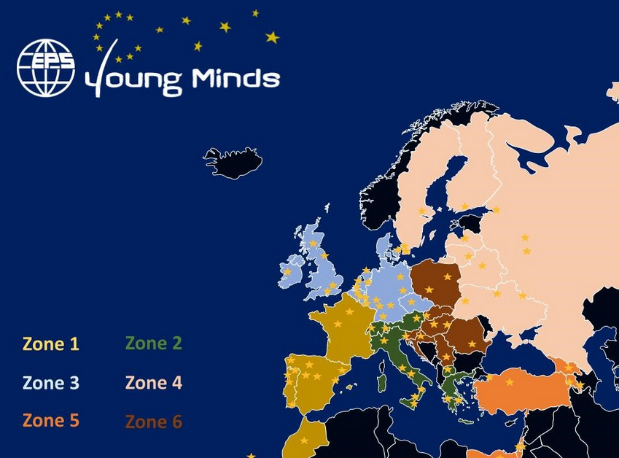
| News and perspectives – Information
The YM AC has established a FAQ, please use it if you are unsure about a certain topic.
Still growing, please contact us if you believe a point is missing and should be added.
We have established a zone-based distribution of the sections among the AC member (available on the website)
If you have a question, please make sure to contact the right AC member

Slide 19
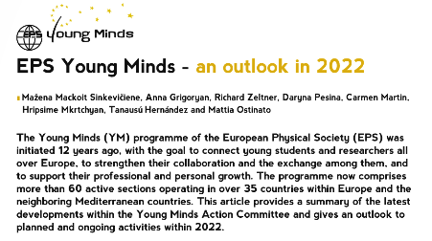
| News and perspectives – Engagement
The YM section in Europhysics News
EPN is the magazine of the EPS, 4 issues per year
Since 2020 YM has a section in each issue
(1,5 pages 700 words + 1-2 pictures)
Topics of relevance:
Young Minds and its sections and activities
Equality, diversity and mental health within the (young) physics community
YM sections are invited to contribute on a regular basis to share their work with the EPS community.
Next slot: December 16

Slide 20
| News and perspectives – Engagement
The eEPS newsletter
The eEPS newsletter is sent out on a monthly basis to the EPS network
YM is contributing to the newsletter on a regular basis, featuring mostly articles on section activities. Usual article length is ~ 400 words including a picture
We are always happy to share the work of the YM sections with the EPS community.
Interested in contributing?
Contact Carmen Martin.
carmen.martin@epsyoungminds.org

Slide 21
| In 2022: The EPS Forum in Paris
Conferences, round tables and workshops on topics such as: Condensed Matter, Energy and Sustainability, High-energy particle physics, Quantum Tech., ML and AI, Biophysics
Bridge between PhD students/postdocs and physics-based industry
High-profile scientists review latest developments in this fields from a fundamental point of view

Slide 22
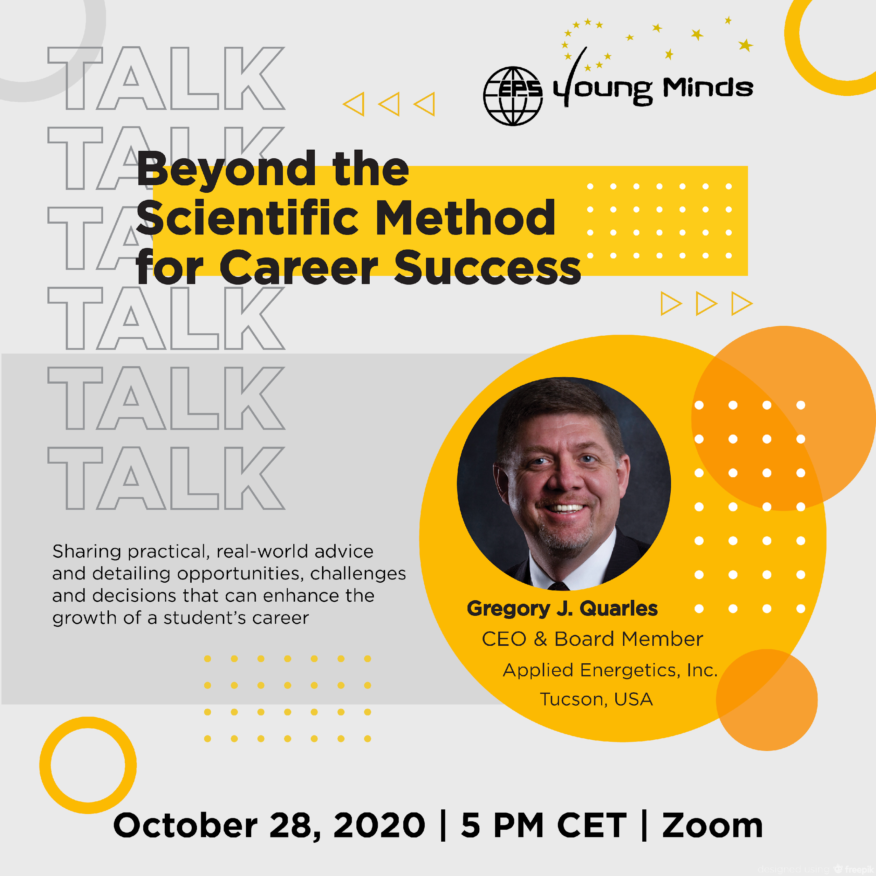
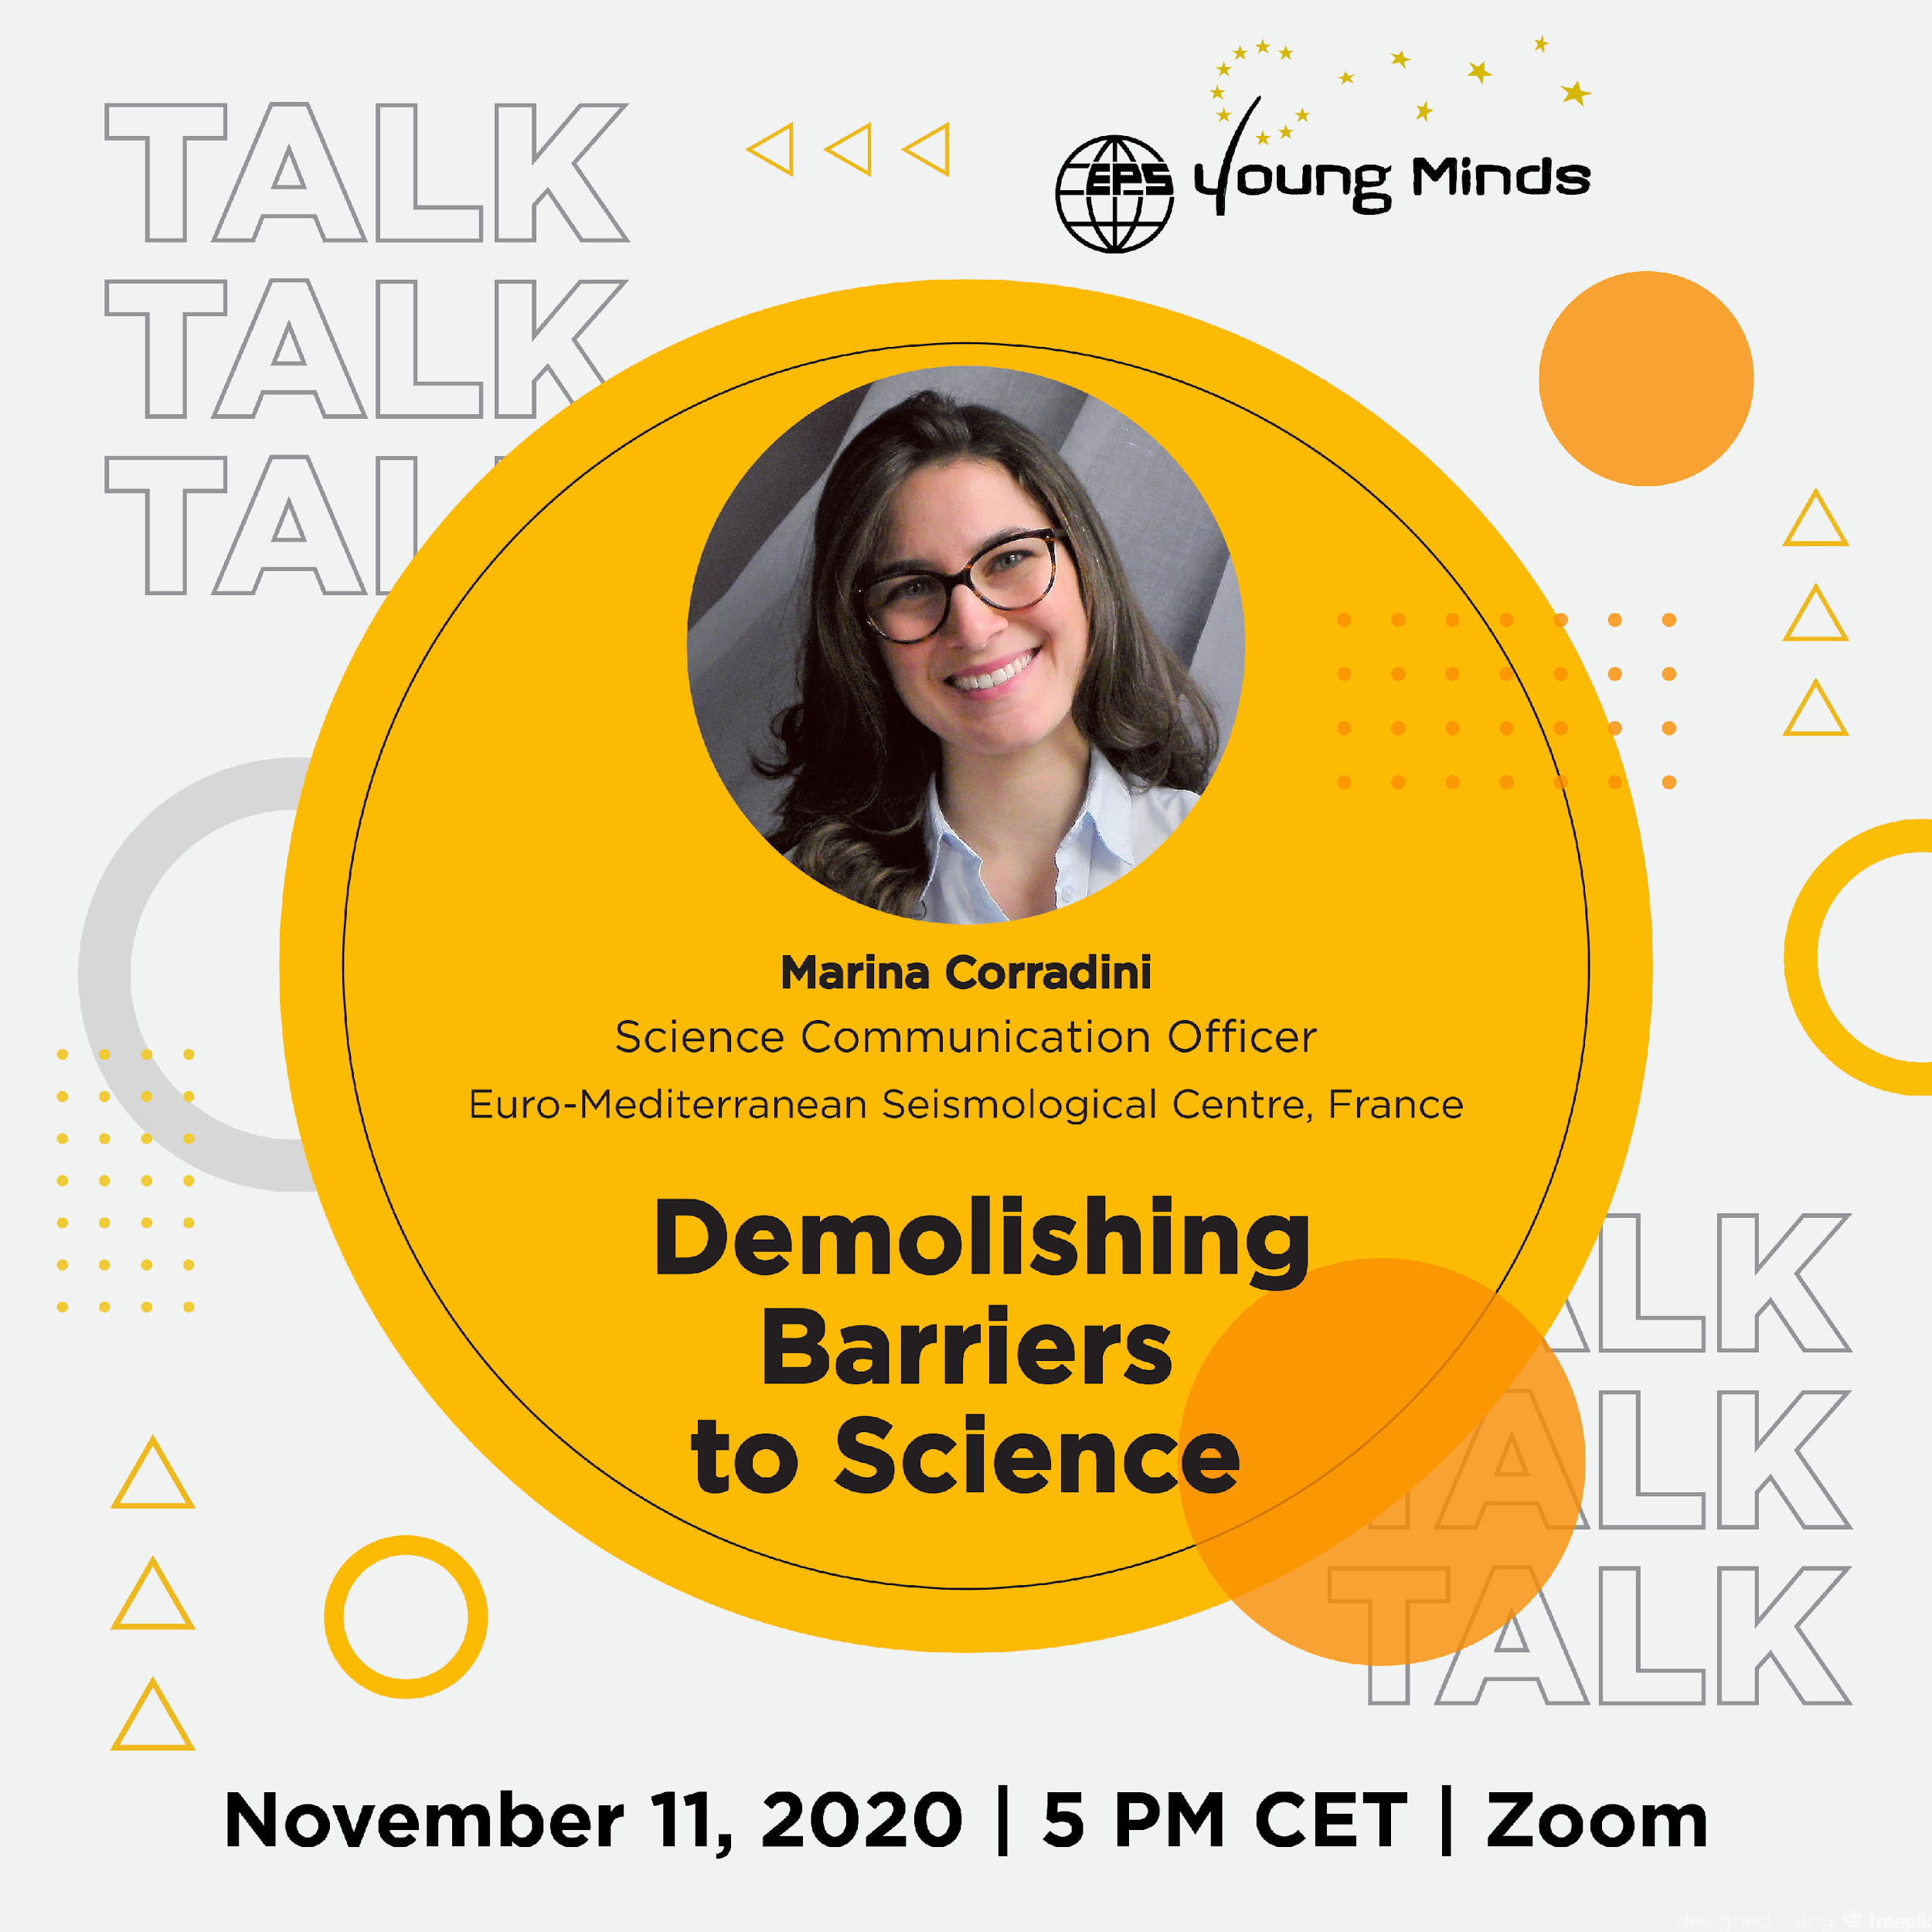
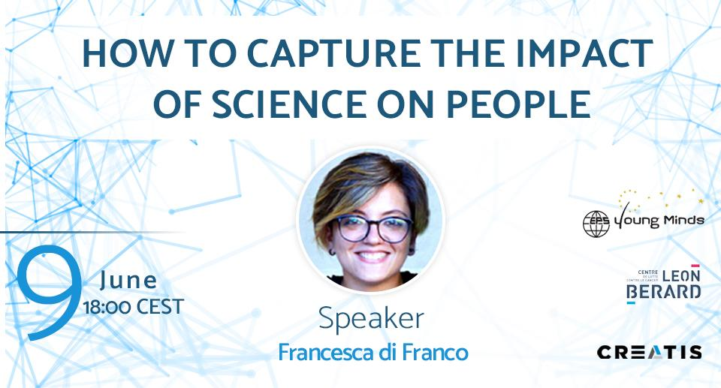
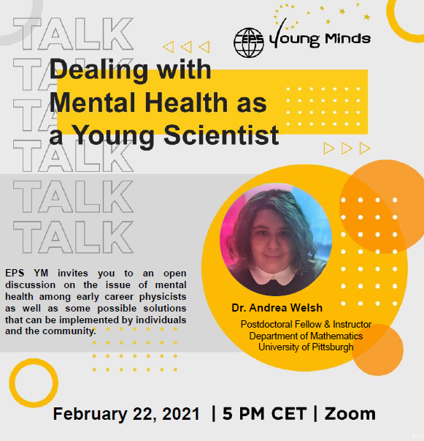
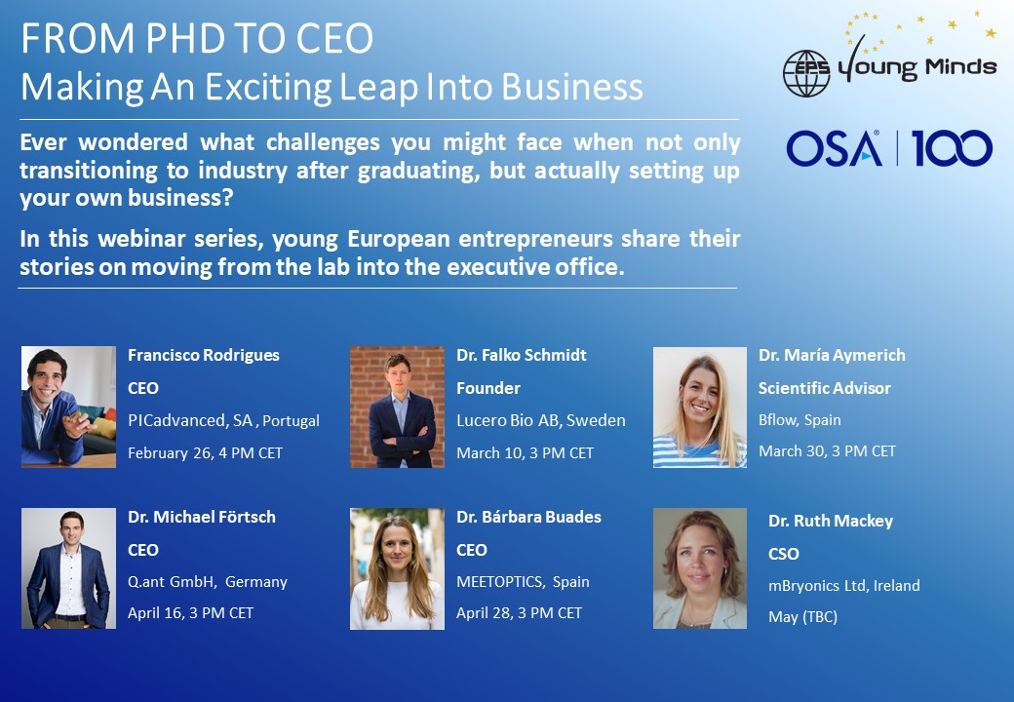
| Virtual activities
Webinars organized by the AC

