Slide 1
From Science to Science Policy
Dr. Enrique Sánchez Bautista
Policy Officer of the European Physical Society

Slide 2
The question

Slide 3
The question
PhD?
Private sector?
Public sector?
Entrepreneur?

Slide 4
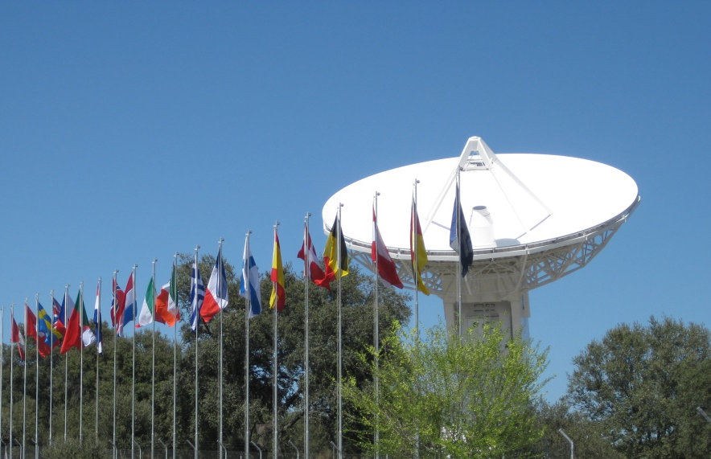
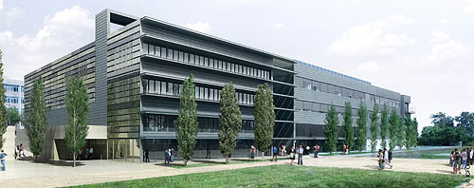

Slide 5
The question

Slide 6
The question
What I liked?
Science
Politics
Physics
Community service

Slide 7
The question
Willing to do?
Work many hours
Move to another city
Go out of the box

Slide 8
The question
What I knew?
Science to benefit society
Politics need inputs from society…
…specially in complex topics

Slide 9
Finding answers to my question…

Slide 10
Finding answers to my question… …working in Science Policy for EPS

Slide 11
What is Science Policy?

Slide 12
What is Science Policy?
Science policy is concerned with the allocation of resources for the conduct of science towards the goal of best serving the public interest.

Slide 13
What is Science Policy?
Science policy is concerned with the allocation of resources for the conduct of science towards the goal of best serving the public interest.
Topics include:
Funding of science
Careers development for scientists
An efficient translation of scientific discoveries into technological innovation
Competitiveness, economic growth, economic development, etc.
Transmit the position of scientific community to public administrators

Slide 14
What is required in Science Policy?
Understanding of…
Science, and how is produced
How to generate innovation and knowledge
A bit of Public Administration
How the legislative process works
Know relation between basic and applied science
…and a large etc.

Slide 15
Some examples (that we all know)

Slide 16
Some examples (that we all know)

Slide 17
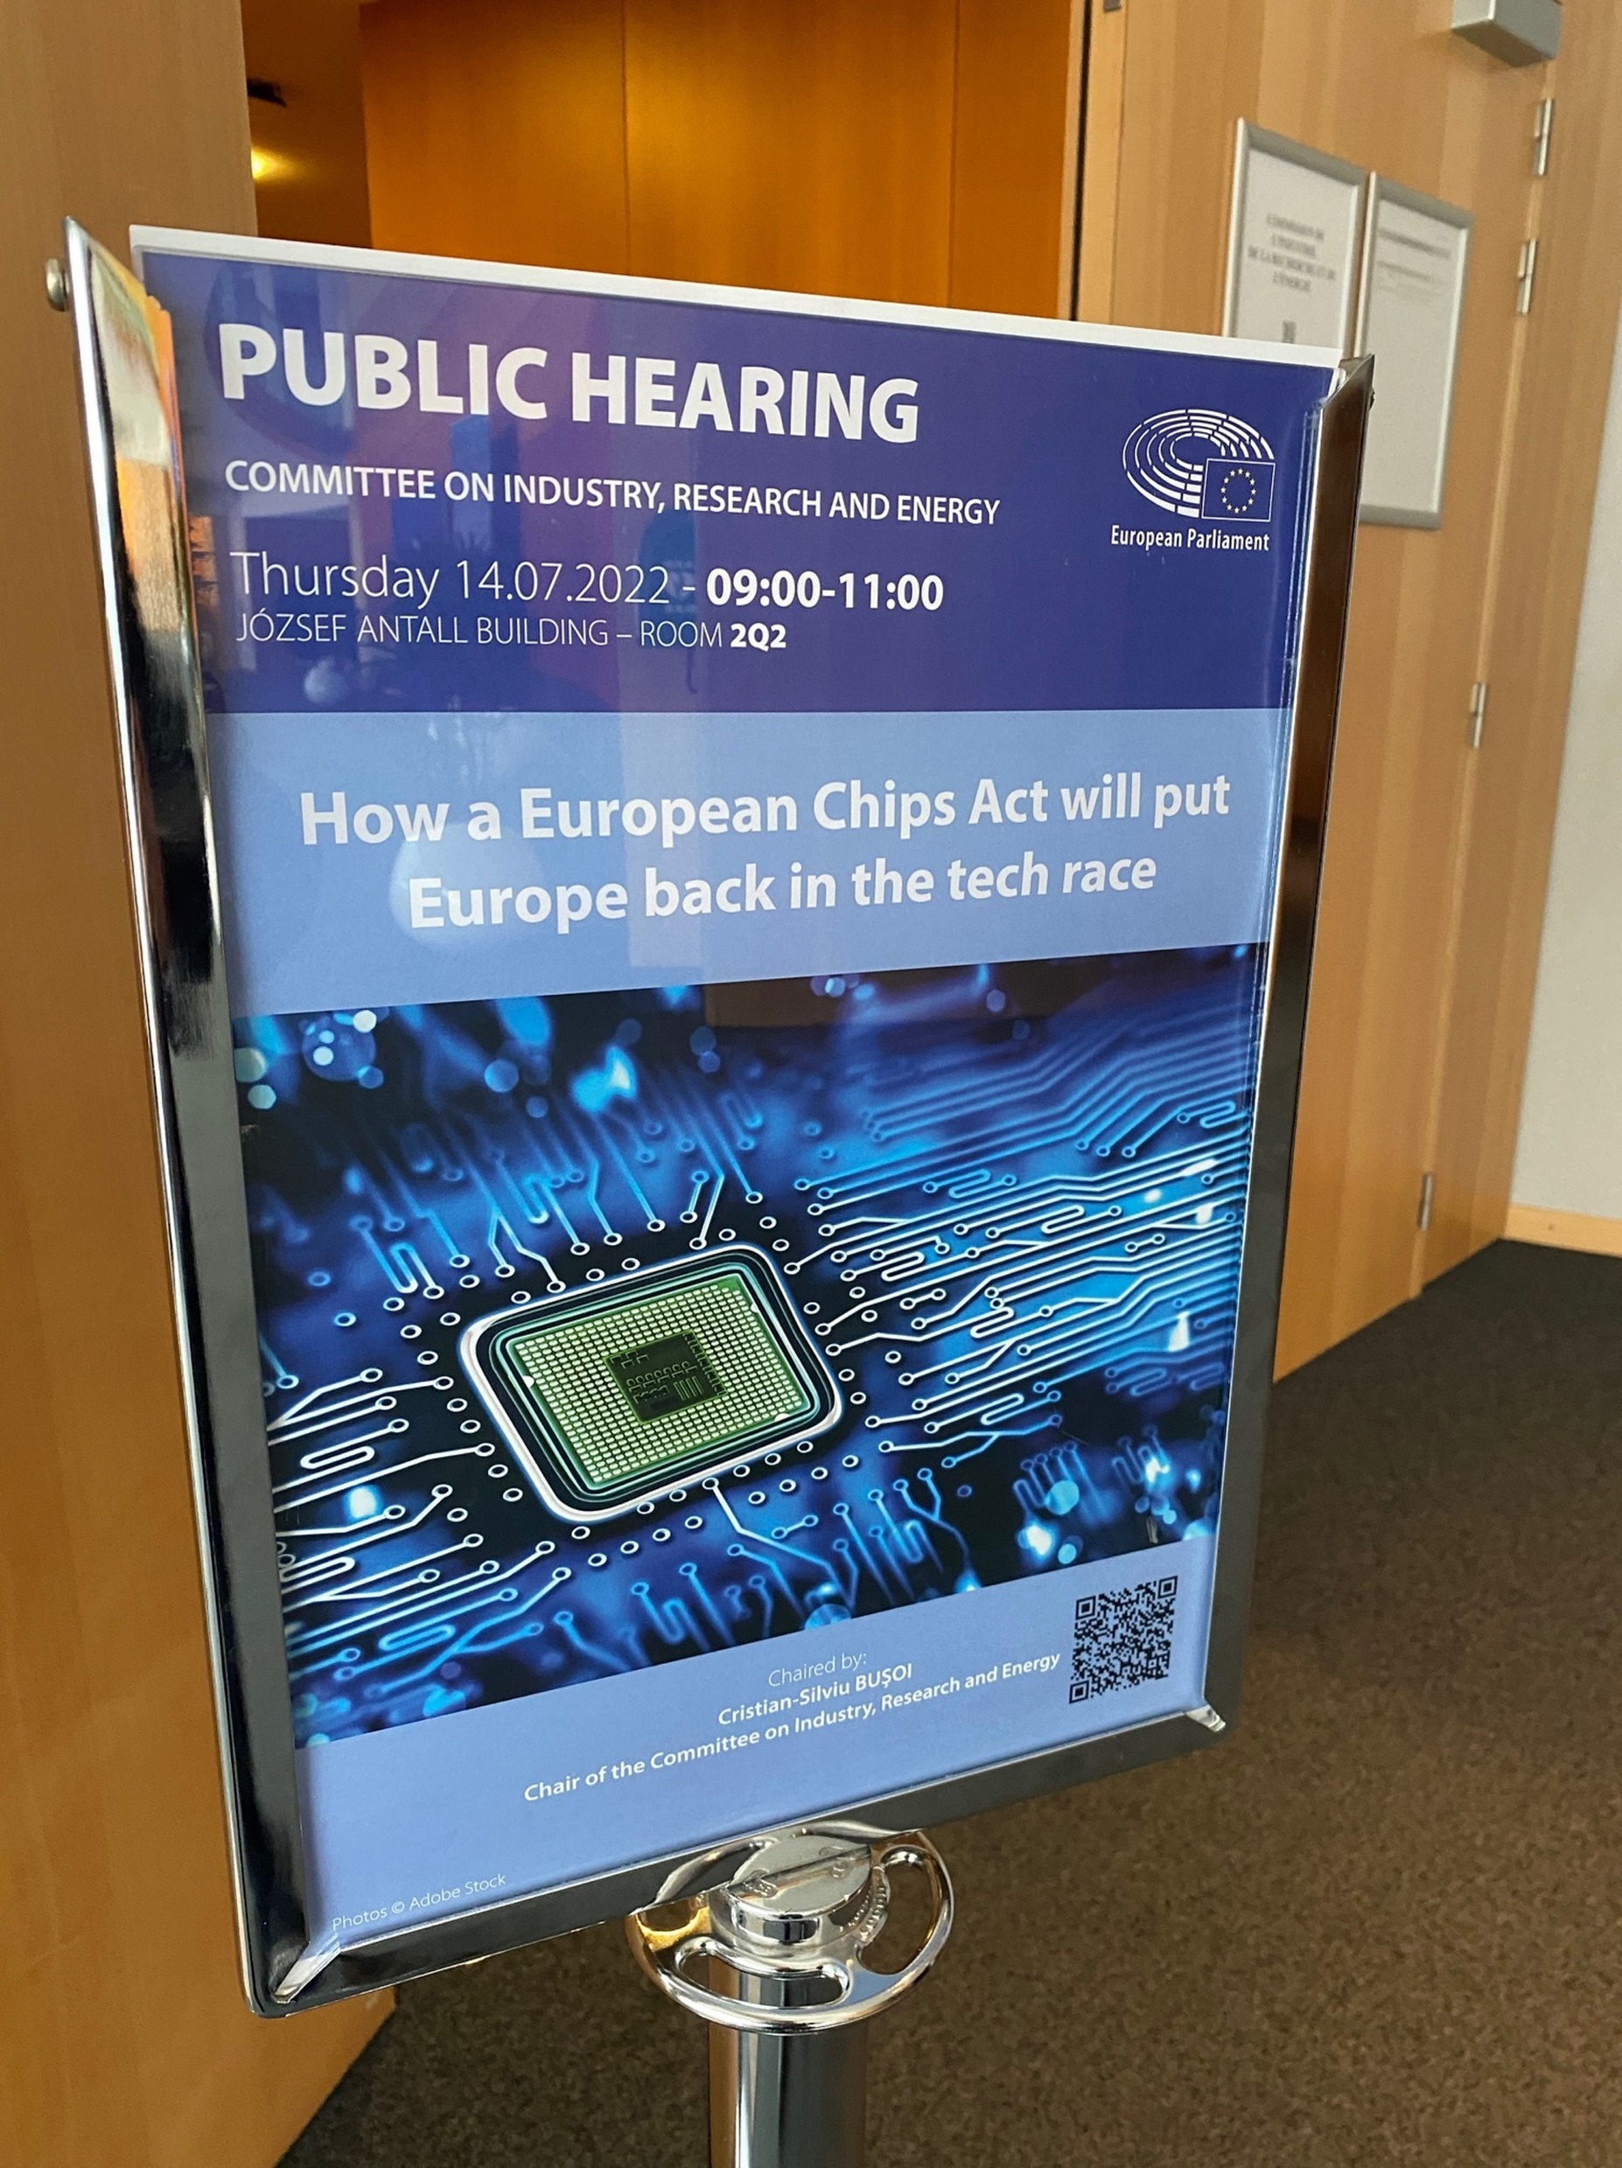
Current examples
Regulation of the
EU Chips Act

Slide 18
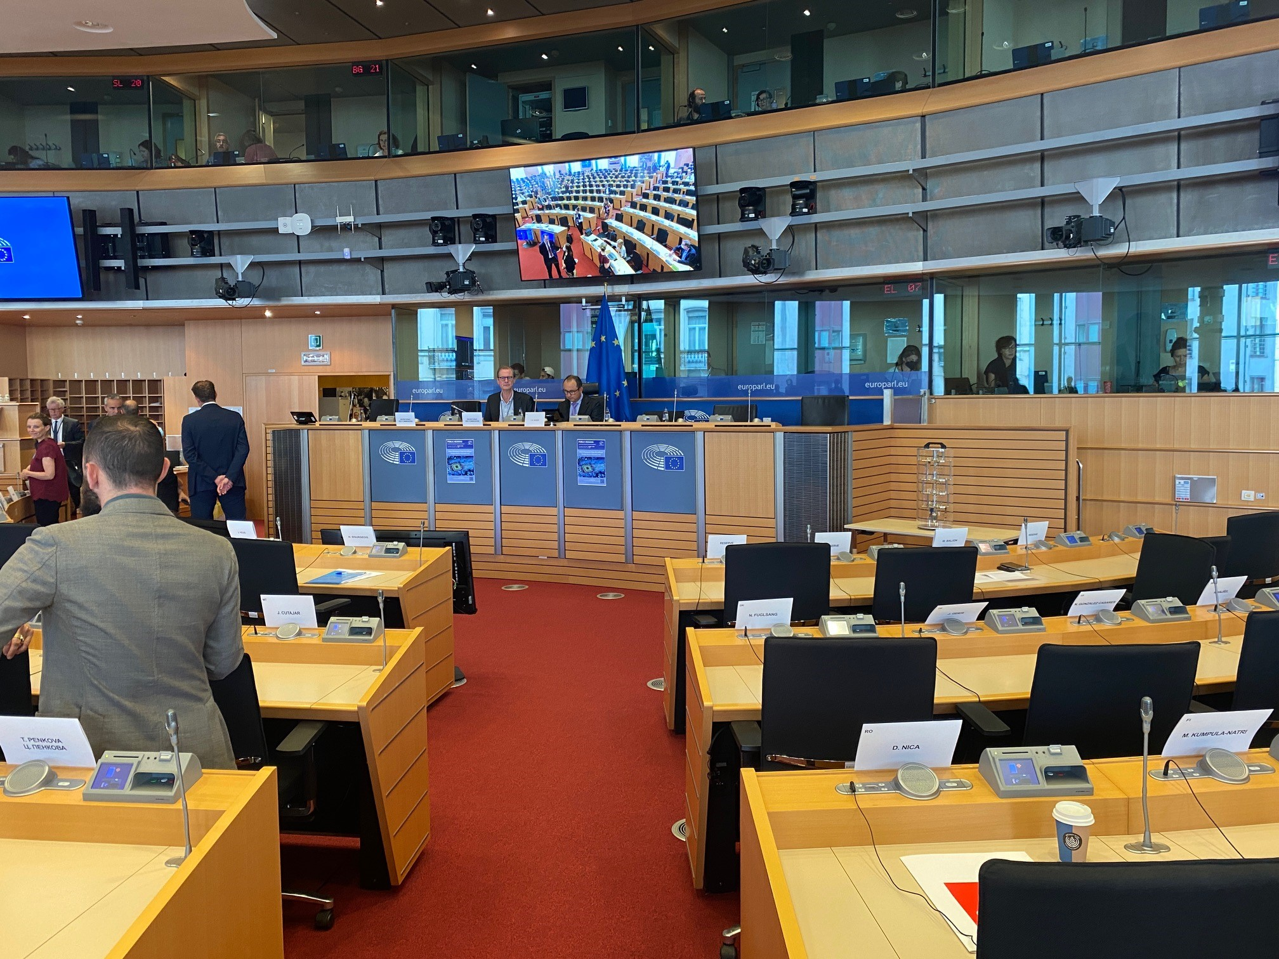

Slide 19
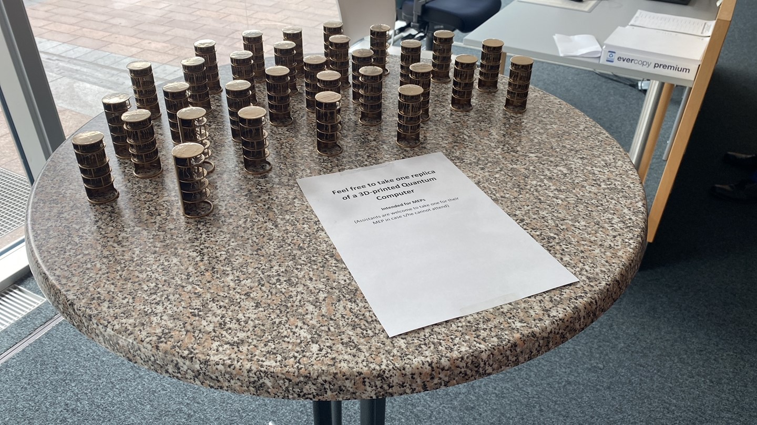
Current examples

Slide 20
How to work in Science Policy?
European Union
Directorate-General for Research
Joint Research Centre
European Research Council
Learned Societies (EPS, EuChems, EMBO, etc.)
National, European and International
National governments
Regional Administration
Private sector
Etc.

Slide 21
How can I start working on Science Policy?
European Union
EPSO Portal
https://epso.europa.eu/
Learned societies
National governments
Regional Administration

Slide 22
From Science to Science Policy
Feel free to contact me!
Enrique.sanchez@eps.org

