Slide 1
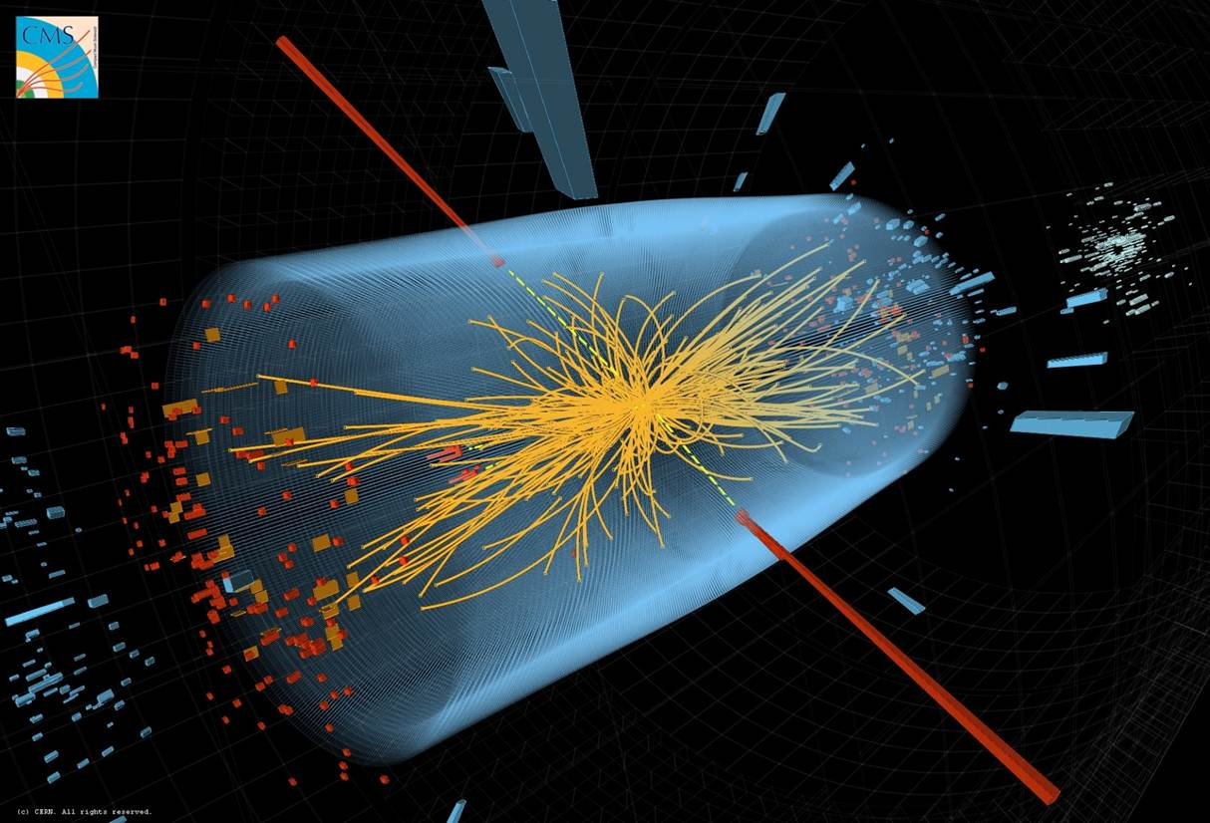
The Future of Particle Physics
CERN view
Balkan Physical Union
11th Congress
Joachim Mnich - CERN
August 29th, 2022

Slide 2
Reminder Update European Strategy for Particle Physics
CERN Council updated the European Strategy for Particle Physics in June 2020
Scientific recommendations
Full exploitation of the LHC and HL-LHC
Highest-priority next collider: e+e- Higgs factory
Increased R&D on accelerator technologies
Investigation of the technical and financial feasibility of a future ≥ 100 TeV hadron collider
Long-baseline neutrino projects in US and Japan
High-impact scientific diversity programme complementary to high-energy colliders
R&D on detector and computing
Theory
Other high priority items:
Exploit synergies with neighboring field, in particular nuclear and astroparticle physics
Mitigate environmental impact of particle physics
Invest in next generation of researchers
Support knowledge and technology transfer
Public engagement, education and communication
This strategy provides guidelines to CERN and the entire field for the coming years

Slide 3

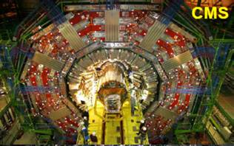


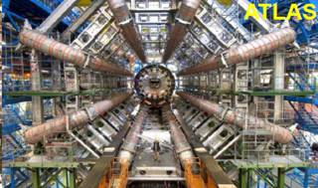


Large Hadron Collider (LHC)
Protons
(ions)
Atlas
Protons
(ions)

Slide 4

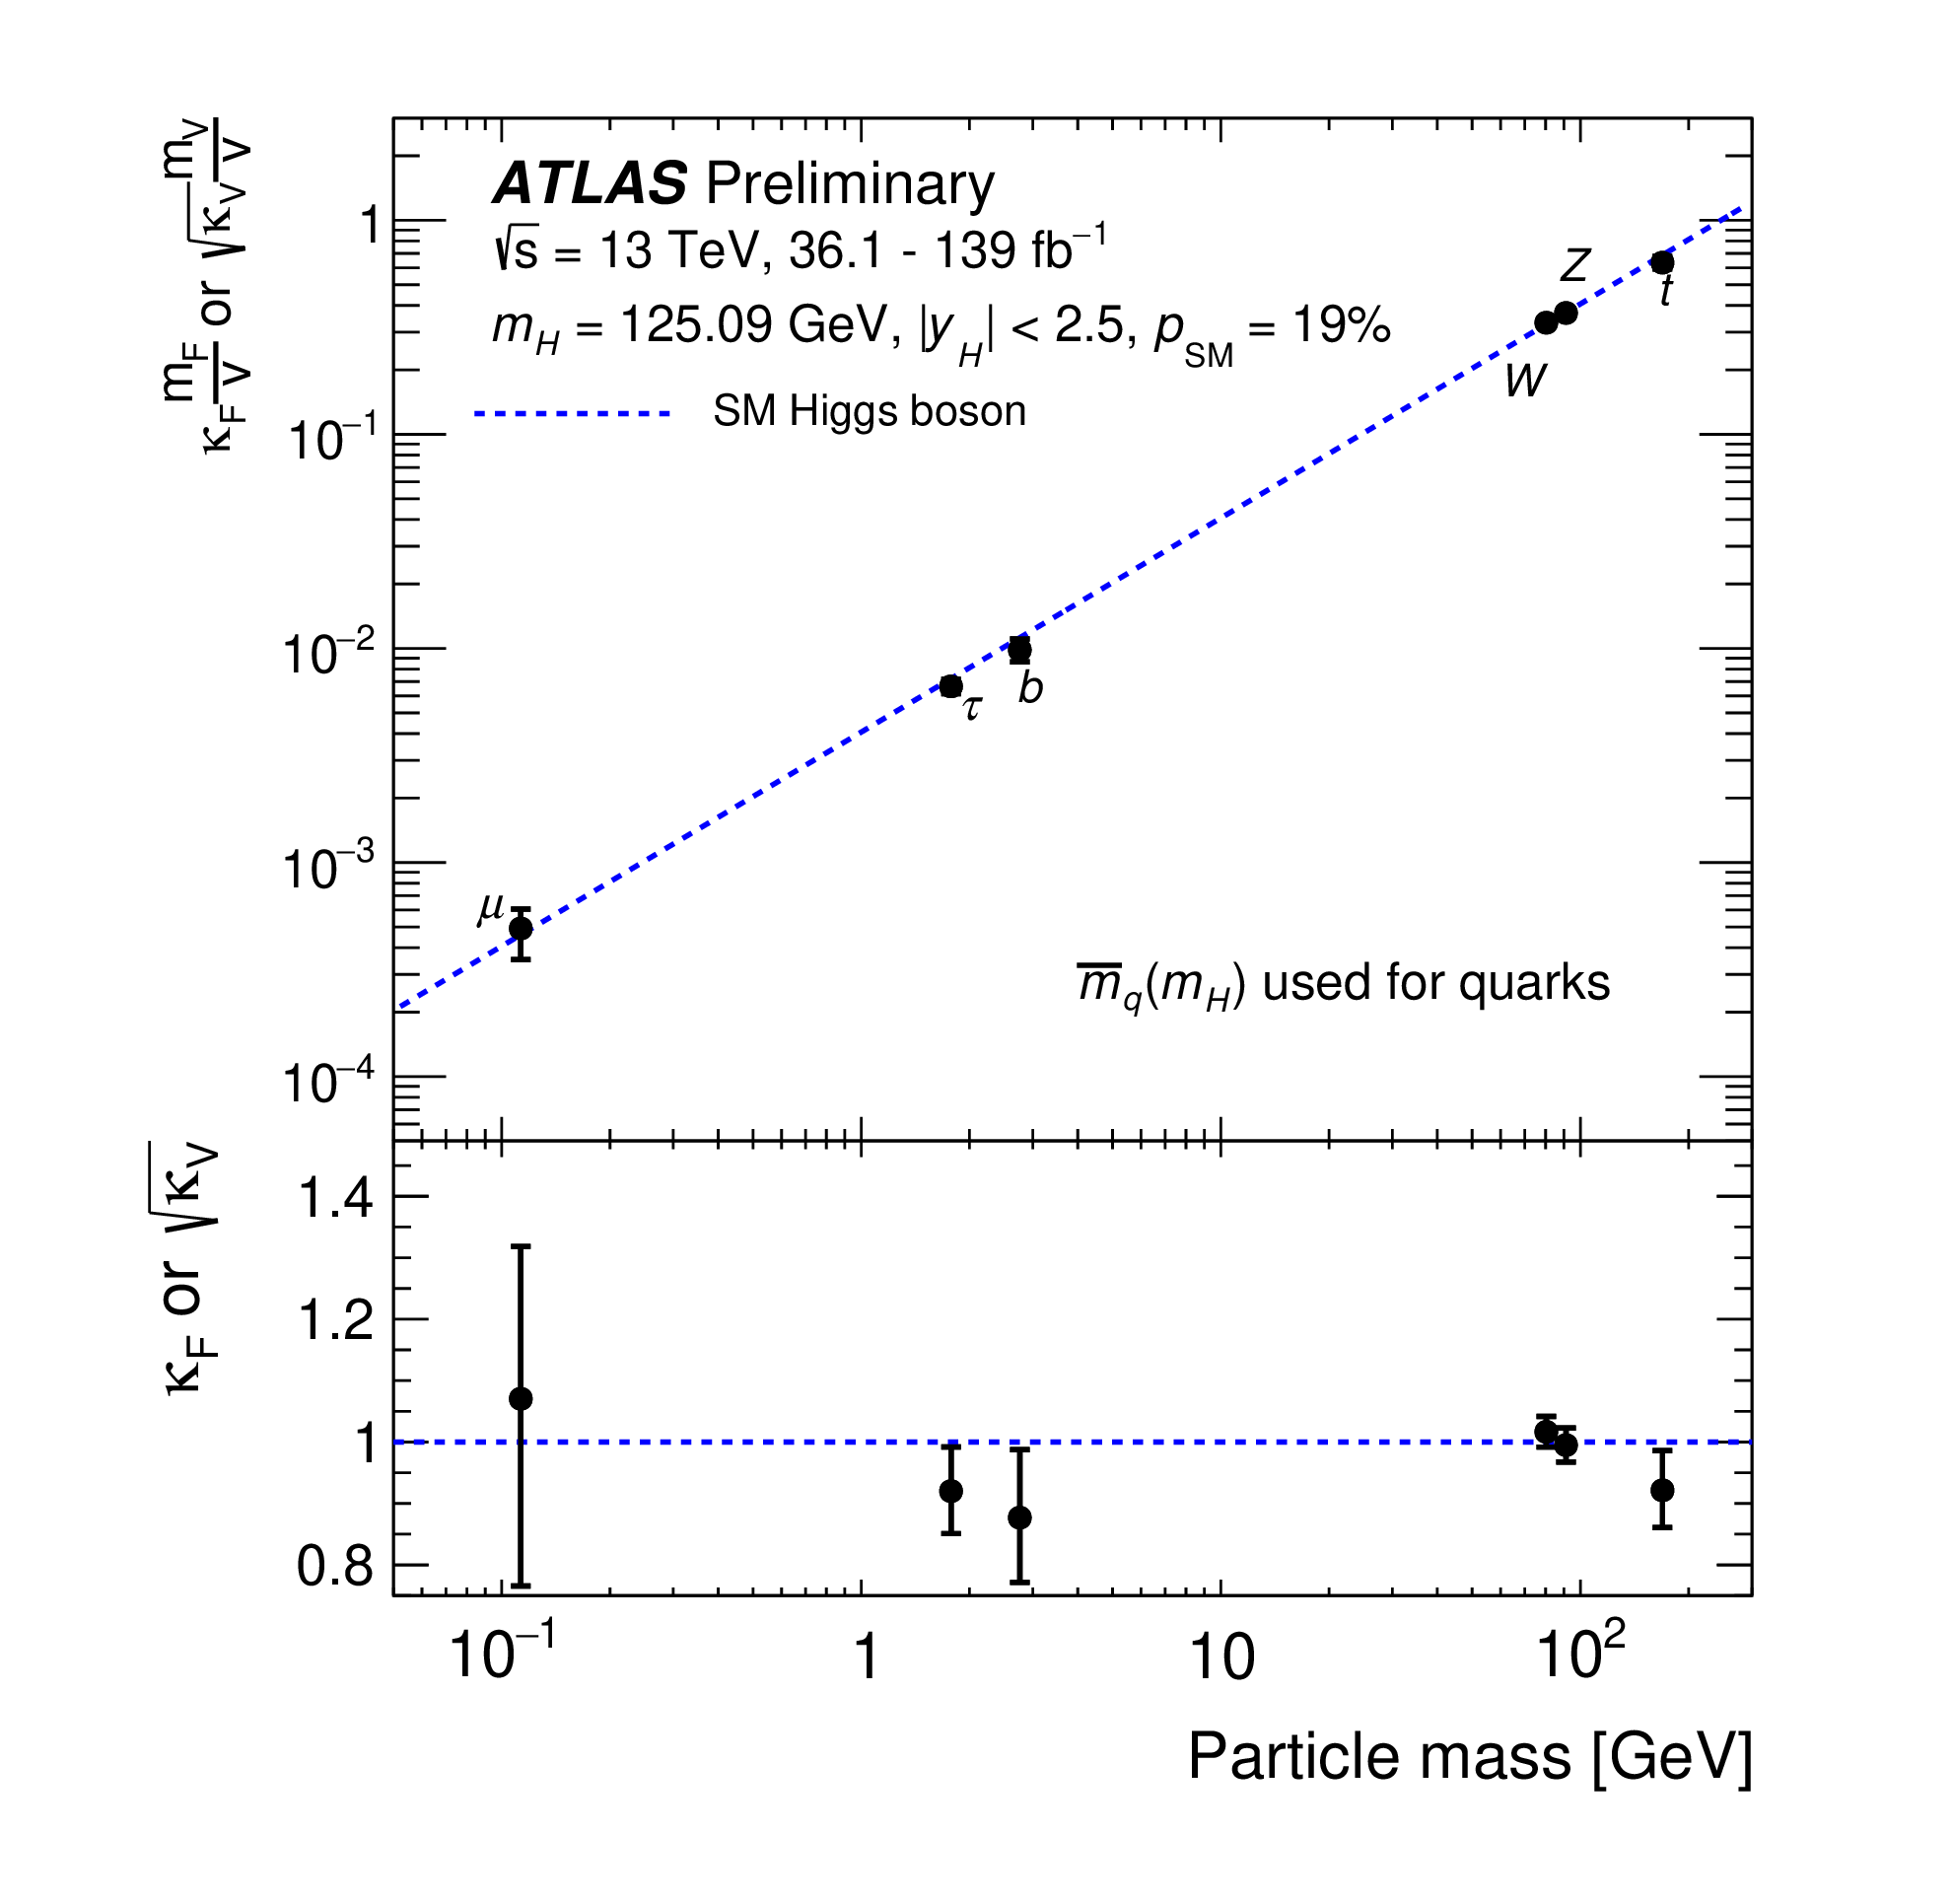
Achievements since the Higgs Boson Discovery
Coupling measurements (B_{i} = B_{u} = 0)
Example: measurement of the Higgs couplings to fundamental particles
ATLAS result based on the full data set (Run 2)
Key prediction of the Standard Model:
Higgs coupling to particles is proportional to their mass
Impressive verification with an accuracy often better than 10%
+0.07
+0.31
κ_{𝛾} = 1.04 ± 0.06, κ_{g} = 0.92 , κ_{Z𝛾} = 1.37
–0.06
–0.37
ATLAS-CONF-2021-053
Precision on couplings reached
κ_{µ} < 30%
κ_{𝜏} = 7%
κ_{b} = 11%
κ_{t} = 6%
κ_{W,Z} = 6%
Notes:
B_i and B_u: invisible and undetected Branching fractions

Slide 5
The LHC Scientific Programme
Today
Start of the scientific programme
Upgrade of accelerator and detectors
Upgrade of accelerator and detectors (Phase II)
Status Feb 2022

Slide 6
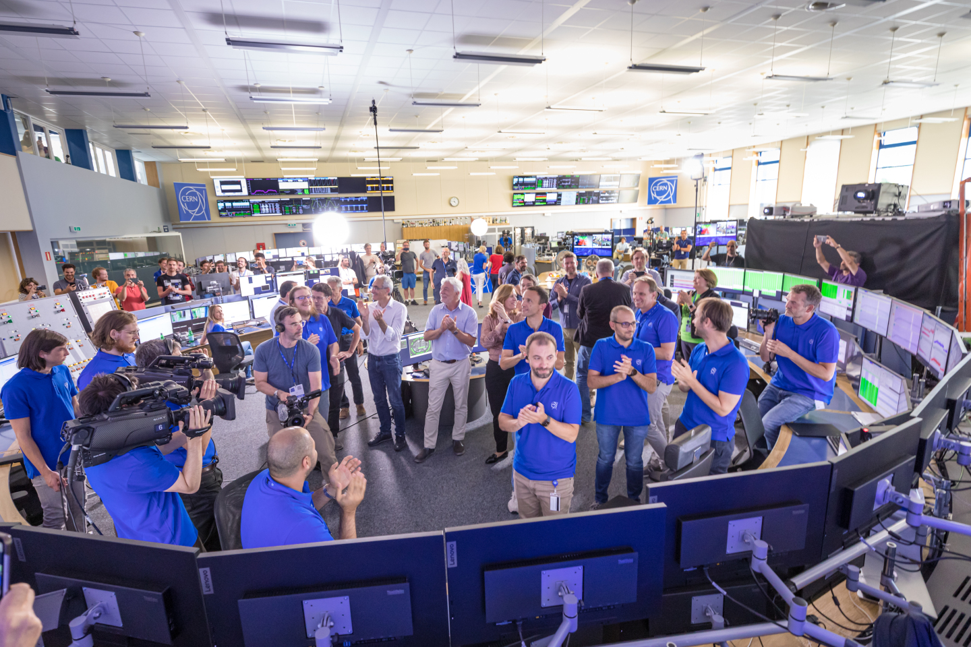
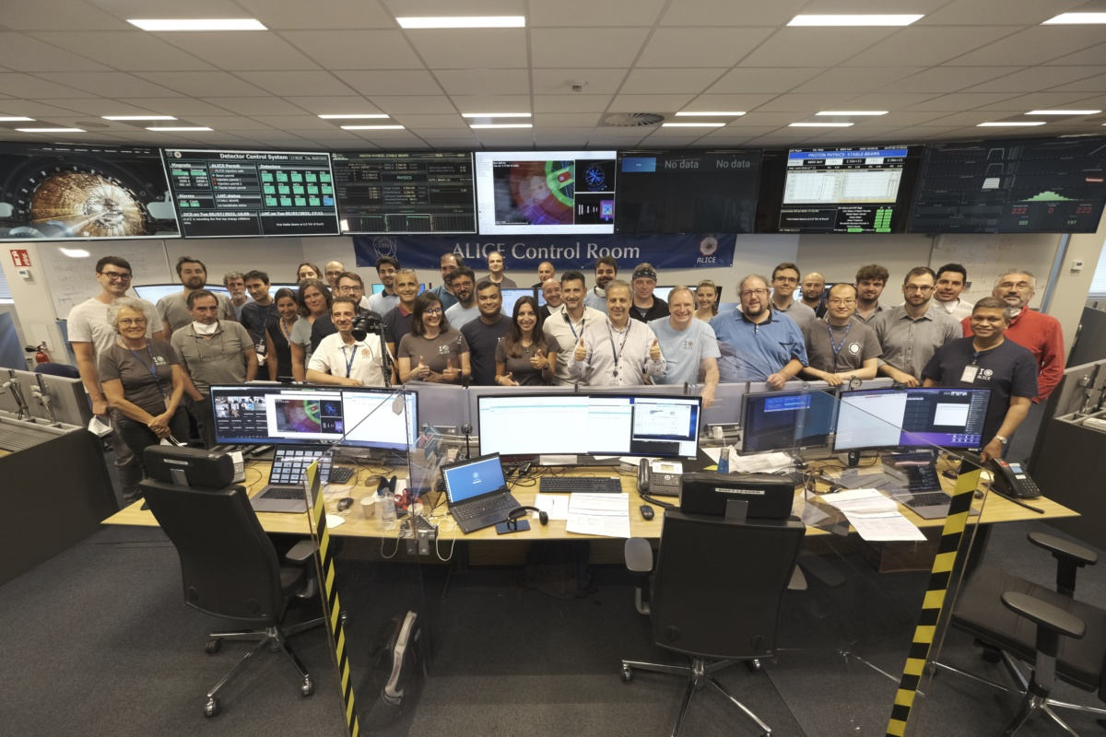
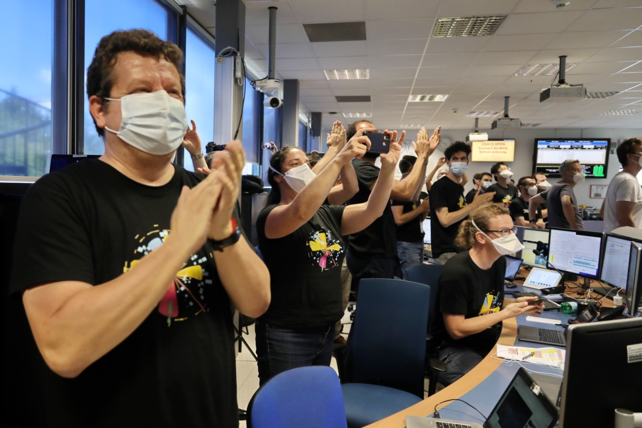
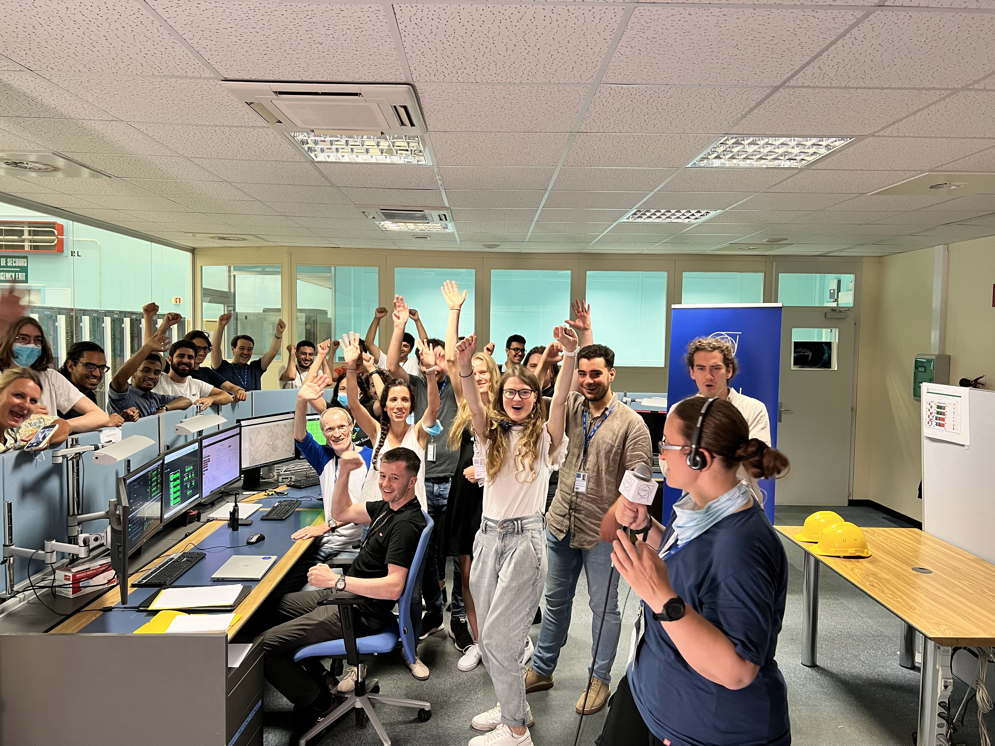
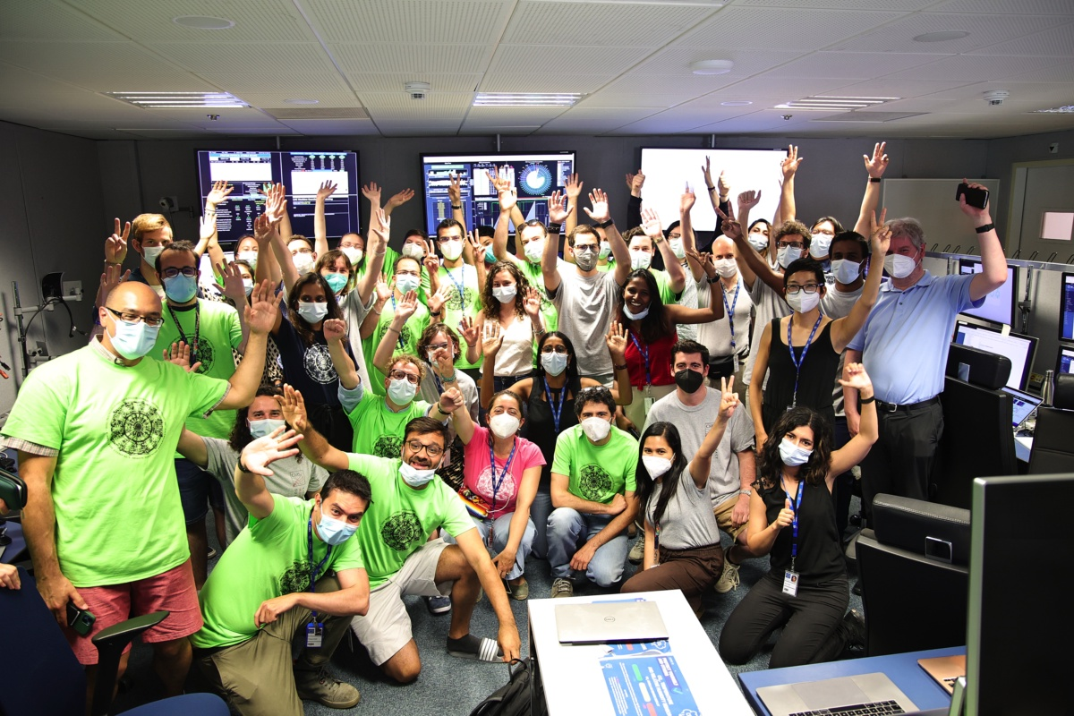
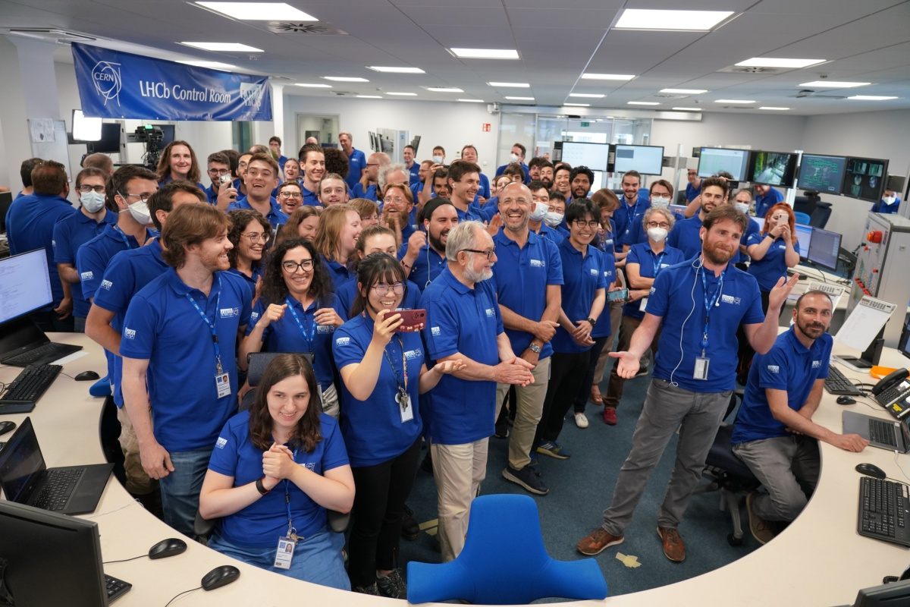
CERN on July 5th
CCC
ALICE
ATLAS
Computer
Centre
CMS
LHCb

Slide 7
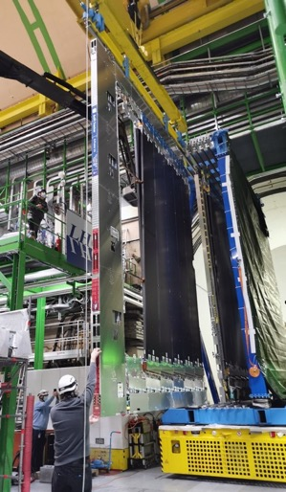
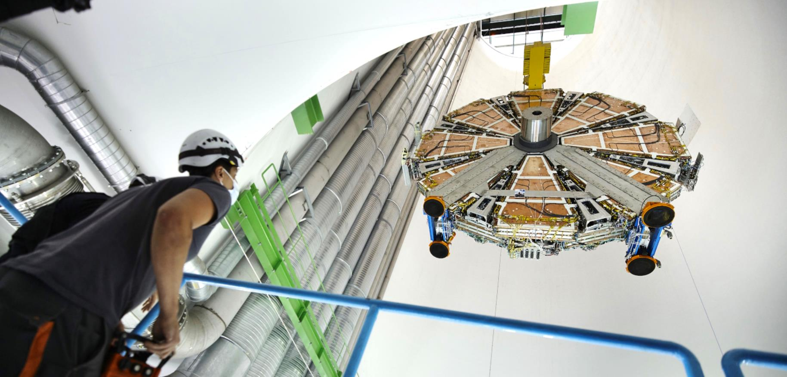
Upgrades of the Detectors
LHCb Scintillating Fibre Tracker
All 4 LHC experiments improved with new detectors, electronics, DAQ systems
A few examples:
ATLAS New Small Wheel
Notes:
SciFi: 11,000 km of fibres

Slide 8
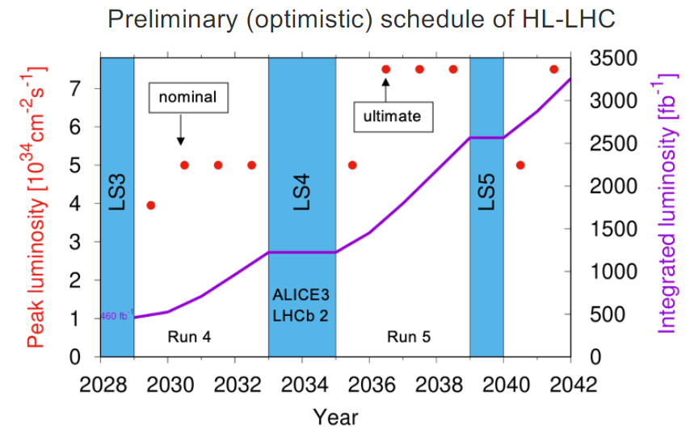
LHC Programme
Preliminary HL-LHC schedule
2022: Re-start LHC again (Run 3)
  Over the last years significant improvements on accelerator (incl. HL-LHC preparations) and detectors
  Goal for Run 3 is to approx. double the luminosity for ATLAS and CMS
  Even more potential for ALICE and LHCb due to increased rate capabilities
HL-LHC
  Long shutdown 2026 - 28 to upgrade accelerator and detectors (ATLAS & CMS)
  Will increase luminosity by factors 5 to 7
Final goal is > 3000 fb⁻¹
  About 20 times the luminosity collected until today
ALICE and LHCb upgrade planned in the 2030ies

Slide 9
The High-Luminosity LHC
HL-LHC will provide 3000 – 4000 fb⁻¹ by ≈ 2040
i.e. ≈ 20 times the currently available data
Will allow measurement
Higgs couplings to the
percent-level
incl. establishing Higgs
self coupling
Significantly extend reach
for new physics
Start operation in 2029
2 examples for illustration
Notes:
CERN Yellow Report CERN-2019-007

Slide 10
Challenges for the Detectors
Example: event pile-up
in 2018 typically 20 - 40 pp collisions per bunch crossing
At the HL-LHC: 150 - 200 pp collisions per bunch crossing expected
Need to identify the right vertex at which the Higgs was produced

Slide 11
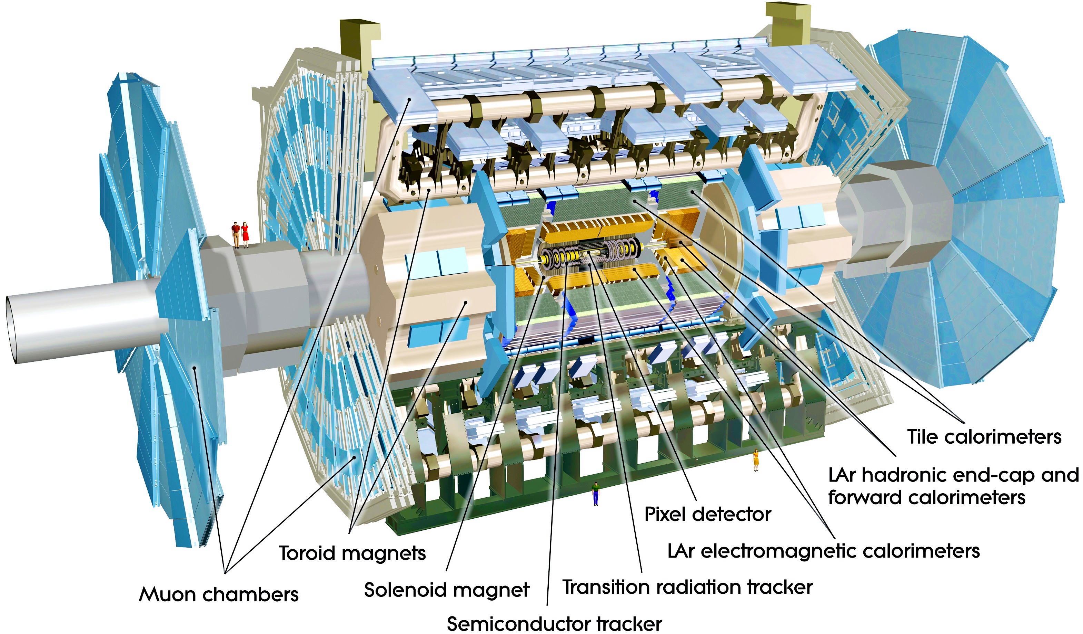
ATLAS Phase II Upgrades
Upgraded Trigger and Data Acquisition system
L0 at 1 MHz
Improved High-Level Trigger (100 kHz full-scan tracking)
The full scientific exploitation of the
HL-LHC requires major upgrades of the detectors, mainly for ATLAS and CMS
Higher granularity
Better resolution in space and time
→ Phase II upgrades
Electronics Upgrades
LAr Calorimeter
Tile Calorimeter
Muon system
High Granularity Timing Detector (HGTD)
Forward region
Low-Gain Avalanche Detectors (LGAD)
New Muon Chambers
Inner barrel region
New Inner Tracking Detector (ITk)
Pixel and Strip detectors
All silicon, up to |η| = 4

Slide 12
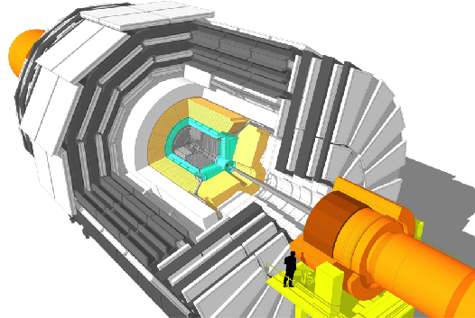
CMS Phase II Upgrades
L1-Trigger HLT/DAQ
https://cds.cern.ch/record/2714892
https://cds.cern.ch/record/2283193
Tracks in L1-Trigger at 40 MHz
PFlow selection 750 kHz L1 output
HLT output 7.5 kHz
40 MHz data scouting
Barrel Calorimeters
https://cds.cern.ch/record/2283187
ECAL crystal granularity readout at 40 MHz with precise timing for e/γ at 30 GeV
ECAL and HCAL new Back-End boards
Muon systems
https://cds.cern.ch/record/2283189
DT & CSC new FE/BE readout
RPC back-end electronics
New GEM/RPC 1.6 < η < 2.4
Extended coverage to η ≃ 3
Calorimeter Endcap
https://cds.cern.ch/record/2293646
3D showers and precise timing
Si, Scint+SiPM in Pb/W-SS
Beam Radiation Instr. and Luminosity
http://cds.cern.ch/record/002706512
Bunch-by-bunch luminosity measurement: 1% offline, 2% online
Tracker
https://cds.cern.ch/record/2272264
Si-Strip and Pixels increased granularity
Design for tracking in L1-Trigger
Extended coverage to η ≃ 3.8
MIP Timing Detector
https://cds.cern.ch/record/2667167
Precision timing with:
  Barrel layer: Crystals + SiPMs
  Endcap layer: Low Gain Avalanche Diodes

Slide 13
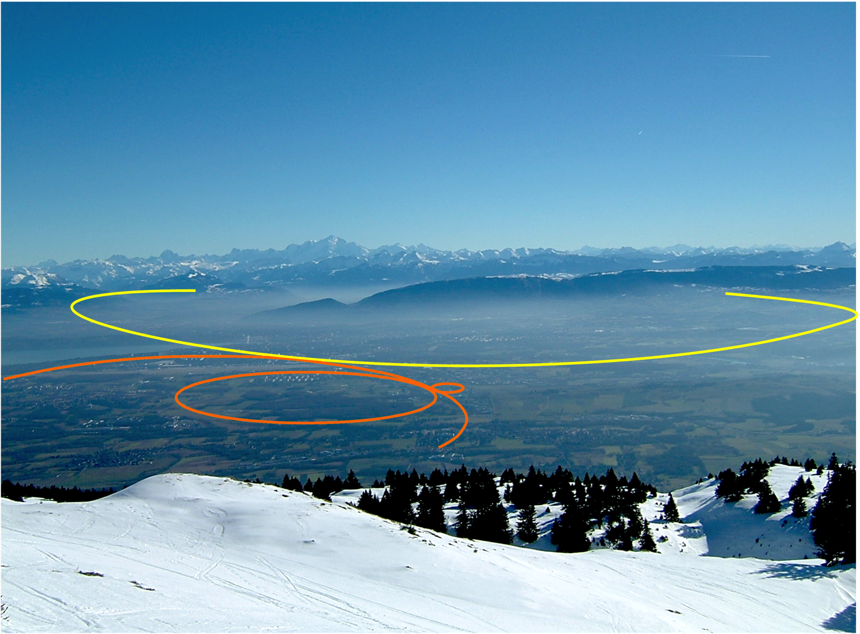
Future Circular Collider (FCC)

Slide 14
Future Circular Collider (FCC): Feasibility Study
European Strategy for Particle Physics:
An electron-positron Higgs factory is the highest-priority next collider. For the longer term, the European particle physics community has the ambition to operate a proton-proton collider at the highest achievable energy.
“Europe, together with its international partners, should investigate the technical and financial feasibility of a future hadron collider at CERN with a centre-of-mass energy of at least 100 TeV and with an electron-positron Higgs and electroweak factory as a possible first stage.
Such a feasibility study of the colliders and related infrastructure should be established as a global endeavour and be completed on the timescale of the next Strategy update.”
CERN has launched the FCC feasibility study to address these recommendations

Slide 15

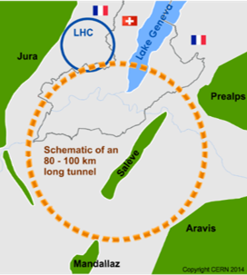
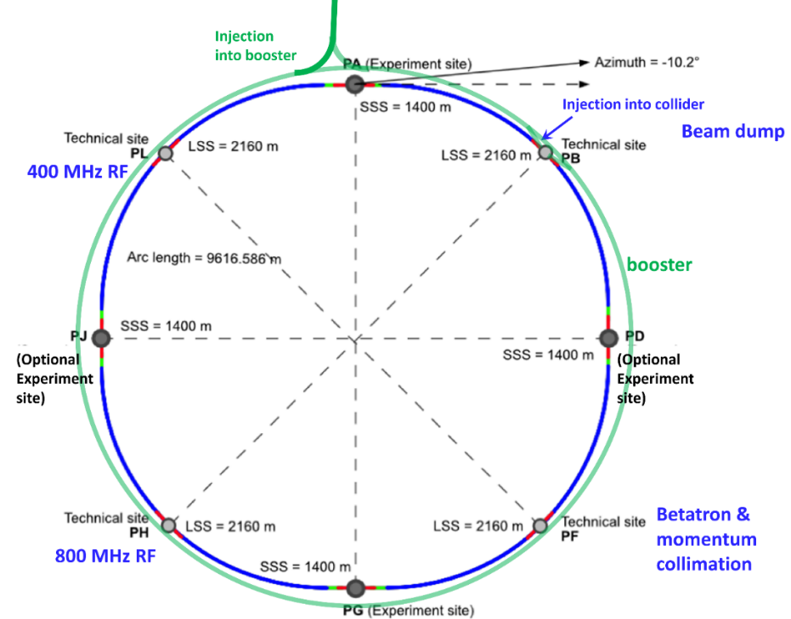
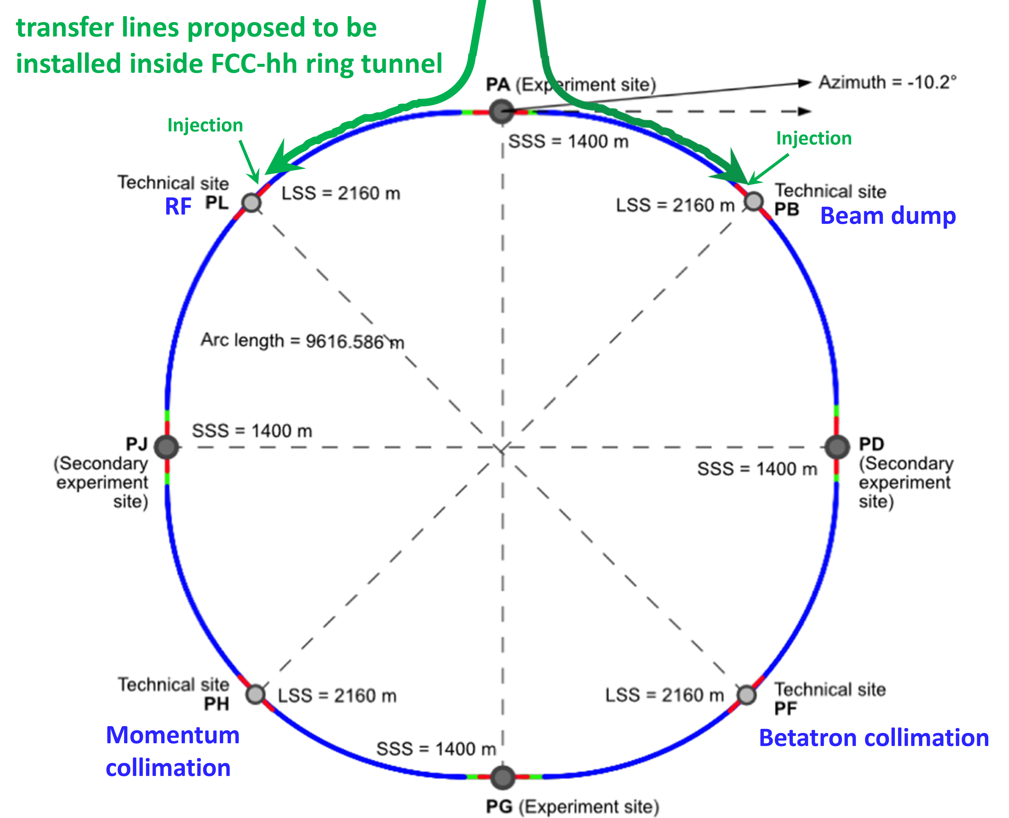
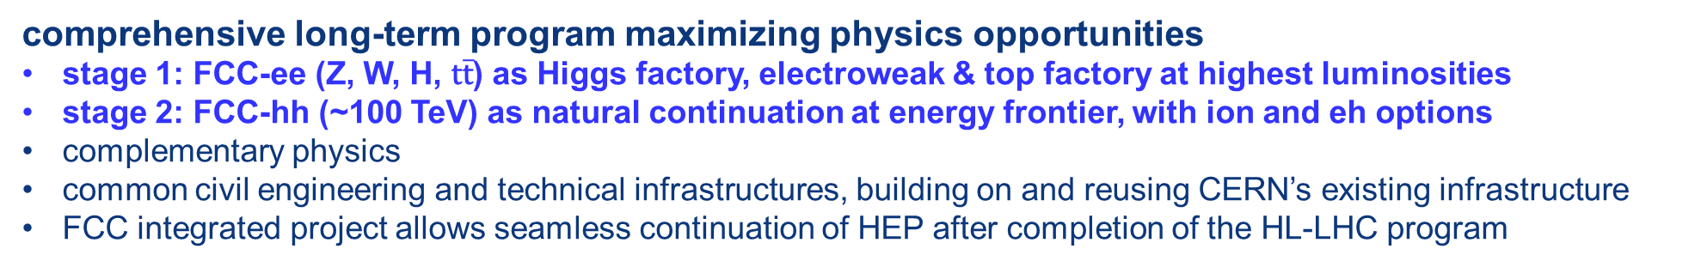
The FCC integrated program
inspired by successful LEP – LHC programs at CERN
comprehensive long-term program maximizing physics opportunities
stage 1: FCC-ee (Z, W, H, $\text{t}\overline{\text{t}}$) as Higgs factory, electroweak & top factory at highest luminosities
stage 2: FCC-hh (~100 TeV) as natural continuation at energy frontier, with ion and eh options
complementary physics
common civil engineering and technical infrastructures, building on and reusing CERN’s existing infrastructure
FCC integrated project allows seamless continuation of HEP after completion of the HL-LHC program
M. Benedikt
April 2022
FCC-ee
FCC-hh
2020 - 2040
2045 - 2060
2065 - 2090

Slide 16

Status of Global FCC Collaboration
Increasing international collaboration as a prerequisite for success:
links with science, research & development and high-tech industry will be essential to further advance and prepare the implementation of FCC
147
Institutes
30
Companies
34
Countries
EC
H2020

Slide 17
Accelerator Roadmap
CERN and the national laboratories in Europe (LDG) are charged by CERN Council to define a Roadmap for Accelerator R&D
Topics:
High-field magnets
High-gradient accelerations
(plasma, SCRF)
Muon beams/collider
Energy recovery linacs
Education and training
Goal: be able at the next strategy update to identify
viable options which deserve to be pursued
 | High Field Magnets Low Temp & HTS | High Gradient Acceleration (plasma) | Muon Collider | ERL | High Gradient Accelerating Structures (sc & nc)
chair | Pierre Vedrine, IRFU | Ralph Assmann, DESY & INFN | Daniel Schulte, CERN | Max Klein, Liverpool | Sebastien Bousson, IJCLab
co-chair | Luis Garcia-Tabares Rodriguez, CIEMAT | Edda Gschwendtner, CERN | Nadia Pastrone, INFN | Andrew Hutton, JLAB | Hans Weise, DESY
Roadmap to be presented to Council end of 2021
Key importance for a successful execution of the roadmap: collaboration between labs and universities in Europe and beyond

Slide 18
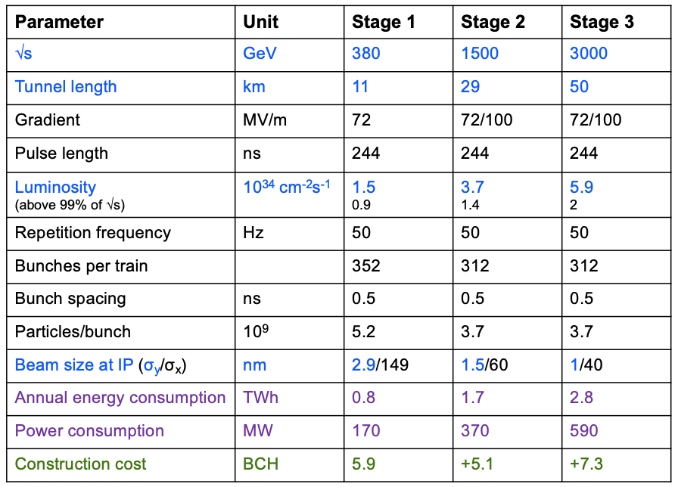
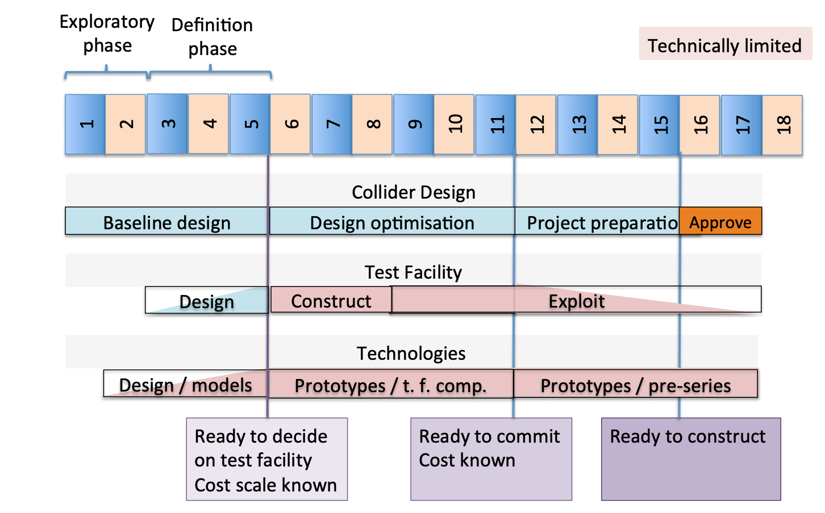
Accelerator R&D at CERN
CLIC
In addition to the high-field magnet programme (part of FFC study)
Continue CLIC study to prepare for next strategy update
  finalize X-band technology towards construction readiness
  improve power efficiency (klystrons)
  project readiness report by end 2025
Muon collider
  work on main challenges:
  muon source, cooling, fast ramping magnets, accelerator, collider ring, neutrino bkgd, civil engineering
  for next strategy: is investment into µ-collider test facility justified?
µ-collider
now

Slide 19
ECFA Detector R&D Roadmap Panel
CERN Council has charged European Committee for Future Accelerators
(ECFA) to define a detector R&D Roadmap
Involvement of the community:
open Symposia took place between March 27th and May 7th
https://indico.cern.ch/event/957057/program
presentation on July 30th at EPS for further feedback
ECFA endorsement of final document in November 2021

Slide 20

Physics Beyond Collider Study
PBC is an exploratory study launched in 2016 aimed at exploiting the full scientific potential of CERN's accelerator complex and its scientific infrastructure
http://pbc.web.cern.ch/
complementary to LHC and other high-energy colliders
target fundamental physics questions that are similar in spirit to those addressed by high-energy colliders
Provided in put to the ESPP
PBC Summary Report: arXiv:1902.00260
Study will continue
workshop March 2021
https://indico.cern.ch/event/1002356/
Topics include:
LHC injectors:
Low energy facilities
High energy fixed target
Other opportunities gamma-factory
nuSTORM @CERN
Precision measurement and rare decays
High energy beam dumps
Low energy hidden sector (axions, EDM)
QCD and HI
Study leaders:
Joerg Jaeckel (Heidelberg)
Mike Lamont (CERN) → Gianluigi Arduini
Claude Vallee (Marseille)
Notes:
Nobody from PSI in the study

Slide 21
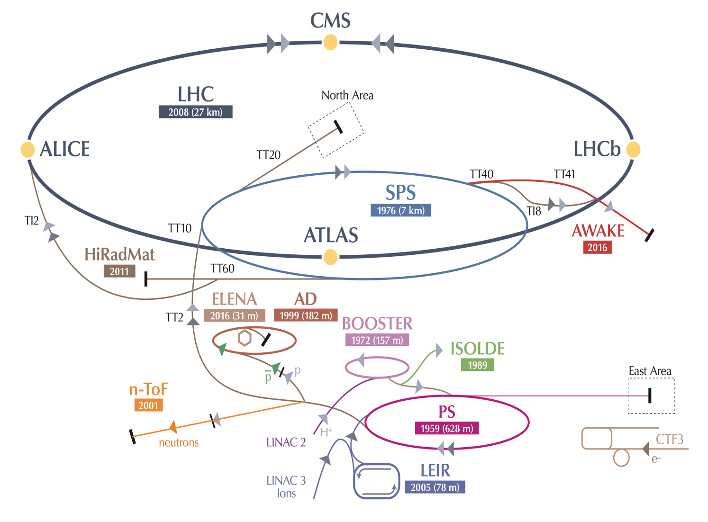
CERN Diversity Programme
AD: Antiproton Decelerator for antimatter studies
AWAKE: proton-induced plasma wakefield acceleration
CAST, OSQAR: axions
CLOUD: impact of cosmic rays on aeorosols and clouds → implications on climate
COMPASS: hadron structure and spectroscopy
ISOLDE: radioactive nuclei facility
LHC
NA61/Shine: ions and neutrino targets
NA62: rare kaon decays
NA63: radiation processes in strong EM fields
NA64: search for dark photons
Neutrino Platform: ν detector R&D for experiments in US, Japan
n-TOF: n-induced cross-sections
UA9: crystal collimation
~20 projects other than LHC with > 1200 physicists
Notes:
Key messages:
While the Large Hadron Collider (LHC) is the flagship of CERN’s accelerator complex and the results of the LHC experiments are often in the limelight, CERN has a very diverse research programme
This programme covers a wide range of physics topics, from the Standard Model to supersymmetry, from dark matter to cosmic rays.
Experiments at other accelerators and facilities both on-site and off are an equally important part of the Laboratory’s activities.
Supporting all the experiments is a very strong theory programme, which carries out cutting-edge research in theoretical particle physics.
The speaker should avoid describing each of the experiments shown on the slide but rather focus on the messages above.

Slide 22
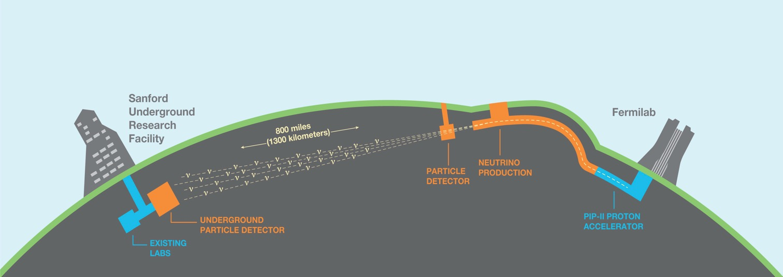

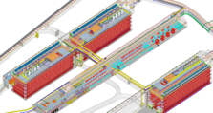
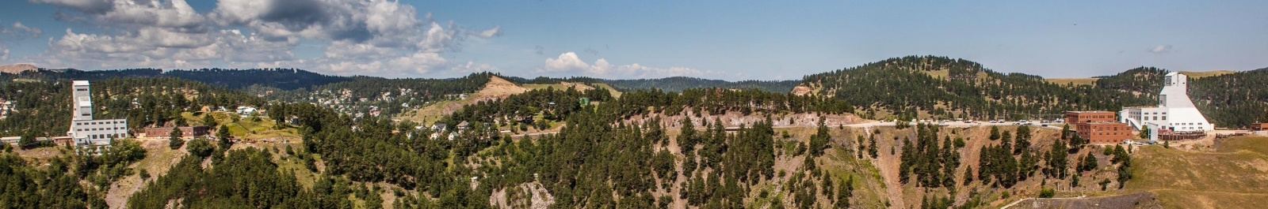
The Long-Baseline Neutrino Facility (LBNF) supporting the international
Deep Underground Neutrino Experiment (DUNE)
1300 km
South
Dakota
Chicago
ν_{μ}
ν_{μ} & ν_{e}
FD
ND
“The LBNF/DUNE project will be the first internationally conceived, constructed, and operated mega-science project hosted by the Department of Energy in the United States” - DOE
Ross shaft headframe
Yates shaft headframe

Slide 23
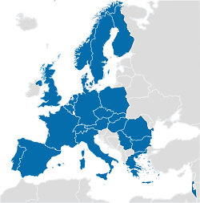






















CERN Quantum Technology Initiative
  QTI established in 2020
  Four technical areas:
    Quantum Computing And Algorithms
    Quantum Theory and Simulation
    Quantum Sensing, Metrology and Materials
    Quantum Communication and Networks
  Collaborations being established in the Member States, US (Fermilab, Oak Ridge) and Japan (Tokyo – ICEPP)
  Signed Quantum Hub Agreement with IBM
INQI

Slide 24
Backup Slides

Slide 25
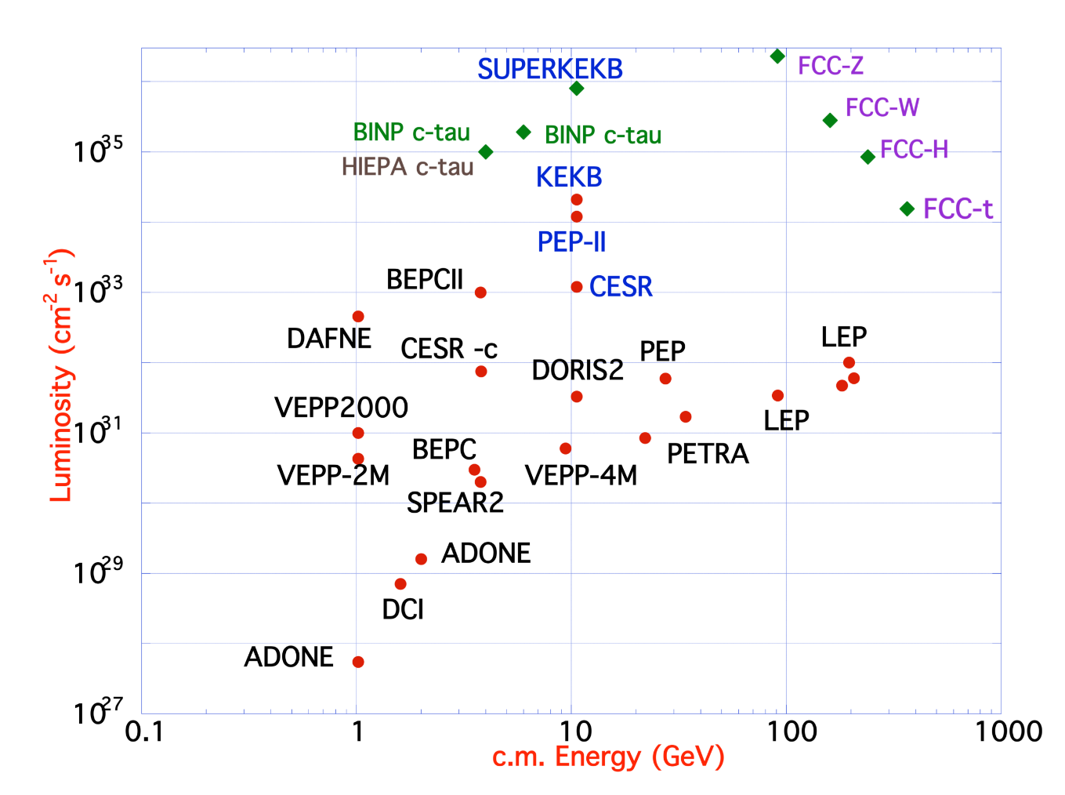
FCC-ee Design Concept
  Based on lessons and techniques from past colliders (last 40 years)
  B-factories: KEKB & PEP-II:
    double-ring lepton colliders,
    high beam currents,
    top-up injection
  DAFNE: crab waist, double ring
  S-KEKB: low by*, crab waist
  LEP: high energy, SR effects
  VEPP-4M, LEP: precision E calibration
  KEKB: e⁺ source
  HERA, LEP, RHIC: spin gymnastics
Marica Biagini
Marica Biagini
Combining successful ingredients of several recent colliders → highest luminosities & energies

Slide 26
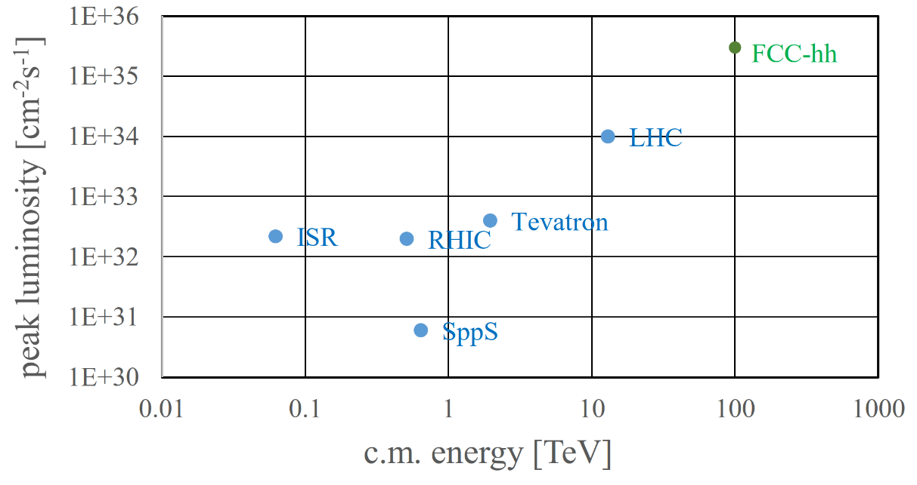
FCC-hh: Highest Collision Energies
Key challenges:
Order of magnitude performance increase in both energy & luminosity
100 TeV cm collision energy (vs 14 TeV for LHC)
20 ab⁻¹ per experiment collected over 25 years of operation (vs 3 ab⁻¹ for LHC)
Similar performance increase as from Tevatron to LHC
Key technology: high-field magnets

