Slide 1



Bringing nobel prize physics to the classroom
Emmanuel Chaniotakis,
Research and Development Department,
Ellinogermaniki Agogi,
Greece
www.frontiers-project.eu | www.reinforceeu.eu

Slide 2
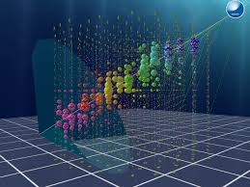
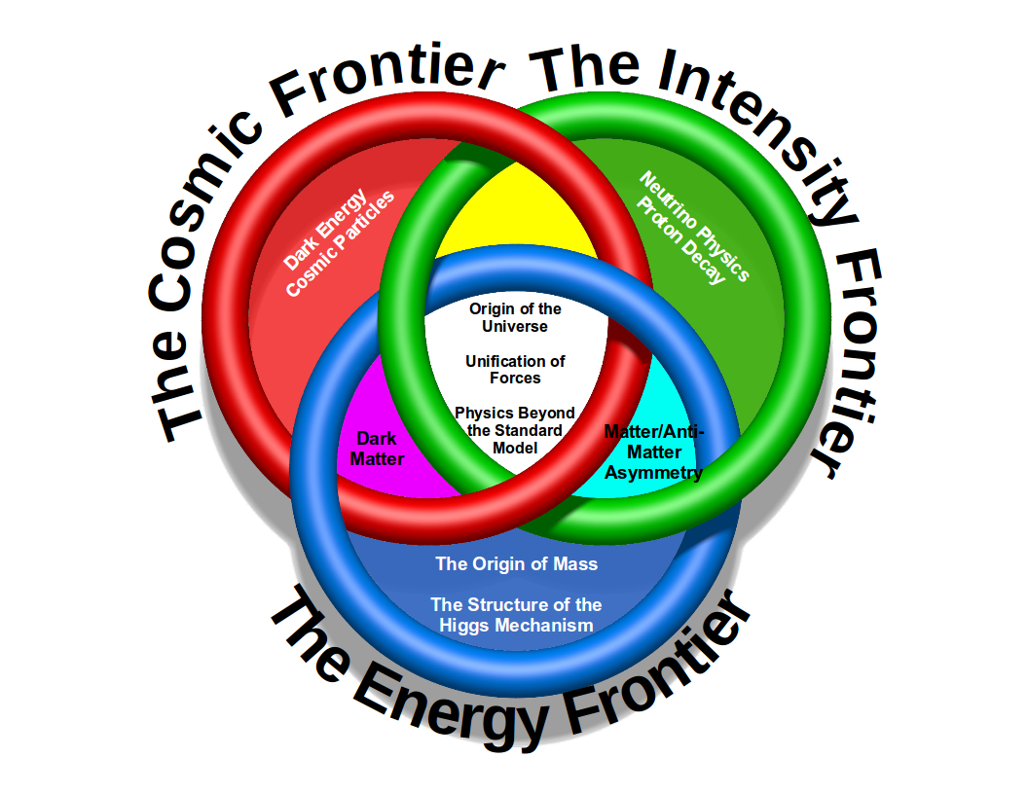
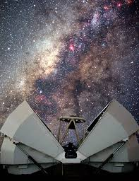
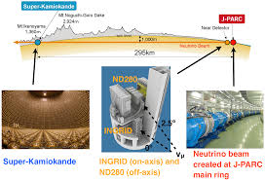
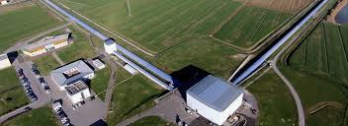

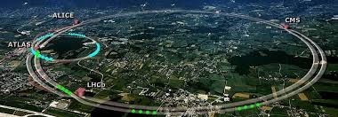
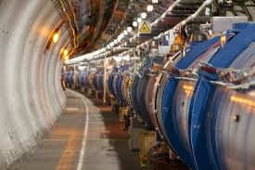
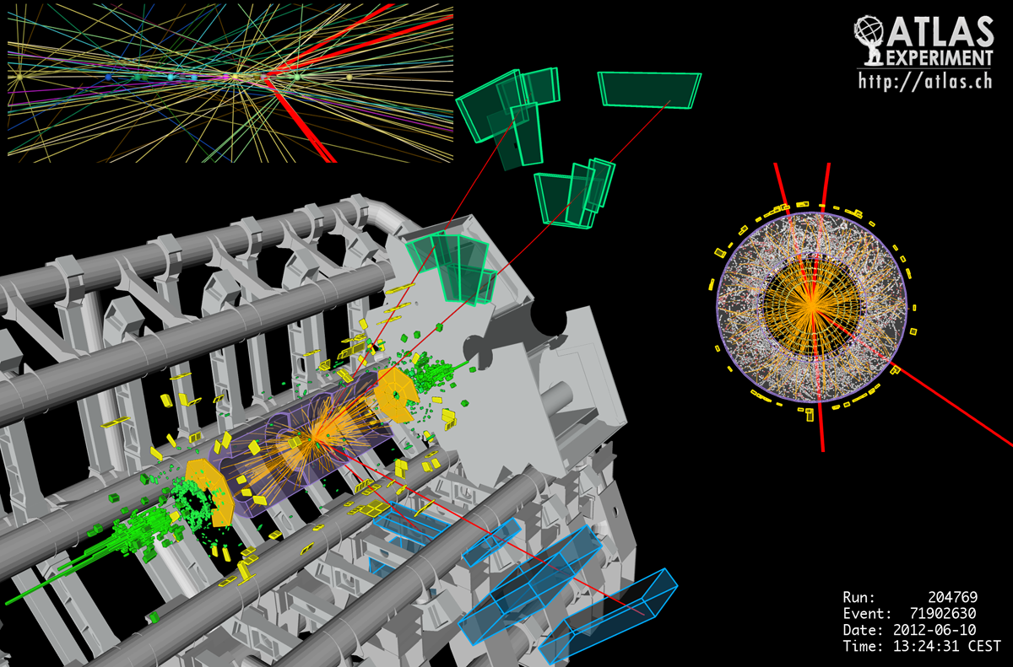


FRONTIERS in fundamental science research
Frontiers has been funded within the framework of the European Union Erasmus+ programme

Slide 3
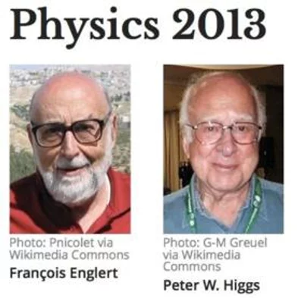
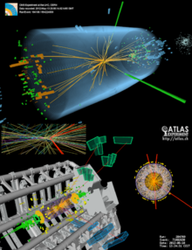
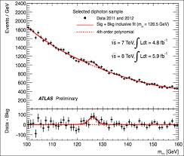
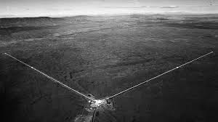
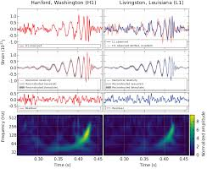
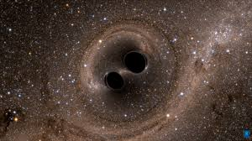
Game Changing
Scientific Discoveries with great media coverage
Frontiers has been funded within the framework of the European Union Erasmus+ programme

Slide 4
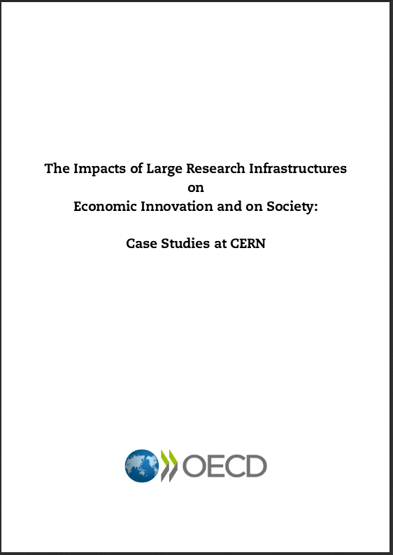
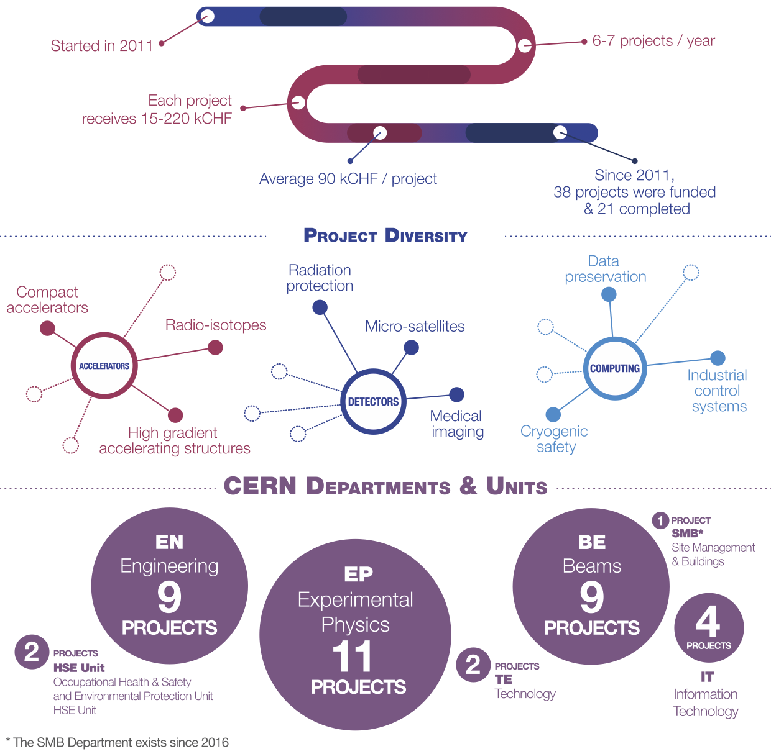
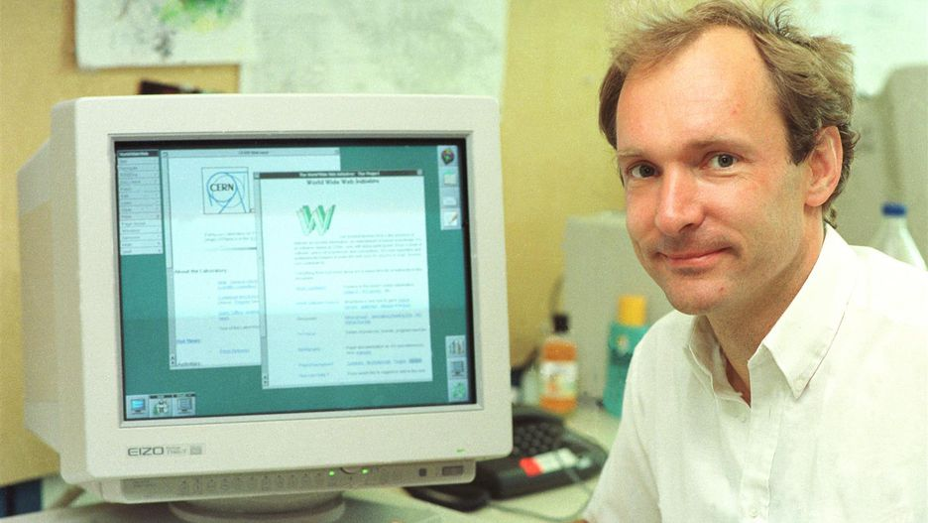

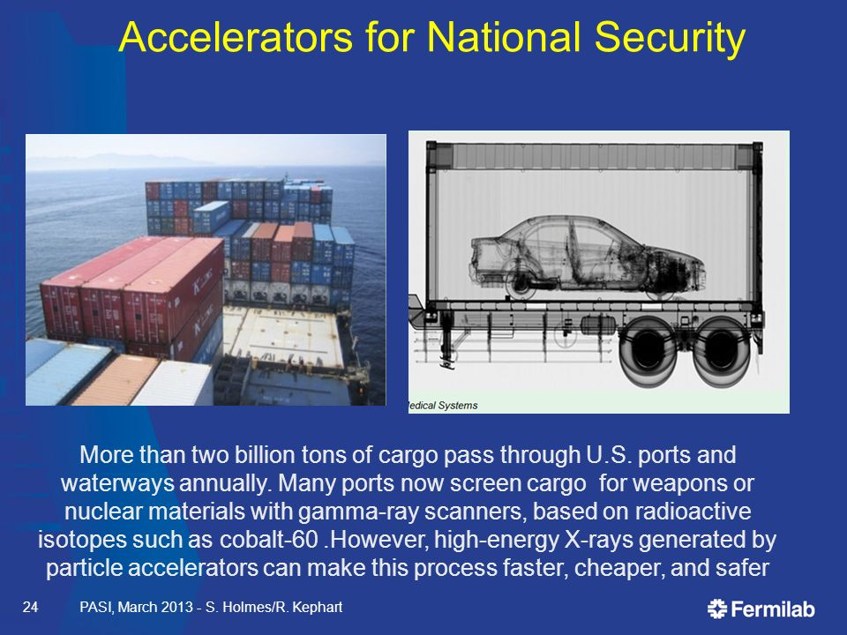
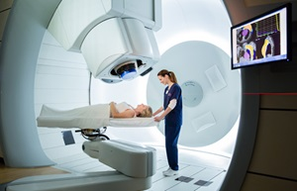
And unprecedented impact in humankind
The World Wide Web
Proton therapy
Frontiers has been funded within the framework of the European Union Erasmus+ programme

Slide 5
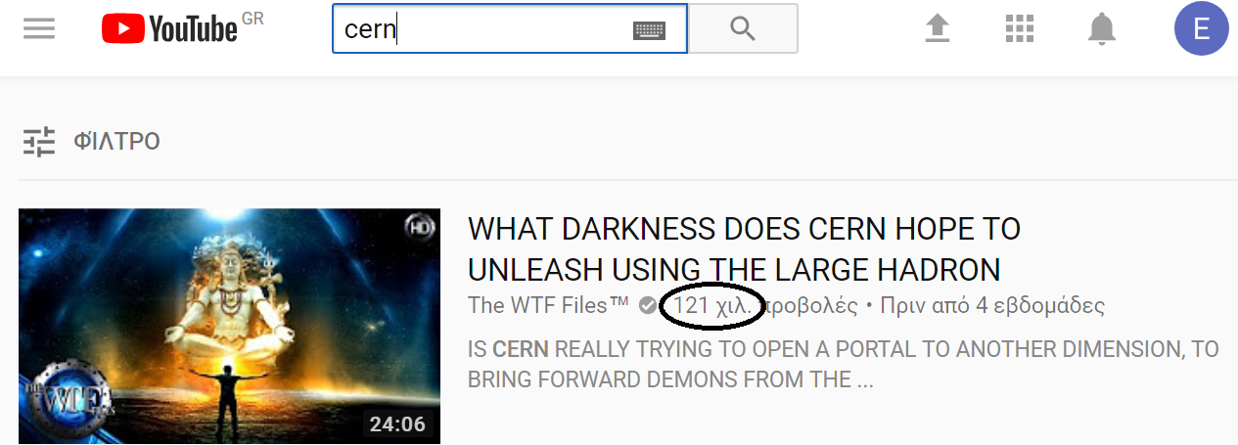
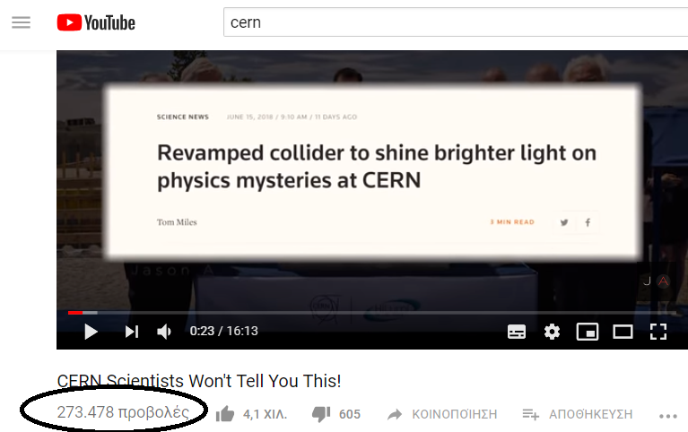
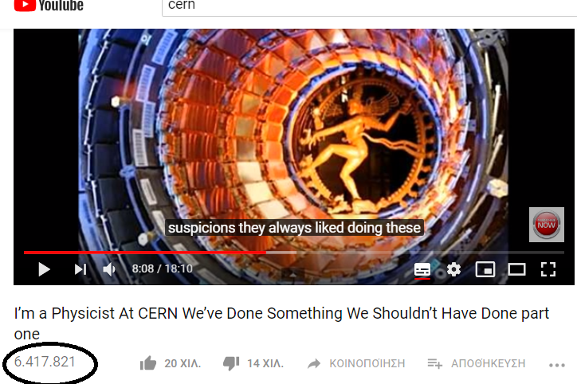
Yet.. If you search CERN on YouTube
Frontiers has been funded within the framework of the European Union Erasmus+ programme

Slide 6
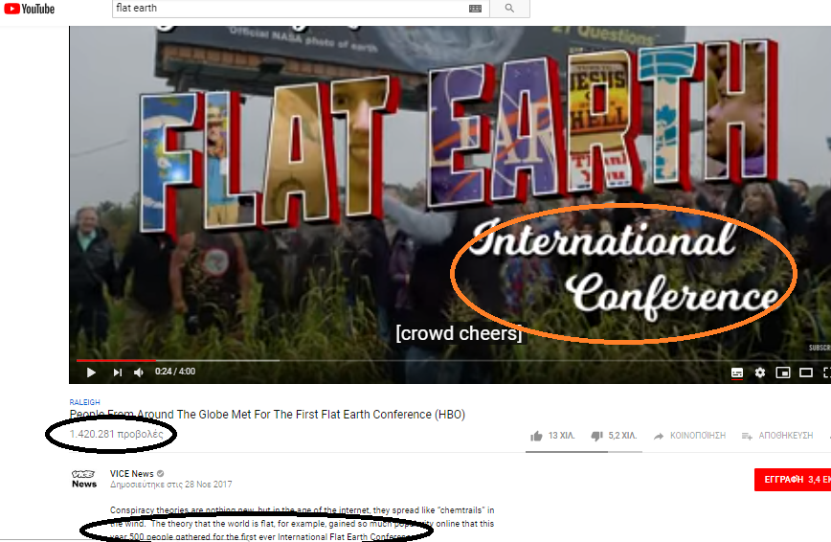
Or ..Flat Earth
Frontiers has been funded within the framework of the European Union Erasmus+ programme

Slide 7
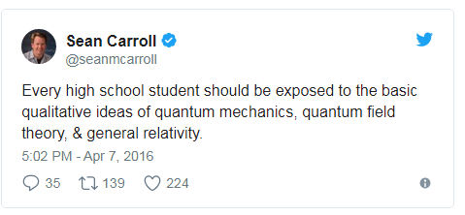
It all starts from education..
20th Century Physics not systematically integrated in K12 formal education!
Teachers don’t feel confident to address students’ questions regarding newest discoveries in modern science
Frontiers has been funded within the framework of the European Union Erasmus+ programme

Slide 8
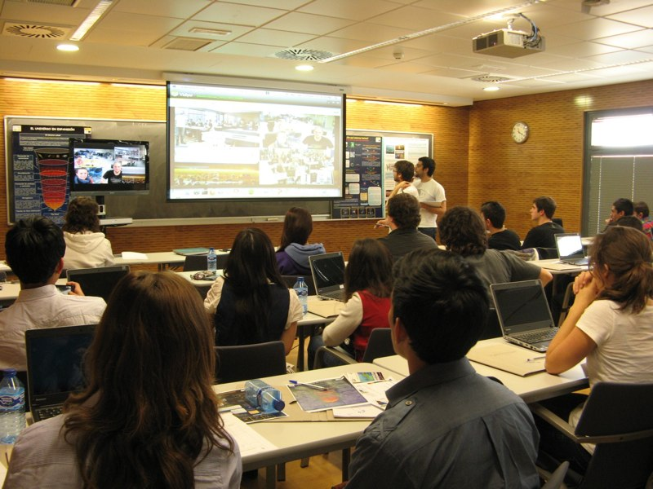
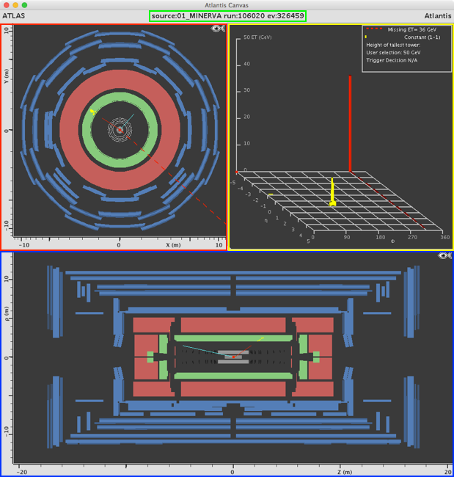
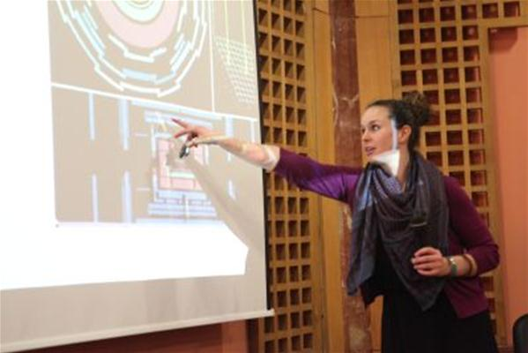
Many education and outreach initiatives, especially in HEP and Astronomy
Frontiers has been funded within the framework of the European Union Erasmus+ programme

Slide 9
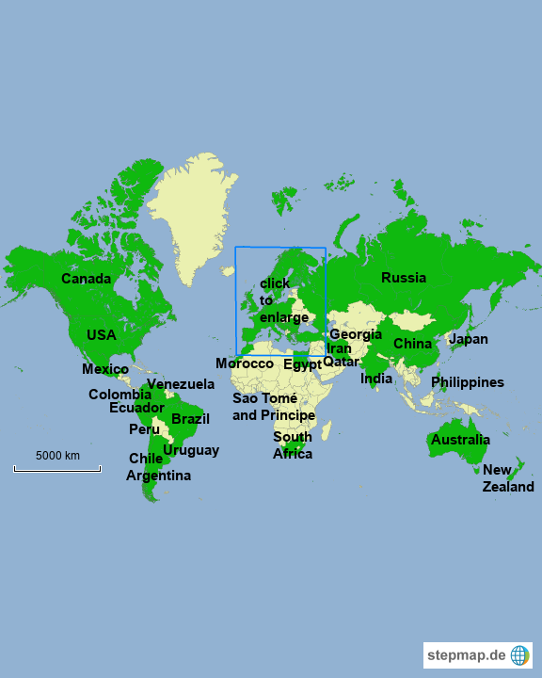
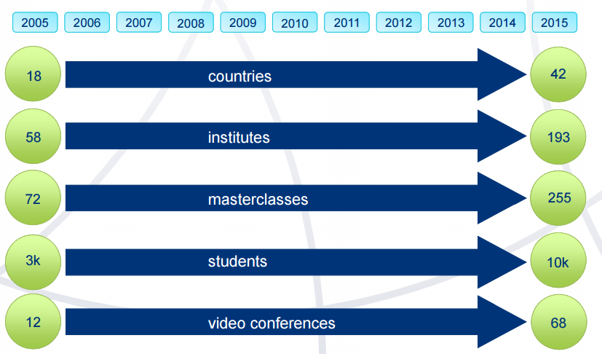
With documented impact
https://arxiv.org/ftp/arxiv/papers/1801/1801.08830.pdf
Frontiers has been funded within the framework of the European Union Erasmus+ programme

Slide 10
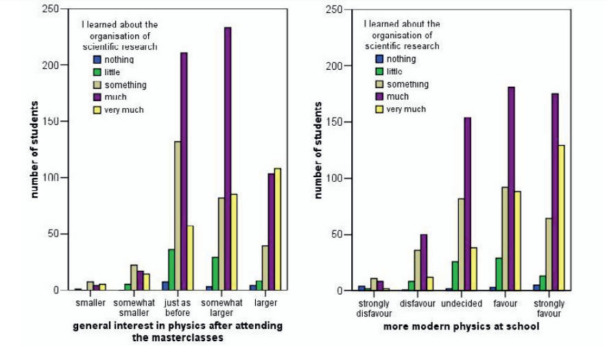
http://inspirehep.net/record/1294255/files/epjconf_icnfp2013_00017.pdf
Frontiers has been funded within the framework of the European Union Erasmus+ programme

Slide 11
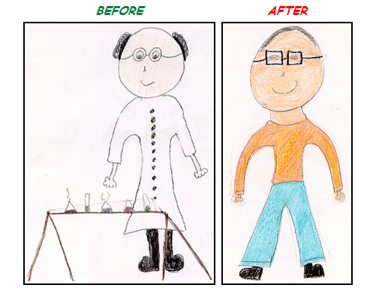
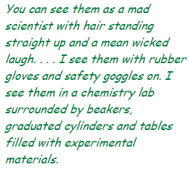

And the potential to change students’ vision of science and scientists..
WHAT DOES A SCIENTIST LOOK LIKE?
Student answers after a visit at Fermi National Laboratory (Fermilab) in USA

Slide 12
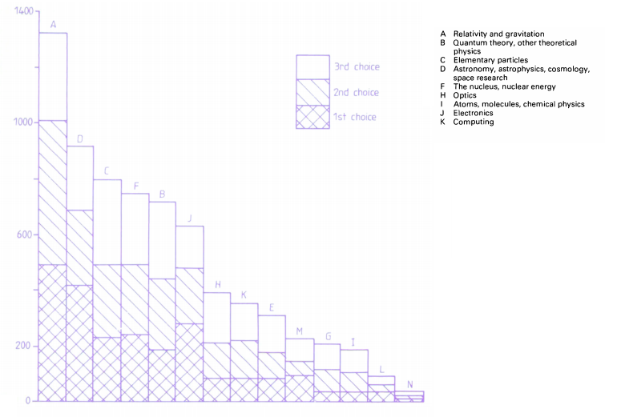
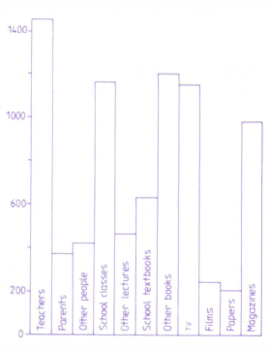
As well as potential to attract students to science careers
Research on more than 2000 college students in Physics in UK.
Kalmus, P. I. P. (1985). What attracts students towards physics? Physics Bulletin, 36(4), 168–170. doi:10.1088/0031-9112/36/4/029
School impact
Relativity, Gravitation, Astrophysics and
Elementary Particles in students’ top 5 list.

Slide 13
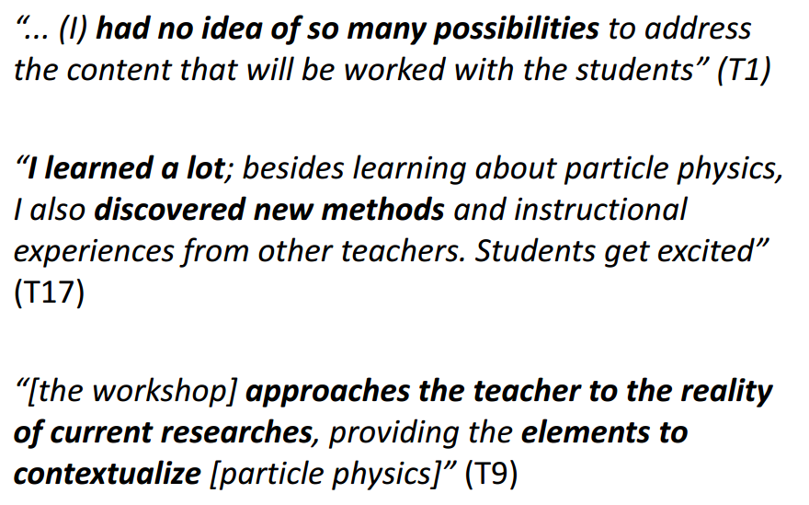
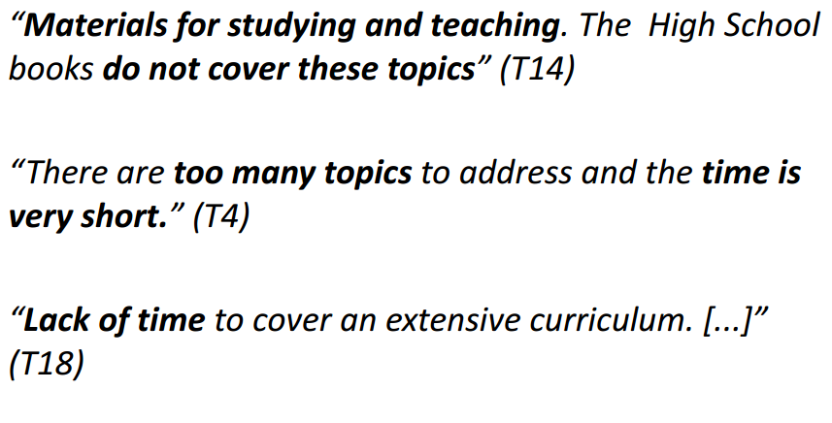
Some teacher feedback
Feedback from teachers in Brazil who participated in HEP Masterclasses
Frontiers has been funded within the framework of the European Union Erasmus+ programme

Slide 14
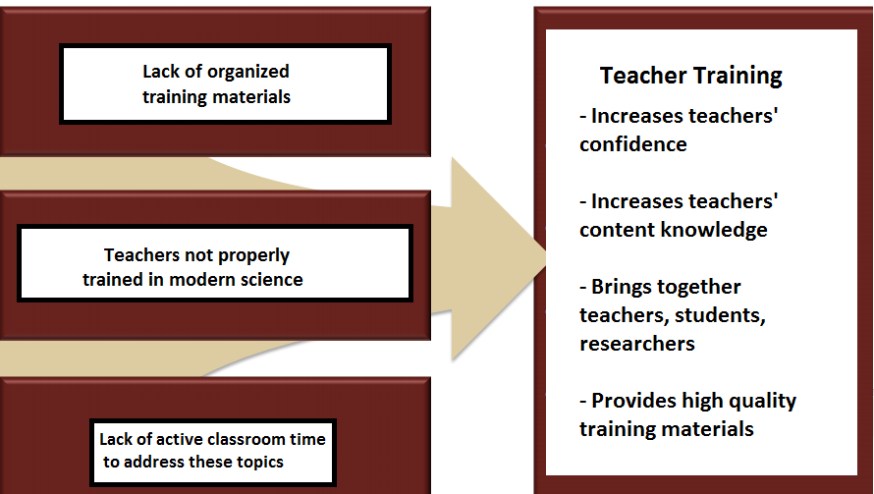
The value of teacher training in Frontier Science
Challenges
Solutions
Frontiers has been funded within the framework of the European Union Erasmus+ programme

Slide 15
Challenges and problems
Lack of organized educational content introducing modern Physics in the classroom in a consistent fashion.
Lack of teacher training in modern Physics topics.
Lack of a pedagogical framework and methodology to introduce these topics in the classroom.
Lack of feedback and systematic communication between educators – researchers as well as between educators with the same passion for introducing Modern Physics in their school.
Lack of time and curriculum pressure for timely completion of the prescribed syllabus and preparation for exams.
Lack of support from the state.

Slide 16

The role of
FRONTIERS is a network of teachers- researchers and outreach groups. It started as a project funded by the Erasmus+ framework of the EU with duration from 2018 to 2021.
It aims to address the challenges of introducing frontier Physics in the Classroom.

Slide 17
HOW;

Slide 18





By bringing together research and educational institutions from all over europe
Scientific Research
Science Education
Teacher Training Networks and Astrophysics Outreach
Frontiers has been funded within the framework of the European Union Erasmus+ programme

Slide 19
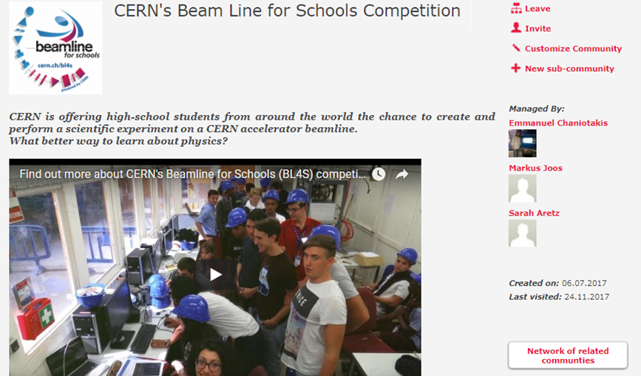

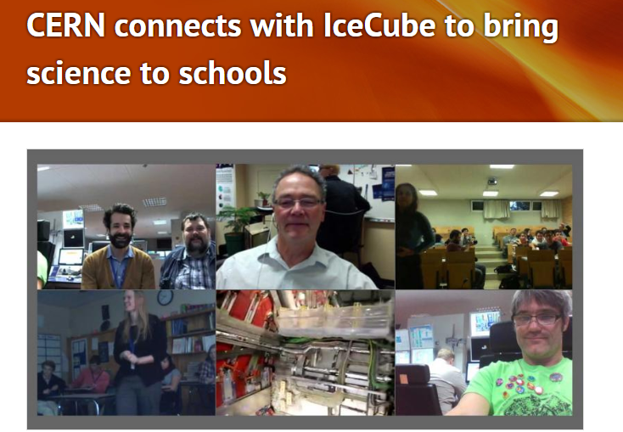
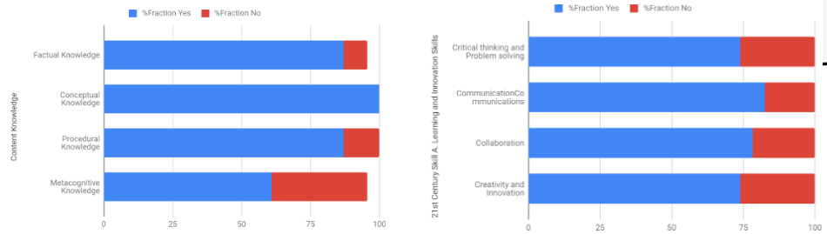
Investigating already existent outreach practices and drawing lessons learnt from them
https://zenodo.org/record/3405912#.XaD3ASjVLZ4

Slide 20
Adopting the inquiry based science education pedagogy
Learners are engaged by scientifically oriented questions.
Learners give priority to evidence which allows them to develop and evaluate explanations that address scientifically oriented questions.
Learners formulate explanations from evidence to address scientifically oriented questions.
Learners evaluate their explanations in light of alternative explanations, particularly those reflecting scientific understanding.
Learners communicate and justify their proposed explanations.

Slide 21
Adopting the inquiry based science education pedagogy
Orienting and Asking Questions
Conclusions- Evaluation
Hypothesis Generation and Design
Analysis and Interpretation
Planning and Investigation
https://www.youtube.com/watch?v=TJQAfJwVGyk

Slide 22
Orienting and Asking Questions. The topic of the lesson is introduced, assumptions the students may have are challenged, and questions they may have are formulated.
Hypothesis Generation and Design. During which the students develop one of their questions into a hypothesis.
Planning and Investigation. In which the hypothesis previously developed is tested.
Analysis and Interpretation. Where the students analyse the data collected from their investigation and refute or confirm the hypothesis.
Conclusion and Evaluation. When the students communicate their findings.

Slide 23
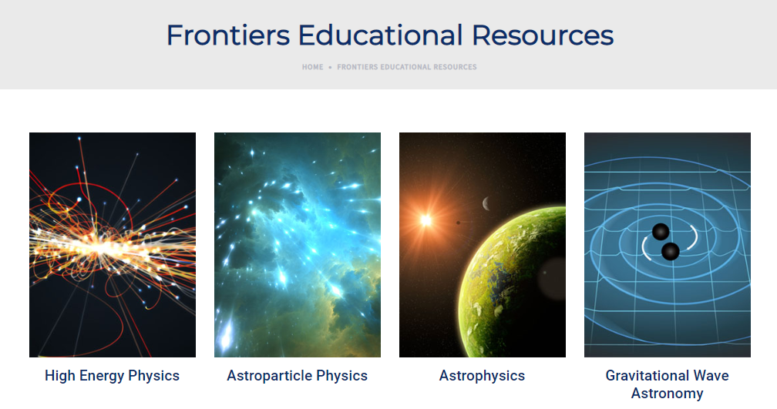
Developing the frontiers demonstrators: cutting edge educational activities for your classroom
http://www.frontiers-project.eu/frontiers-educational-resources/

Slide 24
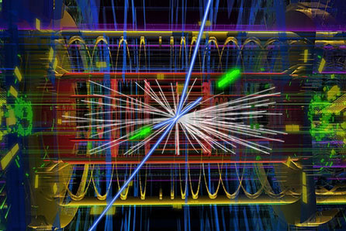
FRONTIERS has prepared 20 demonstrator lessons that are about a modern physics topic for secondary school; ready to be used (or adapted);
follow an inquiry methodology; available @ ISE platform: and follow up teacher activities:
High Energy Physics
Discover the Z and Higgs Bosons
World Data Day
Magnetic Field
Let’s Accelerate particles
The ALICE Experiment at CERN
Mass- Energy Equivalence

Slide 25

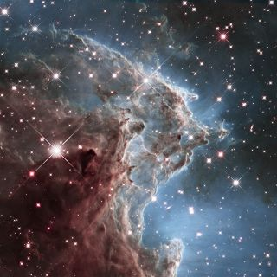
Gravitational Wave Astronomy
VIRGO Virtual Visit
VIRGO Control (Class) Room
Gravitational Wave Noise Hunting
Finding black-holes in a chirp”
The Michelson Interferometer
Earthquake Interferometer
Astrophysics – Astroparticle Physics
Black Holes
Solar Rotation
Discovering Alien Worlds
Build your own cloud chamber
Relativistic Muons and Time Dilation
Cosmic Rays
Neutrino Astronomy
Age of the Universe

Slide 26
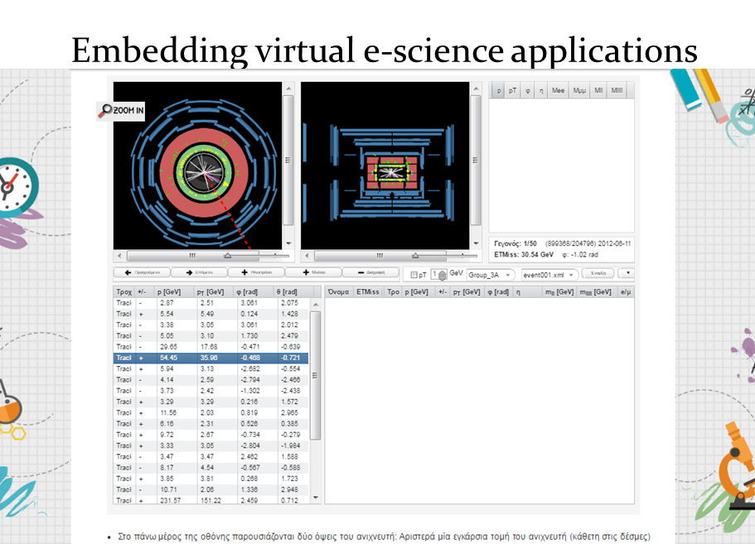
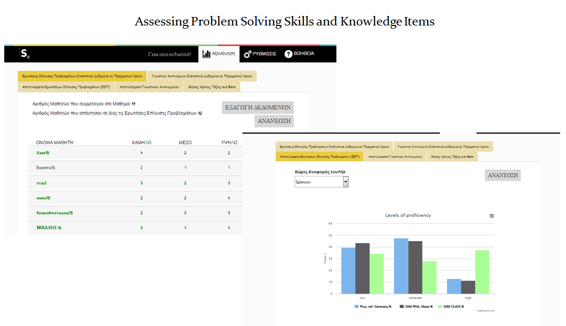
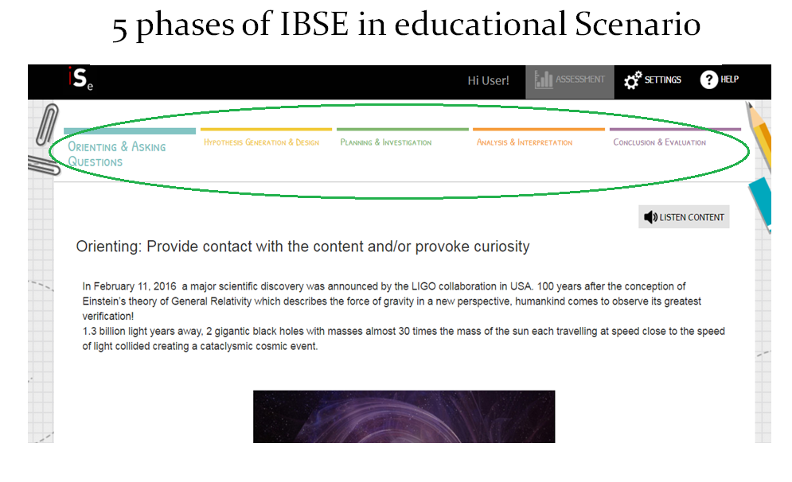
Developing cutting edge educational content
Free for everyone
Following the inquiry based science education model.
Connecting students with large research infrastructures in Physics.
Offering real data for analysis by the students.
Utilizing virtual and experiential labs for the deeper comprehension of modern Physics concepts.
Building “bridges” to connect with school curricula.

Slide 27
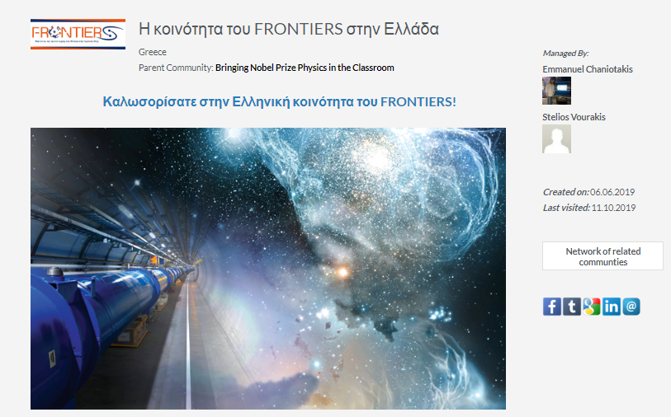
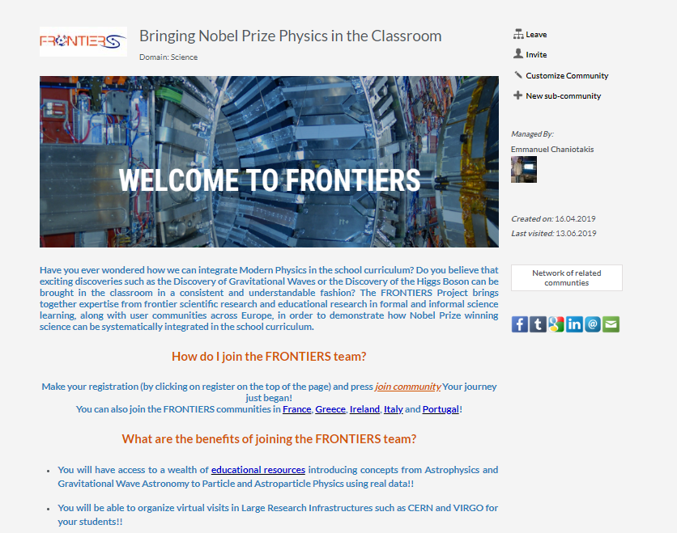
Developing national and international communities of practice for educators
Giving opportunities for immediate interaction and feedback between researchers and educators.
Useful for the exchange of good practices.
With the capacity to host educational content
Offering you the tools to create your own educational content.

Slide 28
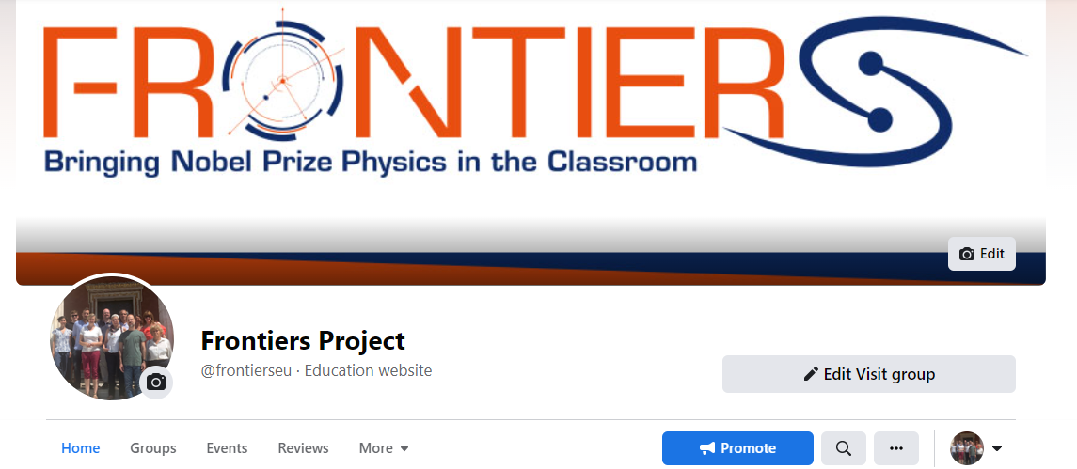
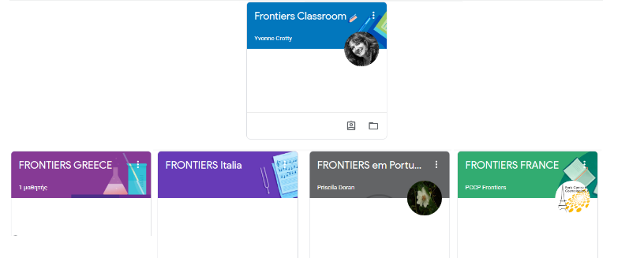

https://portal.opendiscoveryspace
.eu/
en/community/frontiers
-community-greece-855295
https://portal.opendiscoveryspace.eu
/en/community/frontiers-community-
ireland-855298
https://portal.opendiscoveryspace.eu
/en/community/frontiers-community
-italy-855296
https://portal.opendiscoveryspace.eu/
en/community/frontiers-community-portugal-855297
https://portal.opendiscoveryspace.eu/en/community/frontiers-community-france-855299

Slide 29
Offering continuous training and support for the implementation of frontiers activities in your classroom.
Through the systematic organization of in situ and online training workshops for continuous professional development..
Through the organization of summer and winter schools
Both online and face to face.

Slide 30









Training and support
  Year-round training workshops for continuous professional development
Pre-COVID
During the pandemic

Slide 31


Training and support
  International Schools examples:
  http://www.frontiers-project.eu/past-international-training-events/
E-Summer School :
13 – 24 July 2020
https://indico.ego-gw.it/event/73/timetable/
E-Winter School :
29 Jannuary – 7 February 2021
https://indico.ego-gw.it/event/133/timetable/

Slide 32


Slide 33



Organizing Virtual Visits to Large Research Infrastructures in Physics for students

Slide 34





Slide 35




Slide 36


Organizing and supporting competitions for students

Slide 37

And co-organizing competitions for citizens
http://reinforce.ea.gr/eps-citizen-science-competition/

Slide 38




Organizing and supporting in-school implementation activities

Slide 39
IF..
You believe that it is worthwhile to introduce topics such as the discovery of Gravitational Waves or of the Higgs Boson in your classroom in a systematic and understandable fashion.
You want your students to be able to perform virtual visits at VIRGO or CERN, to analyze real data and to interact with leading experts in Physics and Education research.
You want to receive continuous training and support in these scientific topics.
You want to become part of our international community of educators and researchers with who you will be able to interact, collaborate, exchange ideas and practices.
We invite you to become members of the FRONTIERS family!

Slide 40
Thank you very much
For further details visit:
FRONTIERS website:
www.frontiers-project.eu
Facebook page:
https://www.facebook.com/frontierseu
Facebook group:
https://www.facebook.com/groups/665957563876838/
Don’t hesitate to contact us : info@frontiers-project.eu

