Slide 1

Bridging the Gap between Frontier Physics Research and Society through Citizen Science
Emmanuel Chaniotakis,
Research and Development Department
Ellinogermaniki Agogi
11th International Conference of the Balkan Physical Union
28 August – 1 September 2022, Belgrade, Serbia

Slide 2
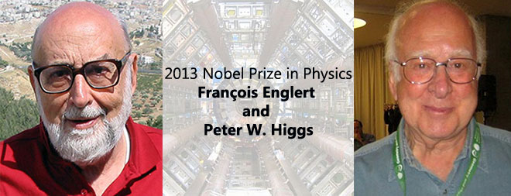
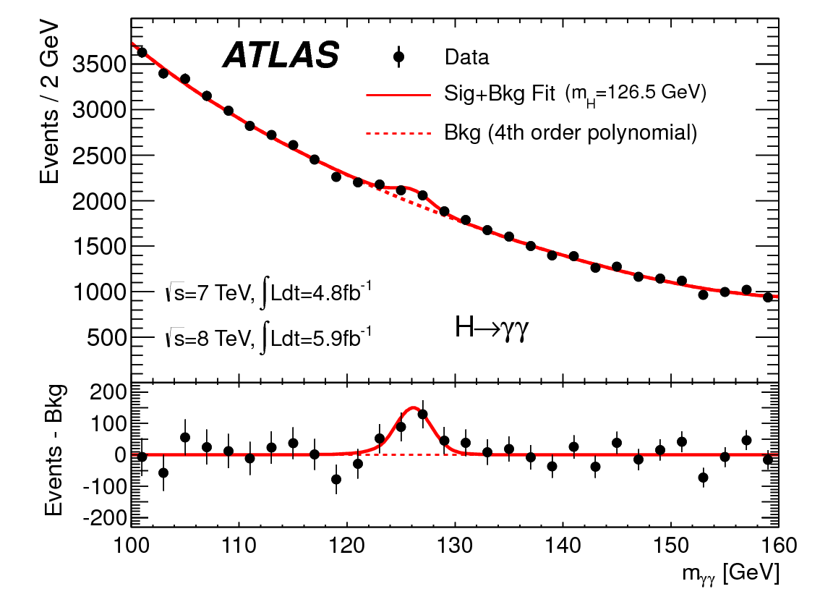
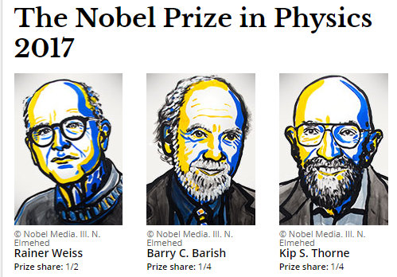
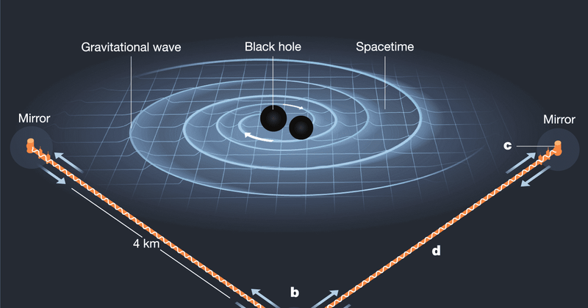
Game changing discoveries in fundamental Physics

Slide 3
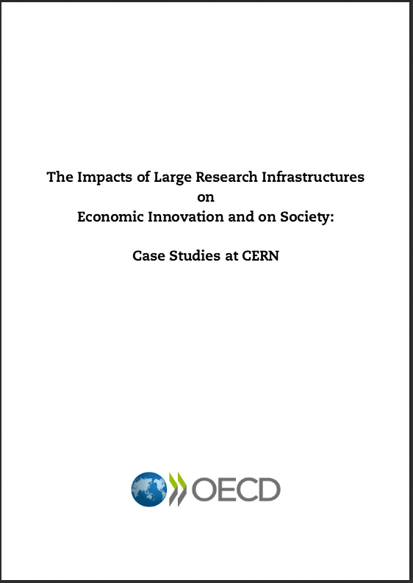
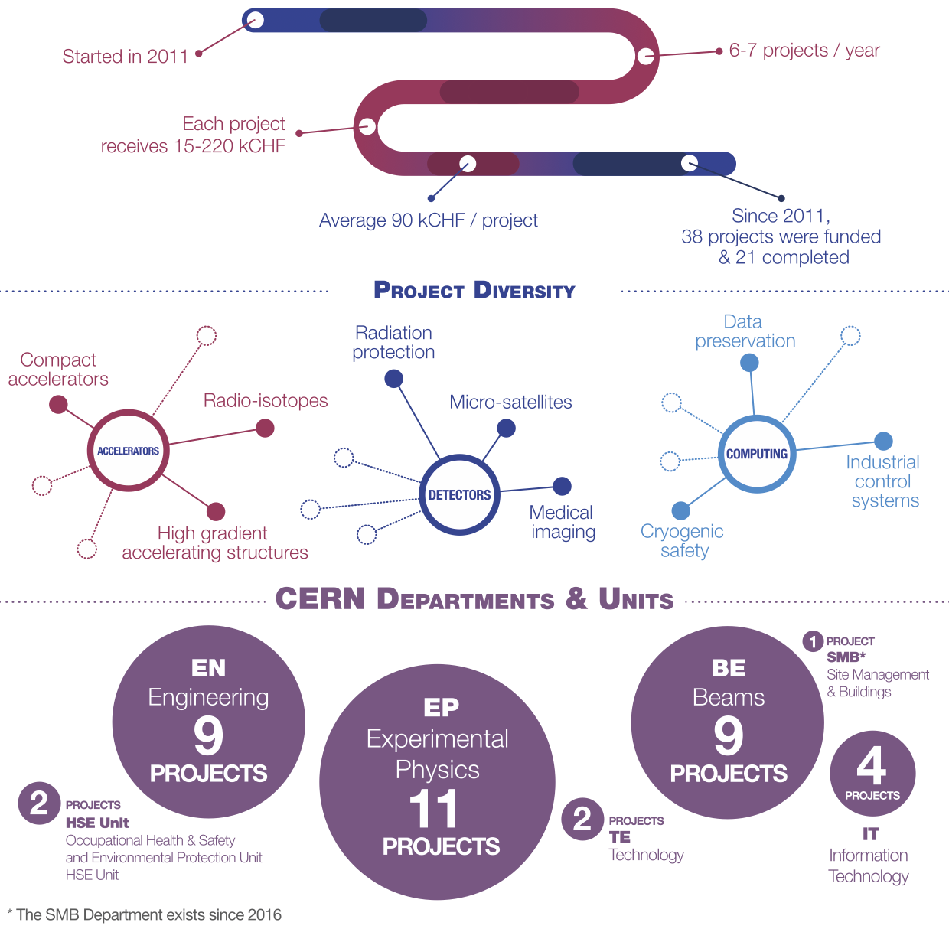

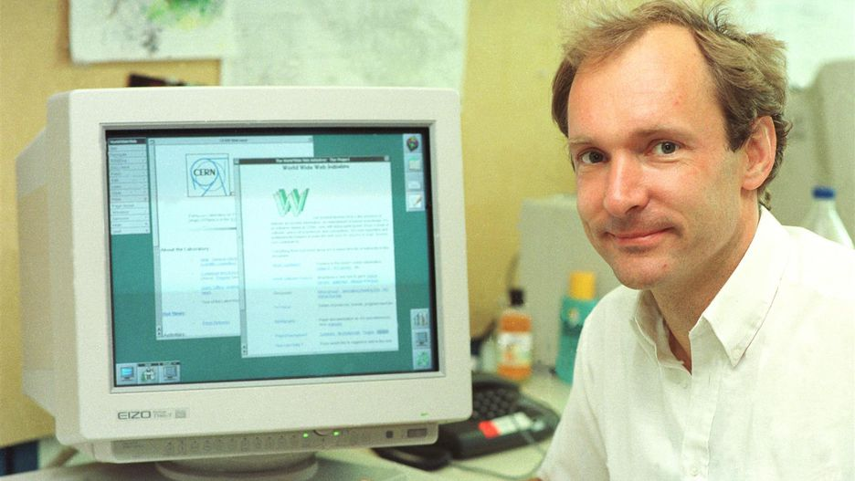
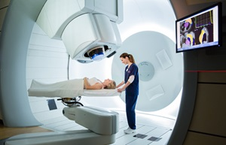
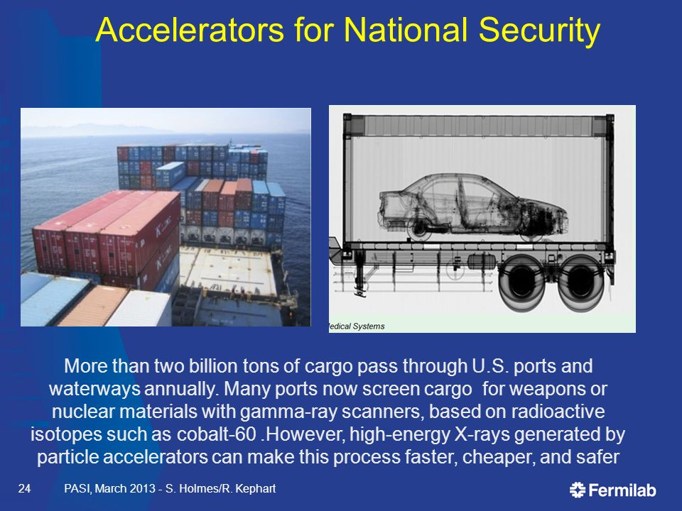
With unprecedented impact in humankind
The World Wide Web
Proton therapy

Slide 4
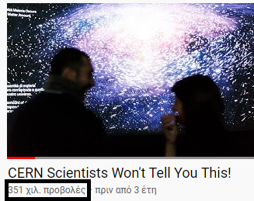
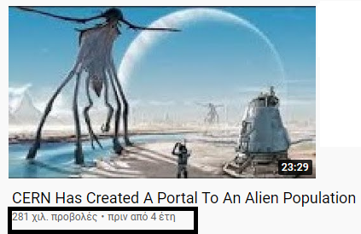
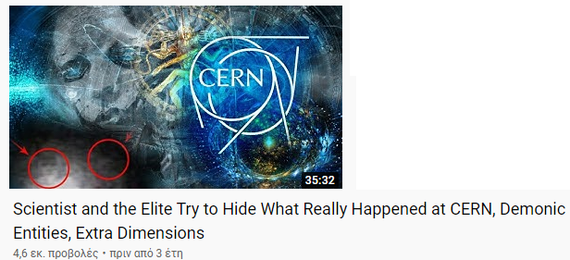
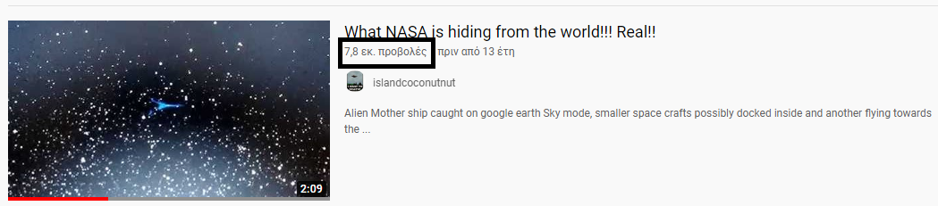
Yet, if you do an online search based on number of views..

Slide 5
Or investigate school curricula you will identify a gap between frontier scientific research with society and education
20th – 21st Century Physics not systematically integrated in K12 formal education!
Teachers don’t feel confident to address students’ questions regarding newest discoveries in modern science

Slide 6
To address the gap between frontier scientific research and society we go beyond outreach and connect citizens with Large Research Infrastructures through citizen science

Slide 7
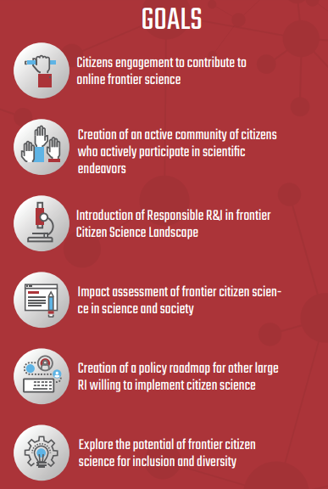

Introducing REINFORCE
REINFORCE (REsearch INfrastructures FOR Citizens in Europe) is a H2020 RIA EU funded project running from 2019 to 2022 with the aim to investigate the following questions with 100K citizens and 5K students:
Can citizen science help to minimize the knowledge gap between Large Research Infrastructures and Society and help reinforce the science capital of citizens?
Are citizens actually able to develop new knowledge? Can they make a contribution in sophisticated scientific fields such as Neutrino Astronomy or Gravitational Wave Astronomy?
Can citizens apply new knowledge developed in frontier large research infrastructures to solve societal problems?
Can we balance social inclusion and scientific efficiency in the design and implementation of a frontier citizen science project?
www.reinforceeu.eu

Slide 8
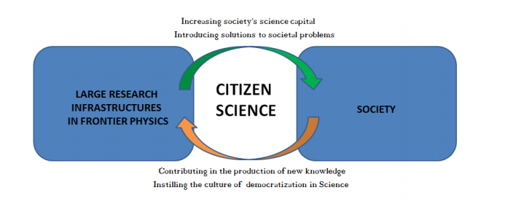
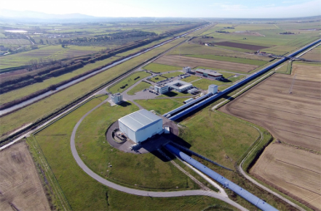

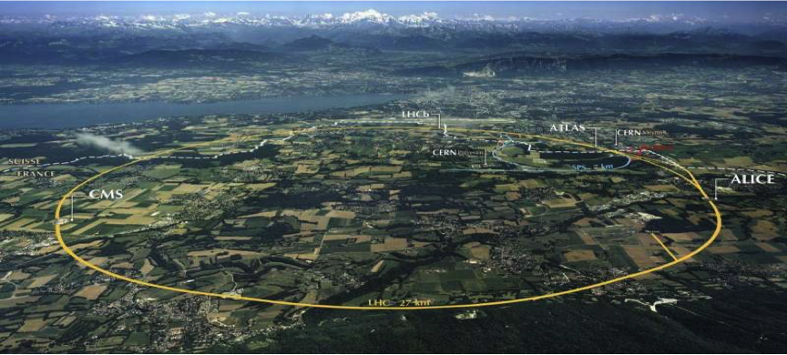
The interplay of Large Research Infrastructures, Citizen Science and School education in REINFORCE

Slide 9
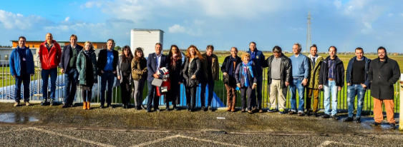
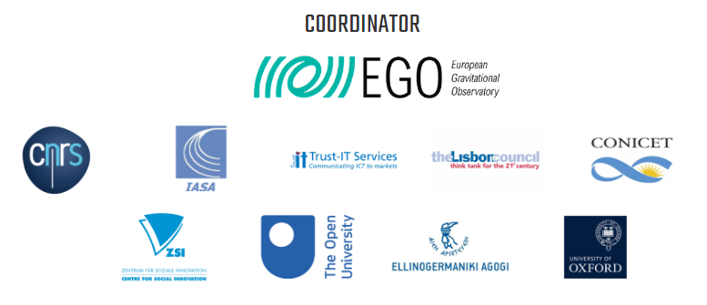

The consortium

Slide 10
The
Infrastructures
REINFORCE
Virgo
KM3NET
LHC
Geoscience

Slide 11
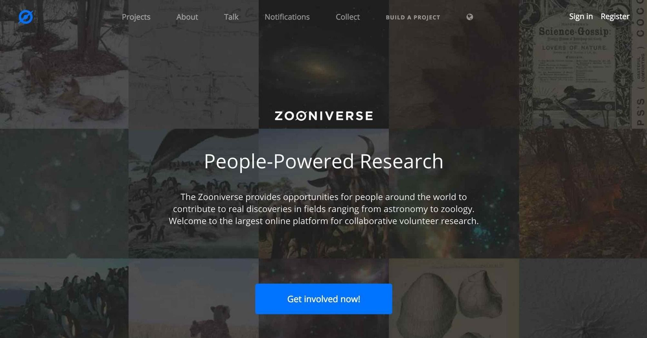
The platform (www.zooniverse.org )

Slide 12
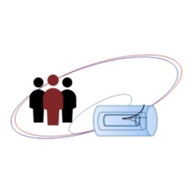
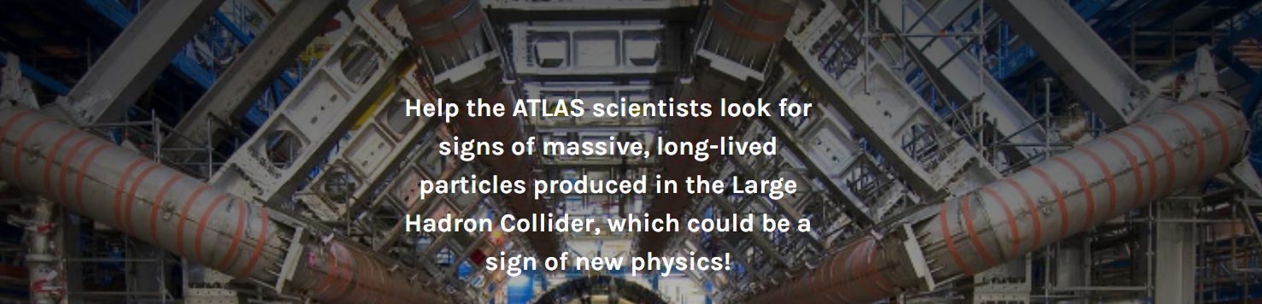
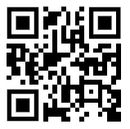
The citizen science demonstrators @ Zooniverse
New Particle Search at CERN
https://tinyurl.com/9judw4w

Slide 13
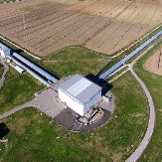

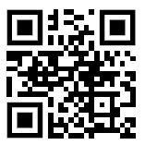
The citizen science demonstrators @ Zooniverse
GWitchHunters
https://tinyurl.com/3fyrr4e2

Slide 14
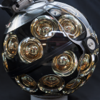
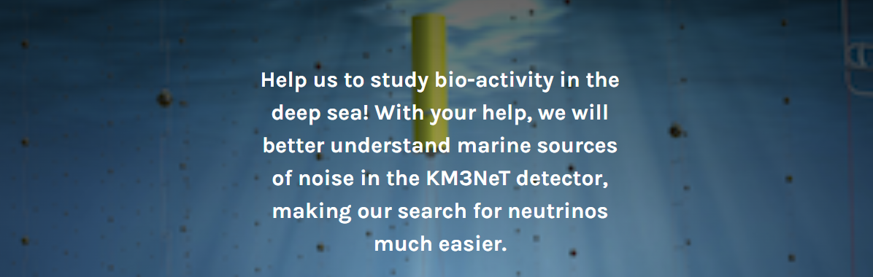
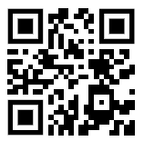
The citizen science demonstrators @ Zooniverse
Deep Sea Explorers
https://tinyurl.com/jhmahpef

Slide 15
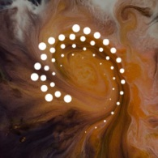
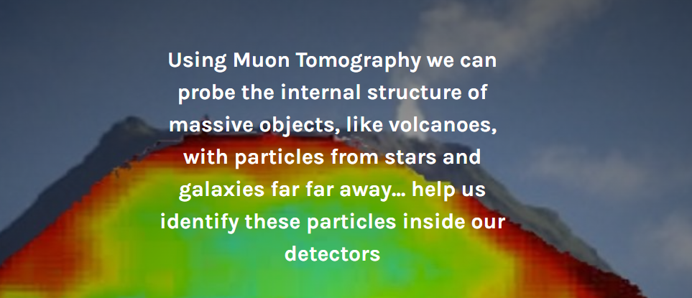
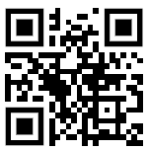
The citizen science demonstrators @ Zooniverse
Cosmic Muon Images
https://tinyurl.com/5u69x5nt

Slide 16

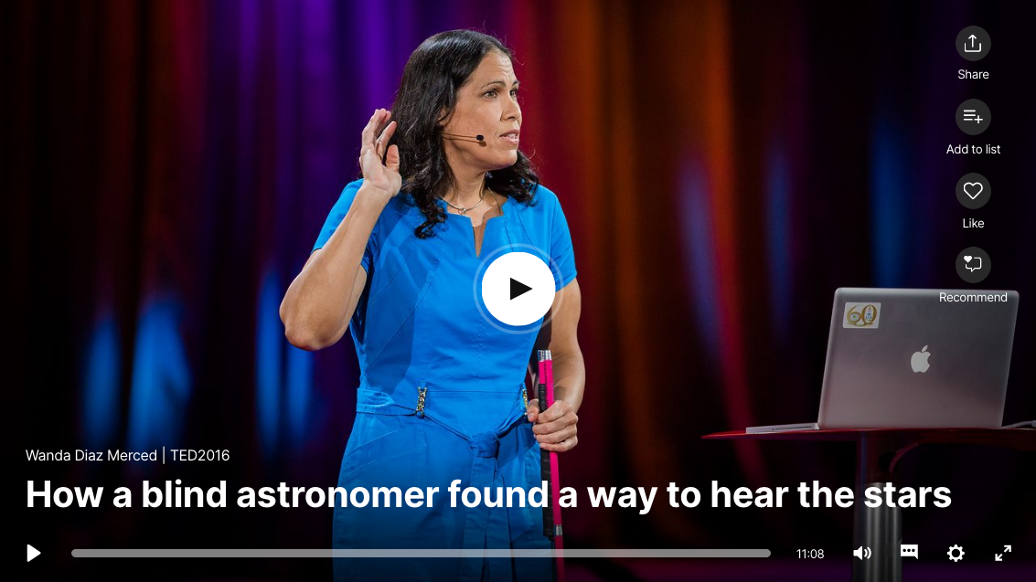
INCREASING THE SENSES INCREASING INCLUSION
Not only increasing inclusion
Also increasing the researchers discrimination power of signal over background by using sonification of scientific data.
https://www.ted.com/talks/wanda_diaz_merced_how_a_blind_astronomer_found_a_way_to_hear_the_stars?referrer=playlist-ted_deep_cuts_vol_2&language=en

Slide 17
Citizen Engagement Strategy
Increasing Level of Engagement & Participation of Citizen Scientists in CS Projects
Level | Inform | Involve | Collaborate | Consult | Empower
Goal | Awareness | Interest & Motivation | Contribution | Co-creation | Recognition
Engagement Activities | Website / social media Newsletter Webinars Outreach activities of LRI (Online) Conference presentations | Vision-building Workshops Demonstrations of projects, Virtual Visits, Community Building activities | Practice-Reflection Workshops Training (on subject & project) Forum / Discussions Community Building activities | Summative Workshops and Focus Groups | Contests / Competitions Educational resources Conference publications
Citizens Tasks, Roles and Contributions | Citizens are being informed about the research needs, intentions, goals, and foreseen activities. They will understand how they can assist researchers to achieve them. | Citizens work with scientists to ensure that their needs, ideas, concerns, and aspirations are consistently understood and integrated in the project design and activities. | Citizens implement and contribute to the CS project. They are keeping direct contact and discuss observations directly with researchers and other citizen scientists. | Citizens can provide feedback, share their initial ideas, or concerns on the citizen science project design and activities. | Citizens are being assisted by scientists in making use of the CS activities to inform others, train citizens in scientific skills, or in conducting their own research.
Researchers Tasks and Roles | Researchers inform the general public. Various target groups will be contacted and informed separately and according to their perceived interests. | Researchers ensure that citizens ideas, concerns, motivations are directly reflected in the project design. They are providing feedback on how input influences CS project design and activities. | Researchers collect contributions and incorporate findings, observations, and comments into their research work. They provide ongoing feedback to the citizens and acknowledge their work. | Researchers start a dialogue, acknowledge the shared ideas and concerns, needs and motivations of citizens. They explain the benefits of becoming involved and what contributions citizen scientists can make to the research work | Researchers provide resources, advice, and assistance to support citizens further utilize CS projects, to create new research-related activities, implement trainings, or conduct own research.

Slide 18
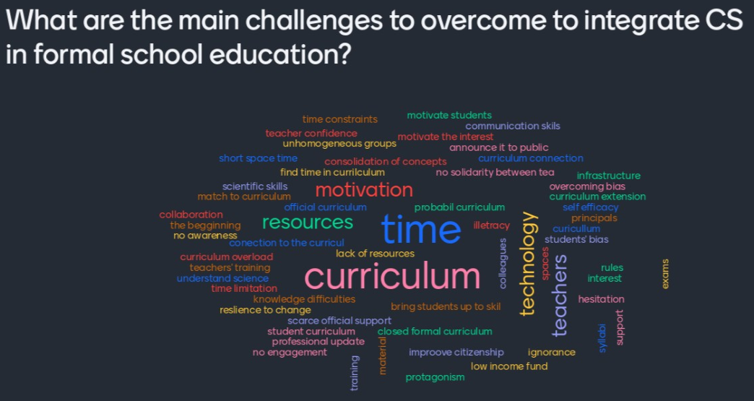
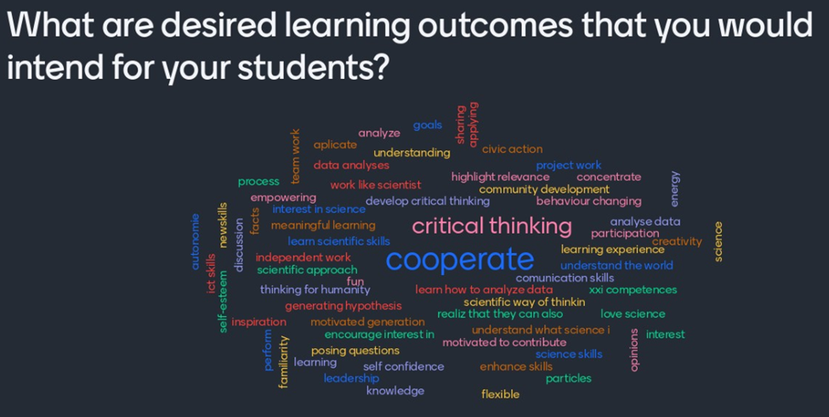
Identifying the needs of different citizen target groups (example: Science teachers)

Slide 19
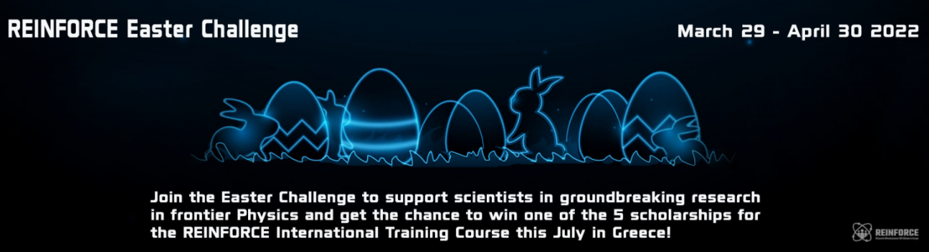
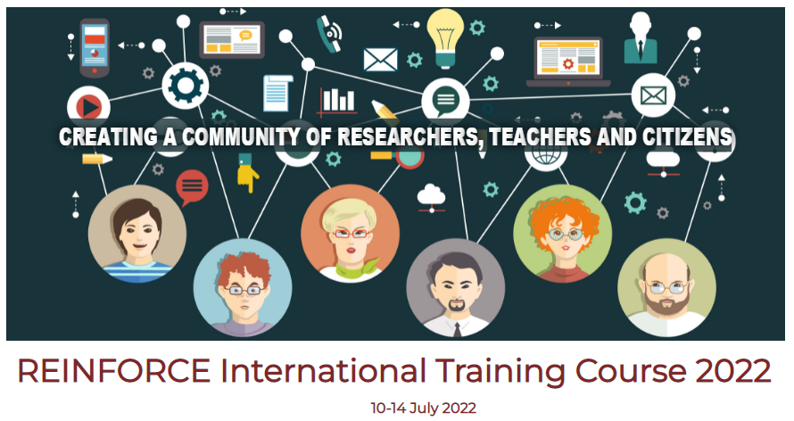
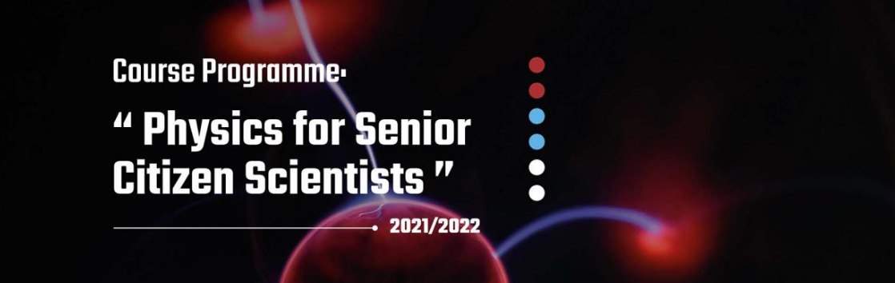
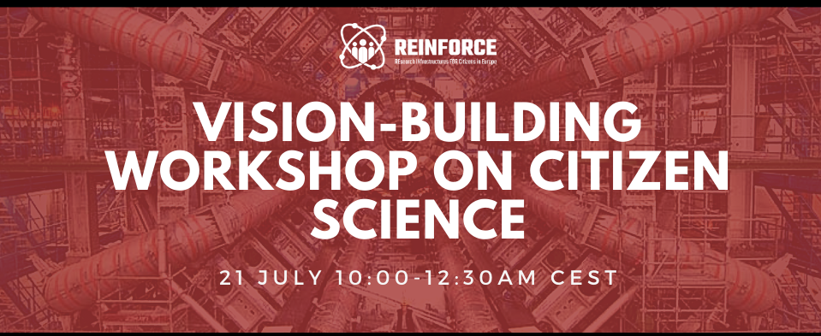
Examples of Participatory engagement activities
http://reinforce.ea.gr/easter-challenge/
http://reinforce.ea.gr/international-training-course/
https://www.reinforceeu.eu/news/course-physics-senior-citizen-scientists
https://reinforceeu.eu/events/training-workshop/vision-building-workshop-citizen-science

Slide 20
Monitoring citizen engagement
Launch of the REINFORCE
Winter Challenge
Engagement activities in
Gravitational Wave Noise
Hunting
Launch of Gravitational Wave Noise
Hunting Demonstrator
Launch of New Particle
Search at CERN Demonstrator
Launch of Cosmic Muon Images
Demonstrator

Slide 21
Conclusions and future outlook
So far, ~10,000 volunteers have actively contributed more than 450,000 classifications in the citizen science projects of REINFORCE. Citizens’ contributions are being analyzed and shared with the volunteers and scientific impact is being evaluated.
A strong and constantly growing community of practice involving citizens from different target groups (teachers, students, senior citizens) has been built around the citizen science demonstrators with volunteers taking active part as ambassadors of the research teams to their peers. Citizen feedback is being acquired and incorporated to the citizen science demonstrators and impact is being assessed.
A roadmap for the mainstreaming of citizen science as an effective way of bridging the gap between frontier research and society is being prepared.

Slide 22
www.reinforceeu.eu https://twitter.com/ReinforceEU
www.reinforceeu.eu
LinkedIN
@ReinforceEU

