Slide 1
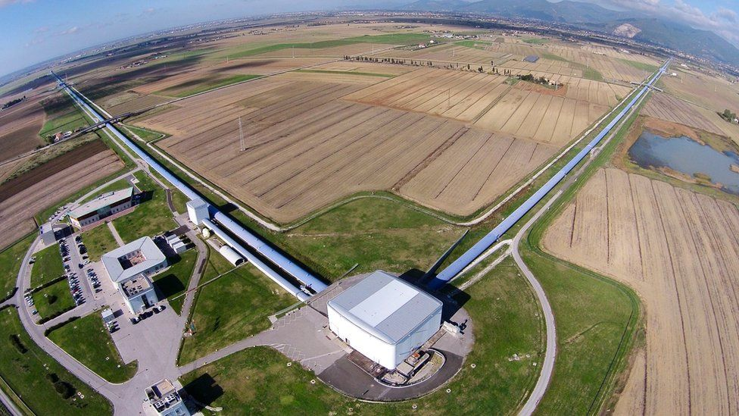


Gravitational Waves a new observational window to the Cosmos
E. Chaniotakis,
Research and Development Department, Ellinogermaniki Agogi
11th International Conference of the Balkan Physical Union
28 August – 1 September 2022, Belgrade, Serbia

Slide 2
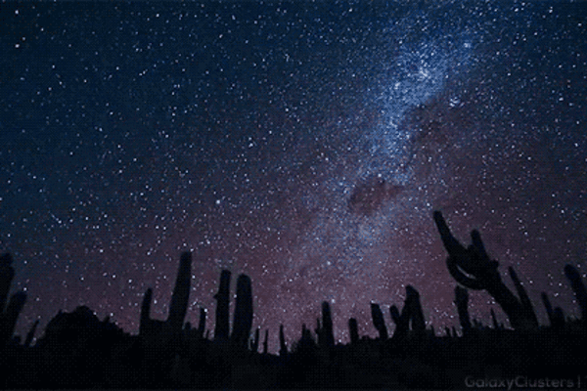
The Sky as we observe it

Slide 3
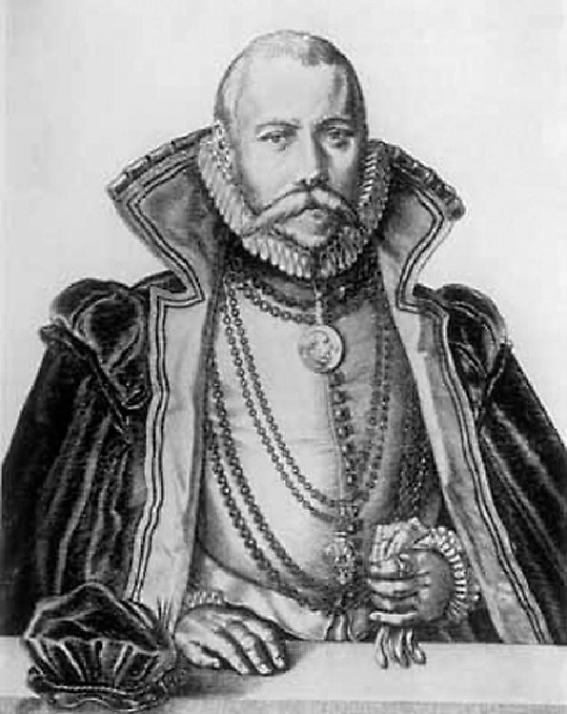
The seeds of the first Scientific Revolution
Tycho Brahe (1546 – 1601)
In 1572 the Danish Astronomer Tycho Brache observes for the first time “a new star” close to the Cassiopeia constellation. It was actually a Supernova explosion which changed the cosmological status quo of the day, according to which the “heavens are eternal and unchanging”

Slide 4
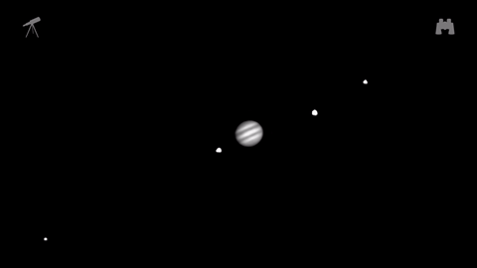
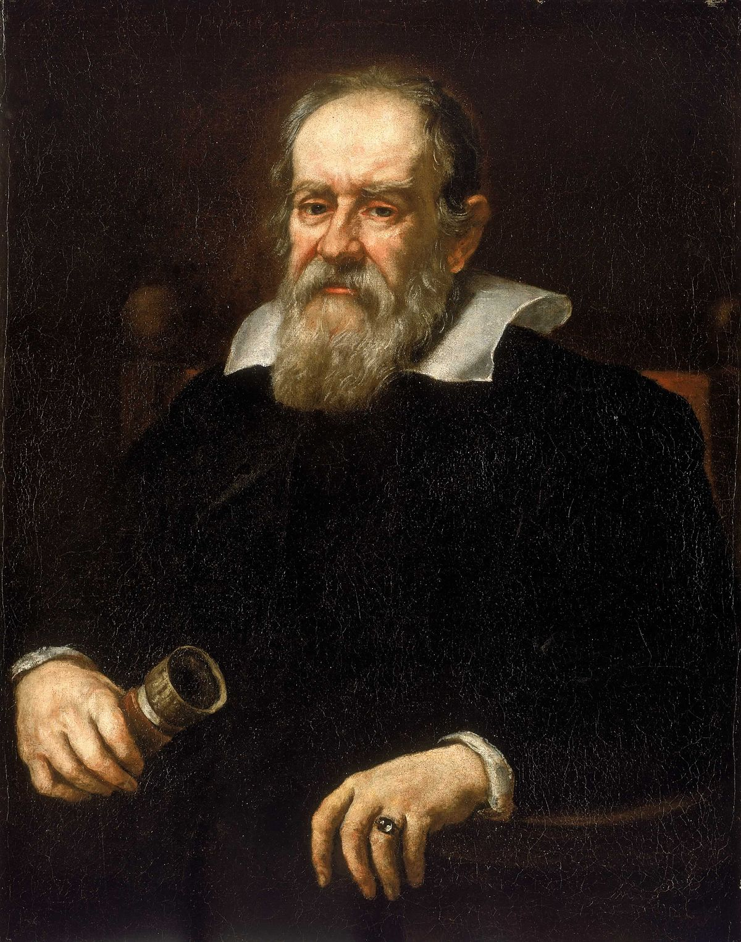
Galileo Galilei (1564 – 1642)
In 1609, Galileo Galilei turns his telescope to the sky for the first time and triggers the first Scientific Revolution. He observes the moons of Jupiter, the phases of Venus, the surface of the Sun and the Moon, the stars in the galaxy..
Our perception for the Universe changes radically.

Slide 5
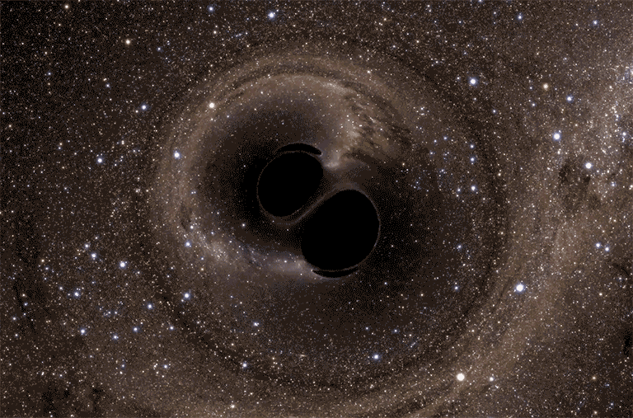
Gravitational Waves, a new observational window to the Cosmos
In 2015 the LIGO collaboration in the US announces the first detection of Gravitational Waves from a binary black hole merger, 1.4 billion light years away from us! The power emitted in GWs was estimated to be 50 times greater than the power emitted by all the stars in the observable Universe!
A new observational window opens to the Extreme Universe: that of Gravitational Wave Astronomy!

Slide 6
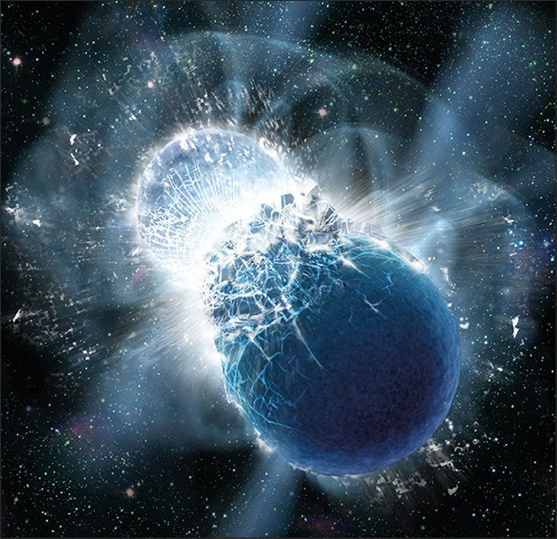
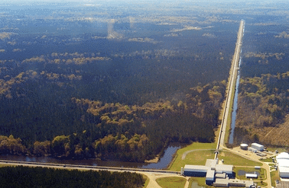
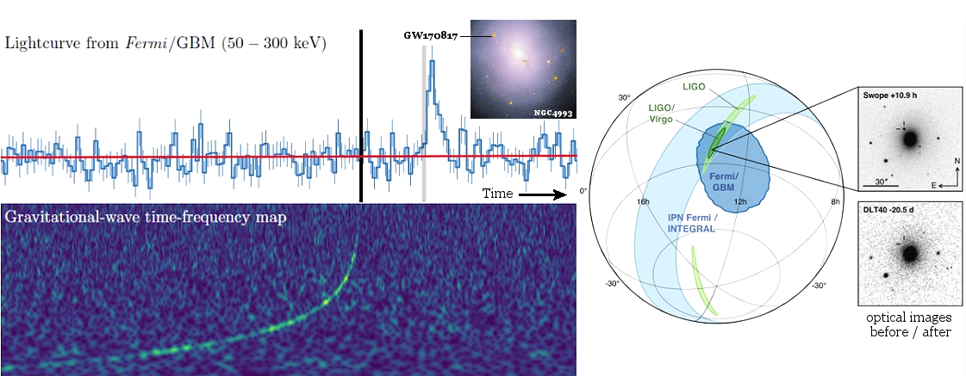
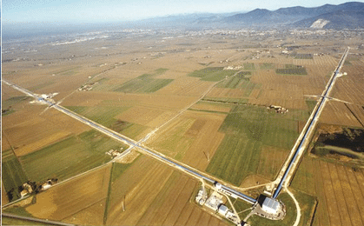
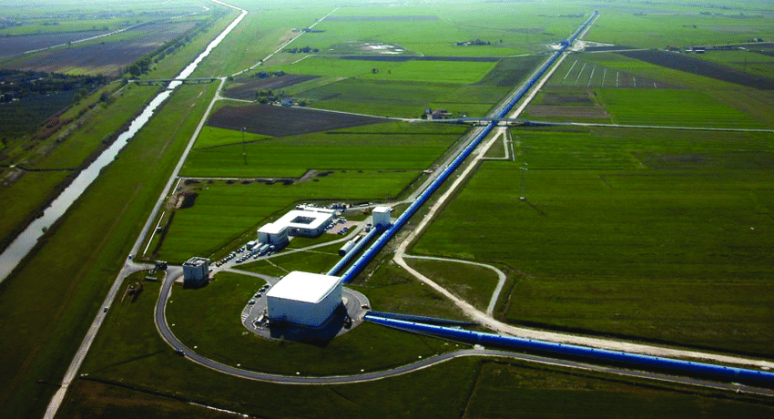
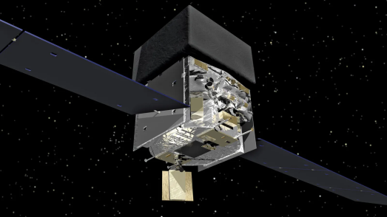
In 2017 , the LIGO and Virgo Gravitational Wave Detectors together with the Fermi Gamma Ray Telescope and other observatories observe for the first time a neutron star merger, the “goldmine” of the Universe!
Multimessenger Astronomy officially begins!

Slide 7
What shall we discuss today?
What are Gravitational Waves?
How do we detect them?
What is the Virgo detector and how does it work?
What does the future hold?

Slide 8
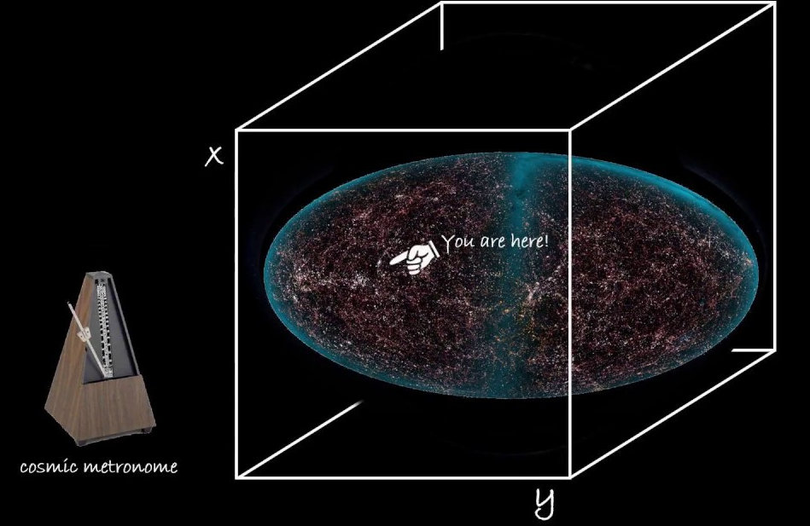
Space and Time in Classical Physics
Space is an empty “theater” in the Universe. It is absolute, unchanging, and all phenomena take place within it.
Time is absolute and unchanging. It moves forward with a rate of “1sec/sec” and is independent of the other phenomena of the Universe, the same for all observers. One can think of a cosmic “metronome” which counts the time during which phenomena occur. All observers measure the same time between two events.

Slide 9
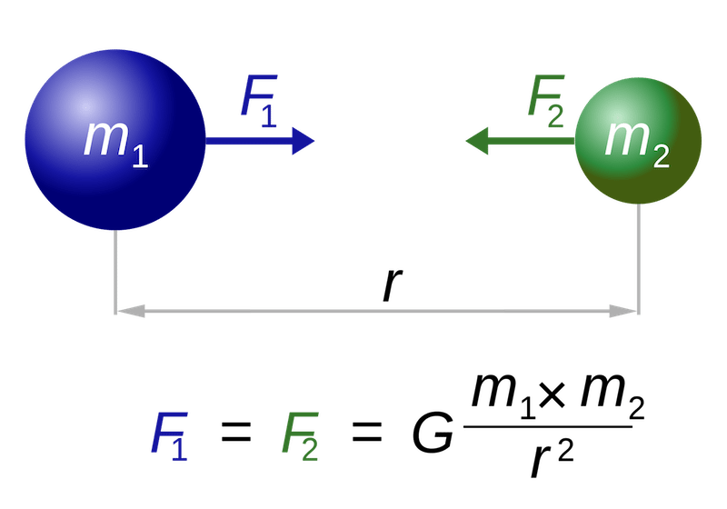
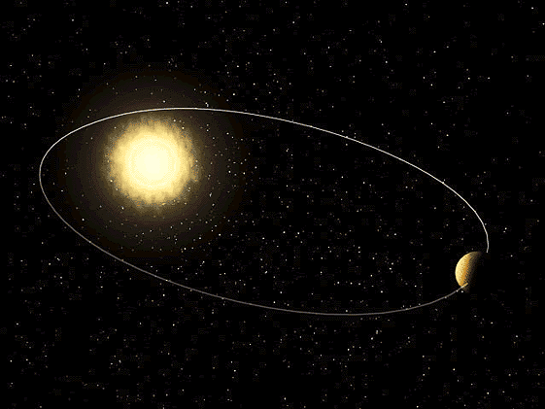

Newtonian Gravity and Celestial Mechanics
Kepler’s 3rd Law
$$\frac{T^{2}}{R^{3}}=const.$$
In Newtonian Mechanics, closed elliptic planetary orbits have constant Energy. If the total energy was reduced, then the distance between the celestial bodies would decrease and the frequency of rotation would increase.

Slide 10
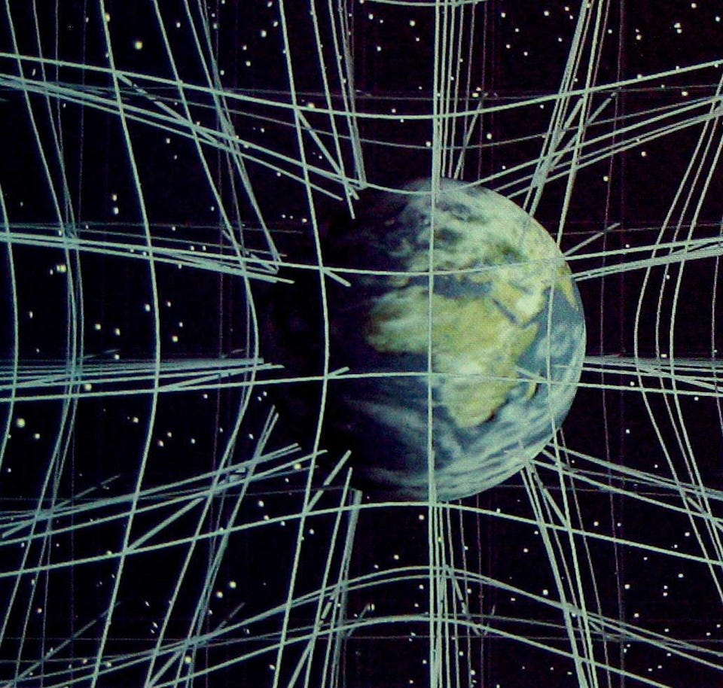
Spacetime
«..Henceforth, space by itself, and time by itself, are doomed to fade away into mere shadows, and only a kind of union of the two will preserve an independent reality.» (Η. Μinkowski, 1908).
The measurement of space and time differs between two observers (inertial). Spacetime interval remains constant.
Mass/Energy curve spacetime: The time and distance between two events change with respect to the distance from a mass/energy distribution. ( your feet age slower than your head..)

Slide 11
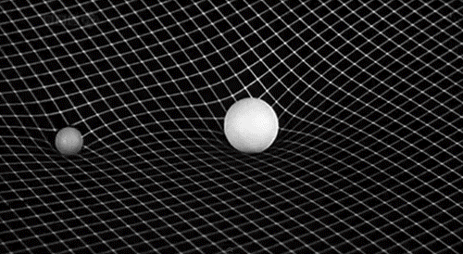
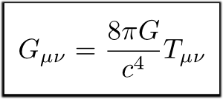

The Einstein Equation in the General Theory of Relativity (1915)
According to the General Theory of Relativity, Matter tells spacetime how to curve and spacetime tells matter how to move (J. A. Wheeler) .
$${2.077∗10}^{−43}N^{−1}$$
Einstein Tensor
(Spacetime Curvature**)
Energy- Momentum
Tensor
Large densities of mass/energy are required in order to have observable curvature of spacetime.
The sky is a unique lab for the study of General Relativity.

Slide 12
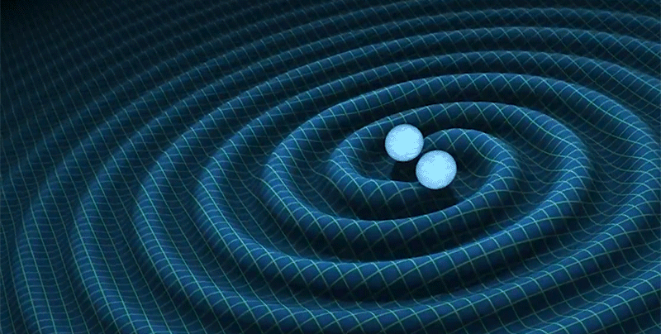
Gravitational Waves
Gravitational Waves are solutions of the Einstein Equation. They are ripples in space that are produced when an asymmetric mass distribution (such as a black hole binary) undergoes a rapidly varying motion.
They propagate outwards from the source with the speed of light. Their small coupling with matter makes them extremely difficult to detect but also extremely interesting for Astronomy since they undergo almost no absorption after their production. By studying them we can obtain information about their sources, to observe more closely the horizon of a black hole but also learn more about the nature of gravity itself.
https://www.youtube.com/watch?v=FlDtXIBrAYE

Slide 13
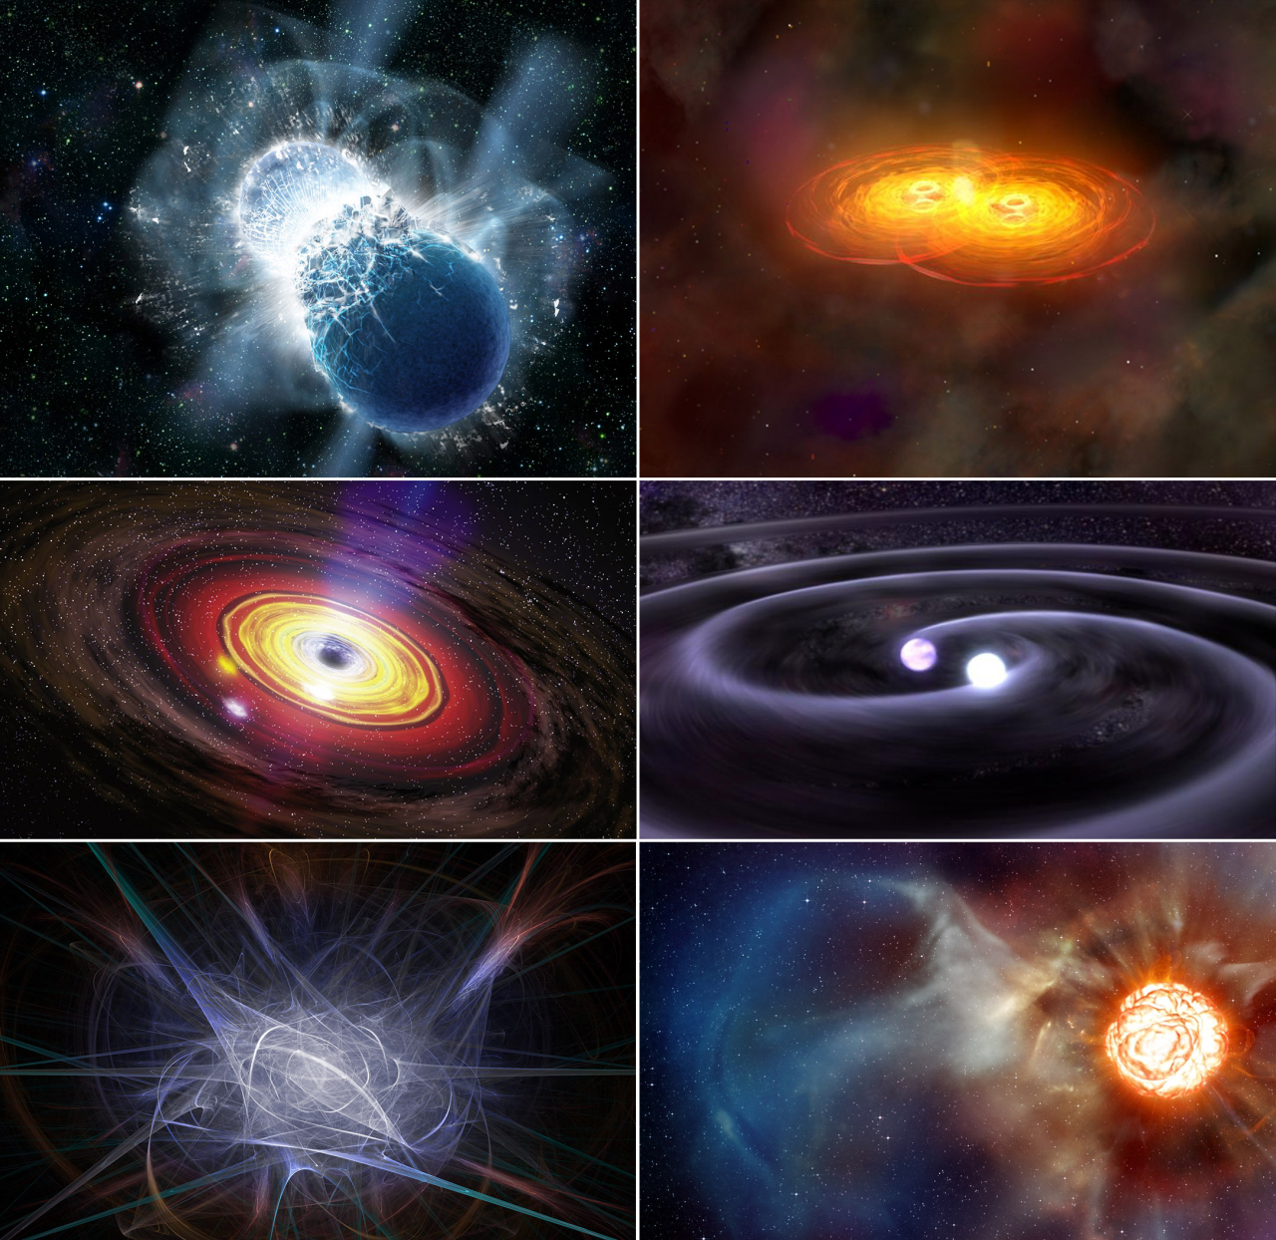
Sources of Gravitational Waves
Binary Systems(black holes, neutron stars, black hole-neutron star binaries, white dwarfs).
Supernova explosions.
Rotating neutron stars
Stochastic Gravitational Wave Background from the Big Bang.

Slide 14
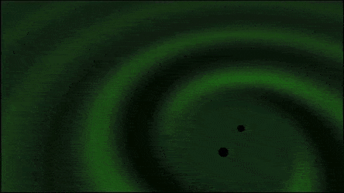
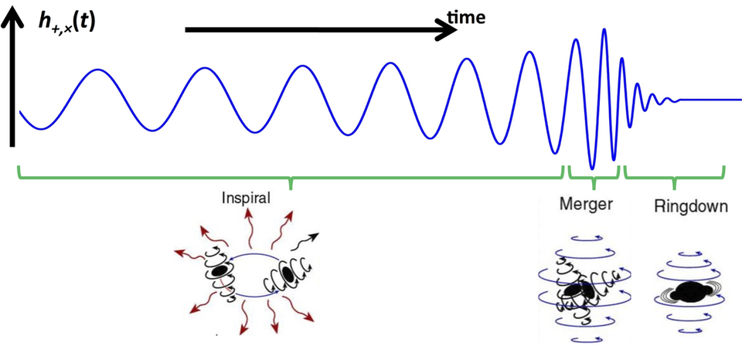
GW production mechanism

Slide 15
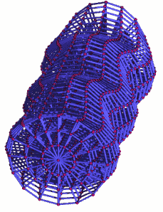
What do GWs do?
They change the metric of Spacetime through which they propagate in the plane vertical to their propagation direction.
Space “stretches and squeezes” when a GW passes through. The amplitude of GWs is inversely proportional to the distance to the source and depends on the mass and period of the source.

Slide 16
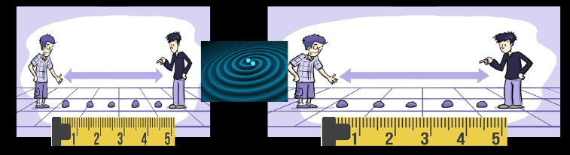
How can we detect Gravitational Waves?
GWs stretch and squeeze space. We can detect the coming of a GW by measuring the relative change of position (δL) between two masses placed at an initial distance L.
However, as the distance changes, the length of the ruler that I use to measure it changes in a similar way. If the coordinate distance between the two masses was equal to 5m before the coming of the GW it will still write 5m as it passes through. The GWs don’t change the coordinate distance but the proper distance between the two masses.

Slide 17
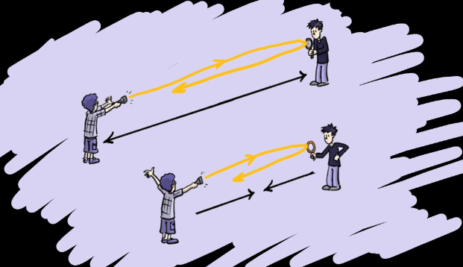
Let’s use light!
Light always moves with the speed of light! If the distance between two test masses increases, a light ray’s time of flight to and from the masses will last longer.

Slide 18
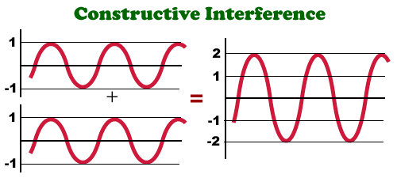
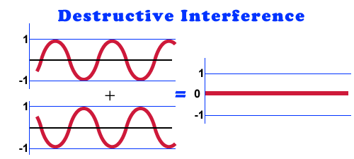
(A quick reminder)Wave Interference
Wave interference is the phenomenon that occurs when two waves meet while traveling along the same medium. The interference of waves causes the medium to take on a shape that results from the net effect of the two individual waves upon the particles of the medium.

Slide 19
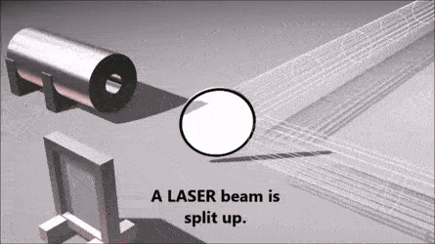
The Michelson Interferometer
Is an ingenious way of measuring small distances with great precision. Its working principle depends on the phenomenon of light interference:
We can tune the distances of the interferometer’s arms in order to achieve destructive interference: If a GW passes through, the length of the interferometer arms changes, resulting in differences in the time of flight of the light between the two arms and therefore its phase difference.

Slide 20



Gravitational wave sources emit ginormous amounts of power.. But they are very far away.. As a result, the amplitude of the GWs we measure is of the order..
$h=\frac{δL}{L}$ $\sim {10}^{−21}$
How small is that? If the arm of the interferometer has a length equal to L=1km, then the displacement will be of the order of
$δL={10}^{−18}$ m!
More or less, the increase of the global sea level if I dropped one glass of wine in the ocean!! To detect such small displacements, our detector needs to have impressive sensitivity!

Slide 21
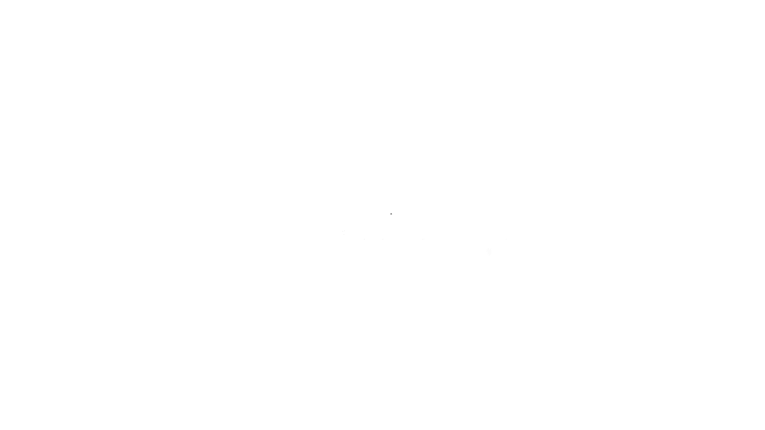
Let’s do a quick recap of what we learned

Slide 22
The Virgo Gravitational Wave Detector

Slide 23
The Virgo Gravitational Wave Detector
Detector based in the principle of operation of the Michelson Interferometer with arm length equal to 3km.
Its construction was completed in 2003 and has been operating since 2007. In 2017 it was replaced by the 10 times more sensitive Advanced Virgo Detector which, together with the LIGO detectors in the USA have detected together the first Binary Neutron Star merger in August, 2017.
It is located in the premises of the European Gravitational Observatory (EGO: www.ego-gw.it) in Cascina, a few kilometers outside Pisa in Italy. EGO is a consortium of the National Labs INFN (Italy), CNRS (France) and NIKHEF (Netherlands).
More than 700 scientists from 129 institutes in 16 countries participate in the Virgo Collaboration.
Let’s take a look: http://virgo360.dfa.unipd.it/

Slide 24
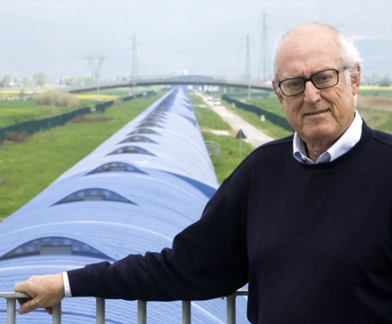
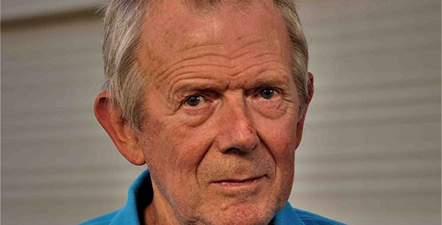
Virgo
The founding fathers
A. Giazotto (1940-2017)
A. Brillet (1947-)

Slide 25
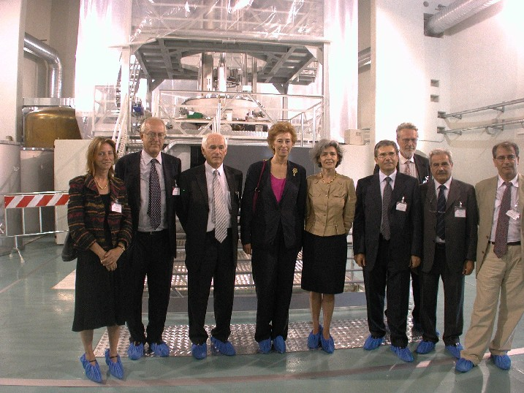
Virgo
A bit of history
Approval
Inauguration
July 23rd, 2003

Slide 26
Discoveries and current status of
GW Astronomy

Slide 27

The birth of Multimessenger Astronomy

Slide 28
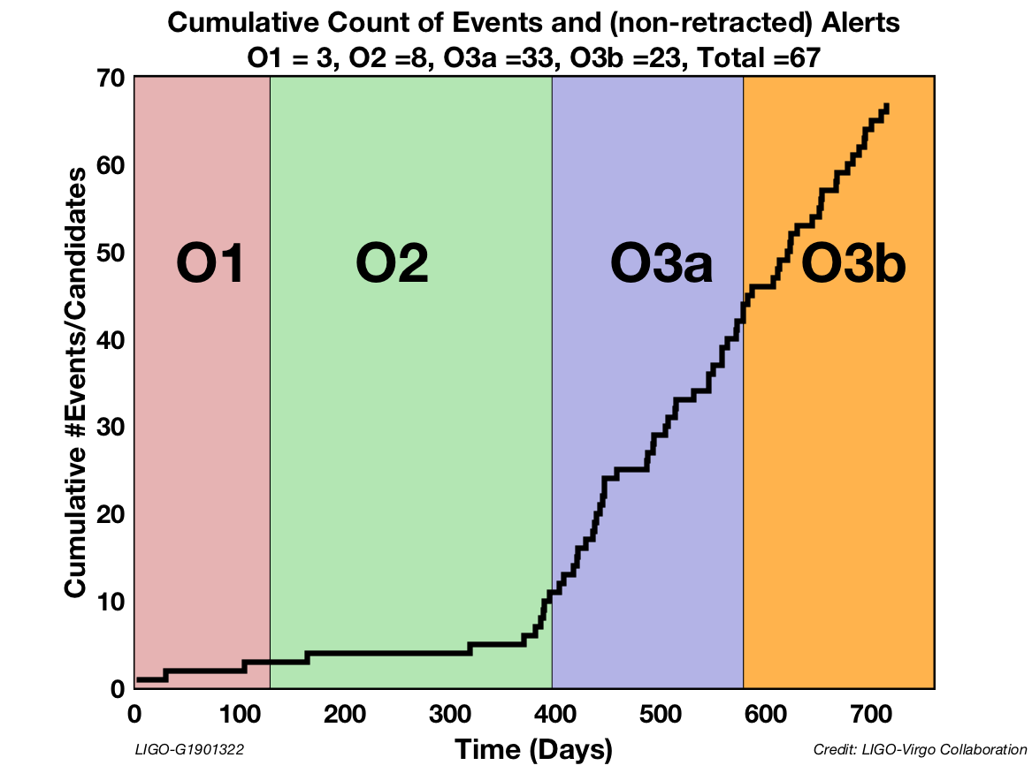
Candidate events

Slide 29
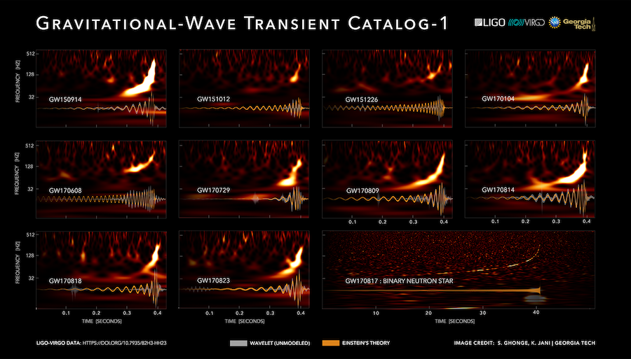
Ο1 – Ο2

Slide 30
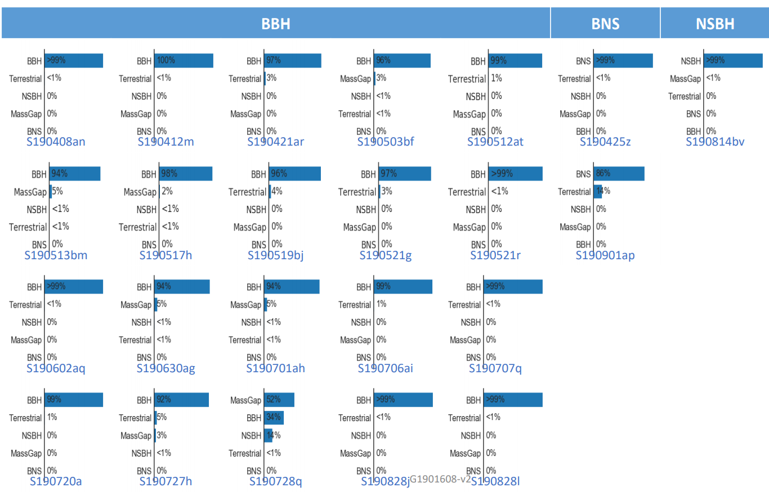
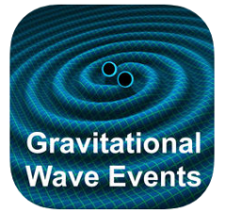
O3: More than 1 events per week
https://gracedb.ligo.org/latest/

Slide 31
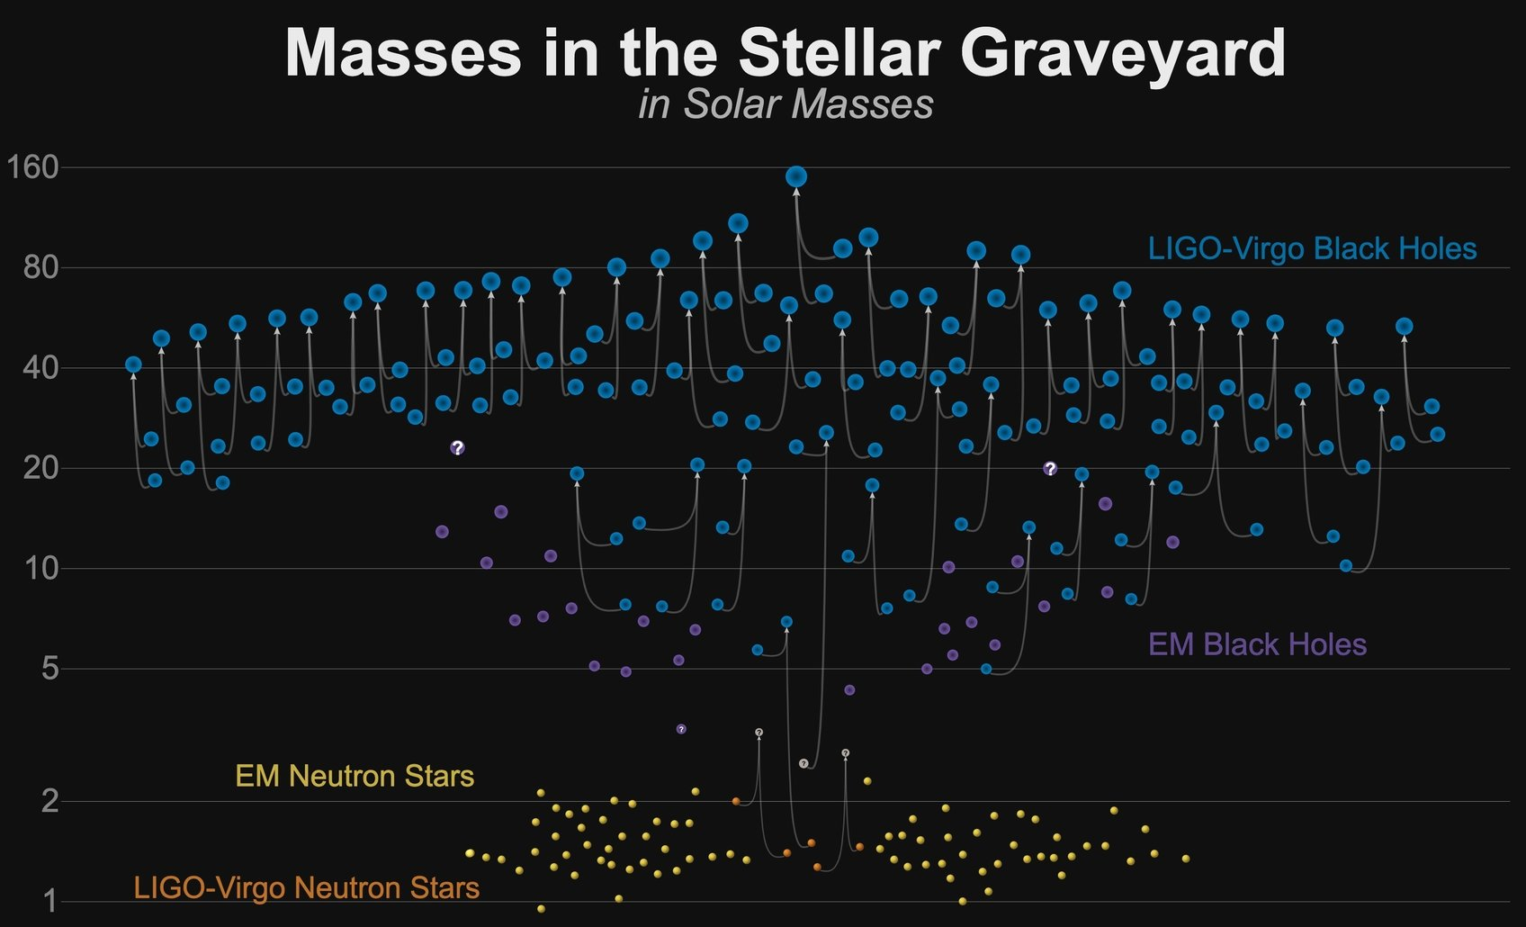

Slide 32
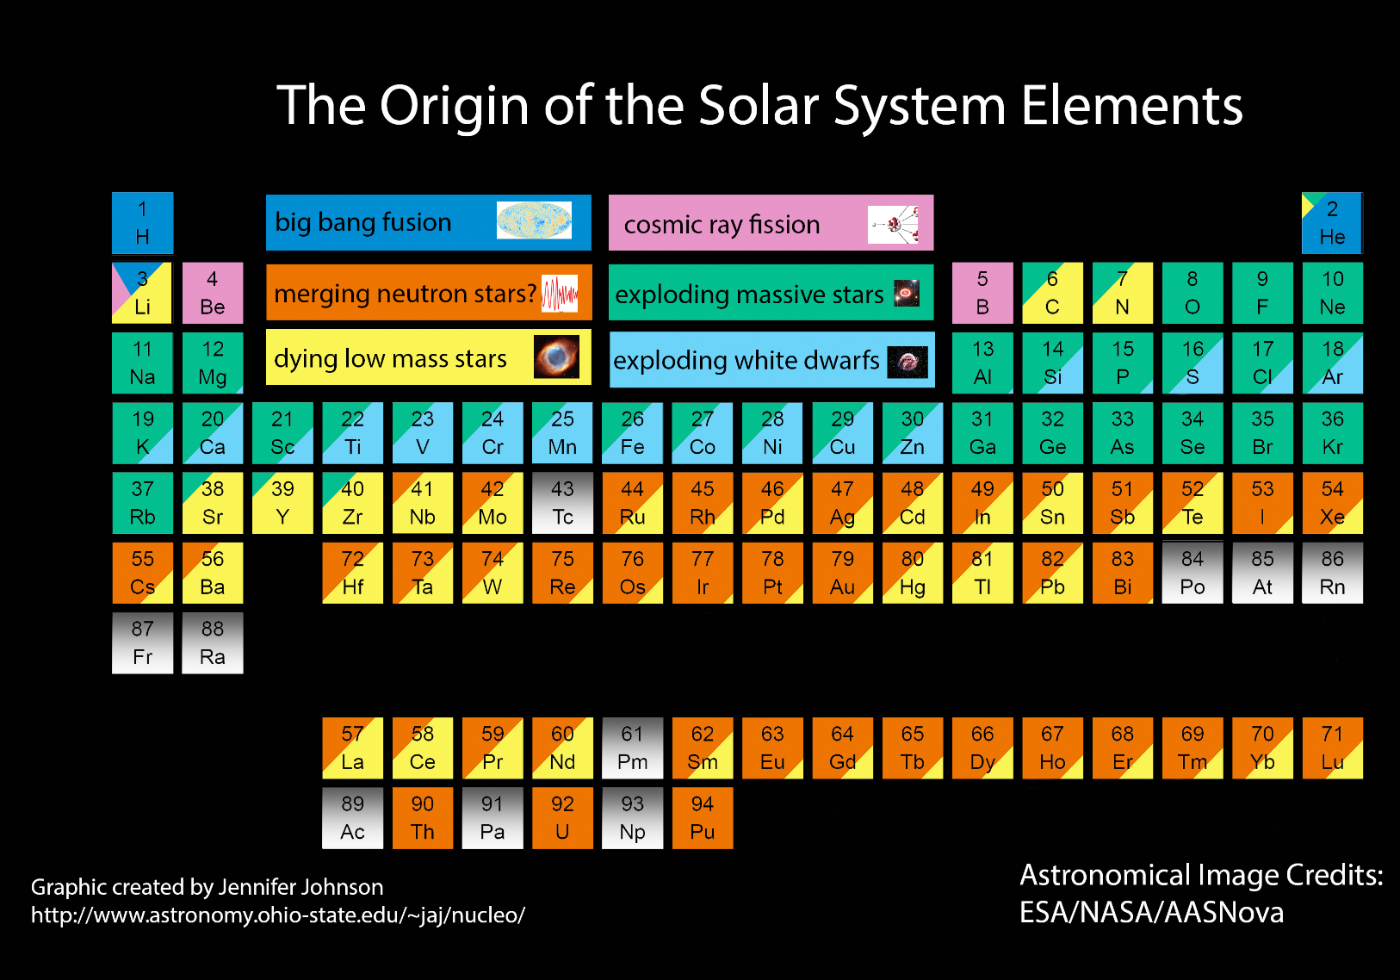
BNS mergers: the Universe’s goldmines!

Slide 33
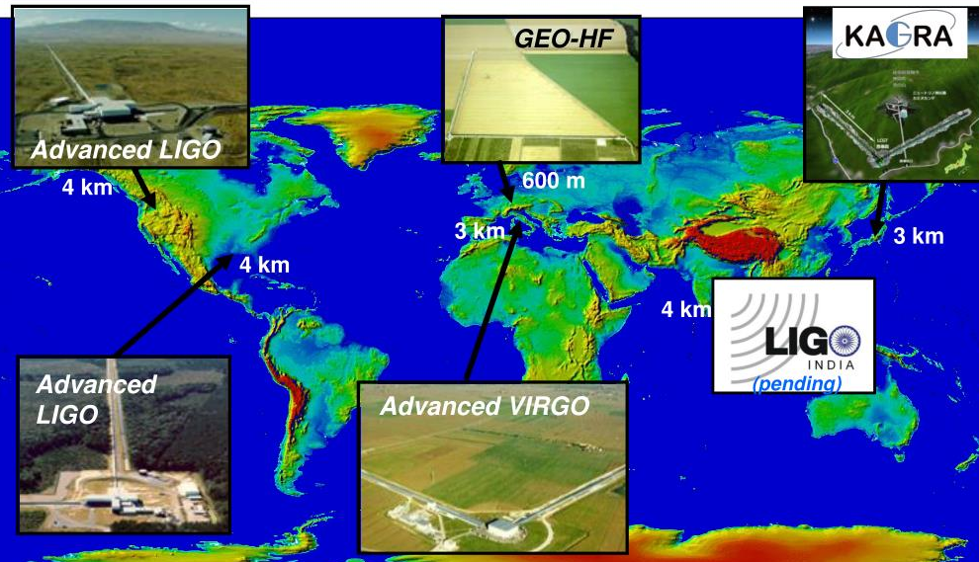
The GW detector Network

Slide 34
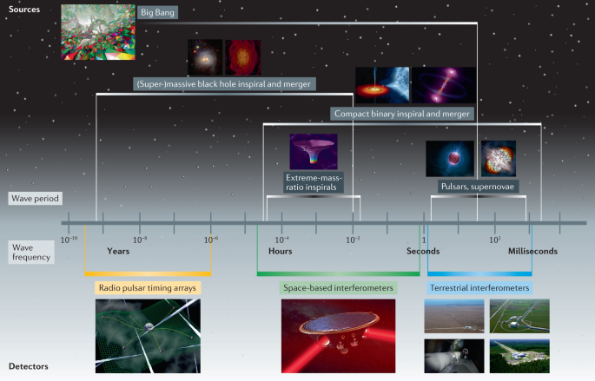
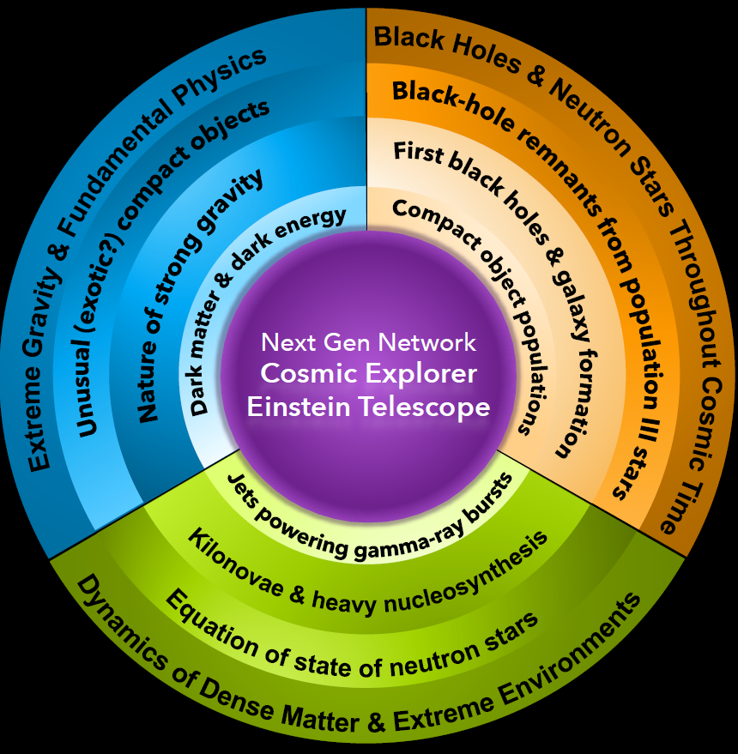
Future Challenges

Slide 35
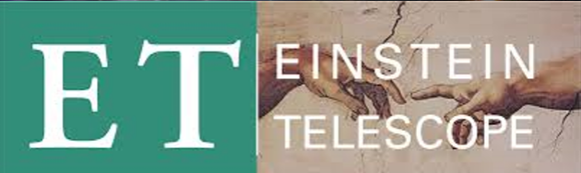
Einstein Telescope
Einstein Telescope (ET) is expected to have a triangular configuration, with 10 km of length for each side, in order to host two detectors with different bandwidths, and, to drastically reduce the effects of ground motion, will be built underground, making the needed infrastructural works very complex and expensive.
In Europe three candidate sites have been identified for ET: an area in the Nuoro province, in Sardinia, Italy, the Meuse-Rhine euroregion at the border between Netherlands, Belgium and Germany, and a location in Saxony, Germany.

Slide 36
Cosmic Explorer
A next-generation US-led gravitational-wave observatory project: https://cosmicexplorer.org/
40 km and 20 km L-shaped surface observatories
10x sensitivity of today’s observatories (Advanced LIGO+)
Under development, anticipated to begin operations in the 2030s
Will observe most black holes and neutron star collisions in the universe, including to (and possibly before) times when the first stars formed

Slide 37
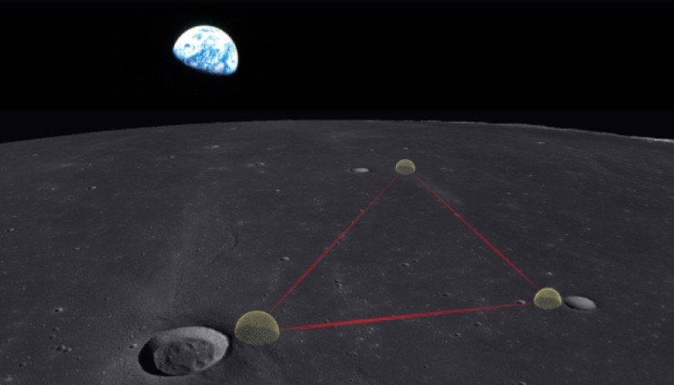
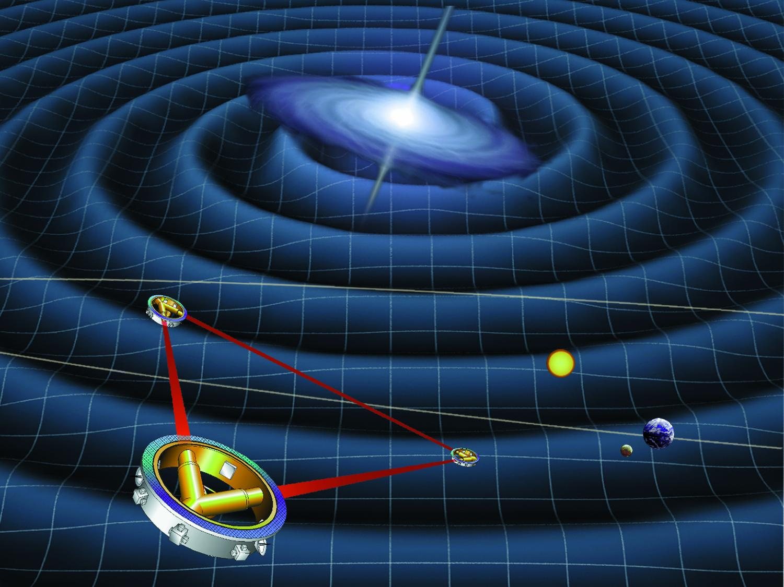
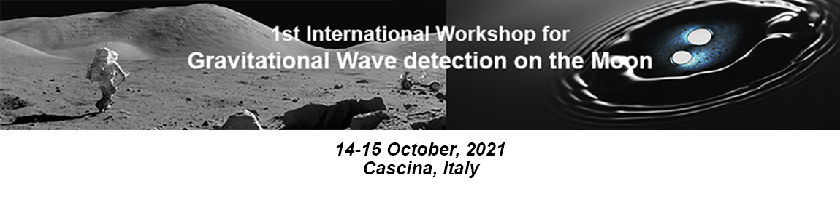
Beyond the Earth

Slide 38
Τhe problem: Noise

Slide 39
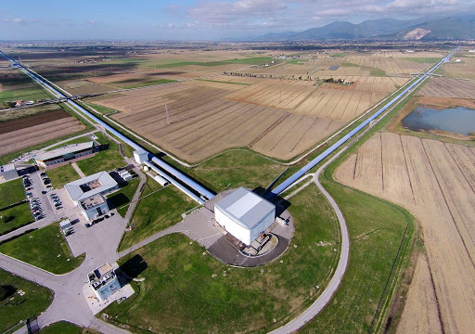
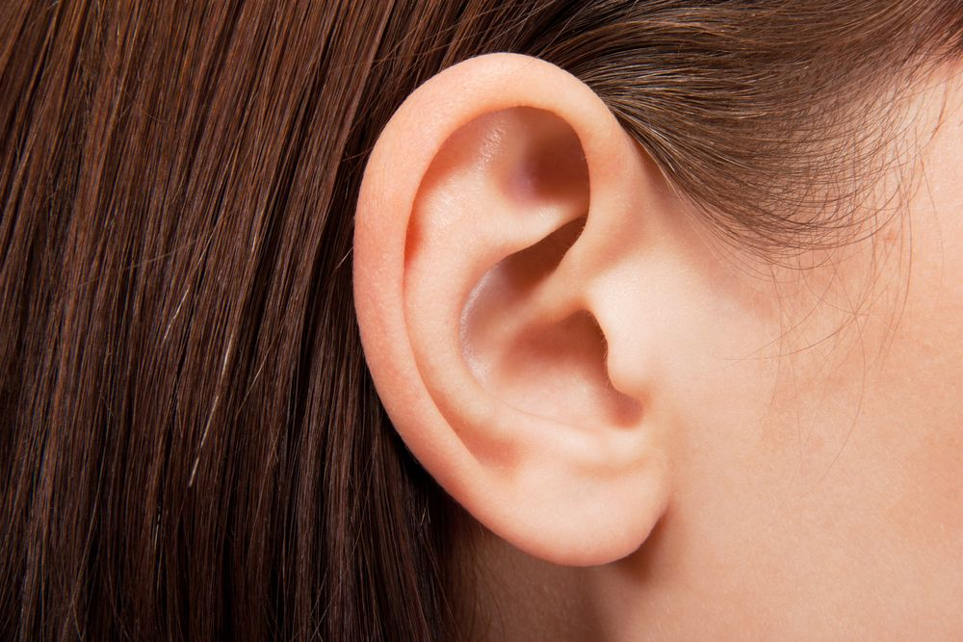
Let’s follow an analogy
Imagine a gravitational wave detector as an “ear”

Slide 40
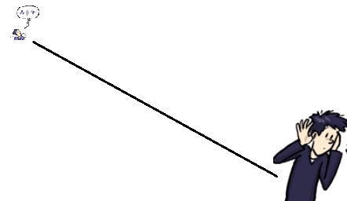


Your friend is humming a tune at some distance from your “ear”. The ear will listen to the tune.
Similarly, a gravitational wave detector’s sensitivity corresponds to how far in the universe it can reach and thus to its discovery potential!
Your friend keeps his voice level the same. The farther he is, the weaker
the sound you hear. A more sensitive ear will be able to listen
to your friend humming from a greater distance.
Therefore: “more sensitive ears” → “can identify signals from larger distances”

Slide 41

What affects a gravitational wave detector’s sensitivity? Let’s go back to our analogy with the ear..
Trying to detect gravitational waves is like trying to identify a song your friend is humming (signal) in a very noisy party (noise).

Slide 42
To detect gravitational waves even from the strongest events in the Universe, VIRGO needs to be able to know when the length of its 3-kilometer arms change by a distance 10,000 times smaller than the diameter of a proton! This makes VIRGO susceptible to a great deal of instrumental and environmental sources of noise.
These sources of noise need to be understood and controlled.
There are sources of noise that are understood…

Slide 43
A few examples of environmental noise..

Slide 44


Have you ever wondered how an earthquake in magoula/ greece affects the virgo gravitational wave detector in pisa? (19 July 2019)
Due to the earthquake in Magoula, the horizon of the Virgo detector dropped by a factor of 3!
*A measure of How far in the Universe can the detector “hear”
* BNS range is defined as the distance up to which a single
detector could observe the coalescence of a pair of 1.4solar masses
neutron stars with signal to noise ratio of 8.

Slide 45


Does the wind blowing, affect a gravitational wave detector?
On March 22, from 20.00 UTC and on, the wind speed jumped from a few to >40km/hr and exceeded 60km/hr around 08.00 in the morning.
This induced seismic noise both to the ground and to the building where the VIRGO detectors are housed, thus affecting its performance.
What does this plot tell us?
"If two neutron stars with mass equal to 1.4 solar masses merged in distance higher than 50 MPc and a signal arrived to our detector around 08.00 A.M, we wouldn't be able to detect it because the wind was blowing furiously!"

Slide 46



Seismic noise:
Keeping our setup isolated
Attenuation of the order ~10¹²
Standard filter
Suspended mirror

Slide 47

Loss of timing information from light scattering of air molecules:
The Virgo vacuum system
North Arm
3 km
West Arm
3 km
Total volume equal to 7000 m³ is in pressure of 1
millionth of a millionth of the atmospheric pressure. The highest vacuum in Europe. (10⁻⁷ bar)

Slide 48


Mirror thermal noise and radiation pressure:
The Virgo mirrors
Mirrors made of SiO2, with diameter 350 mm, thickness 200 mm inhomogeneities < 10⁻⁸ m.
Monolithic suspensions: made with very thin silica fibers (diameter 400 µm ) to support mirrors with mass equal to 42 kg.

Slide 49

Different sources of “noise” affect the gravitational wave detector’s sensitivity
Adapted from : Laser Labs’ Spacetime Quest: https://www.laserlabs.org/spacetimequest.php

Slide 50
Let’s play with noise in gravitational wave detectors! A school activity
https://tinyurl.com/m5fpmfn5

Slide 51
GLITCH HUNTING!

Slide 52
Introducing spectrograms..
As we said, gravitational wave detectors resemble very sensitive “ears”. One of our most important visualizations to understand the signals coming from GW detectors are spectrograms.
Assume that you observe a complex waveform, such as the waveform of an earthquake.
The frequencies of which the waveform consists may contribute in different proportions over time. In order to visualize this attribute, we use the spectrogram. The spectrogram shows both frequency and amplitude with respect to time.
A spectrogram is essentially a 3D plot:
It is a graph with x-axis representing time, y-axis representing frequency and the z-axis representing amplitude. Usually, the z-axis is replaced by a color code.
Connecting gravitational wave noise hunting with sound!!

Slide 53

This picture shows the spectrogram of a sound consisting of three frequencies. Can you say which frequency sounds the loudest at t=2s? At which time does frequency equal to 500 Hz sound louder than the others?

Slide 54

Let’s play with spectrograms
https://academo.org/demos/spectrum-analyzer/

Slide 55

The sound of a gravitational wave
https://www.youtube.com/watch?v=TWqhUANNFXw

Slide 56
There are sources of “noise” in Gravitational Wave detectors that are poorly understood.. The so called “Glitches”!

Slide 57


The frequency spectrum of a class of glitches
How far in the Universe can a Gravitational Wave
Detector “reach”
“Glitches”: Noise “triggers” that make their way in the GW data
and introduce dead time in the detector and mimic GW signals.

Slide 58
Classifying glitches using computers has proven to be an exceedingly difficult task. A family of data analysis algorithms known as machine learning have made huge strides over the past decade in classification problems, though they usually require a large pre-classified dataset to operate effectively. However, human intuition has proven time and time again to be a useful tool in pattern recognition problems such as this.
This is where your help is needed!

Slide 59

How can we help Virgo Researchers Classify Noise Triggers and Optimize their detector?
https://www.zooniverse.org/projects/reinforce/gwitchhunters/
LET’S TRY IT!

Slide 60




Slide 61
Thank you
Contact:
info@reinforce.ea.gr
Website REINFORCE:
www.reinforceeu.eu | www.reinforce.ea.gr
GWitchHunters:
https://www.zooniverse.org/projects/reinforce/gwitchhunters
Educational Activities in GW Astronomy:
http://www.frontiers-project.eu/gravitational-wave-astronomy/
Virgo and EGO websites:
https://www.virgo-gw.eu | www.ego-gw.it

