Slide 1
Determination of Radioactivity in Soil Samples and Evaluation of Excess Lifetime Cancer Risk in Albania
BALKAN PHYSICAL UNION
11th BPU – Belgrade, Serbia (28 August – 1 September 2022)
ERJON SPAHIU^{1,a)}, IRMA BËRDUFI^{2,b)}, MANJOLA SHYTI^{2,c)}
¹University of Tirana, Faculty of Natural Sciences, Department of Physics, Tirana, Albania
²University of Tirana, Institute of Applied Nuclear Physics, Tirana, Albania
^{a)}Corresponding author: Erjon Spahiu (erjon.spahiu@fshn.edu.al)

Slide 2
Topics of this study
Introduction
The samples analysed in this study
Sampling and sample preparation
Gamma-ray spectrometry laboratory
Results and discussions
Conclusions
Perspectives

Slide 3
Introduction
This work has been to provide an essential information concerning reference baseline concentrations of natural and artificial radioactive isotopes and environmental pollution.
The main contributors of natural radioactivity in soil are ²²⁶Ra, ²³²Th and ⁴⁰K. Artificial radionuclides can also be present such as ¹³⁷Cs, resulting from fallout from weapons testing or nuclear accidents.
The aim of this study has been not only the determination of activity concentration values of gamma emitting radionuclides, but also the evaluation of radiological hazard of radioactivity as total absorbed dose rate (D), the annual effective dose equivalent (AEDE) and excess lifetime cancer risk (ELCR).
The radiological hazard values were calculated and compared to the data reported by UNSCEAR (2000).

Slide 4
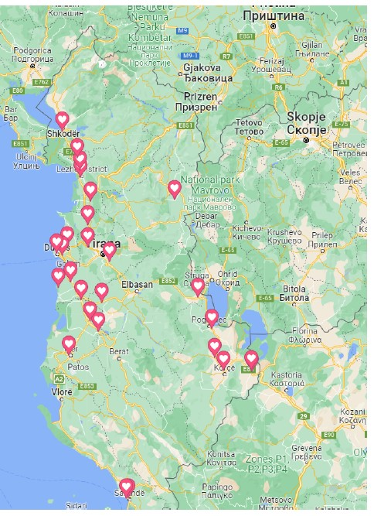
The samples analyzed
Sample ID | City | North | East
1 | Laç | 41.6405556 | 19.7163889
2 | Lundër | 41.2833333 | 19.8666667
3 | Sukth | 41.3758333 | 19.5347222
4 | Peshkopi | 41.6500000 | 20.3833333
5 | Maliq | 40.7147222 | 20.6994444
6 | Pogradec | 40.8877778 | 20.6750000
7 | Balldre i ri | 41.8233333 | 19.6333333
8 | Sarandë | 39.8722222 | 20.0169444
9 | Rrajcë, | 41.0758333 | 20.5683333
10 | Sarandë | 39.8722222 | 20.0011111
11 | Lushnjë | 40.8736111 | 19.7808333
12 | Durrës | 41.3330556 | 19.4494444
13 | Peqin | 41.0461111 | 19.8058333
14 | Lushnjë | 40.9357730 | 19.7145430
15 | Fier | 40.7295875 | 19.5489844
16 | Lezhë | 41.7794444 | 19.6394444
17 | Korçë | 40.6383333 | 20.7677778
18 | Fushë Krujë | 41.5025000 | 19.6972222
19 | Shkodër | 42.0519667 | 19.4954333
20 | Kavajë | 41.1691167 | 19.5601500
21 | Fishtë | 41.8957167 | 19.6117500
22 | Zona e plazhit | 41.3193000 | 19.4964000
23 | Kashar | 41.3683333 | 19.6975667
24 | Rrogozhinë | 41.0609833 | 19.6426333
25 | Plazhi Gjeneralit | 41.1333333 | 19.4642778
26 | Bitinckë 1 | 40.6334631 | 20.9922334
27 | Bitinckë 2 | 40.6415832 | 20.9887783
28 | Bitinckë 3 | 40.6416113 | 20.9890002
29 | Bitinckë 4 | 40.6417784 | 20.9886111
30 | Bitinckë 5 | 40.6418897 | 20.9902786
30 soil samples were collected from different locations of Albania.

Slide 5
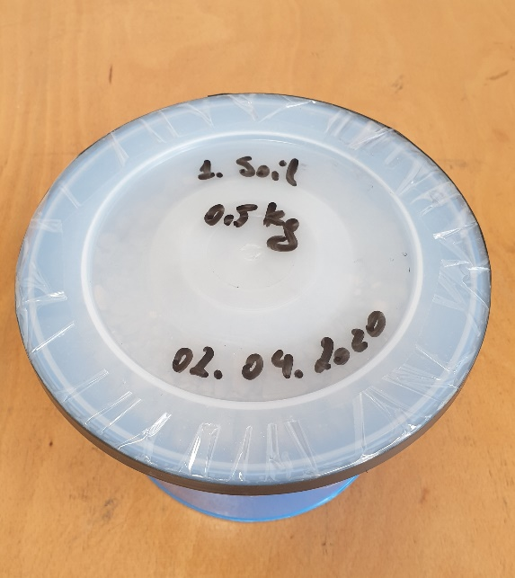
Sampling and sample preparation
- Samples were open in air for drying on trays for a period of one week and then in oven were dried at a temperature over 100⁰C for 2 to 4 hours until constant mass was obtained and to remove as much as possible moisture.
- Each of them is placed in a Marineli beaker and isolated, they are kept about 30 days until the secular equilibrium is reached.

Slide 6
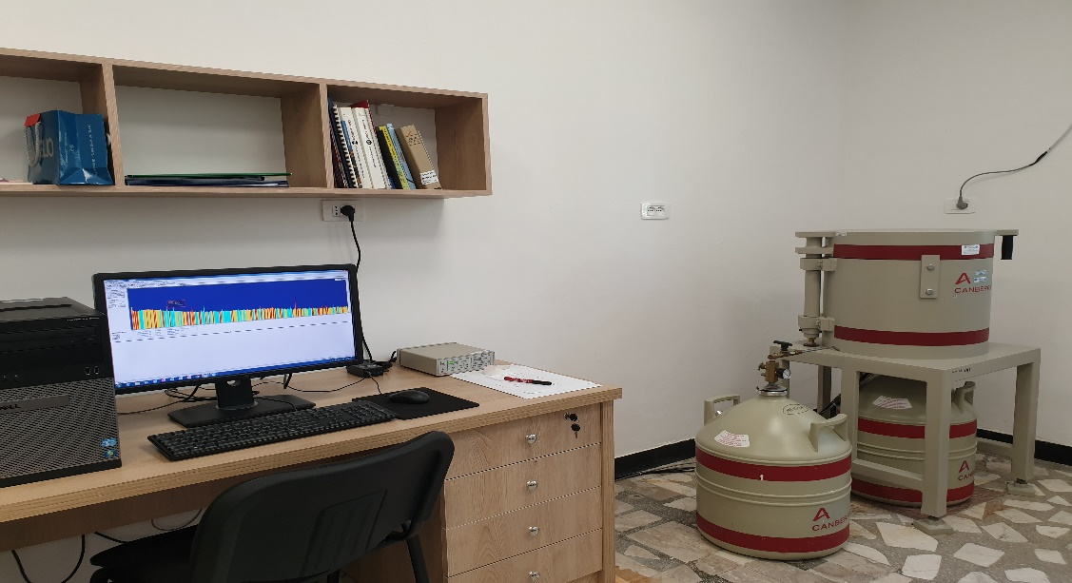
Gamma-ray spectrometry laboratory
HPGe detector | Coaxial p-type, 40% of rel. eff.
Energetic resolution | 1.8 keV at 1332 keV (⁶⁰Co)
Cooling technology | LN₂ (-196°C)
Shielding | 10 cm Pb and Cu-Cd foils
Acquisition time | 24 hours (500 cc sample volume)
Spectrum for Sample ID 1

Slide 7
Results and discussions I
Table 1. Activity concentrations of ²²⁶Ra, ²³²Th, ⁴⁰K and ¹³⁷Cs in (Bq/kg)
ID | ¹³⁷Cs | Unct. ¹³⁷Cs | ⁴⁰K | Unct. ⁴⁰K | ²²⁶Ra | Unct. ²²⁶Ra | ²³²Th | Unct. ²³²Th
1 | 2.99 | 0.30 | 405.28 | 17.88 | 27.75 | 0.92 | 27.09 | 1.05
2 | 2.16 | 0.18 | 428.30 | 18.54 | 24.95 | 0.79 | 28.52 | 1.04
3 | 1.53 | 0.16 | 479.15 | 20.83 | 23.32 | 0.79 | 28.97 | 1.06
4 | 13.54 | 0.86 | 564.59 | 24.31 | 41.13 | 1.17 | 57.06 | 1.87
5 | 9.72 | 0.63 | 526.12 | 22.58 | 24.71 | 0.81 | 31.60 | 1.12
6 | 2.94 | 0.22 | 464.92 | 19.99 | 24.13 | 0.78 | 29.01 | 1.05
7 | 1.49 | 0.21 | 382.46 | 16.67 | 23.48 | 0.76 | 24.53 | 0.92
8 | 14.12 | 0.89 | 332.30 | 14.72 | 62.96 | 1.94 | 52.93 | 1.72
9 | 48.68 | 2.96 | 117.82 | 5.87 | 7.60 | 0.37 | 7.17 | 0.44
10 | 3.84 | 0.29 | 279.96 | 12.67 | 38.44 | 1.20 | 40.30 | 1.39
11 | 0.75 | 0.17 | 527.06 | 22.59 | 30.19 | 0.94 | 38.26 | 1.30
12 | 2.77 | 0.21 | 424.89 | 18.37 | 21.53 | 0.71 | 23.59 | 0.89
13 | 4.79 | 0.34 | 426.50 | 18.67 | 31.36 | 1.01 | 36.81 | 1.30
14 | 7.68 | 0.50 | 299.80 | 13.29 | 16.92 | 0.59 | 17.10 | 0.72
15 | 6.27 | 0.50 | 332.16 | 14.72 | 16.92 | 0.60 | 17.52 | 0.75
16 | 6.58 | 0.44 | 332.46 | 14.61 | 19.27 | 0.65 | 21.03 | 0.82
17 | 21.11 | 1.31 | 368.78 | 16.11 | 23.15 | 0.75 | 22.10 | 0.85
18 | 4.53 | 0.33 | 661.56 | 28.36 | 27.42 | 0.90 | 37.82 | 1.44
19 | 6.84 | 0.42 | 436.50 | 18.27 | 23.91 | 0.76 | 25.85 | 1.01
20 | 1.10 | 0.08 | 184.26 | 7.85 | 11.63 | 0.43 | 12.56 | 0.53
21 | 6.37 | 0.39 | 363.31 | 15.24 | 23.86 | 0.76 | 27.99 | 1.11
22 | 7.49 | 0.46 | 352.20 | 14.73 | 18.53 | 0.59 | 14.34 | 0.62
23 | 3.88 | 0.24 | 448.19 | 18.78 | 30.57 | 1.06 | 32.05 | 1.25
24 | 0.83 | 0.06 | 283.33 | 11.92 | 17.26 | 0.62 | 16.38 | 0.67
25 | 5.98 | 0.37 | 204.87 | 14.31 | 7.74 | 0.27 | 8.53 | 0.30
26 | 0.79 | 0.1 | 7.96 | 1.36 | 4.72 | 0.22 | 0.65 | 0.11
27 | < MDA | -- | 2.04 | 0.96 | 7.07 | 0.27 | 0.73 | 0.11
28 | < MDA | -- | 79.82 | 4.11 | 10.64 | 0.38 | 8.70 | 1.43
29 | < MDA | -- | 19.99 | 1.73 | 9.28 | 0.34 | 5.37 | 1.16
30 | < MDA | -- | 37.01 | 2.24 | 14.92 | 0.47 | 11.31 | 0.94

Slide 8
Results and discussions II
Table 2. Total absorbed dose rate (D), the annual effective dose equivalent (AEDE) and excess lifetime cancer risk (ELCR) in the soil samples.
ID | D (nGy/h) | AEDE (μSv/y) | ELCR (x10⁻³)
1 | 46.170 | 56.623 | 0.198
2 | 46.678 | 57.246 | 0.200
3 | 48.296 | 59.230 | 0.207
4 | 77.414 | 94.940 | 0.332
5 | 52.731 | 64.669 | 0.226
6 | 48.145 | 59.046 | 0.207
7 | 41.657 | 51.088 | 0.179
8 | 75.338 | 92.394 | 0.323
9 | 14.213 | 17.431 | 0.061
10 | 53.890 | 66.091 | 0.231
11 | 59.055 | 72.426 | 0.253
12 | 41.994 | 51.501 | 0.180
13 | 54.650 | 67.023 | 0.235
14 | 30.878 | 37.868 | 0.133
15 | 32.436 | 39.779 | 0.139
16 | 35.666 | 43.741 | 0.153
17 | 40.053 | 49.121 | 0.172
18 | 63.232 | 77.548 | 0.271
19 | 45.068 | 55.271 | 0.193
20 | 20.674 | 25.355 | 0.089
21 | 43.269 | 53.066 | 0.186
22 | 32.136 | 39.412 | 0.138
23 | 52.287 | 64.125 | 0.224
24 | 29.707 | 36.432 | 0.128
25 | 17.452 | 21.403 | 0.075
26 | 2.93 | 3.59 | 0.01
27 | 3.29 | 4.65 | 0.02
28 | 13.50 | 16.56 | 0.06
29 | 6.36 | 10.26 | 0.04
30 | 15.27 | 18.72 | 0.07
The average absorbed dose rate D (nGy/h) in air at 1 m above ground level due to the presence of ²²⁶Ra, ²³²Th, ⁴⁰K and ¹³⁷Cs in the soil samples was 38.23 nGy/h.
The calculated values of annual effective dose equivalent (AEDE) for the all soil samples was found a average of 46.89 μSv/y, which is smaller than the world average value of 70 μSv/y.
The average of excess lifetime cancer risk (ELCR) value was calculated to be 0.16×10⁻³.

Slide 9
Conclusions I
In this paper, a study of the natural and artificial radioactivity of 30 soil samples in Albania is presented.
The average activity concentrations of natural radionuclides is found:
22.18 Bq kg⁻¹ for ²²⁶Ra,
23.53 Bq kg⁻¹ for ²³²Th,
325.79 Bq kg⁻¹ for ⁴⁰K
The average activity concentration of the artificial radionuclide is found:
6.29 Bq kg⁻¹ for ¹³⁷Cs.
The average absorbed dose rate D in air at 1 m above ground level due to the presence natural and artificial radionuclides in the soil samples was 38.23 nGy/h,
which is smaller than the World Average Value of 60 nGy/h.

Slide 10
Conclusions II
The average value of annual effective dose equivalent AEDE were found:
46.89 μSv y⁻¹ , which is smaller than the World Average Value of 70 μSv y⁻¹
The average of excess lifetime cancer risk (ELCR) value is found to be:
0.16×10⁻³ , World’s Average is 0.29×10⁻³
Lifetime risk of cancer result lower for all localities.
The all average values of radiological hazard for all soil samples, were lower than the world average. It is safe for population living or other human activities without any radiological risk.
This paper provides an essential information of its kind to determine the level of natural and artificial radioactivity values in soil samples in Albania.

Slide 11
Perspectives
This is a preliminary study and included only a few places, we are working further in order to cover as much as possible areas of Albania.
We will build a complete map for study of the soils in Albania
In the future, a essential information of its kind to determine the level of natural and artificial radioactivity values in soil samples in Albania.

Slide 12
Thank You for Your attention!

