Slide 1
NS super-excited molecular states in the collision of electrons with NS⁺ cation
Felix Iacob
West University of Timisoara,
ROMANIA

Slide 2
In collaboration with
J. Zs Mezei, Institute for Nuclear Research (ATOMKI), H-4001 Debrecen, Hungary
I. F. Schneider, LOMC CNRS-UMR6294, Université Le Havre Normandie, F-76058 Le Havre, France
T. Meltzer, Institute of Theoretical Physics, Charles University, 11636 Prague, Czech Republic
J. Tennyson, University College London, WC1E 6BT London, UK

Slide 3
Outline
Scattering technique in electron-ion collision
Super-excited molecular states
Research method
Applications
Study of case: NS⁺
Motivation, NS+ - in interstellar media
e⁻ + NS⁺ scattering, results
Outlook

Slide 4
Scattering technique in electron-ion collision
Fundamental processes:
e⁻ (l) + AB⁺(Ni⁺,vi⁺) → | AB + (Nf⁺,vf⁺) + e⁻ (l’) | Ro-Vibrational (de)Excitation: VE(VdE)
 | A + B | Dissociative Recombination: DR | Rearrangement or Resonance scattering
 | A + B⁺ + e⁻ | Dissociative Excitation: DE
Consider:
partial wave of projectile, l
internal structure of target, N_{pi}, v_{i}

Slide 5
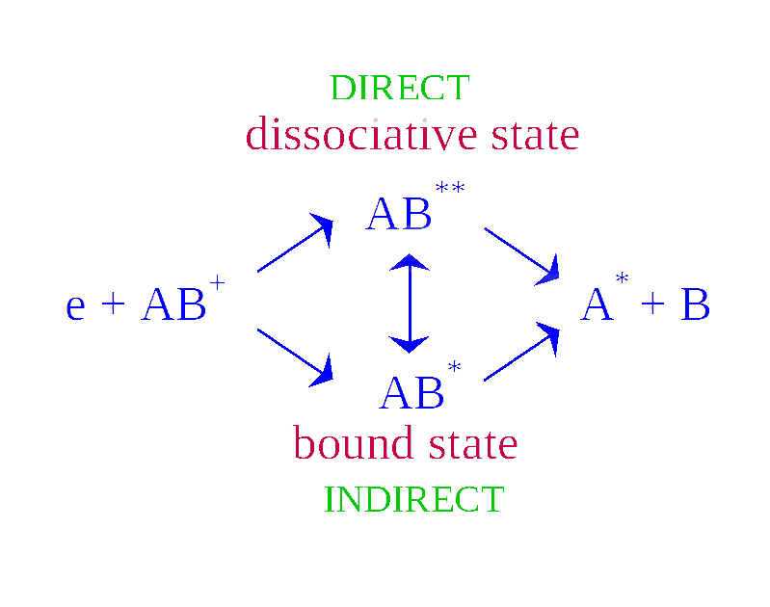
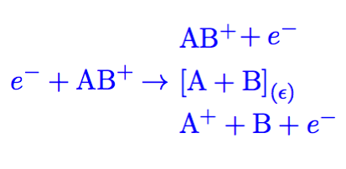
Scattering technique in electron-ion collision
chemical reaction
scatter

Slide 6
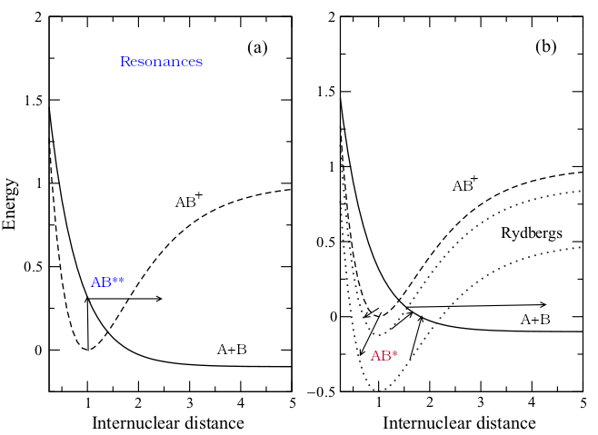
Scattering technique in electron-ion collision
Born-Oppenheimer

Slide 7
Scattering technique in electron-ion collision

Slide 8
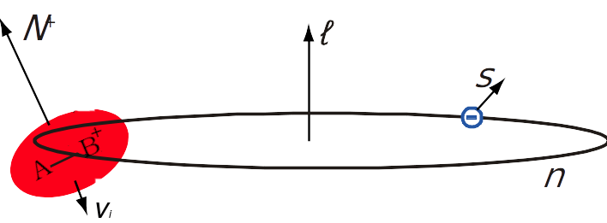
Super-excited molecular states
Electronic excitation emerges when:
intense radiation arising from sources such as lasers, swift ions, or high-flux X-ray or electron pulses, interact with molecules.
low electron collision with molecules, especially molecular cations
The scattered electron is viewed in the outermost
occupied molecular orbital, called virtual orbital

Slide 9
Research method
I. Ab-Initio calculation involving multireference electronic structure configurations
Deliverables:
Feshbach resonances
bound mono-excited Rydberg states
autoionization widths
quantum defects
II. Multichannel Quantum Defect Theory
Deliverables:
cross-sections
thermal rate coefficients

Slide 10
Result applies to molecular dynamics
incorporating rate constants as kinetic constraints

Slide 11
Study of case
NS⁺ + e⁻ → NS*, NS** → N+S
“ NS⁺ is principally destroyed through dissociative recombination with electrons.
No measurement nor theoretical estimate is yet available for the dissociative recombination (DR) of NS⁺ “.
J. Cernicharo et al 2018 ApJL 853 L22

Slide 12
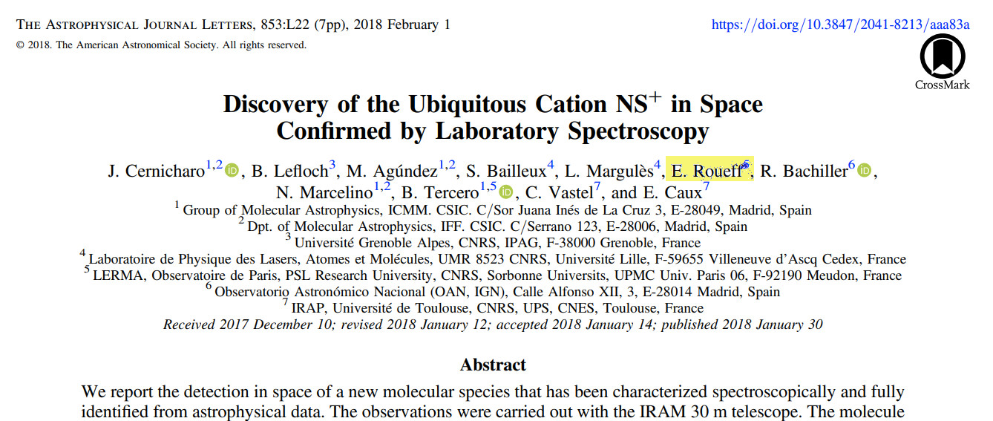
NS⁺ - in interstellar media

Slide 13
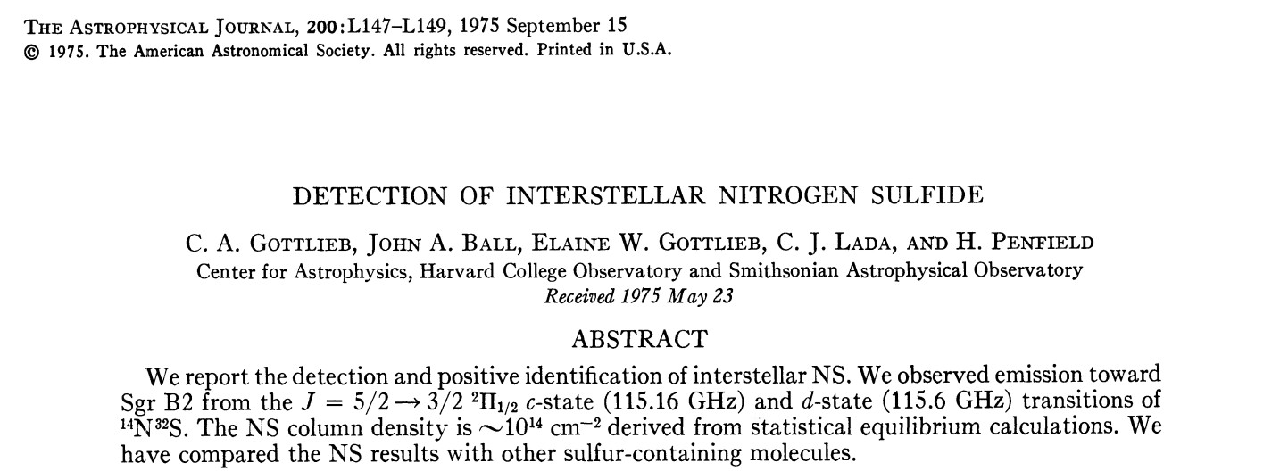
NS - in interstellar media

Slide 14
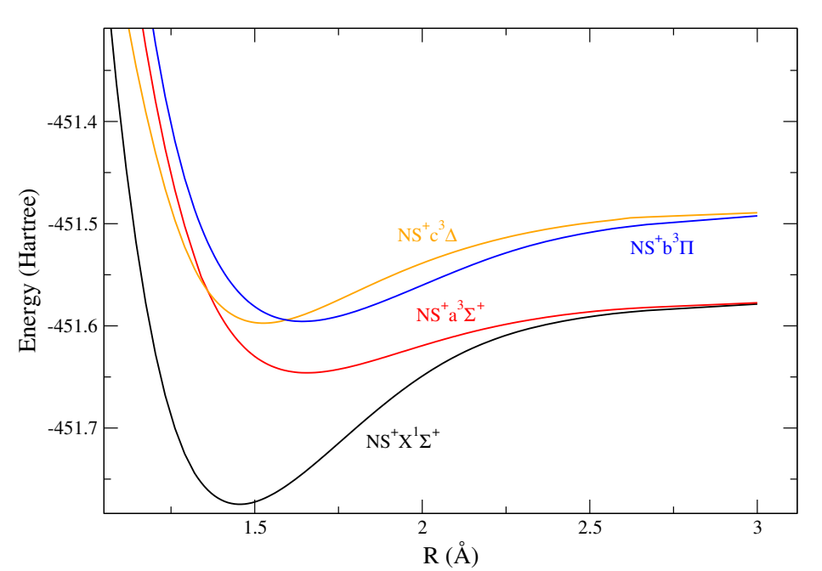
NS⁺ target
Multi-Configuration, Self-Consistent-Field approach
Complete Active Space - CASSCF
C_{2v} point group
code symmetry
Ordering:
A₁ B₁ B₂ A₂
FRO(4,1,1,0)
CAS(4,2,2,0)
------------------
OCC(8,3,3,0)
VIR(2,1,1,1)
------------------
TOT(10,4,4,1)

Slide 15
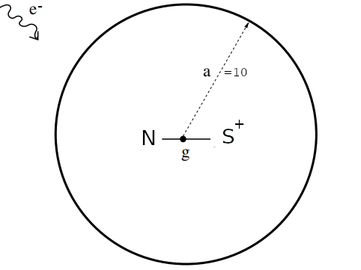
e⁻ + NS⁺ scattering, R-matrix method
In the inner region, exchange and other short range, possibly non-local, interactions are important
In the outer region it is assumed that only long range potentials will affect the scattering
Asymptotic channel i is a state
of target with energy E_{i}^{N}
and of the scattering electron of energy E with partial wave , (l_{i}, m_{i}) .
The wavenumber of the scattering electron associated with this channel k_{i}² = 2(E – E_{i}^{N}).
A channel is said to be open if k_{i}² ≥ 0
The wave function of the outer region solutions:

Slide 16
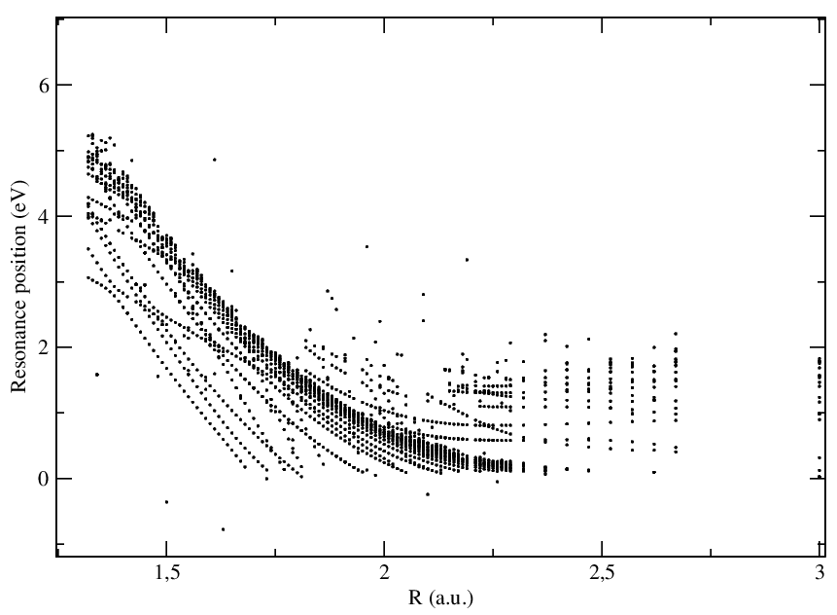
e⁻ + NS⁺ scattering, R-matrix method
Feshbach resonances:
temporary trapping of an electron to form a quasibound or short-lived state of neutral in continuum of ion.
NS**
energy of ion is zero reference

Slide 17
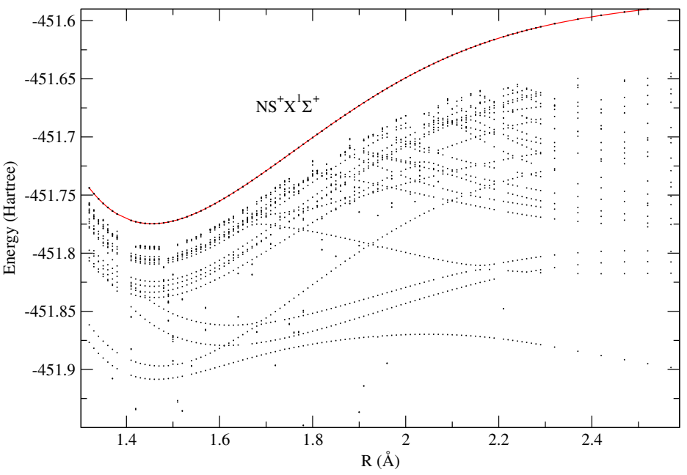
e⁻ + NS⁺ scattering, R-matrix method
Bound states
temporary trapping of an electron to form a quasibound or short-lived state of neutral,
are found by performing the scattering calculations at negative energy.
NS*

Slide 18
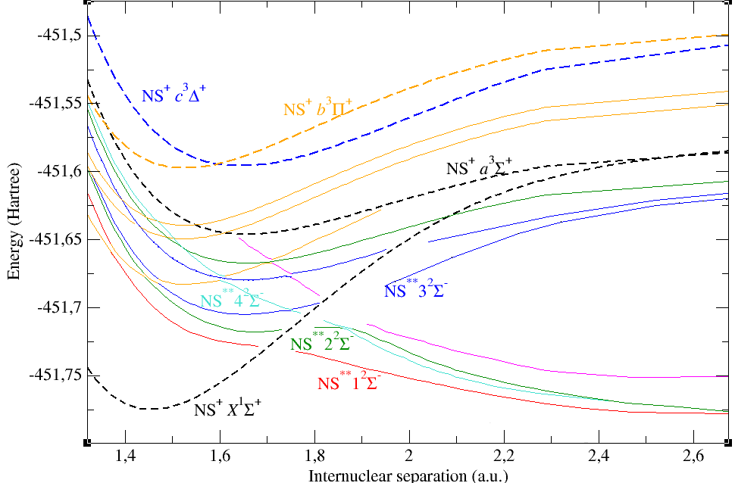
Diabatization: PEC of NS*,NS**

Slide 19
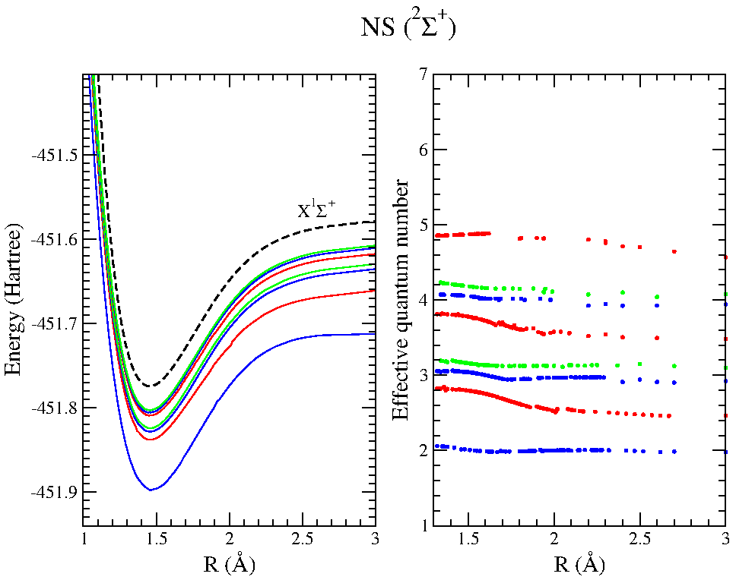
Diabatization: PEC of NS*
partial wave characterizing the incoming electron:
blue s-state,
red p-state,
green d-state

Slide 20
Outlook: Multichannel Quantum Defect Theory
The minimum set of input data for an MQDT:
PEC of the ground state of the molecular ion,
PEC of the dissociative states of the neutral,
Widths, electronic couplings of the dissociative states with the ionization continuum of the ground state of ion,
Quantum defects of the each Rydberg series converging to the ground state of the ion.
MQDT → cross-sections,
thermal rate coefficients → estimate for the dissociative recombination of NS⁺

Slide 21
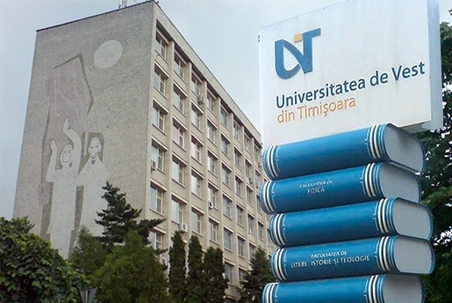
Thank you for your attention
acknowledge
West University of Timisoara for support

