Slide 1
Compound-state model for non-sequential double ionization
Nenad SIMONOVIĆ
Institute of Physics Belgrade

Slide 2
Non-sequential double ionization
Non-sequential double ionization (NSDI) is a strong-field atomic process in which two electrons simultaneously leave atom irradiated by an intense laser pulse.
This process has been described successfully by the three-step (TS) model.
For the laser field intensities close to the threshold for NSDI the so-called compound-state (CS) model might be a valid alternative.

Slide 3
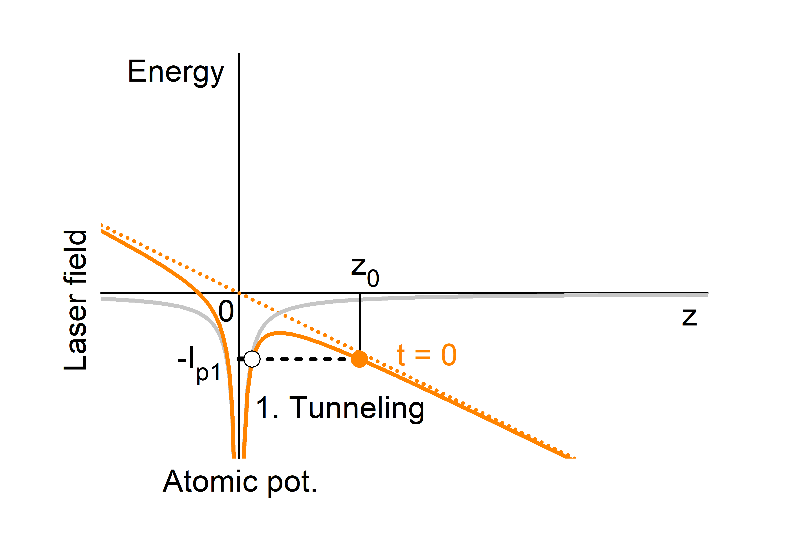
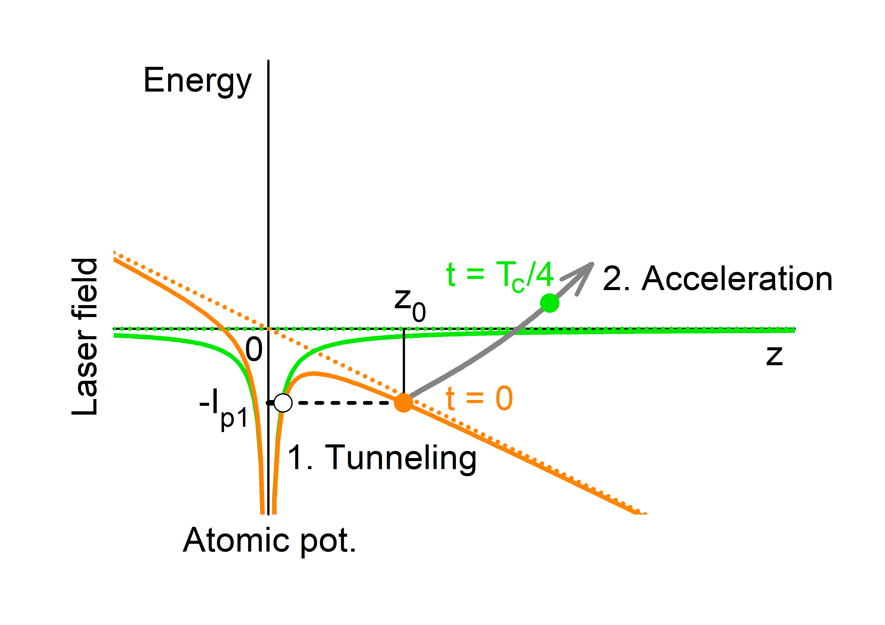
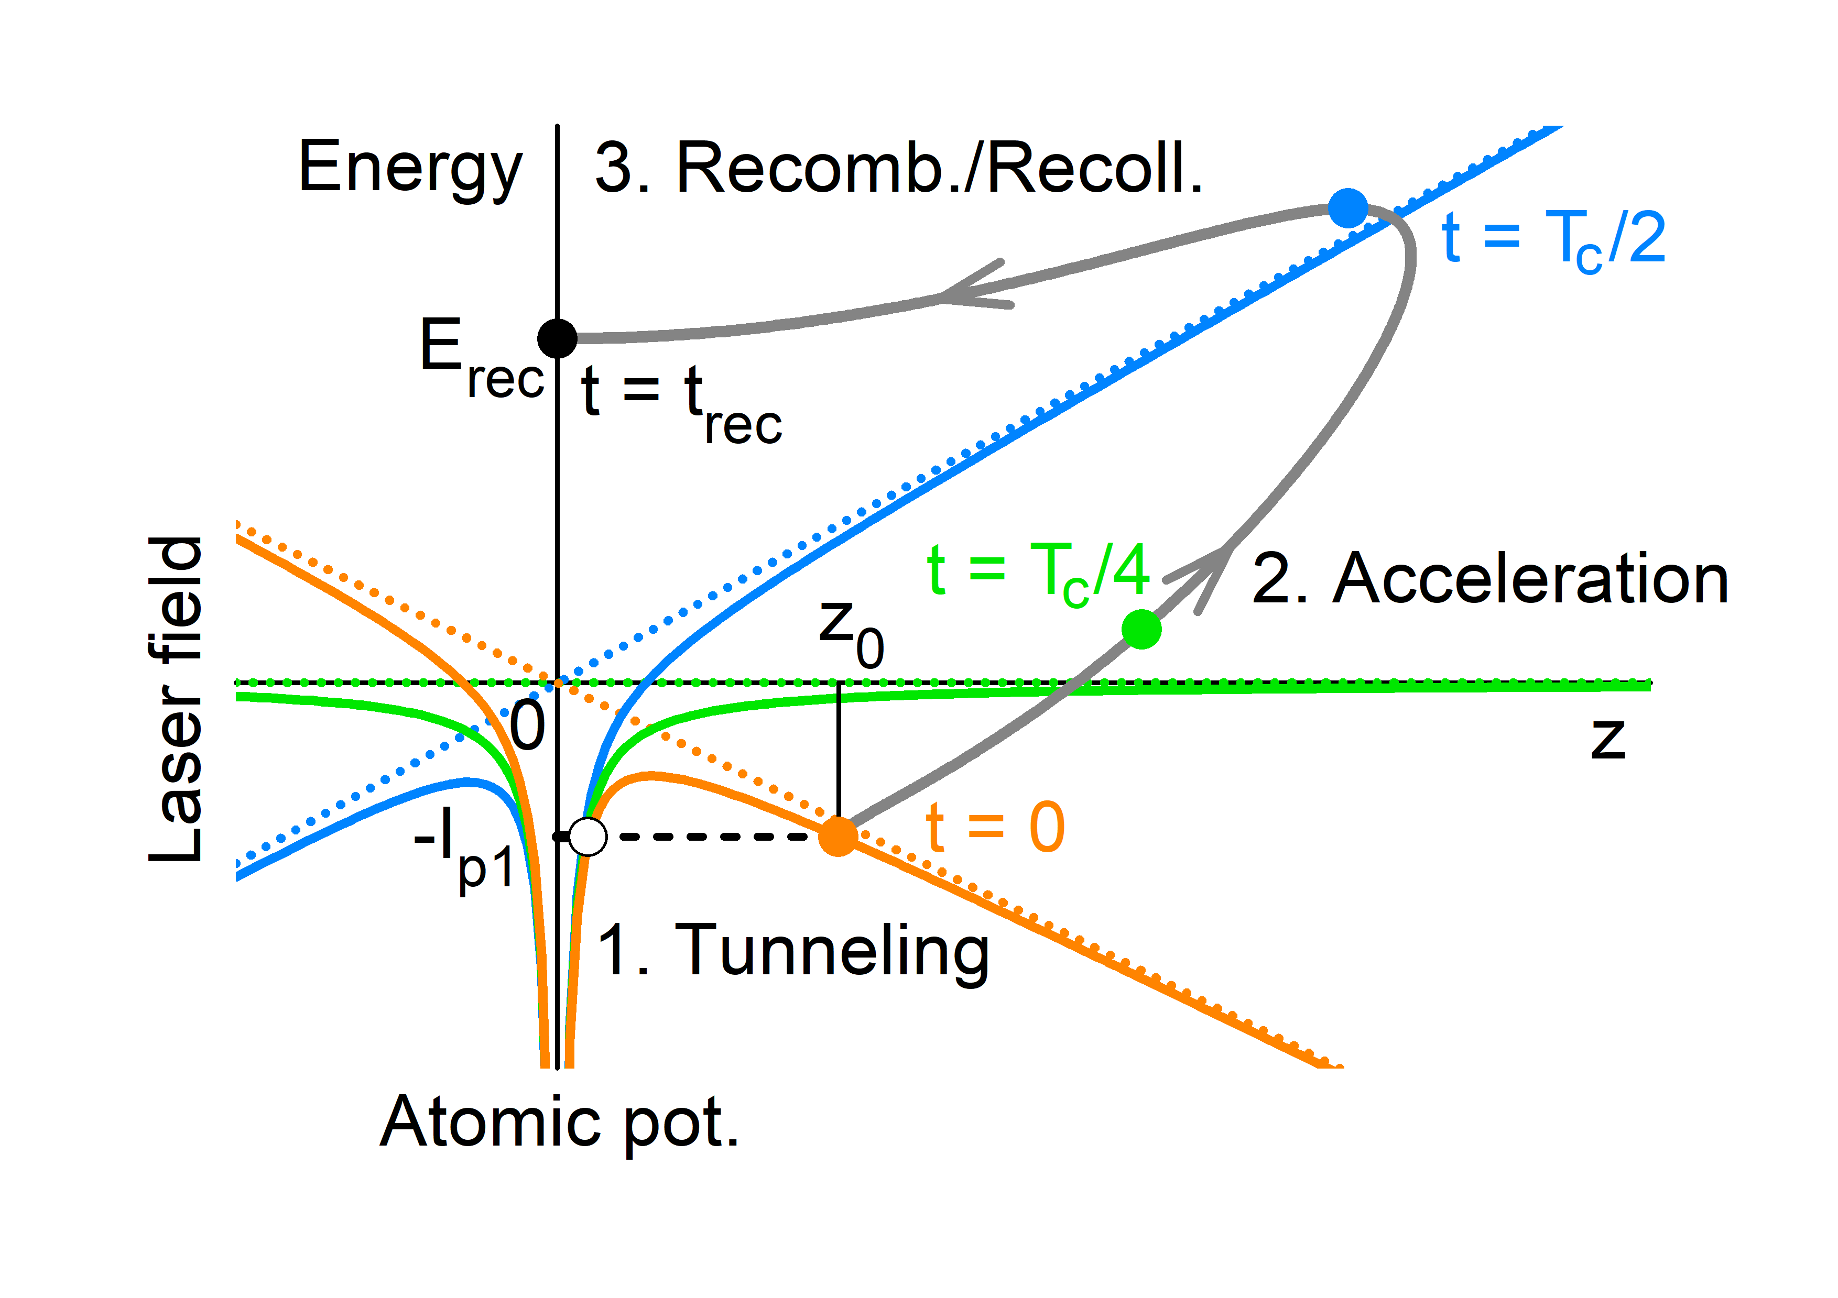
The three-step model
Stages of the TS model:
tunneling of the active el.
its acceleration
recombination/recollision
Eff. potential (full color lines):
$$V\left(r,t\right)=V_{at}(r)−e z F_{0}\cos{ωt}$$
el. comp. of the laser field
$$T_{c}=2π/ω$$

Slide 4
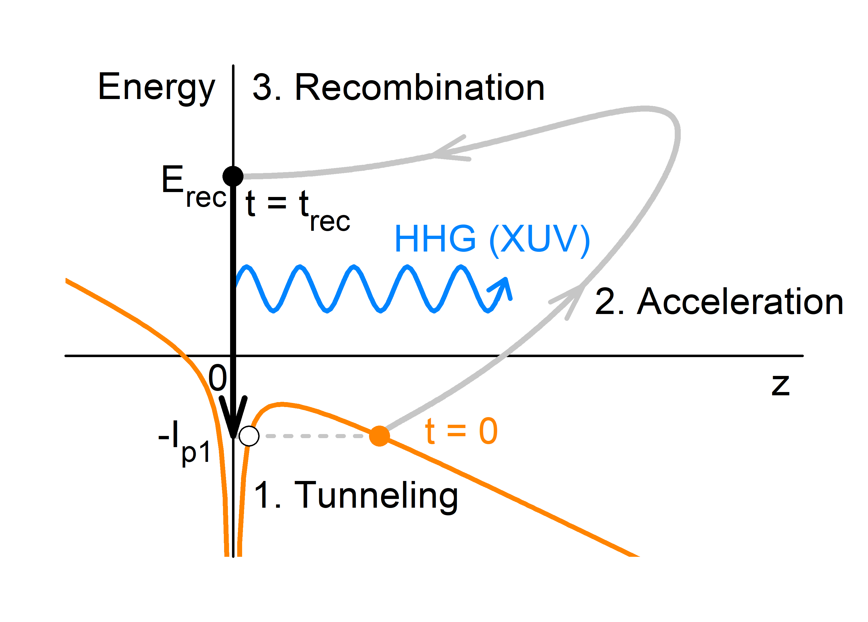
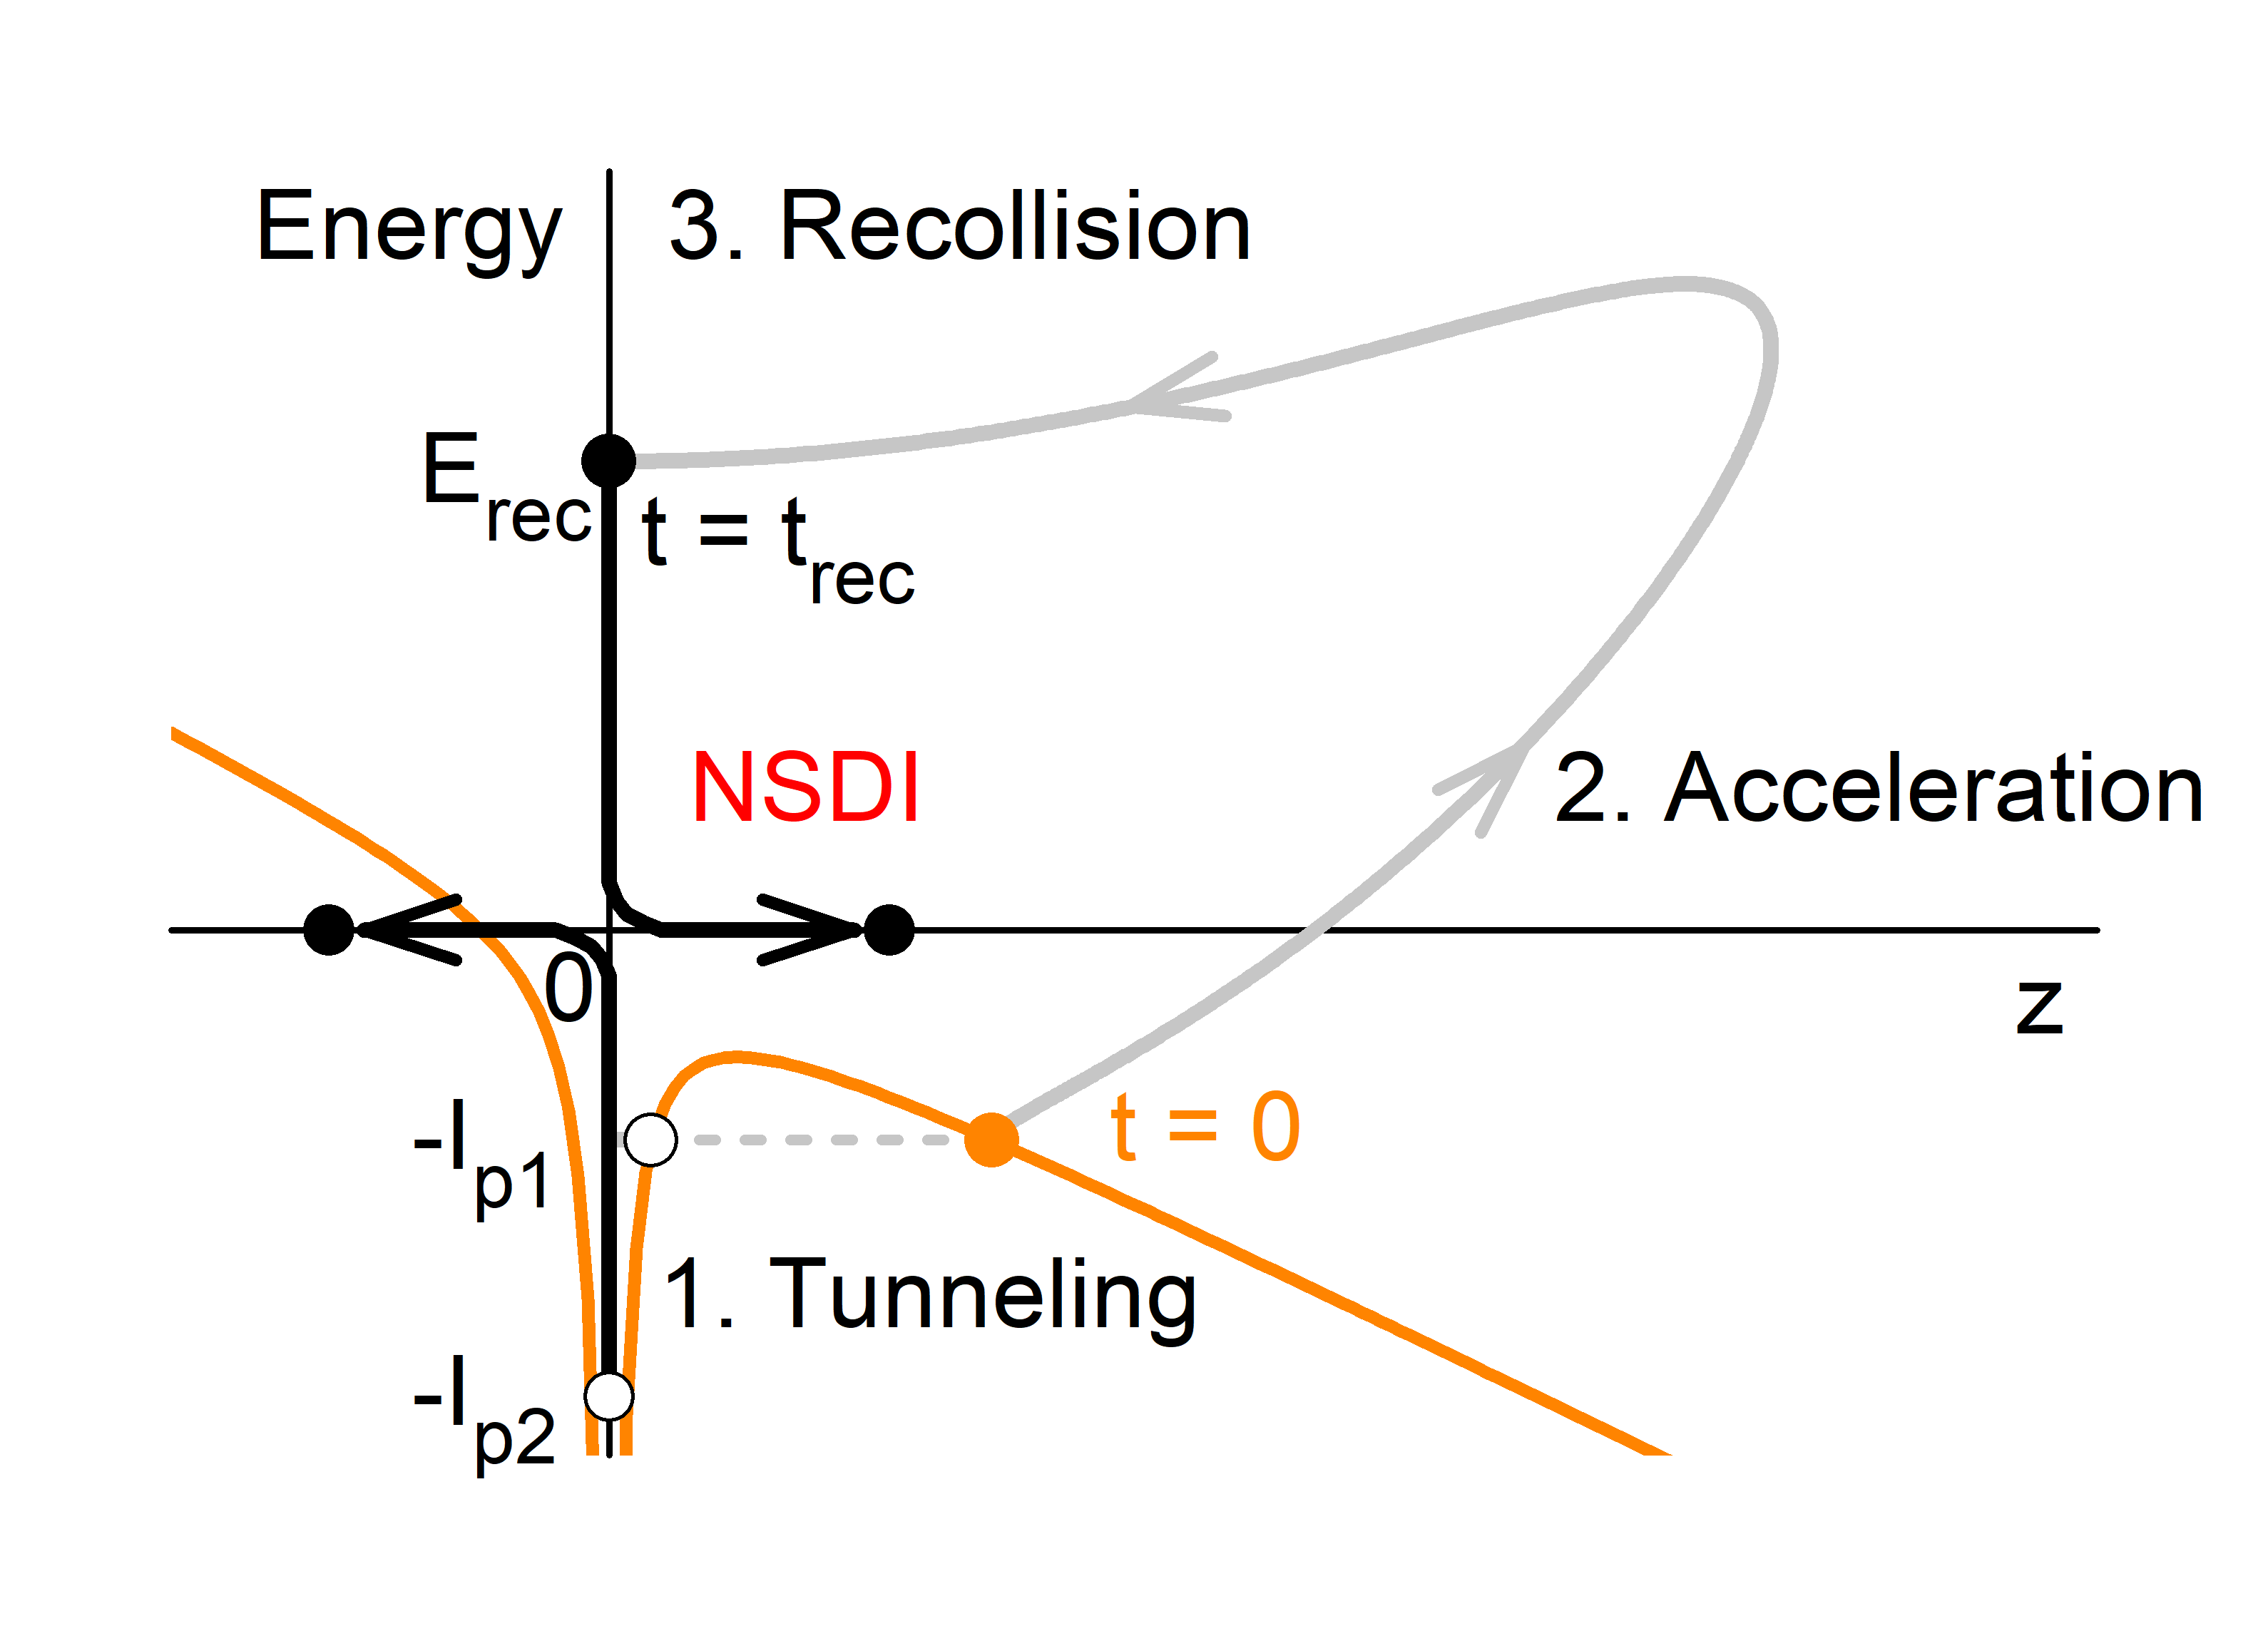
Formation and decay of a highly excited state
Recombination/recollision leads to formation of a highly excited atomic state, which can be de-excited to the ground state by emitting radiation (high harmonic generation - HHG) or decomposed by NSDI.

Slide 5
Numerical method
In numerical simulations of the NSDI the tunneling dynamics (the 1st step) is usually treated semiclassically. The active electron (e1) appears at the barrier exit ($z_{0}$) with a rate given by the ADK formula.¹ It has zero longitudinal velocity and a Gaussian distribution on the transverse velocity $w\left(v_{1}^{0}\right)\sim exp⁡(−\sqrt{2I_{p1}}v_{1}^{0}/F)$.² The bound electron (e2) is sampled from a microcanonical distribution.³
The motion of the active electron in the 2nd and the 3rd step is treated fully classically. In order to collect a sufficient amount of data for quantitative analysis, simulations are performed using the classical trajectory Monte Carlo (CTMC) method.
¹ M. V. Ammosov, N. B. Delone, and V. P. Krainov, Sov. Phys. JETP 64, 1191 (1986)
² N. B. Delone and V. P. Krainov, J. Opt. Soc. Am. B 8, 1207 (1991)
³ R. Abrines and I. C. Percival, Proc. Phys. Soc. London 88, 861 (1966)

Slide 6
The compound-state model
For the field intensities close to the threshold for NSDI the compound-state (CS) model¹ might be a valid alternative to the TS model.
The both models assume that the NSDI goes via formation of a doubly excited intermediate state in the recollision process.
The CS model assumes that, due to strong electron-electron interactions during recollision, the excited state lost almost the complete memory of its formation dynamics such that a compound state (CS) is prepared. The electron trajectories inside the CS are so irregular that the electrons have no favored path of escape (quasi-ergodic hypothesis).²
¹ K. Sacha and B. Eckhardt, Phys. Rev. A 63, 043414 (2001)
² P. Grujić and N. Simonović, Physics Today 65, 40 (2012)

Slide 7
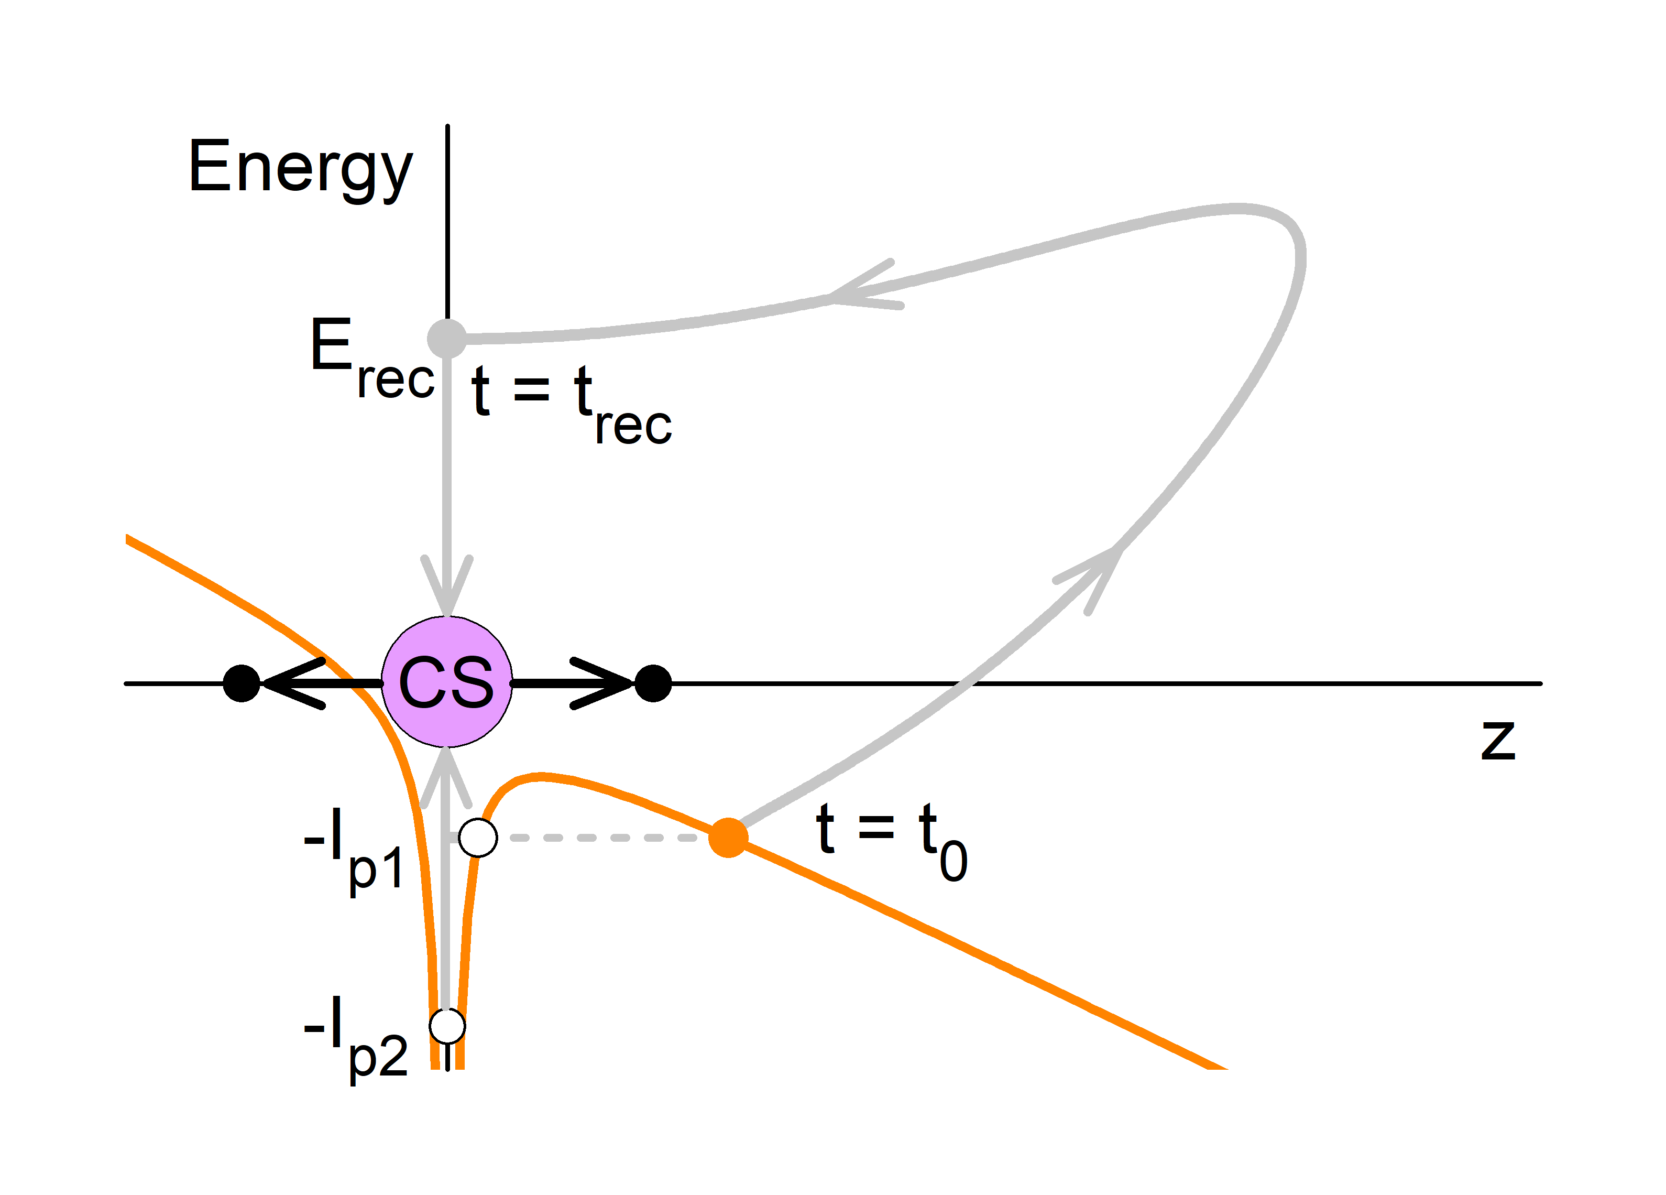
The compound-state model
The CS determines initial conditions for the rest of the NSDI process. Thus, while the TS model is a full-collision model, the CS model is a half-collision one.
We start with the CS of a given energy
$$E_{CS}=E_{rec}−I_{p2}$$
formed at the time of recollision $t_{rec}$ and consider its decay in the laser field.
$E_{CS}$ and $t_{rec}$ are functions of $t_{0}$ which can be determined numerically using the 1D re-collision model, where only the motion of e1 in the field direction is taken into account.

Slide 8
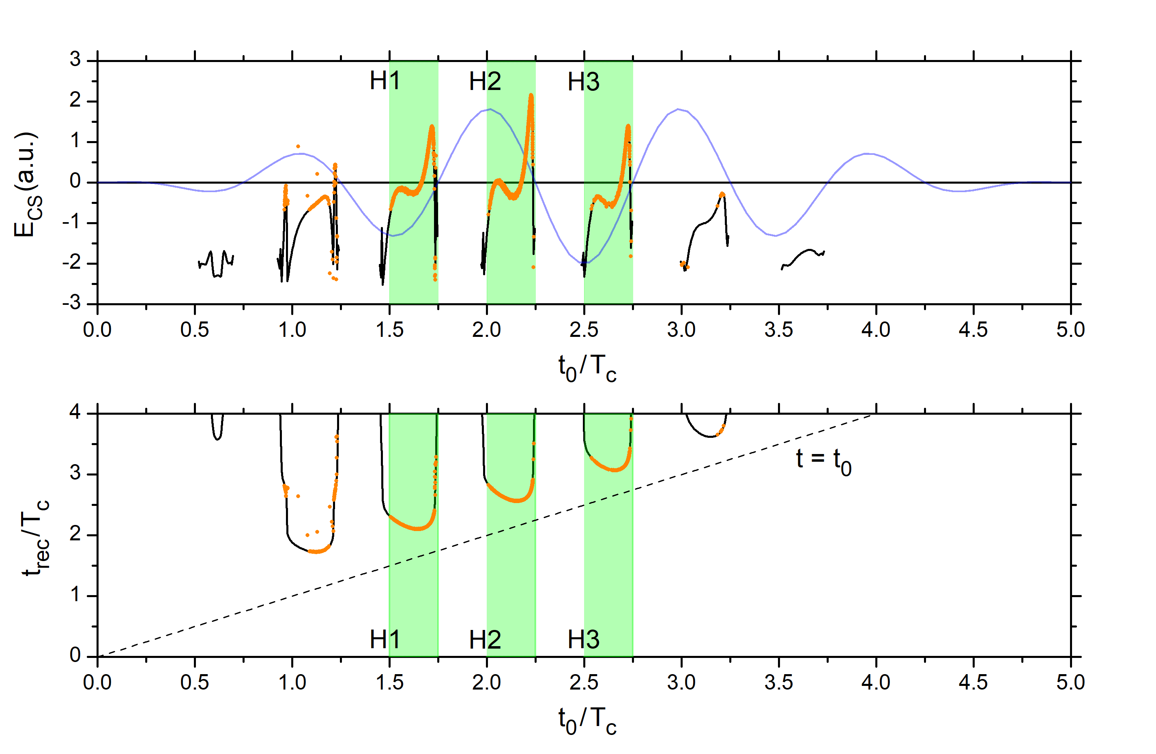
Functions E_{CS} (t₀) and t_{rec}(t₀)
The CS energy (top) and the recollision time $t_{rec}$ (bottom) as functions of $t_{0}$ obtained using the 1D recollision model for the helium atom interacting with the 5-cycle laser pulse. For comparison, the values obtained using the full-collision CTMC 3D calculations (orange) corresponding to NSDI trajectories of the same system.
pulse duration $T_{p}=5T_{c}$
peak intensity $2.5∙{10}^{14}$ W/cm²
wavelength $780$ nm, CEP $φ_{0}=0$

Slide 9
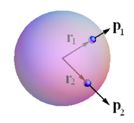
The half-collision CTMC calculations
In the half-collision CTMC calculations of the NSDI we vary randomly the time $t_{0}$, which determines $t_{rec}$ and $E_{CS}$, and the initial positions $r_{1}, r_{2}$ and momenta $p_{1}$, $p_{2}$ (at$t_{rec}$) of the two escaping electrons.
For $r_{1}, r_{2}$ we take randomly chosen points on a sphere of radius $r_{0}∼a_{0}$. The momenta $p_{1}$, $p_{2}$ are directed radially outwards, while their intensities are at first varied randomly in the interval $(0,1)$and then rescaled with the same factor such that
$$\frac{1}{2} \left(p_{1}^{2}+p_{2}^{2}\right)=E_{k}=E_{CS}(t_{0})−V\left(r_{1}, r_{2},t_{rec}(t_{0})\right),$$
where $V\left(r_{1}, r_{2},t\right)=−2/r_{1}−2/r_{2}+1/r_{12}+F(t)(z_{1}+z_{2})$.
CS initial conditions

Slide 10
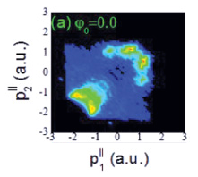
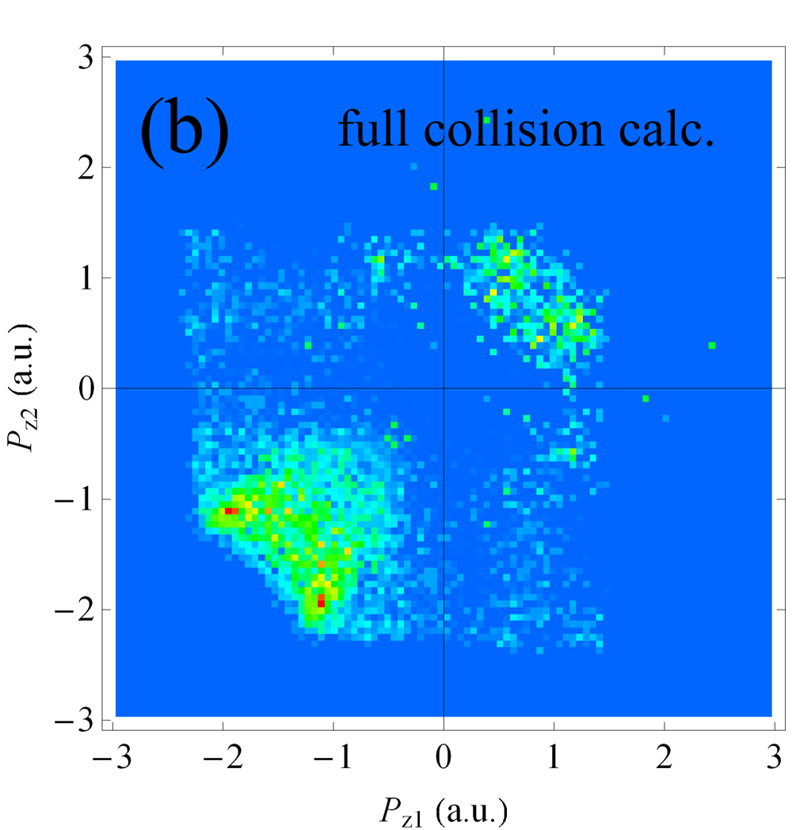
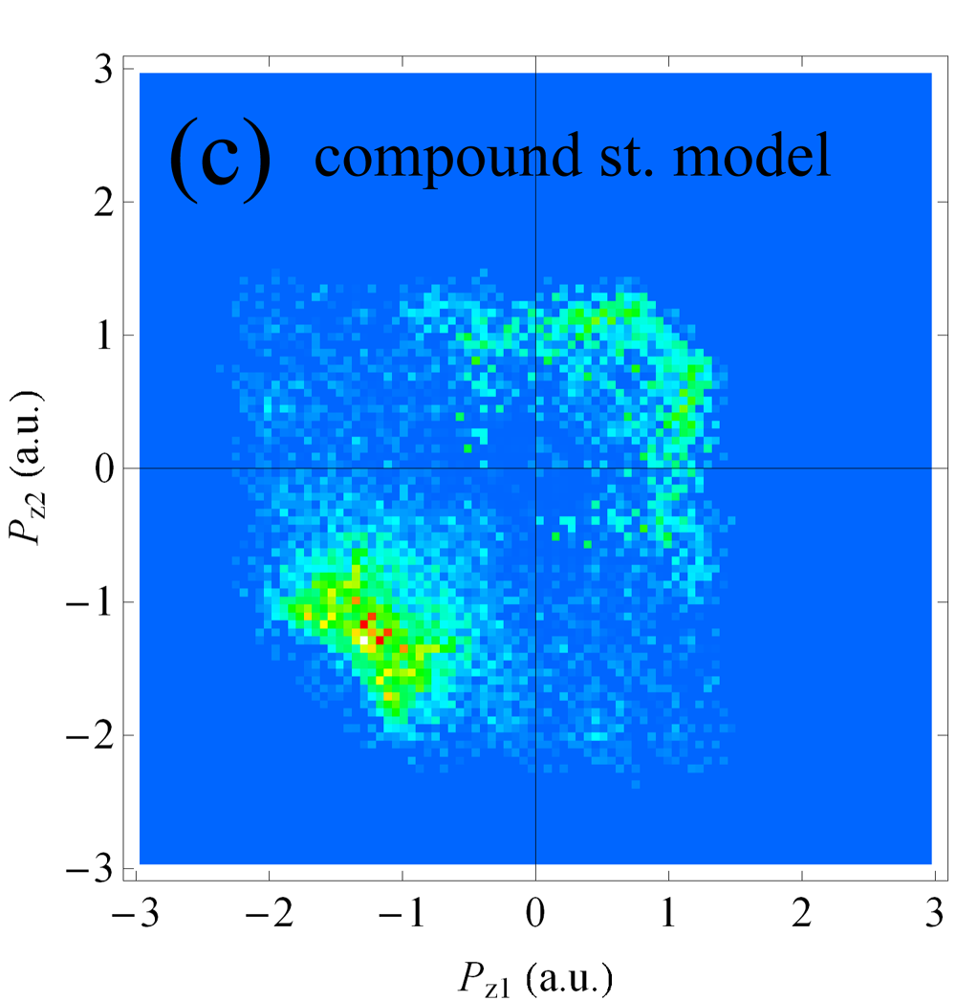
The correlated momentum diagrams
Numerically calculated (CTMC) photoelectron momentum distributions p_{z1}-p_{z2} at the NSDI of helium induced by the laser pulse of 2.510¹⁴ W/cm² peak intensity, 780nm wavelength, 5Tc pulse duration and CEP = 0: (a) Xin et al (FC)¹, (b) present calculations (FC, 10⁶ traj.  10⁴ NSDI traj.) and (c) using the CS (HC) model for r₀ = 0.75 (10⁵ traj.  10⁴ NSDI traj.).
¹ G. G. Xin, D. F. Ye and J. Liu, Phys. Rev. A 82, 063423 (2010)

