Slide 1
Anomalous Josephson effect in $d_{x^{2}−y^{2}}$/F/I/F/$d_{xy}$ juctions
Stevan Djurdjević^{1,2} and Zorica Popović²
¹University of Montenegro, Faculty of Natural Sciences and Mathematics, Montenegro
²Faculty of Physics, University of Belgrade, Serbia
BPU11, 28.8.-1.9.2022.

Slide 2
Model and formalism
We use Stoner model for ferromagnets. $h_{1,2}=h_{1,2}\left(0, \sin{α_{1,2}},\cos{α_{1,2}}\right)$
$$α=α_{1}−α_{2}$$
Pair potential is:
$$∆\left(r,θ\right)=∆_{L}\left(θ\right)e^{iφ_{L}}Θ\left(−x\right)+Δ_{R}\left(θ\right)e^{iφ_{R}}Θ\left(x−d_{1}−d_{2}\right)$$
$∆_{L}\left(θ_{±}\right)=Δ\left(T\right)\cos\left(2θ∓2β_{L}\right)$ $∆_{R}\left(±\right)=Δ\left(T\right)\cos\left(2θ∓2β_{R}\right) Δ\left(T\right)=1,74\sqrt{T_{c}/T−1}$
$θ_{+}=θ$ for ELQ
$θ_{−}=π−θ$ for HLQ
$φ_{L,R}$ are macroscopic phases in two superconductors.

Slide 3
Model and formalism
Bogoliubov-de Gennes (BdG) equations:
$$\left(\begin{matrix}H_{0}−h_{z} & −h_{x}+ih_{y} & 0 & ∆(r,θ) \\ −h_{x}−ih_{y} & H_{0}+h_{z} & ∆(r,θ) & 0 \\ 0 & ∆^{∗}(r,θ) & −H_{0}+h_{z} & −h_{x}−ih_{y} \\ ∆^{∗}(r,θ) & 0 & −h_{x}+ih_{y} & −H_{0}−h_{z}\end{matrix}\right)\left(\begin{matrix}u_{↑}(r,θ) \\ u_{↓}(r,θ) \\ v_{↑}(r,θ) \\ v_{↓}(r,θ)\end{matrix}\right)=E\left(\begin{matrix}u_{↑}(r,θ) \\ u_{↓}(r,θ) \\ v_{↑}(r,θ) \\ v_{↓}(r,θ)\end{matrix}\right)$$
Since the translational invariance is satisfied: $Ψ\left(r\right)=ψ(x,θ)e^{ik_{y}y}$
$$ψ\left(x,θ\right)={\left[u_{↑}\left(x,θ\right), u_{↓}\left(x,θ\right), v_{↑}\left(x,θ\right), v_{↓}(x,θ)\right]}^{T}$$
Boundary conditions:
${\left.ψ\left(x,θ\right)\right|}_{x_{i}+0}={\left.ψ\left(x,θ\right)\right|}_{x_{i}−0}=ψ\left(x_{i},θ\right)$
$${\left.\frac{dψ\left(x,θ\right)}{dx}\right|}_{x_{i}+0}−{\left.\frac{dψ\left(x,θ\right)}{dx}\right|}_{x_{i}−0}=Z_{i}k_{F}^{\left(S\right)}ψ\left(x_{i},θ\right)$$
$Z_{i}$ - measure of non transparency of interfaces between layers
$Z_{1}=Z_{3}=0$ and $Z_{2}=0$ or 3

Slide 4
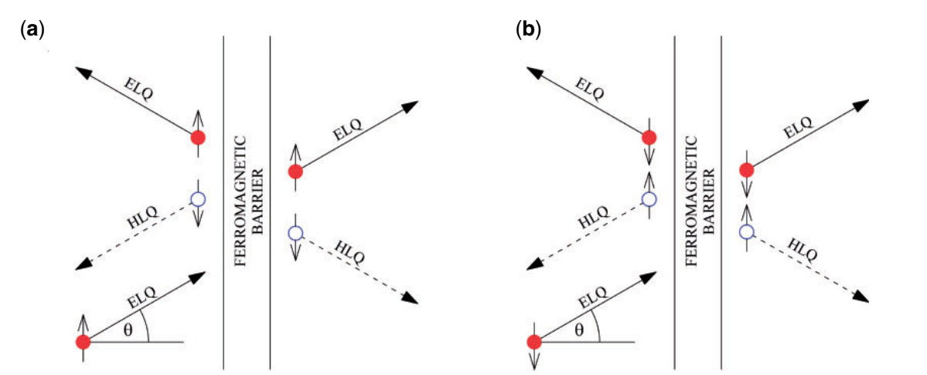
Model and formalism
Shematic illustration of reflection and transmission at the ferromagnetic barrier of ELQ injected from the left superconductor for spin-up (a) and spin-down (b) projection.
S. Djurdjević and Z. Popović, Progres of Theoretical and Experimental Physics 2021, 083I02 (2021).

Slide 5
Model
Josephson current can be evaluated by using temperature Green function formalism:
$$I\left(φ\right)=\frac{eℏk_{B}T}{2im}\lim_{x′→x}\left(\frac{∂}{∂x′}−\frac{∂}{∂x}\right)\sum_{ω_{n}}{TrG_{ω_{n}}(x,x′)}$$
Final formulae for calculating current-phase relation in these kind of junctions is
$$I\left(φ\right)=−\frac{ek_{B}T}{2ℏ}\sum_{ω_{n},σ,k_{y}}{\left(\frac{a_{nσ}}{2Ω_{L+n}}\left|Δ_{L}(θ_{+})\right|\frac{k_{L−n}+k_{L+n}}{k_{Fx}}−\frac{{\tilde{a}}_{nσ}}{2Ω_{L−n}}\left|Δ_{L}(θ_{−})\right|\frac{{\tilde{k}}_{L−n}+{\tilde{k}}_{L+n}}{k_{Fx}}\right)}$$
$a_{σ}$ and ${\tilde{a}}_{σ}$ - Andreev reflection amplitudes
$k_{L±}$ and ${\tilde{k}}_{L±}$-$x$ components of wave vectors in left superconductor
$k_{L±n}$, ${\tilde{k}}_{L±n}$, $a_{σn}$, and ${\tilde{a}}_{σn}$ are obtained by the analytical continuation $E→iω_{n}$ from $k_{L±}, {\tilde{k}}_{L±}, a_{σ}$ and ${\tilde{a}}_{σ}$.
$$k_{L±}=k_{F}\cos{θ}±\frac{mΩ_{L+}}{ℏ^{2}k_{F}\cos{θ}} k_{L±}=k_{F}\cos{θ}±\frac{mΩ_{L−}}{ℏ^{2}k_{F}\cos{θ}}$$
$$Ω_{L±}=\sqrt{E^{2}−{\left|∆_{L}(θ_{±})\right|}^{2}}$$

Slide 6
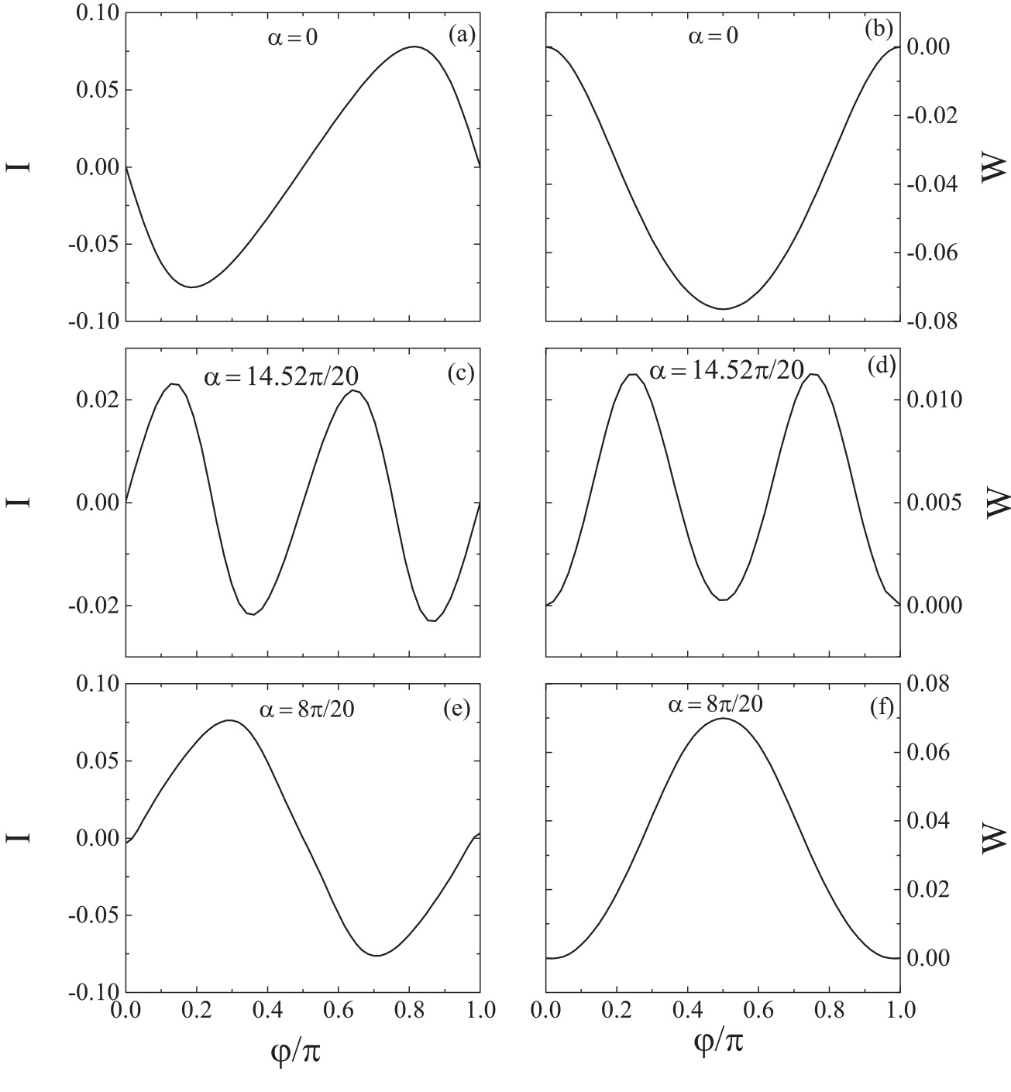
$$\sim \sin{(−2φ)}$$
Phase diagram in ($α,d$) space of parameters for junction $d_{x^{2}−y^{2}}$/F/F/$d_{xy}$ at $T/T_{c} =$0.1 and $h/E_{F}$=0.1.
The lines formed by scatters separate the parameters areas for witch we have stable $π/2$ state of junction and coexistence of $0$ and $π$ states.
For values of parameters from red lines there are triplets of stable states $0$, $π/2$ and $π$. The CPR is almost four harmonic.
$$\sim \sin{(4φ)}$$
$\sim \sin{(2φ)}$
S. Djurdjević and Z. Popović, Progres of Theoretical and Experimental Physics 2021, 083I02 (2021).

Slide 7
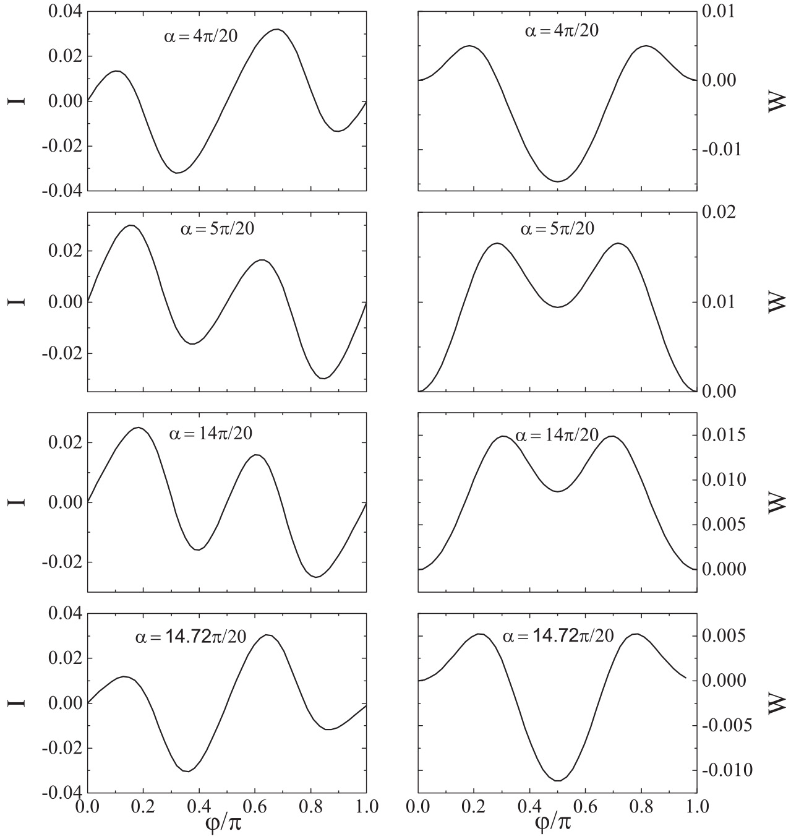
Shaded zones around semicircles present the area of parameters where stable and metastable states can coexist.

Slide 8
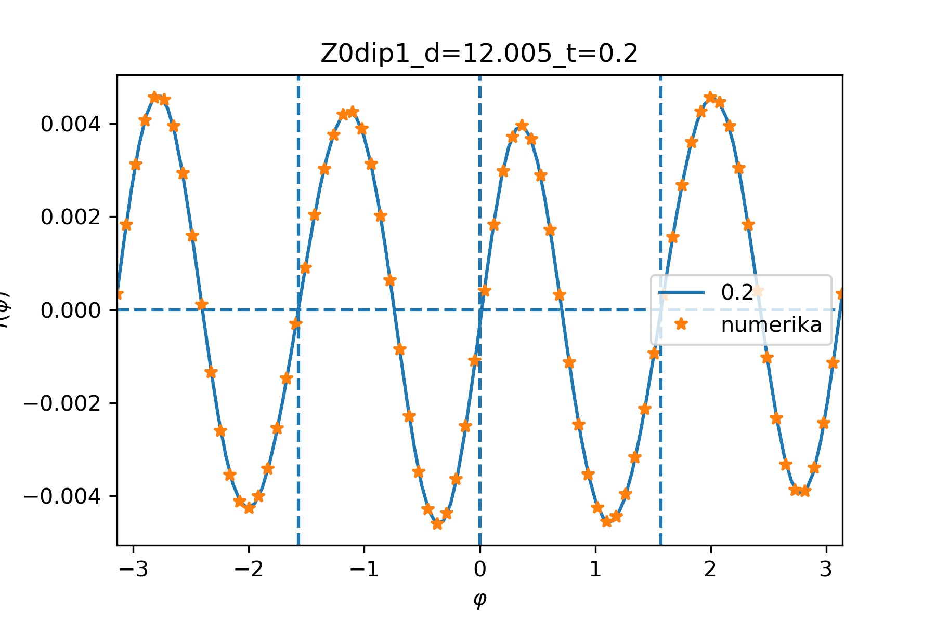
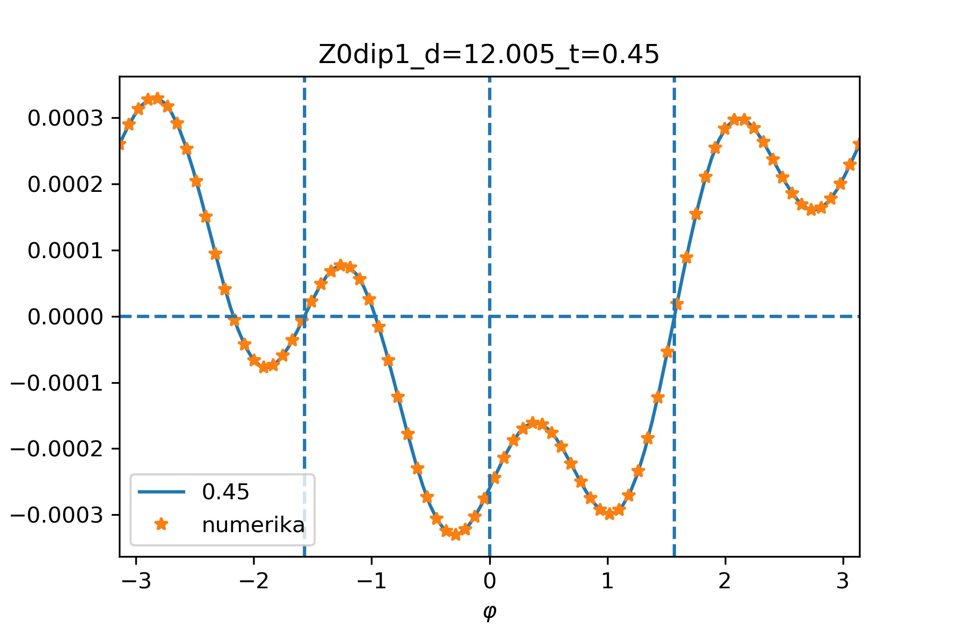
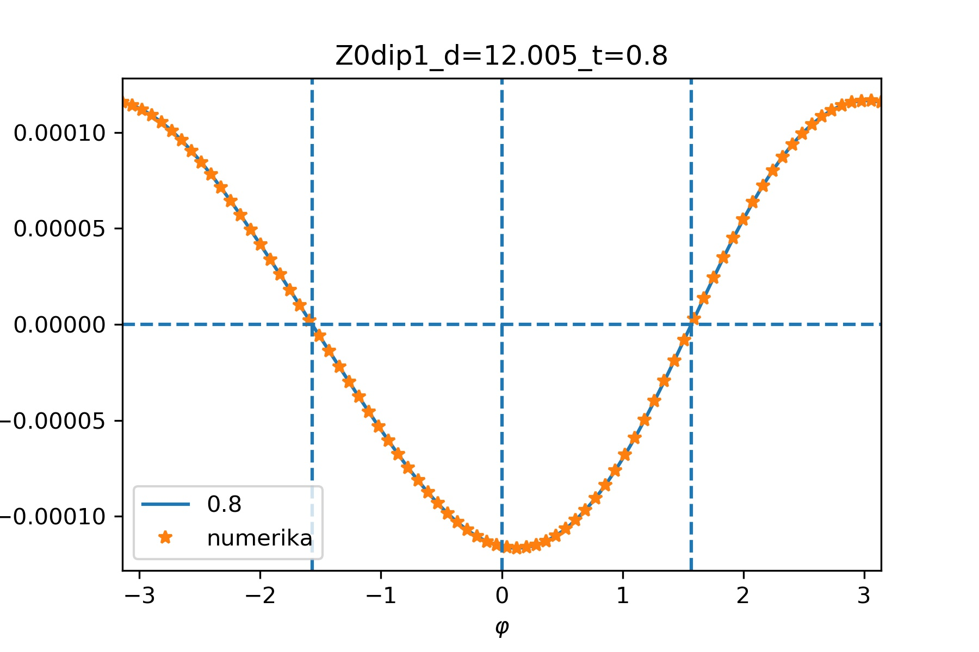
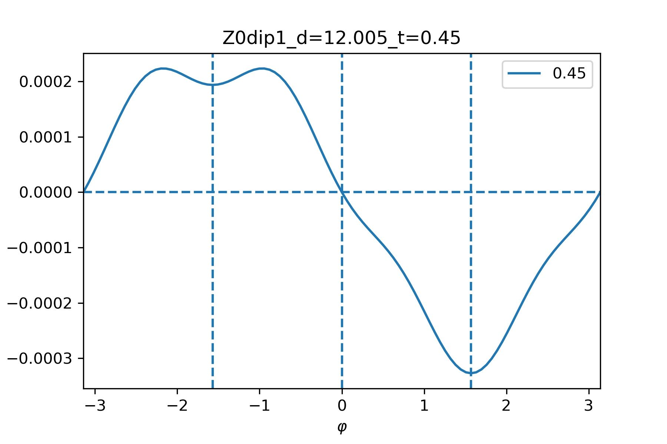
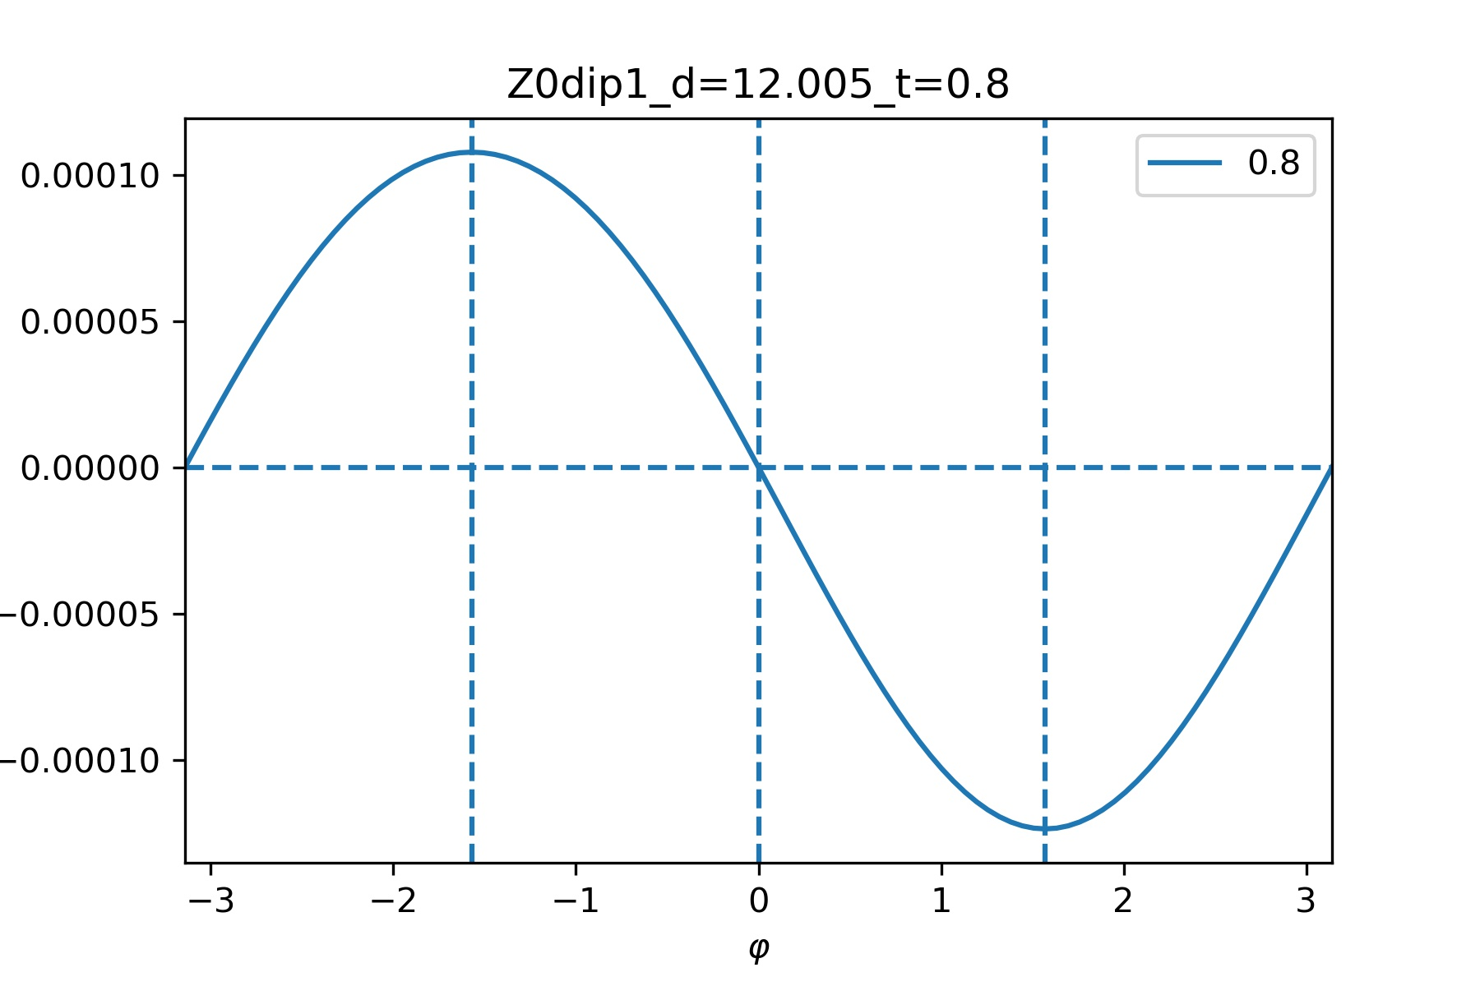
What happens on higher temperatures? CPRs
Anomalous Josephson current appears, $I\left(φ=0\right)≠0$ . Free energies

Slide 9
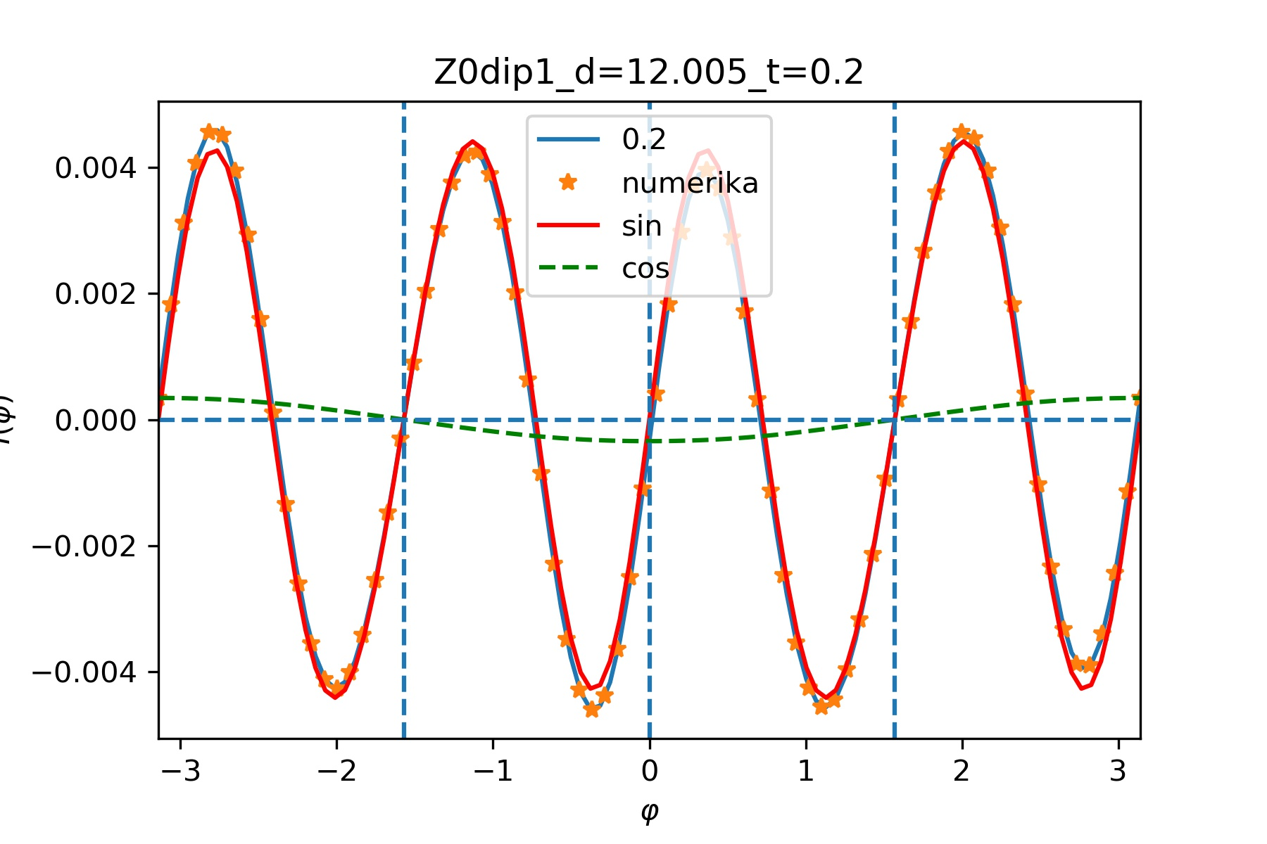
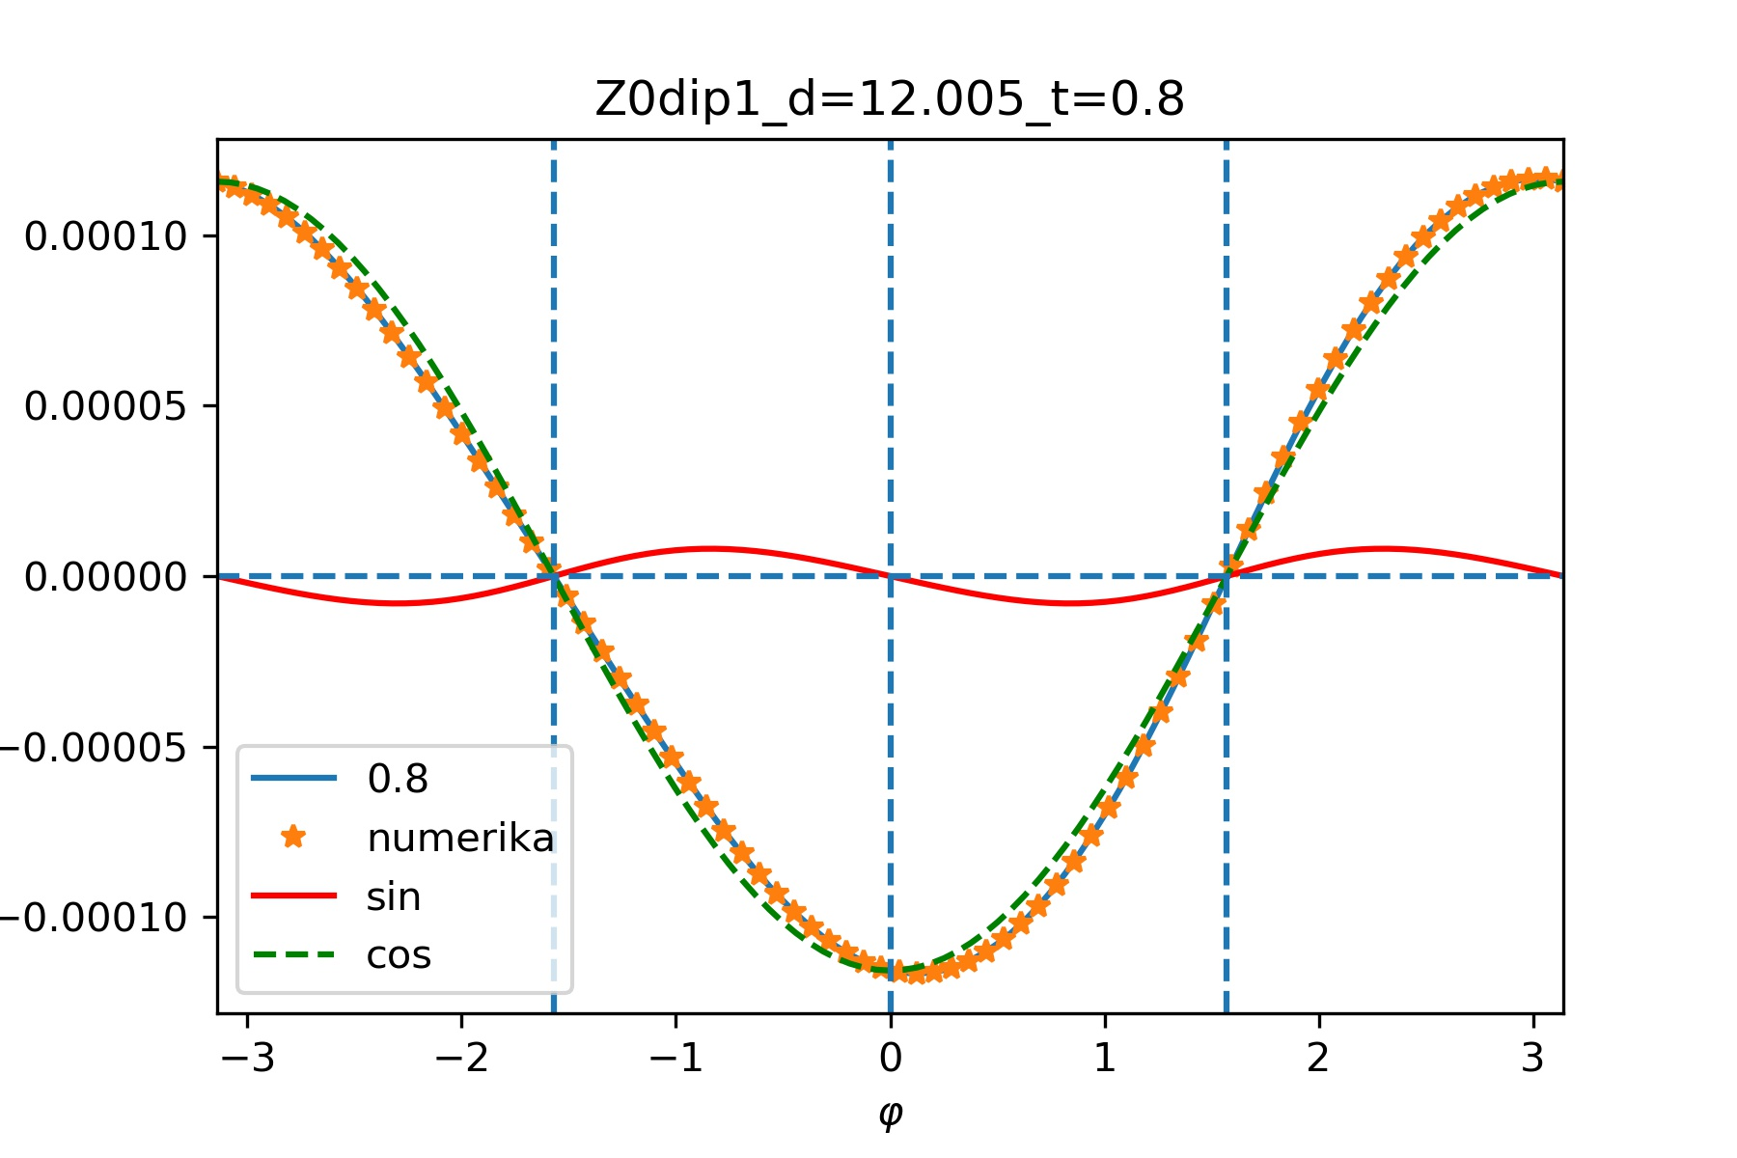
To analyze CPR we decompose the Josephson current
into a series of different orders of Josephson coupling:
$$I\left(φ\right)=\sum_{n}{I_{n}\sin{(nφ)}+J_{n}\cos{(nφ)}}$$
where $n≥1$ is an integer.
In the $d_{x^{2}−y^{2}}$/F/$d_{xy}$ junction we find that $I\left(φ\right)$ becomes zero in $φ=±π/2$. And then
$$I\left(φ\right)=\sum_{k}{I_{2k}\sin{(2kφ)}+J_{2k−1}\cos{((2k−1)φ)}}$$
for $k≥1$.
On higher temperatures component proportional to $\sum_{k}{\cos{((2k−1)φ)}}$ is generated and gradually becomes dominant.

Slide 10
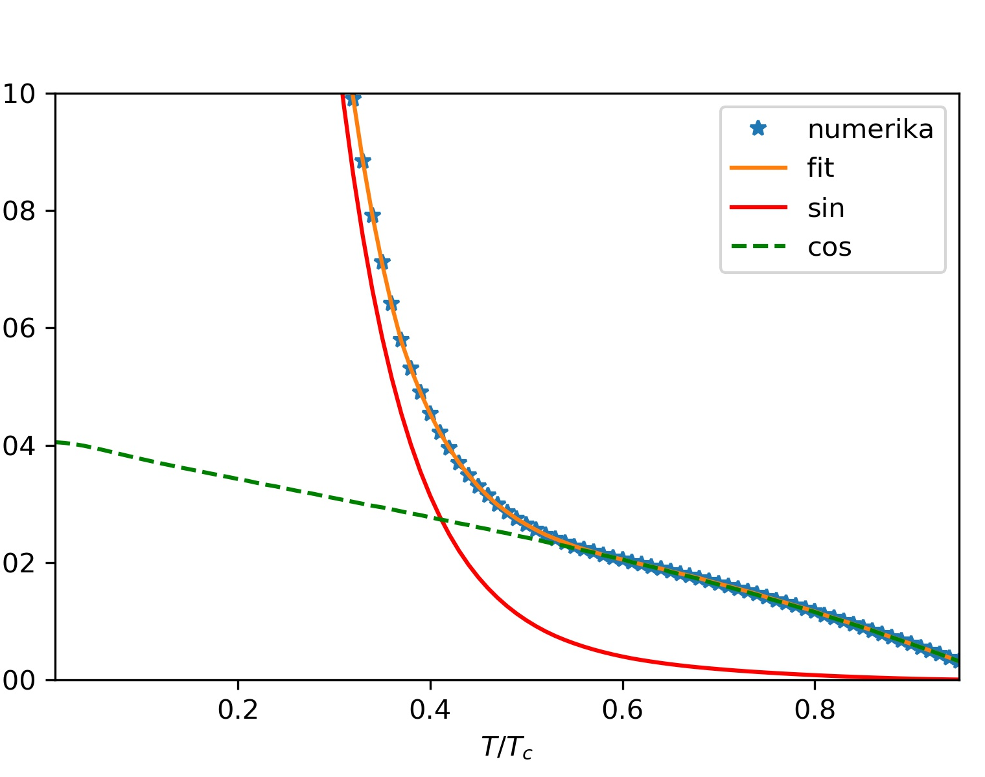
Critical current ($I_{c}=\max_{φ}{|I(φ)}$| ) vs temperature.
In $d_{x^{2}−y^{2}}$/F/$d_{xy}$ junction with high transparency ($Z=0$) of interface between two ferromagnets there is no phase transition induced by temperature.

Slide 11
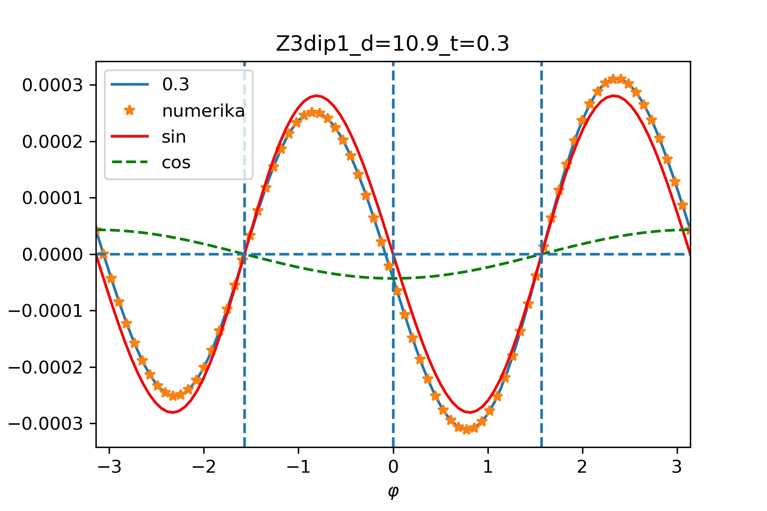
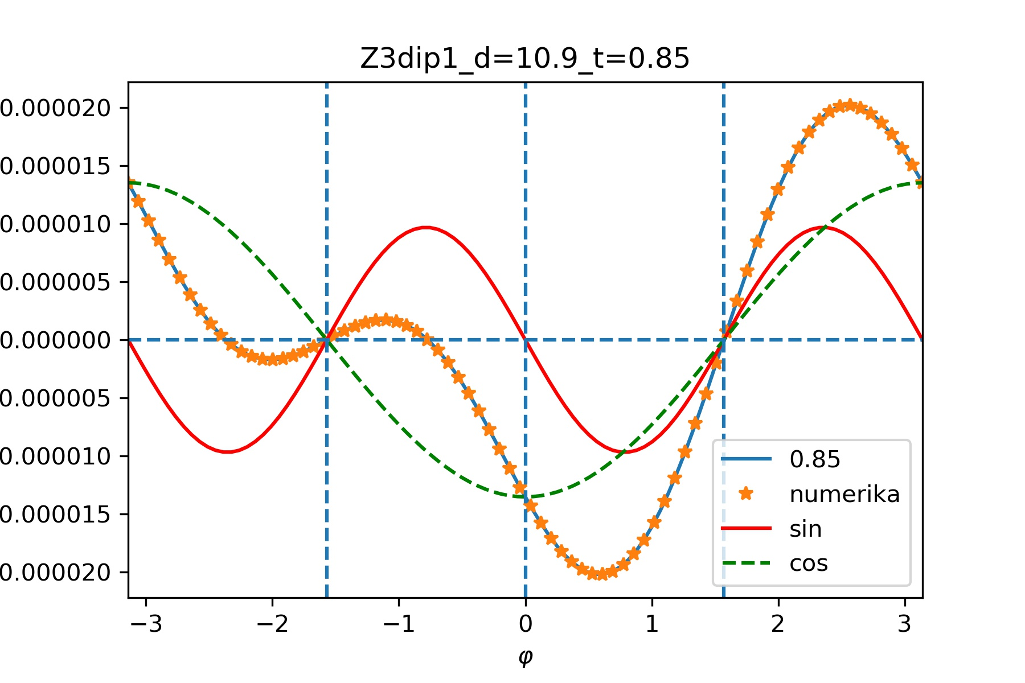
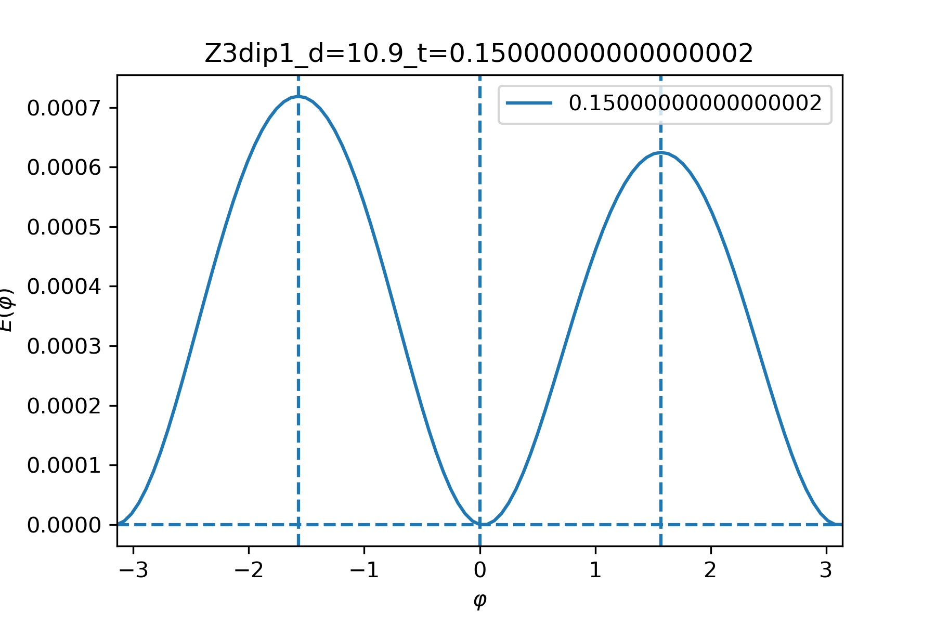
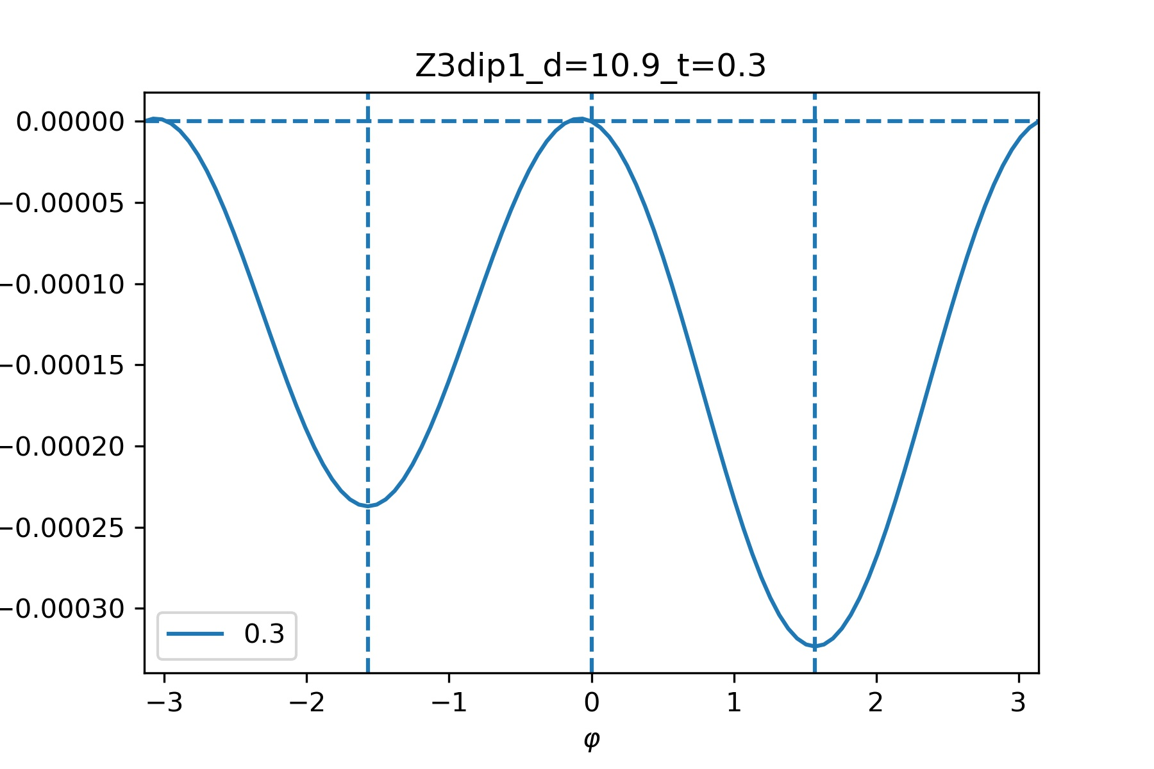
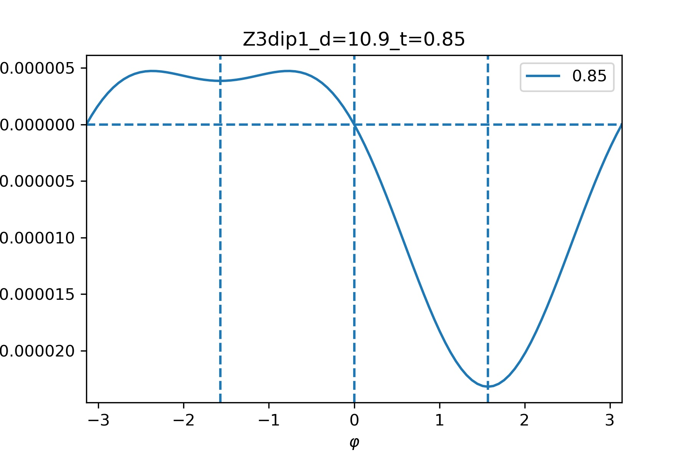
$Z=3$ CPRs
Free energies

Slide 12
To try to explain anomalous CPR in $d_{x^{2}−y^{2}}$/F/$d_{xy}$ junction we focus on symmetry of Hamiltonian. We consider the mirror reflection with respect to $xz$-plane $M_{xz}=iσ_{x}τ_{0}$ and time-reversal symmetry $T=−iσ_{y}Kτ_{0}$. $K$ is the complex-conjugation operator.
Both of these symmetries are broken.
Since the pair potential of $d_{x^{2}−y^{2}}(d_{xy}$) is mirror even (odd) with respect to $xz$-plane, $M_{xz}$ operation produces additional phase
$I\left(φ\right)→I\left(φ+π\right)$.
Time-reversal operation transforms $I\left(φ\right)→−I\left(−φ\right).$
The composition operator ${Q=M}_{xz}T$ will give $I\left(φ\right)→−I(−φ+π)$.
$I\left(φ\right)=−I(−φ+π)$ will be satisfied at any $φ$ if we consider the junction of mirror even and mirror odd pair potential.
Here we see temperature induced phase transition from coexistence of $0$ and $π$ state of junction to $π/2$ state.
This is due to finite transparency of interface between two ferromagnetic layers.

Slide 13
Thank you for your attention!

