Slide 1
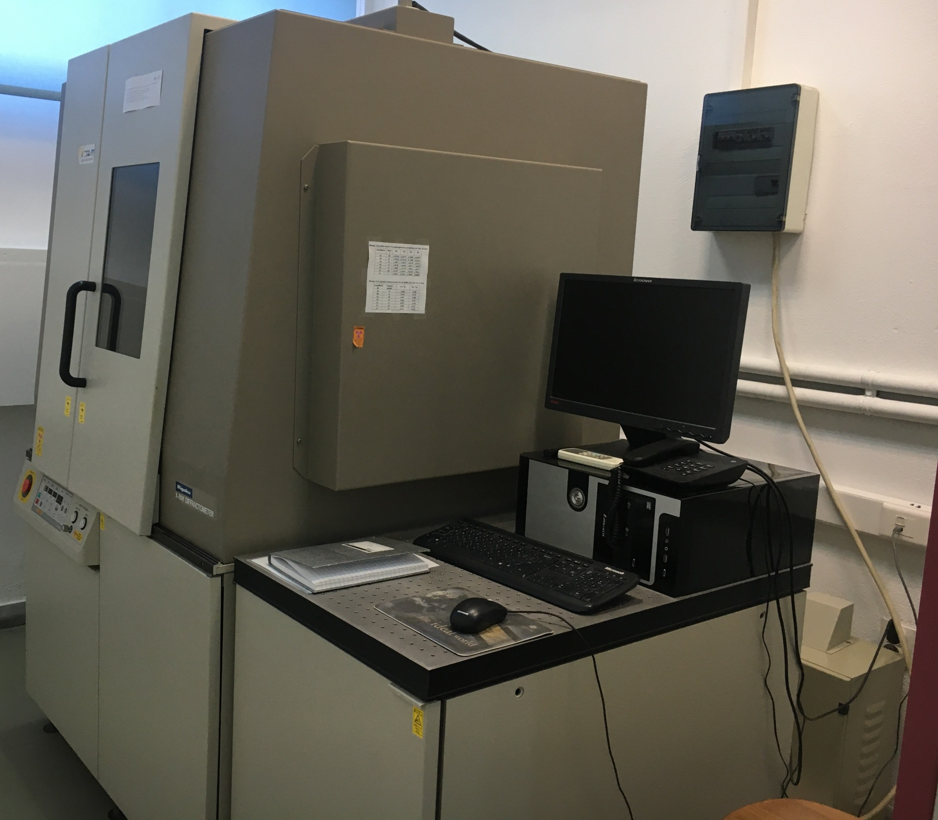
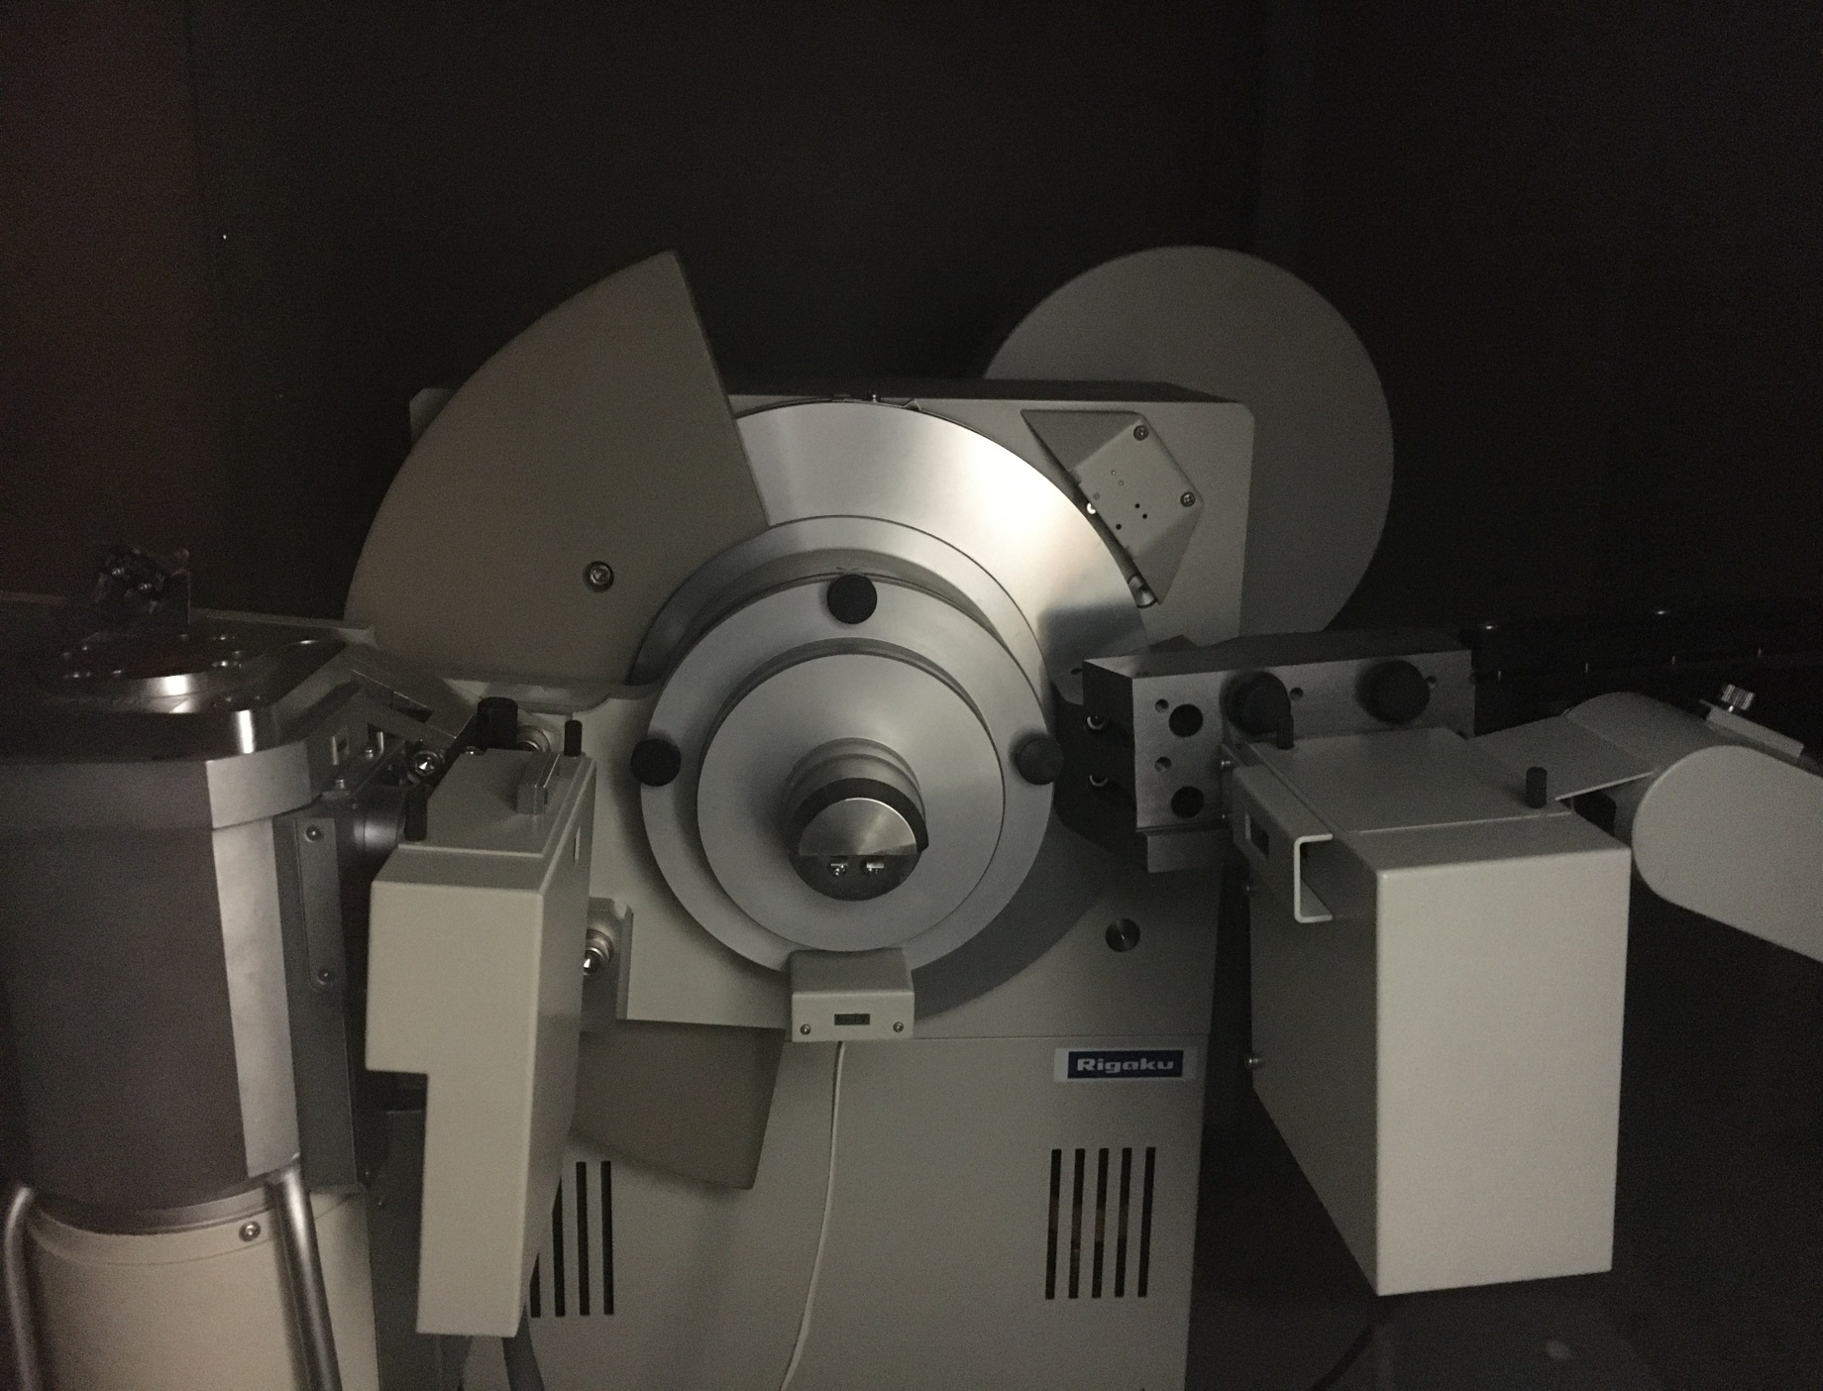
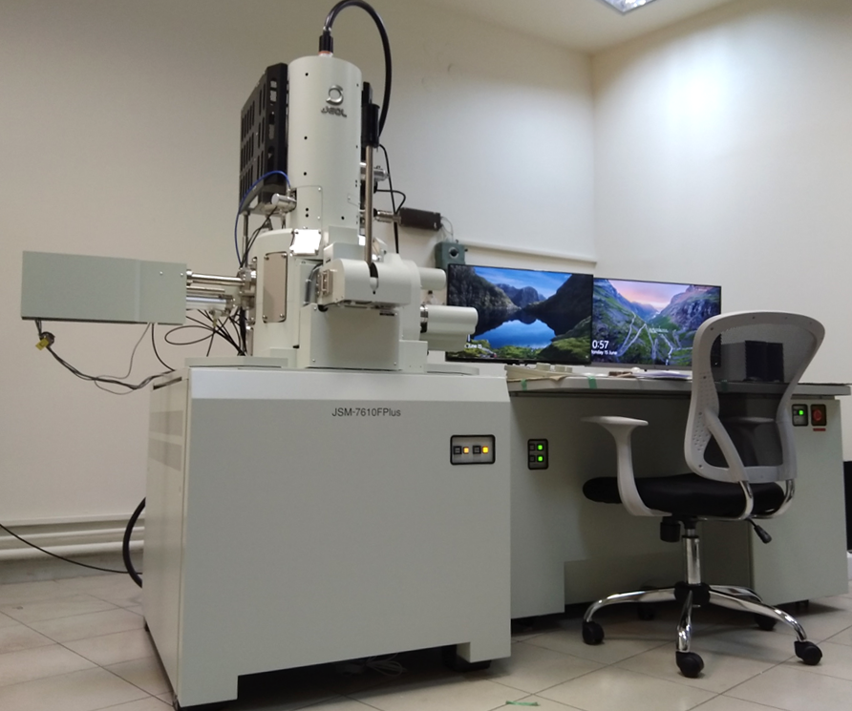
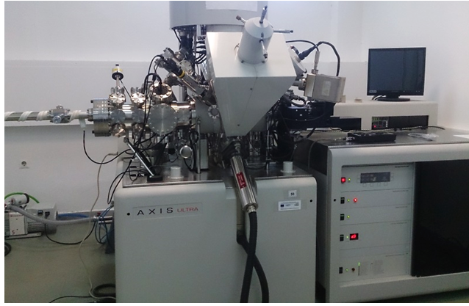
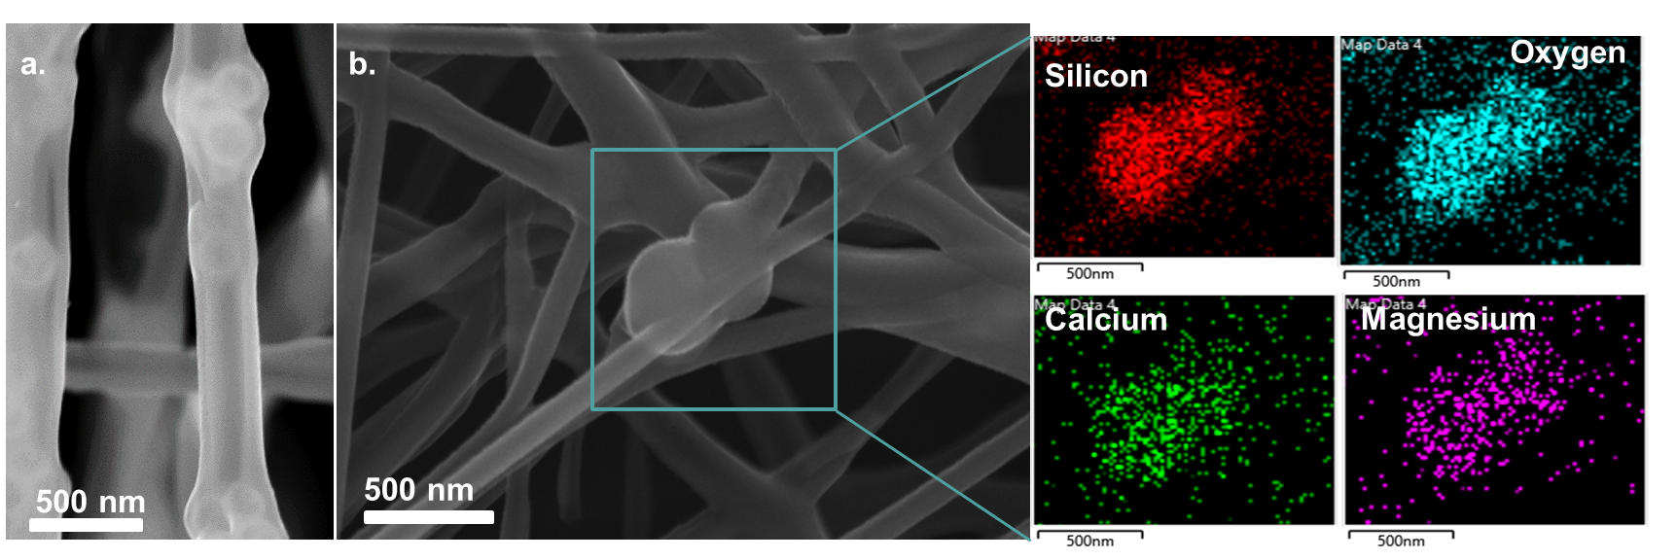
BPU11 CONGRESS
11th International Conference of the Balkan Physical Union 28 August – 1 September 2022, Belgrade, Serbia
Rigaku Ultima⁺ XRD
JEOL JSM-7610F Plus SEM
Kratos Axil Ultra DLD XPS
Characterization of advanced technological materials using X-ray techniques and SEM
Abstract
Characterization of advanced materials using X-rays and Imaging techniques is considered crucial towards the understanding of their structural and chemical properties as well as their potential usage. In particular, X-rays diffraction (XRD), X-ray Photoelectron Spectroscopy (XPS) and Scanning Electron Microscopy (SEM) are widely used material characterization methods which provide essential knowledge and in depth analysis regarding the surface, structural and chemical properties of the materials and open the possibility for new material related technological advances.
X-ray Diffraction (XRD)
In-depth Characterization (Bragg-Brentano Geometry)
Crystalline phase identification
Particle size analysis
Strain evaluation
Composition quantification (Rietveld analysis)
Multilayer structure detection
X-ray Photoelectron Spectroscopy (XPS)
Surface Characterization (Depth from which information is obtained ~10 nm)
Elemental analysis
Elemental quantification
Spin orbit and multiplet splitting
Shake-up and plasmon losses
Auger spectroscopy
Valence band analysis
Elemental spectroscopic imaging
Depth Profile Elemental Analysis
Fig. 2.Identifying the formation of NiAl2O 4 from Ni/Al2O4 pounder. Spinel and NiO percentages were calculated using Rietveld analysis indicating the amount of Ni incorporated in the alumina structure. NiO particle size was also calculated using Scherrer analysis.
Scanning Electron Microscopy (SEM)
High Resolution Imaging (Theoretical Max. Resolution ~0.7 nm)
EDX Surface Characterization
Elemental analysis
Elemental quantification
Mapping
Fig. 1.Identifying the oxidation state of Ni on the surface of a zeolite using XPS. Three different Ni oxidation states and the 2p spin orbit split is shown .
Fig. 3. High resolution imaging and EDX mapping of bioactive polymer membranes reinforced with SiO2CaOMgO nanoparticles for osteogenesis and angiogenesis
Authors
Dr. Evangelia Delli, evdelli@physics.auth.gr
Prof. Pavlidou Eleni, elpavlid@auth.gr
Prof. George Vourlias, gvourlia@auth.gr
Web link
http://amdelab.physics.auth.gr/
index-en.htm

