Slide 1




Quantum Computing Challenges for Transition Dynamics in Atomic and
Systems
Predrag S. Krstić^{1,2} & Yulun Wang¹
¹Institute for Advanced Computational Science, Stony Brook University, NY 11794-5250, USA
²TheoretiK Consulting, Port Jefferson, NY 11776-3403, USA

Slide 2
Outline
Introduction: What is Quantum Computing (QC)?
Multistate transition dynamics by a strong time-dependent perturbation in NISQ era
Collisional S-matrix for the vibrational dynamics of H+H₂ including dissociative processes by quantum computing
Conclusions

Slide 3
I. What is Quantum Computing?

Slide 4
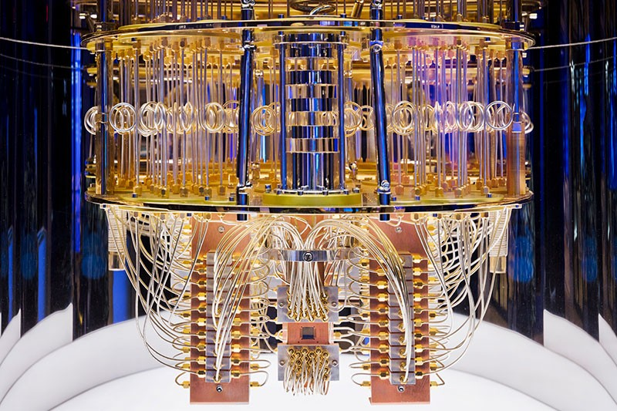
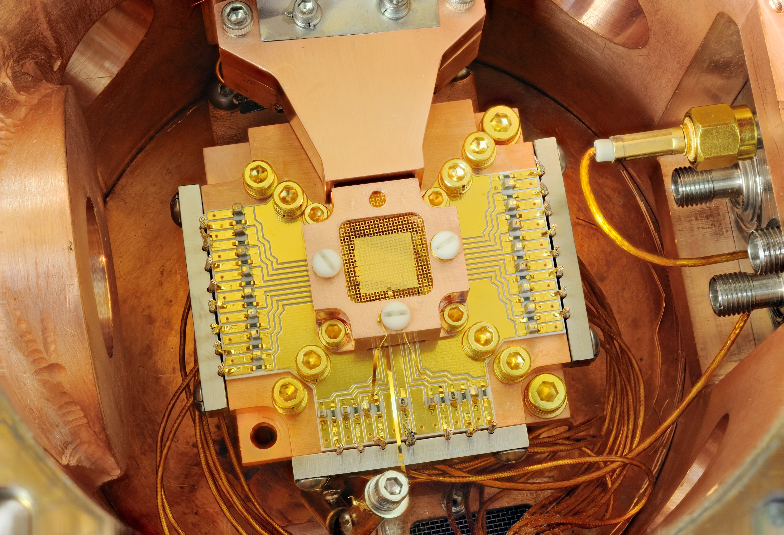
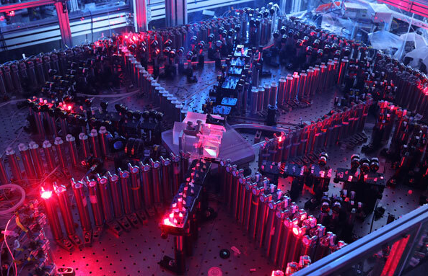
What is computing?
A physical process that is performed on a machine
whose operation obeys certain physical laws.
In Quantum Computing machines are:
Superconducting
Trapped ion
Photonic
IBM-Q, Rigetti
Ion-Q
QuiX

Slide 5
The classical theory of computation is based on an abstract model of universal machine, the Universal Turing Machine (1936):
Theoretical machine which idealizes a mechanical computational device which obeys the laws of classical physics, and which can be used to compute any computable sequence or algorithm.
It contains:
*I/O unit that feed the computer with data,
*known set of commands,
*memory and storage space,
*processing units,
*I/O unit can write desired data output.

Slide 6
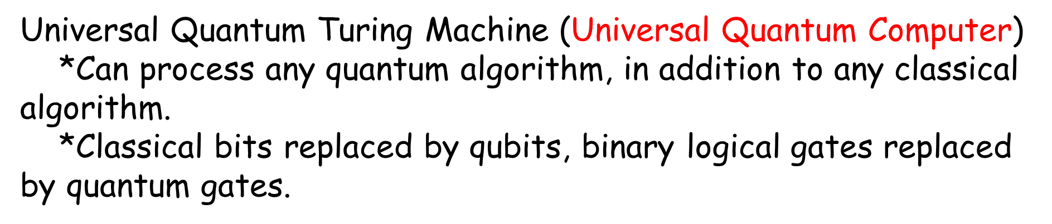
When problems are too complex, and time is a factor:

Slide 7
Principles of Quantum Mechanics
where QC starts

Slide 8
The three fundamental, and not very intuitive phenomena of the quantum theory are foundation of quantum computation:
The principle of superposition of states,
The principle of measurement,
The phenomenon of entanglement.

Slide 9
Superposition: The ability of a quantum system to be in multiple states at the same time
For any two states |yellow> and |blue>, there is state |yellow> +|blue> , which sometimes appear as |yellow> or as |blue>, but never as green; this uncertainty is in the hart of QM…
And is resolved by observation (measurement) which projects the state into one of the eigenstates (yellow or blue) of a property, with some probability :
Collapse of the Wave function.
Quantum parallelization: From the ability of a quantum memory register to exist in a superposition
of base states
Quantum interference: Consequence of addition of probability amplitudes

Slide 10
Entanglement of two systems 1 and 2 means that the values of certain properties of 1 are correlated with the values of the same properties of 2. The properties are correlated even if 1 and 2 are spatially separated!
If each of the quantum systems 1 and 2 can be in a particular state yellow or blue, the compound system could be in superposition state |1-yellow>|2-yellow>+|1-blue>|2-blue>
If observe 1 and find the result yellow, the product state has collapsed in |1-yellow>|2-yelow>, the second state is yellow, no need for additional measurement.
If |1> is in one spatial region and |2> in another, distant one, (let’s say Belgrade and NYC) and these are entangled, measurement will collapse it to one region –and we will know the color of another one immediately, irrespectively of distance => non-locality: The system is in indeterminate state, which is both yellow and blue, both in BG and NYC, simultaneously. The result of observation is uncertain in advance and can be determined statistically by measurement!
This removes meaning of “local realism” from quantum particles, which was wrongly believed that:
Locality: Measurement of particle 1 in no way disturbs the state of spatially separated particle 2.
Realism: The values of measurable properties of each particle are objectively real. They have definite values prior to measurement and regardless of whether they are observed.

Slide 11
“Objective" obstacles of QC:
A natural idea to observe how the machine works fails because of the famous Schrodinger's cat paradox: one cannot look at a quantum system without stopping its quantum behavior.
If we measure an arbitrary qubit which is in a superposition of |0> and |1> - we get either 0 or 1. The information on intermediate states is lost in the process of measurement, and even worse, almost all observables are value indefinite, that is, they do not have a value before measurement .

Slide 12
How are Quantum Computers Different
than Classical Ones ?

Slide 13
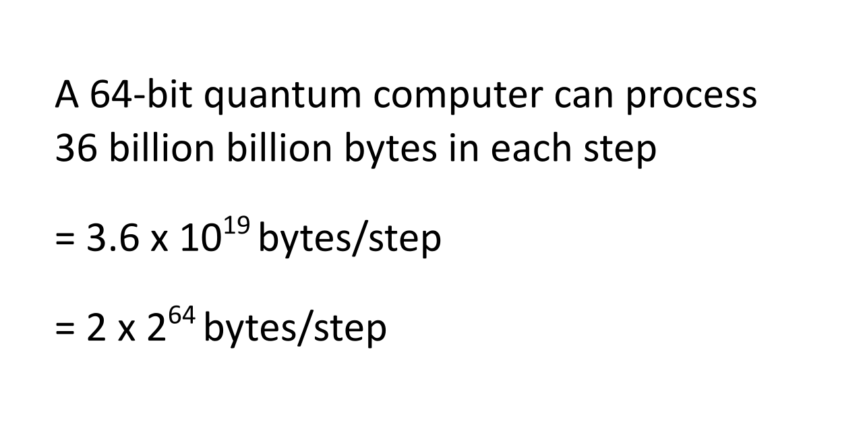
The classical 64-bit computer can process 8 bytes in a
single step.

Slide 14
Quantum bits (qubits)
What is a qubit?
A mathematical object that can be in any linear superposition of states |0> and |1>
Computational basis
and β are complex numbers, while |0> and |1> are called computational basis states, and are orthonormal basis for this
2-dimensional complex vector space.
When measure (observe) qubit we can either get |0> with probability or |1> with probability
Thus, and qubit is a unit vector in a 2-dimensional complex vector space.

Slide 15
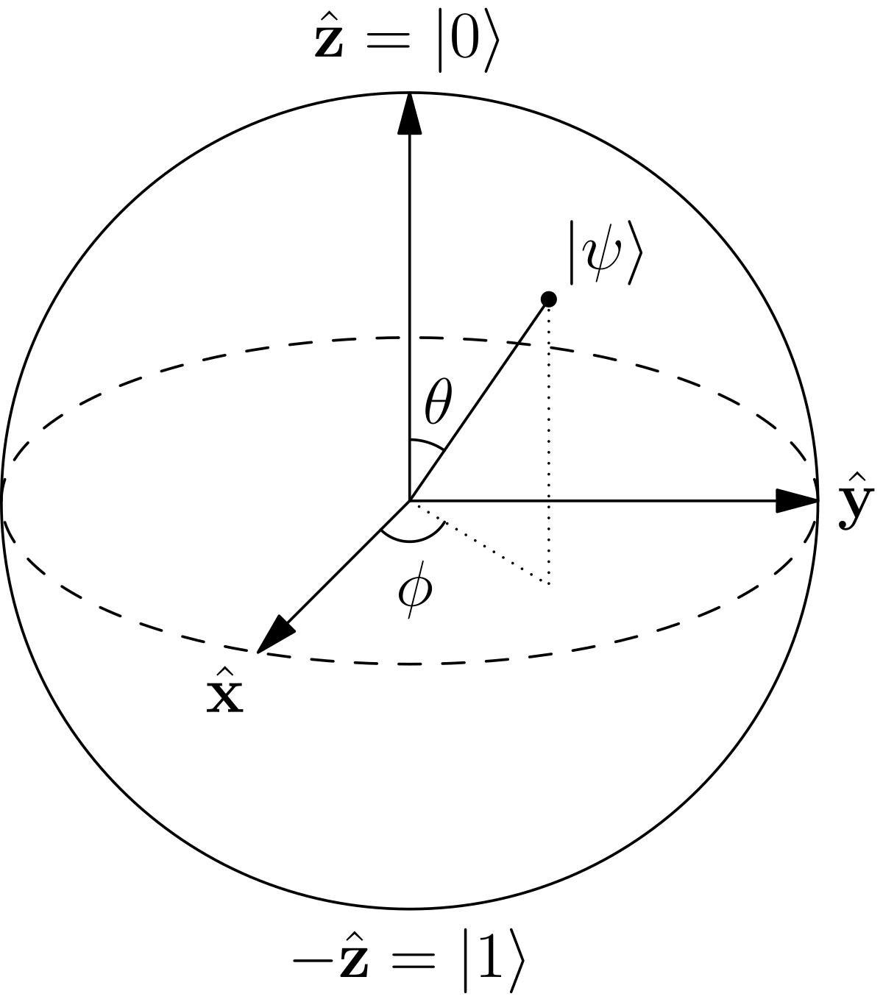
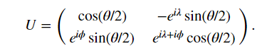
Geometrical interpretation of qubits
Overall phase of a quantum state has no observable effect, can be
Omitted
Examples: θ=0 -> |0>, θ=π -> |1>
What are quantum gates?
Unitary operations U over qubits.
What is an unitary operation?
The one for which
Bloch sphere

Slide 16
Multiple qubits
How many states can we make of two classical bits? Answer is four, these are 00, 01, 10, 11.
Two qubit system has 4 computational basis states |00>, |01>, |10>, |11>. However, a pair of qubits can exist in
superposition of these state: The quantum state of two qubits involves 4 complex coefficient (amplitudes) ,
creating a vector
Measurement results in one of x=00, 01, 10 and 11 states with probability and normalization condition
(0,1)² is notation for string containing 0’s and 1’s of length 2.
One can measure just one qubit and probability that it is for example |0> is and post measurement state
after measuring |0> at first qubit shows the system collapses into a normalized state
If have a system of n-qubits, the computational basis states are of the form where x’s are combinations
of all 0’s and 1’s. How many of these are there? It is the number od combinations with repetition of the 2nd class
(combinatorial analysis) i.e. 2^{n} . For N a few hundreds this is a huge number., which is in heart of huge potential of quantum
computing.

Slide 17
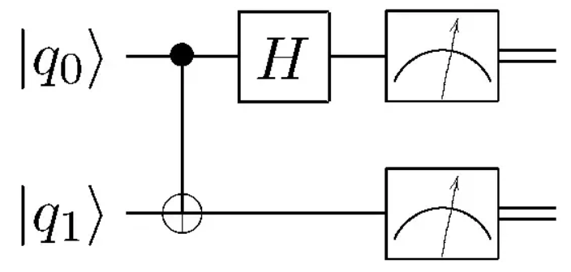
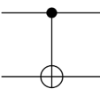
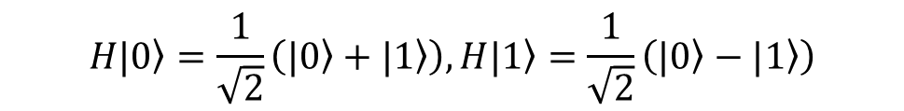
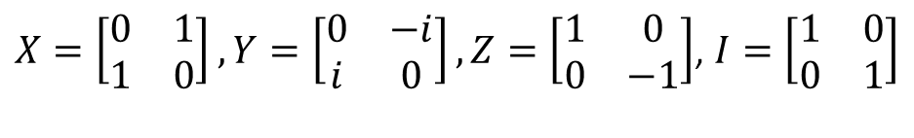
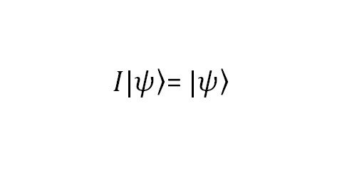
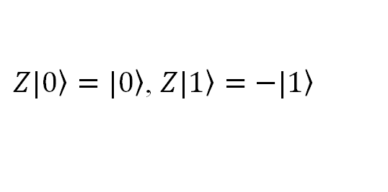
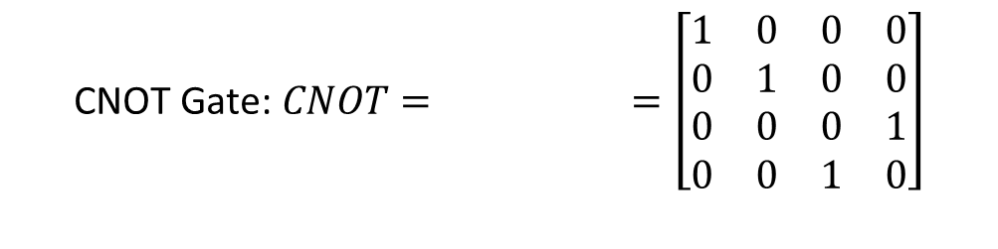
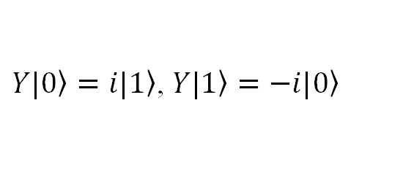

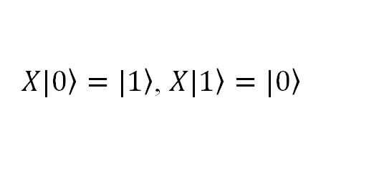
  Quantum Circuits and Basic Quantum Operations
Measurement
Initial state
2 qubits gate
single qubit gate
Pauli Gates:
$$\text{Hadamard} \text{Gate}\text{: }H=\frac{1}{\sqrt{2}}\left[\begin{matrix}1 & 1 \\ 1 & −1\end{matrix}\right]$$
$X=\left[\begin{matrix}0 & 1 \\ 1 & 0\end{matrix}\right], Y=\left[\begin{matrix}0 & −i \\ i & 0\end{matrix}\right], Z=\left[\begin{matrix}1 & 0 \\ 0 & −1\end{matrix}\right]$, $I=\left[\begin{matrix}1 & 0 \\ 0 & 1\end{matrix}\right]$
$$H|\left.0\right\rangle =\frac{1}{\sqrt{2}}\left(|\left.0\right\rangle +|\left.1\right\rangle \right), H|\left.1\right\rangle =\frac{1}{\sqrt{2}}\left(|\left.0\right\rangle −|\left.1\right\rangle \right)$$
Bit flip
$X|\left.0\right\rangle =|\left.1\right\rangle$, $X|\left.1\right\rangle =|\left.0\right\rangle$
Phase flip
$Z|\left.0\right\rangle =|\left.0\right\rangle$, $Z|\left.1\right\rangle =−|\left.1\right\rangle$
$$\text{CNOT} \text{Gate}\text{: }CNOT= =\left[\begin{matrix}1 & 0 & 0 & 0 \\ 0 & 1 & 0 & 0 \\ 0 & 0 & 0 & 1 \\ 0 & 0 & 1 & 0\end{matrix}\right]$$
Bit-phase flip
$Y|\left.0\right\rangle =i|\left.1\right\rangle$, $Y|\left.1\right\rangle =−i|\left.0\right\rangle$
Identity
$I|\left.ψ\right\rangle$= $|\left.ψ\right\rangle$

Slide 18
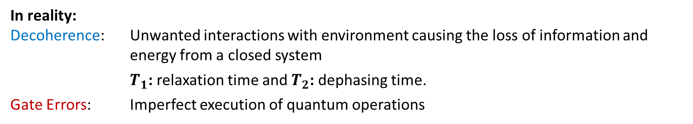
  Quantum Noise and Error
Ideally:
The qubits are considered as closed quantum system and well isolated from outside environment.
All the quantum gates in the circuit are unitary operations until qubits are measured.
System initialized in a state easy to prepare system evolves unitarily answer deduced from projection of the
system to a unique state =measurement
The amplitude of reaching a specified final state depends on interference of all paths from initial to final state
System sensitive to any phase disturbance in any path!!!!
In reality:
Decoherence: Unwanted interactions with environment causing the loss of information and energy from a closed system
$T_{1}$: relaxation time and $T_{2}$: dephasing time.
Gate Errors: Imperfect execution of quantum operations
Decoherence
Errors
Bit flip
Amplitude Damping
Phase flip
Phase Damping
Depolarizing
Sampling Error
etc.

Slide 19
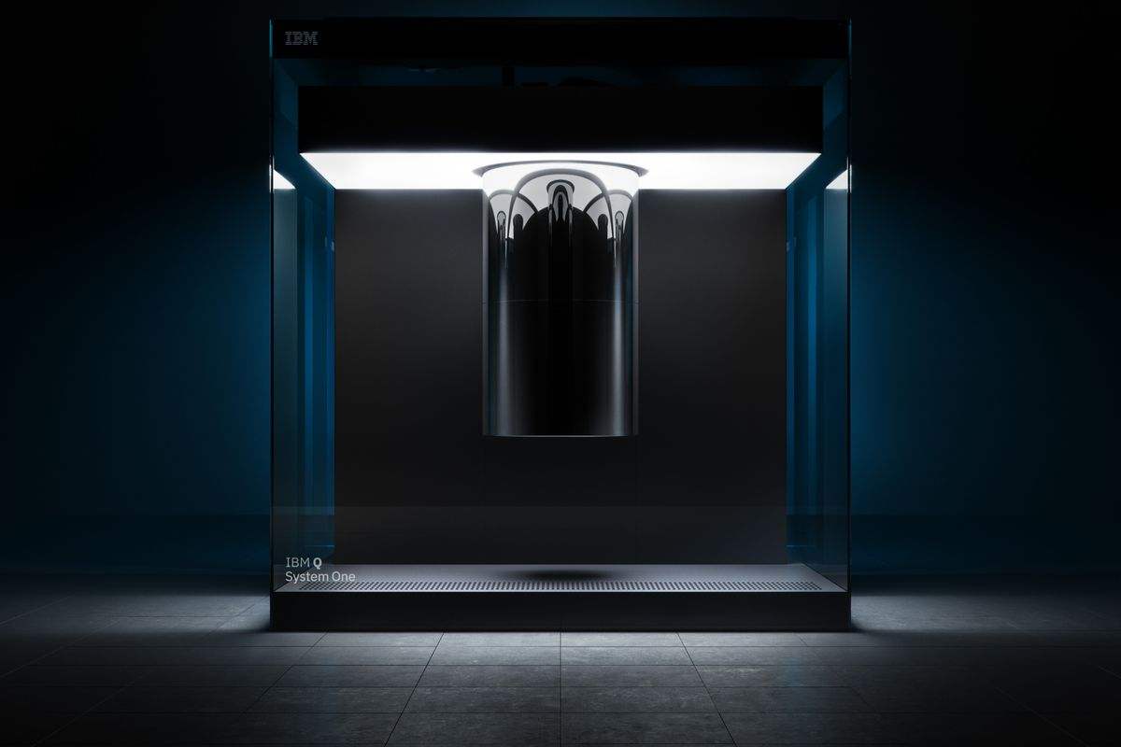
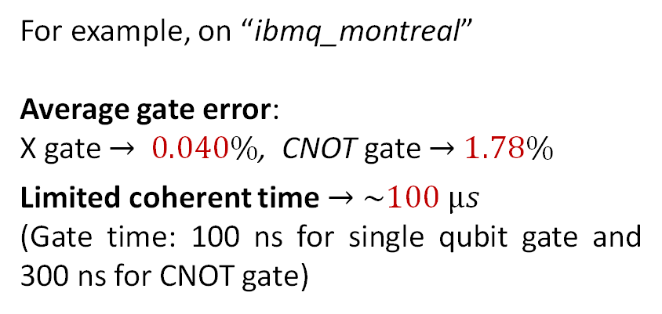
  NISQ era
The current quantum computers with a notable level of noise, decoherence and gate errors with 50 to a few hundred qubits are called Noisy Intermediate-Scale Quantum (NISQ) computers.
For example, on “ibmq_montreal”
Average gate error:
X gate $→$ $0.040\%$, CNOT gate $→$ $1.78\%$
Limited coherent time $→$ $\sim 100 µs$
(Gate time: 100 ns for single qubit gate and 300 ns for CNOT gate)
With NISQ machines, the implementation of quantum computing requires either optimization or new design of quantum algorithms.
Two key points are:
Low circuit depth: minimizing the number of gates
Low circuit width: reducing the number of qubits needed.

Slide 20
An algorithm is a set of instructions to perform a well-defined task on a computer
*Non-cloning theorem (1982) Not possible to output two copies of unknown state |ψ>
*Entanglement Swapping
Effect: Two qubits which have never interacted become entangled (whatever their distance is).
*Superdense Coding
Procedure that allows us to send two classical bits to a party using a single qubit
*Teleportation: Transfer quantum information between quantum processors in a quantum computer by infinite speed? In order to have the accurate decoding of the information in the receiver the emitter has to contact through a classical channel the receiver and tell them the needed peace of information
*Quantum Fourier transform
*Quantum phase estimation
*Shor’s polynomial-time factoring algorithm:
The task: Given an integer N, find its prime factors
*Solving System of Linear Equations
*HHL fully quantum, Solving system of linear equations, but at present need hybrid with classical
*VQLS, Hrushikesh Patel – master thesis at SBU, dynamically adaptive algorithm with smaller quantum depth
*Grover’s algorithm for unstructured search, time is , PhD student Yulun Wang, SBU
**Time evolution of an atomic and molecular system under external perturbation: Using time-dependent variation principles and quantum encoding – Part of the PhD thesis of Yulun Wang, SBU
This is the subject of the present talk.

Slide 21
II.Multistate transition dynamics by a strong time-dependent perturbation in NISQ era
Y. Wang and P. Krstic, arXiv:2112.06365 [quant-ph] (Phys. Rev. A, 2022)

Slide 22
There are three classes of computationally difficult problems to simulate accurately:
The static eigenvalue problem of many-body systems, including excited states,
The time evolution of a system, including transition dynamics among (many) highly excited states (even for a few-body systems).
A third class of problems would be combination of the two, too difficult to treat presently
Class 1): Currently by Variational Quantum Eigensolver (VQE): Ground state of a multibody system,
so far system with small number of electrons; Excited states are in toddler phase
We attack class 2): Main problem – large number of steps under an external time-dependent
Perturbation; here we needed 200,000 steps for accuracy better than 1%
Grand Challenge: Quantum algorithm for an universal quantum computer, which evolves with
controlled accuracy under strong time-dependent perturbation which excites
many system states.
Example: Hydrogen atom in a strong, attosecond laser field pulse.
The algorithm is hybrid as needed for the NISQ era.
Potential advantage in quantum computer: Qubit Efficient Encoding (QEE) for dynamic of 16 states
with only 4 qubits. The dynamics of 10⁶ states can be described with 20 qubits.

Slide 23


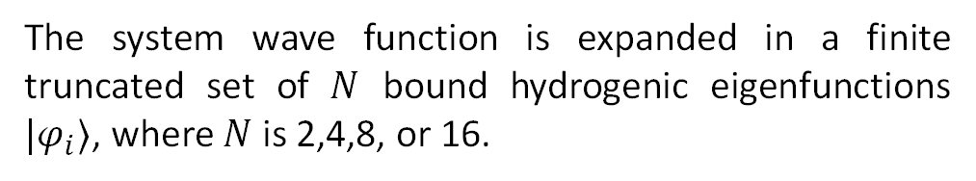
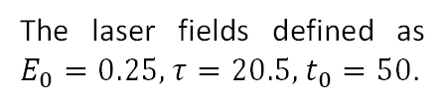
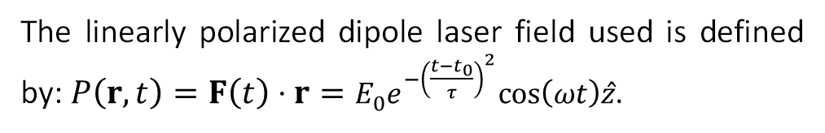
  Define the System
A dynamic atomic quantum system is described by the Time Dependent Schrodinger Equation:
$$\frac{∂ψ\left(r,t\right)}{∂t}+iH\left(r,t\right)ψ\left(r,t\right)=0$$
where $H\left(r,t\right)=H_{0}\left(r\right)+P\left(r,t\right)$ with unperturbed Hamiltonian $H_{0}\left(r\right)$ and an external time-dependent perturbation $P\left(r,t\right)$.
The linearly polarized dipole laser field used is defined by: $P\left(r,t\right)=F\left(t\right)⋅r=E_{0}e^{−{\left(\frac{t−t_{0}}{τ}\right)}^{2}}cos\left(ωt\right)\hat{z}$.
The system wave function is expanded in a finite truncated set of $N$ bound hydrogenic eigenfunctions $|φ_{i}⟩$, where $N$ is 2,4,8, or 16.
$$ψ\left(r,t\right)=\sum_{i=1}^{N}{c_{i}}\left|φ_{i}\right\rangle$$
The laser fields defined as $E_{0}=0.25,τ=20.5,t_{0}=50$.
where $c_{i}$ is the amplitude of each $|φ_{i}⟩$.

Slide 24

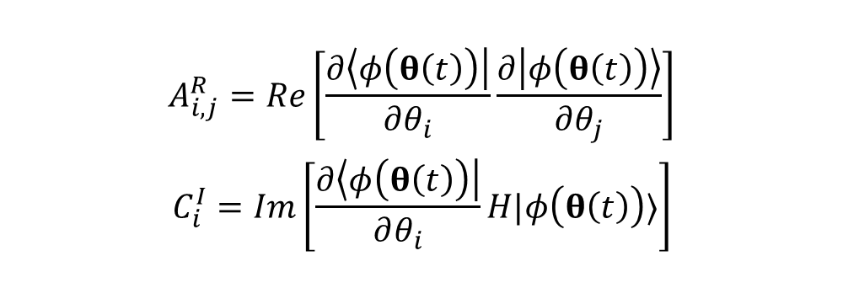
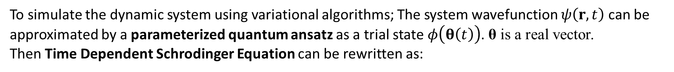
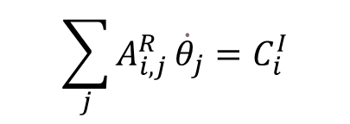


  McLachlan variational principle
To simulate the dynamic system using variational algorithms; The system wavefunction $ψ\left(r,t\right)$ can be approximated by a parameterized quantum ansatz as a trial state $φ\left(θ\left(t\right)\right)$. θ is a real vector.
Then Time Dependent Schrodinger Equation can be rewritten as:
$$\sum_{i}{\frac{∂\left|φ\left(θ\left(t\right)\right)\right\rangle }{∂θ_{i}}}{\dot{θ}}_{i}+iH\left|φ\left(θ\left(t\right)\right)\right\rangle ≈0$$
The McLachlan variational principle aims to minimize the squared norm of the left side:
$$\begin{aligned}δ∥\left(\frac{d}{dt}+iH\right)\left|φ\left(θ\left(t\right)\right)\right\rangle ∥^{2}=0\end{aligned}$$
The variation of real $\dot{θ}$ yields
$$\begin{aligned}A_{i,j}^{R}=Re\left[\frac{∂\left\langle φ\left(θ\left(t\right)\right)\right|}{∂θ_{i}}\frac{∂\left|φ\left(θ\left(t\right)\right)\right\rangle }{∂θ_{j}}\right]\#\end{aligned}$$
$$\begin{aligned}C_{i}^{I}=Im\left[\frac{∂\left\langle φ\left(θ\left(t\right)\right)\right|}{∂θ_{i}}H|φ\left(θ\left(t\right)\right)⟩\right]\#\end{aligned}$$
$$\sum_{j}{A_{i,j}^{R}}{\dot{θ}}_{j}=C_{i}^{I}$$
where
X. Yuan, S. Endo, Q. Zhao, Y. Li, and S. C. Benjamin, Quantum 3, 191 (2019).

Slide 25

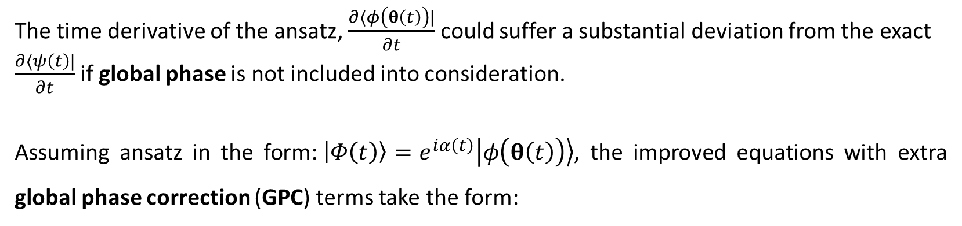
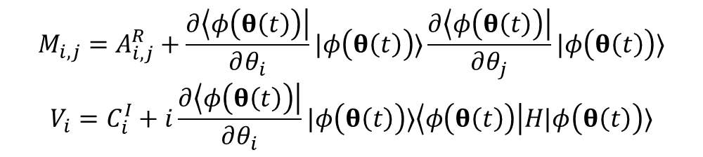
  McLachlan variational principle
The time derivative of the ansatz, $\frac{∂⟨φ\left(θ\left(t\right)\right)|}{∂t}$ could suffer a substantial deviation from the exact $\frac{∂⟨ψ\left(t\right)|}{∂t}$ if global phase is not included into consideration.
Assuming ansatz in the form:$\begin{aligned}\left|Φ\left(t\right)\right\rangle =e^{iα\left(t\right)}\left|φ\left(θ\left(t\right)\right)\right\rangle \end{aligned}$, the improved equations with extra global phase correction (GPC) terms take the form:
$$\sum_{j}{M_{i,j}}{\dot{θ}}_{j}=V_{i}$$
$$\begin{aligned}M_{i,j}=A_{i,j}^{R}+\frac{∂\left\langle φ\left(θ\left(t\right)\right)\right|}{∂θ_{i}}|φ\left(θ\left(t\right)\right)⟩\frac{∂\left\langle φ\left(θ\left(t\right)\right)\right|}{∂θ_{j}}|φ\left(θ\left(t\right)\right)⟩\end{aligned}$$
$$\begin{aligned}V_{i}=C_{i}^{I}+i\frac{∂\left\langle φ\left(θ\left(t\right)\right)\right|}{∂θ_{i}}|φ\left(θ\left(t\right)\right)⟩\left\langle φ\left(θ\left(t\right)\right)\right|H|φ\left(θ\left(t\right)\right)⟩\end{aligned}$$
where

Slide 26
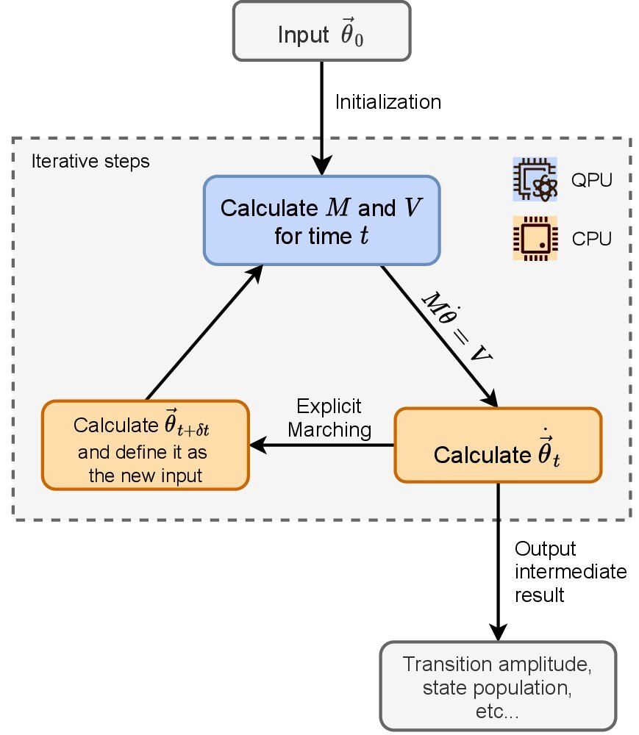
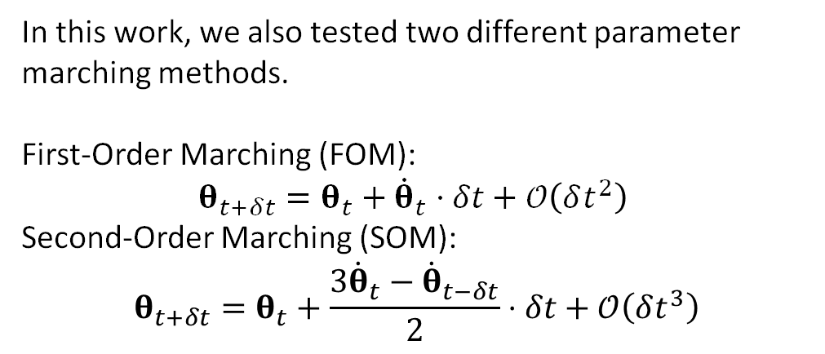

  Variational Quantum-Classical Hybrid Algorithms
$$\sum_{j}{M_{i,j}}{\dot{θ}}_{j}=V_{i}$$
In this work, we also tested two different parameter marching methods.
First-Order Marching (FOM):
$$θ_{t+δt}=θ_{t}+{\dot{θ}}_{t}⋅δt+𝒪\left(δt^{2}\right)$$
Second-Order Marching (SOM):
$$θ_{t+δt}=θ_{t}+\frac{3{\dot{θ}}_{t}−{\dot{θ}}_{t−δt}}{2}⋅δt+𝒪\left(δt^{3}\right)$$

Slide 27

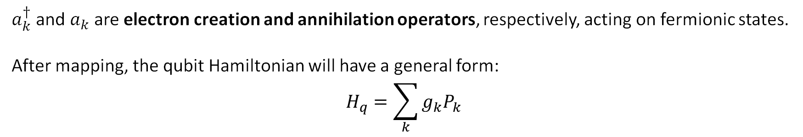
  Encoding the Hamiltonian
To simulate the dynamic system using quantum computers, the fermionic Hamiltonian needs to be mapped into a form accessible by a quantum circuit, qubit Hamiltonian.
By using the second quantization, one can obtain the single-electron Hamiltonian:
$$H=\sum_{i,j}^{N−1}{h_{ij}}a_{i}^{†}a_{j}$$
where $h_{ij}$ are the one-electron integrals for the chosen basis set $|φ⟩$ defined as:
$$\begin{aligned}h_{ij}=\left\langle φ_{i}\left|H\left(r,t\right)\right|φ_{j}\right\rangle =\left\langle φ_{i}\left|H_{0}\left(r\right)+P\left(r,t\right)\right|φ_{j}\right\rangle \end{aligned}$$
$a_{k}^{†}$ and $a_{k}$ are electron creation and annihilation operators, respectively, acting on fermionic states.
After mapping, the qubit Hamiltonian will have a general form:
$$H_{q}=\sum_{k}{g_{k}P_{k}}$$
where $g_{k}$ is the linear combination of $h_{ij}$ coeffcients and $P_{k}∈{\left\{I,X,Y,Z\right\}}^{⨂n}$ represent the $n$-fold tensor product of Pauli operators.

Slide 28
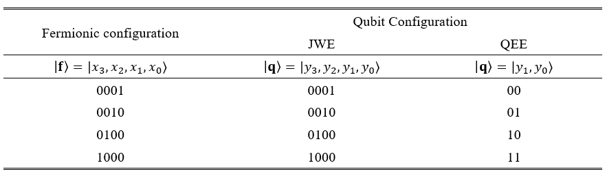
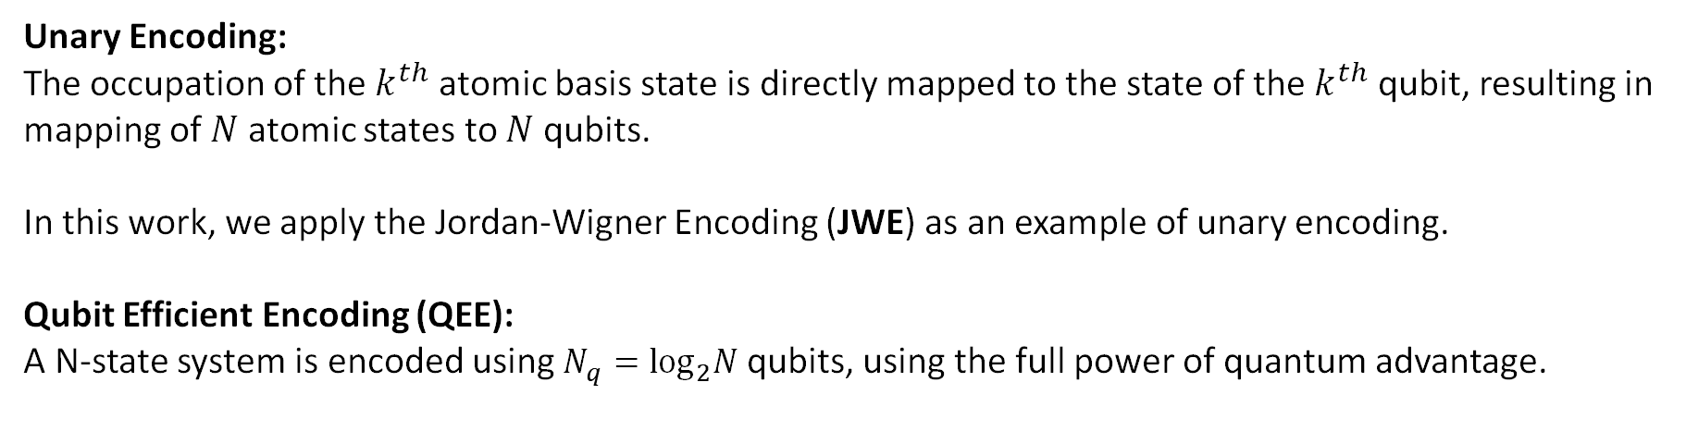
  Unary Encoding and Qubit Efficient Encoding
Unary Encoding:
The occupation of the $k^{th}$ atomic basis state is directly mapped to the state of the $k^{th}$ qubit, resulting in mapping of $N$ atomic states to $N$ qubits.
In this work, we apply the Jordan-Wigner Encoding (JWE) as an example of unary encoding.
Qubit Efficient Encoding (QEE):
A N-state system is encoded using $N_{q}=\log_{2}N$ qubits, using the full power of quantum advantage.
Examples of encoding 4-state system using JWE and QEE methods

Slide 29
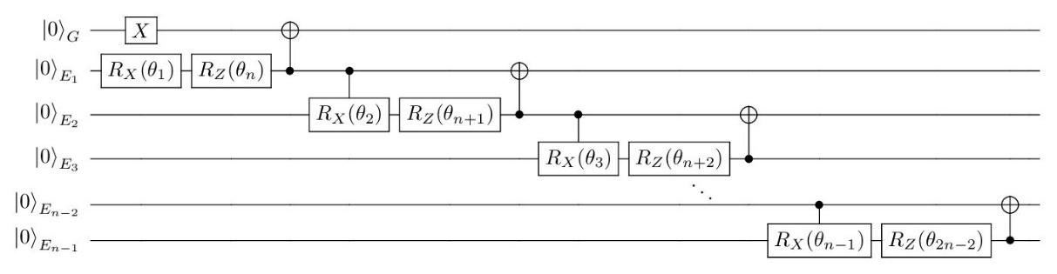
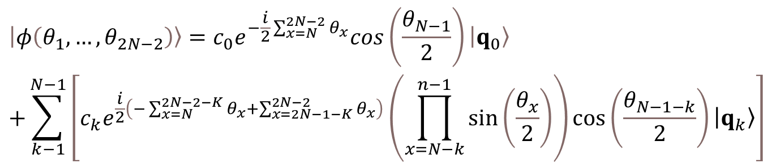
  Quantum Ansatz $φ\left(θ\left(t\right)\right)$for JWE
Variational ansatz for JWE with N qubits.
The symbolic formula for the ansatz takes the form:
$$\begin{aligned}&\left|φ\left(θ_{1},…,θ_{2N−2}\right)\right\rangle =c_{0}e^{−\frac{i}{2}\sum_{x=N}^{2N−2}{θ_{x}}}cos\left(\frac{θ_{N−1}}{2}\right)\left|q_{0}\right\rangle \\ &+\sum_{k−1}^{N−1}{\left[c_{k}e^{\frac{i}{2}\left(−\sum_{x=N}^{2N−2−K}{θ_{x}}+\sum_{x=2N−1−K}^{2N−2}{θ_{x}}\right)}\left(\prod_{x=N−k}^{n−1}{sin}\left(\frac{θ_{x}}{2}\right)\right)cos\left(\frac{θ_{N−1−k}}{2}\right)\left|q_{k}\right\rangle \right]}\#\end{aligned}$$

Slide 30
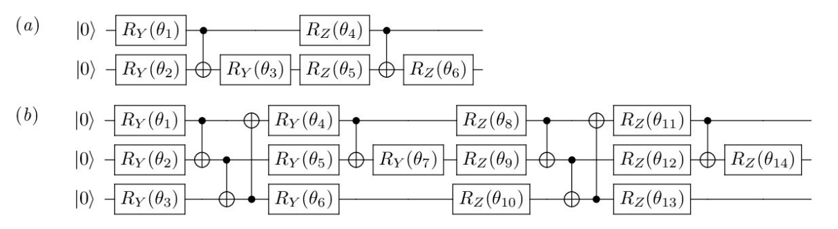
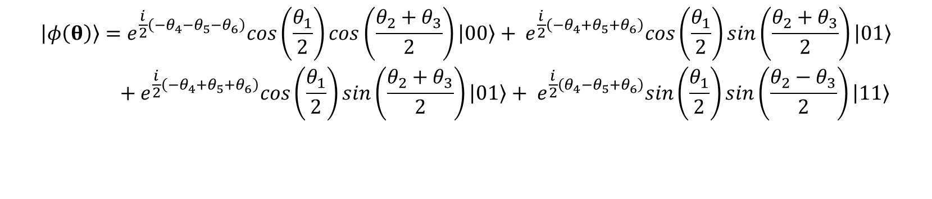
  Quantum Ansatz $φ\left(θ\left(t\right)\right)$for QEE
Variational ansatz for QEE with 2 (a) and 3 (b) qubits.
The symbolic formula for the 2-qubit ansatz takes the form:
$$\begin{aligned}&\left|φ\left(θ\right)\right\rangle =e^{\frac{i}{2}\left(−θ_{4}−θ_{5}−θ_{6}\right)}cos\left(\frac{θ_{1}}{2}\right)cos\left(\frac{θ_{2}+θ_{3}}{2}\right)\left|00\right\rangle + e^{\frac{i}{2}\left(−θ_{4}+θ_{5}+θ_{6}\right)}cos\left(\frac{θ_{1}}{2}\right)sin\left(\frac{θ_{2}+θ_{3}}{2}\right)\left|01\right\rangle \\ & + e^{\frac{i}{2}\left(−θ_{4}+θ_{5}+θ_{6}\right)}cos\left(\frac{θ_{1}}{2}\right)sin\left(\frac{θ_{2}+θ_{3}}{2}\right)\left|01\right\rangle + e^{\frac{i}{2}\left(θ_{4}−θ_{5}+θ_{6}\right)}sin\left(\frac{θ_{1}}{2}\right)sin\left(\frac{θ_{2}−θ_{3}}{2}\right)\left|11\right\rangle \\ \\ \\ \#\end{aligned}$$

Slide 31
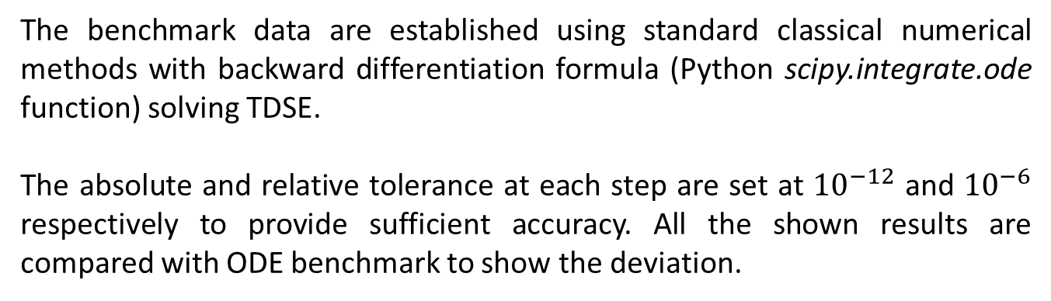
  ODE Benchmark
The benchmark data are established using standard classical numerical methods with backward differentiation formula (Python scipy.integrate.ode function) solving TDSE.
The absolute and relative tolerance at each step are set at ${10}^{−12}$ and ${10}^{−6}$ respectively to provide sufficient accuracy. All the shown results are compared with ODE benchmark to show the deviation.

Slide 32
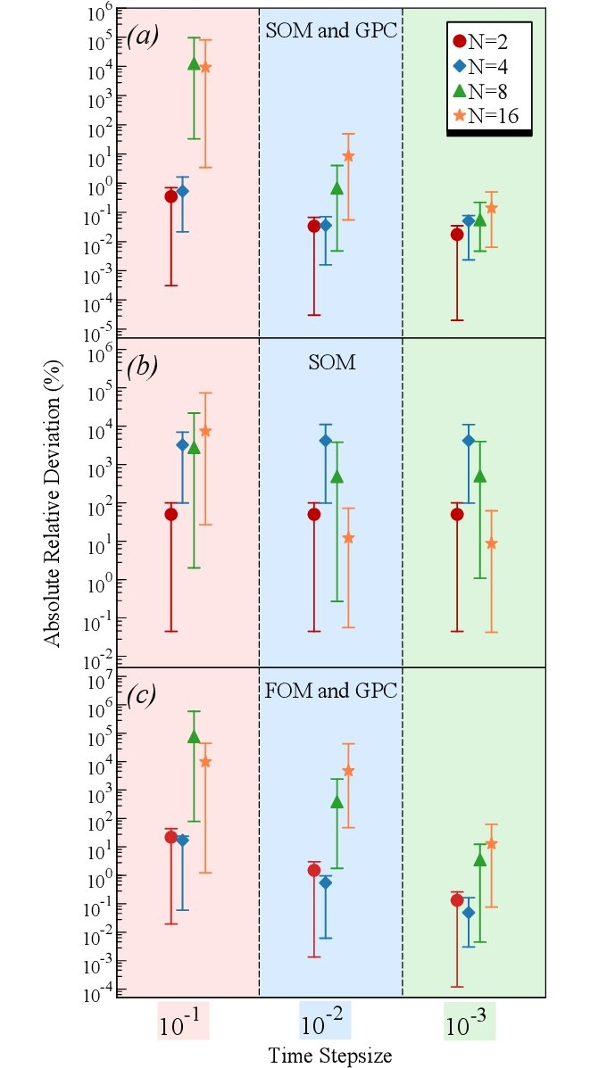
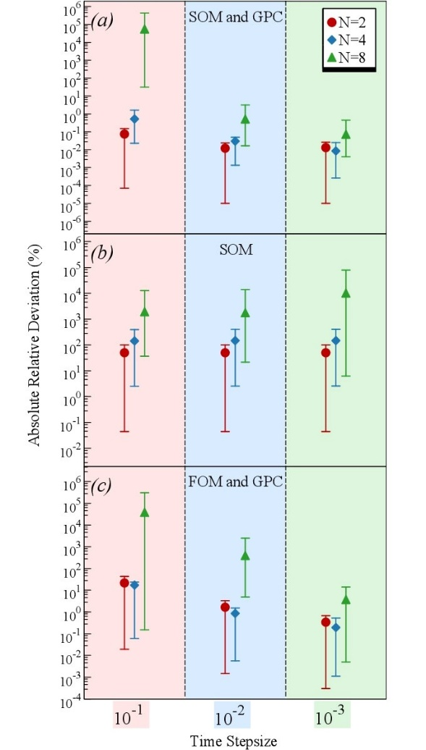
  Results
JWE
QEE
The absolute relative deviations of final transition probabilities comparing to ODE benchmark
using JWE with different step sizes
with SOM and GPC,
with SOM and no-GPC
(c) with FOM and GPC
SOM: Second Order Marching
FOM: First Order Marching
GPC: Global Phase Correction

Slide 33
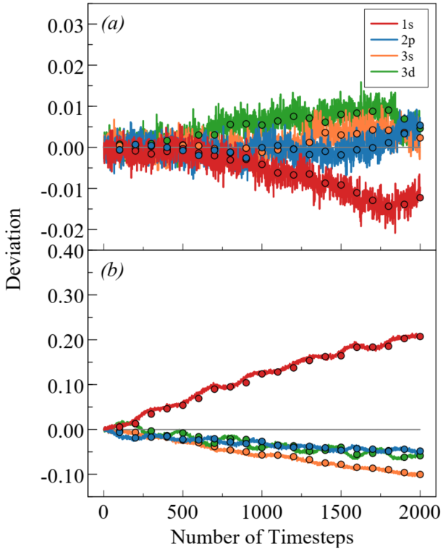
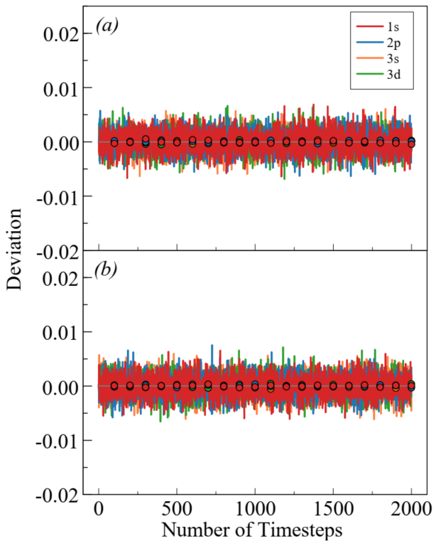
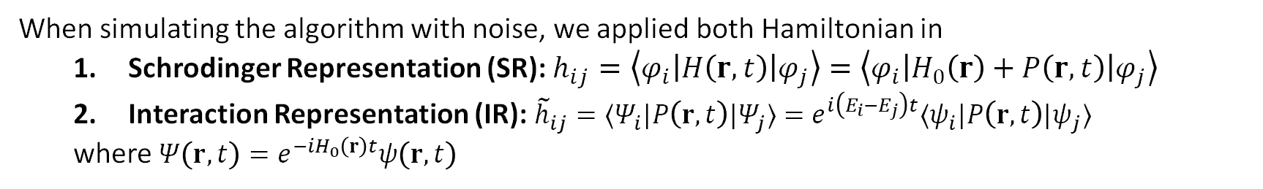
  Noise Simulation
When simulating the algorithm with noise, we applied both Hamiltonian in
  Schrodinger Representation (SR): $h_{ij}=\left\langle φ_{i}\left|H\left(r,t\right)\right|φ_{j}\right\rangle =\left\langle φ_{i}\left|H_{0}\left(r\right)+P\left(r,t\right)\right|φ_{j}\right\rangle$
  Interaction Representation (IR): ${\tilde{h}}_{ij}=⟨Ψ_{i}|P\left(r,t\right)|Ψ_{j}⟩=e^{i\left(E_{i}−E_{j}\right)t}⟨ψ_{i}|P\left(r,t\right)|ψ_{j}⟩$
  where $Ψ\left(r,t\right)=e^{−iH_{0}\left(r\right)t}ψ\left(r,t\right)$
Deviation from initial state when the perturbation is off:
SR
IR
No perturbation
Only sampling error
No perturbation
Sampling error and real device noise

Slide 34
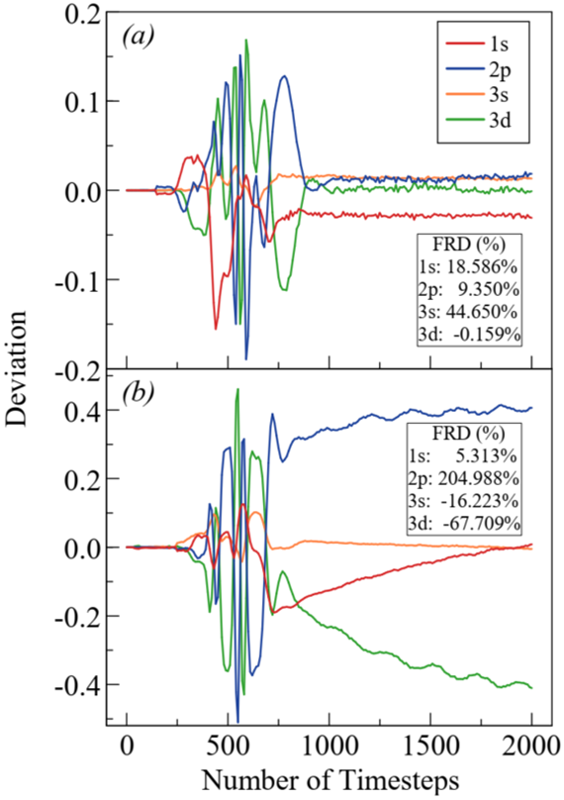
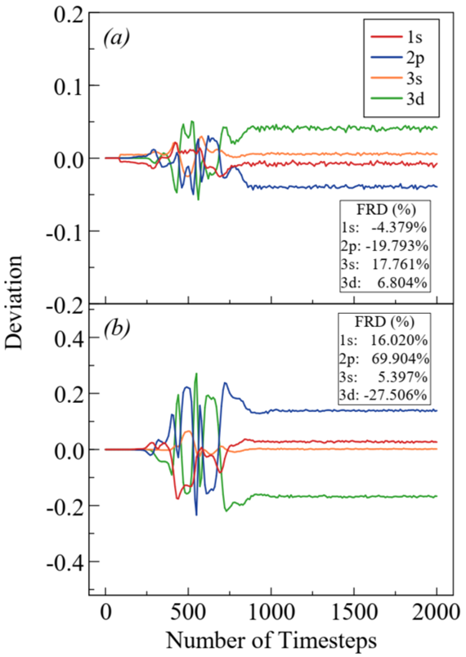
  Noise Simulation
Deviation from ODE benchmark when the perturbation is on:
SR
IR
With perturbation
Only sampling error
With perturbation
Sampling error and real device noise

Slide 35
III. Collisional S-matrix for the vibrational dynamics of H+H₂ including dissociative processes by quantum computing
Y. Wang and P. Krstic, arXiv:2205.14201 [quant-ph] (New J. Phys, 2022)

Slide 36

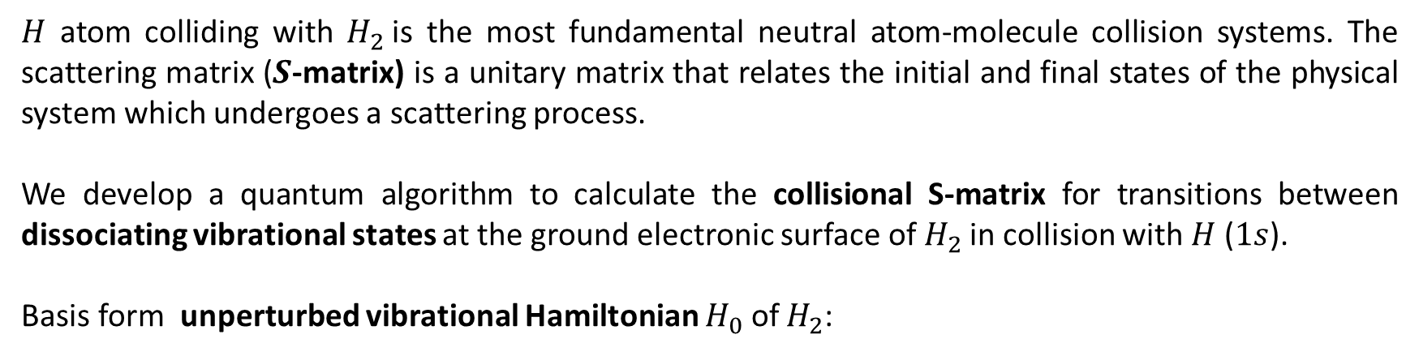
  Definition of the Problem
$H$ atom colliding with $H_{2}$is the most fundamental neutral atom-molecule collision systems. The scattering matrix ($S$-matrix) is a unitary matrix that relates the initial and final states of the physical system which undergoes a scattering process.
We develop a quantum algorithm to calculate the collisional S-matrix for transitions between dissociating vibrational states at the ground electronic surface of $H_{2}$in collision with $H$ ($1s$).
Basis form unperturbed vibrational Hamiltonian $H_{0}$ of $H_{2}$:
$$H_{0}φ=\left(−\frac{1}{2μ}\frac{∂^{2}}{∂r^{2}}+V_{H_{2}}\left(r\right)\right)φ\left(r,t\right)=εφ$$
where $r$ is the vibrational coordinate and μ is the reduced mass of $H_{2}$.

Slide 37
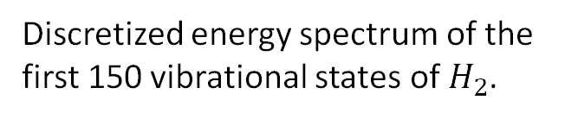
This eigenvalue problem was solved with finite quantization “volume” boundary conditions to obtain 15 bound and 241 continuum (positive energy) pseudo-states (box 20 a.u. lateral)
Discretized energy spectrum of the first 150 vibrational states of $H_{2}$.

Slide 38
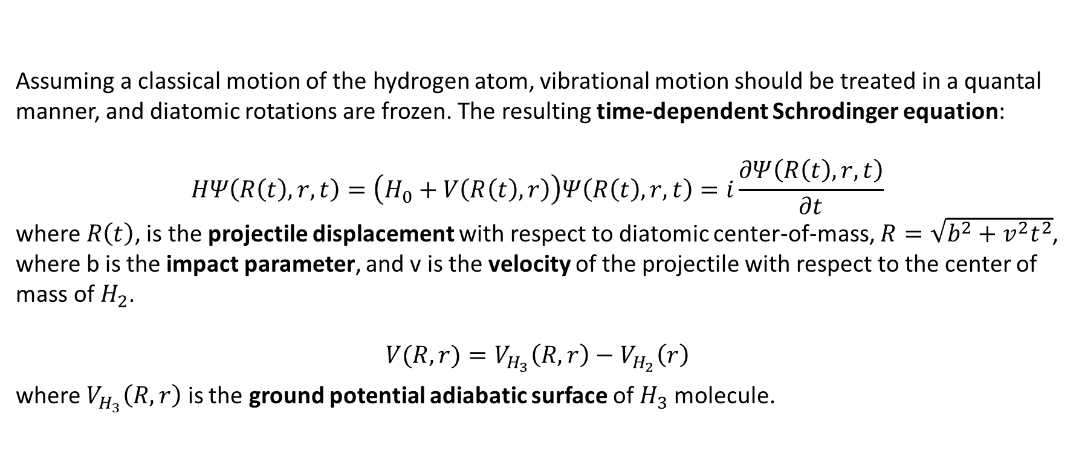

  The System Configuration
Assuming a classical motion of the hydrogen atom, vibrational motion should be treated in a quantal manner, and diatomic rotations are frozen. The resulting time-dependent Schrodinger equation:
$$HΨ\left(R\left(t\right),r,t\right)=\left(H_{0}+V\left(R\left(t\right),r\right)\right)Ψ\left(R\left(t\right),r,t\right)=i\frac{∂Ψ\left(R\left(t\right),r,t\right)}{∂t}$$
where $R\left(t\right)$, is the projectile displacement with respect to diatomic center-of-mass, $R=\sqrt{b^{2}+v^{2}t^{2}}$, where b is the impact parameter, and v is the velocity of the projectile with respect to the center of mass of $H_{2}$.
$$V(R,r)=V_{H_{3}}\left(R,r\right)−V_{H_{2}}\left(r\right)$$
where $V_{H_{3}}\left(R,r\right)$ is the ground potential adiabatic surface of $H_{3}$ molecule.
R
$$$$
v
r
Notes:
Shows figure Jacobian coordinates

Slide 39

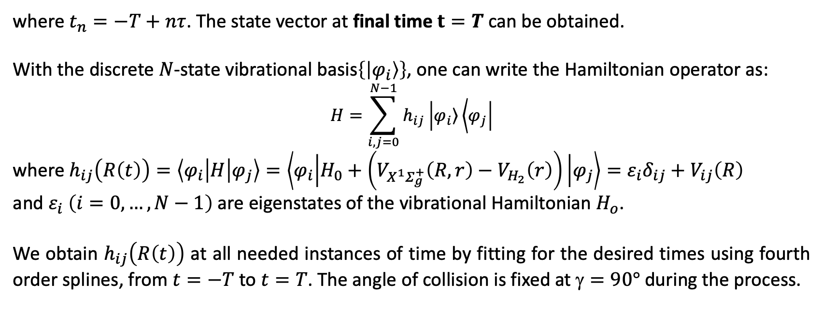
  Vibrational Dynamics
Iterating the state vector $Ψ_{0}=Ψ\left(−T\right)$ in time from some large initial time $t=−T$:
$$\begin{aligned}&Ψ_{1}=e^{−iτH\left(t_{1}\right)}Ψ_{0} \\ &Ψ_{2}=e^{−iτH\left(t_{2}\right)}Ψ_{1} \\ &… \\ &Ψ_{n}=e^{−iτH\left(t_{n}\right)}Ψ_{n−1}\#\end{aligned}$$
where $t_{n}=−T+nτ$. The state vector at final time $t=T$can be obtained.
With the discrete $N$-state vibrational basis$\left\{\left|φ_{i}\right\rangle \right\}$, one can write the Hamiltonian operator as:
$$H=\sum_{i,j=0}^{N−1}{h_{ij}\left|\left.φ_{i}\right\rangle \left\langle φ_{j}\right.\right|}$$
where $h_{ij}\left(R\left(t\right)\right)=\left\langle φ_{i} | H | φ_{j}\right\rangle =\left\langle φ_{i} | H_{0}+\left(V_{X^{1}Σ_{g}^{+}}\left(R,r\right)−V_{H_{2}}\left(r\right)\right) | φ_{j}\right\rangle =ε_{i}δ_{ij}+V_{ij}\left(R\right)$
and $ε_{i} \left(i=0,…,N−1\right)$ are eigenstates of the vibrational Hamiltonian $H_{o}$.
We obtain $h_{ij}\left(R\left(t\right)\right)$ at all needed instances of time by fitting for the desired times using fourth order splines, from $t=−T$ to $t=T$. The angle of collision is fixed at $=90°$during the process.

Slide 40
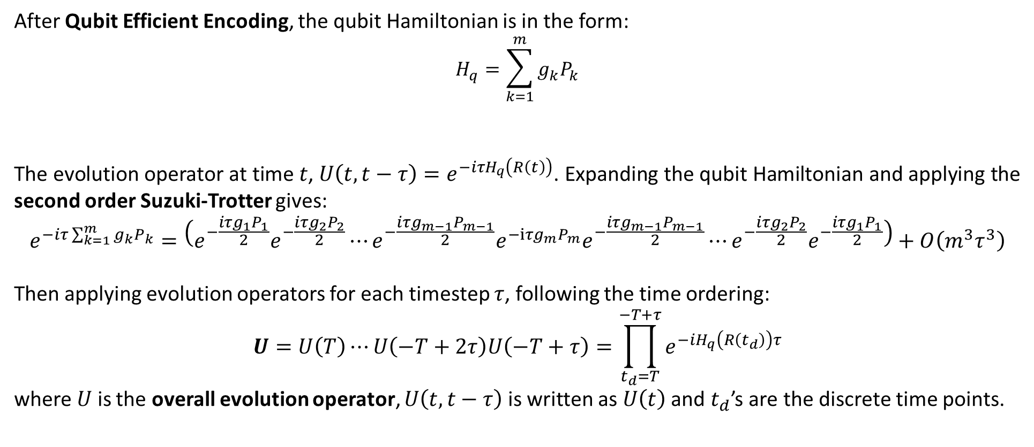
  Trotterization of Evolution Operator
After Qubit Efficient Encoding, the qubit Hamiltonian is in the form:
$$H_{q}=\sum_{k=1}^{m}{g_{k}P_{k}}$$
The evolution operator at time $t$, $U\left(t,t−τ\right)=e^{−iτH_{q}\left(R\left(t\right)\right)}$. Expanding the qubit Hamiltonian and applying the second order Suzuki-Trotter gives:
$$e^{−iτ\sum_{k=1}^{m}{g_{k}P_{k}}}=\left(e^{−\frac{iτg_{1}P_{1}}{2}}e^{−\frac{i{τg}_{2}P_{2}}{2}}⋯e^{−\frac{i{τg}_{m−1}P_{m−1}}{2}}e^{−iτg_{m}P_{m}}e^{−\frac{i{τg}_{m−1}P_{m−1}}{2}}⋯e^{−\frac{i{τg}_{2}P_{2}}{2}}e^{−\frac{iτg_{1}P_{1}}{2}}\right)+Ο\left({m^{3}τ}^{3}\right)$$
Then applying evolution operators for each timestep $τ$, following the time ordering:
$$U=U\left(T\right)⋯U\left(−T+2τ\right)U\left(−T+τ\right)=\prod_{t_{d}=T}^{−T+τ}{e^{−iH_{q}\left(R\left(t_{d}\right)\right)τ}}$$
where $U$ is the overall evolution operator, $U\left(t,t−τ\right)$ is written as $U\left(t\right)$ and $t_{d}$’s are the discrete time points.

Slide 41
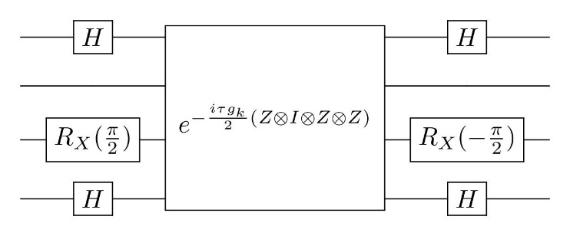

  Quantum Circuits of Time Evolution
Each term after Trotterization, $e^{−\frac{i{τg}_{k}P_{k}}{2}}$, can be applied by quantum circuits.
In the first step, $e^{−\frac{i{τg}_{k}P_{k}}{2}}$ is decomposed to the $n$-fold tensor product of Pauli-$Z$ and $I$ matrices $e^{−\frac{i{τg}_{k}Α}{2}}$ ($A∈{\left\{I,Z\right\}}^{⨂n}$) and a few single qubit gates.
For example, in a 4-qubit case $e^{−\frac{i{τg}_{k}}{2}\left(X⊗I⊗Y⊗X\right)}$ operation can be decomposed to a circuit of $e^{−\frac{i{τg}_{k}}{2}\left(Z⊗I⊗Z⊗Z\right)}$ operation and several single qubit gates:

Slide 42


  Quantum Circuits for Time Evolution
In the second step, the operator $e^{−\frac{i{τg}_{k}Α}{2}}$ will be further decomposed to $CNOT$ gates and $R_{Z}\left({τg}_{k}\right)$ rotation gates.
For example, the circuit for decomposing $e^{−\frac{i{τg}_{k}}{2}\left(Z⊗I⊗Z⊗Z\right)}$:
Then the evolution operator $U\left(t\right)=e^{−i{τH}_{q}\left(R\left(t\right)\right)}$ at time $t$, which is a product of many $e^{−\frac{i{τg}_{k}\left(R\left(t\right)\right)P_{k}}{2}}$ terms after Trotterization, can be expressed by the quantum circuit

Slide 43

  Quantum Circuits for Time Evolution
Furthermore, by grouping all evolution operators for each time step as a product, the quantum circuit of overall evolution operator $U$ is obtained:
The final transition probabilities can be obtained upon measurements of multiple shots.
More details for measurement of the phases of the S matrix elements in
Y. Wang and P. Krstic, arXiv:2205.14201 [quant-ph] (New J. Phys, 2022)

Slide 44

  Cross-Section
We calculated the transition probabilities $P_{ij}$ for specific cases of initial and finals states, $\left|i\right\rangle$ and $\left|j\right\rangle$, for various values of impact parameter $b$. The cross section can then be obtained as:
$$σ_{i−j}=2π\int{bP_{ij}(b)db}$$
We also calculate the cross sections for dissociation of a bound vibrational state $\left|i\right\rangle$ by summation of the probabilities for transition for $\left|i\right\rangle$ to all included states of dissociative continuum $\left|j_{D}\right\rangle$:
$$σ_{i−D}=2π\int{b\sum_{j_{D}}{P_{ij_{D}}(b)}db}$$

Slide 45

  ODE Benchmark
The benchmark data is established using standard classical numerical methods with the explicit Runge-Kutta method of orders 5 and 4 (RK45, using Python scipy.integrate.solve_ivp function) solving TDSE.
The absolute and relative tolerance at each step are set at ${10}^{−12}$ and ${10}^{−6}$ respectively to provide sufficient accuracy. All the shown results are verified by ODE benchmark within a few percents of deviation.

Slide 46





  Results
The cross sections for dissociation from various initial vibrational states, from the ground state ($i=0$) and states $i=1, 2, 3, 7, 12$ to the dissociative continuum.
We used various number of included continuum states from $N_{c}$= 2 (5 qubits) to $N_{c}^{max}$=113 (7 qubits) to establish convergence (in Cauchy sense) with depth into continuum.
The deviations comparing to $N_{c}^{max}$for $N_{c}=70$ are between $\sim 0.5\%$ and $\sim 5\%$
$N_{c}^{max}=113$ continuum states are sufficient to obtain converged dissociation results with error up to 5%.
Notes:
Establish comparison with ode benchmark fully classical

Slide 47



  Results
The cross sections for transition from chosen initial ($υ_{i}=0, 1, 2$) to all bound vibrational states,
with various $N_{c}$ Included.
The agreement is reached with available literature results at the used collision energy.
Coupling to the continuum influences transitions from lower only to higher vibrational states
In summary:
The cross sections for inelastic transitions between low-lying vibrational states of $H_{2}$ can be accurately calculated without inclusion of dissociative continuum, at least at the considered collision energy 100 eV.
Krstic, JPB, 1999
Notes:
Put reference

Slide 48



  Results
The cross sections for transition from chosen initial ($υ_{i}=7, 12$) to all bound vibrational states,
with various $N_{c}$ Included.
For the initials state $i=7:$
  Significant influence of the continuum appears in transition to the $j≥10$.
For the initials state $i=12:$
  Transitions to both lower and higher states are persistently reduced by the presence of continuum.
  In summary:
  Cross sections to or from higher vibrational states of $H_{2}$, require inclusion of dissociative continuum of 113 states (as deep as 5 eV of positive energy).

Slide 49
IV. In place of Conclusions
Quantum Computing: Is it a Dream or the Reality?
Thanks to superposition and entanglement, a quantum computer can process a vast number of calculations simultaneously: Whereas a classical computer works with ones and zeros, a quantum computer will have the advantage of using ones, zeros and “superpositions” of ones and zeros, called qubits.
The QM theory is the most accurate and successful theory in the history of physics, and when the formidable technological issues in building quantum computer are resolved, the QC will work along the QM predictions. Of course, the interaction with environment will have to be taken into account, raising the issues of the errors and decoherence, which are also formidable problems to be solved.
Nature keeps track of all its content consistently – “hidden info” if we do not measure.
The goal of QC is to control the flow of such “hidden information” and grasp it in a desired moment – This was what we hoped to do in this work for atomic transition dynamics.

Slide 50
Thank you!

