Slide 1
Everlasting educational reforms – on the road to quality and permanent knowledge or…
Lambe Barandovski
University ,,Ss. Cyril and Methodius",
Faculty of Natural Sciences and Mathematics, Institute of physics, Skopje, Macedonia
„BPU 11 Congress“
Belgrade, 28.08-1.09.2022

Slide 2
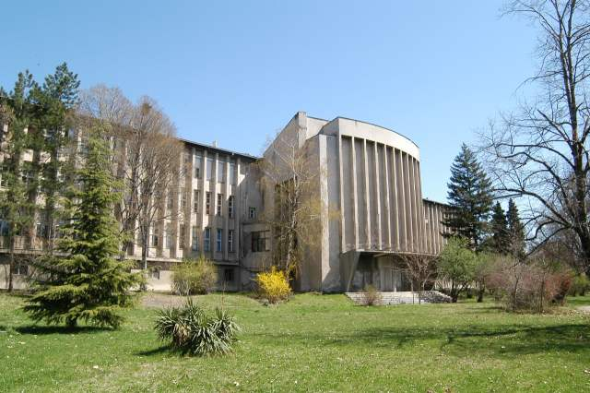
Department for natural sciences and mathematics was found in 1946 in the framework of Faculty of philosophy with institutes of mathematics, physics, chemistry, biology and geography.
1958 Faculty of Natural sciences was formed with 5 institutes.
Until 2020
more then 900 students graduated physics and 250 graduated mathematics-physics
more then 60 MSc thesis defended
more then 60 PhD thesis defended
Human resources in the Institute of Physics
28 permanent researchers of which:
  22 senior scientists with PhD and
  6 junior researchers with MSc degree
6 laboratory technicians

Slide 3
Last few reforms in the Macedonian educational system have been:
2007/2008 primary education is transformed from 8 to 9 years of study
2008/2009 high school becomes obligatory
2013 External testing for high school students was introduced
2014 Cambridge Science and Mathematics Curriculum was introduced
2014 1st to 3rd grade
2015 4th to 6th grade
2016 7th to 9th grade
2017 External testing was stopped
2017/2018 Cambridge Science and Mathematics Curriculum was postponed for realization in the high schools.
There are no changes in gymnasium education since 2001
There are changes in the curricula for vocational high school 2019-2022 (Study smart work professionally)
2020 New concept for primary school approved by the Macedonian Parliament as a proposition of the Ministry of education and science and the Government
2022 External testing was renewed

Slide 4
Science in Primary schools
Physics in High schools
Type of school | Class | Hours per week
Gymnasium A | 1-4 | 2
Gymnasium B | 1-4 | 2
Vocational high school | 1 (1-2) | 2

Slide 5
Reforms in the educational system
Mathematics and Science - 2014
Translated textbooks according the Cambridge International Examinations Center (3 circles)
Translation followed by adaptation (only names, geographical terms, notion names and terms previously adopted)
Questions:
  Was it a political decision (yes)
  Was it according a survey publicly conducted (no)
  Was there a need? (yes)
  Which was the right way to introduce the new programs and syllabuses?
  How much time from idea till realization was needed?

Slide 6
Reforms in the educational system
Mathematics and Science
  Have the result of assessment of knowledge improved? (no, just opposite)
  Were necessary conditions (financial and material) fulfilled before introducing the this reforms? (no)
  Was the right choice of textbooks made? (seems not)
  How to overcome the gap in knowledge on the bridge between Primary and High School
  In sense of improving the system, is the spiral approach better? (results don’t show that)
  Can the different experiences teachers have somehow be overcome?
  In this environment, did we get the right feedback of introducing the research approach in everyday math and science teaching (no)

Slide 7
What teachers expected before this reform
The basic idea was to stress the need of transferring knowledge from theory to practice, as one of the most important characteristics of science and math, starting with the basics of science
introducing independent students work on a higher level
using students research on a law level in introducing the notions, properties and facts
Improving learning materials
Keeping the level and depth of introduced mathematics and science notions and problems

Slide 8
What teachers obtained
More work, more preparations and greater need of additional materials
Less math and science themes covered (in width and in depth)
Less knowledge presented by students
Incompatibility with high school needs
Less interest in mathematics and physics (opposite of the expectations)

Slide 9
What about physics?
Cambridge curriculum was introduced in 8th and 9th grade, without taking into account the repetition or lack of certain thematic units in the ninth grade, which of course has consequences for further education in the this generation of students. For example, Forces and movement was a unit present in the eight grade in the old curriculum and now in the ninth grade in the new curriculum. The same situation is with the unit Energy and heat, which was a part in the eighth grade in the old curricula and now is a part of the curriculum in the ninth grade. On the other hand, units like Light and Astronomy that were traditionally learnt in the ninth grade, now belong to the eight grade curriculum.

Slide 10
Simple analysis on the material that was studied before and after the implementation of the Cambridge curriculum shows that today’s 8th and 9th graders are learning less than 20% of what the students were learning in physics classes before the 2016/2017 school year.
Physics is science that is mainly based on measurements. The first topic (topic where the students should learn how to observe and do the measurements of the physical quantities), that is a key in understanding the physics phenomena is not present in Cambridge curriculum.
Today students who are living in a highly technologically developed period, most probably will not know anything about alternative current, semiconductors, semiconductor devices, generators and transformers, lenses and spherical mirrors, optic devices, ionizing radiation, radioactive dating and many other topics, until finishing high school.
Students are not encourage to do calculations and solve numerical problems. In the 8th grade physics text book, there are only 4 formulas that students can use for calculation of physics quantities and three formulas in the text book of physics in 9th grade.
This analysis is not even the “top of the iceberg” of all of the problems that the introduction of Cambridge curriculum brought in.

Slide 11
Curriculum 2009–2016 | Curriculum 2016–2019
Eight grade
1. Objects around us 1.1 Subject of physics, physics phenomena, observation and experiment 1.2 Measurements of physical quantities 1.3 Measurement of length 1.4 Measurement of volume 1.5 Measurement of time 1.6 Mass of solid body 1.7 Densities of the substances | 1. Forces and movement 1.1 Introduction of forces 1.2 Change of the shape of the objects 1.3 How fast? 1.4 Speed and distances 1.5 Speed units 1.6 Distance/time graph 1.7 Calculation of the speed from distance/time graph 1.8 Calculation of traveled distance and time 1.9 Introduction of acceleration 1.10 Measurement of the speed and calculation of acceleration 1.11Speed/time graph 1.12 Impact of the forces in the process of movement 1.13 Measurement and calculation of the force 1.14 Friction forces – very important forces 1.15 Gravitational force 1.16 Free fall 1.17 Air resistance
2 Matter is made of particles 2.1 Particle nature of the substance 2.2 Molecules and Atoms 2.3 Aggregate states
3 Movement 3.1 Mechanical movement 3.2 Motion along straight line with constant speed 3.3 Distance/time and speed/time graphs in motion along straight line with constant speed 3.4 Motion with acceleration along the straight line 3.5 Free fall
4. About the force 4.1. First and Third Newton laws 4.2 Types of forces, measurement of the force 4.3 Earth gravitational force 4.4 Weight of the objects 4.5 Friction 4.6 Balanced forces, components of the forces 4.7 Centre of mass, different types of equilibrium states 4.8 Second Newton law | 2. Energy 2.1 Use of energy 2.2 Other sources of energy 2.3 Transfer of the energy 2.4 Energy forms 2.5 Conservation of energy

Slide 12
5 Pressure 5.1 Pressure 5.2 Pascal law 5.3 Hydrostatic pressure 5.4 Archimedes law of buoyancy 5.5 Atmospheric pressure | 3. Light 3.1 How light travels? 3.2 How shadows are formed? 3.3 Camera obscure 3.4 How reflections form 3.5 Optic illusions 3.6 Refraction 3.7 The Spectrum of white light 3.8 Colored light
6 Mechanical work and energy 6.1. Mechanical work 6.2 Energy 6.3 Mechanical energy 6.4 Energy conservation law 6.5 Power, Efficiency
7 Internal energy 7.1 Internal energy 7.2 Internal energy change, heat and temperature 7.3 Measurement of temperature – thermometers 7.4 Heat 7.5 Law of thermal equilibrium 7.6 Thermal expansions of solid bodies 7.7 Thermal expansion of liquids 7.8 Thermal expansion of gasses 7.9 Boyle's law 7.10 Gay-Lussac's law 7.11 Heat conductivity 7.12 Convection 7.13 Melting and solidification 7.14 Evaporation 7.15 Condensation | 4. The Earth and beyond 4.1 Day and night 4.2 Seasons 4.3 The starry night 4.4 The moving of the planets 4.5 Seeing stars and planets 4.6 Grate discoveries in astronomy 4.7 Moon and moon fazes 4.8 Astronomy in the last 4 centuries 4.9 Journey into the space

Slide 13
Ninth grade
1 Electrical and magnetic phenomena 1.1 Electric charges and their interaction 1.2 Electrons, ions end electric current 1.3 Electric current. Conductors, isolators and semiconductors 1.4 Current circuit end electric elements 1.5 Electric current and its effect 1.6 Electric voltage 1.7 Resistance 1.8 Ohm's law 1.9 Serial and parallel connection of resistors 1.10 Capacitance, Capacitates 1.11 Work and power of the electrical current 1.12 Protection form electrical shock 1.13 Magnets and magnetic field 1.14 Magnetic field generated by the electrical current 1.15 Ampere force 1.16 Electromagnetic induction 1.17 Alternative current. Generators 1.18 Transformers 1.19 Semiconductors 1.20 Semiconductor devices | 1. Forces and movement 1.1 Introduction of leavers 1.2 Law of the leaver 1.3 Calculating moments of force 1.4 Density 1.5 Measuring density 1.6 Measuring density and Archimedes 1.7 Calculating density 1.8 Pressure 1.9 Calculating pressure 1.10 Pressure in gasses and liquids
 | 2. Energy 2.1 Heat 2.2 Heat conductivity 2.3 Convection 2.4 Radiation 2.5 Evaporation 2.6 Fossil fuels 2.7 Renewable and un renewable sources of energy 2.8 How we use the energy

Slide 14
2 Oscillation and waves. Sound 2.1 Oscillatory motion 2.2 Wave motion 2.3 Characteristics of wave motion 2.4 Sound waves 2.5 Ultrasound. Application of ultrasound | 3. Electricity and magnetisms 3.1 Static electricity 3.2 Positive and negative charge 3.3 Electrons on the move 3.4 Electrical current 3.5 Conductors and isolators in the electric circuit 3.6 Electrical current in the circuit 3.7 Components in parallel 3.8 Voltage in the circuits 3.9 Resistance in the circuits 3.10 Magnets and magnetic materials 3.11 Magnetic poles 3.12 How we represent magnetic field 3.13 Electromagnet
3. Light phenomena 3.1 Traveling of the light 3.2 Reflection of the light. Mirrors 3.3 Spherical mirrors 3.4 Refraction of the light 3.5 Total refraction 3.6 Dispersion of the light 3.7 Lenses 3.8 Human eye as optical device 3.9 Mixing of colors
4. Atomic and nuclear physics 4.1 Structure of the atom. Isotopes 4.2 Radiation from the atom 4.3 Discovery of the ionizing radiation 4.4 Radioactive decay | 4. Sound 4.1 Different sounds 4.2 How the sound travels 4.3 Explanation of the oscillations 4.4. Visualization of the sound wave with an oscilloscope 4.5 How we hear?

Slide 15
What kind of physics we learn our primary school students?
Macedonian 8th grade physcs textbook starts with the introduction of the concept of force. This part of the text book is taken from Cambridge Checkpoint Science Coursebook 7. There, chapter 9.1 (page 128), is named “Seeing forces”, which is quite confusing.
“A force arrow is a good way to represent a force because it shows the direction in which the force is acting. A force arrow shows us the direction of the force. We label the arrow to show two things: The object that the force is acting on and the object that is producing the force”.

Slide 17
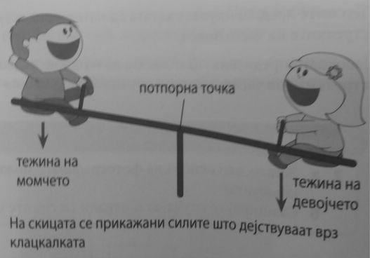

Slide 18
On page 120 in Cambridge Checkpoint Science Coursebook 9, one can find: “A heavier” material is more dense than “a lighter” material. It has a greater density”.
On page 122 in the same book, there is a statement: “Density is a measure of how light or heavy a material is”.
On page 140 - “Lightning is another example of the static electricity on much larger scale”.
On page 146 - “Metals are described as conductors because they allow electricity to pass through them. Plastic and non-metals are described as insulators – they do not allow electricity to pass through them”.

Slide 19
What about mathematics?
One other aspect of current curricula is the lack of correlation between mathematics and physics. And instead for mathematics to be the back bone of physics, mathematics, thanks to the new approach, became a brake, a preventer of widening the knowledge of physics. To be precise, for some units, the mathematics curriculum is the reason why the physics teachers are not able to explain some of the physical phenomena. For example, if vectors are completely taken out of the math curriculum, how can we have effective physics lessons? There is no time to introduce vectors, operations with vectors and properties. It is not only vectors. It is the same with most of geometrical notions and properties, similarity of triangles, area and volume of geometrical bodies (a cylinder, a ball). There are some algebra units also, for example systems of linear equations are introduced at the end of 9th grade and are needed earlier. Some of the units have been completely taken out or the introduction has been postponed for the latter years, so the physics teacher cannot use them when they need them. If you ask a mathematician, he would probably say the same, the new curricula has taken down the level of introduced material, notions and statements. Even more, it is completely inappropriate for the need of adopted knowledge for entering High School. On the other hand, lately the correlation concept is highly emphasized and is expected to be done as a learning objective.

Slide 20
What about the new concept 2020?

Slide 21
Mathematics Pisa testing 2019

Slide 22
Science Pisa testing 2019

Slide 28
Unanswered questions remaining
The role of the teacher in the research approach and problem solving against the role of the textbook
The role of the classroom (equipment)
The role of the parents (projects)
The role of the teacher in the complete process of education and upbringing the students

Slide 29
Thank you for your attention!

