Slide 1
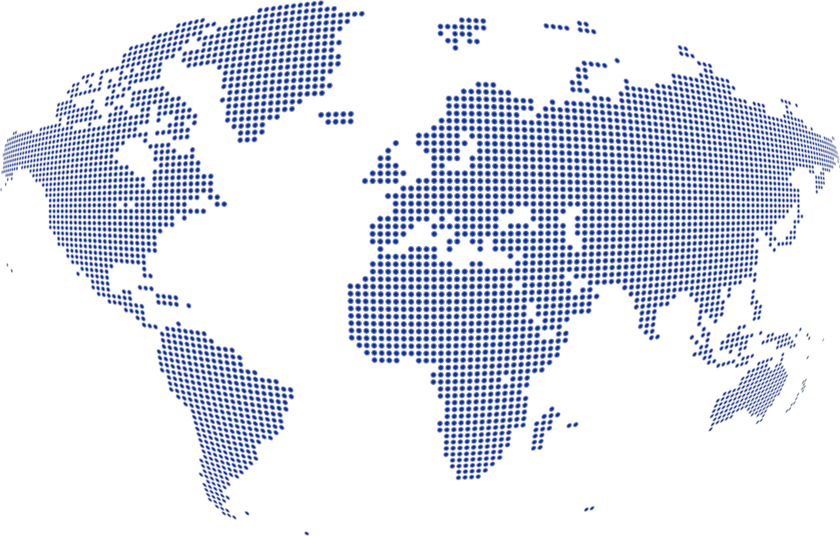
Science for peace
CERN was founded in 1954 with 12 European Member States
CERN’s annual budget
is 1200 MCHF (equivalent
to a medium-sized European university)
23 Member States
Austria – Belgium – Bulgaria – Czech Republic
Denmark – Finland – France – Germany – Greece Hungary – Israel – Italy – Netherlands – Norway
Poland – Portugal – Romania – Serbia – Slovakia Spain – Sweden – Switzerland – United Kingdom
As of 31 December 2021
Employees:
2676 staff, 783 fellows
Associates:
11 175 users, 1556 others
3 Associate Member States
in the pre-stage to membership
Cyprus – Estonia – Slovenia
7 Associate Member States
Croatia – India – Latvia – Lithuania – Pakistan
Türkiye – Ukraine
6 Observers
Japan – Russia (suspended) – USA
European Union – JINR (suspended) – UNESCO
Around 50 Cooperation Agreements
with non-Member States and Territories
Albania – Algeria – Argentina – Armenia – Australia – Azerbaijan – Bangladesh – Belarus – Bolivia
Bosnia and Herzegovina – Brazil – Canada – Chile – Colombia – Costa Rica – Ecuador – Egypt – Georgia – Honduras
Iceland – Iran – Jordan – Kazakhstan – Lebanon – Malta – Mexico – Mongolia – Montenegro – Morocco – Nepal
New Zealand – North Macedonia – Palestine – Paraguay – People's Republic of China – Peru – Philippines – Qatar
Republic of Korea – Saudi Arabia – Sri Lanka – South Africa – Thailand – Tunisia – United Arab Emirates – Vietnam
Notes:
The speaker can highlight CERN’s second mission as stated when it was established: to foster peaceful collaborations between nations that had recently been at war.
Additional information (OPTIONAL)
More than 40% of CERN’s budget is returned to industry through materials, utilities and services

Slide 2
A laboratory for people around the world
Distribution of all CERN Users by the country of their home institutes as of 31 December 2021
Geographical & cultural diversity
Users of 110 nationalities
19.4% women
Member States 6642
Austria 74 – Belgium 122 – Bulgaria 39 – Czech Republic 227 Denmark 42 – Finland 71 – France 811 – Germany 1129 Greece 133 – Hungary 69 – Israel 67 – Italy 1423
Netherlands 157 – Norway 69 – Poland 278 – Portugal 89 Romania 105 – Serbia 36 – Slovakia 66 – Spain 328
Sweden 88 – Switzerland 372 – United Kingdom 847
Associate Member States
in the pre-stage to membership 55
Cyprus 10 – Estonia 24 – Slovenia 21
Associate Member States 367
Croatia 36 – India 130 – Latvia 11 – Lithuania 12 – Pakistan 30
Türkiye 122 – Ukraine 26
Observers 2917
Japan 189 – Russia (suspended) 971 – United States of America 1757
Non-Member States and Territories 1194
Algeria 3 – Argentina 16 – Armenia 10 – Australia 20 – Azerbaijan 3 – Bahrain 2 – Belarus 24 – Brazil 106 Canada 189 – Chile 23 – Colombia 18 – Cuba 3 – Ecuador 6 – Egypt 16 – Georgia 36 – Hong Kong 17 Iceland 3 – Indonesia 6 – Iran 11 – Ireland 6 – Jordan 5 – Kuwait 5 – Lebanon 15 – Madagascar 1
Malaysia 4 – Malta 2 – Mexico 48 – Montenegro 5 – Morocco 18 – New Zealand 8 – Oman 1 – People’s Republic of China 314 – Peru 2 – Philippines 1 – Republic of Korea 113 – Singapore 3 – South Africa 52
Sri Lanka 10 – Taiwan 45 – Thailand 18 – United Arab Emirates 6
Notes:
THIS SLIDE WILL INCLUDE THE NUMBER OF MEMBERS OF PERSONNEL OF THE VISITORS’ COUNTRY OF ORIGIN

