Slide 1
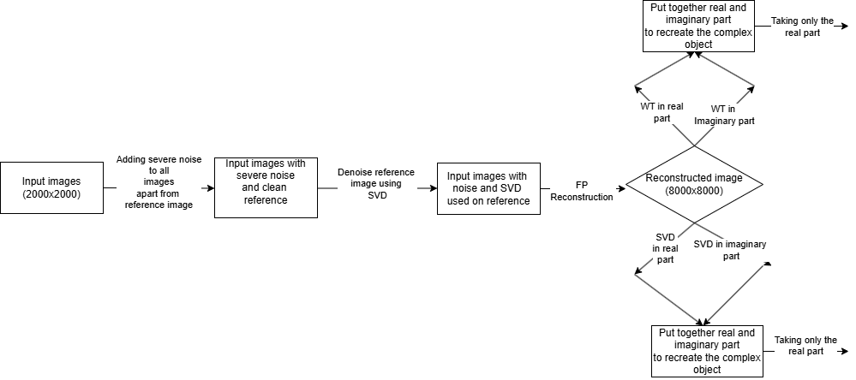
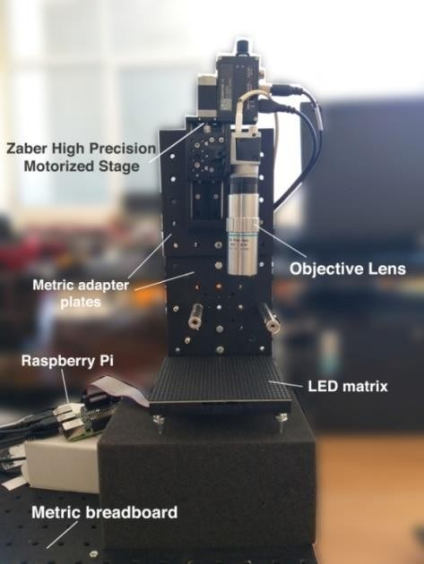
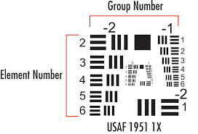
Optimizing Fourier ptychographic reconstruction for illumination wavelength and noise reduction
Arban UKA¹, Kevin Haxhi¹, Gent Imeraj², Griselda Alushllari³
¹Department of Computer Engineering, Epoka University, 1000, Tirana, Albania
²Department of Applied Informatics, Hosei University, Tokyo, Japan
³Department of Physics, Tirana University, Tirana, Albania
Abstract
Methodology
Results
Microscopy is an important field that has seen significant improvements over the last decades to overcome unique inherent limitations. Some times the physical limitations could be overcome by using computational imaging. Fourier Ptychography is a powerful computational imaging technique that overcomes the resolution limitations of traditional microscopy by combining multiple low-resolution images captured under varied illumination angles. It overcomes the limitations of the traditional microscopes numerical aperture and reconstruct high-resolution image. The essence of this method lies in the reconstruction of images that go up to gigapixels using series of low-quality images. The traditional microscopic technique involves illumination by white light of the samples that are fixed on uniform glass slides. Here we test whether the Fourier Ptychography implemented on microscopic images acquired from a microfluidic chamber system depends on the wavelength of the illumination. We conclude that a shorter wavelength leads to a higher resolution of the images that are reconstructed. Results are combined with careful noise removal techniques involving different wavelets.
Datasets:
The images are acquired in a homemade microscope that uses an array of LED or laser sources as illumination for the sample. Once we know the distance between neighbouring LED sources, we can use this information when we fuse the information in the fourier domain. One can take 9 images from 3 rows of LEDs that has 3 LED on each column. Or take, 25 images using 5-by-5 LED array.
Figure 1: Sample illumination in a microscope from 2 different directions
USAF 1951 is a standard components that is used to quantify the resolution or absolute magnification of microscopes.
Image | Sharpness level | Contrast level | NIQE | PIQE | BRISQUE
Red Laser Without the diffuser | 4.5901 | 241 | 3.6167 | 11.9396 | 7.1491
Red Laser with diffuser and moving | 3.1549 | 111 | 5.2511 | 7.3790 | 30.1557
Red Laser Fluidic chamber without a diffuser | 2.6998 | 103 | 5.5395 | 3.8028 | 37.0938
Red Laser Fluidic chamber static diffuser | 4.5882 | 103 | 3.9959 | 4.2268 | 36.8657
Red Laser Fluidic chamber with moving diffuser | 2.5579 | 80 | 6.2645 | 3.6800 | 33.2244
Conclusion
When all dataset images contain realistic noise, applying SVD to reference image is highly effective. If the noise in the dataset is severe, using SVD on reference image did not help to reduce all of it. As a result, the algorithm starts with a poor initial intensity estimate, which will result in diverging from the fine-structure image. Increasing alpha parameter to an extent, will lead to better convergence towards the reference image. This will be beneficial only when the reference image is relatively clean. FP algorithm reconstructs phase from known intensity of the images. If the intensity has noise, the reconstructed phase will be noisy, too. So, applying SVD/WT only on the intensity, without trying to fix the phase, will not correct the image. Using SVD/WT post-reconstruction worked fine when we applied them separately in the real and imaginary part. Then, after creating the complex object, it preserved better details and high information when we displayed only the real part, compared to displaying the whole magnitude. It turned out that the imaginary part had most of the noise. Using WT/SVD during reconstruction (Fourier domain), proved to be highly effective, despite the noise in the dataset images. But, to reconstruct an image with fine details, it also needs high alpha parameter and a noiseless reference image.
These components have precisely drawn lines with line thickness down to 0.7 micrometer.
Several images acquired are fused in the fourier domain, and then then this information is used to reconstruct a higher resolution image by transforming to real domain. The quality of these images is quatitatively evaluated using quality metrics: NIQE, PIQE, BRISQUE
USAF 1951
$$∆x∗∆k≥\frac{h}{4π}$$
We notice that the resolution is higher for smaller wavelengths (blue color vs red). We evaluate also the robustness of this technique to noise. We add noise to the acquired images and evaluate the quality of the reconstructed images using several different scenarios. The noise is removed using SVD and Wavelets.
Introduction
Fourier Ptychography Microscopy a computational imaging technique that is able to bypass the barrier of SBP without involving procedures like mechanical scanning or phase measurement. We use this technique in homemade portable microscopes that acquire images from multiparametric microfluidic chambers and improving the image resolution using computation imaging provides a great improvement in the resolutions. This includes the use of programmed illumination using LED. Here we use also lasers that inherently have a narrower bandwidth that the LED’s.
$\text{Field} \text{of} \text{View} X=∆x∗N$-> Real Domain – Object Plane
$K=∆k∗N$-> Transform Domain – Image Plane
Uncertainty principle is valid in microscopy and the resolution in reral domain in inversely proportional to the transform/reciprocal/Fourier domain. We observe also the dependency on the wavelength of the illumination, where a lower wavelength corresponds to a higher resolution
References
[1] Zheng, G., Horstmeyer, R., & Yang, C. (2013). Wide-field, high-resolution Fourier ptychographic microscopy. Nature photonics, 7(9), 739-745.
[2] Zheng, G., Shen, C., Jiang, S., Song, P., & Yang, C. (2021). Concept, implementations and applications of Fourier ptychography. Nature Reviews Physics, 3(3), 207-223.
[3] Uka, A., Imeraj, G., Qesaraku, B., & Shehu, B. (2022). Fourier Ptychography Microscopy Resolution Improvement Employing Refocusing. In BIODEVICES (pp. 191-195)
RED LIGHT
GREEN LIGHT
BLUE LIGHT

