Slide 1
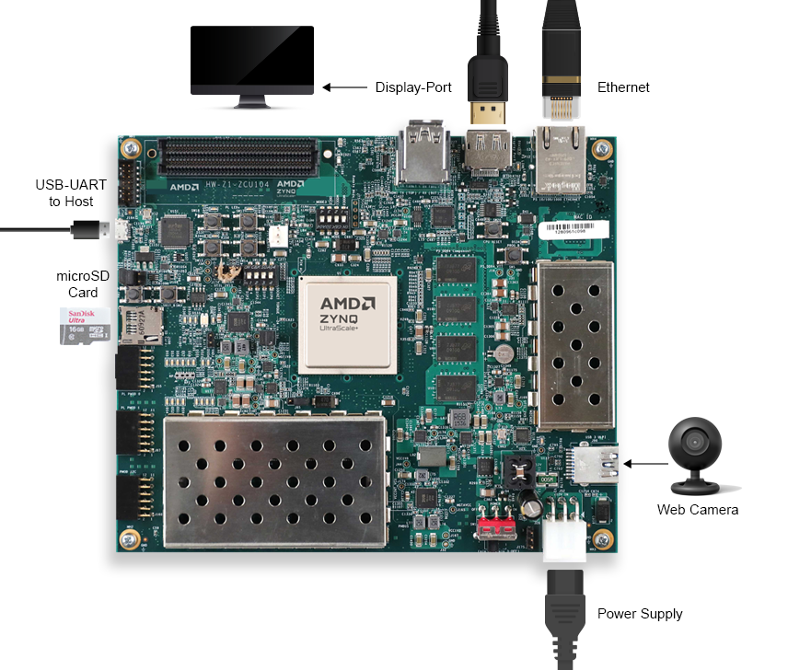
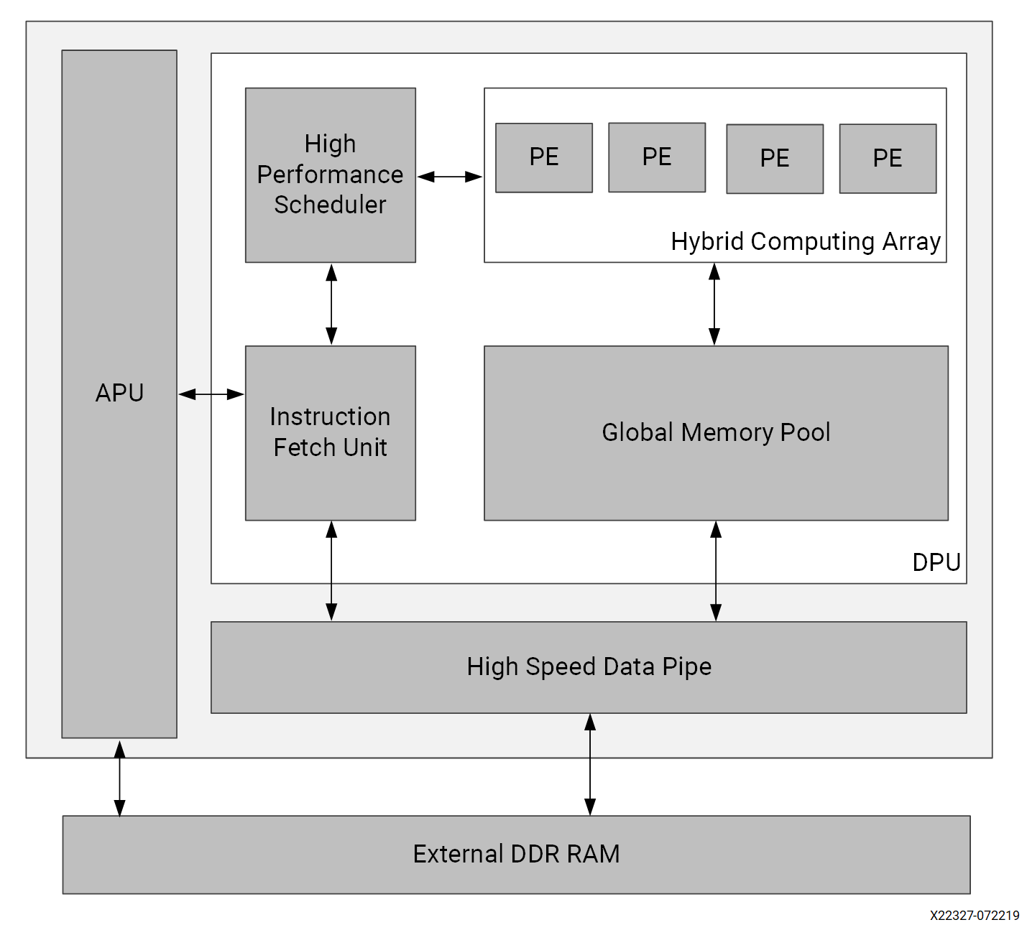
Efficient U-Net Model on FPGAs: A VitisAI Approach with Xilinx ZCU104
Arban UKA¹, Igli Stergu¹, Griselda Alushllari^{2,} Bekir Karlik¹
¹Department of Computer Engineering, Epoka University, 1000, Tirana, Albania
²Department of Physics, Tirana University, Tirana, Albania
Abstract
Methodology
Results
In addition to quantitative performance benchmark, the qualitative results are taken for functional correctness. The inference on model ZCU104 despite speed and efficency, has to some extent reduced accuracy but still useful for deployment in edge computing.
Field programmable gate arrays (FPGA) are reconfigurable and serve as prototyping platforms for application-specific integrated circuits (ASIC). FPGA are composed of configurable logic blocks and programmable interconnects and allow rapid testing of digital designs. Many challenges in medical field, in agriculture and in security are solved by the implementation of artificial intelligence techniques in high performance computing units with an inherently higher quantitative accuracy than any user. The implementation of these techniques on portable computing units (including FPGA) has gained great attention in the new field of tinyML. Here, we present an efficient FPGA implementation of UNET architecture segmentation of unstained brightfield cell images achieving a 97% accuracy. Quantization and pruning are used by effectively reducing the model size without a significant decrease in the accuracy. This work indicates the importance of combining algorithmic based compression techniques with hardware-aware optimizations.
Hardware used:
ZCU 104 was used for the experiments reported here. Board overview: ARM Cortex-A53 + FPGA architecture; 2GB DDR4 RAM, HDMI, Ethernet, USB; Integrated DPU support for AI acceleration.
VITIS AI Gramework is used for: Quantization, Compilation, and Runtime APIs; Model compression with minimal accuracy drop; Docker containerized development environment
Research Gap:
• Lack of quantized U-Net benchmarks on FPGA
• This thesis compares CPU, GPU, FPGA
• Uses real-time images and Mean IOU scoring
Host OS: Kubuntu 24.04 LTS (64-bit), Python Version: 3.8; Tensorflow Version: 2.10, Vitis AI Version: 3.0, CUDA Toolkit: CUDA 11.2 and cuDNN 8.x
• Quantization accuracy drop → mitigated using pof2s
• Model size reduced: 1.4GB → 120MB
• Pre/post-processing scripted manually
Nr. Images | i7-1165G7 | Ryzen 3970K | i7-14650HX | ZCU104 (FPGA) | RTX 4070 (GPU)
1 | 7,126,843,494 | 2,916,915,989 | 1,903,445,118 | 128,065,933 | 6,502,333,520
10 | 12,194,143,907 | 5,623,325,464 | 2,805,650,230 | 1,189,527,194 | 5,712,852,828
50 | 56,483,480,140 | 27,609,589,443 | 12,763,419,586 | 5,929,861,980 | 24,529,292,335
100 | 97,637,499,656 | 53,597,758,995 | 24,876,678,449 | 11,855,544,519 | 5,738,694,686
a) Ground truth b) Segmented image using FPGA
Conclusion
Table: Inference time(ns) vs batch size
Here we reported deployment of deep learning models on edge devices using the Vitis AI framework, with a specific focus on Xilinx ZCU104 platform to explore the performance, applicability, and challenges. With the help of comparative analysis and systematic benchmarking important information was found. The ZCU104 FPGA with Vitis AI gave us superior low-latency inference, especially for small image batches, leaving behind traditional CPUs and in some cases even high-end GPUs. Quantization using Vitis AI (INT8) kept model accuracy while significantly reducing both model size and inference time, making it highly suitable for deployment on resource-constrained environments. If we compare modern CPUs and GPUs, the DPU on the ZCU104 gave excellent speed-to-power efficiency, an essential consideration for real-time, low-power embedded AI systems. The benchmarking process showed the importance of batch size, with GPU performance improving at larger batches and DPU performance peaking at smaller ones.
Here we report the segmentation of cell images that are acquired in microscopy images. These images have low contrast and this makes as the most challenging dataset to analyses together with electron microscope images.
Introduction
ZCU104 Board Overview
DPU IP Architecture
Image processing, medical diagnostics, autonomous vehicles – these are just a few fields that have been heavily transformed by deep learning, more specifically Convolutional Neural Networks (CNNs). A noteworthy architecture among the CNNs, the U-Net, is leading the models for image segmentation tasks thanks to its accurate and efficient performance features. In the meantime, CPUs, GPUs, and their traditional implementation are at capacity, in terms of energy efficiency and real-time performance. Hereon we’re diving into FPGA-based acceleration, more specifically, using Vitis AI quantization technique on the Xilinx ZCU104 evaluation board with a clear objective in mind: break the limits and deliver powerful real-time segmentation.
Here we primarily focus on assessing the effectiveness of integrating a quantized U-Net model on the ZCU104 FPGA via Vitis AI. Step by step:
1. Quantization Accuracy: Assess the effects of Vitis AI quantization in terms of accuracy and performance of the U-Net model against the traditional implementations.
2. FPGA Performance: Analyze the quantized U-Net model’s inference speed, latency, and power consumption.
3. Comparative Analysis: Review the performance of FPGA-based versus similar CPU and GPU deployments highlighting potential benefits and notable limitations.
Nr. Images | Ryzen 3970K | i7-14650HX | ZCU104 FPGA | RTX 4070 GPU
1 | 2.44× | 3.74× | 55.65× | 1.10×
10 | 2.17× | 4.35× | 10.25× | 2.13×
50 | 2.05× | 4.43× | 9.53× | 2.30×
100 | 1.82× | 3.92× | 8.24× | 17.01×
References
[1] Ng, W. S., Goh, W. L., & Gao, Y. (2024, May). High Accuracy and Low Latency Mixed Precision Neural Network Acceleration for TinyML Applications on Resource-Constrained FPGAs. In 2024 IEEE International Symposium on Circuits and Systems (ISCAS) (pp. 1-5). IEEE. [2] Uka, A., Topalli, G., Hoxha, J., & Vrana, N. E. (2021). FPGA Implementation of Filters in Medical Imaging. In BIODEVICES (pp. 195-200). [3] Prakash, S., Callahan, T., Bushagour, J., Banbury, C., Green, A. V., Warden, P., ... & Reddi, V. J. (2023, April). Cfu playground: Full-stack open-source framework for tiny machine learning (tinyml) acceleration on fpgas. In 2023 IEEE International Symposium on Performance Analysis of Systems and Software (ISPASS) (pp. 157-167). IEEE.
Inference speedup vs Image size

